Slide 1
HW #5: Due June 6th 23:59

Slide 2
Generate test cases that covers all possible execution paths of the triangle program through depth first search (DFS) traversal.
Assume that initial test case is (1,1,1)
Write down a current executed symbolic path condition φ and a next symbolic path condition ψ obtained through DFS traversal
Write down a LIA SMT formula for the next symbolic path condition ψ
Solve the LIA SMT specification through Z3
If UNSAT, try to negate another branch in a DFS order
If SAT, record the solution as next input and repeat from Step 2 until all paths are covered/
You have to submit
- a completed table in page 4 that contains test cases and all executed
symbolic path conditions and next PCs
- a completed execution tree whose leaves are marked with TCs or UNSAT in pg 4
- All LIA SMT specifications for ψs and their solutions by Z3 (submit both hardcopy and softcopy that should be sent to hongshin@gmail.com)

Slide 3
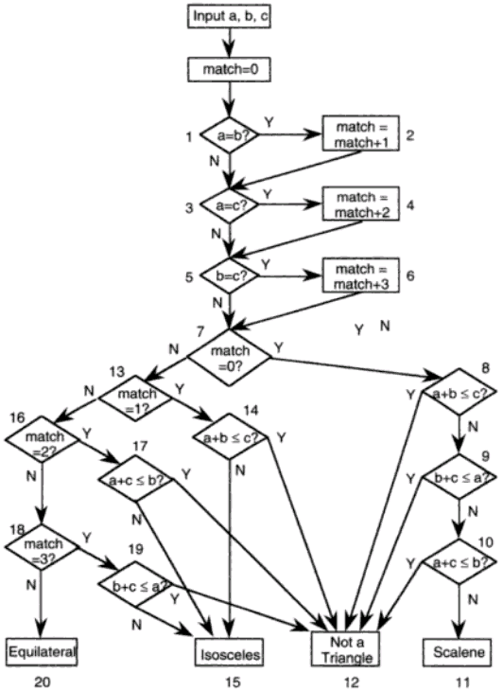
#include <crest.h>
int main() {
int a,b,c, match=0;
CREST_int(a); CREST_int(b); CREST_int(c);
// filtering out invalid inputs
if(a <= 0 ) exit(); if(b <= 0 ) exit(); if(c <= 0 ) exit();
printf("a,b,c = %d,%d,%d:",a,b,c);
//0: Equilateral, 1:Isosceles,
// 2: Not a traiangle, 3:Scalene
int result=-1;
if(a==b) match=match+1;
if(a==c) match=match+2;
if(b==c) match=match+3;
if(match==0) {
if( a+b <= c) result=2;
else if( b+c <= a) result=2;
else if(a+c <= b) result =2;
else result=3;
} else {
if(match == 1) {
if(a+b <= c) result =2;
else result=1;
} else {
if(match ==2) {
if(a+c <=b) result = 2;
else result=1;
} else {
if(match==3) {
if(b+c <= a) result=2;
else result=1;
} else result = 0;
} }}
printf("result=%d\n",result); }
“Software Testing a craftsman’s approach” 2nd ed by P.C.Jorgensen
(no check for positive inputs)

Slide 4
Concolic Testing the Triangle Program
Test case | Input (a,b,c) | Executed symbolic path condition (PC) φ | Next PC ψ | Solution for the next PC ψ from SMT solver
1 | 1,1,1 | a=b Æ a=c Æ b=c | a=b Æ a=c Æ b≠c | Unsat
 |  |  | a=b Æ a≠c | 1,1,2
2 | 1,1,2 | a=b Æ a≠c Æ b≠c Æ a+b ≤c | a=b Æ a≠c Æ b≠c Æa+b>c | 2,2,3
3 | 2,2,3 | a=b Æ a≠c Æ b≠c Æ a+b >c | a=b Æ a≠c Æ b=c | Unsat
 |  |  | a≠b | 2,1,2
4 | 2,1,2 | a≠b Æ a=c Æ b≠c Æ a+b>c | a≠bÆ a=c Æ b≠c Æa+b ≤c | 2,5,2
a=b
a≠b
a=c
a≠c
a=c
b=c
b≠c
b≠c
b=c
b≠c
TC1
(1,1,1)
UNSAT
UNSAT
a+b ≤c
a+b >c
a+b >c
TC2
(1,1,2)
TC3
(2,2,3)
TC4

