Slide 1
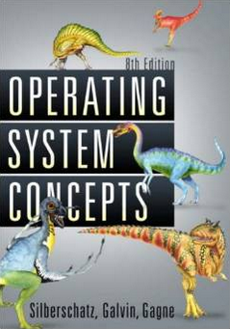
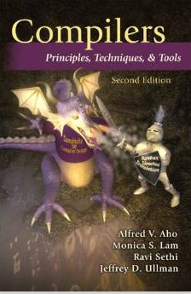

Intro. To Quality Software
- Fight the Complexity of SW
Moonzoo Kim
CS Dept. KAIST

Slide 2
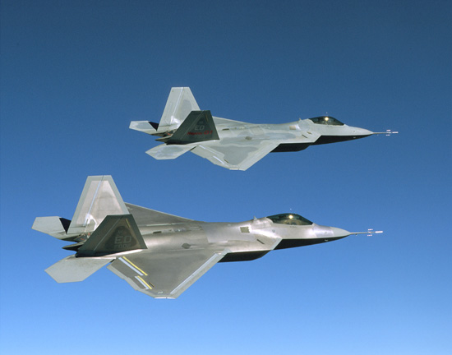
Role of S/W: Increased in Everywhere
F-35 (8 Mloc)
2012년
자료출처: Watts Humphrey 2002

Slide 3
Hardware v.s. Software
Flexibility leads to low development cost
  Minimal costs for HW board manufacturing > 20K$
  Minimal costs for SW development = 0$
Growing popularity leads to complex software systems
  Pentium IV (Willamette): 42 million transistors
  Windows XP: hundreds million instructions
Much harder to validate/verify (V&V) software
  HW design exploits symmetry, structure, and components
    Formal design and V&V tools (e.g. Verilog, VHDL, etc) are popular
      Standard property spec. language: OVL, PSL, SVA, etc
  SW design allows maximal degree of freedom in programs
    Formal principles and techniques have been rarely applied to SW due to
      Failure to manage (entire) SW complexity
      Lack of commercial tools and supports
      (relatively) High learning curve
    Products of all engineering fields provide warranty except SW
      Ex> Intel CPU provides 3 years warranty
      Ex> Microsoft Windows® provides no warranty - Use it at your own risk!!!
Notes:
Smallest hw board manufacturins cost: $20k
Ex. Boing is not anymore airplane company, but SW company. Costs of SW development overwhelm the whole airplane development
I interviewed Samsung D-TV 4 years ago. Boss said he was able to develop HW but does not understand SW
SW is double-sharpened razor -> use as you want at your own risk!!!
After 6 months’s training, people think he is a programmer. Not in EE, ME, and any other fields!!!

Slide 4
Analogy of SE with Civil Engineering
There are various kinds of
construction from a house
to a building complex

Slide 5
Analogy with Civil Engineering(Cont.)
When building a small house,...
With simple tools
From just a blueprint
By small group of
novice workers
Some failures
are endurable

Slide 6
Analogy with Civil Engineering(Cont.)
When constructing a building complex,...
we must re-think everything

Slide 7
Analogy with Civil Engineering(Cont.)
With scalable tools
as well as simple ones
Use different
materials

Slide 8
Analogy with Civil Engineering(Cont.)
By a big group of various technicians
With collaborations
and guides
Set of blueprints
As well as careful plans

Slide 9

Software Development Cycle
A practical end-to-end formal framework for software development
A SW Development Framework for SW with High Assurance
Requirement
analysis
System
design
Design
analysis
Implement-
ation
Testing
Monitoring
Formal
require-
ment
Spec.
Formal
system
modeling
Model
analysis/
verification
Model-
assisted
code
generation
Model-
based
testing
Runtime
monitoring
and
checking

Slide 10
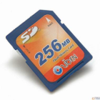
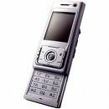
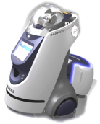

Related Disciplines to SW Development
Undergraduate CS classes contributing to SW development
  Discrete math
  Algorithm
  PL
  Automata
OS
  System programming
  Cyber physical system
  Intro. to SE
SW
Development
Embedded
Systems
System
Engineering
Programming
Languages
Algorithms
OK
System
modeling
System
spec.
Automated
Testing &
Debugging
or
Requirement
properties
Req.
spec.
Logic
(Φ Ω)
Counter
example(s)

Slide 11
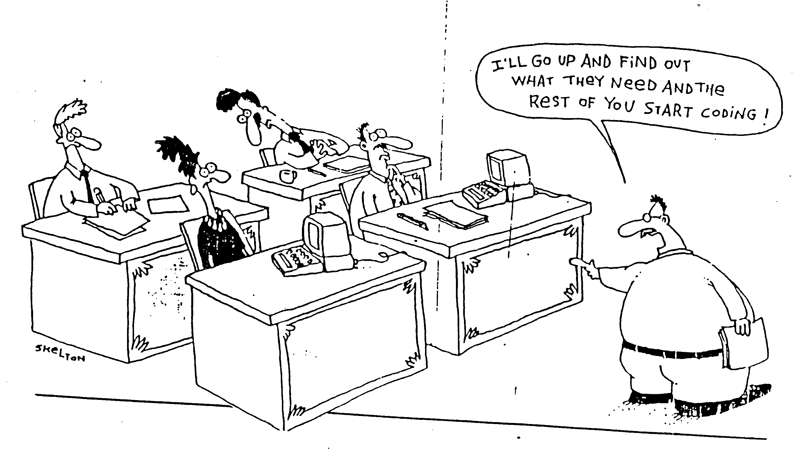
Current Practice for SW Development
SW developers have to follow systematic disciplines for building and analyzing software with high quality
  This class focuses on the analysis activities
Notes:
-SW development cost takes 35% of total automotive production cost (Software Engineering for Automotive Systems Workshop, 2004)
-Due to complexity for reliable SW, the low productivity causes severe problem

Slide 12
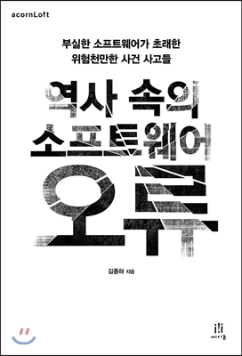
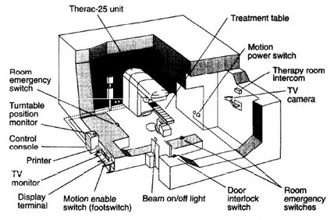
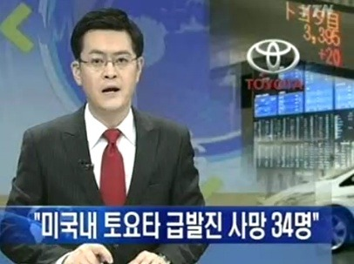
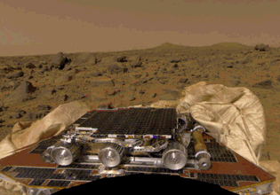
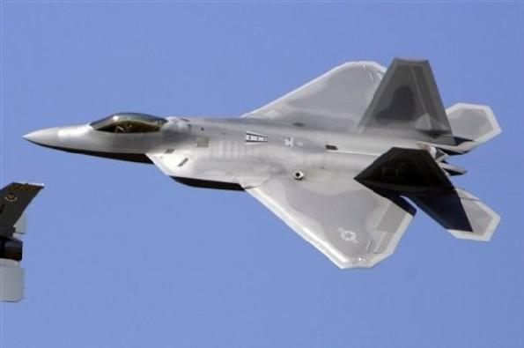
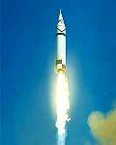
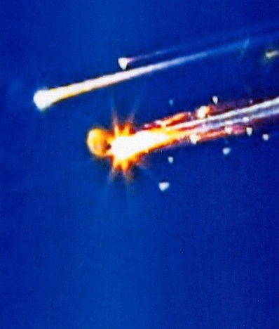
Safety Problems due to Poor Quality of SW

Slide 13
Tragic Accidents I
The Therac-25 Story
  Between June 1985 and Jan 1987, a computer-controlled radiation therapy machine, called the Therac-25, massively overdosed six people
    software coding error
http://sunnyday.mit.edu/papers/therac.pdf
Notes:
Reusing a shared variables for different purposes and a race condition on that variable led to a situation where lethal doses of radiation were given.
Several deaths resulted from this software error.
The Therac-25 accidents were fairly unique in having software coding errors involved—most computer-related accidents have not involved coding errors but rather errors in the software requirements such as omissions and mishandled environmental conditions and system states. Although using good basic software-engineering practices will not prevent all software errors, it is certainly required as a minimum

Slide 14

Tragic Accidents II
Ariane 5
  “On 4 June 1996, the maiden flight of the Ariane 5 launcher ended in a failure…The failure of the Ariane 501 was caused by the complete loss of guidance and attitude information …This loss of information was due to specification and design errors in the software of the inertial reference system.”
    Floating number conversion problem
    http://www.ima.umn.edu/~arnold/disasters/ariane5rep.html
Notes:
Ariane 5 software reused old code from Ariane 4 that was not respecified and retested in new environment
Code in question performed floating point calculations
Ariane 5 (being more powerful than Ariane 4) caused unanticipated floating-point exception (which would have never occurred on Ariane 4), causing an exception to be thrown which was not caught
Triggered automatic destruction: $500 million loss

Slide 15
Tragic Accidents III
NASA Mars Pathfinder (1997)
  Priority inversion problem led to a system reset and a one-day delay in retransmission of data which wasted valuable mission time.
  http://www.cis.ksu.edu/~hatcliff/842/Docs/Course-Overview/pathfinder-robotmag.pdf

Slide 16
Quoted from ``1. Information Technology: Transforming our Society'‘
President's Information Technology Advisory Committee 1999
Software Crisis
“…Furthermore, the Nation needs software that is far more usable, reliable, and powerful than what is being produced today. We have become dangerously dependent on large software systems whose behavior is not well understood and which often fail in unpredicted ways ... We need scientifically sound approaches to software development … ”
Quoted from “Science for Global Ubiquitous Computing (GUC)“
A 15 year Grand Challenges for Computing Research
Supported by UK Computing Research Committee 2004
“…unless we offer a mathematically sound methodology to supplant the practice of opportunist software creation there will be consequences of the kind we have illustrated, and a further mass of inscrutable legacy software. These consequences will be greatly more damaging than previously, because the GUC is pervasive, self-modifying and complex in the extreme…“
Notes:
We all know critical SW failures such as
0. Windows crash
Buffer overflow attack, back door attack (security bleach)
No warranty exists in SW in contrast to HW.
More and more embedded systems utilizes SW. ex. Car electronics
Pathfinder infinite rebooting, etc
Overdose of radioactive ray in hospital
Airline 5 flight crash (float # calculation mismatch)

Slide 17
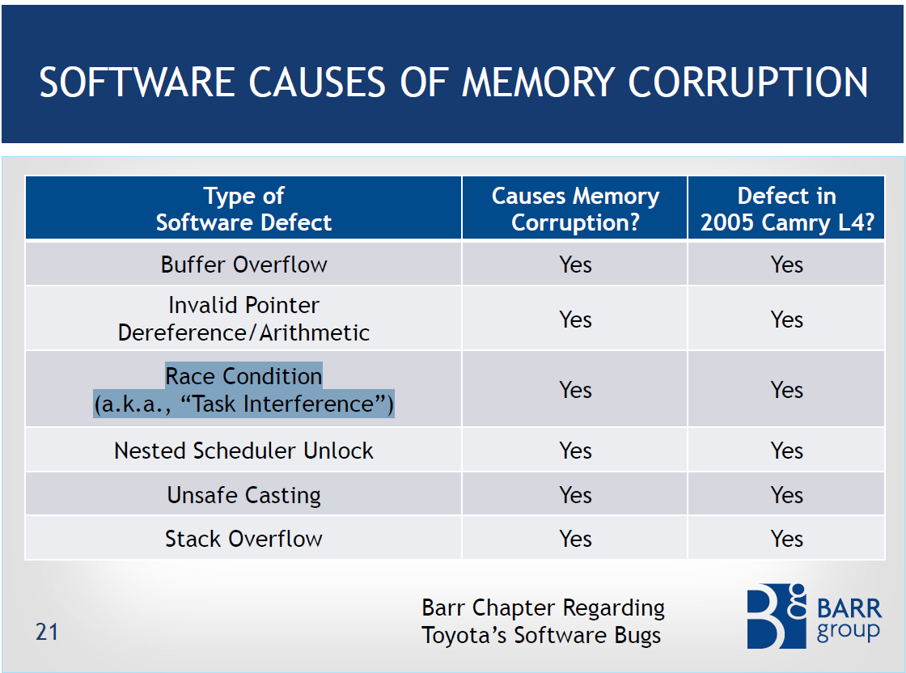
Static analysis falls short of detecting
such complex bugs accurately
High false negatives
High false positives
Systematic and dynamic analysis
(i.e. automated sw testing) is
MUST for high quality SW

Slide 18
The Essence of Software
- Operational Semantics of SW
A software has its semantics as a set of system executions σ’s
  A software execution σ is a sequence of states s₀.s₁.s₂…
    A state s has an environment ρ_{s}:Var-> Val
x:0,y:0
s₀
x:0,y:1
s₁
x:1,y:2
x:5,y:1
s₂
s₁₁
x:1,y:3
x:5,y:2
s₃
s₁₂
x:2,y:4
x:5,y:3
x:7,y:3
s₄
s₁₃
s₂₁
x:5,y:4
x:7,y:4
s₁₄
s₂₂
Notes:
We view the program execution as a sequence of states. A state consists of variable environment rho and time stamp t. This viewpoint states that information of program remains between two consecutive states.
Furthermore, a state in the execution indicates that something happens at the time instant corresponding to the state.
As the execution has more states, more computational resource is required to analyze the execution. Therefore, to reduce the overhead, if possible, we need to abstract out unnecessary states in terms of properties. For example, for property p, we don’t need variable x. Thus removing states …
Furthermore, not every value of y is important because only s0 and s6 affects the property. Thus, we might want to remove states s1-s5. We will discuss this abstraction in more detail later

Slide 19
Example
active type A() {
byte x;
again:
x++;
goto again;
}
x:0
x:1
x:2
x:255
active type A() {
byte x;
again:
x++;
goto again;
}
active type B() {
byte y;
again:
y++;
goto again;
}
x:0,y:0
x:0,y:1
x:0,y:255
x:1,y:0
x:1,y:1
x:1,y:255
x:2,y:0
x:2,y:1
x:2,y:255
x:255,y:0
x:255,y:255

Slide 20

Testing is a Very Complex and Challenging task!!!
Remarks by Bill Gates
17th Annual ACM Conference on Object-Oriented Programming, Systems Languages, and Applications, 2002
“… When you look at a big commercial software company like Microsoft, there's actually as much testing that goes in as development. We have as many testers as we have developers. Testers basically test all the time, and developers basically are involved in the testing process about half the time…”
“… We've probably changed the industry we're in. We're not in the software industry; we're in the testing industry, and writing the software is the thing that keeps us busy doing all that testing.”
“…The test cases are unbelievably expensive; in fact, there's more lines of code in the test harness than there is in the program itself. Often that's a ratio of about three to one.”
Notes:
심지어는 Bill Gate 가 말하길, “MS는 소프트웨어 기업이 아니라, 테스팅 기업” 이라고 까지 말할 정도로 테스팅에 많은 시간, 인원, 비용을 소모하고 있다. 그렇다고 완전한 것도 아니다.
20

Slide 21
Significance of Automated SW Analysis
Software has become more ubiquitous and more complex at the same time
Human resources are becoming less reliable and more expensive for highly complex software systems
Computing resources are becoming ubiquitous and free
  Tencent @ China provides 10TB storage free
  Amazon EC2 price: you can use thousands of CPUs @ 0.057$/hr for 3.2Ghz Quad-core CPU
Remaining task?
  To develop automated and scientific software analysis tools to utilize computing resource effectively and efficiently
Notes:
0.057$ *24*365=500$/year

Slide 22
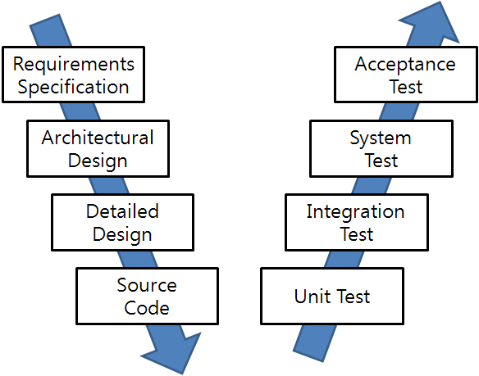
SW Development and Testing Model
(a.k.a. V model)
Manual
Labor
Abstraction

Slide 23
Ex. Testing a Triangle Decision Program
Input : Read three integer values from the command line. The three values represent the length of the sides of a triangle.
Output : Tell whether the triangle is
• 부등변삼각형 (Scalene) : no two sides are equal
• 이등변삼각형(Isosceles) : exactly two sides are equal
• 정삼각형 (Equilateral) : all sides are equal
Create a Set of Test Cases for this program
(3,4,5), (2,2,1), (1,1,1) ?

Slide 24
Precondition (Input Validity) Check
Condition 1: a > 0, b > 0, c > 0
Condition 2: a < b + c
  Ex. (4, 2, 1) is an invalid triangle
  Permutation of the above condition
    a < b +c
    b < a + c
    c < a + b
What if b + c exceeds 2³² (i.e. overflow)?
  long v.s. int v.s. short. v.s. char
Developers often fail to consider implicit preconditions
  Cause of many hard-to-find bugs

Slide 25
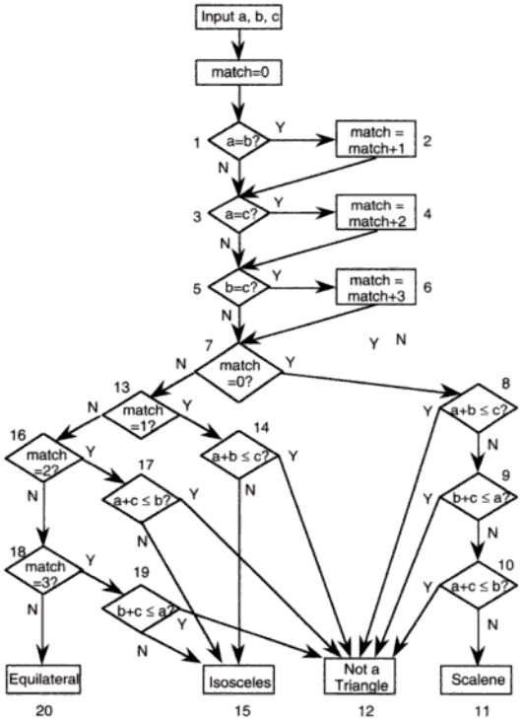
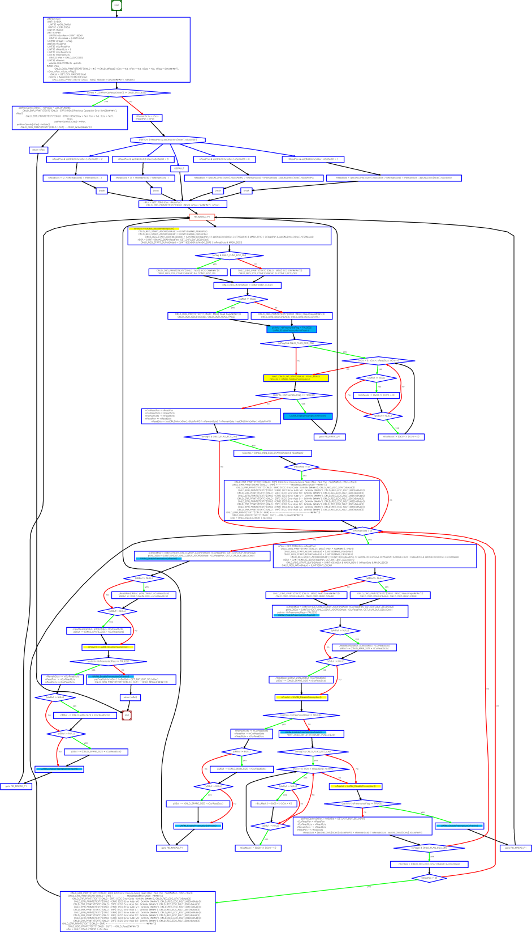
“Software Testing a craftsman’s approach” 2nd ed by P.C.Jorgensen
(no check for positive inputs)
# of test cases required?
  4
  10
  50
  100
# of feasible unique execution paths?
  11 paths
  guess what test cases needed
Notes:
a,b,c = 1,1,1:result=0
a,b,c = 2,1,1:result=2
a,b,c = 2,1,2:result=1
a,b,c = 1,2,1:result=2
a,b,c = 3,2,1:result=2
a,b,c = 2,1,3:result=2
a,b,c = 4,3,2:result=3
a,b,c = 2,3,1:result=2
a,b,c = 3,2,2:result=1
a,b,c = 2,2,1:result=1
a,b,c = 1,1,2:result=2
~

Slide 26
More Complex Testing Situations (1/3)
Software is constantly changing
  What if “integer value” is relaxed to “floating value” ?
    Round-off errors should be handled explicitly
  What if new statements S₁ … S_{n} are added to check whether the given triangle is 직각삼각형 (a right angle triangle)?
    Will you test all previous tests again?
    How to create minimal test cases to check the changed parts of the target program

Slide 27
More Complex Testing Situations (2/3)
Regression testing is essential
  How to select statements/conditions affected by the revision of the program?
  How to create test cases to cover those statements/conditions?
  How to create efficient test cases?
    How to create a minimal set of test cases (i.e. # of test cases is small)?
    How to create a minimal test case (i.e. causing minimal execution time)?
  How to reuse pre-existing test cases?

Slide 28
More Complex Testing Situations (3/3)
However, conventional coverage is not complete
  Ex. Int adder(int x, int y) { return 3;}
    Test case (x=1,y=2) covers all statements/branches of the target program and detects no error
    In other words, all variable values must be explored for complete results
Formal verification aims to guarantee completeness
  Model checking analyzes all possible x, y values through 2⁶⁴ (=2³² x 2³²) cases
  However, model checking is more popular for debugging, not verification

Slide 29
Concurrency
Concurrent programs have very high complexity due to non-deterministic scheduling
Ex. int x=0, y=0, z =0;
  void p() {x=y+1; y=z+1; z= x+1;}
  void q() {y=z+1; z=x+1; x=y+1;}
  Total 20 interleaving scenarios
    = (3+3)!/(3!x3!)
  However, only 11 unique outcomes
p()
x=y+1
y=z+1
z=x+1
q()
y=z+1
z=x+1
x=y+1
Trail1: 2,2,3
Trail2: 3,2,4
Trail3: 3,2,3
Trail4: 2,4,3
Trail5: 5,4,6
Trail6: 5,4,3
Trail7: 2,1,3
Trail8: 2,3,3
Trail9: 4,3,5
Trail10: 4,3,2
Trail11: 2,1,2
Notes:
x,y,z
2,1,2
2,1,3
2,2,3
2,3,3
2,4,3
3,2,3
4,3,2
4,3,5

Slide 30
An Example of Mutual Exclusion Protocol
char cnt=0,x=0,y=0,z=0;
void process() {
char me=_pid +1; /* me is 1 or 2*/
again:
  x = me;
  If (y ==0 || y== me) ;
  else goto again;
  z =me;
  If (x == me) ;
  else goto again;
  y=me;
  If(z==me);
  else goto again;
  /* enter critical section */
  cnt++;
  assert( cnt ==1);
  cnt --;
  goto again;
}
Process 0
x = 1
If(y==0 || y == 1)
z = 1
If(x == 1)
y = 1
If(z == 1)
cnt++
Process 1
x = 2
If(y==0 || y ==2)
z = 2
If(x==2)
y=2
If (z==2)
cnt++
Software
locks
Critical
section
Violation detected !!!
Mutual
Exclusion
Algorithm
Counter
Example

Slide 31
More Concurrency Bugs
Data race bugs
Atomicity bugs
class Account_DR {
double balance;
// INV:balance should be always non-negative
void withdraw(double x) {
1: if (balance >= x) {
2: balance = balance–x;}
...
}}
class Account_BR {
Lock m;
double balance;
// INV: balance should be non-negative
double getBalance() {
double tmp;
1: lock(m);
2: tmp = balance ;
3: unlock(m);
4: return tmp; }
void withdraw(double x){
/*@atomic region begins*/
11: if (getBalance() >= x){
12: lock(m);
13: balance = balance – x;
14: unlock(m); }
/*@atomic region ends*/
... }
(a) Buggy program code
(a) Buggy program code
[Initially, balance:10]
-th1: withdraw(10)-
1: if(balance >= 10)
2: balance = 0 – 10;
-th2: withdraw(10)-
1: if(balance >= 10)
2: balance = 10-10;
[Initially, balance:10 ]
-th1: withdraw(10)-
11:if(getBalance()>=10)
getBalance()
1:lock(m);
2:tmp = balance;
3:unlock(m);
4:return tmp;
12: lock(m);
13: balance=0 – 10;
14: unlock(m);
-th2 : withdraw(10)-
...
12: lock(m);
13: balance=10–10;
14: unlock(m);
operation block b_{i}
The invariant is violated as
balance becomes -10.
The invariant is violated as
balance becomes -10.
(b) Erroneous execution
(b) Erroneous execution

Slide 32
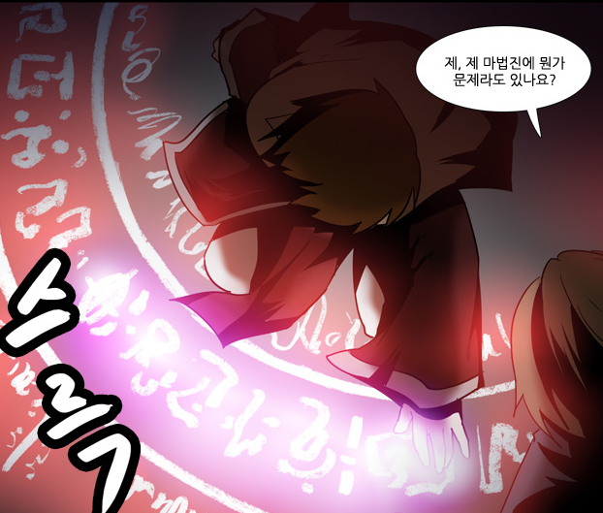
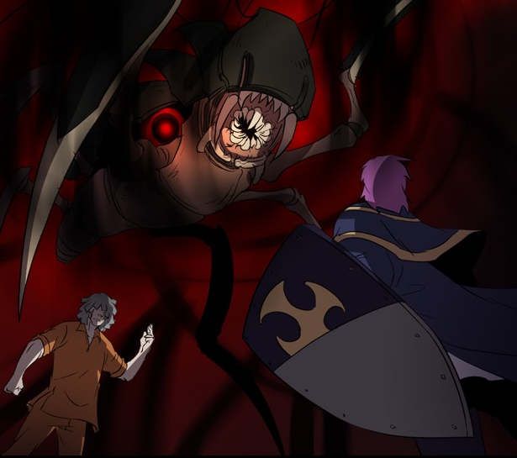
Software v.s. Magic Circle (마법진)
Written by a software developers line by line
Requires programming expertise
SW executes complicated tasks which are far more complex than the code itself
The software often behaves in unpredicted ways and crash occurs
Written by a human magician line by line
Requires magic spell knowledge
Summoned monsters are far more powerful than the magic spell itself
The summoned demon is often uncontrollable and disaster occurs
네이버 웹툰 “그 판타지 세계에서 사는법“ by 촌장

Slide 33
Research Trends toward Quality Systems
Academic research on developing embedded systems has reached stable stage
  just adding a new function to a target system is not considered as an academic contribution anymore
Research focus has moved on to the quality of the systems from the mere functionalities of the systems
  Energy efficient design, ez-maintenance, dynamic configuration, etc
Software reliability is one of the highly pursued qualities
  ASPLOS 2011 Best paper
    “S2E: a platform for in-vivo multi-path analysis for software systems” @ EPFL
  OSDI 2008 Best paper
    “Klee: Unassisted and Automatic Generation of High-Coverage Tests for Complex Systems Programs” @ Stanford
  NSDI 2007 Best paper
    “Life, Death, and the Critical Transition: Finding Liveness Bugs in Systems Code” @ U.C. San Diego

Slide 34

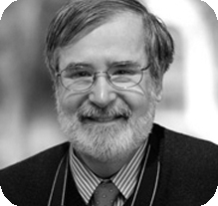
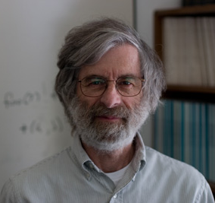
Formal Analysis of Software as a Foundational and Promising CS Research
2007 ACM Turing Awardees
  Prof. Edmund Clarke, Dr. Joseph
  Sipfakis, Prof. E. Allen Emerson
  For the contribution of migrating
  from pure model checking research
  to industrial reality
2013 ACM Turing Awardee
  Dr. Leslie Lamport
  For fundamental contributions to the theory and practice of distributed and concurrent systems
    Happens-before relation, sequential consistency, Bakery algorithm, TLA+, and LaTeX

Slide 35



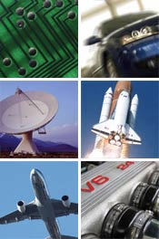







Companies Working on Software Testing/Verification Tools

Slide 36
Summary
Software = a large set of unique executions
SW testing = to find an execution that violates a given requirement among the large set
  A human brain is poor at enumerating all executions of a target SW, but computer is good at the task
Automated SW testing
= to enumerate and analyze the executions of SW systematically (and exhaustively if possible)

Slide 38
소프트웨어 구성요소와 테스팅
Spec
요구사항 spec, 시스템 model로 구성됨
소프트웨어에 기대하는 기능을
추상적으로 기술한 것
2. 구현
1. 표현
Program
3. 실행
Test case
소프트웨어의 기능을 구현한 코드의
집합으로 구성
프로그램 입력 값과 그에 해당하는
기대 출력 값의 쌍(pair)으로 구성됨
소프트웨어 테스팅 품질
요구사항 spec이 test case로 모두 올바르게 표현됐는가?
→ 시나리오 기반 테스팅
시스템 model이 Program 요소로 모두 올바르게 구현됐는가?
→ 모델 기반 테스팅
Program의 코드가 test case로 모두 올바르게 실행되는가?
→ 코드 기반 테스팅 (white-box testing)

Slide 39
Limitations of the Conventional Quality Assurance Techniques
Most QA techniques in industry practice target easy-to-detect bugs at low cost (i.e., light-weight approaches)
  Secure coding rule checkers:
    MISRA C, CERT C Coding standard, CERT Oracle secure coding standard
  Static analyzer:
    Coverity, Sparrow, Code sonar, Findbugs
  Various random + heuristic test case generation techniques
    Suresoft codescroll
Such techniques often fail to detect hard-to-detect corner case bugs because
  These techniques focus to analyze the syntax (i.e., form/appearance) of a target program
  However, the difficulty/complexity is caused by the semantics (i.e., meaning) of a target program.

