Slide 1
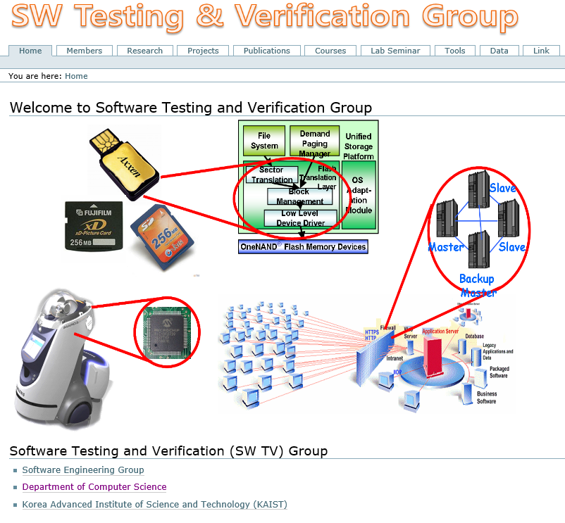
CS453: Automated Software Testing
Moonzoo Kim
Software Testing and Verification Group
CS Dept. KAIST

Slide 2
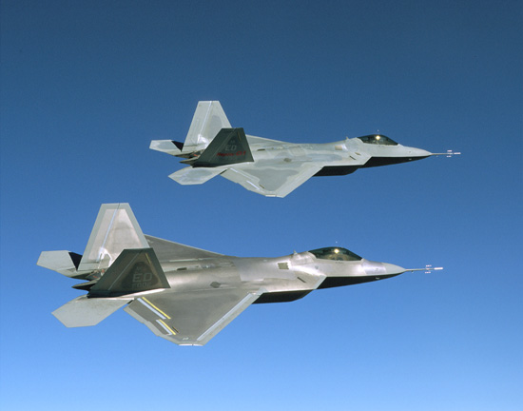
Role of S/W: Increased in Everywhere
F-35 (8 Mloc)
2012년
자료출처: Watts Humphrey 2002

Slide 3
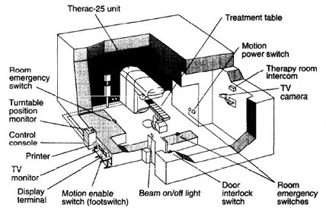
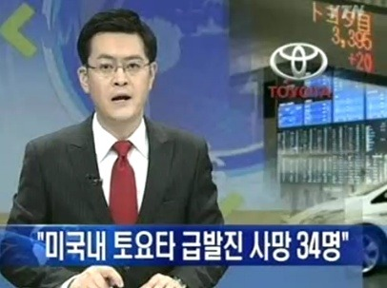

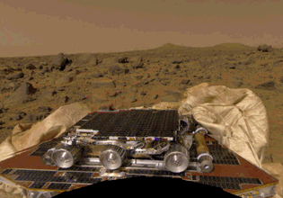
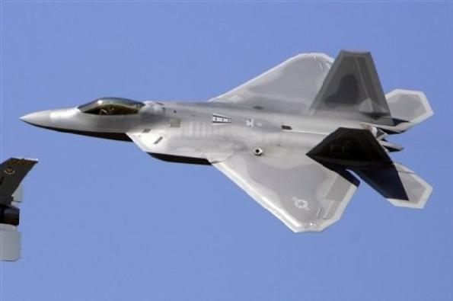


Safety Problems due to Poor Quality of SW

Slide 4
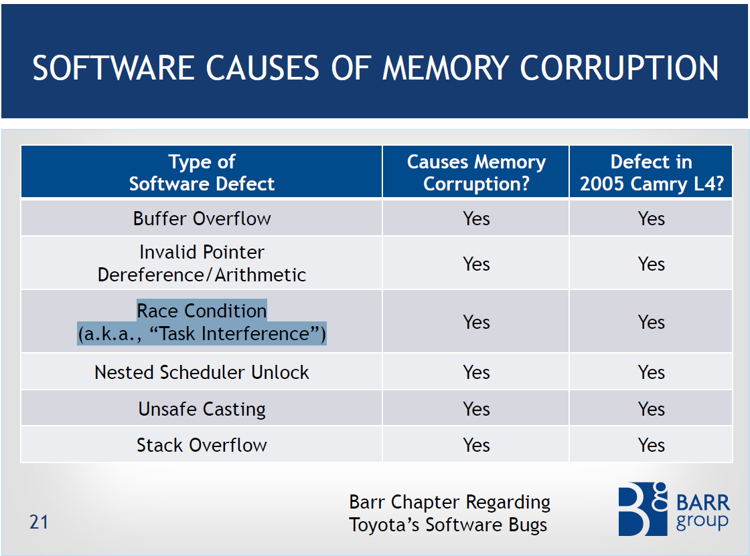
Static analysis falls short of detecting
such complex bugs accurately
High false negatives
High false positives
Systematic and dynamic analysis
(i.e. automated sw testing) is
MUST for high quality SW

Slide 5
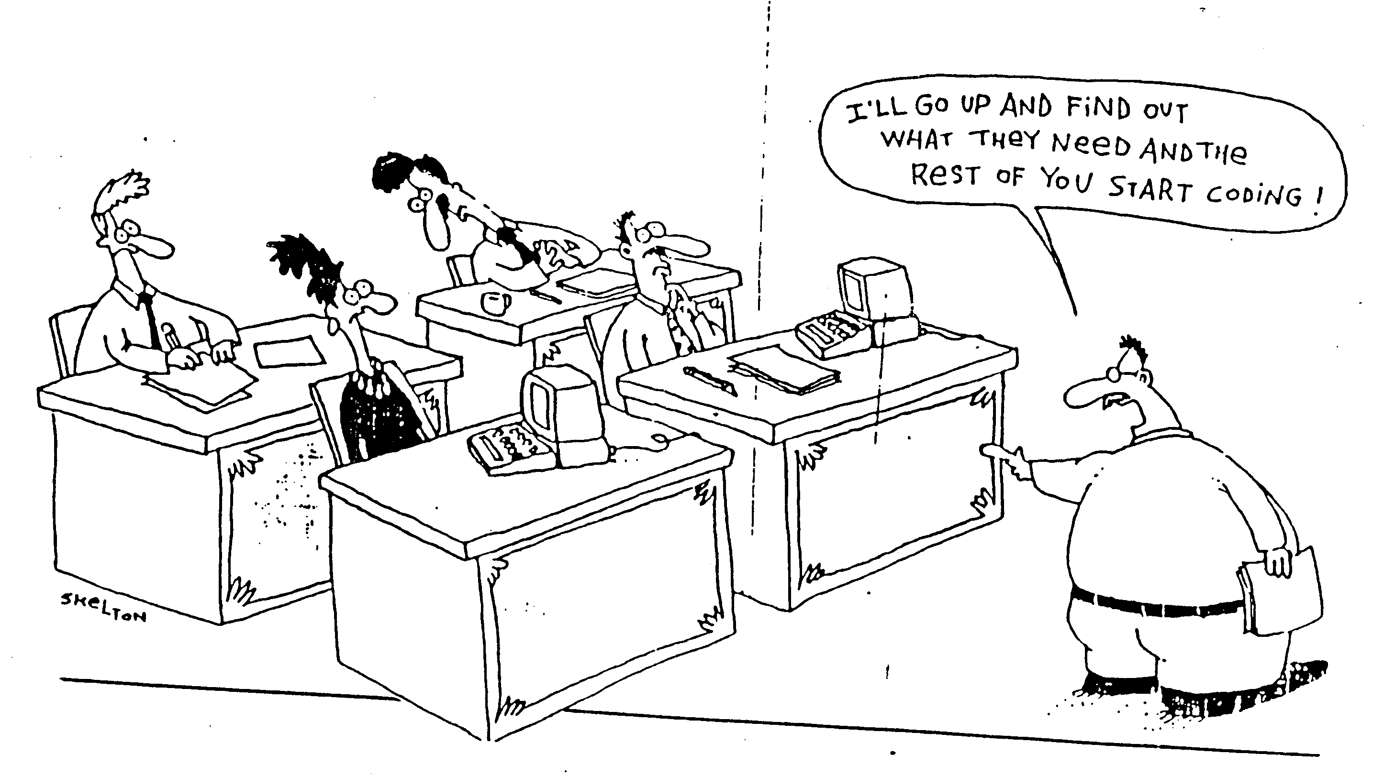
Current Practice for SW
SW developers have to follow systematic disciplines for building and analyzing software with high quality
  This class focuses on the analysis activities
Notes:
-SW development cost takes 35% of total automotive production cost (Software Engineering for Automotive Systems Workshop, 2004)
-Due to complexity for reliable SW, the low productivity causes severe problem

Slide 6

Software Development Cycle
A practical end-to-end formal framework for software development
A SW Development Framework for SW with High Assurance
Requirement
analysis
System
design
Design
analysis
Implement-
ation
Testing
Monitoring
Formal
require-
ment
Spec.
Formal
system
modeling
Model
analysis/
verification
Model-
assisted
code
generation
Model-
based
testing
Runtime
monitoring
and
checking

Slide 7
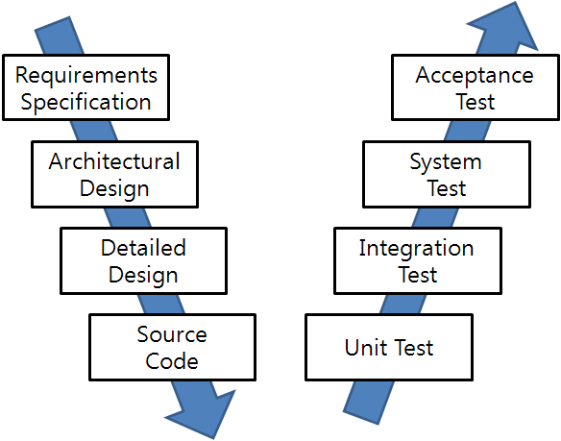
SW Development and Testing Model
(a.k.a. V model)
Manual
Labor
Abstraction

Slide 8
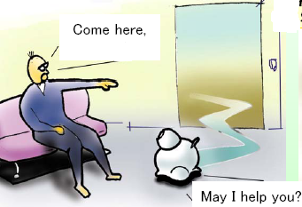
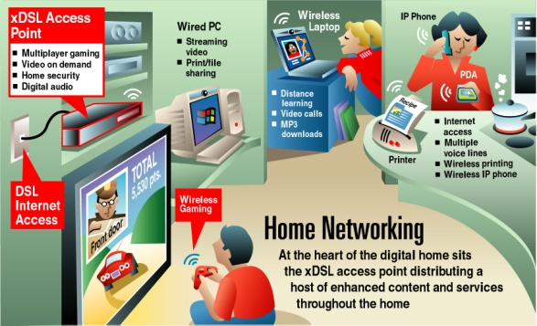
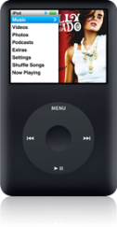
Main Target Systems
Embedded systems where highly reliable SW technology is a key to the success
  The portion of SW in commercial embedded devices increases continuously
  More than 50% of development time is spent on SW testing and debugging
Intelligent Medical Devices
Home Service Robots
Home Network
Intelligent Mobile Systems
Highly Reliable Systems
Notes:
-SW development cost takes 35% of total automotive production cost (Software Engineering for Automotive Systems Workshop, 2004)
-Due to complexity for reliable SW, the low productivity causes severe problem

Slide 9



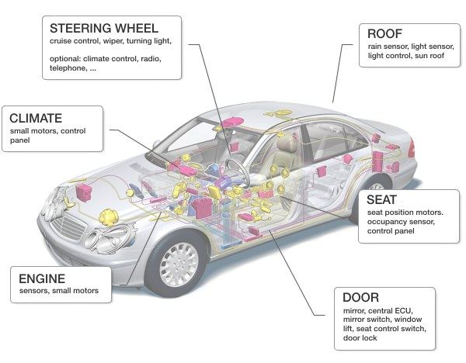


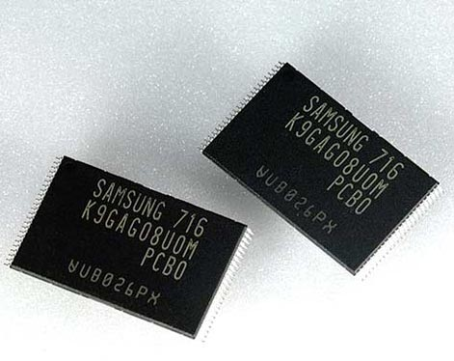


Strong IT Industry in South Korea
Time-to-Market?
SW Quality?
Moonzoo Kim
Notes:
Not method oriented, but problem oriented research

Slide 10
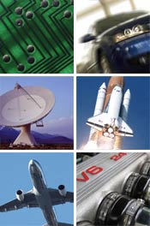
Embedded Software in Two Different Domains
Conventional Testing
Concolic testing
Model checking
 | Consumer Electronics | Safety Critical Systems
Examples | Smartphones, flash memory platforms | Nuclear reactors, avionics, cars
Market competition | High | Low
Life cycle | Short | Long
Development time | Short | Long
Model-based development | None | Yes
Important value | Time-to-market | Safety
Moonzoo Kim
Notes:
Not method oriented, but problem oriented research

Slide 11
How to Improve the Quality of SW
Systematic testing (can be still manual)
  Coverage criteria
  Mutation analysis
Testing through automated analysis tools
  Scientific treatment of SW with computing power
  Useful tools are available
Formal verification
  Guarantee the absence of bugs

Slide 12
Questions???
Is automated testing really beneficial in industry?
  Yes, dozens of success stories at Samsung
Is automated testing academically significant?
  Yes, 3 Turing awardees in ‘07
Is automated testing too hard to learn and use?
  No, there are tools available

Slide 13
Research Trends toward Quality Systems
Academic research on developing embedded systems has reached stable stage
  just adding a new function to a target system is not considered as an academic contribution anymore
Research focus has moved on to the quality of the systems from the mere functionalities of the systems
  Energy efficient design, ez-maintenance, dynamic configuration, etc
Software reliability is one of the highly pursued qualities
  USENIX Security 2015 best paper
    “Under-Constrained Symbolic Execution: Correctness Checking for Real Code” @ Stanford
  ICSE 2014 best paper
    “Enhancing Symbolic Execution with Veritesting” @ CMU
  ASPLOS 2011 Best paper
    “S2E: a platform for in-vivo multi-path analysis for software systems” @ EPFL
  OSDI 2008 Best paper
    “Klee: Unassisted and Automatic Generation of High-Coverage Tests for Complex Systems Programs” @ Stanford
  NSDI 2007 Best paper
    “Life, Death, and the Critical Transition: Finding Liveness Bugs in Systems Code” @ U.C. San Diego

Slide 14
Tool-based Interactive Learning
Code analyzer
  C/C++ AST parser: Clang
  Language independent Intermediate representation (IR) : LLVM
Model checker
  Explicit model checker: Spin home page
Software model checker
  Bounded model checker for C program: CBMC home page
Satisfiability solver
  MiniSAT home page
Satisfiability Module Solver
  Yices home page
  Z3 home page
Concolic testing tools
  CREST home page

Slide 15
Final Remarks 1/2
For undergraduate students:
  Highly recommend URP studies or independent studies
    Ex. 이준희 (05학번) got a silver award and macbook air notebook ☺
      Debugging Linux kernel through model checking to detect concurrency bugs
    Ex2. Nam Dang wrote down a paper on distributed concolic testing
      Y.Kim, M.Kim, N.Dang, Scalable Distributed Concolic Testing: a Case Study on a Flash Storage Platform, Verified Software Track @ Intl. Conf. on Theoretical Aspects of Computing (ICTAC), Aug 2010

Slide 16
Final Remarks 2/2
For graduate students:
  Welcome research discussions to apply formal analysis techniques
    Systematically testing/debugging C programs
    Concurrency bug detection
    Model-based testing
Pre-requisite:
  Knowledge of the C/C++/Java programing language
  Basic understanding of linux/unix
  ~6 hours of analysis/programming per week for HW

