Slide 1
Introduction to Concurrent Programming
Jaehyuk Huh and Moonzoo Kim
Computer Science, KAIST

Slide 2
Course Objectives
Parallel computing in the past
Only a handful of scientists need to know
Mostly limited to supercomputing
Changes in computing environments
Multi-cores are everywhere (even in smart phones)
GPUs for general purpose computing
Ever increasing data to process : peta-scale computing
Course objectives
Understand changes in underlying parallel systems
Understand different parallel programming models for different types of parallel systems
Understand concurrent program analysis techniques

Slide 3
Course Information
Class website: http://swtv.kaist.ac.kr/courses/cs492-spring-13/cs492-spring-13
QnA in Noah BBS: http://noah.kaist.ac.kr/course/CS492B
Class meetings
MW 1:00 – 2:15 pm
N-1 110
Teaching assistant
Boyeong Kim(bokyeong@calab.kaist.ac.kr)
Shin Hong (hongshin@gmail.com)

Slide 4
References
The Art of Multiprocessor Programming, Revised Reprint by Maurice Herlihy and Nir Shavit (Jun 5, 2012)
Introduction to Parallel Computing, 2nd Edition, Grama et al. Addison-Wesley
Parallel Computer Architecture, Culler et al. Morgan Kaufmann

Slide 5
Grading and Assignments
Grading:
Attendance and quiz: 20%
Assignments: 50%
Final exam:30%
Late HW is accepted with 10% penalty of the max score in 1 day, 30% penalty of the max score in 3 days. HW will not be accepted after then.
HW should be submitted both in hardcopy and softcopy (through email to TA). 10% penalty for missing hardcopy or softcopy.
Note: The official language in the class is English. All students should submit homework in English; 10% penalty otherwise

Slide 6
Attendance
More than 8 absences of class will get F grade
To start class on time, late attendance is considered as 1/3 absence.

Slide 7
Cheating
What is cheating?
Sharing code: by copying, retyping, looking at, or supplying a file
Coaching: helping your friend to write a lab, line by line
Copying code from previous course or from elsewhere on WWW
Only allowed to use code we supply
What is NOT cheating?
Explaining how to use systems or tools
Helping others with high-level design issues
Penalty for cheating:
Removal from course with failing grade
Detection of cheating:
We do check
Our tools for doing this are much better than most cheaters think!

Slide 8
Course Organization
Programming for Concurrency (Huh)
How to make concurrent programs faster and more efficient?
Architectural implication for concurrent programming
Programming models for concurrency
Performance optimization and architectural consideration
Concurrent Program Analysis (Kim)
How to make concurrent programs correct?
Model checking methodology
Concurrent program testing
Race, deadlock, and atomicity

Slide 9
Programming for Concurrency
Parallel computer architectures
Shared memory systems and cache coherence
Consistency
Architectural support for synchronization
Concurrent programming models
Pthreads
OpenMP
Performance optimization for concurrent programs
Decomposition and scheduling
Implication of memory hierarchy
GPU architecture and programming
GPU architectures
GPU programming with CUDA

Slide 10
Concurrent Program Analysis
Model checking for concurrent program anlaysis
Model checker SPIN
Linear temporal logic (LTL) for requirement specification
Concurrent program testing
Model-based concurrent program testing
Pattern-based concurrent program testing
Race, deadlock, and atomicity violation
Race bug detection techniques
Deadlock detection techniques
Atomicity bug detection techniques
Random noise-based concurrent program testing
Classification of race bugs
Concurrent coverage-based testing

Slide 11
Assignments
5 Assignments to experience different parallel programming models and analysis techniques
Tentative assignments
Pthread and OpenMP parallel programming for shared memory systems
Programming with CUDA for GPUs
Model checking
Random noise-based program testing

Slide 12
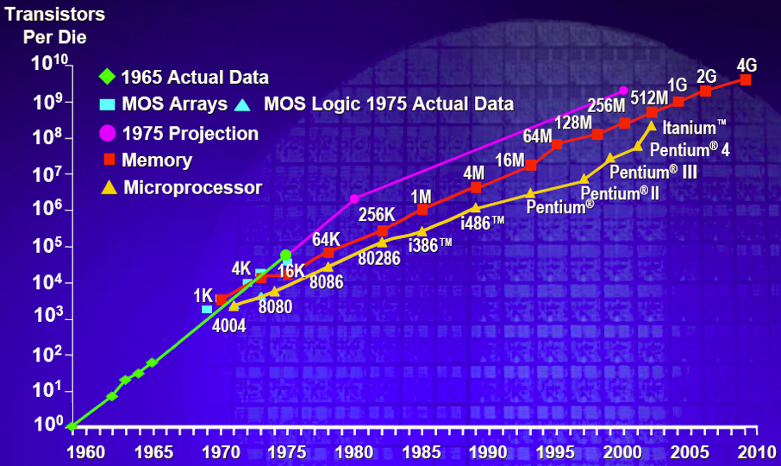
Moore’s Law
Gordon Moore, Founder of Intel
1965: since the integrated circuit was invented, the number of transistors/inch² in these circuits roughly doubled every year; this trend would continue for the foreseeable future
1975: revised - circuit complexity doubles every 18 months

Slide 13
Leveraging Moore’s Law
From increasing circuit density to performance
More transistors = ↑ opportunities for exploiting parallelism
Microprocessors
implicit parallelism: not visible to the programmer
pipelined execution of instructions → faster clock speed
multiple functional units for multiple independent pipelines
explicit parallelism
streaming and multimedia processor extensions
operations on 1, 2, and 4 data items per instruction
integer, floating point, complex data: MMX, Altivec, SSE
long instruction words
bundles of independent instructions that can be issued together

Slide 14
Microprocessor Architecture (Mid 90’s)
Superscalar (SS) designs were the state of the art
multiple instruction issue
dynamic scheduling: HW tracks dependencies between instr.
speculative execution: look past predicted branches
non-blocking caches: multiple outstanding memory ops
Apparent path to higher performance?
wider instruction issue
support for more speculation

Slide 15
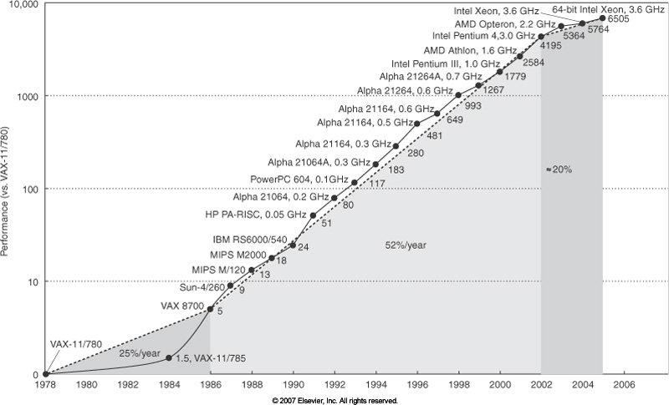
The End of the Free Lunch
Computer Organization and Design by Pattern & Hennesy

Slide 16
Era of 50%/Year Improvement
Performance improvement in the past decades
Clock frequency
Instruction-level parallelism (ILP)
Clock frequency improvement
Faster and smaller transistors
Aggressive pipeline : ILP loss, but frequency gain
ILP improvement
Wide issue, out-of-order processor
Larger caches and better prefetch systems
Performance doubling every two years

Slide 17
The End of 50%/year Era
Power (and heat) limits clock frequency
Cannot keep increasing pipeline length
Less and less work between stages
Critical loop lengths increase
Slow wires
Diminishing returns of ILP features
2x area to get 10-20% ILP improvement
Control and data dependencies
Slowdown of single-core performance improvement
Hope: Moore’s law is still valid

Slide 18
Power and Heat Stall Clock Frequencies
May 17, 2004 …
Intel, the world's largest chip maker, publicly acknowledged that it had hit a ''thermal wall'' on its microprocessor line. As a result, the company is changing its product strategy and disbanding one of its most advanced design groups. Intel also said that it would abandon two advanced chip development projects …
Now, Intel is embarked on a course already adopted by some of its major rivals: obtaining more computing power by stamping multiple processors on a single chip rather than straining to increase the speed of a single processor … Intel's decision to change course and embrace a ''dual core'‘ processor structure shows the challenge of overcoming the effects of heat generated by the constant on-off movement of tiny switches in modern computers … some analysts and former Intel designers said that Intel was coming to terms with escalating heat problems so severe they threatened to cause its chips to fracture at extreme temperatures…
New York Times, May 17, 2004

Slide 19
Recent Multicore Processors
March 10: Intel Westmere
6 cores; 2 way SMT
March 10: AMD Magny Cours
2 6-core dies in a single package
Jan 10: IBM Power 7
8 cores; 4-way SMT; 32MB shared cache
June 09: AMD Istanbul
6 cores
Sun T2
8 cores; 8-way fine-grain MT per core
IBM Cell
1 PPC core; 8 SPEs w/ SIMD parallelism
Tilera:
64 cores in an 8x8 mesh; 5MB cache on chip

Slide 20
New Applications
Intel’s Recognition, Mining, Synthesis Research Initiative
Compute-Intensive, Highly Parallel Applications and Uses
Intel Technology Journal, 9(2), May 19, 2005
http://www.intel.com/technology/itj/2005/volume09issue02/
graphics, computer vision, data mining, large-scale optimization

Slide 21
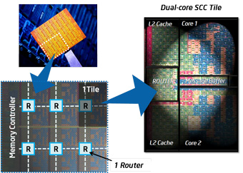
Intel Single Chip Cloud Computer
Experimental 48 core processor
24 “tiles” with two IA cores per tile
A 24-router mesh network with 256 GB/s bisection bandwidth
4 integrated DDR3 memory controllers
Hardware support for message-passing

Slide 22
GPUs for General Purpose Computing
A quiet revolution and potential build-up
Calculation: TFLOPS vs. 100 GFLOPS
Memory Bandwidth: ~10x
GPU in every PC– massive volume and potential impact

Slide 23
BlueGene to compete on Jeopardy!
I.B.M. Supercomputer ‘Watson’ to Challenge ‘Jeopardy’ Star, New York Times
An I.B.M. supercomputer system named after the company’s founder, Thomas J. Watson Sr., is almost ready for a televised test: a bout of questioning on the quiz show “Jeopardy!” I.B.M. and the producers of “Jeopardy!” will announce on Tuesday that the computer, Watson, will face the two most successful players in “Jeopardy!” history, Ken Jennings and Brad Rutter, in three episodes that will be broadcast the week of Feb. 14. One million dollars will be on the line; if Watson wins, the money will be donated to charity. “Jeopardy!” producers said the computer qualified for the show by passing the same test that human contestants must pass.
IBM Blue Gene /P
Designed to run continuously at 1 PFLOPS (petaFLOPS)
Four 850 MHz PowerPC 450 processors are integrated on each Blue Gene/P chip
The 1-PFLOPS Blue Gene/P configuration is a 294,912-processor, 72-rack system harnessed to a high-speed, optical network.

Slide 24
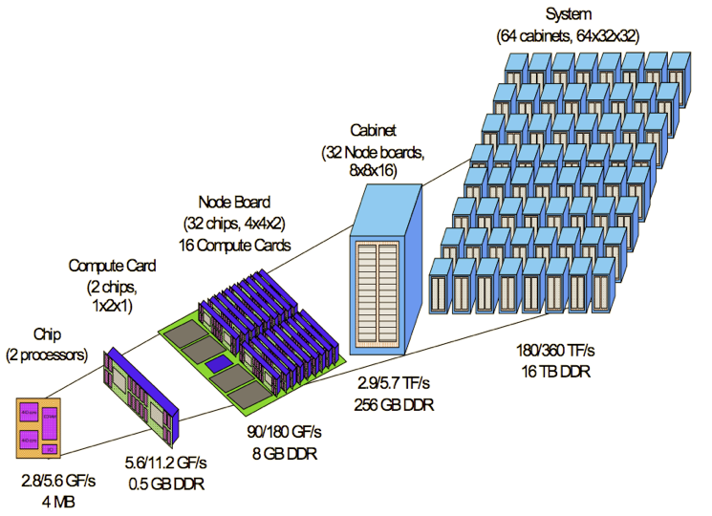
Hierarchical Parallelism in Supercomputers
Cores with pipelining and short vectors
Multicore processors
Shared-memory multiprocessor nodes
Scalable parallel systems
Image credit: http://www.nersc.gov/news/reports/bluegene.gif

Slide 25
Challenges of Explicit Parallelism
Algorithm development is harder
Complexity of specifying and coordinating concurrent activities
Software development is much harder
Lack of standardized & effective development tools and programming models
Subtle program errors: race conditions, deadlock, etc
Rapid pace of change in computer system architecture
today’s hot parallel algorithm may not be a good match for tomorrow’s parallel hardware!
example: homogeneous multicore processors vs. GPGPU

Slide 26
Achieving High Performance on Parallel Systems
Computation is only part of the picture
Memory latency and bandwidth
CPU rates have improved 4x as fast as memory over last decade
bridge speed gap using memory hierarchy
multicore exacerbates demand
Inter-processor communication
Input/output
I/O bandwidth to disk typically grows linearly with # processors

Slide 27
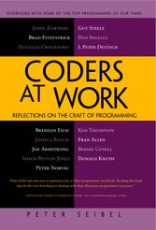
Motivation for Concurrency Analysis
Multithreaded programming are becoming popular more and more
37 % of all open-source C# applications and 87% of large applications in active code repositories use multi-threading [Okur & Dig FSE 2012]
However, multithreaded programming remains as error-prone
Writing correct multithreaded program is difficult
Testing written multithreaded program is difficult
Most of my subjects (interviewee) have found that the hardest bugs to track down are in concurrent code
…
And almost every one seem to think that
ubiquitous multi-core CPUs are going to force some serious changes in the way software is written
 | Small (1K-10K) | Medium (10K-100K) | Large (>100K)
# of all projects in the study | 6020 | 1553 | 205
# of projects with multithreading | 1761 | 916 | 178
# of projects with parallel library uses | 412 | 203 | 40
P. Siebel, Coders at work (2009) -- interview with 15 top programmers of our times:
Jamie Zawinski, Brad Fitzpatrick, Douglas Crockford, Brendan Eich,
Joshua Bloch, Joe Armstrong, Simon Peyton Jones, Peter Norvig,
Guy Steele, Dan Ingalls, L Peter Deutsch, Ken Thompson, Fran Allen,
Bernie Cosell, Donald Knuth

Slide 28
Concurrency
Concurrent programs have very high complexity due to non-deterministic scheduling
Ex. int x=0, y=0, z =0;
void p() {x=y+1; y=z+1; z= x+1;}
void q() {y=z+1; z=x+1; x=y+1;}
p()
q()
Notes:
x,y,z
2,1,2
2,1,3
2,2,3
2,3,3
2,4,3
3,2,3
4,3,2
4,3,5

Slide 29
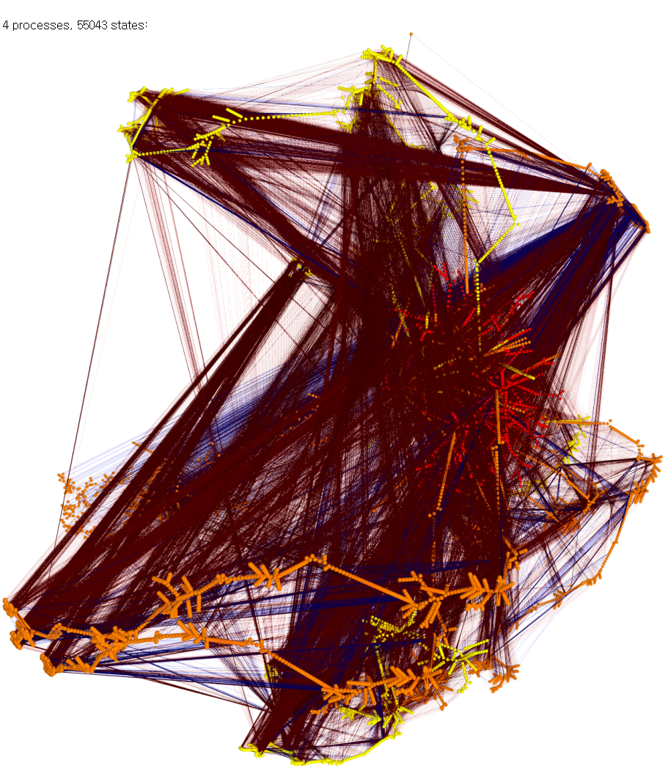
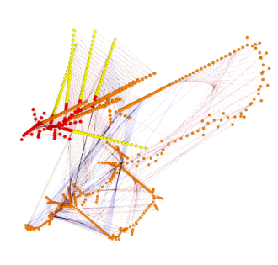
Concurrent Programming is Error-prone
Correctness of concurrent programs is hard to achieve
Interactions between threads should be carefully performed
A large # of thread executions due to non-deterministic thread scheduling
Testing technique for sequential programs do not properly work
4 processes, 55043 states
3 processes, 853 states
2 processes
, 30 states
Ex. Peterson mutual exclusion (From Dr. Moritz Hammer’s Visualisierung )

Slide 30
An Example of Mutual Exclusion Protocol
char cnt=0,x=0,y=0,z=0;
void process() {
char me=_pid +1; /* me is 1 or 2*/
again:
x = me;
If (y ==0 || y== me) ;
else goto again;
z =me;
If (x == me) ;
else goto again;
y=me;
If(z==me);
else goto again;
/* enter critical section */
cnt++;
assert( cnt ==1);
cnt --;
goto again;
}
Process 0
x = 1
If(y==0 || y == 1)
z = 1
If(x == 1)
y = 1
If(z == 1)
cnt++
Process 1
x = 2
If(y==0 || y ==2)
z = 2
If(x==2)
y=2
If (z==2)
cnt++
Software
locks
Critical
section
Violation detected !!!
Mutual
Exclusion
Algorithm
Counter
Example

Slide 31
Research on Concurrent Program Analysis
We have developed static/dynamic techniques for finding bugs in large concurrent programs effectively
Coverage-guided testing is a promising technique for effective/efficient concurrent program quality assurance
CUVE [ISSTA’12]
Industry-size concurrent programs
Precision
MOKERT
[MBT’08]
Coverage-guided
thread scheduling
generation
Model-
based
testing
Model
Checking
Testing
Code pattern-based
analysis
Sync. pattern based
bug
detection
COBET
[JSS’12]
Race bug
classification
Bug pattern +
static analysis
Scalability

Slide 32
Techniques to Test Concurrent Programs
Pattern-based bug detection
Systematic testing
Find predefined patterns of suspicious synchronizations [Eraser, Atomizer, CalFuzzer]
Limitation: focused on specific bug
Explore all possible thread scheduling cases [CHESS, Fusion]
Limitation: limited scalability
Random testing
Generate random thread scheduling [ConTest]
Limitation: may not investigate
new interleaving
Direct thread scheduling
for high test coverage

Slide 33
Challenge: Thread Schedule Generation
Thread-1
5 | 4 | 3 | 2 | 1
Thread
scheduler
Interleaved execution-1
Thread-2
5 | 4 | 3 | 2 | 1
5 | 5 | 5 | … | 4 | 3 | 2 | 1 | 2 | 1 | 2 | 1
Thread-3
Interleaved execution-2
5 | 4 | 3 | 2 | 1
5 | 5 | 5 | … | 4 | 3 | 2 | 1 | 2 | 1 | 2 | 1
Interleaved execution-3
Testing environment
5 | 5 | 5 | … | 4 | 3 | 2 | 1 | 2 | 1 | 2 | 1
The basic thread scheduler repeats similar schedules in a fixed environment
Testing with the basic thread scheduler is not effective to generate diverse schedules, possible for field environments

Slide 34
Limitation of Random Testing Technique
Noise injector
Thread-1
5 | 4 | 3 | 2 |  |  | 1
Interleaved execution-1
Thread
scheduler
5 | 5 | 5 | … | 2 | 3 | 2 | 3 | 1 | 2 | 1 | 1
Thread-2
5 |  | 4 |  | 3 | 2 | 1
Interleaved execution-2
Thread-3
5 | 5 | 5 | … | 2 | 3 | 2 | 1 | 3 | 2 | 1 | 1
5 | 4 | 3 | 2 |  | 1
Testing environment
5 | 4 | 3 | … | 3 | 2 | 5 | 1 | 4 | 3 | 2 | 1
Limitation
The probability to cover subtle behavior may be very low
No guarantee that the technique keeps discover new behaviors

Slide 35
Systematic Testing Technique
Thread-1
5 | 4 | 3 | 2 | 1
Interleaved execution-1
Systematic
testing
technique
5 | 4 | 3 | … | 3 | 2 | 1 | 5 | 4 | 3 | 2 | 1
Thread-2
5 | 4 | 3 | 2 | 1
Interleaved execution-2
Thread-3
5 | 4 | 3 | … | 3 | 2 | 5 | 1 | 4 | 3 | 2 | 1
5 | 4 | 3 | 2 | 1
$$\frac{\left(5+5+5\right)!}{5!5!5!}$$
:
:
Testing environment
Interleaved execution-10
5 | 4 | 3 | … | 3 | 5 | 4 | 2 | 1 | 3 | 2 | 1
Limitation
Not efficient to check diverse behaviors
A test might be skewed for checking local behaviors

Slide 36
Pattern-directed Testing Technique
Pattern-based
bug predictor
Thread-1
Interleaved execution-1
5 | 4 | 3 | 2 | 1
5 | 4 | 3 | … | 2 | 1 | 4 | 3 | 2 | 1 | 2 | 1
Bug-driven
scheduler
Thread-2
Interleaved execution-2
5 | 4 | 3 | 2 | 1
5 | 4 | 3 | … | 2 | 1 | 4 | 3 | 2 | 1 | 2 | 1
Thread-3
5 | 4 | 3 | 2 | 1
Interleaved execution-3
Testing environment
5 | 4 | 3 | … | 3 | 2 | 4 | 3 | 2 | 1 | 1 | 1
Limitation
Not effective to discover diverse behaviors
The technique may miss concurrency faults not predicted
No guarantee to have a chance to induce predicted faults

Slide 37
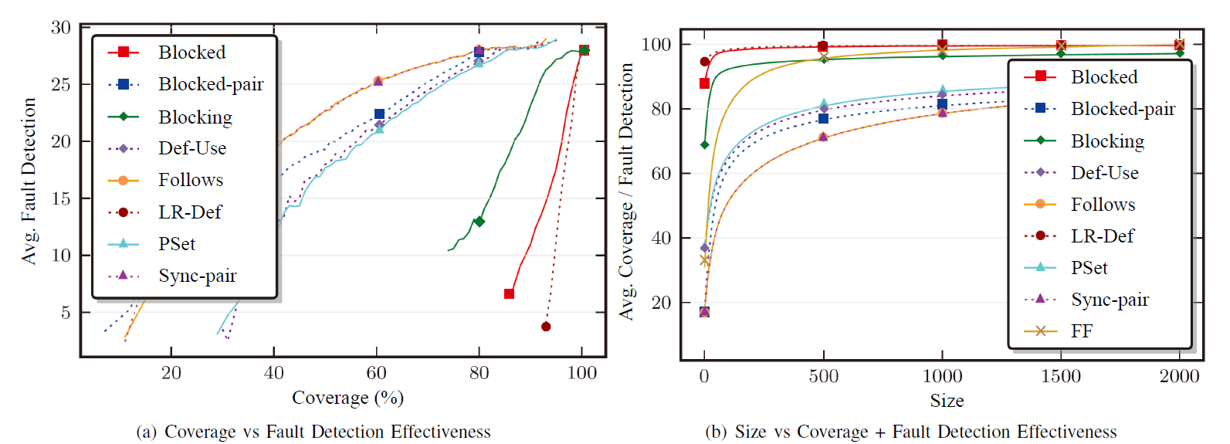
Coverage-based Testing Technique
Coverage
metric
Coverage
info.
Coverage
measure
Thread-1
5 | 4 | 3 | 2 | 1
Coverage-
based
scheduler
Interleaved execution-1
Thread-2
5 | 4 | 3 | 2 | 1
5 | 5 | 4 | … | 2 | 3 | 2 | 3 | 1 | 2 | 1 | 1
:
:
Thread-3
5 | 4 | 3 | 2 | 1
Testing environment
Advantage
High co-relation between concurrent coverage and fault-finding
Engineer can measure testing progress explicitly
Note that coverage-based testing is a standard testing process in sequential program testing

