Slide 1
Random Testing of Concurrent Programs
CS492B Analysis of Concurrent Programs
Prof. Moonzoo Kim
Computer Science, KAIST

Slide 2
Testing of Concurrent Programs
A test runs a target program with given input to generate actual executions (test case executions) to detect faults
No abstraction (i.e., true result)
no effort for modeling/analysis (c.f. compared to model checking)
No false positive (no need for validation)
A test case of a concurrent program has two aspects:
input value and thread schedule
Thus, a tester executes a program with an input value repeatedly while varying thread schedules
Testers need to generate various thread schedules to detect concurrency bugs that only appear with certain schedules

Slide 3
Testing Concurrent Program is Challenging
Thread-1
5 | 4 | 3 | 2 | 1
Execution start
Thread
scheduler
Interleaved execution-1
Thread-2
5 | 4 | 3 | 2 | 1
5 | 5 | 5 | … | 4 | 3 | 2 | 1 | 2 | 1 | 2 | 1
Interleaved execution-2
Thread-3
5 | 5 | 5 | … | 4 | 3 | 2 | 1 | 2 | 1 | 2 | 1
5 | 4 | 3 | 2 | 1
Interleaved execution-3
Testing environment
5 | 5 | 5 | … | 4 | 3 | 2 | 1 | 2 | 1 | 2 | 1
Testing with ordinary thread schedulers is not effective to generate various thread schedules
Repeats similar schedules in a fixed environment
not effective to consider various circumstances (e.g. CPU workload, I/O waiting, etc.)
No standard method to represent/include thread schedules in test cases

Slide 4
Stress Testing (Load Testing)
Program under test
Thread-1
5 | 4 | 3 | 2 | 1
Execution start
Thread-2
Thread
scheduler
Interleaved execution-1
5 | 4 | 3 | 2 | 1
5 | 5 | 5 | … | 4 | 3 | 3 | 1 | 2 | 2 | 1 | 1
Thread-3
5 | 4 | 3 | 2 | 1
Interleaved execution-2
…
5 | 5 | 5 | … | 4 | 3 | 2 | 2 | 2 | 1 | 1 | 1
Interleaved execution-3
…
5 | 5 | 5 | … | 3 | 3 | 2 | 2 | 2 | 1 | 1 | 1
Testing environment
Put heavy concurrent workload with test executions to lead thread schedulers to generate unusual thread schedules for test executions

Slide 5
Limitation of Stress Testing
Low chance to generate diverse thread schedules
No way to find a useful stress testing configuration for an arbitrary program
No guarantee that every test execution exposes a new target program behavior
No scientific measure of testing quality
Cannot know when a test generation should stop

Slide 6
Random Testing Techniques
Random testing techniques enforces a thread scheduler to generate various test executions randomly
Approaches
Timing noise-injection techniques
Randomized scheduling technique
Probabilistic concurrency testing (PCT) technique

Slide 7
Timing Noise Injection-based Technique
Noise injector
Thread-1
5 | 4 | 3 | 2 |  |  | 1
Execution start
Thread
scheduler
Thread-2
Interleaved execution-1
5 |  | 4 |  | 3 | 2 | 1
5 | 5 | 5 | … | 2 | 3 | 2 | 3 | 1 | 2 | 1 | 1
Thread-3
Interleaved execution-2
5 | 4 | 3 | 2 |  | 1
5 | 5 | 5 | … | 2 | 3 | 2 | 1 | 3 | 2 | 1 | 1
Testing environment
Interleaved execution-3
5 | 5 | 5 | … | 2 | 3 | 2 | 3 | 2 | 1 | 1 | 1
Insert artificial time delay operations to a target program to perturb thread schedules intentionally
No need to directly control thread scheduler

Slide 8
ConTest
Testing framework for concurrent Java programs developed by IBM research
Insert a timing noise before/after target concurrent operations of a target program to induce unusual thread schedules
Target concurrent operations: shared variable accesses, and synchronization
Timing noise
yield() or sleep() with a random amount of period
Inject a noise with a certain probability
*O. Edelstein et al.: Multithreaded Java Program Test Generation, IBM Systems Journal, 41(1), 2002

Slide 9
Bug Pattern-based Noise Injection
ConTest is extended to use static bug pattern detectors to detect suspicious statements, and then insert noise probes to these suspicious statements
A probe for a bug pattern is designed to generate error-inducing thread schedules for the pattern
E.g. lost notify pattern
Scheduling
noise probe
fun(){
...
m.wait() ;
...
}
fun() {
...
while(not all other threads are blocked)
sleep(duration);
m.wait() ;
...
}
<Original target program>
<Instrumented program>

Slide 10
Random Noise Injection Technique Rstest *
Insert a scheduling probe right before every shared variable access and blocking synchronization operation (e.g. lock, wait)
Scheduling probe: inject yield() with a given probability
Do not use sleep() since sleep() makes a target program slow which degrades testing efficiency
*S. D. Stoller: Testing Concurrent Java Programs using Randomized Scheduling, Runtime Verification, 2003

Slide 11
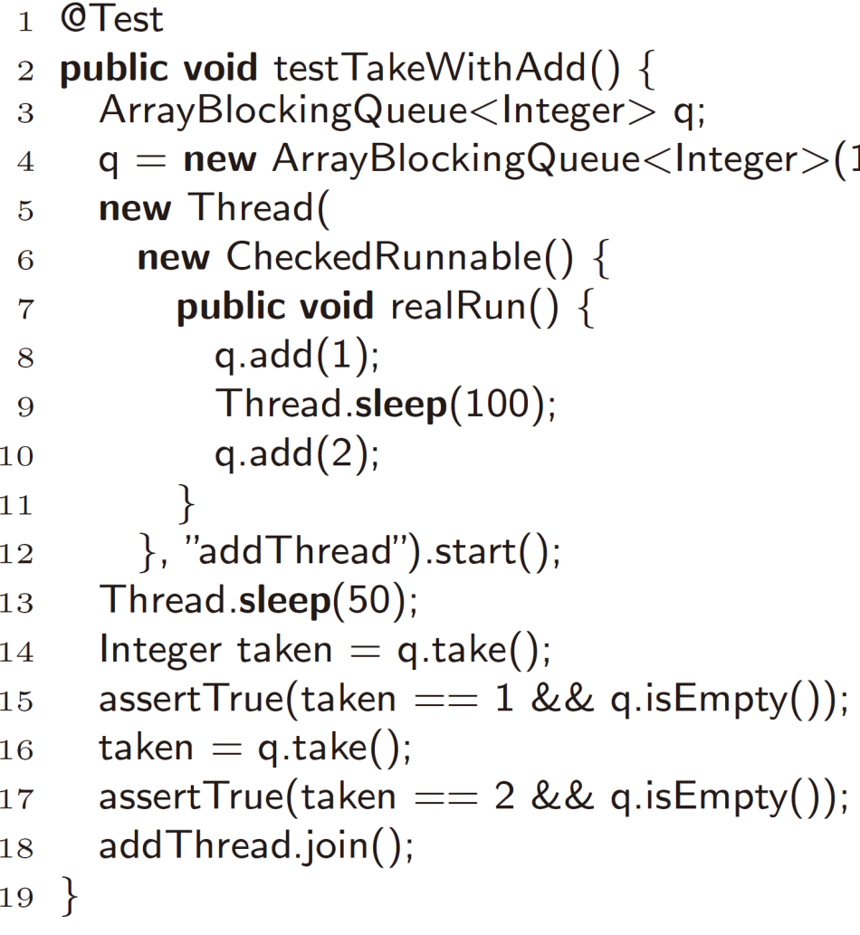
Explicit Timing Noise Used for Unit Testing
Unit test cases of real-world multithreaded programs often use explicit timing noise to enforce certain ordering of operations
Limitation
No guarantee that intended ordering is exercised in any circumstances
Low efficiency
<A JUnit test case of ArrayBlockingQueue>
V. Jagannath et al.: Improved Multithreaded Unit Testing, ACM SIGSOFT FSE, 2011

Slide 12
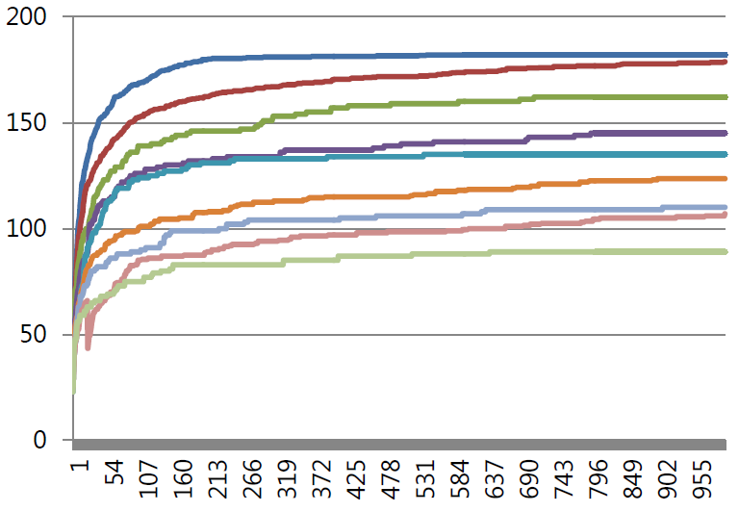
Limitation of Noise-injection Techniques
Difficult to predict best-performing noise configuration (e.g. injection probability, sleeping duration )
Timing noise makes a target program slow, which degrades testing efficiency
E.g. Random testing result with ArrayList
Concurrency coverage
Techniques with
different
noise configuration
Testing time

Slide 13
Randomized Scheduling (1/2)
Idea: make a thread scheduler to select a thread to run randomly to generate various executions
Algorithm
Instrument a target program to invoke scheduling probe before every shared memory access and sync. operation
When scheduling probe is invoked, the probe intentionally pauses the current thread
When all enabled threads are paused by the probe, a schedule decision algorithm randomly picks a paused thread, and resumes its execution
K. Sen: Effective Random Testing of Concurrent Programs, International Conference on Automated Software Engineering, 2007

Slide 14
Randomized Scheduling (2/2)
Input
s₀: an initial state of a target program
1 s $←$ s₀ ;
2 paused $←∅$ ;
3 while enabled(s) $≠∅$ do
4 p $←$ a random operation in enabled(s) \ $paused$;
5 if p is a concurrent operation then
6 $paused ←paused∪\left\{p\right\}$ ;
7 else
8 s $←$ execute(s, p) ;
9 end
10 if $paused$= enabled(s) then
11 p $←$ a random operation in enabled(s) ;
12 s $←$ execute(s, p) ;
13 $paused ←paused\backslash \left\{p\right\}$
14 end
15 end
16 if alive(s) $≠∅$ then
17 print “Deadlock detected!” ;
18 end
Make a thread paused when it executes a concurrent operation (shared memory access, synchronization),
enabled(s): the set of enabled operations of all non-blocked threads (i.e., at most one operation per thread)
execute(s, p): make a program to execute operation p at state s
alive(s): the set of non-terminated threads
Randomly select an operation from paused,
and schedule it.

Slide 15
Limitation: Redundant Scheduling
thread1():
1 lock(m);
2 x = 1;
3 x = 2;
4 x = 3;
5 x = 4;
6 unlock(m);
7 lock(n);
8 if(y==0)
9 assert(false);
10 unlock(n);
thread2():
11 lock(n);
12 y = 0;
13 unlock(n);
14 lock(n)
15 y = 1;
16 unlock(n);
17 lock(n)
18 y = 2;
19 unlock(n);
thread3():
21 lock(l);
22 z = 1 ;
23 z = 2 ;
24 z = 3 ;
25 unlock(l);
Independent to each other
(i.e. the result state does not depend on execution order)
Test execution#1: 1 → 11 → 21 → 12 → 2 → 22 → 13 → 3 → 23 → 4 → 14 …
Test execution#2: 11 → 21 → 1 → 12 → 22 → 2 → 3 → 13 → 23 → 14 → 4 …
Test execution#3: 21 → 22 → 11 → 1 → 12 → 2 → 13 → 23 → 3 → 4 → 5 …
:
:
Test execution#10: 11 → 12 → 1 → 21 → 2 → 13 → 3 → 22 → 14 → 4 → 5 …
Error execution: 1 → 2 → 3 → 4 → 5 → 11 → 12 → 13 → 7 → 8 → 9

Slide 16
Partial Order Reduction (POR)
A number of concurrent execution of a target program is equivalent to each other when these correspond to different execution orders of independent operations
If an execution causes an error, all equivalent executions also do it
Concurrent executions having the same happens-before relation are equivalent
Two executions have the same happens-before relation if they have the same operations, and the order of synchronization operations and shared memory accesses are the same.
In testing, it is sufficient to check only one execution order of independent operations
The effort to diversify execution orders of independent operations is not rewarding

Slide 17
Randomized Scheduling with POR (1/2)
For every scheduling decision at a state s, select a set of independent operations P, rather than a single operation
Executing any sequence of P is possible from s, and
The execution result of any sequence of P from s is the same
Independent operation set
P₁={t1, t2, t3, t5},
P₂={t2, t3, t4, t5},
all non-empty subsets of P₁,
all non-empty subsets of P₂
t1: lock(m)
s
t5: lock(n)
t2: read(x)
t4: lock(m)
t3: write(y)
t3: write(y)
t4: lock(m)
t2: read(x)
t5: lock(n)

Slide 18
Randomized Scheduling with POR (2/2)
Input
s₀: an initial state of a target program
1 s $←$ s₀ ;
2 paused $←∅$ ;
3 while enabled(s) $≠∅$ do
4 p $←$ a random operation set of enabled(s) \ paused ;
5 if p is a concurrent operation then
6 $paused ←paused∪\left\{p\right\}$ ;
7 else
8 s $←$ execute(s, p) ;
9 end
10 if paused = enabled(s) then
11 P $←$ a random set of independent operations in enabled(s) ;
12 foreach $p∈P$ do
13 s $←$ execute(s, p) ;
14 end
15 $paused ←paused \backslash P$ ;
16 end
17 if alive(s) $≠∅$ then
18 print “Deadlock detected!” ;
19 end

Slide 19
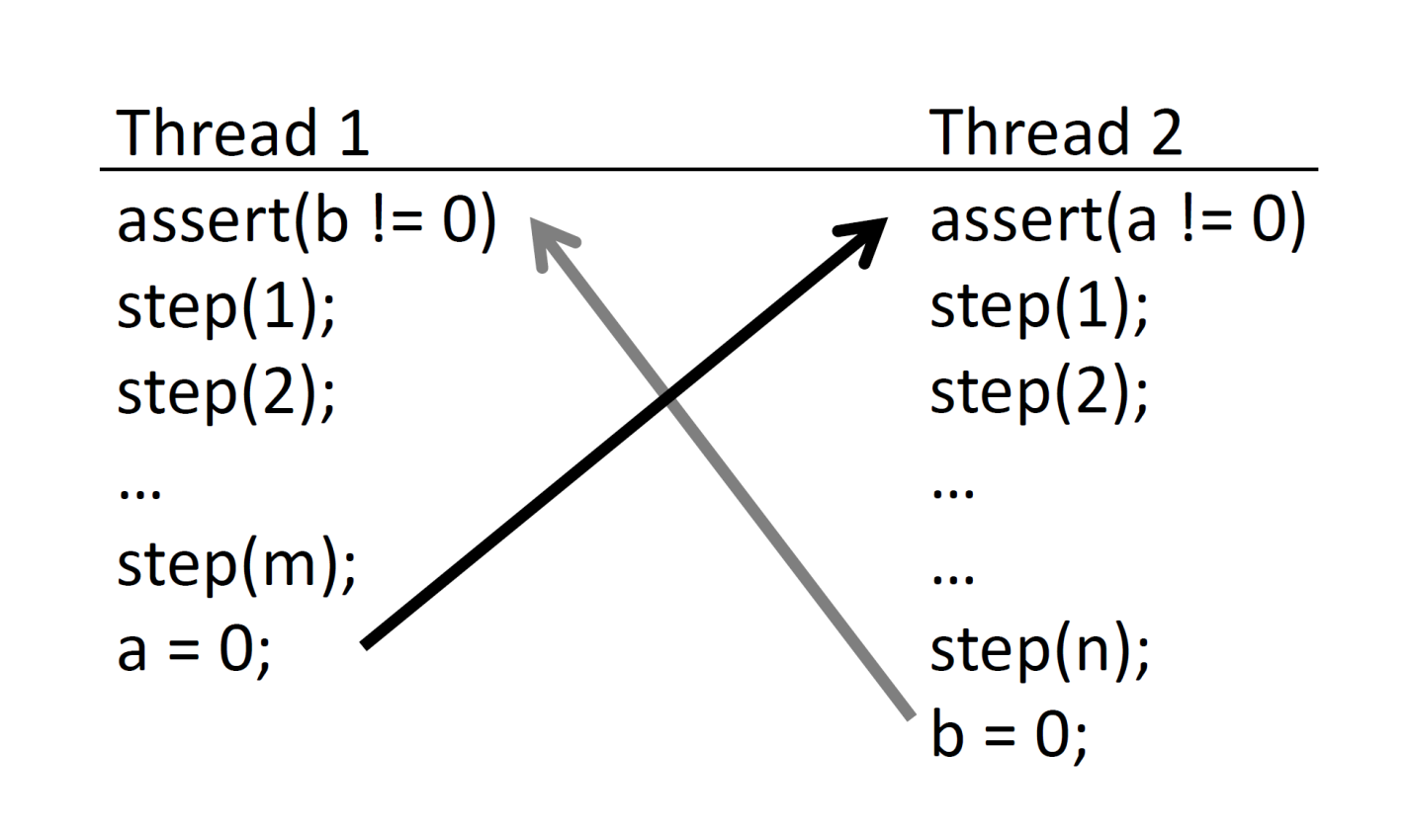
Limitation of Randomized Scheduling
Initially, a=b=1
Detecting a concurrency bug depends more on execution order of certain buggy operations, than thread scheduling sequence.

Slide 20
Probabilistic Concurrency Testing (PCT)
Test generation
Selects a small number of thread scheduling points
Generates executions of diverse ordering of these points
Theoretical guarantee on the probability that a generated execution detects a concurrency error of a certain kind
Possible to assess the sufficient number of test executions for detecting a kind of bug with a certain confidence level
Target simple concurrency bugs to complex ones gradually
* S. Burckhardt et al.: A Randomized Scheduler with Probabilistic Guarantees of Finding Bugs, ASPLOS, 2010

Slide 21
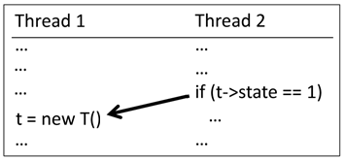
Depth of Concurrency Bug
The depth of a concurrency bug is the minimum number of ordering constraints sufficient to induce an error
Large portion of concurrency bugs in real world have very small depths (i.e., 1, 2, or 3)
(a) Simple race bug (i.e. order violation)
(b) Atomicity violation
(c) ABBA deadlock

Slide 22
Scheduling Technique Overview
Partitioning: initially, the technique defines partitions over a target multithreaded programs
Scheduling: at the beginning of an execution, the technique randomly decides priorities (i.e., execution orders) of the partitions
Test generation: in the execution, the scheduler selects the partition of the highest priority for each step
Similar to priority scheduling
No interleaving within each execution of a partition except when the thread starts to wait for another thread

Slide 23
Partitioning Execution
Suppose that a program has n threads, the program has total k instructions, and the depth of target concurrency bug is d.
The technique defines each thread as a partition (n partitions)
Each partition starts at the thread starting point, and ends at the thread termination point
In addition, the technique randomly divides a partition into 2 for d-1 times (d-1 partitions in addition)
For an instruction in a program, the probability that the instruction belongs to an additional partition is 1/k at minimum

Slide 24
t1
t2
tn
t1
t2
tn
Partitioning
New partition defined randomly

Slide 25
Scheduling
The technique randomly assigns the priorities d, d+1,...,d+n-1 to n partitions each of which starts from a thread
The priority d+n-1 is the highest one
The probability that a partition has the lowest priority (i.e. d) is 1/n at minimum.
For a partition generated by i-th division (1 $≤$ i $≤$ d-1), the technique assigns its priority as d-i.
For an instruction s in a program, the probability that s has a priority i is 1/k at minimum

Slide 26
Test Execution Generation
Before test executions, a user sets the target depth of concurrency bugs, and a starting state
Before each test execution, the technique sets the partitions, and their priorities
For each state, the PCT runtime scheduler selects the thread that executes the partition of the highest priority in enabled threads
A thread enabled when it is not terminated, and not blocked by any synchronization
A context-switching occurs if
A thread begins/ends, or
A thread is blocked, or
A thread reaches to the end of a partition (randomly selected)

Slide 27
Probability to Detect Depth-1 Bug (1/2)
Suppose that a target program has n threads and there is a concurrency bug of depth 1
The bug consists of two instructions p₁ and p₂ in two threads t₁ and t₂
The bug induces an error if p₂ is executed before p₁.
The technique defines n partitions each of which corresponds to each thread (no additional partition since d = 1)
The partition s₁ and s₂ correspond to t₁ and t₂
s₁
s₂

Slide 28
Probability to Detect Depth-1 Bug (2/2)
The probability for a generated execution to detect an error for the bug is 1/n at minimum (in worst case)
The probability that s₂ has a higher priority than s₁ $≥$ the probability that s₁ has the lowest priority.
The probability that s₁ has the lowest priority is 1/n

Slide 29
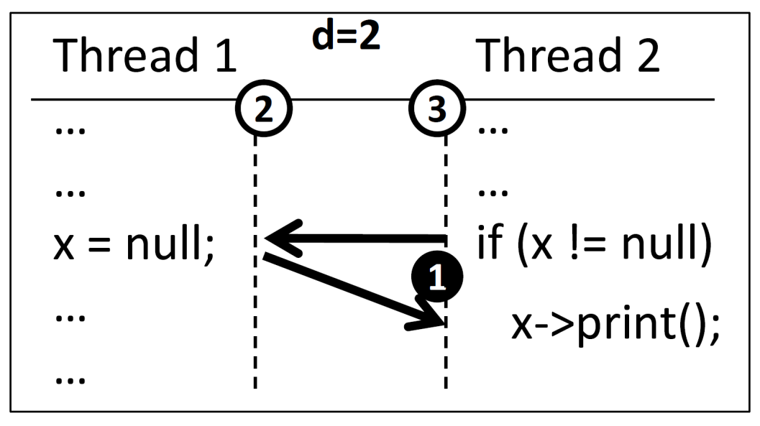
Probability to Detect Depth-2 Bug (1/2)
Suppose that a target program has n threads and k instructions, and there is a concurrency bug of depth 2
The bug consists of p₁, p₂, and p₃ where p₁ and p₂ belong to different threads (t₁$≠$t₂), and p₂ and p₃ belongs to different threads (t₂$≠$t₃).
The technique defines n partitions that begins from thread starts, and one partition that starts from a randomly selected instruction.

Slide 30
Probability to Detect Depth-2 Bug (2/2)
The probability of a generated execution to detect the error is $\frac{1}{n × k}$ at minimum
The probability that p₃ belongs to the additional partition $≥1/k$
because the probability that the additional partition starts from p₃ is $1/k$ at minimum
The probability that s₁ has a higher priority than s₂ $≥ 1/n$

Slide 31
Probability to Detect Depth-d Bugs
Suppose that a target program has n threads and k instructions, and there is a concurrency bug of depth d
Suppose that the bug consists of the instructions p₁, p₂, …, p_{d+1} and
The bug induces an error only if these instructions are executed in order
The probability of a generated execution to detects the error is $\frac{1}{n{ × k}^{d−1}}$ at minimum
The probability that p₁ executes before p₂ $≥ \frac{1}{n}$
The probability that p₃, … , p_{d+1} belongs to the corresponding additional partitions $≥ \frac{1}{k^{d−1}}$

Slide 32
Empirical Evaluation
Q1: is a real-world concurrency bug simple? (i.e. the depth is only 1, 2, or 3)
Q2: does PCT detect the concurrency bugs of a given depth within the estimated probability?
Theoretical worst case probability vs. actual probability

Slide 33
Empirical Evidence on Short Bug Depth
Program | Bug description | LOC | d | n | k
Splash-FFT | Platform dependent macro missing a wait leading to order violations | 1200 | 1 | 2 | 791
Splash-LU |  | 1130 | 1 | 2 | 1517
Splash-Barnes |  | 3465 | 1 | 2 | 7917
Pbzip2 | Crash during decompressions | 1978 | 2 | 4 | 1981
Work Steal Queue | Internal assertion fails due to a race condition | 495 | 2 | 2 | 1488
Dryad | Use after free failing an internal assertion | 16036 | 2 | 5 | 9631
IE | JavaScript parse error | - | 1 | 25 | 1.4M
Mozilla | Crash during restoration | 245172 | 1 | 12 | 38.4M
The concurrency bugs in real-world applications in the study have small depth

Slide 34
Fault Detection Effectiveness of PCT
Program | d | n | k | k_{eff} | Stress | Random sleep | PCT | PCT
 |  |  |  |  |  |  | measured | guaranteed
Splash-FFT | 1 | 2 | 791 | 139 | 0.06 | 0.27 | 0.50 | 0.5
Splash-LU | 1 | 2 | 1517 | 996 | 0.07 | 0.39 | 0.50 | 0.5
Splash-Barnes | 1 | 2 | 7917 | 318 | 0.0074 | 0.01 | 0.4916⁺ | 0.5
Pbzip2 | 2 | 4 | 1981 | 1207 | 0.00 | 0.00 | 0.701 | 0.0001
Work Steal Queue | 2 | 2 | 1488 | 75 | 0.00 | 0.001 | 0.002 | 0.0003
Dryad | 2 | 5 | 9631 | 1990 | 0.00 | 0.00 | 0.164 | 2 $×{10}^{−5}$
The actual fault detection probability is higher than other techniques and the estimated fault detections in most cases
⁺due to the imprecise heuristics of the PCT scheduler to avoid starvation case

Slide 35
Limitation of PCT
Concurrency bugs in real-world are not simple (i.e., the depth of a bug can be large )
because only the depth depends on not only buggy statements in a target program, but also on test cases
Test cases are usually built to have many threads that manipulate the same data structure repeatedly
Such test cases will require high degree of interactions to reveal concurrency bugs
The effectiveness of partition selection relies on luck
Low scalability in terms of program size
No systematic exploration of thread scheduling space
Use code coverage for systematic partitioning and exploration of thread scheduling space

