Slide 1
Concurrency Analysis for Correct Concurrent Programs: Fight Complexity Systematically and Efficiently
Moonzoo Kim
Computer Science, KAIST

Slide 2
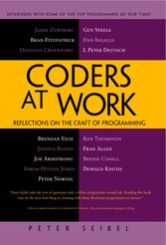
Motivation for Concurrency Analysis
Most of my subjects (interviewee) have found that the hardest bugs to track down are in concurrent code
…
And almost every one seem to think that
ubiquitous multi-core CPUs are going to force some serious changes in the way software is written
P. Siebel, Coders at work (2009) -- interview with 15 top programmers of our times:
Jamie Zawinski, Brad Fitzpatrick, Douglas Crockford, Brendan Eich, Joshua Bloch, Joe Armstrong, Simon Peyton Jones, Peter Norvig, Guy Steele, Dan Ingalls, L Peter Deutsch, Ken Thompson, Fran Allen, Bernie Cosell, Donald Knuth
Unintended/unexpected thread scheduling (a.k.a., interleaving scenarios) raises hard to detect concurrency errors

Slide 3
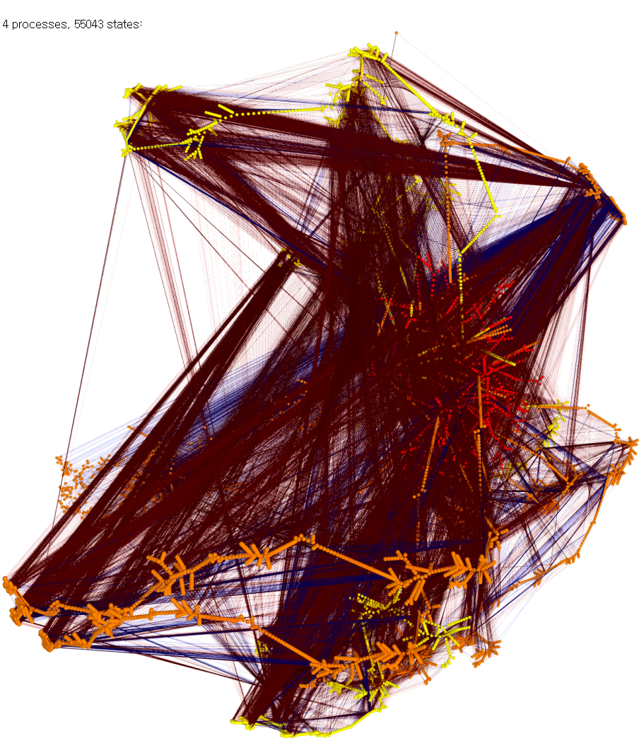
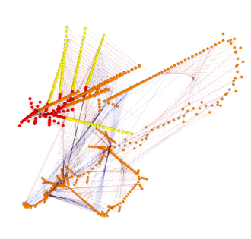
Concurrent Programming is Error-prone
Correctness of concurrent programs is hard to achieve
Interactions between threads should be carefully performed
A large # of thread executions due to non-deterministic thread scheduling
Testing technique for sequential programs do not properly work
4 processes, 55043 states
3 processes, 853 states
2 processes
, 30 states
Ex. Peterson mutual exclusion (From Dr. Moritz Hammer’s Visualisierung )
Notes:
Input space v.s. thread scheduling space which is not under-control

Slide 4
Concurrency
Concurrent programs have very high complexity due to non-deterministic scheduling
Ex. int x=0, y=0, z =0;
void p() {x=y+1; y=z+1; z= x+1;}
void q() {y=z+1; z=x+1; x=y+1;}
Total 20 interleaving scenarios
= (3+3)!/(3!x3!)
However, only 11 unique outcomes
p()
x=y+1
y=z+1
z=x+1
q()
y=z+1
z=x+1
x=y+1
Trail1: 2,2,3
Trail2: 3,2,4
Trail3: 3,2,3
Trail4: 2,4,3
Trail5: 5,4,6
Trail6: 5,4,3
Trail7: 2,1,3
Trail8: 2,3,3
Trail9: 4,3,5
Trail10: 4,3,2
Trail11: 2,1,2
Notes:
x,y,z
2,1,2
2,1,3
2,2,3
2,3,3
2,4,3
3,2,3
4,3,2
4,3,5

Slide 5
Very difficult to find concurrency bugs !!!

Slide 6
Operational Semantics of Software
A system execution σ is a sequence of states s₀s₁…
A state has an environment ρ_{s}:Var-> Val
A system has its semantics as a set of system executions
x:0,y:0
s₀
x:0,y:1
s₁
x:1,y:2
x:5,y:1
s₂
s₁₁
x:1,y:3
x:5,y:2
s₃
s₁₂
x:2,y:4
x:5,y:3
x:7,y:3
s₄
s₁₃
s₂₁
x:5,y:4
x:7,y:4
s₁₄
s₂₂
Notes:
We view the program execution as a sequence of states. A state consists of variable environment rho and time stamp t. This viewpoint states that information of program remains between two consecutive states.
Furthermore, a state in the execution indicates that something happens at the time instant corresponding to the state.
As the execution has more states, more computational resource is required to analyze the execution. Therefore, to reduce the overhead, if possible, we need to abstract out unnecessary states in terms of properties. For example, for property p, we don’t need variable x. Thus removing states …
Furthermore, not every value of y is important because only s0 and s6 affects the property. Thus, we might want to remove states s1-s5. We will discuss this abstraction in more detail later

Slide 7
Model Checker Analyzes All Possible Scheduling
active type A() {
byte x;
again:
x++;
goto again;
}
x:0
x:1
x:2
x:255
active type A() {
byte x;
again:
x++;
goto again;
}
active type B() {
byte y;
again:
y++;
goto again;
}
x:0,y:0
x:0,y:1
x:0,y:255
x:1,y:0
x:1,y:1
x:1,y:255
x:2,y:0
x:2,y:1
x:2,y:255
x:255,y:0
x:255,y:255

Slide 8
Hierarchy of SW Coverage Criteria
Complete Value Coverage
CVC
(SW) Model checking
Complete Path Coverage
CPC
Concolic testing
Prime Path Coverage
PPC
All-DU-Paths Coverage
ADUP
Edge-Pair Coverage
EPC
All-uses Coverage
AUC
Complete Round Trip Coverage
CRTC
Edge Coverage
EC
All-defs Coverage
ADC
Simple Round Trip Coverage
SRTC
Node Coverage
NC

