Slide 1
Java Code Coverage Tools - EclEmma and JaCoCo

Slide 2
Introduction: Coverage-Based Testing
Code coverage measures quality of test suite.
An element is covered if a test suite executes/makes a behavior for the element.
A class is covered if a test suite accesses the class.
A method is covered if a test suite invokes the method.
A statement is covered if a test suite executes the statement.
A branch is covered if a test suite follows the branch.
A instruction is covered if a test suite executes the instruction.
If a test suite does not an element, errors in the element cannot be found by the test suite.
The higher test suite coverage, the more errors is likely to be found.

Slide 3
Coverage Measurement Tools
There are tools to measure coverage in many languages.
C – gcov
C++ - …
Java – EclEmma(JaCoCo)
We will look into EclEmma and JaCoCo for SafeHome project.
EclEmma is an Eclipse plugin that measures Java code coverage.
JaCoCo is Java code coverage library developed by EclEmma project team.
See http://www.eclemma.org/
See http://www.eclemma.org/jacoco/index.html
EclEmma can be used with JUnit, TestNG, and so on.
They are Java test frameworks.
JUnit is provided in Eclipse as well.

Slide 4
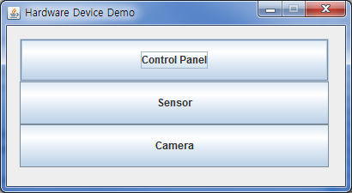
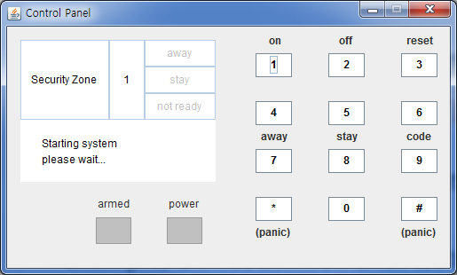
EclEmma – Measuring Coverage in Eclipse Example (1/3)
Target project: SafeHomeDevice.zip
1. Execute SafeHomeDevice with EclEmma.
2. Click control panel.
3. Click button 1.
4. Terminate the application.
5. (Cont.)

Slide 5
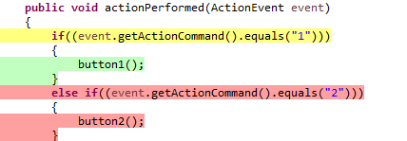
EclEmma – Measuring Coverage in Eclipse Example (2/3)
5. Check DeviceControlPanelAbstract.java:244. Eclipse shows coverage status like the following.
Yellow line is partially covered.
Only parts of Bytecode instructions are covered or,
A branch is not completely covered.
Green line is fully covered.
Red line is not covered.
Test suite coverage is union of each test case coverage.
EclEmma supports merging coverage measurement of test case.
EclEmma manages ‘session’s. session represents coverage measurement.

Slide 6
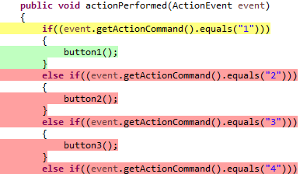
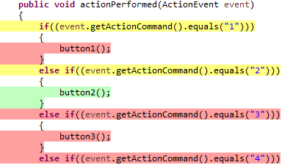
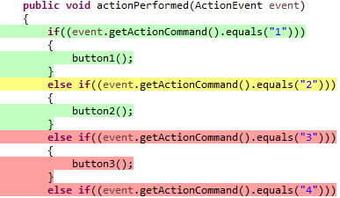
EclEmma – Measuring Coverage in Eclipse Example (3/3)

Slide 7
EclEmma Installation & Configuration (1/3)
From http://www.eclemma.org/installation.html
In Eclipse, Help->Install New Software…
Type http://update.eclemma.org at “Work with:” field.
Select and install EclEmma.
You may see application launch options provided EclEmma.

Slide 8
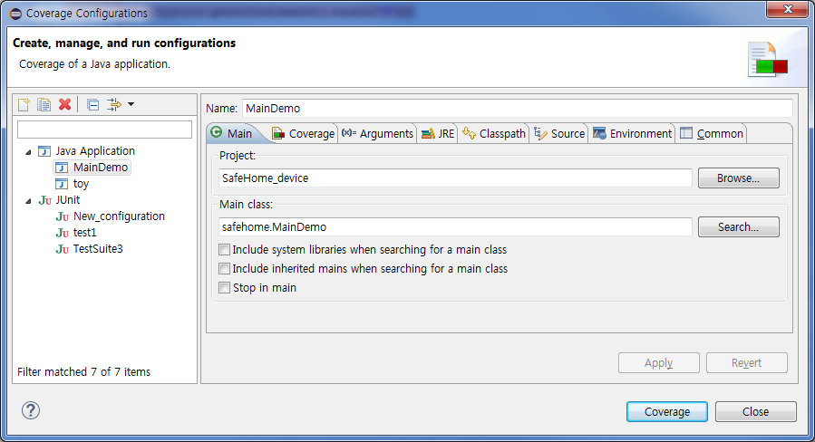
EclEmma Installation & Configuration (2/3)
You can configure launch options as default launcher provided in Eclipse.

Slide 9
EclEmma Installation & Configuration (3/3)
Go to Window->Show view->other->Java. And, select Coverage. Then, you can see coverage status window.
You can check coverage measurement, manage coverage data and export data in HTML format.
See report template in http://www.eclemma.org/jacoco/trunk/coverage/.

Slide 10
JaCoCo – Java Code Coverage Library
JaCoCo provides coverage measurement by load-time instrumentation.
When executing JVM, use –javaagent arguments to use JaCoCo.
JaCoCo will generate jacoco.exec which contains execution data.
JaCoCo provides library to generate coverage reports using jacoco.exec.
See http://www.eclemma.org/jacoco/trunk/doc/examples/java/ReportGenerator.java.
EclEmma can import jacoco.exec generated by JaCoCo into a session.
There are various options using JaCoCo. See http://www.eclemma.org/jacoco/trunk/doc/agent.html.

Slide 11
Demo
1. SafeHomeDevice
2. Triangle

Slide 12
Appendix

