Slide 1
Chapter 8
Understanding Requirements
Moonzoo Kim
KAIST

Slide 2
Requirements Engineering-I
Inception—ask a set of questions that establish …
  basic understanding of the problem (what)
  the people who want a solution (who)
  the nature of the solution that is desired, and
  the effectiveness of preliminary communication and collaboration between the customer and the developer
Elicitation—elicit requirements from all stakeholders
Elaboration—create an analysis model that identifies data, function and behavioral requirements
Negotiation—agree on a deliverable system that is realistic for developers and customers

Slide 3
Requirements Engineering-II
Specification—can be any one (or more) of the following:
  A written document
  A set of models
  A collection of user scenarios (use-cases)
  A prototype
Validation—a review mechanism that looks for
  Errors in content or interpretation
  Areas where clarification may be required (ambiguity)
  Missing information (incomplete requirement)
  Inconsistencies
    a major problem when large products or systems are engineered
  Unrealistic (unachievable) requirements.
Requirements management

Slide 4
Inception
Identify stakeholders
  “who else do you think I should talk to?”
Recognize multiple points of view
Work toward collaboration
The first questions
  Who is behind the request for this work?
  Who will use the solution?
  What will be the economic benefit of a successful solution
  Is there another source for the solution that you need?

Slide 5
Eliciting Requirements
meetings are conducted and attended by both software engineers and customers
an agenda is suggested
a "facilitator" (can be a customer, a developer, or an outsider) controls the meeting
a "definition mechanism" (can be work sheets, flip charts, or wall stickers or an electronic bulletin board, chat room or virtual forum) is used
the goal is
  to identify the problem
  propose elements of the solution
  negotiate different approaches, and
  specify a preliminary set of solution requirements

Slide 6
Elicitation Work Products
a set of usage scenarios that provide insight into the use of the system or product under different operating conditions.
any prototypes developed to better define requirements.
a statement of need and feasibility.
a bounded statement of scope for the system or product.
a list of customers, users, and other stakeholders who participated in requirements elicitation
a description of the system’s technical environment.
a list of requirements (preferably organized by function) and the domain constraints that apply to each.

Slide 7
Quality Function Deployment (QFD)
Function deployment determines each function required of the system
Information deployment identifies data objects and events
Task deployment examines the behavior of the system
Value analysis determines the relative priority of requirements during each of the three deployments
  Value should be one that are perceived by the customer

Slide 8
Non-Functional Requirements
Non-Functional Requirement (NFR) – quality attribute, performance attribute, security attribute, or general system constraint. A two phase process is used to determine which NFR’s are compatible:
  The first phase is to create a matrix using each NFR as a column heading and the system SE guidelines a row labels
  The second phase is for the team to prioritize each NFR using a set of decision rules to decide which to implement by classifying each NFR and guideline pair as
    complementary
    overlapping
    conflicting
    independent

Slide 9
Conducting a Requirements Gathering Meeting (pg145)
The scene:
  A meeting room. The first requirements gathering meeting is in progress.
The players:
  Jamie Lazar, software team member;
  Vinod Raman, software team member;
  Ed Robbins, software team member;
  Doug Miller, software engineering manager;
  three members of marketing;
  a product engineering representative;
  a facilitator.
The conversation:
Facilitator (pointing at white board): So that's the current list of objects and services for the home security function.
Marketing person: That about covers it from our point of view.
Vinod: Didn't someone mention that they wanted all SafeHome functionality to be accessible via the Internet? That would include the home security function, no?
Marketing person: Yes, that's right ... we'll have to add that functionality and the appropriate objects.
9
CS350 Intro. to SE Spring 2008

Slide 10
Facilitator: Does that also add some constraints?
Jamie: It does, both technical and legal.
Production rep: Meaning?
Jamie: We better make sure an outsider can't hack into the system, disarm it, and rob the place or worse. Heavy liability on our part.
Doug: Very true.
Marketing: But we still need Internet connectivity. Just be sure to stop an outsider from getting in.
Ed: That's easier said than done and....
Facilitator (interrupting): I don't want to debate this issue now. Let's note it as an action item and proceed. (Doug, serving as the recorder for the meeting, makes an appropriate note.)
Facilitator: I have a feeling there's still more to consider here.
(The group spends the next 45 minutes refining and ex­panding the details of the home security function.)
10
CS350 Intro. to SE Spring 2008

Slide 11
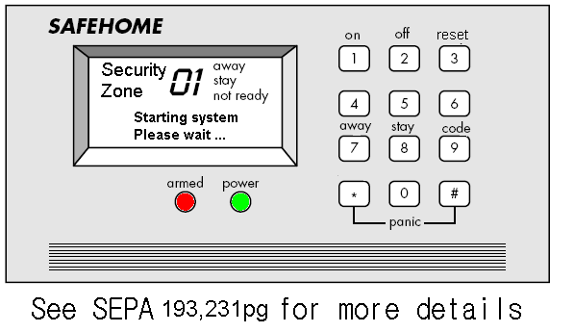
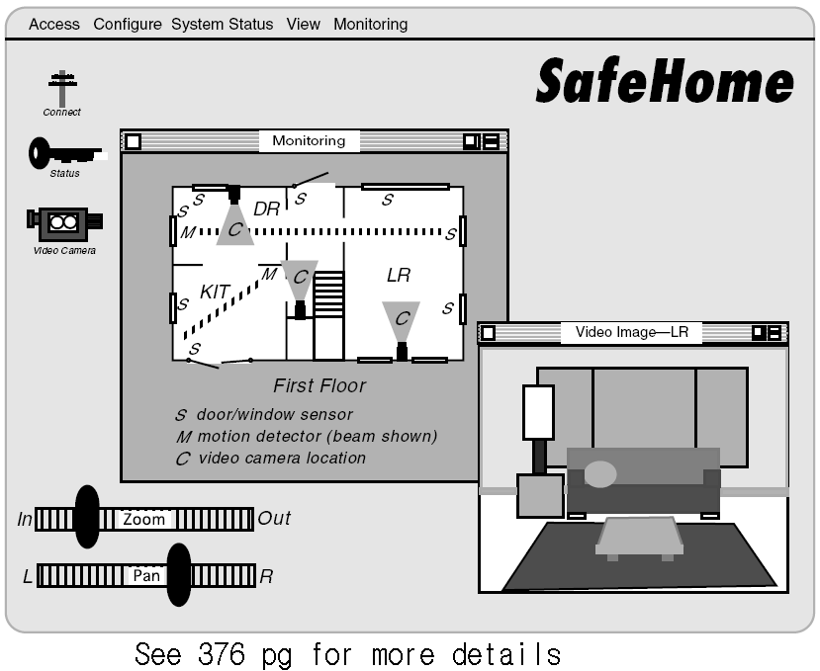
SafeHome Product

Slide 12
Use-Cases
A collection of user scenarios that describe the thread of usage of a system
Each scenario is described from the point-of-view of an “actor”—a person or device that interacts with the software in some way
Each scenario answers the following questions:
  Who is the primary actor, the secondary actor (s)?
  What are the actor’s goals?
  What preconditions should exist before the story begins?
  What main tasks or functions are performed by the actor?
  What extensions might be considered as the story is described?
  What variations in the actor’s interaction are possible?
  What system information will the actor acquire, produce, or change?
  Will the actor have to inform the system about changes in the external environment?
  What information does the actor desire from the system?
  Does the actor wish to be informed about unexpected changes?

Slide 13
Example of Use Case for SafeHome
Use-case: InitiateMonitoring
Primary actor: Homeowner
Goal in context: To set the system to monitor sensors when the homeowner leaves the house or remains inside
Preconditions: System has been programmed for a password and to recognize various sensors
Trigger: The homeowner decides to “set” the system, i.e., to turn on the alarm functions
Scenario:
  Homeowner: observes control panel
  Homeowner:enters password
  Homeowner: selects “stay” or “away”
  Homeowner: observes red alarm light to indicate that SafeHome has been armed
Exceptions:
  1a. Control panel is not ready: homeowner checks all sensors to determine which are open; closes them
  2a. Password is incorrect
Priority: Essential, must be implemented
When available: first increment
Frequency of use: Many times per day
Channel to actor: Via control panel interface
Secondary actors: Support technician
Channels to secondary actors: support technician: phone line
Open issues:
  Do we enforce time limit for password entering?

Slide 14
Use-Case Diagram

Slide 15
Building the Analysis Model
Elements of the analysis model
  Scenario-based elements
    Functional—processing narratives for software functions
    Use-case—descriptions of the interaction between an “actor” and the system
  Class-based elements
    Implied by scenarios
  Behavioral elements
    State diagram
  Flow-oriented elements
    Data flow diagram

Slide 16
Eliciting Requirements

Slide 17
Class Diagram
From the SafeHome system …

Slide 18
State Diagram

Slide 19
Negotiating Requirements
Identify the key stakeholders
  These are the people who will be involved in the negotiation
Determine each of the stakeholders “win conditions”
  Win conditions are not always obvious
Negotiate
  Work toward a set of requirements that lead to “win-win”

Slide 20
Validating Requirements-I
Is each requirement consistent with the overall objective for the system/product?
Have all requirements been specified at the proper level of abstraction? That is, do some requirements provide a level of technical detail that is inappropriate at this stage?
Is the requirement really necessary or does it represent an add-on feature that may not be essential to the objective of the system?
Is each requirement bounded and unambiguous?
Does each requirement have attribution? That is, is a source (generally, a specific individual) noted for each requirement?

Slide 21
Validating Requirements-II
Do any requirements conflict with other requirements?
Is each requirement achievable in the technical environment that will house the system or product?
Is each requirement testable, once implemented?
Does the requirements model properly reflect the information, function and behavior of the system to be built.
Has the requirements model been “partitioned” in a way that exposes progressively more detailed information about the system.

Slide 22
Specification Guidelines
use a layered format that provides increasing detail
as the "layers" deepen
use consistent graphical notation and apply textual
terms consistently (stay away from aliases)
be sure to define all acronyms
be sure to include a table of contents; ideally,
include an index and/or a glossary
write in a simple, unambiguous style (see "editing
suggestions" on the following pages)
always put yourself in the reader's position, "Would
I be able to understand this if I wasn't intimately
familiar with the system?"

Slide 23
Specification Guidelines

Slide 24
Specification Guidelines

