Slide 1
Chapter 23
Testing Conventional Applications
Moonzoo Kim
CS Dept. KAIST

Slide 2
Overview of Ch23. Testing Conventional Applications
23.1 Software Testing Fundamentals
23.2 Internal and External Views of Testing
23.3 White-Box Testing
23.4 Basis Path Testing
  Flow Graph Notation
  Independent Program Paths
  Deriving Test Cases
  Graph Matrices
23.5 Control Structure Testing
  Condition Testing
  Data Flow Testing
  Loop Testing
23.6 Black-box Testing

Slide 3
Testing v.s. Verification
Program testing can be used to show the presence of bugs, but never to show their absence!
By Edsger W. Dijkstra (1970)
Testing: to detect bugs
Verification: to prove the absence of bugs
  Verification techniques are much powerful but often not scalable for real-world problems
    theorem proving or model checking (CS408 and CS453)
A good test has a high probability of finding an error
A good test is not redundant.

Slide 4
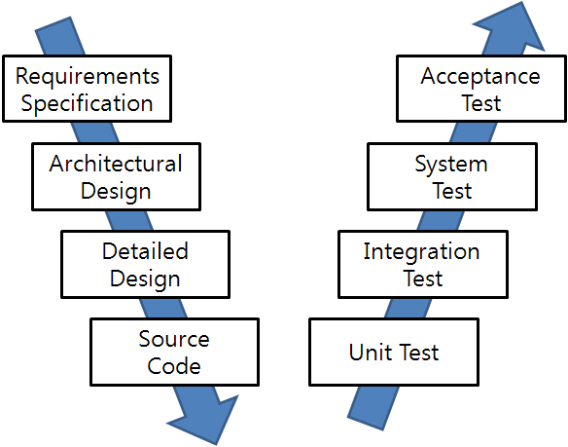
SW Development and Testing Model
(a.k.a. V model)
Manual
Labor
Abstraction

Slide 5
소프트웨어 구성요소와 테스팅
Spec
요구사항 spec, 시스템 model로 구성됨
소프트웨어에 기대하는 기능을
추상적으로 기술한 것
2. 구현
1. 표현
Program
3. 실행
Test case
소프트웨어의 기능을 구현한 코드의
집합으로 구성
프로그램 입력 값과 그에 해당하는
기대 출력 값의 쌍(pair)으로 구성됨
소프트웨어 테스팅 품질
요구사항 spec이 test case로 모두 올바르게 표현됐는가?
→ 시나리오 기반 테스팅 (black-box testing)
시스템 model이 Program 요소로 모두 올바르게 구현됐는가?
→ 모델 기반 테스팅 (model-based testing)
Program의 코드가 test case로 모두 올바르게 실행되는가?
→ 코드 기반 테스팅 (white-box testing)

Slide 6
Software Testing
Based on
SW design
(model-based testing)
Based on
SW requirements
(high-level testing)
Based on SW
code structure
(low-level testing)
white-box
methods
grey-box
methods
black-box
methods
Methods
Strategies

Slide 7
Ex. Testing a Triangle Decision Program
SRS should be refined into assert() for testing
Input : Read three integer values from the command line. The three values represent the length of the sides of a triangle.
Output : Tell whether the triangle is
• 부등변삼각형 (Scalene) : no two sides are equal
• 이등변삼각형(Isosceles) : exactly two sides are equal
• 정삼각형 (Equilateral) : all sides are equal
Black box testing creates test cases to check if the program satisfies SRS : (3,4,5), (2,2,1), (1,1,1), (3,1,1)
White box testing creates test cases to check all program branches are covered:

Slide 8
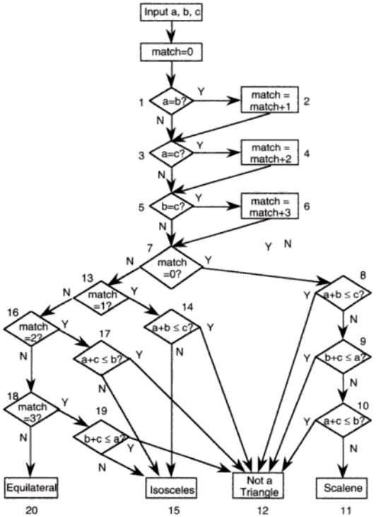
(3,4,5)
(2,2,1)
“Software Testing a craftsman’s approach” 2nd ed by P.C.Jorgensen
(no check for positive inputs)
(1,1,1)
(3,1,1)
Notes:
a,b,c = 1,1,1:result=0
a,b,c = 2,1,1:result=2
a,b,c = 2,1,2:result=1
a,b,c = 1,2,1:result=2
a,b,c = 3,2,1:result=2
a,b,c = 2,1,3:result=2
a,b,c = 4,3,2:result=3
a,b,c = 2,3,1:result=2
a,b,c = 3,2,2:result=1
a,b,c = 2,2,1:result=1
a,b,c = 1,1,2:result=2
~

Slide 9
Designing Unique Tests (pg499)
The scene:
  Vinod's cubical.
The players:
  Vinod, Ed
  members of the SafeHome software engineering team.
The conversation:
Vinod: So these are the test cases you intend to run for the password validation operation.
Ed: Yeah, they should cover pretty much all possibilities for the kinds of passwords a user might enter.
Vinod: So let's see ... you note that the correct password will be 8080, right?
Ed: Uh huh.
Vinod: And you specify passwords 1234 and 6789 to test for errors in recognizing invalid passwords?
Ed: Right, and I also test passwords that are close to the correct password, see ... 8081 and 8180.
Vinod: Those are okay, but I don't see much point in running both the 1234 and 6789 inputs. They're redundant . . . test the same thing, don't they?
9
CS350

Slide 10
Ed: Well, they're different values.
Vinod: That's true, but if 1234 doesn't uncover an error ... in other words ... the password validation operation notes that it's an invalid password, it is not likely that 6789 will show us anything new.
Ed: I see what you mean.
Vinod: I'm not trying to be picky here ... it's just that we have limited time to do testing, so it's a good idea to run tests that have a high likelihood of finding new errors.
Ed: Not a problem ... I'll give this a bit more thought.
10
CS350

Slide 11
White-Box Testing
... our goal is to ensure that all
statements and conditions have
been executed at least once ...
(statement coverage, branch coverage,
path coverage, MC/DC coverage, etc)

Slide 12
Hierarchy of Structural/graph SW Coverages
Complete Value Coverage
CVC
(SW) Model checking
Complete Path Coverage
CPC
Concolic testing
Prime Path Coverage
PPC
All-DU-Paths Coverage
ADUP
Edge-Pair Coverage
EPC
All-uses Coverage
AUC
Complete Round Trip Coverage
CRTC
Edge Coverage
EC
All-defs Coverage
ADC
Simple Round Trip Coverage
SRTC
Node Coverage
NC

Slide 13
Exhaustive Path Testing
loop < 20 X
There are 10¹⁴ (= 5²⁰) possible paths! If we execute one test per millisecond, it would take 3,170 years to test this program!!
  However, advanced automated testing techniques such as symbolic model checking can analyze more than 10¹⁴ test scenarios in minutes (see CS453)

Slide 14
Example
fact=1, i=0
n==0
no
int factorial( unsigned char n) {
unsigned char fact=1,i=0;
if( n == 0) fact=1; // 0!=1
for(i=1; i <= n; i++)
fact = fact * i;
return fact;
}
yes
fact=1
i=1
i <= n
no
yes
fact=fact * i
i++;
Statement <= Branch <= Path
Coverage coverage coverage
return fact

Slide 15
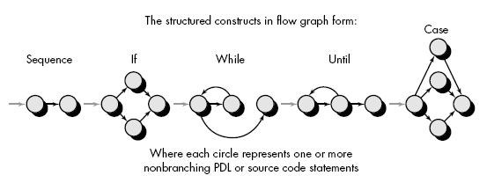
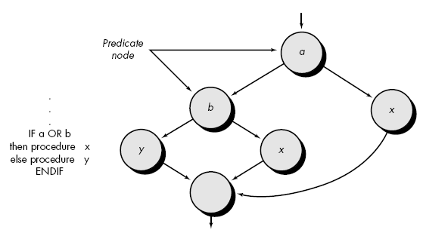
Basis Path Testing: Flow Graph Notation

Slide 16
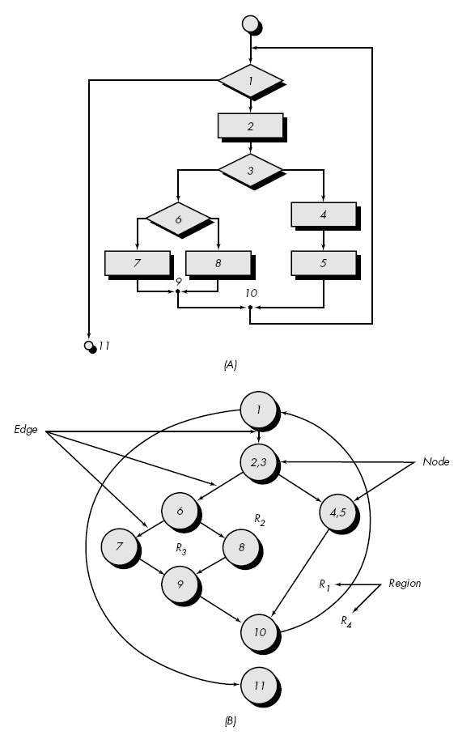
Basis Path Testing: an Independent Path
An independent path is any path through the program that introduces at least one new statement or a new condition.
Ex. A set of independent paths
  Path 1: 1-11
  Path 2: 1-(2,3)-(4,5)-10-1-11
  Path 3: 1-(2,3)-6-8-9-10-1-11
  Path 4: 1-(2,3)-6-7-9-10-1-11
But the following path is not
  1-(2,3)-(4,5)-10-1-(2,3)-6-8-9-10-1-11
Paths 1,2,3, and 4 constitute a basis set
  If tests can be designed to exercise a basis set, the followings can be guaranteed.
    Every statement will be executed at least once
    Every condition will be executed on its true and false sides
16

Slide 17
Basis Path Testing: How Many Paths?
First, we compute the cyclomatic complexity, which is a quantitative measure of the logical complexity
Cyclomatic complexity defines the # of independent paths to test for complete statement/branch coverage
- number of simple decisions + 1
- number of edge – number of node +2
- number of enclosed areas + 1
- In this case, V(G) = 4
V(G) is the upper bound for the # of
independent paths for complete coverage

Slide 18
Basis Path Testing
Next, we derive the
independent paths:
(paths containing a new edge)
1
2
Since V(G) = 4,
3
there are four paths
4
5
6
Path 1: 1,2,3,6,7,8
Path 2: 1,2,3,5,7,8
Path 3: 1,2,4,7,8
7
Path 4: 1,2,4,7,2,4,7,8
8
Finally, we should derive test cases to exercise these paths

Slide 19
Cyclomatic Complexity
A number of industry studies have indicated
that the higher V(G), the higher the probability
or errors.
modules
V(G)
modules in this range are
more error prone

Slide 20
Using Cyclomatic Complexity (pg504)
The scene:
  Shakira's cubicle.
The players:
  Vinod,Shakira
  members of the SafeHome software engineering team who are working on test planning for the security function.
The conversation:
Shakira: Look ... I know that we should unit test all the components for the security function, but there are a lot of 'em and if you consider the number of operations that have to be exercised, I don't know ...
maybe we should forget white-box testing, integrate everything, and start running black-box tests.
Vinod: You figure we don't have enough time to do component tests, exercise the operations, and then integrate?
Shakira: The deadline for the first increment is getting closer than I'd like ... yeah, I'm concerned.
Vinod: Why don't you at least run white-box tests on the operations that are likely to be the most error prone?
20
CS350

Slide 21
Shakira (exasperated): And exactly how do I know which are likely to be the most error prone?
Vinod: V of G.
Shakira: Huh?
Vinod: Cyclomatic complexity--V of G. Just compute V(G) for each of the operations within each of the components and see which have the highest values for V(G). They're the ones that are most likely to be error prone.
Shakira: And how do I compute V of G?
Vinod: It's really easy. Here's a book that describes how to do it.
Shakira (leafing through the pages): Okay, it doesn't look hard. I'll give it a try. The ops with the highest V(G) will be the candidates for white-box tests.
Vinod: Just remember that there are no guarantees. A component with a low V(G) can still be error prone.
Shakira: Alright. But at least this'll help me to narrow down the number of components that have to undergo white-box testing.
21
CS350

Slide 22
Basis Path Testing Notes
you don't need a flow chart,
but the picture will help when
you trace program paths
count each simple logical test,
compound tests count as 2 or
more
basis path testing should be
applied to critical modules

Slide 23
Prime Path Coverage
Def. Prime Path
  A path from n_{i} to n_{j} A is a prime path if it is a simple path and it does not appear as a proper subpath of any other simple path
n₃
n₀
n₁
n₂
n₅
n₄
n₆

Slide 24
Why More than Path Coverage?
A flow graph does not reflect a real imperative program
  A state of a real imperative program consists of values of variables while graph theory considers a node as a simple entity
Most complicated error is caused from loop construct
  Coverage test does not consider loop
Therefore, statement/branch/path coverage testing should not be considered as complete analysis
  Those coverage does not consider value analysis
  Dijkstra said that testing cannot show the absence of a bug, but a presence of a bug in this sense
// Only one path exists
// Suppose we use a test case of x=0, and y=0
int adder(int x, int y) { return 0;}

Slide 25
Model Checking Basics
Specify requirement properties and build a system model
  Similar to a test oracle and a target software under testing (SUT) in testing
Generate all possible states (containing values of variables) from the model and then check whether given requirement properties are satisfied within the state space
System
model
OK
Model Checking
(state exploration)
or
Requirement
properties
Counter
example(s)
(Φ Ω)

Slide 26
An Example of Model Checking ½
(checking every possible values of variables)
26
System
Spec.
unsigned char x=0;
unsigned char y=0;
void proc_A() {// Thread 1
while(1)
x++;
}
void proc_B() {Thread 2
while(1)
if (x>y)
y++;
}
x:0,y:0
x:1,y:0
x:1,y:1
x:2,y:0
x:2,y:1
x:2,y:2
x:255,y:0
x:255,y:255
x:0,y:0
x:0,y:1
x:0,y:255
x:1,y:0
x:1,y:1
x:1,y:255
Over-
flow
x:2,y:0
x:2,y:1
x:2,y:255
Req.
Spec
always (x >= y)
x:255,y:0
x:255,y:1
x:255,y:255

Slide 27
An Example of Model Checking 2/2
(checking every possible thread scheduling )
27
char cnt=0,x=0,y=0,z=0;
void process() {
char me = _pid +1; /* me is 1 or 2*/
again:
  x = me;
  If (y ==0 || y== me) ;
  else goto again;
  z =me;
  If (x == me) ;
  else goto again;
  y=me;
  If(z==me);
  else goto again;
  /* enter critical section */
  cnt++;
  assert( cnt ==1);
  cnt --;
  goto again;
}
Process 0
x = 1
y==0 || y == 1
z = 1
x==1
y = 1
z == 1
cnt++
Process 1
x = 2
y==0 || y ==2
z = 2
x==2
y=2
(z==2)
cnt++
Software
locks
Violation detected !!!
Critical
section
Mutual
Exclusion
Algorithm
Counter
Example
Notes:
27

Slide 28
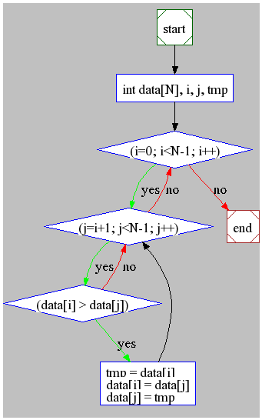
Model Checking Example: Bubble Sort
#include <stdio.h>
#define N 4
int main(){
int data[N], i, j, tmp;
/* It misses the last element,
i.e., data[N-1]*/
1: for (i=0; i<N-1; i++) {
2: for (j=i+1; j<N-1; j++) {
3: if (data[i] > data[j]) {
4: tmp = data[i];
data[i] = data[j];
data[j] = tmp;
}
}
}
5: /* Check the array is sorted */
}
There exist at most 8 (2x2x2) simple paths
  However, the following test cases fail to detect the bug
  (0,1,2,3),
  (0,2,1,3),
  (1,0,2,3),
  (1,2,0,3)
  (2,0,1,3)
  (2,1,0,3)
A number of possible states is (2³²)⁴ = 3.4x10³⁸
  Suppose that 1 test takes1 microsecond total testing takes 3.4x 10³² seconds
  (= 10²⁵ years)
  However, SAT based model checking completes the analysis in 1 second
Notes:
28

Slide 29
Graph Matrices
A graph matrix is a square matrix whose size (i.e., number of rows and columns) is equal to the number of nodes on a flow graph
Each row and column corresponds to an identified node, and matrix entries correspond to connections (an edge) between nodes.
By adding a link weight to each matrix entry, the graph matrix can become a powerful tool for evaluating program control structure during testing

Slide 30
Control Structure Testing
Condition testing
  a test case design method that exercises the logical conditions contained in a program module
Data flow testing
  selects test paths of a program according to the locations of definitions and uses of variables in the program

Slide 31
Data Flow Testing
For a statement S
  DEF(S) = {X| statement S contains a definition of X}
  USE(S) = {X| statement S contains a use of X}
A definition-use (DU) chain of variable X is of the form [X,S,S’] where S and S’ are statement, X is in DEF(S) and USE(S’)
  [x,s1,s3] is a DU chain
  [y,s1,s3] is NOT a DU chain
A branch is not guaranteed to be
covered by DU testing
void f() {
s1: int x = 10, y;
s2: if ( …) {
…
s3: y = x + 1;
}

Slide 32
Loop Testing
Simple
loop
Nested
Loops
Concatenated
Loops
Unstructured
Loops

Slide 33
Loop Testing: Simple Loops
Minimum conditions—Simple Loops
1. skip the loop entirely
2. only one pass through the loop
3. two passes through the loop
4. m passes through the loop m < n
5. (n-1), n, and (n+1) passes through
the loop
where n is the maximum number
of allowable passes

Slide 34
Loop Testing: Nested Loops
Nested Loops
Start at the innermost loop. Set all outer loops to their
minimum iteration parameter values.
Test the min+1, typical, max-1 and max for the
innermost loop, while holding the outer loops at their
minimum values.
Move out one loop and set it up as in step 2, holding all
other loops at typical values. Continue this step until
the outermost loop has been tested.
Concatenated Loops
If the loops are independent of one another
then treat each as a simple loop
else* treat as nested loops
endif*
for example, the final loop counter value of loop 1 is
used to initialize loop 2.

Slide 35
Black-Box Testing
requirements
output
input
events

Slide 36
Black-Box Testing
How is functional validity tested?
How is system behavior and performance tested?
What classes of input will make good test cases?
Is the system particularly sensitive to certain input values?
How are the boundaries of a data class isolated?
What data rates and data volume can the system tolerate?
What effect will specific combinations of data have on system operation?

Slide 37
Graph-Based Methods
To understand the objects that are modeled in software and the relationships that connect these objects
In this context, we consider the term “objects” in the broadest possible context. It encompasses data objects, traditional components (modules), and object-oriented elements of computer software.

Slide 38
Equivalence Partitioning
user
queries
output
formats
FK
input
mouse
picks
data
prompts

Slide 39
Sample Equivalence Classes
Valid data
user supplied commands
responses to system prompts
file names
computational data
physical parameters
bounding values
initiation values
output data formatting
responses to error messages
graphical data (e.g., mouse picks)
Invalid data
data outside bounds of the program
physically impossible data
proper value supplied in wrong place

Slide 40
Boundary Value Analysis
user
queries
output
formats
FK
input
mouse
picks
data
prompts
output
domain
input domain

Slide 41
Comparison Testing
Used only in situations in which the reliability of software is absolutely critical (e.g., human-rated systems)
  Separate software engineering teams develop independent versions of an application using the same specification
  Each version can be tested with the same test data to ensure that all provide identical output
  Then all versions are executed in parallel with real-time comparison of results to ensure consistency

Slide 42
Orthogonal Array Testing
Used when the number of input parameters is small and the values that each of the parameters may take are clearly bounded

Slide 43
Testing Methods
Fault-based testing
  The tester looks for plausible faults (i.e., aspects of the implementation of the system that may result in defects). To determine whether these faults exist, test cases are designed to exercise the design or code.
Class Testing and the Class Hierarchy
  Inheritance does not obviate the need for thorough testing of all derived classes. In fact, it can actually complicate the testing process.
Scenario-Based Test Design
  Scenario-based testing concentrates on what the user does, not what the product does. This means capturing the tasks (via use-cases) that the user has to perform, then applying them and their variants as tests.

Slide 44
OOT Methods: Random Testing
Random testing
  identify operations applicable to a class
  define constraints on their use
  identify a miminum test sequence
    an operation sequence that defines the minimum life history of the class (object)
  generate a variety of random (but valid) test sequences
    exercise other (more complex) class instance life histories

Slide 45
OOT Methods: Partition Testing
Partition Testing
  reduces the number of test cases required to test a class in much the same way as equivalence partitioning for conventional software
  state-based partitioning
    categorize and test operations based on their ability to change the state of a class
  attribute-based partitioning
    categorize and test operations based on the attributes that they use
  category-based partitioning
    categorize and test operations based on the generic function each performs

Slide 46
OOT Methods: Inter-Class Testing
Inter-class testing
  For each client class, use the list of class operators to generate a series of random test sequences. The operators will send messages to other server classes.
  For each message that is generated, determine the collaborator class and the corresponding operator in the server object.
  For each operator in the server object (that has been invoked by messages sent from the client object), determine the messages that it transmits.
  For each of the messages, determine the next level of operators that are invoked and incorporate these into the test sequence

Slide 47
OOT Methods: Behavior Testing
The tests to be designed should achieve all state coverage [KIR94]. That is, the operation sequences should cause the Account class to make transition through all allowable states

Slide 48
Testing Patterns
Pattern name: pair testing
  Abstract: A process-oriented pattern, pair testing describes a technique that is analogous to pair programming (Chapter 4) in which two testers work together to design and execute a series of tests that can be applied to unit, integration or validation testing activities.
Pattern name: separate test interface
  Abstract: There is a need to test every class in an object-oriented system, including “internal classes” (i.e., classes that do not expose any interface outside of the component that used them). The separate test interface pattern describes how to create “a test interface that can be used to describe specific tests on classes that are visible only internally to a component.” [LAN01]
Pattern name: scenario testing
  Abstract: Once unit and integration tests have been conducted, there is a need to determine whether the software will perform in a manner that satisfies users. The scenario testing pattern describes a technique for exercising the software from the user’s point of view. A failure at this level indicates that the software has failed to meet a user visible requirement. [KAN01]

