Slide 1
Intro. to 1st Order Logic (a.k.a. Predicate Calculus) Moonzoo Kim CS Dept. KAIST moonzoo@cs.kaist.ac.kr

Slide 2
Introduction to predicate calculus (1/2)
Propositional logic (sentence logic) dealt quite satisfactorily with sentences using conjunctive words (접속사) like not, and, or, and if … then. But it fails to reflect the finer logical structure of the sentence
What can we reason about a sentence itself which deals with its target domain?
ex. Jane is taller than Alice (target domain : human being)
ex2. For natural numbers x and y, x+y ¸ - (x + y) (target domain: N)
What can we reason about a sentence itself which also deal with modifiers like there exists…, all …, among … and only …. ?
Note that these modifiers enable us to reason about an infinite domain because we do not have to enumerate all elements in the domain

Slide 3
Introduction to predicate calculus (2/2)
Ex. Every student is younger than some instructor
We could simply identify this assertion with a propositional atom p. However, this fails to reflect the finer logical structure of this sentence
This statement is about being a student, being an instructor and being younger than somebody else for a set of university members as a target domain
We need to express them and use predicates for this purpose
S(yunho), I(moonzoo), Y(yunho,moonzoo)
We need variables x, y to not to write down all instance of S(-), I(-), Y(-)
Every student x is young than some instructor y
Finally, we need quantifiers to capture the actual elements by variables
For every x, if x is a student, then there is some y which is an instructor such that x is younger than y compare with
8x (S(x) ! (9y (I(y) Æ Y(x,y))))
Compare with 8x (S(x) ! (9y (I(y) ! Y(x,y))))

Slide 4
Examples of 1st Order-logic Formula
predicate
element of domain
a variable for a domain
Bill is a student. Student(Bill)
All students are smart. 8 x ( Student(x) ! Smart(x) )
There exists a student. 9 x Student(x).
There exists a smart student. 9 x ( Student(x) Æ Smart(x) )
Every student loves some student. 8 x ( Student(x) ! 9 y ( Student(y) Æ Loves(x,y) ))
Every student loves some other student. 8x(Student(x)!9y (Student(y) Æ :(x=y) Æ Loves(x,y)))
There is a student who is loved by every other student. 9 x ( Student(x) Æ 8 y ( Student(y) Æ :(x = y) ! Loves(y,x) ))
No student loves Bill. : 9 x ( Student(x) Æ Loves(x, Bill) )
Bill does not take Analysis. : Takes(Bill, Analysis).
Bill takes Analysis or Geometry (or both). Takes(Bill,Analysis)Ç Takes(Bill, Geometry)
Bill takes Analysis and Geometry. Takes(Bill, Analysis) Æ Takes(Bill, Geometry)
Bill takes either Analysis or Geometry (but not both) Takes(Bill, Analysis) $↔$ : Takes(Bill, Geometry)
quantifier
Excerpted from www.uobabylon.edu.iq/eprints/publication_5_29514_1380.pdf
Notes:
Examples for how to Translate English Sentences into First-Order Logic
If you would like to practise, there are some more problems (with sample solutions) in Nilsson, Section 15.6.2, and ((without sample solutions) in Russell and Norvig, Exercise 7.2. The following problems were inspired by them. In the following, it is important to remember the precedence of the operators, which are (from highest to lowest): Ø : (NOT), Ù Æ(AND), Ú Ç(OR), Þ ! (IMPLIES),Û $↔$(EQUIV). Notice also that there are always several (equivalent) sentences in first-order logic that correspond to a given English sentence. We give only one example.

Slide 5
Relations and predicates
The axioms and theorems of mathematics are defined on arbitrary sets (domain) such as the set of integers Z
ex. Fermat's last theorem
If an integer n is greater than 2, then the equation a^{n} + b^{n} = c^{n} has no solutions in non-zero integers a, b, and c.
Can we express the Fermat’s last theorem in propositional logic?
The predicate calculus extends the propositional calculus with predicate letters that are interpreted as relations on a domain
i.e., predicates are interpreted upon domain
Def 5.2. A relation can be represented by a boolean valued function R:D^{n} ! {T,F}, by mapping an n-tuple to T iff it is included in the relation
R(d₁,…d_{n}) = T iff (d₁,… d_{n}) 2 R

Slide 6
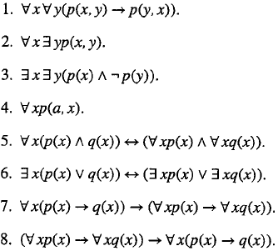
Predicate formulas
Let P, A and V be countable sets of symbols called predicate letters, constants, and variables, respectively.
P={p,q,r} A={a,b,c}, V={x,y,z}
Def 5.4 Atomic formulas and formulas
atomic formula
argument ::= x for any x 2 V
argument ::= a for any a 2 A
argument_list ::= argument⁺
atomic_formula ::= p |
p(argument_list) for any p 2 P
formula ::== atomic_formula
formula ::= : formula
formula ::= formula Ç formula
formula ::= 8 x formula
formula ::= 9 x formula

Slide 7
Free and bound variables
Def 5.6
8 is the universal quantifier and is read ‘for all’.
9 is the existential quantifier and is read ‘there exists’.
In a quantified formula 8 xA, x is the quantified variable and A is the scope of the quantified variable.
Def 5.7 Let A be a formula. An occurrence of a variable x in A is a free variable of A iff x is not within the scope of a quantified variable x.
Notation: A(x₁,…x_{n}) indicates that the set of free variables of the formula A is a subset of {x₁,… x_{n}}. A variable which is not free is bound.
If a formula has no free variable it is closed
If {x₁,…,x_{n}} are all the free variables of A, the universal closure of A is
8x₁… 8x_{n} A and the existential closure is 9x₁… 9x_{n} A
Ex 5.8 p(x,y), 9 y p(x,y), 8x 9y p(x,y)
Ex 5.9
In (8x p(x)) Æ q(x), the occurrence of x in p(x) is bound and the occurrence in q(x) is free. The universal closure is 8x (8xp(x) Æ q(x)).
Obviously, it would have been better to write the formula as 8xp(x)Æ q(y) where y is the free variable

Slide 8
Interpretations (1/5)
Def 5.10 Let U be a set of formulas s.t. {p₁,…p_{m}} are all the predicate letters and {a₁,…, a_{k}} are all the constant symbols appearing in U. An interpretation I is a triple (D, {R₁,…R_{m}}, {d₁,…,d_{k}}), where
D is a non-empty set,
R_{i} is an n_{i}-ary relation on D that is assigned to the n_{i}-ary predicate p_{i}
Notation: p_{i}^{I} = R_{i}
d_{i} 2 D is an element of D that is assigned to the constant a_{i}
Notation: a_{i}^{I} = d_{i}
Ex 5.11. Three numerical interpretations for 8x p(a,x):
I₁= (N, {·}, {0}), I₂=(N, {·}, {1}). I₃=(Z, {·}, {0}).
I₄=(S, {substr},{“”}) where S is the set of strings on some alphabet

Slide 9
Interpretations (2/5)
Def 5.12 Let I be an interpretation. An assignment ¾_{I} : V ! D is a function which maps every variable to an element of the domain of I. ¾_{I}[x_{i} Ã d_{i}] is an assignment that is the same as ¾_{I} except that x_{i} is mapped to d_{i}
Def 5.13 Let A be a formula, I an interpretation and ¾_{I} an assignment. v_{¾I}(A), the truth value of A under ¾_{I} is defined by induction on the structure of A:
Let A = p_{k}(c₁,…,c_{n}) be an atomic formula where each c_{i} is either a variable x_{i} or a constant a_{i}. v_{¾I}(A) = T iff
<d₁,…d_{n}> 2 R_{k} where R_{k} is the relation assigned by I to p_{k} and
d_{i} is the domain element assigned to c_{i}, either
by I if c_{i} is a constant or
by ¾_{I} if c_{i} is variable
v_{¾I}(:A)= T iff v_{¾I}(A)= F
v_{¾I}(A₁ Ç A₂) iff v_{¾I}(A₁)= T or v_{¾I}(A₂)= T
v_{¾I}(8x A₁) = T iff v_{¾I[x Ã d]}(A₁)= T for all d 2 D
v_{¾I}(9x A₁) = T iff v_{¾I[x Ã d]}(A₁)= T for some d 2 D

Slide 10
Interpretations (3/5)
Thm 5.14 Let A be a closed formula. Then v_{¾I}(A) does not depend on ¾_{I} . In such cases, we use simply v_{I}(A) instead of v_{¾I}(A)
(important!) Thm 5.15 Let A’ = A(x₁,…,x_{n}) be a non-closed formula and let I be an interpretation. Then:
v_{¾I}(A’)=T for some assignment ¾_{I} iff v_{I}(9x₁…9x_{n} A’) = T
v_{¾I}(A’)=T for all assignment ¾_{I} iff v_{I}(8x₁… 8x_{n} A’) = T
Thm 5.15 is important since we have many chances to add or remove quantified variables to and from formula during proofs.
Def 5.16 A closed formula A is true in I or I is a model for A, if v_{I}(A) = T.
Notation: I ² A
Note that we overload ² with usual logical consequence as in propositional logic
{A₁, A₂, A₃} ² A
Def 5.18 A closed formula A is satisfiable if for some interpretation I, I ² A. A is valid if for all interpretations I, I ² A
Notation: ² A.

Slide 11
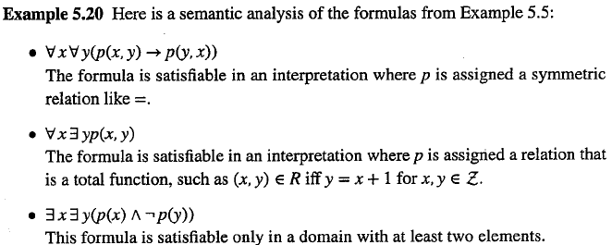
Interpretation (4/5)
Ex 5.19 ² (8x p(x)) ! p(a)
Suppose that it is not. Then there must be an interpretation
I = (D, {R}, {d}) such that v_{I}(8x p(x)) = T and v_{I}(p(a)) = F
By Thm 5.15, v_{¾I}(p(x)) = T for all assignments ¾_{I}, in particular for the assignment ¾’_{I} that assigns d to x (i.e. v_{¾’I}(p(x)) = T). But p(a) is closed, so v_{¾’I}(p(a)) = v_{I}(p(a)) = F, a contradiction

Slide 12
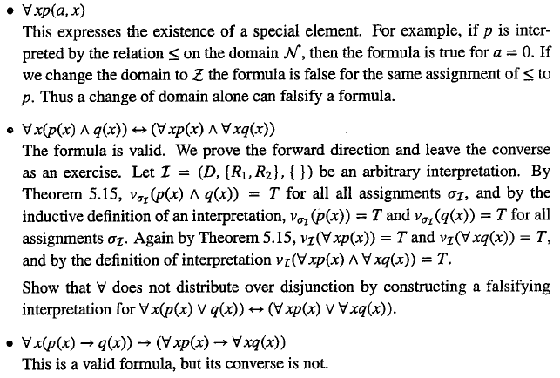
Interpretation (5/5)

Slide 13
Example: finite automata
For an interpretation I = (D,R,F,C) where
D = {a,b,c}
R= {Trans, Final, Equality} where
Trans = {(a,a),(a,b),(a,c),(b,c),(c,c)}
Final = {b,c}
Equality={(a,a),(b,b),(c,c)}
F={}
C={a}
Formulas for I where R^{I}=Trans, F^{I}=Final, =^{I} =Equality, i^{I}=a
I ² 9y R(i,y)
I ² :F(i)
I 2 8x8y8z (R(x,y) Æ R(x,z) ! y = z)
I ² 8x9y R(x,y)
b
a
c

Slide 14
Example: partial order set (POSET)
Def. U is a partially ordered set (poset) if U is a model of
8xyz ( x · y Æ y · z ! x · z) (transitivity)
8xy (x·y Æ y·x $ x = y) (anti-symmetry)
U₁² 9x 8y (x · y)
i.e., U₁ has a least element
U₃² 8x:9y (x < y)
i.e., in U₃ no element is strictly less than another element
Def. U is a totally ordered set if U is a poset and U ² 8x 8y (x · y Ç y · x)
Def. U is densely ordered if U ² 8x 8y (x < y ! 9z (x<z Æ z< y)
We can distinguish U₃ and U₄ by A(x)=8y (y ≠ x ! :(y · x) Æ :(x · y))
U₄ ² 8x 8y (A(x) Æ A(y) ! x = y)
U₃ ² :8x 8y (A(x) Æ A(y) ! x = y)
a
b
a
a
c
·
b
c
b
d
h
d
U₂
U₃
a
b
c
U₄
U₁
c
e
d
e
f
g

Slide 15
Exercise: POSET (cont.)
Define formulas for
x is the maximum (the largest element in a target domain)
8y y · x
x is maximal (not smaller than any other elements)
:9y x < y ≡ 8y :(x < y)
Note the difference between 8y y · x and 8y :(x < y).
For totally ordered set, these two formulas are same, but for POSET, they are different.
There is no element between x and y
:9z ((x · z Æ z · y) Ç (y · z Æ z · x))
x is an immediate successor of y
(x > y) Æ :9z (y · z Æ z · x)
z is the infimum of x and y (the greatest element less than or equal to x and y)
8st ((s·x Æ t·y) ! (s·z Æ t·z) Æ (z·x Æ z·y))
Give a formula Á s.t. U₂² Á and U₄ ² :Á
Let Á = 9x8y (x · y Ç y · x). Find posets U₁ and U₂ s.t. U₁ ² Á and U₂ ² : Á

Slide 16
A formula represents a set of models
A formula Á describes characteristics of target structures in a compact way.
ex. deterministic automata, partial order sets, binary trees, relational database, etc
In other words, a formula Á designates a set of models (i.e., interpretations) that satisfies Á
8x8y8z (R(x,y) Æ R(x,z) ! y = z) represents all deterministic graphs
8x8y8z (R(x,y) Æ R(y,z) ! R(x,z)) represents all transitive graphs.
Validity, satisfiability, and provability of a predicate formula is all undecidable. However, checking formulas on concrete interpretations is practical
ex. SQL queries over relational database
ex. XQueries over XML documents
ex. Model checking of a program

