Slide 1
HW6: Due Nov 26 23:59
To specify a corresponding Promela specification
Note that no atomic allowed
To specify the following properties in LTL
Note that procname[pid]@label
returns a nonzero value only if a statement at the corresponding label is executable now
Mutual exclusion
Deadlock-freedom
Starvation-freedom
Check whether your Promela spec satisfies the above three properties by using Spin. Also explain the counter examples.
/* Assume that there are two processes */
char count=0,x=0,y=0,z=0;
void process() {
char me=_pid +1; /* me is 1 or 2*/
again:
x= me;
if (y ==0 || y== me) ;
else goto again;
z =me;
if (x == me) ;
else goto again;
y=me;
if(z==me);
else goto again;
/* enter a critical section */
count++;
InCritSec: …
count --;
/* leaving a critical section */
goto again;
}

Slide 2
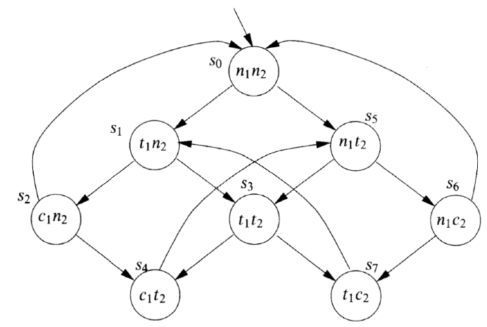
2. Build the following mutual exclusion protocol in Promela.
- Your Promela spec should contain 2 processes.
- You should use a global lock with atomic keyword to check entrance to the critical section.
- Verify the following correctness properties of your Promela model
Mutual exclusion
Liveness
mtype ={n,t,c}
byte lock=0;
active [2] proctype process() {
byte status=n;
…
}

Slide 3
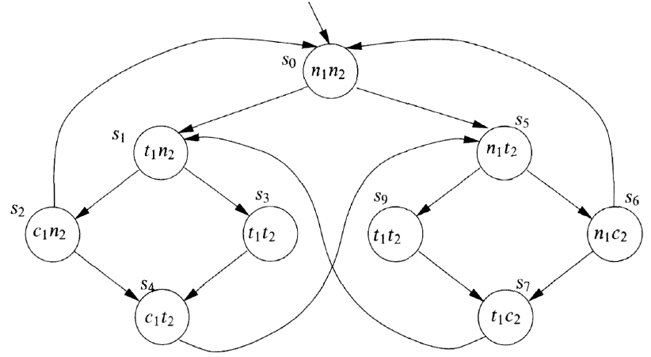
3. Build the following mutual exclusion protocol in Promela. And verify the correctness of your Promela model
Mutual exclusion
Liveness
You may use a global variable turn to indicate which process has a higher priority to enter critical section
Note that you can access a local variable of the other processes through remote reference procname[pid]:localvar
mtype={n,t,c};
byte lock;
byte turn=255;
active [2] proctype process() {
…
}

