Slide 1
How To Build Busybox with Gcov
by Yunho Kim
Provable Software Lab, KAIST

Slide 2
Contents
How to compile busybox with gcov
How to get coverage information

Slide 3
Compile Busybox
How to compile busybox with gcov

Slide 4
Compile Busybox (Step 1~3)
1) Download busybox 1.17.3 version and unzip the archive file.
2) Execute the following command
$ make allnoconfig
to uncheck all build options
3) Execute the following command
$ make menuconfig
This command requires a ncurses library

Slide 5
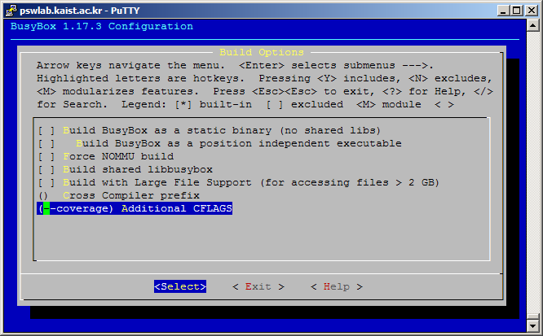
Compile Busybox (Step 4)
4) Go to Busybox Settings -> Build Options -> Additional CFLAGS and enter --coverage

Slide 6
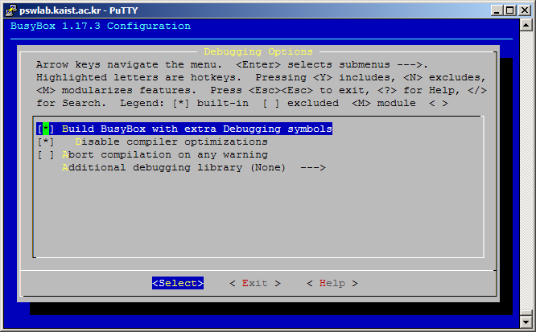
Compile Busybox (Step 5)
5) Go to Busybox Settings -> Debugging Options and check ‘Build BusyBox with extra Debugging symbols’
and ‘Disable compiler optimizations’ option.

Slide 7
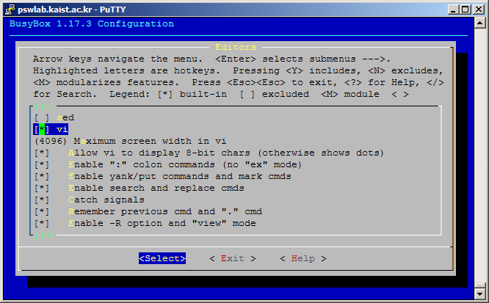
Compile Busybox (Step 6)
6) Check the 5 utilities(vi, expr, prinf, grep, ls) in Applets Coreutils -> expr, printf, ls Editors -> vi Finding Utilities -> grep

Slide 8
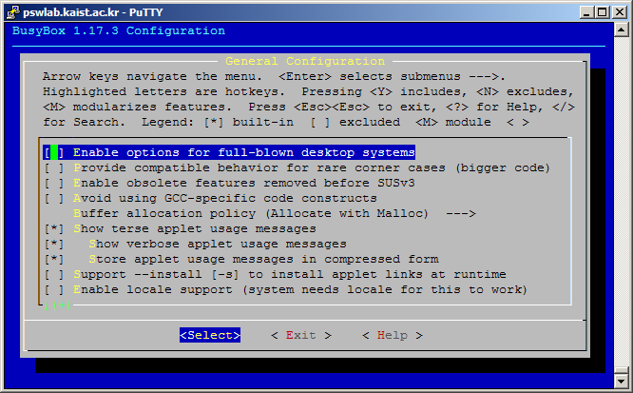
Compile Busybox (Step 7)
7) Go to Busybox Settings -> General Configuration and check ‘Show terse applet usage messages’ and its sub-options

Slide 9
Compile Busybox (Step 8)
8) Save your configuration and exit. Then, execute $ make
When the build process terminates successfully, ‘busybox’ and ‘busybox_unstripped’ files are generated.
‘busybox’ is stripped version of ‘busybox_unstripped’
‘busybox’ does not have any symbol information.
Thus, you should use busybox_unstripped to get symbol information

Slide 10
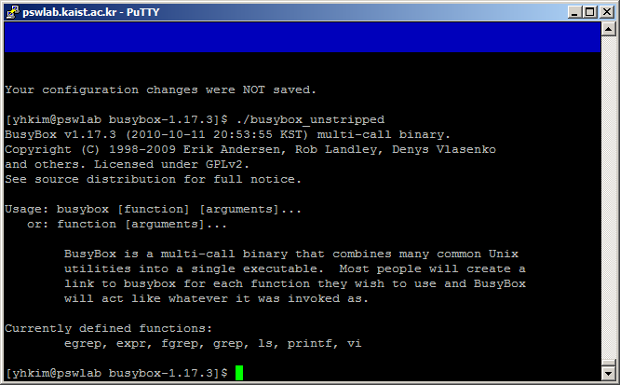
Compile Busybox (Step 9)
9) Execute ./busybox_unstripped and check expr, grep, ls, printf, and vi are defined in the binary.

Slide 11
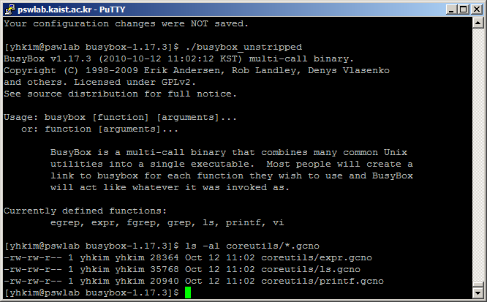
Compile Busybox (Step 10)
10) Check that sourcefile.gcno are generated in sub-directories.
If not, you may make a mistake in step 4

Slide 12
Get Coverage Information
How to get coverage information

Slide 13
Get Coverage Information (Step 1~2)
1) Execute ls utility $ ./busybox_unstripped ls
2) Copy coreutils/ls.gcno and coreutils/ls.gcda into the busybox root directory(parent directory of coreutils directory) $ cp coreutils/ls.gcda coreutils ls.gcno .

Slide 14
Get Coverage Information (Step 3~4)
3) Execute gcov to get coverage information $ gcov -b ls.c
4) You can find coverage information from ls.c.gcov
You can obtain coverage information of other source files in a similar way.

