Slide 1

Necessity of Systematic & Automated Testing Techniques
Moonzoo Kim
CS Dept, KAIST

Slide 2

Remarks by Bill Gates
17th Annual ACM Conference on Object-Oriented Programming, Systems Languages, and Applications,
Seattle, Washington, November 8, 2002
“… When you look at a big commercial software company like Microsoft, there's actually as much testing that goes in as development. We have as many testers as we have developers. Testers basically test all the time, and developers basically are involved in the testing process about half the time…”
“… We've probably changed the industry we're in. We're not in the software industry; we're in the testing industry, and writing the software is the thing that keeps us busy doing all that testing.”
“…The test cases are unbelievably expensive; in fact, there's more lines of code in the test harness than there is in the program itself. Often that's a ratio of about three to one.”
Notes:
심지어는 Bill Gate 가 말하길, “MS는 소프트웨어 기업이 아니라, 테스팅 기업” 이라고 까지 말할 정도로 테스팅에 많은 시간, 인원, 비용을 소모하고 있다. 그렇다고 완전한 것도 아니다.
2

Slide 3
Ex. Testing a Triangle Decision Program
Input : Read three integer values from the command line. The three values represent the length of the sides of a triangle.
Output : Tell whether the triangle is
• 부등변삼각형 (Scalene) : no two sides are equal
• 이등변삼각형(Isosceles) : exactly two sides are equal
• 정삼각형 (Equilateral) : all sides are equal
Create a Set of Test Cases for this program
(3,4,5), (2,2,1), (1,1,1) ?

Slide 4
Precondition (Input Validity) Check
Condition 1: a > 0, b > 0, c > 0
Condition 2: a < b + c
  Ex. (4, 2, 1) is an invalid triangle
  Permutation of the above condition
    a < b +c
    b < a + c
    c < a + b
What if b + c exceeds 2³² (i.e. overflow)?
  long v.s. int v.s. short. v.s. char
Developers often fail to consider implicit preconditions
  Cause of many hard-to-find bugs

Slide 5
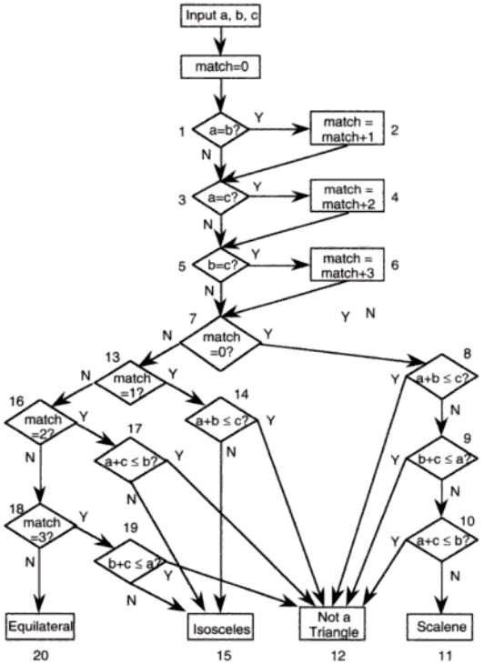
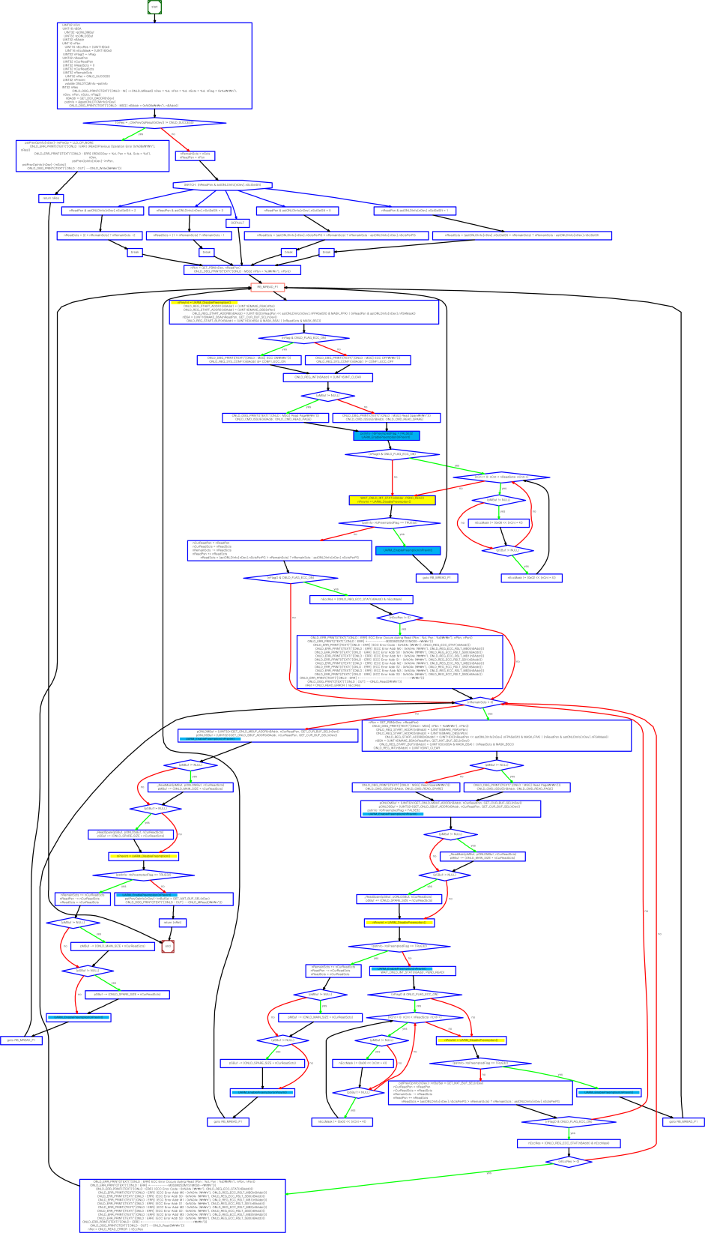
“Software Testing a craftsman’s approach” 2nd ed by P.C.Jorgensen
(no check for positive inputs)
# of test cases required?
  4
  10
  50
  100
# of feasible unique execution paths?
  11 paths
  guess what test cases needed
Notes:
a,b,c = 1,1,1:result=0
a,b,c = 2,1,1:result=2
a,b,c = 2,1,2:result=1
a,b,c = 1,2,1:result=2
a,b,c = 3,2,1:result=2
a,b,c = 2,1,3:result=2
a,b,c = 4,3,2:result=3
a,b,c = 2,3,1:result=2
a,b,c = 3,2,2:result=1
a,b,c = 2,2,1:result=1
a,b,c = 1,1,2:result=2
~

Slide 6
More Complex Testing Situations (1/3)
Software is constantly changing
  What if “integer value” is relaxed to “floating value” ?
    Round-off errors should be handled explicitly
  What if new statements S₁ … S_{n} are added to check whether the given triangle is 직각삼각형 (a right angle triangle)?
    Will you test all previous tests again?
    How to create minimal test cases to check the changed parts of the target program

Slide 7
More Complex Testing Situations (2/3)
Regression testing is essential
  How to select statements/conditions affected by the revision of the program?
  How to create test cases to cover those statements/conditions?
  How to create efficient test cases?
    How to create a minimal set of test cases (i.e. # of test cases is small)?
    How to create a minimal test case (i.e. causing minimal execution time)?
  How to reuse pre-existing test cases?

Slide 8
More Complex Testing Situations (3/3)
However, conventional coverage is not complete
  Ex. Int adder(int x, int y) { return 3;}
    Test case (x=1,y=2) covers all statements/branches of the target program and detects no error
    In other words, all variable values must be explored for complete results
Formal verification aims to guarantee completeness
  Model checking analyzes all possible x, y values through 2⁶⁴ (=2³² x 2³²) cases
  However, model checking is more popular for debugging, not verification

Slide 9
Concurrency
Concurrent programs have very high complexity due to non-deterministic scheduling
Ex. int x=0, y=0, z =0;
  void p() {x=y+1; y=z+1; z= x+1;}
  void q() {y=z+1; z=x+1; x=y+1;}
  Total 20 interleaving scenarios
    = (3+3)!/(3!x3!)
  However, only 11 unique outcomes
p()
x=y+1
y=z+1
z=x+1
q()
y=z+1
z=x+1
x=y+1
Trail1: 2,2,3
Trail2: 3,2,4
Trail3: 3,2,3
Trail4: 2,4,3
Trail5: 5,4,6
Trail6: 5,4,3
Trail7: 2,1,3
Trail8: 2,3,3
Trail9: 4,3,5
Trail10: 4,3,2
Trail11: 2,1,2
Notes:
x,y,z
2,1,2
2,1,3
2,2,3
2,3,3
2,4,3
3,2,3
4,3,2
4,3,5

Slide 10
An Example of Mutual Exclusion Protocol
char cnt=0,x=0,y=0,z=0;
void process() {
char me=_pid +1; /* me is 1 or 2*/
again:
  x = me;
  If (y ==0 || y== me) ;
  else goto again;
  z =me;
  If (x == me) ;
  else goto again;
  y=me;
  If(z==me);
  else goto again;
  /* enter critical section */
  cnt++;
  assert( cnt ==1);
  cnt --;
  goto again;
}
Process 0
x = 1
If(y==0 || y == 1)
z = 1
If(x == 1)
y = 1
If(z == 1)
cnt++
Process 1
x = 2
If(y==0 || y ==2)
z = 2
If(x==2)
y=2
If (z==2)
cnt++
Software
locks
Critical
section
Violation detected !!!
Mutual
Exclusion
Algorithm
Counter
Example

Slide 11
More Concurrency Bugs
Data race bugs
Atomicity bugs
class Account_DR {
double balance;
// INV:balance should be always non-negative
void withdraw(double x) {
1: if (balance >= x) {
2: balance = balance–x;}
...
}}
class Account_BR {
Lock m;
double balance;
// INV: balance should be non-negative
double getBalance() {
double tmp;
1: lock(m);
2: tmp = balance ;
3: unlock(m);
4: return tmp; }
void withdraw(double x){
/*@atomic region begins*/
11: if (getBalance() >= x){
12: lock(m);
13: balance = balance – x;
14: unlock(m); }
/*@atomic region ends*/
... }
(a) Buggy program code
(a) Buggy program code
[Initially, balance:10]
-th1: withdraw(10)-
1: if(balance >= 10)
2: balance = 0 – 10;
-th2: withdraw(10)-
1: if(balance >= 10)
2: balance = 10-10;
[Initially, balance:10 ]
-th1: withdraw(10)-
11:if(getBalance()>=10)
getBalance()
1:lock(m);
2:tmp = balance;
3:unlock(m);
4:return tmp;
12: lock(m);
13: balance=0 – 10;
14: unlock(m);
-th2 : withdraw(10)-
...
12: lock(m);
13: balance=10–10;
14: unlock(m);
operation block b_{i}
The invariant is violated as
balance becomes -10.
The invariant is violated as
balance becomes -10.
(b) Erroneous execution
(b) Erroneous execution

Slide 12
Summary
Software = a large set of unique executions
SW testing = to find an execution that violates a given requirement among the large set
  A human brain is poor at enumerating all executions of a target SW, but computer is good at the task
Automated SW testing
= to enumerate and analyze the executions of SW systematically (and exhaustively if possible)

Slide 13
Black Box Testing
A main goal of testing is to generate multiple test cases, one of which may reveal a bug.
Black box testing concerns only input/output of a target program (i.e., ignore program code)
  Ex1. Requirement specification based testing
  Ex2. Random (input generation) testing
  Ex3. Category partitioning method
  Ex4. T-way testing
Advantage of black box testing
  Intuitive and simple
  Requires little expertise on program/code analysis techniques
  Requires less effort compared to white-box testing
    cheaper but less effective

Slide 14
White Box Testing
White box testing concerns program code itself
Many different viewpoints on “program code”
  program code as a graph (i.e., structural coverage)
  program code as a set of logic formulas (i.e., logical coverage)
  program code as a set of execution paths (i.e., behavioral/dynamic coverage)
Advantages:
  More effective than blackbox testing in general
  Can measure the testing progress quantitatively based on coverage achieved
Should be used with blackbox testing together for maximal bug detection capability
  Blackbox testing and whitebox testing often explore different segments of target program space

