Slide 1
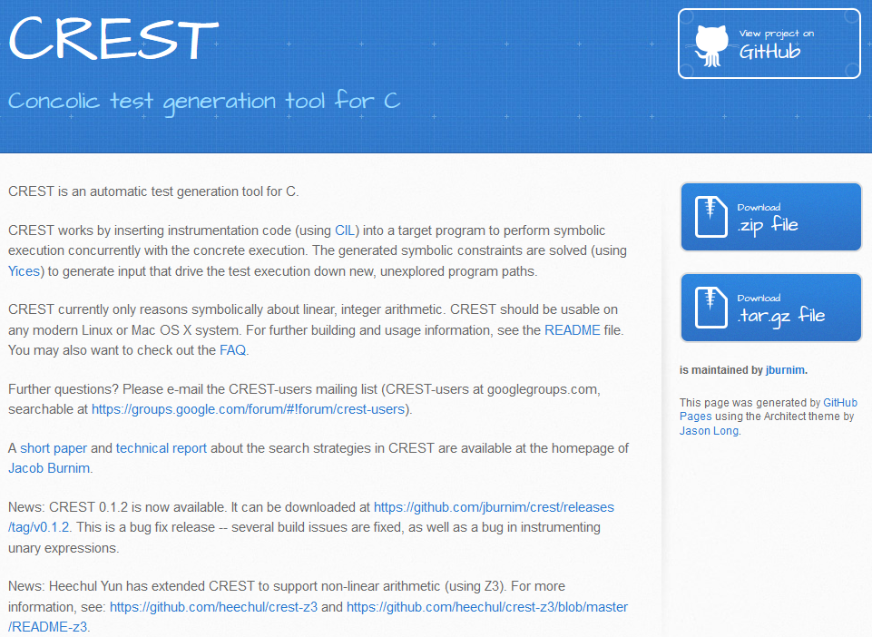
CREST Tutorial
Moonzoo Kim
CS Dept. KAIST

Slide 2
CREST
CREST is a concolic testing tool for C programs
Generate test inputs automatically
Execute target under test on generated test inputs
Explore all possible execution paths of a target systematically
CREST is a open-source re-implementation of CUTE
mainly written in C++
CREST’s instrumentation is implemented as a module of CIL(C Intermetiate Language) written in Ocaml

Slide 3
Overview of CREST code
C source
code
CIL
EXT
cil/src/ext/crestInstrument.ml
src/libcrest/crest.cc
src/base/symbolic_interpreter.cc
src/base/symbolic_execution.cc
src/base/symbolic_expression.cc
src/base/symbolic_path.cc
src/base/symbolic_predicate.cc
Instrumented
code
CREST symbolic execution library
Legend
Source
code
External
tool
GCC
CREST
src/run_crest/run_crest.cc
src/run_crest/concolic_search.cc
src/base/yices_solver.cc
src/base/symbolic_execution.cc
src/base/symbolic_expression.cc
src/base/symbolic_path.cc
src/base/symbolic_predicate.cc
src/base/basic_types.cc
constraint
yices
run_crest
next input

Slide 4
4 Main Steps of Concolic Testing
1. Instrumentation of a target program
To insert probes to build symbolic path formula
2. Transform a constructed symbolic path formula to SMT-compatible format
SMT solvers can solve simple formula only
3. Select one branch condition to negate
Core technique impacting both effectiveness and efficiency
4. Invoking SMT solvers on the SPF SMT formula
Selection of a SMT solver and proper configuration parameters
Preprocessor of Concolic Testing: CIL and Ocaml
Back-end Engine of Concolic Testing: SMT solver and API Application in CREST
Real-world Concolic Testing 1: Memory model and CFG algorithm
Real-world Concolic Testing 2: Hybrid Concolic + Genetic and distributed DFS algorithm

Slide 5
4 Main Tasks of Human Engineers
1. Adding proper assert() statements
W/o assert(), no test results obtained
2. Selection of symbolic variables in a target program
Identify which parts of a target program are most important
3. Construction of symbolic external environment
To detect real bugs
4. Performance tuning and debugging
To obtain better concolic testing results
SAT based Automated Program Analysis Technique: a Case Study on Flash Memory File System
Real-world case study: Libexif (system level testing) and security lib (unit level testing)

Slide 6
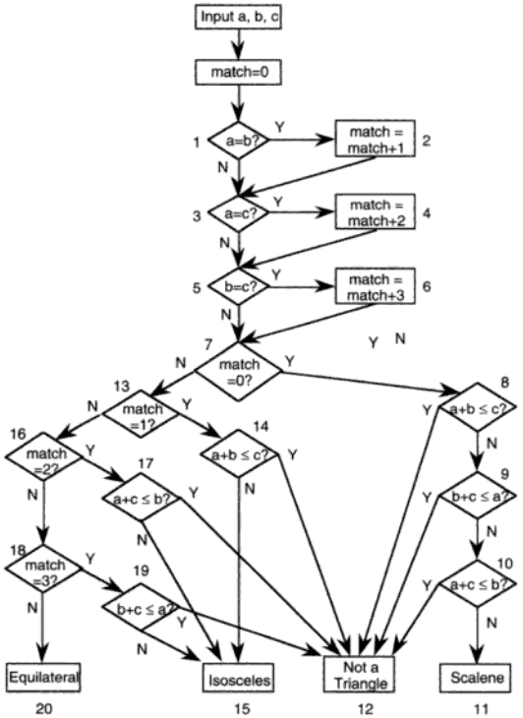
“Software Testing a craftsman’s approach” 2nd ed by P.C.Jorgensen
(no check for positive inputs)
1 #include <crest.h>
2 main() {
3 int a,b,c, match=0;
4 CREST_int(a); CREST_int(b); CREST_int(c);
// filtering out invalid inputs
5 if(a <= 0 || b<= 0 || c<= 0) exit();
6 printf("a,b,c = %d,%d,%d:",a,b,c);
7
8 //0: Equilateral, 1:Isosceles,
// 2: Not a traiangle, 3:Scalene
9 int result=-1;
10 if(a==b) match=match+1;
11 if(a==c) match=match+2;
12 if(b==c) match=match+3;
13 if(match==0) {
14 if( a+b <= c) result=2;
15 else if( b+c <= a) result=2;
16 else if(a+c <= b) result =2;
17 else result=3;
18 } else {
19 if(match == 1) {
20 if(a+b <= c) result =2;
21 else result=1;
22 } else {
23 if(match ==2) {
24 if(a+c <=b) result = 2;
25 else result=1;
26 } else {
27 if(match==3) {
28 if(b+c <= a) result=2;
29 else result=1;
30 } else result = 0;
31 } }}
32 printf("result=%d\n",result);
33 }

Slide 7
Concolic Testing the Triangle Program
Testcase | Input (a,b,c) | Executed path conditions (PC) | Next PC | Solution for the next PC
1 | 1,1,1 | a=b Æ a=c Æ b=c | a=b Æ a=c Æ b≠c | Unsat
 |  |  | a=b Æ a≠c | 1,1,2
2 | 1,1,2 | a=b Æ a≠c Æ b≠c Æ a+b ≤c | a=b Æ a≠c Æ b≠c Æ a+b > c | 2,2,3
3 | 2,2,3 | a=b Æ a≠c Æ b≠c Æ a+b >c | a=b Æ a≠c Æ b=c | Unsat
 |  |  | a≠b | 2,1,2
4 | 2,1,2 | a≠b Æ a=c Æ b≠c Æ a+c>b | a≠bÆ a=c Æ b≠c Æ a+c ≤b | 2,5,2
a=b
a≠b
a=c
a≠c
a=c
b=c
b≠c
b≠c
b=c
b≠c
TC1
a+b ≤c
a+b >c
a+c >b
TC2
TC3
TC4

Slide 8
CREST Commands
crestc <filename>.c
Output
<filename>.cil.c // instrumented C file
branches // lists of paired branches
<filename> // executable file
run_crest ./filename <n> -[dfs|cfg|random|random_input|hybrid]
<n>: # of iterations/testings
dfs: depth first search (but in reverse order)
cfg: uncovered branch first
random: negated branch is randomly selected
random_input: pure random input
hybrid: combination of dfs and random

Slide 9
Instrumented C Code
#line 10
{ /* Creates symbolic expression a==b */
__CrestLoad(36, (unsigned long )(& a), (long long )a);
__CrestLoad(35, (unsigned long )(& b), (long long )b);
__CrestApply2(34, 12, (long long )(a == b));
if (a == b) {
__CrestBranch(37, 11, 1); //extern void __CrestBranch(int id , int bid , unsigned char b )
__CrestLoad(41, (unsigned long )(& match), (long long )match);
__CrestLoad(40, (unsigned long )0, (long long )1);
__CrestApply2(39, 0, (long long )(match + 1));
__CrestStore(42, (unsigned long )(& match));
match ++;
} else {
__CrestBranch(38, 12, 0);
} }

Slide 10
Execution Snapshot (1/2)
[moonzoo@verifier crest]$ run_crest ./triangle 10000 -dfs
Iteration 0 (0s): covered 0 branches [0 reach funs, 0 reach branches].
Iteration 1 (0s): covered 1 branches [1 reach funs, 32 reach branches].
Iteration 2 (0s): covered 3 branches [1 reach funs, 32 reach branches].
Iteration 3 (0s): covered 5 branches [1 reach funs, 32 reach branches].
a,b,c = 1,1,1:result=0
Iteration 4 (0s): covered 13 branches [1 reach funs, 32 reach branches].
a,b,c = 2,1,1:result=2
Iteration 5 (0s): covered 17 branches [1 reach funs, 32 reach branches].
a,b,c = 2,1,2:result=1
Iteration 6 (0s): covered 20 branches [1 reach funs, 32 reach branches].
a,b,c = 1,2,1:result=2
Iteration 7 (0s): covered 21 branches [1 reach funs, 32 reach branches].
a,b,c = 3,2,1:result=2
Iteration 8 (0s): covered 24 branches [1 reach funs, 32 reach branches].
a,b,c = 2,1,3:result=2
Iteration 9 (0s): covered 25 branches [1 reach funs, 32 reach branches].
a,b,c = 4,3,2:result=3
Iteration 10 (0s): covered 27 branches [1 reach funs, 32 reach branches].
a,b,c = 2,3,1:result=2
Iteration 11 (0s): covered 28 branches [1 reach funs, 32 reach branches].
a,b,c = 3,2,2:result=1
Iteration 12 (0s): covered 29 branches [1 reach funs, 32 reach branches].
a,b,c = 2,2,1:result=1
Iteration 13 (0s): covered 31 branches [1 reach funs, 32 reach branches].
a,b,c = 1,1,2:result=2
Iteration 14 (0s): covered 32 branches [1 reach funs, 32 reach branches].
[moonzoo@verifier crest]$ cat coverage
3 /* covered branch ids*/
4
5
6
7
8
11
12
14
15
17
18
20
21
22
23
24
25
26
27
28
29
30
31
32
33
34
35
36
37
38
39

Slide 11
Execution Snapshot (2/2)
[moonzoo@verifier crest]$ run_crest ./triangle 10000 -dfs
Iteration 0 (0s): covered 0 branches [0 reach funs, 0 reach branches].
Iteration 1 (0s): covered 1 branches [1 reach funs, 32 reach branches].
Iteration 2 (0s): covered 3 branches [1 reach funs, 32 reach branches].
Iteration 3 (0s): covered 5 branches [1 reach funs, 32 reach branches].
a,b,c = 1,1,1:result=0
Iteration 4 (0s): covered 13 branches [1 reach funs, 32 reach branches].
a,b,c = 2,1,1:result=2
Iteration 5 (0s): covered 17 branches [1 reach funs, 32 reach branches].
a,b,c = 2,1,2:result=1
Iteration 6 (0s): covered 20 branches [1 reach funs, 32 reach branches].
a,b,c = 1,2,1:result=2
Iteration 7 (0s): covered 21 branches [1 reach funs, 32 reach branches].
a,b,c = 3,2,1:result=2
Iteration 8 (0s): covered 24 branches [1 reach funs, 32 reach branches].
a,b,c = 2,1,3:result=2
Iteration 9 (0s): covered 25 branches [1 reach funs, 32 reach branches].
a,b,c = 4,3,2:result=3
Iteration 10 (0s): covered 27 branches [1 reach funs, 32 reach branches].
a,b,c = 2,3,1:result=2
Iteration 11 (0s): covered 28 branches [1 reach funs, 32 reach branches].
a,b,c = 3,2,2:result=1
Iteration 12 (0s): covered 29 branches [1 reach funs, 32 reach branches].
a,b,c = 2,2,1:result=1
Iteration 13 (0s): covered 31 branches [1 reach funs, 32 reach branches].
a,b,c = 1,1,2:result=2
Iteration 14 (0s): covered 32 branches [1 reach funs, 32 reach branches].
[moonzoo@verifier crest]$ cat input
1
1
2
[moonzoo@verifier crest]$ print_execution
(= x0 1)
(= x1 1)
(= x2 2)
(> (+ 0 (* 1 x0)) 0)
(> (+ 0 (* 1 x1)) 0)
(> (+ 0 (* 1 x2)) 0)
(= (+ 0 (* 1 x0) (* -1 x1)) 0)
(/= (+ 0 (* 1 x0) (* -1 x2)) 0)
(/= (+ 0 (* 1 x1) (* -1 x2)) 0)
(<= (+ 0 (* 1 x0) (* 1 x1) (* -1 x2)) 0)
-1
4
6
8
11
15
18
27
28
29
-2

Slide 12
Supported Symbolic Datatypes
#define CREST_unsigned_char(x) __CrestUChar(&x)
#define CREST_unsigned_short(x) __CrestUShort(&x)
#define CREST_unsigned_int(x) __CrestUInt(&x)
#define CREST_char(x) __CrestChar(&x)
#define CREST_short(x) __CrestShort(&x)
#define CREST_int(x) __CrestInt(&x)

Slide 13
Decision/Condition Coverage Analysis by CREST
1 int main(){
2 int A, B, C, D;
3 if (A && B || C && D){
4 printf("Yes\n");
5 }else{
6 printf("No\n");
7 }
8 }
1 if (A != 0) {
2 __CrestBranch(5, 2, 1);
3 if (B != 0) {
4 __CrestBranch(10, 3, 1);
5 printf("Yes\n");
6 } else {
7 __CrestBranch(11, 4, 0);
8 goto _L;
9 }
10 } else {
11 __CrestBranch(6, 5, 0);
12 _L: /* CIL Label */
13 if (C != 0) {
14 __CrestBranch(16, 6, 1);
15 if (D != 0) {
16 __CrestBranch(21, 7, 1);
17 printf("Yes\n");
18 } else {
19 __CrestBranch(22, 8, 0);
20 printf("No\n");
21 }
22 } else {
23 __CrestBranch(17, 9, 0);
24 printf("No\n");
25 }
26 }
A == T
A == T && B == T
A == T && B != T
CREST consider all possible cases with short-circuit
Thus, coverage reported by CREST might be lower than actual branch coverage
A != TRUE
(A != T || A == T && B != T)
&& C == T
(A != T || A == T && B != T)
&& C == T && D == T
(A != T || A == T && B != T)
&& C == T && D != T
(A != T || A == T && B != T)
&& C != T

