Slide 1


Concolic Testing for High Test Coverage and
Reduced Human Effort in Automotive Industry
Yunho Kim, SWTV group
KAIST, South Korea
Dongju Lee
Junki Baek
Moonzoo Kim

Slide 2
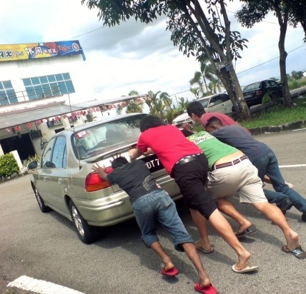
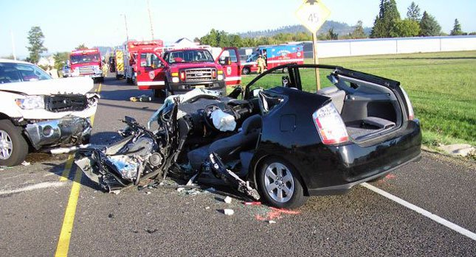
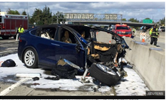

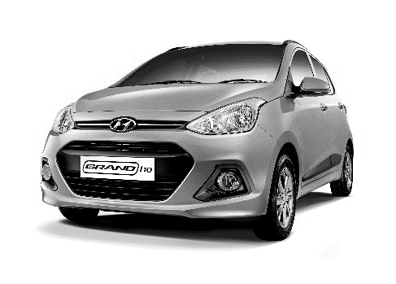

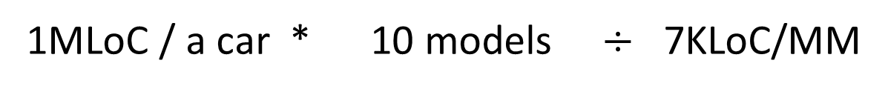

Manual Testing in Automotive Industry:
- Large Human Effort Required
Manual Testing
SW reliability is critical for cars
Toyota “Unintended Acceleration” has killed 89
Tesla fatal crash was on Autopilot
Achieving high reliability requires large human effort
…
$$÷$$
1MLoC / a car * 10 models $÷$ 7KLoC/MM
= 120MYr (for coverage testing)
Notes:
Achieving high coverage requires large human effort because Automotive SW is large and complex due to many sources of inputs and complex logic.
Automotive SW 이미지 (자동차를 사람이 밀고 (시동꺼진 차))
예. 분기 커버리지 달성에 100 LOC = 1.5 MM
ISO 26262
테슬라 차 사고 => SW 신뢰성이 매우 억수로 중요. => 매우 복잡한 MC/DC 테스팅 인력 억수로 많이 들고 힘듦

Slide 3


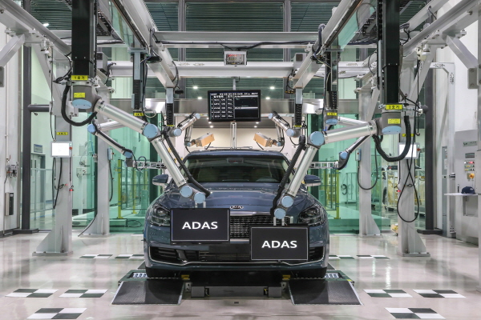

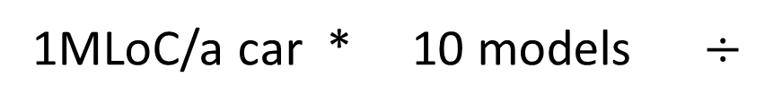

Automated Testing can Achieve High Reliability and Reduce Human Testing Effort
Automated testing achieves high reliability
Automated Testing
Achieving high code coverage
Detecting
hidden bugs
Automated testing can be 100x faster than manual one
…
$$÷$$
1MLoC/a car * 10 models $÷$
700KLoC/1CM
= 1.2CYr (= 0.1M on 100 cloud cores)
Notes:
2페이지랑 동일한 레이아웃, 박스로 구분
Automated testing is 100x faster than manual testing and reduce manual testing effort.
100 cores, 1.2 yr
예. 분기 커버리지 달성에 100 LOC = 1.5 MM
ISO 26262
테슬라 차 사고 => SW 신뢰성이 매우 억수로 중요. => 매우 복잡한 MC/DC 테스팅 인력 억수로 많이 들고 힘듦

Slide 4
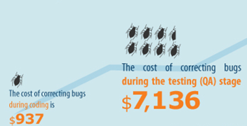
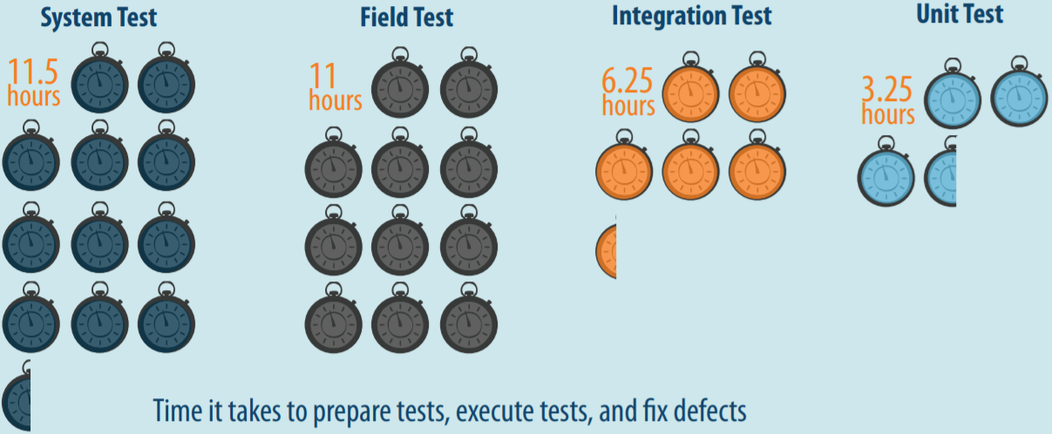
Benefits of Unit Testing
Bug correction cost: 7x cheaper than system tests
  $937 (unit test) vs $7,136 (system test)
Bug correction time: 3x faster than system testing
  3.25 hours vs 11.5 hours
Source: B. Boehm and V. Basil, Software Defect Reduction Top 10 List, IEEE Computer, January 2001
Source: Capers Jones, Applied Software Measurement: Global Analysis of Productivity and Quality
Excerpted from the CONBRIO paper slides [Kim et al., ICSE18]
Notes:
All of us know that unit testing has benefits over system testing. Unit testing is 7 times cheaper than system testing to detect and fix a bug as well as unit testing is 3 times faster than system testing to run and detect a bug. Unfortunately, such benefits of unit testing is not much enjoyed in real-world because of false alarm problems. To run a target unit in an isolated environment for unit testing, we have to write down stub and mock functions to provide contexts to the unit. If such stub and mock functions provide inaccurate context, unit testing raises a false alarm, which is feasible in unit execution, but infeasible in system execution. Such false alarm problem is severe in automated unit test generation techniques because such techniques do not know the appropriate context of the target unit. To address such false alarm problems in automated unit test generation techniques, we propose two ideas

Slide 5
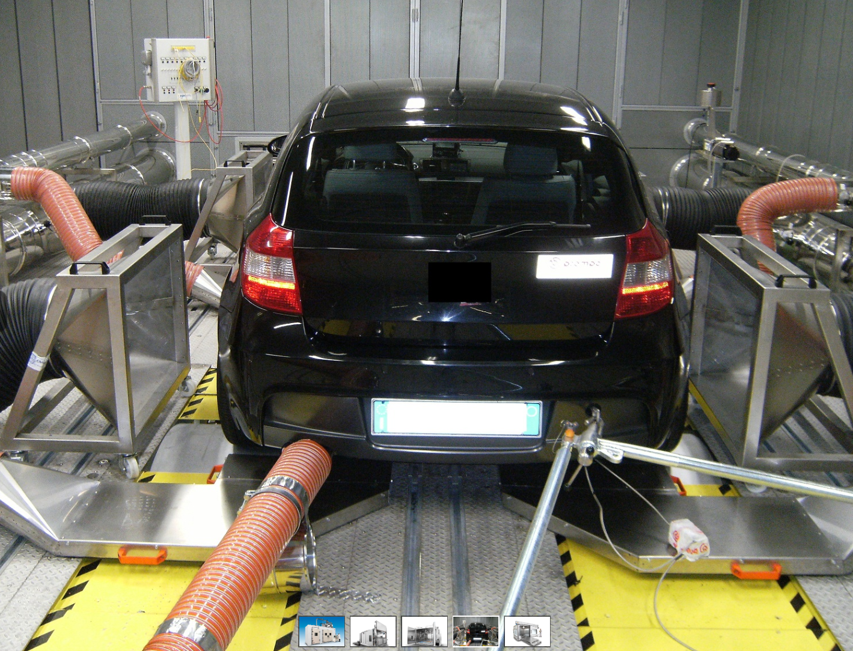
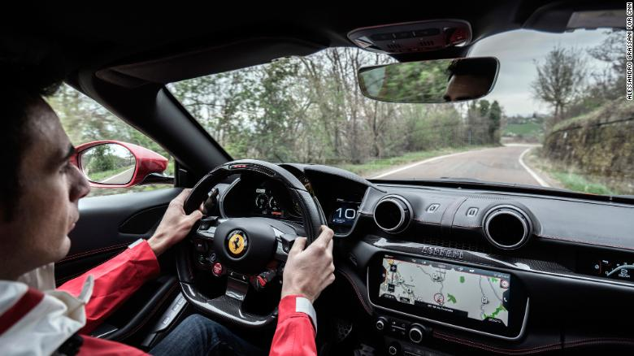


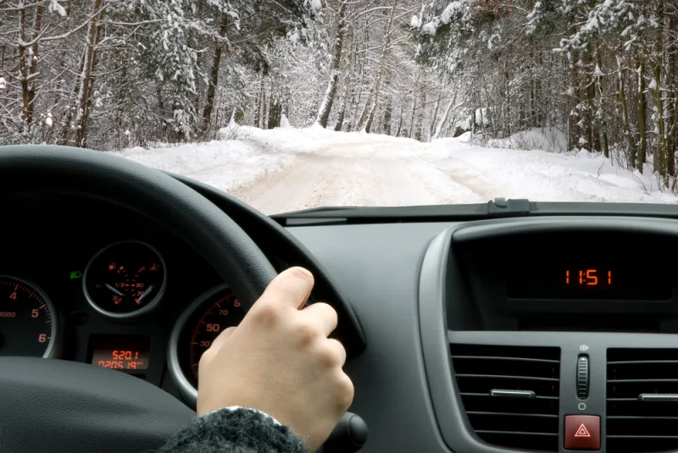

Importance of Automated Unit Testing In Automotive SW
System testing is expensive and less effective
  Full vehicle HW and human drivers are required
  Driving a car with various physical environments spends a lot of time
  Hard-to-achieve high test coverage due to low controllability
Unit testing is cheap and more effective
  Full vehicle HW and human drivers are NOT necessary
  No need to drive a car
  Easy-to-achieve high coverage due to high controllability
VS
Notes:
Unit testing 서서히 나타나는 애니메이션으로
Compared to system testing requires lots of resources,
Unit testing rmfla\
비주얼
자동차 테스트 장비 등

Slide 6

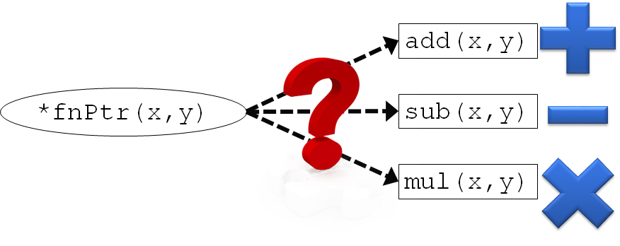
3 Technical Challenges for Automated Unit Testing
False alarms
Bit-fields
18bits
5bits
int z:18
int y:5
char x
struct S : 4 Bytes
Function pointers
Notes:
To achieve high test coverage using automated testing, we need to address 3 technical challenges to address
False alarm 그림 다시

Slide 7
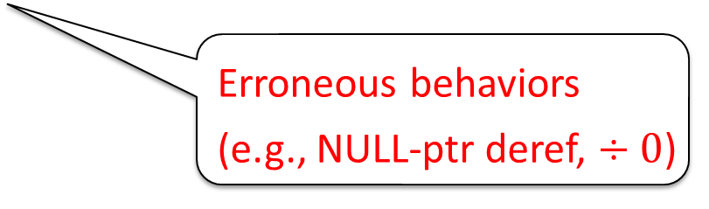
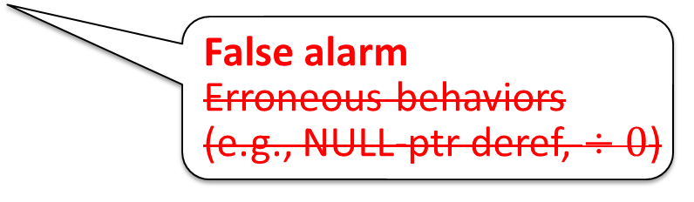
False Alarms due to Infeasible Unit Executions
False alarms can be raised due to missing contexts
Target unit’s behavior
w/o any contexts
Target unit’s REAL behavior w/
proper contexts in a pgm P
False alarm
Erroneous behaviors
(e.g., NULL-ptr deref, $÷0$)
Erroneous behaviors
(e.g., NULL-ptr deref, $÷0$)
Notes:
False alarms
False alarm 나타낼 더 명확한 그림(bug가 아니어야 함)

Slide 8
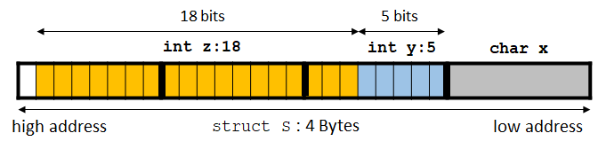
No Support of Symbolic Bit-fields
Tracking symbolic expression for bit-fields is NOT possible
  bit-fields are NOT addressable (i.e., &(s.y) is not allowed)
Symbolic Memory Map
1: struct S{
2: char x;
3: int y:5;
4: int z:18;};
Memory address (key) | Sym. Exp. (value)
&(S.x) | S.x₀+3
&(S.y) NOT allowed | N/A
&(S.z) NOT allowed | N/A
Notes:
18 bits, 5 bits (띄어쓰기)
Bitfield 왜 사용하나 설명
그림으로 (pictorial) 하게

Slide 9

No Support of Symbolic Function Pointers
Hard-to-know which function a given func. ptr. points to
add(x,y)
*fnPtr(x,y)
sub(x,y)
mul(x,y)
Notes:
Add, sub, mul clipart 추가
그림으로 (pictorial) 하게

Slide 10

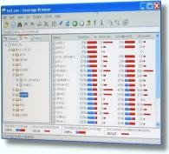
Overview of MAIST
Sol. 1: Task-oriented
driver/stub gen. to
reduce false alarms
MAIST
Test harness generator
Test
drivers/
stubs
MAIST
Test input
generator
Driver gen.
Test cases
Target
C code p
Stub gen.
Search strategy coordinator
Sol. 2: Bit-field
transform. to support
sym. bit-fields
MAIST
Converter
Target
C code p’
CROWN
Coverage
Report
Bit-field transform.
Sol. 3: Static
analysis to support
sym. function pointer
Legend
CROWN features
- Bit-level accuracy
- Easy-to-extend
- Low memory overhead
- Fast through lightweight instr.
MAIST
External tool
C code
Notes:
말풍선 사라지지 않게
CROWN features
솔루션이랑 매칭되게

Slide 11


Unit Testing f without
Contexts of f
Unit Testing f with Contexts of f
Without Contexts of f
Pros: fast exploration of target
unit execution paths
Cons: infeasible target unit
executions
With Contexts of f
Pros: reduced infeasible target
unit executions
Cons: slow exploration of target unit
execution due to large cost of
exploring context functions
Excerpted from the CONBRIO paper slides [Kim et al., ICSE18]
Notes:
If we perform unit testing on a target function f without its contexts functions such as f’s callers and f’s callees,
+ the unit testing can be very fast because f’s code size is small.
But, we are testing f without any constraints enforced by f’s real contexts, many infeasible target unit executions may occur which can raise false alarms.
In contrast, if we utilize the context functions of a target function f,
+ we can reduce infeasible target unit executions because the context functions enforces realistic constraints to target unit executions
- But, unit testing becomes slow and misses bugs because target unit execution paths may not be fully explored in given time budget of unit testing. This is because we have to also explore the execution paths of the context functions (shown as light blue arrows).
Therefore, we have clear trade-off between unit testing accuracy and unit testing cost by the decision of how much target unit context to include in unit testing.
We propose the 2 ideas to identify and utilize sweet spot of this trade-off so that unit testing can be *both effective and accurate* using

Slide 12
Task-oriented Unit-test Driver/Stubs Generation
  A Task is a mostly minimal independent unit
Task t₁
Task t₂
Legend
driver_f
f
g
File scope
h
Entry function
driver_g
s1
s4
s5
Static function
stub_h
Driver/stub functions
s2
s3
Function call
sym_harness.c
file1.c
file2.c
Notes:
자동차 DOMAIN 의 특성상 task 위주의 개발을 하게 되는데
이유1.
이유2.
…..
Task oriented unit testing is a key to the success of MAIST

Slide 13
Bit-field Transformation
1: struct S{
2: char x;
3: int y:5;
4: int z:18;};
1: struct S_nb{
2: char x;
3: unsigned char ba0[3];
4: } ;
Original program p | Transformed program p’
n=S.z+1; | n=(((S_nb.ba0[2]&127)<<16)| (S_nb.ba0[1]<<8)| S_nb.ba0[0])>>5 +1;
S.z=S.x+3; | S_nb . ba0 [2]= ((((S_nb.x+3) <<5) > >(2*8)) &127)| (S_nb .ba0 [2]&128); S_nb . ba0 [1]= (((S_nb.x+3) <<5) > >(1*8)) &255; S_nb . ba0 [0]= (((S_nb.x+3) <<5) &224) | ( S_nb .ba0 [0]&31);
struct S : 4 Bytes
high address
low address
18 bits
5 bits
int z:18
int y:5
char x
ba0[2] | ba0[1] | ba0[0] | x
struct S_nb : 4 bytes
Notes:
회색 진하게

Slide 14

Symbolic Function Pointer Support
Step 1: Identifying candidate functions using static analysis
Step 2: Set *fnPtr as one of the candidates using a symbolic var sym_choice
Function pointer input
harness_target.c
1:void drv_do_chk(){
2: …
3: SYM_int(sym_choice);
4: switch(sym_choice){
5: case 0:
6: fnPtr=add;
7: break;
8: case 1:
9: fnPtr=sub;
10: break;
11: case 2:
12: fnPtr=mul;
13: default: break;}
14: SYM_int(p1);
15: do_chk(p1);}
target.c
1:int (*fnPtr)(int,int);
2:int add(int,int) {…}
3:int sub(int,int) {…}
3:int mul(int,int) {…}
4:void f() {…
5: fnPtr=add;}
6:int g(){…
7: fnPtr=sub;}
7:int h(){…
8: fnPtr=mul;}
8:void do_chk(int model){
9:…
10: int ret=fnPtr(x,y);
11: …}
Set *fnPtr as add()
if sym_choice==0
Candidate1: add()
Set *fnPtr as sub()
if sym_choice==1
Candidate2: sub()
Candidate3: mul()
Set *fnPtr as mul()
if sym_choice==2
Notes:
함수 포인터 +, -, *로 3개
12-13 한 장으로

Slide 15

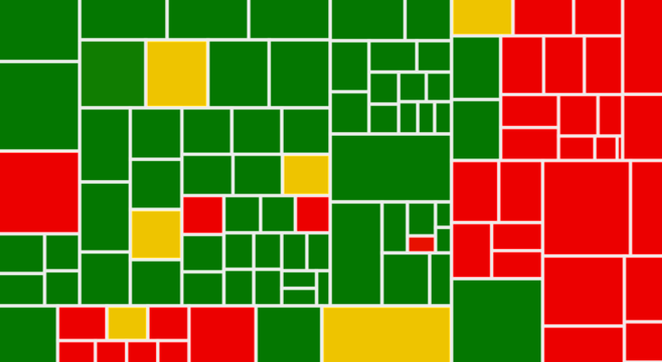
Research Questions
RQ1-2: Overall benefit of MAIST
RQ1: How much
test coverage
does MAIST achieve?
RQ2: How much
human test effort
does MAIST reduce?
Notes:
RQ4-6 은 달라보이게 시각적으로

Slide 16
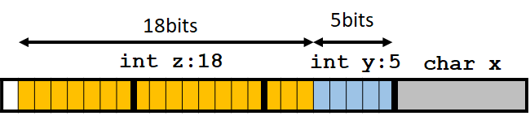
Research Questions
RQ3-5: Effectiveness of MAIST for addressing the technical difficulties
False alarm
RQ3: Effect of Task-oriented test Gen.
RQ4: Effect of Sym. bit-fields
RQ5: Effect of Sym. Func. Ptr.
Notes:
RQ4-6 은 달라보이게 시각적으로

Slide 17
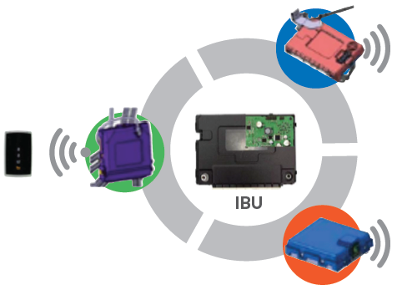
Overview of Target SW: Integrated Body Unit
Body Control Module (BCM)
  Wiper, door control
  Burglar alarm
Smart Key (SMK)
  Remote door lock/unlock
  Button start
IBU
Tire Pressure Monitor (TPM)
  Tire pressure sensing
Module | #files | #tasks | #functions | LoC | Avg. CC per func.
BCM | 27 | 143 | 656 | 53,690 | 4.3
SMK | 198 | 554 | 2,521 | 135,877 | 5.8
TPMS | 29 | 68 | 302 | 16,951 | 4.1
Total | 254 | 767 | 3,479 | 206,518 | 4.9
Notes:
LoC

Slide 18
RQ1:MAIST Achieved 90.5% Branch and 77.8% MC/DC Cov.
  100% branch cov. of 72.2% of funcs
  100% MC/DC cov. of 57.1% of funcs
* Running 20 hours on 12 CPU cores (3.0GHz)
Notes:
그래프 label
메시지 각 RQ별로 (BR > 90, 90.5%) almost all possible
빠진 uncovered branches RQ 다시 넣기

Slide 19
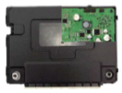




RQ2. MAIST Reduced Testing Cost from 30MM to 5MM (↓83.3%)
5MM
Manual testing for 9.5% uncovered brs
IBU code
210KLoC
30MM
$$÷$$
$$=$$
9MM
MAIST
Development
(one time cost!)
7KLoC/MM
(cov. testing)
Manual testing cost
Notes:
5mm 9mm 공간 띄어서
9mm 색 변경 (회색, 연노랑)
30MM(붉은색)이랑 5MM 색 다르게
Cost of manual testing of IBU
210KLoC (IBU LoC) / (350 LoC (LoC that 1 engineer can handle in a day) * 20 business day) = 30 MM
Cost of automated testing of MAIST
9 MM (to develop MAIST and train engineers to use MAIST) + 5 MM (to cover 9.5% of branches that MAIST did not cover)

Slide 20
RQ2: Analysis of the Uncovered Branches
Imprecise stub is the main cause of uncovered branches
  Manually analyze 33 BCM functions having <60% br. Cov.
Reasons | #uncovered brs | Ratio (%)
Imprecise stub | 43 | 41.7
Path explosion | 21 | 20.4
Static local variable | 21 | 20.4
Imprecise driver | 10 | 9.7
Unreachable branches | 8 | 7.8
Total | 103 | 100
Notes:
메시지 각 RQ별로 (BR > 90, 90.5%) almost all possible
빠진 uncovered bran
We manually analyzed the uncovered branches of BCM as
an example. Among the 66 (=0+14+52) functions in BCM
whose branch coverage is less than 60%, we selected the
largest 33 functions in terms of the number of branches.ches RQ 다시 넣기

Slide 21
RQ3:No false crash alarms by Task-oriented driver/stub generation
146
#false crash alarms
No false crash alarm at all!
Function-oriented
unit testing
Task-oriented Unit testing (MAIST)
Notes:
그래프 label
그래프에서 그라데이션 전부 삭제

Slide 22
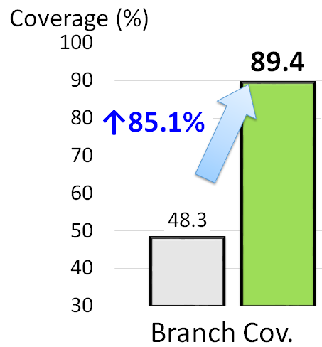
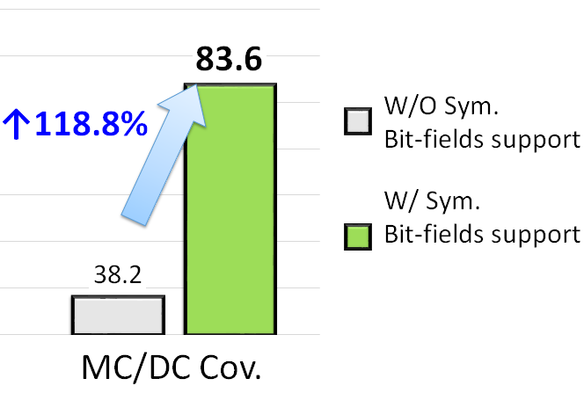
RQ4: Symbolic Bit-fields Support Highly Increases Test Coverage
Notes:
그래프 label
그래프로 작성 예정

Slide 23
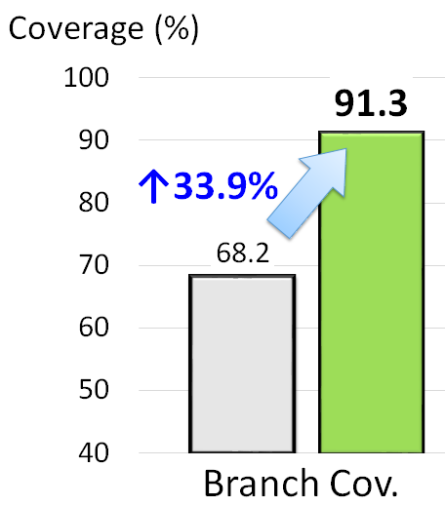
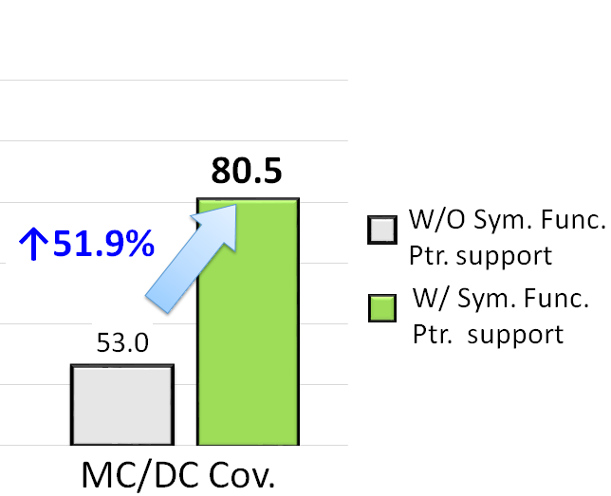
RQ5: Sym. Function Pointer Support Increases Test Coverage
Notes:
그래프로 작성 예정

Slide 24
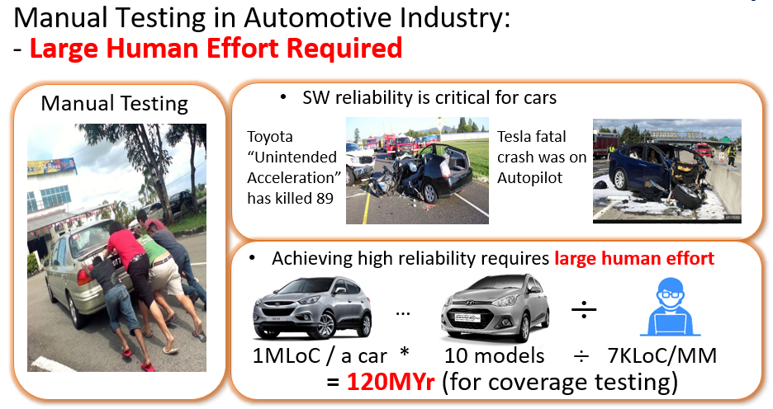
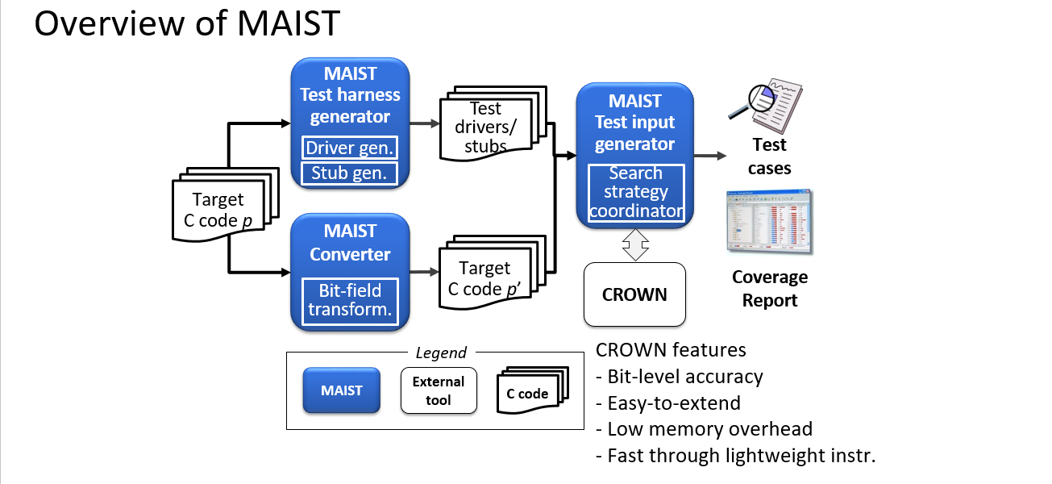
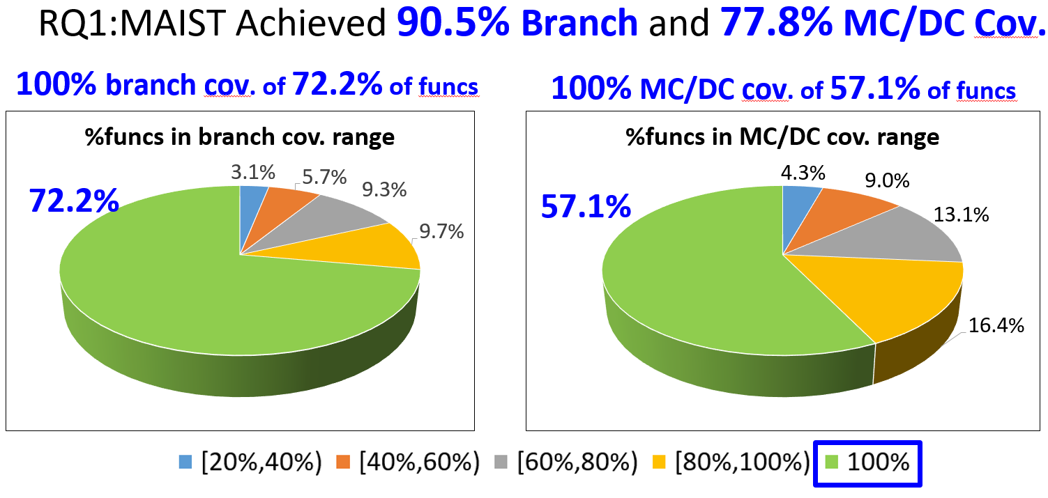
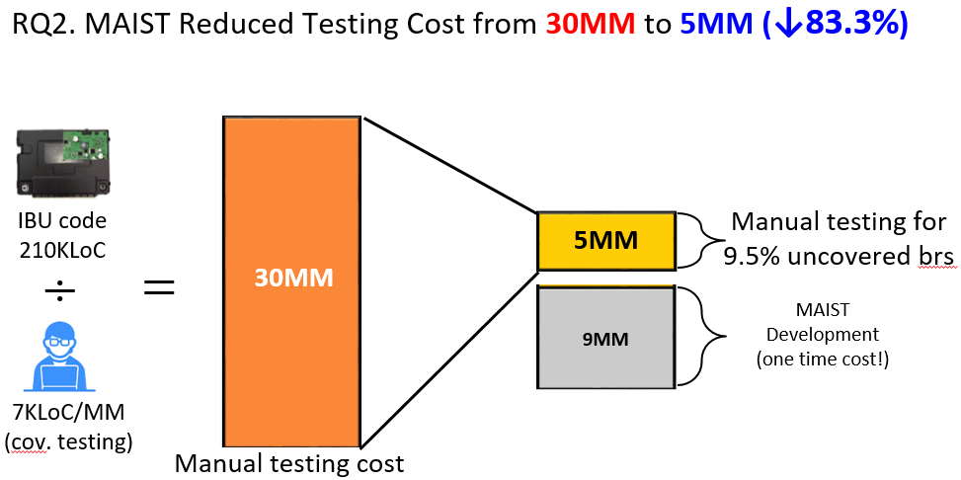
Conclusion

Slide 25
Concolic Testing for High Test Coverage and
Reduced Human Effort in Automotive Industry
Yunho Kim, SWTV group
KAIST, South Korea
Dongju Lee
Junki Baek
Moonzoo Kim

