Slide 1


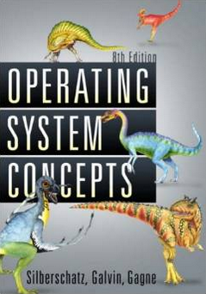
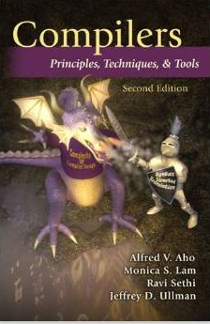

Necessity of Automated SW Testing
- Fight the Complexity of SW
Moonzoo Kim
Notes:
안녕하세요,
자동차 SW 를 대상으로, AI를 활용한 SW 테스팅 자동화 도구를 개발/판매하는 브이플러스랩 김문주 입니다.

Slide 2


SW Testing is Very Complex and Difficult Task
  The ratio of time spent for developing and testing SW products is 1:3
“… We have as many testers as we have developers. Testers basically test all the time, and developers basically are involved in the testing process about half the time…”
  The ratio of program code written for SW products and test harness is 1:3
“…The test cases are unbelievably expensive; in fact, there's more lines of code in the test harness than there is in the program itself. Often that's a ratio of about three to one.”
Object-Oriented Programming, Systems Languages, and Applications, Seattle, Washington, 2002

Slide 3
Summary: What is (the essense of) Software?
Software = a large set of unique executions
SW testing = to find an execution that violates a given requirement among the large set
  A human brain is poor at enumerating all executions of a target SW, but computer is good at the task
Automated SW testing
= to enumerate and analyze the executions of
SW systematically (and exhaustively if possible)

Slide 4


Static SW Code vs. Dynamic SW Executions
Thread1()
x=y+1
y=z+1
z=x+1
Thread2()
int x=0, y=0, z =0;
void Thread1()
{x=y+1; y=z+1; z= x+1;}
void Thread2()
{y=z+1; z=x+1; x=y+1;}
y=z+1
z=x+1
x=y+1

Slide 5

Software Development Cycle
A practical end-to-end formal framework for software development
A SW Development Framework for SW with High Assurance
Requirement
analysis
System
design
Design
analysis
Implement-
ation
Testing
Monitoring
Formal
require-
ment
Spec.
Formal
system
modeling
Model
analysis/
verification
Model-
assisted
code
generation
Model-
based
testing
Runtime
monitoring
and
checking

Slide 6
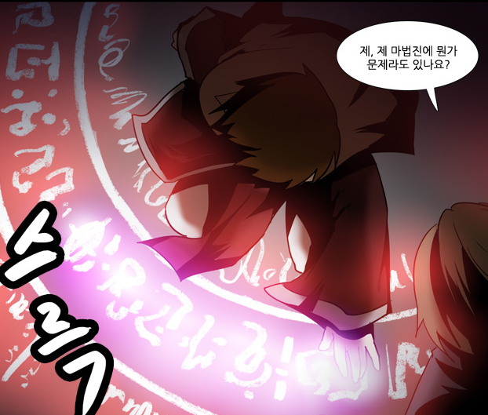
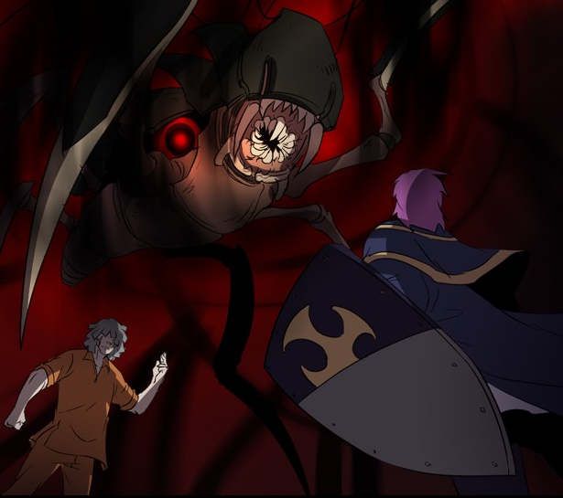
Software v.s. Magic Circle (마법진)
Written by a software developers line by line
Requires programming expertise
SW executes complicated tasks which are far more complex than the code itself
The software often behaves in unpredicted ways and crash occurs
Written by a human magician line by line
Requires magic spell knowledge
Summoned monsters are far more powerful than the magic spell itself
The summoned demon is often uncontrollable and disaster occurs
네이버 웹툰 “그 판타지 세계에서 사는법“ by 촌장

Slide 7
Requirement Specification Problems
Ambiguity
  Expression does not have unique meaning, but can be interpreted as several different meaning.
    Ex. For a natural number input, do X
      What if a 0 is given? Is 0 a natural number?
Incompleteness
  Relevant issues are not addressed , e.g. what to do when user errors occur or software faults show.
    Ex. For a positive integer input, do Y
      What if a negative input is given?
Inconsistency
  Contradictory requirements in different parts of the specification.
    Ex. For a non-negative input, execute Z, and for a non-positive input, do not execute Z
      What if 0 is given?

Slide 8
Example (retail chain management software)
If the sales for the current month are below the target sales, then a report is to be printed,
  unless the difference between target sales and actual sales is less than half of the difference between target sales and actual sales in the previous month
  or if the difference between target sales and actual sales for the current month is under 5 percent.

Slide 9
Example 2: Leap year (윤년) detection
The Februray of a leap year has 29th day (i.e., an extra day).
Given year, print “Leap year” if the following conditions hold:
a) if a year is divisible by 4, it is a leap year. Otherwise, it is not.
b) if a year is divisible by both 4 and 100, it is not a leap year.
c) if a year is divisible by 400, it is a leap year.
예시:
isLeapYear(2008)
isLeapYear(2100)
isLeapYear(2021)
isLeapYear(2000)
Leap year
Not a leap year
Not a leap year
Leap year
Notes:
def isLeapYear(year):
if (year % 4 == 0 and year % 100 != 0 ) or (year % 400 == 0) :
print ("윤년")
else :
print ("평년")

Slide 10
Ex. Testing a Triangle Decision Program
Input : Read three integer values from the command line. The three values represent the length of the sides of a triangle.
Output : Tell whether the triangle is
• Scalene (부등변삼각형 ) : no two sides are equal
• Isosceles (이등변삼각형) : exactly two sides are equal
• Equilateral(정삼각형) : all sides are equal
Create a Set of Test Cases for this program
(3,4,5), (2,2,1), (1,1,1) ?

Slide 11
Precondition (Input Validity) Check
Condition 1: a > 0, b > 0, c > 0
Condition 2: a < b + c
  Ex. (4, 2, 1) is an invalid triangle
  Permutation of the above condition
    a < b +c
    b < a + c
    c < a + b
What if b + c exceeds 2³² (i.e. overflow)?
  long v.s. int v.s. short. v.s. char
Developers often fail to consider implicit preconditions
  Cause of many hard-to-find bugs

Slide 12
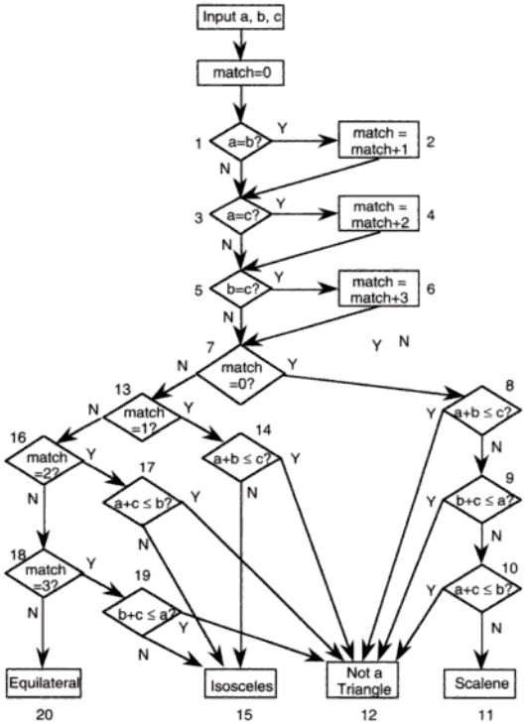
Test Cases for the Triangle Decision
int triangle(int a, int b, int c) {
int match=0, result=-1;
1: if(a==b) match=match+1;
3: if(a==c) match=match+2;
5: if(b==c) match=match+3;
7: if(match==0) {
8: if( a+b <= c) result=2;
9: else if( b+c <= a) result=2;
10: else if(a+c <= b) result =2;
else result=3;
} else {
13: if(match == 1) {
14: if(a+b <= c) result =2;
else result=1;
} else {
16: if(match ==2) {
17: if(a+c <=b) result = 2;
else result=1;
} else {
18: if(match==3) {
19: if(b+c <= a) result=2;
else result=1;
} else result = 0;
} }}
return result; }
“Software Testing a craftsman’s approach” 2nd ed by P.C.Jorgensen
Notes:
int triangle(int a, int b, int c) {
int match=0, result=-1;
if(a==b) match=match+1;
if(a==c) match=match+2;
if(b==c) match=match+3;
if(match==0) {
if( a+b <= c) result=2;
else if( b+c <= a) result=2;
else if(a+c <= b) result =2;
else result=3;
} else {
if(match == 1) {
if(a+b <= c) result =2;
else result=1;
} else {
if(match ==2) {
if(a+c <=b) result = 2;
else result=1;
} else {
if(match==3) {
if(b+c <= a) result=2;
else result=1;
} else result = 0;
} }}
return result; }

Slide 13
Test Cases for the Triangle Decision
“Software Testing a craftsman’s approach” 2nd ed by P.C.Jorgensen
# of test cases required?
  4
  11
  50
  100
# of feasible unique execution paths?
  11
The goal of testing
  Generate 11 test cases that exercise the 11 unique execution paths

Slide 14
Test Cases for the Triangle Decision
a,b,c = 1,1,1:match=6:result=0:p1
a,b,c = 3,2,2:match=3:result=1:p2
a,b,c = 2,1,2:match=2:result=1:p3
a,b,c = 2,2,1:match=1:result=1:p4
a,b,c = 2,1,1:match=3:result=2:p5
a,b,c = 1,2,1:match=2:result=2:p6
a,b,c = 1,1,2:match=1:result=2:p7
a,b,c = 2,1,3:match=0:result=2:p8
a,b,c = 3,2,1:match=0:result=2:p9
a,b,c = 2,3,1:match=0:result=2:p10
a,b,c = 4,3,2:match=0:result=3:p11
“Software Testing a craftsman’s approach” 2nd ed by P.C.Jorgensen
3
8
6
7
9
1
4
11
2
5
10
3
Notes:
a,b,c = 1,1,1:match=6:result=0:p1
a,b,c = 3,2,2:match=3:result=1:p2
a,b,c = 2,1,2:match=2:result=1:p3
a,b,c = 2,2,1:match=1:result=1:p4
a,b,c = 2,1,1:match=3:result=2:p5
a,b,c = 1,2,1:match=2:result=2:p6
a,b,c = 1,1,2:match=1:result=2:p7
a,b,c = 2,1,3:match=0:result=2:p8
a,b,c = 3,2,1:match=0:result=2:p9
a,b,c = 2,3,1:match=0:result=2:p10
a,b,c = 4,3,2:match=0:result=3:p11

Slide 15
Test Cases for the Triangle Decision
a) a≠b /\ a≠b /\ a≠b (match=0)
b) a=b (match=1)
c) a=c (match=2)
d) b=c (match=3)
e) a=b /\ a=b /\ a=b (match=6)
“Software Testing a craftsman’s approach” 2nd ed by P.C.Jorgensen
Cartesian
product
1) match≠0 /\ match≠1 /\ match≠2 /\ match≠3 (EQ)
2) match≠0 /\ match≠1 /\ match≠2 /\ match=3
/\ b+c > a (ISO)
3) match≠0 /\ match≠1 /\ match≠2 /\ match=3
/\ b+c ≤ a (NTR)
4) match≠0 /\ match≠1 /\ match=2 /\ a+c > b (ISO)
5) match≠0 /\ match≠1 /\ match=2 /\ a+c ≤ b (NTR)
6) match≠0 /\ match=1 /\ a+b > c (ISO)
7) match≠0 /\ match=1 /\ a+b ≤ c (NTR)
8) match=0 /\ a+b ≤ c (NTR)
9) match=0 /\ a+b > c /\ b+c ≤ a (NTR)
10) match=0 /\ a+b > c /\ b+c > a /\ a+c ≤ b (NTR)
11) match=0 /\ a+b > c /\ b+c > a /\ a+c > b (SCL)
3
8
6
7
9
1
4
11
2
5
10
3
Notes:
a,b,c = 1,1,1:match=6:result=0:p1
a,b,c = 3,2,2:match=3:result=1:p2
a,b,c = 2,1,2:match=2:result=1:p3
a,b,c = 2,2,1:match=1:result=1:p4
a,b,c = 2,1,1:match=3:result=2:p5
a,b,c = 1,2,1:match=2:result=2:p6
a,b,c = 1,1,2:match=1:result=2:p7
a,b,c = 2,1,3:match=0:result=2:p8
a,b,c = 3,2,1:match=0:result=2:p9
a,b,c = 2,3,1:match=0:result=2:p10
a,b,c = 4,3,2:match=0:result=3:p11

Slide 16
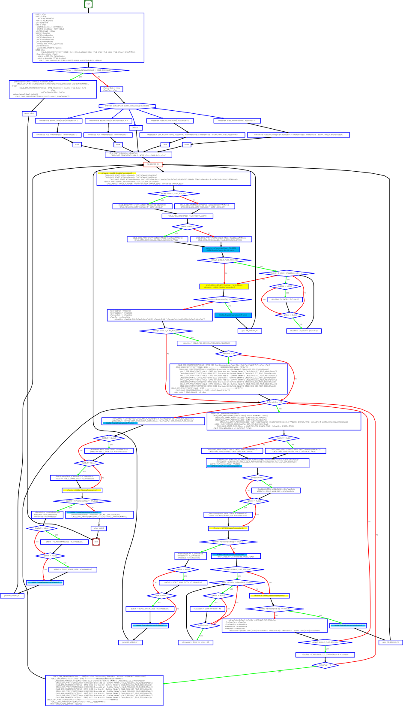
Test Cases for the Triangle Decision
# of test cases required?
  4
  11
  50
  100
# of feasible unique execution paths?
  11
The goal of testing
  Generate 11 test cases that exercise the 11 unique execution paths
“Software Testing a craftsman’s approach” 2nd ed by P.C.Jorgensen

Slide 17
More Complex Testing Situations (1/3)
Software is constantly changing
  What if “integer value” is relaxed to “floating value” ?
    Round-off errors should be handled explicitly
  What if new statements S₁ … S_{n} are added to check whether the given triangle is a right angle triangle (직각삼각형)?
    Will you test all previous tests again?
    How to create minimal test cases to check the changed parts of the target program

Slide 18
More Complex Testing Situations (2/3)
Regression testing is essential
  How to select statements/conditions affected by the revision of the program?
  How to create test cases to cover those statements/conditions?
  How to create efficient test cases?
    How to create a minimal set of test cases (i.e. # of test cases is small)?
    How to create a minimal test case (i.e. causing minimal execution time)?
  How to reuse pre-existing test cases?

Slide 19
More Complex Testing Situations (3/3)
However, conventional coverage is not complete
  Ex. int adder(int x, int y) { return 3;}
    Test case (x=1,y=2) covers all statements/branches of the target program and detects no error
    In other words, all variable values must be explored for complete results
Formal verification aims to guarantee completeness
  Model checking analyzes all possible x, y values through 2⁶⁴ (=2³² x 2³²) cases
  However, model checking is more popular for debugging, not verification

Slide 20
Concurrency
Concurrent programs have very high complexity
due to non-deterministic scheduling
Ex. int x=0, y=0, z =0;
  void Thread1() {x=y+1; y=z+1; z= x+1;}
  Void Thread2() {y=z+1; z=x+1; x=y+1;}
  Total 20 interleaving scenarios
    = (3+3)!/(3!x3!)
  However, only 11 unique outcomes
    assert(x+y+z > 5)???
    assert(x+y+z < 15)???
Thread1()
x=y+1
y=z+1
z=x+1
Thread2()
y=z+1
z=x+1
x=y+1
Trail1: 2,1,2
Trail2: 2,1,3
Trail3: 2,2,3
Trail4: 2,3,3
Trail5: 2,4,3
Trail6: 3,2,3
Trail7: 3,2,4
Trail8: 4,3,2
Trail9: 4,3,5
Trail10: 5,4,3
Trail11: 5,4,6

Slide 21
An Example of Mutual Exclusion Protocol
char cnt=0,x=0,y=0,z=0;
void process() {
char me=_pid +1; /* me is 1 or 2*/
again:
  x = me;
  If (y ==0 || y== me) ;
  else goto again;
  z =me;
  If (x == me) ;
  else goto again;
  y=me;
  If(z==me);
  else goto again;
  /* enter critical section */
  cnt++;
  assert( cnt ==1);
  cnt --;
  goto again;
}
Process 0
x = 1
If(y==0 || y == 1)
z = 1
If(x == 1)
y = 1
If(z == 1)
cnt++
Process 1
x = 2
If(y==0 || y ==2)
z = 2
If(x==2)
y=2
If (z==2)
cnt++
Software
locks
Critical
section
Violation detected !!!
Mutual
Exclusion
Algorithm
Counter
Example

Slide 22
More Concurrency Bugs
Data race bugs
Atomicity bugs
class Account_DR {
double balance;
// INV:balance should be always non-negative
void withdraw(double x) {
1: if (balance >= x) {
2: balance = balance–x;}
...
}}
class Account_BR {
Lock m;
double balance;
// INV: balance should be non-negative
double getBalance() {
double tmp;
1: lock(m);
2: tmp = balance ;
3: unlock(m);
4: return tmp; }
void withdraw(double x){
/*@atomic region begins*/
11: if (getBalance() >= x){
12: lock(m);
13: balance = balance – x;
14: unlock(m); }
/*@atomic region ends*/
... }
(a) Buggy program code
(a) Buggy program code
[Initially, balance:10]
-th1: withdraw(10)-
1: if(balance >= 10)
2: balance = 0 – 10;
-th2: withdraw(10)-
1: if(balance >= 10)
2: balance = 10-10;
[Initially, balance:10 ]
-th1: withdraw(10)-
11:if(getBalance()>=10)
getBalance()
1:lock(m);
2:tmp = balance;
3:unlock(m);
4:return tmp;
12: lock(m);
13: balance=0 – 10;
14: unlock(m);
-th2 : withdraw(10)-
...
12: lock(m);
13: balance=10–10;
14: unlock(m);
operation block b_{i}
The invariant is violated as
balance becomes -10.
The invariant is violated as
balance becomes -10.
(b) Erroneous execution
(b) Erroneous execution

Slide 23
Static SW Code vs. Dynamic SW Executions
Thread1()
x=y+1
y=z+1
z=x+1
Thread2()
int x=0, y=0, z =0;
void Thread1()
{x=y+1; y=z+1; z= x+1;}
void Thread2()
{y=z+1; z=x+1; x=y+1;}
y=z+1
z=x+1
x=y+1

Slide 24

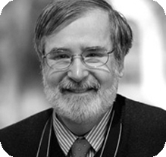
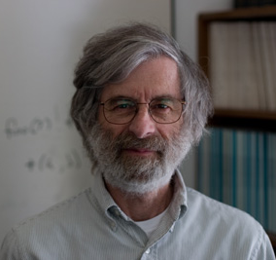
Formal Analysis of Software
2007 ACM Turing Awardees
  Prof. Edmund Clarke, Dr. Joseph
  Sipfakis, Prof. E. Allen Emerson
  For the contribution of migrating
  from pure model checking research
  to industrial reality
2013 ACM Turing Awardee
  Dr. Leslie Lamport
  For fundamental contributions to the theory and practice of distributed and concurrent systems
    Happens-before relation, sequential consistency,
    Bakery algorithm, TLA+, and LaTeX

Slide 25




Significance of Automated SW Testing
Software has become more ubiquitous and more complex at the same time
Human resources are becoming less reliable and more expensive for highly complex software
Computing resources are becoming ubiquitous and cheap
  Amazon AWS price: you can use thousands of CPUs @ 0.03$/hr for 2.5Ghz Quad-core CPU
To-do: Develop automated and scientific software testing tools to utilize computing resource effectively and efficiently

Slide 26
Summary: What is (the essense of) Software?
Software = a large set of unique executions
SW testing = to find an execution that violates a given requirement among the large set
  A human brain is poor at enumerating all executions of a target SW, but computer is good at the task
Automated SW testing
= to enumerate and analyze the executions of
SW systematically (and exhaustively if possible)

