Slide 1
HW#5
1. Verify the max_heapify(int x[],int i,int h_size) by using CBMC
x[] is an array to contain a max-heap
i is the index to the node that may violate the max-heap property
h_size is a total number of nodes in the max-heap:
Assumptions
1. The right and left sub-trees of node i are max heaps, but that x[i] may be smaller than its children
2. The size of x[] is 8.
To do list:
Describe your environment model in detail
Describe your assertion check routine in detail
Describe run-time parameters of CBMC
Report verification results (i.e., time, memory, assert violation, size of generated SAT formula, etc)

Slide 2
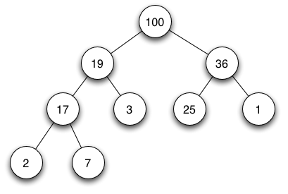
A max heap is a heap data structure created using a binary tree with two constraints:
  The shape property: the tree is a complete binary tree; that is, all levels of the tree, except possibly the last one (deepest) are fully filled, and, if the last level of the tree is not complete, the nodes of that level are filled from left to right.
  The max-heap property: each node is greater than or equal to each of its children according to a comparison predicate defined for the data structure.
Max heap can be implemented using an array as follows (note that array index starts from 1):
Index | 1 | 2 | 3 | 4 | 5 | 6 | 7 | 8 | 9
value | 100 | 19 | 36 | 17 | 3 | 25 | 1 | 2 | 7

Slide 3
/* Example code */
#include<stdio.h>
#define MAX 16
#define H_SIZE 10
#define parent(i)(i/2)
#define left(i) (2*i)
#define right(i)(2*i+1)
/* Ignore the first 0, since max heap
contents start at index 1 */
int a[MAX] = {0,16,4,10,14,7,9,3,2,8,1,};
void max_heapify(int x[],int i,int h_size){
int largest, tmp;
int l=left(i);
int r=right(i);
if (l<=h_size && x[l]>x[i]) largest=l;
else largest=i;
if(r<=h_size && x[r]>x[largest]) largest=r;
if (largest!=i) {
tmp=x[i];
x[i]=x[largest];
x[largest]=tmp;
max_heapify(x,largest,h_size);
}
}
int main(){
int i;
max_heapify(a,2,H_SIZE);
for (i=1;i<=H_SIZE;i++) printf("%d ",a[i]);
return 0;
} /* Output: 16 14 10 8 7 9 3 2 4 1 */
1
max_heapify(a,2,10)
2
16
3
4
10
4
5
6
7
14
7
9
3
8
9
10
2
8
1
1
2
16
3
14
10
4
5
6
7
4
7
9
3
8
9
10
2
8
1
1
2
16
3
14
10
4
5
6
7
8
7
9
3
8
9
10
2
4
1

