Slide 1
The Spin Model Checker : Part I
Moonzoo Kim
KAIST

Slide 2
Hierarchy of SW Coverage Criteria
Complete Value Coverage
CVC
(SW) Model checking
Complete Path Coverage
CPC
Concolic testing
Prime Path Coverage
PPC
All-DU-Paths Coverage
ADUP
Edge-Pair Coverage
EPC
All-uses Coverage
AUC
Complete Round Trip Coverage
CRTC
Edge Coverage
EC
All-defs Coverage
ADC
Simple Round Trip Coverage
SRTC
Node Coverage
NC

Slide 3
Model Checker Analyzes All Possible Scheduling
active type A() {
byte x;
again:
x++;
goto again;
}
x:0
x:1
x:2
x:255
active type A() {
byte x;
again:
x++;
goto again;
}
active type B() {
byte y;
again:
y++;
goto again;
}
x:0,y:0
x:0,y:1
x:0,y:255
x:1,y:0
x:1,y:1
x:1,y:255
x:2,y:0
x:2,y:1
x:2,y:255
x:255,y:0
x:255,y:255

Slide 4
Overview of the Spin Architecture
System Spec.
In Promela
Spin Model
Checker
pan.c
C compiler
a.out
Req. Spec.
In LTL
Counter
Example (s)
OK
A few characteristics of Spin
  Promela allows a finite state model only
  Asynchronous execution
  Interleaving semantics for concurrency
  2-way process communication
  Non-determinism
  Promela provides (comparatively) rich set of constructs such as variables and message passing, dynamic creation of processes, etc

Slide 5
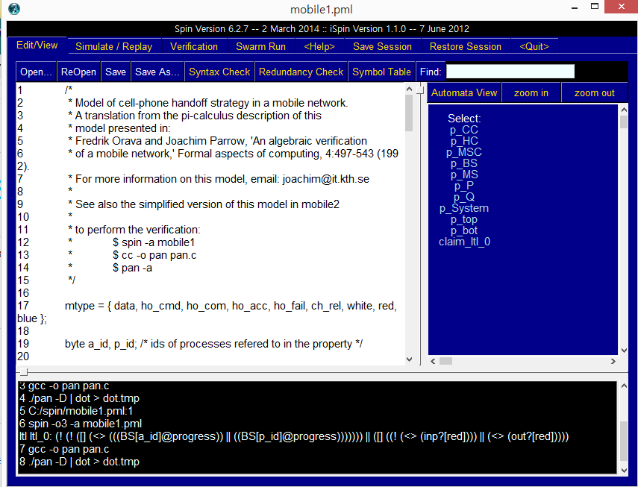
Tcl GUI of SPIN (ispin.tcl): Edit Window

Slide 6
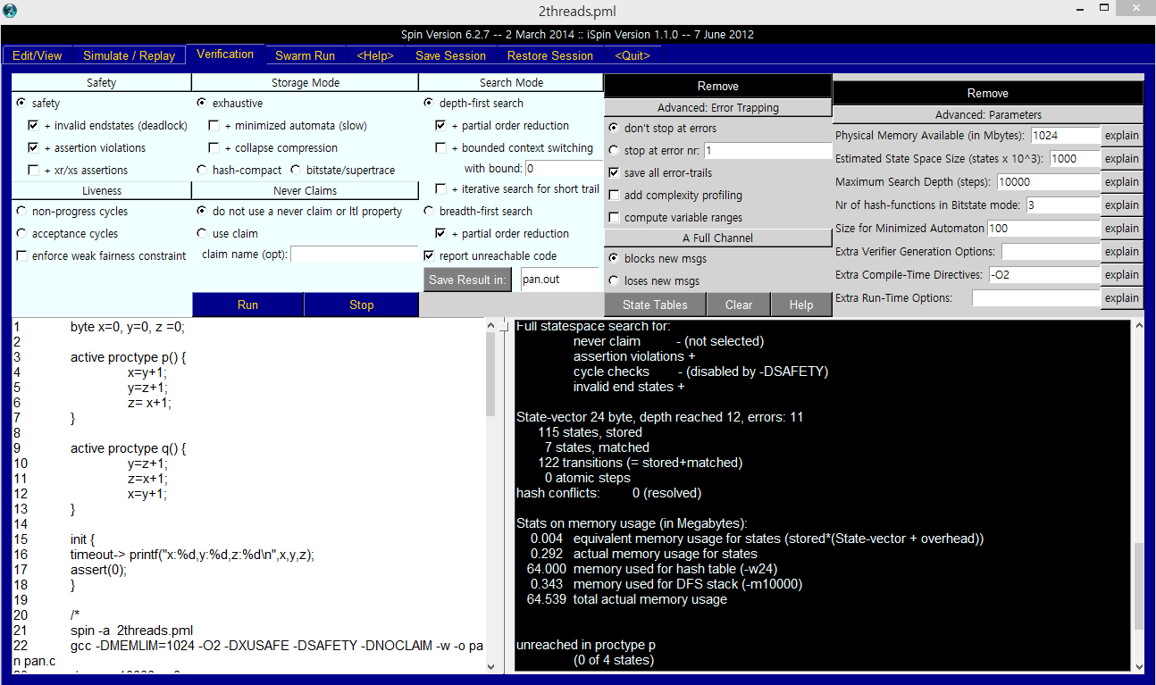
Tcl GUI of SPIN (ispin.tcl): Verification Window

Slide 7
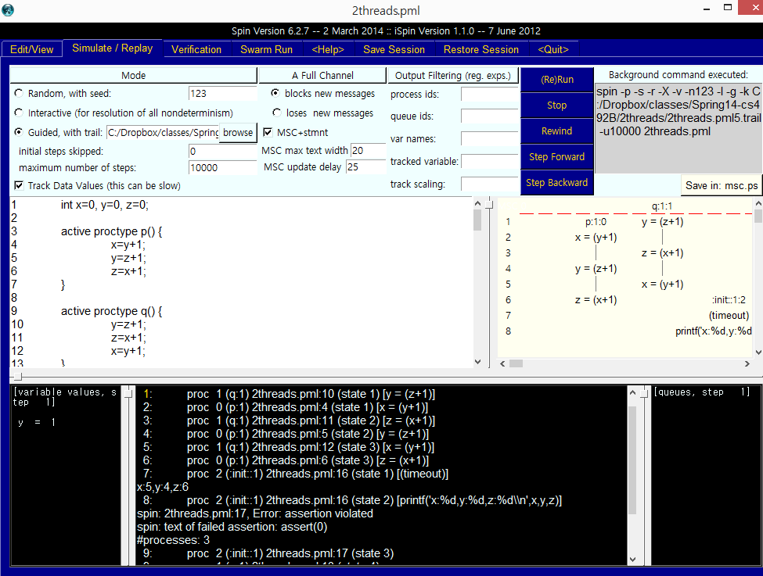
Tcl GUI of SPIN (ispin.tcl): Simulation Window

Slide 8
Overview of the Promela
Global variables
(including channels)
Similar to C syntax but simplified
  No pointer
  No real datatype such as float or real
  No functions
Processes are communicating with each other using
  Global variables
  Message channels
Process can be dynamically created
Scheduler executes one process at a time using interleaving semantics
byte x;
chan ch1= [3] of {byte};
active[2] proctype A() {
byte z;
printf(“x=%d\n”,x);
z=x+1;
ch1!z
}
proctype B(byte y) {
byte z;
ch1?z;
}
Init {
run B(2);
}
Process (thread)
definition and
creation
Another
process
definition
System
initialization

Slide 9
Process Creation Example
active[2] proctype A() {
byte x;
printf(“A%d is starting\n”);
}
proctype B() {
printf(“B is starting\n”);
}
Init {
run B();
}
run() operator creates a process and returns a newly created process ID
There are 6 possible outcomes due to non-deterministic scheduling
  A0.A1.B, A0.B.A1
  A1.A0.B, A1.B.A0
  B.A0.A1, B.A1.A0
In other words, process creation may not immediately start process execution
Notes:
[root@moonzoo ~]# spin test.pml
A0 B A1
4 processes created
[root@moonzoo ~]# spin test.pml
A0 A1 B
4 processes created
[root@moonzoo ~]# spin test.pml
B A0 A1
4 processes created
[root@moonzoo ~]# spin test.pml
A1 B A0
4 processes created
[root@moonzoo ~]# spin test.pml
A1 A0 B
4 processes created

Slide 10
Variables and Types
Basic types
  bit
  bool
  Byte (8 bit unsigned integer)
  short (16 bits signed integer)
  Int (32 bits signed integer)
Arrays
  bool x[10];
Records
  typedef R { bit x; byte y;}
Default initial value of variables is 0
Most arithmetic (e.g.,+,-), relational (e.g. >,==) and logical operators of C are supported
  bitshift operators are supported too.

Slide 11
Finite State Model
Promela spec generates only a finite state model because
  Max # of active process <= 255
  Each process has only finite length of codes
  Each variable is of finite datatype
  All message channels have bounded capability <= 255

Slide 12
Basic Statements
Each Promela statement is either
  executable:
  Blocked
There are six types of statement
  Assignment: always executable
    Ex. x=3+x, x=run A()
  Print: always executable
    Ex. printf(“Process %d is created.\n”,_pid);
  Assertion: always executable
    Ex. assert( x + y == z)
  Expression: depends on its value
    Ex. x+3>0, 0, 1, 2
    Ex. skip, true
  Send: depends on buffer status
    Ex. ch1!m is executable only if ch1 is not full
  Receive: depends on buffer status
    Ex. ch1?m is executable only if ch1 is not empty

Slide 13
Expression Statements
An expression is also a statement
  It is executable if it evaluates to non-zero
  1 : always executable
  1<2:always executable
  x<0: executable only when x < 0
  x-1:executable only when x !=0
If an expression statement in blocked, it remains blocked until other process changes the condition
  an expression e is equivalent to while(!e); in C

Slide 14
assert Statement
assert(expr)
  assert is always executable
  If expr is 0, SPIN detects this violation
  assert is most frequently used checking method, especially as a form of invariance
    ex. active proctype inv() { assert( x> 0);}
      Note that inv() is equivalent to [] (x>0) in LTL with thanks to interleaving semantics

Slide 15





Generation of all possible interleaving scenarios
Original execution tree
After adding Inv() process
Thread1
Thread1
Thread2
Thread2
Inv()
$$σ1$$
$$σ12$$
$σ1$₄
$$σ11$$
$σ1$₃
Therefore, just a single assert(x> 0) statement in Inv() can check if x>0 all the time

Slide 16
Program Execution Control
Promela provides low-level control mechanism, i.e., goto and label as well as if and do
Note that non-deterministic selection is supported
else is predefined variable which becomes true if all guards are false; false otherwise
  proctype A() {
  byte x;
  starting:
  x= x+1;
  goto starting;
  }
  proctype A() {
  byte x;
  if
  ::x<=0 -> x=x+1
  ::x==0 -> x=1
  fi
  }
  proctype A() {
  byte x;
  do
  :: x<=0 ->x=x+1;
  :: x==0 ->x=1;
  :: else -> break
  od
  }
int i;
for (i : 1 .. 10) {
printf("i =%d\n",i)
}

Slide 17
Critical Section Example
[root@moonzoo spin_test]# ls
crit.pml
[root@moonzoo spin_test]# spin -a crit.pml
[root@moonzoo spin_test]# ls
crit.pml pan.b pan.c pan.h pan.m pan.t
[root@moonzoo spin_test]# gcc pan.c
[root@moonzoo spin_test]# a.out
pan: assertion violated (cnt<=1) (at depth 8)
pan: wrote crit.pml.trail
Full statespace search for:
never claim - (none specified)
assertion violations +
acceptance cycles - (not selected)
invalid end states +
State-vector 36 byte, depth reached 16, errors: 1
119 states, stored
47 states, matched
166 transitions (= stored+matched)
0 atomic steps
hash conflicts: 0 (resolved)
4.879 memory usage (Mbyte)
[root@moonzoo spin_test]# ls
a.out crit.pml crit.pml.trail pan.b pan.c pan.h pan.m pan.t
bool lock;
byte cnt;
active[2] proctype P() {
!lock -> lock=true;
cnt=cnt+1;
printf("%d is in the crt sec!\n",_pid);
cnt=cnt-1;
lock=false;
}
active proctype Invariant() {
assert(cnt <= 1);
}

Slide 18
Critical Section Example (cont.)
[root@moonzoo spin_test]# spin -t -p crit.pml
Starting P with pid 0
Starting P with pid 1
Starting Invariant with pid 2
1: proc 1 (P) line 5 "crit.pml" (state 1) [(!(lock))]
2: proc 0 (P) line 5 "crit.pml" (state 1) [(!(lock))]
3: proc 1 (P) line 5 "crit.pml" (state 2) [lock = 1]
4: proc 1 (P) line 6 "crit.pml" (state 3) [cnt = (cnt+1)]
1 is in the crt sec!
5: proc 1 (P) line 7 "crit.pml" (state 4) [printf('%d is in the crt sec!\\n',_pid)]
6: proc 0 (P) line 5 "crit.pml" (state 2) [lock = 1]
7: proc 0 (P) line 6 "crit.pml" (state 3) [cnt = (cnt+1)]
0 is in the crt sec!
8: proc 0 (P) line 7 "crit.pml" (state 4) [printf('%d is in the crt sec!\\n',_pid)]
spin: line 13 "crit.pml", Error: assertion violated
spin: text of failed assertion: assert((cnt<=1))
9: proc 2 (Invariant) line 13 "crit.pml" (state 1) [assert((cnt<=1))]
spin: trail ends after 9 steps
#processes: 3
lock = 1
cnt = 2
9: proc 2 (Invariant) line 14 "crit.pml" (state 2) <valid end state>
9: proc 1 (P) line 8 "crit.pml" (state 5)
9: proc 0 (P) line 8 "crit.pml" (state 5)
3 processes created

Slide 19
Revised Critical Section Example
bool lock;
byte cnt;
active[2] proctype P() {
atomic{ !lock -> lock=true;}
cnt=cnt+1;
printf("%d is in the crt sec!\n",_pid);
cnt=cnt-1;
lock=false;
}
active proctype Invariant() {
assert(cnt <= 1);
}
[root@moonzoo revised]# a.out
Full statespace search for:
never claim - (none specified)
assertion violations +
acceptance cycles - (not selected)
invalid end states +
State-vector 36 byte, depth reached 14, errors: 0
62 states, stored
17 states, matched
79 transitions (= stored+matched)
0 atomic steps
hash conflicts: 0 (resolved)
4.879 memory usage (Mbyte)

Slide 20
Deadlocked Critical Section Example
[[root@moonzoo deadlocked]# a.out
pan: invalid end state (at depth 3)
(Spin Version 4.2.7 -- 23 June 2006)
Warning: Search not completed
+ Partial Order Reduction
Full statespace search for:
never claim - (none specified)
assertion violations +
acceptance cycles - (not selected)
invalid end states +
State-vector 36 byte, depth reached 4, errors: 1
5 states, stored
0 states, matched
5 transitions (= stored+matched)
2 atomic steps
hash conflicts: 0 (resolved)
4.879 memory usage (Mbyte)
bool lock;
byte cnt;
active[2] proctype P() {
atomic{ !lock -> lock==true;}
cnt=cnt+1;
printf("%d is in the crt sec!\n",_pid);
cnt=cnt-1;
lock=false;
}
active proctype Invariant() {
assert(cnt <= 1);
}

Slide 21
Deadlocked Critical Section Example (cont.)
[root@moonzoo deadlocked]# spin -t -p deadlocked_crit.pml
Starting P with pid 0
Starting P with pid 1
Starting Invariant with pid 2
1: proc 2 (Invariant) line 13 "deadlocked_crit.pml" (state 1) [assert((cnt<=1))]
2: proc 2 terminates
3: proc 1 (P) line 5 "deadlocked_crit.pml" (state 1) [(!(lock))]
4: proc 0 (P) line 5 "deadlocked_crit.pml" (state 1) [(!(lock))]
spin: trail ends after 4 steps
#processes: 2
lock = 0
cnt = 0
4: proc 1 (P) line 5 "deadlocked_crit.pml" (state 2)
4: proc 0 (P) line 5 "deadlocked_crit.pml" (state 2)
3 processes created

Slide 22
Communication Using Message Channels
Spin provides communications through various types of message channels
  Buffered or non-buffered (rendezvous comm.)
  Various message types
  Various message handling operators
Syntax
  chan ch1 = [2] of { bit, byte};
    ch1!0,10;ch1!1,20
    ch1?b,bt;ch1?1,bt
  chan ch2= [0] of {bit, byte}
Sender (1,20) (0,10) Receiver

Slide 23
Operations on Channels
Basic channel inquiry
  len(ch)
  empty(ch)
  full(ch)
  nempty(ch)
  nfull(ch)
Additional message passing operators
  ch?[x,y]: polling only
  ch?<x,y>: copy a message without removing it
  ch!!x,y: sorted sending (increasing order)
  ch??5,y: random receiving
  ch?x(y) == ch?x,y (for user’s understandability)
Be careful to use these operators inside of expressions
  They have side-effects, which spin may not allow

Slide 24
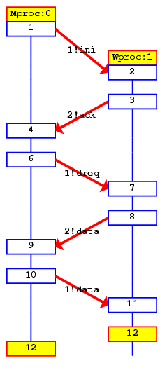
Faulty Data Transfer Protocol
(pg 27, data switch model proposed at 1981 at Bell labs)
mtype={ini,ack, dreq,data, shutup,quiet, dead}
chan M = [1] of {mtype};
chan W = [1] of {mtype};
active proctype Mproc()
{
W!ini; /* connection */
M?ack; /* handshake */
timeout -> /* wait */
if /* two options: */
:: W!shutup; /* start shutdown */
:: W!dreq; /* or request data */
do
:: M?data -> W!data :: M?data-> W!shutup;
break
od
fi;
M?shutup;
W!quiet;
M?dead;
}
active proctype Wproc() {
W?ini; /* wait for ini*/
M!ack; /* acknowledge */
do /* 3 options: */
:: W?dreq-> /* data requested */
M!data /* send data */
:: W?data-> /* receive data */
skip /* no response */
:: W?shutup->
M!shutup; /* start shutdown*/
break
od;
W?quiet;
M!dead;
}
Channel W
Mproc
Wproc
Channel M

Slide 25
The Sieve of Eratosthenes (pg 326)
/*
The Sieve of Eratosthenes (c. 276-196 BC)
Prints all prime numbers up to MAX
*/
#define MAX 25
mtype = { number, eof };
chan root = [0] of { mtype, int };
init
{ int n = 2;
run sieve(root, n);
do
:: (n < MAX) -> n++; root!number(n)
:: (n >= MAX) -> root!eof(0); break
od
}
proctype sieve(chan c; int prime)
{ chan child = [0] of { mtype, int };
bool haschild; int n;
printf("MSC: %d is prime\n", prime);
end: do
:: c?number(n) ->
if
:: (n%prime) == 0 -> printf("MSC: %d = %d*%d\n", n, prime, n/prime)
:: else ->
if
:: !haschild -> /* new prime */
haschild = true;
run sieve(child, n);
:: else ->
child!number(n)
fi;
fi
:: c?eof(0) -> break
od;
if
:: haschild -> child!eof(0)
:: else
fi
}

Slide 26
Simulation Run
[moonzoo@verifier spin]$ spin sieve-of-eratosthenes.pml
MSC: 2 is prime
MSC: 3 is prime
MSC: 4 = 2*2
MSC: 5 is prime
MSC: 6 = 2*3
MSC: 8 = 2*4
MSC: 7 is prime
MSC: 9 = 3*3
MSC: 10 = 2*5
MSC: 12 = 2*6
MSC: 14 = 2*7
MSC: 11 is prime
MSC: 15 = 3*5
MSC: 13 is prime
MSC: 16 = 2*8
MSC: 18 = 2*9
MSC: 20 = 2*10
2
3
5
7
11
13

