Slide 1
Automated Test Generation in System-Level
Pros
+ Can be easy to generate system TCs due to clear interface specification
+ No false alarm (i.e., no assert violation caused by infeasible execution scenario)
Cons
- Low controllability of each unit
- Large and complex search space to explore in a limited time
- Hard to detect bugs in corner cases
T₁
T₂
T₃
T₄
Different system tests T₂ to T₄ exercise the same behavior of the target unit
g1
g2
f
h1
h3
h2
Notes:
장점 Sys tc 만들기 쉽다.
Search space 가 너무 커서 어려움
시간문제
그림 컴포넌트 구분 안감 (입체감)

Slide 2
Automated Test Generation in Unit-Level
Pros
+ High controllability of a target unit
+ Smaller search space to explore than system testing
+ High effectiveness for detecting corner cases bugs
Cons
- Hard to write down accurate unit test drivers/stubs due to unclear unit specification
- High false/true alarm ratio
Different unit tests T_{u1} to T_{u3} directly exercise different behaviors of the target unit, but T_{u2} to T_{u3} exercise infeasible paths
g1
T_{u1}
T_{u2}
g2
T_{u3}
Legend
f
A feasible execution
h1
h3
An infeasible execution
h2
Notes:
드라이버/스텁
Tu2, 3 로 가장 표면에서 가는 선 없는 거 보이기(visual)

Slide 3
Automated Unit Test Generation with Realistic Unit Context
Pros
+ High controllability of a target unit
+ High effectiveness for detecting corner cases bugs
+ Low false alarm ratio
Realistic unit context filters out unit tests that exercise infeasible paths
Unit tests T_{u4} that exercises an infeasible path is filtered out by the unit context
Different unit contexts explore various behaviors of f
T_{u4}
T_{u5}
g1
T_{u6}
g1
g2
g2
Legend
A feasible execution
f
h1
h3
An infeasible execution
h3
h2
h2
Notes:
드라이버/스텁
Tu2, 3 로 가장 표면에서 가는 선 없는 거 보이기(visual)

Slide 4
Related Work on Automated Unit Testing
 | Bug detection ability | False/True alarm ratio | Target languages
Function input generation [PLDI 05][FSE 05][EMSOFT 06][TAP 08][ISSTA 08][SEC 15] | High | High | Procedural or OO languages
Method-sequence generation [ICSE 07] [ICST 10][FSE 11] [ICSE 13] | High | Medium | Object-oriented languages
Capture system tests to generate unit tests [TSE 09] [STTT 09][ISSTA 10] | Low | Low | Object-oriented languages
Automated Unit Test Generation with Realistic Unit Context | High (86.7% of target bugs in SIR and SPEC2006) | Low (2.4 false alarms per one true alarm) | Procedural languages

Slide 5
Approximate Input Space for Symbolic Unit Testing
Over-approximated symbolic inputs
Real inputs to target unit
User-specified
symbolic inputs
Possible false
negative
Infeasible input of false alarm
Under-approximate
symbolic inputs

Slide 6
Unit-testing Busybox ls
We performed unit-testing Busybox ls by using CREST
We tested 14 functions of Busybox ls (1100 lines long)
Note that this is a refined testing activity compared to the previous testing activity for 10 Busybox utilities in a system-level testing

Slide 7
Busybox “ls” Requirement Specification
POSIX specification (IEEE Std 1003.1, 2004 ed.) is a good requirement specification document for ls
A4 ~10 page description for all options
We defined test oracles using assert statements based on the POSIX specification
Automated oracle approach
However, it still required human expertise on Busybox ls code to define concrete assert statements from given high-level requirements

Slide 8
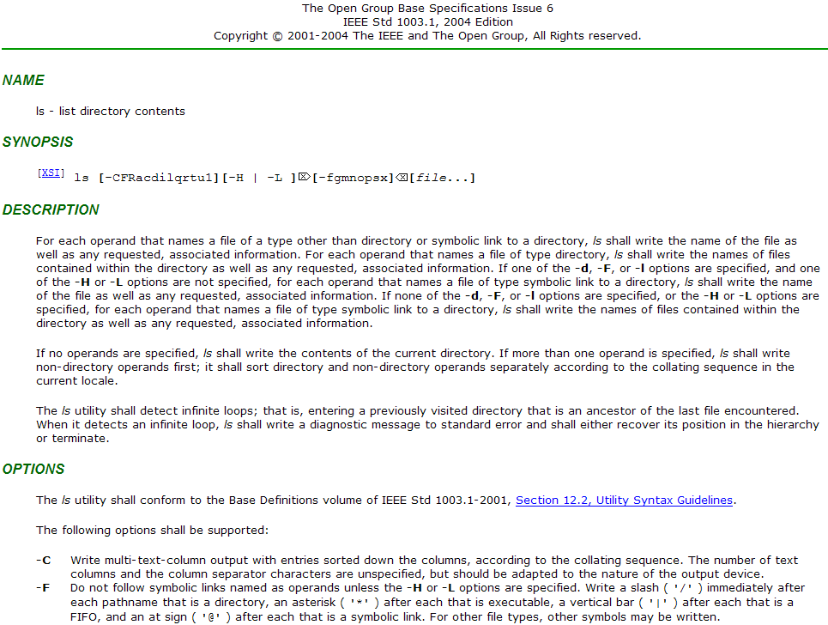

Slide 9
Four Bugs Detected
Missing ‘@’ symbol for a symbolic link file with –F option
Missing space between adjacent two columns with –i or –b options
The order of options is ignored
According to the ls specification, the last option should have a higher priority (i.e., -C -1 and -1 -C are different)
Option –n does not show files in a long format
-n enforces to list files in a long format and print numeric UID and GID instead of user/group name

Slide 10
Missing ‘@’ symbol for symbolic link with –F option
Busybox ls does not print a type marker ‘@’ after a symbolic link file name, when -F is specified and a file name is specified in the command line.
Output of linux ls:
Output of Busybox ls (incorrect behavior):
-F means write a marker (/*|@=) for different type of files.
t.lnk is a symbolic link, which links to file t in the directory ~yang/
We found that the bug was due to the violation of a precondition of my_stat()
$ ls -F t.lnk
t.lnk@
$ ./busybox ls -F t.lnk
t.lnk

Slide 11
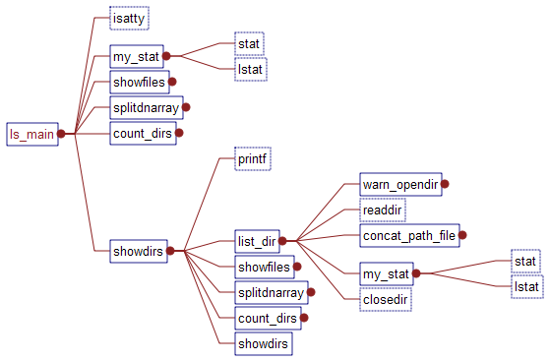
Calls Graph of Busybox ls
buggy behavior
unit-stat
Replaced by unit-stat()
and unit-lstat() for unit-testing
unit-lstat
Replaced by unit-stat()
and unit-lstat() for unit-testing
unit-stat
unit-lstat
correct behavior

Slide 12
ls_main
int ls_main(int argc UNUSED_PARAM,
char **argv)
Purpose:
ls_main obtains specified options and file/dir names from command line input.
Calculate runtime features by specified options.
unsigned int opt is defined to represent all options given in the command line arguments
opt = getopt32(argv, ls_options, &tabstops, &terminal_width)
unsigned int all_fmt is defined to represent all runtime features based on the given command line options and compile time option opt_flags[]
all_fmt=fun (opt, opt_flags)
Print file/dir entries of a file system whose names and corresponding options are given in the command line input by calling sub-functions
Notes:
Mutually-exclusive option pairs shall not be considered as an error. The last option specified in each pair shall determine the output format. e.g. -C and -1

Slide 13
my_stat
static struct dnode *my_stat(const char *fullname, const char *name, int force_follow)
Purpose:
my_stat gets file status by fullname, and store file status in struct dnode *cur which is returned by my_stat
If a file/dir entry corresponding to fullname is available in the file system, cur->stat should stores the corresponding file info. Otherwise, NULL is turned.
Pre condition:
len (fullname) >= len(name)
If any of -d, -F, or -l options is given, and -L option is not given, follow_symlink should be false
((-d || -F || -l) && !-L) -> !follow_symlink
-d: llist directory entries instead of contents, and do not dereference symbolic links
-F: append indicator (one of */=>@|) to entries
-l: use a long listing format
-L: when showing file information for a symbolic link,
show information for the file the link references
rather than for the link itself
t.lnk
(stat_t_lnk)
t
(stat_t)

Slide 14
my_stat
static struct dnode *my_stat(const char *fullname, const char *name, int force_follow)
Post condition:
When fullname is a real file name, the following condition should be satisfied:
(cur!=NULL && cur->fullname==fullname &&
cur->name==name)
struct stat {
dev_t st_dev; /* ID of device containing file */
ino_t st_ino; /* inode number */
mode_t st_mode; /* protection */
nlink_t st_nlink; /* number of hard links */
uid_t st_uid; /* user ID of owner */
gid_t st_gid; /* group ID of owner */
dev_t st_rdev; /* device ID (if special file) */
off_t st_size; /* total size, in bytes */
blksize_t st_blksize; /* blocksize for filesystem I/O */
blkcnt_t st_blocks; /* number of blocks allocated */
time_t st_atime; /* time of last access */
time_t st_mtime; /* time of last modification */
time_t st_ctime; /* time of last status change */};
struct dnode {
const char *name;
const char *fullname;
/* point at the next node */
struct dnode *next;
smallint fname_allocated;
/* the file stat info */
struct stat dstat;
}

Slide 15
Assertions in my_stat
static struct dnode *my_stat(const char *fullname, const char *name, int force_follow)
{
#ifdef ASSERTION
assert(strlen(fullname) >= strlen(name));
#endif
struct stat dstat;
struct dnode *cur;
IF_SELINUX(security_context_t sid = NULL;)
#ifdef ASSERTION
/* If any of -d, -F, or -l options is given, and -L
* option is not given, ls should print out the status
* of the symbolic link file. I.e.,
* ((d || F || l) && !L) -> !FOLLOW_SYM_LNK
*/
unsigned char follow_symlink =
(all_fmt & FOLLOW_LINKS) || force_follow;
assert(!((opt_mask[2] || opt_mask[17] || opt_mask[4])
&& !opt_mask[19]) || !follow_symlink);
#endif
if (follow_symlink) { /*get file stat of link itself*/
//……
#if !CREST
if (stat(fullname, &dstat))
#else
if (unit_stat(fullname, &dstat))
#endif
{
bb_simple_perror_msg(fullname);
exit_code = EXIT_FAILURE;
return 0;
}
} else { /*get file stat of real file which sym_lnk linked to*/
//……
#if !CREST
if (lstat(fullname, &dstat))
#else
if (unit_lstat(fullname, &dstat))
#endif
{
bb_simple_perror_msg(fullname);
exit_code = EXIT_FAILURE;
return 0;
}
}
cur = xmalloc(sizeof(*cur));
cur->fullname = fullname;
cur->name = name;
cur->dstat = dstat;
IF_SELINUX(cur->sid = sid;)
#ifdef ASSERTION
assert(strcmp(fullname, cur->fullname)==0);
assert(strcmp(name, cur->name)==0);
#endif
return cur;
}

Slide 16
Symbolic Environment Setting
Symbolic variables:
Command line options
Target file status
we partially simulate status of a file (struct stat dstat) in a file system by a symbolic value
Test stubs:
stat() and lstat() are replaced by unit-stat() and unit-lstat() for generating symbolic file status
stat(const char *path, struct stat *buf)
lstat(const char *path, struct stat *buf)
Notes:
S_ISLNK(mode) : a macro used to check whether mode is a symbolic link.
12th bit - 15th bit are used to indicate file type.
Flag 0120000 means a symbolic link. (in octal format)
unsigned char modemask[32] is defined as the symbolic mode.
Redefine S_ISLNK(mode) by giving control on 12th - 15th elements of modemask.

Slide 17
Symbolic Variables
Symbolic options
Replacing unsigned int opt with a symbolic value.
opt = getopt32(argv, ……);
unsigned char opt_mask[22] is defined to replace opt
each element in opt_mask[] specifies a symbolic value for each bit of opt
Symbolic file status
Replacing mode_t dstat.st_mode with a symbolic value
st_mode stores information on a file type, file permission, etc. in each bit.
sizeof(st_mode)=sizeof(unsigned int)

Slide 18
Stub Function – unit-stat(), unit-lstat()
File System
stat()
Struct stat {…
mode_t st_mode
…}
file1
lstat()
Struct stat {…
mode_t st_mode
…}
File System
unit-stat()
Struct stat {…
mode_t st_mode //symbolic value
…}
unit-lstat()
Struct stat {…
mode_t st_mode //symbolic value
…}

Slide 19
Test Driver for Symbolic Command Line Options
int ls_main(int argc UNUSED_PARAM, char **argv)
{
//……
/* process options */
IF_FEATURE_LS_COLOR(applet_long_options
= ls_longopts;)
#if ENABLE_FEATURE_AUTOWIDTH
opt_complementary="T+:w+"; /* -T N, -w N */
opt = getopt32(argv, ls_options, &tabstops,
& terminal_width, IF_FEATURE_LS_COLOR
(&color_opt));
#else
opt = getopt32(argv, ls_options
IF_FEATURE_LS_COLOR(&color_opt));
#endif
//START of calculating all_fmt value
for (i = 0; opt_flags[i] != (1U<<31); i++) {
if (opt & (1 << i))
{
unsigned flags = opt_flags[i];
//refresh value when trigger is on
if (flags & LIST_MASK_TRIGGER) //0
all_fmt &= ~LIST_MASK;
//……
all_fmt |= flags;
}
}
//processing all_fmt for some special cases
if (argv[1])
all_fmt |= DISP_DIRNAME; /* 2 or more items? label directories */
//END of calculating all_fmt value
//calling internal functions
}

Slide 20
Test Driver for Symbolic File Status
#define OPTSIZE 22
#define MODESIZE 32
unsigned char opt_mask[OPTSIZE];
unsigned char modemask[2][MODESIZE];
static char file_no=0;
#define SYM_S_ISLNK(mode) ((mode)[12]==0 && (mode)[13]==1 && (mode)[14]==0 && (mode)[15]==1)
//simulating file status by symbolic value
static char gen_sym_file_stat(struct stat *buf){
int i;
for(i=0 ; i<MODESIZE ; i++){ //file type
CREST_unsigned_char(modemask[file_no][i]);
}
return 1;
}
static int unit_stat(const char *path, struct stat *buf){
unsigned char local_mode[32];
char ret;
CREST_char(ret);
if(ret==(char)0){
if(gen_sym_file_stat(buf)){
memcpy(local_mode, modemask[file_no], 32);
if(SYM_S_ISLNK(local_mode)){ //link
local_mode[13]=0; //change to reg file
}
buf->st_mode = bstoi(local_mode, MODESIZE);
}
file_no++;
return 0;
}else
return -1;
}
static int unit_lstat(const char *path, struct stat *buf){
unsigned char local_mode[32];
char ret;
CREST_char(ret);
if(ret==(char)0){
if(gen_sym_file_stat(buf)){
memcpy(local_mode, modemask[file_no], MODESIZE);
buf->st_mode = bstoi(local_mode, MODESIZE);
}
file_no++;
return 0;
}else
return -1;
}

