Slide 1
4 Main Steps of Concolic Testing
1. Instrumentation of a target program
  To insert probes to build symbolic path formula
2. Transform a constructed symbolic path formula to SMT-compatible format
  SMT solvers can solve simple formula only
3. Select one branch condition to negate
  Core technique impacting both effectiveness and efficiency
4. Invoking SMT solvers on the SPF SMT formula
  Selection of a SMT solver and proper configuration ㅔarameters

Slide 2
4 Main Tasks of Human Engineers
1. Adding proper assert() statements
  W/o assert(), no test results obtained
2. Selection of symbolic variables in a target program
  Identify which parts of a target program are most important
3. Construction of symbolic external environment
  To detect real bugs
4. Performance tuning and debugging
  To obtain better concolic testing results

Slide 3
Busybox Overview
We test a busybox by using CREST.
  BusyBox is a one-in-all command-line utilities providing a fairly complete programming/debugging environment
  It combines tiny versions of ~300 UNIX utilities into a single small executable program suite.
  Among those 300 utilities, we focused to test the following 10 utilities
    grep, vi, cut, expr, od , printf, tr, cp, ls, mv.
    We selected these 10 utilities, because their behavior is easy to understand so that it is clear what variables should be declared as symbolic

Slide 4
Experiment overview
Experimental environments
  HW: Core(TM)2 E8400@3GHz, 4GB memory
  OS: fc8 32bit
  SW: CREST 0.1.1 32bit binary, Yices 1.0.28 32bit library
Target program: busybox 1.17.0
Strategies: 4 different strategies are used in our experiment.
  dfs: explore path space by (reverse) Depth-First Search
  cfg: explore path space by Control-Flow Directed Search
  random: explore path space by Random Branch Search
  random_input: testing target program by randomly generating input
In addition, a port-polio approach is applied (i.e., merging the test cases generated by all four above strategies).

Slide 5
Target description -- printf
Description: print ARGUMENT(s) according to FORMAT, where FORMAT controls the output exactly as in C printf.
Usage: printf FORMAT [ARGUMENT]...
Example :
  input: ./busybox printf ‘%s is coming' 'autumn‘
  output: autumn is coming

Slide 6
Target program setting -- printf
Experiment Setting :
  Target utilities: busybox printf
  Usage: printf FORMAT [ARGUMENT]...
  Symbolic variables setting:
    Set FORMAT as symbolic value.
      Type of FORMAT is string. Restrict 5 symbolic characters as input of FORMAT.
    Set ARGUMENT as symbolic value.
      Type of ARGUMENT is array of string. Restrict ARGUMENT to 1 length, 10 symbolic characters for each string.
    Replace library function by source code: strchr().
  We perform experiments in the following approach:
    run experiment by various strategies.

Slide 7
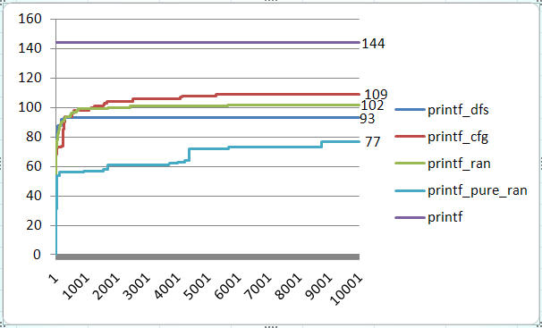
Result -- printf
Experiment setting:
Iterations: 10,000
branches in printf.c : 144
Execution command:
run_crest './busybox '%d123' 0123456789' 10000 -dfs
run_crest './busybox '%d123' 0123456789' 10000 -cfg
run_crest './busybox '%d123' 0123456789' 10000 -random
run_crest './busybox '%d123' 0123456789' 10000 -random_input
Strategy | Time cost (s)
Dfs | 84
Cfg | 41
Random | 40
Pure_random | 30

Slide 8
Symbolic setup in source code for printf
  Two main instruments in busybox printf.c.
    Set 2 symbolic inputs: FORMAT, ARGUMENT.
    Replace library function strchr() by source code.
static void print_direc(char *format, unsigned fmt_length,
int field_width, int precision,
const char *argument)
{
//……
#ifndef CREST
have_width = strchr(format, '*');
#else
have_width = sym_strchr(format, '*');
#endif
//……
}
//……
int printf_main(int argc UNUSED_PARAM, char **argv)
{
int conv_err;
char *format;
char **argv2;
//……
format = argv[1];
argv2 = argv + 2;
int i;
int argcc=strlen(format);
#ifdef CREST
for( i=0 ; i<argcc ; i++){// argcc = 5 due to the fixed input
CREST_char(format[i]);
}
for(i= 0 ; i<10 ; i++){
CREST_char(argv2[0][i]);
}
#endif
//……
}
static char *sym_strchr(const char *str, char ch){
while (*str && *str != ch)
str++;
if (*str == ch)
return str;
return(NULL);
}

Slide 9
Target description -- grep
Description: Search for PATTERN in FILEs (or stdin).
Usage: grep [OPTIONS] PATTERN [FILE]
  OPTIONS includes
  [-1nqvscFiHhf:Lorm:wA:B:C:EaI] (option followed by “:” means one argument is required.)
Example :
  “test_grep.dat” contains
  define
  enifed
  what is defined?
  def ine
  input: busybox grep “define” test_grep.dat
  output: define
  what is defined?
Options:
-H Add 'filename:' prefix
-h Do not add 'filename:' prefix
-n Add 'line_no:' prefix
-l Show only names of files that match
-L Show only names of files that don't match
-c Show only count of matching lines
-o Show only the matching part of line
-q Quiet. Return 0 if PATTERN is found, 1 otherwise
-v Select non-matching lines
-s Suppress open and read errors
-r Recurse
-i Ignore case
-w Match whole words only
-F PATTERN is a literal (not regexp)
-E PATTERN is an extended regexp
-m N Match up to N times per file
-A N Print N lines of trailing context
-B N Print N lines of leading context
-C N Same as '-A N -B N'
-f FILE Read pattern from file

Slide 10
Instrumentation for Concolic Testing
Symbolic variable declaration
  First, identify input variables
  Second, declare these variables as symbolic variable by inserting CREST_<type>(var_name);
    If necessary, additional constraints should be given to restrict symbolic variables to have valid ranges of values
      if (!constraints on var_name) exit(0); shou
Transform complex functions into simpler ones manually, if necessary
  For example, bitwise operators (i.e. &, |, ~) cannot be handled by CREST
    Bitwise operators are replaced by manually made functions containing loops to handle each bit of operands

Slide 11
Symbolic Variable Declaration for grep
PATTERN was not declared as symbolic variables, since grep.c handles PATTERN using external binary libraries
  CREST would not generate new test cases for symbolic PATTERN
  We used a pattern “define”
We use a concrete file “test_grep.dat” as a FILE parameter
Set options as symbolic input (i.e. an array of symbolic character)
  23 different options can be given.
    Specified options are represented by option_mask32, an uint32_t value, of which each bit field indicates one option is ON/OFF.
    Function getopt32(char **argv, const char *applet_opts, …) is used to generate a bit array indicating specified options from command line input.
    We added a bit mask is defined to replace option_mask32, whose type is array of integer. We replace bitwise operators by normal linear integer expressions through additional loops
Set 4 parameters to options as symbolic variables
  Copt, max_matches, lines_before, lines_after.
  Option argument “fopt” is ignored, since it is hard to set file name as symbolic value. “fopt”, the parameter of option “-f” (read pattern form an exist file).

Slide 12
Instrumentation in grep.c
#define BITSIZE 23
int bitmask[23];
int bitopt[23];
int grep_main (int argc UNUSED_PARAM, char **argv)
{
getopt32(argv, OPTSTR_GREP,
&pattern_head, &fopt,
&max_matches, &lines_after,
&lines_before,&Copt);
#ifdef CREST
CREST_int(max_matches);
CREST_int(lines_after);
CREST_int(lines_before);
CREST_int(Copt);
int i;
for(i=BITSIZE-1 ; i>=0 ; i--){
CREST_int(bitmask[i]);
}
#endif
//……
#ifndef CREST
if (option_mask32 & OPT_m)
#else
if (bit_and(bitmask, itobs(OPT_m, bitopt)))
#endif
{
//……
}
//……
}
Notes:
instrumentation

Slide 13
2 Functions Added to Handle Bitwise Operators
Two functions are added to replace “&”. They are bit_and(), itobs().
int* itobs(unsigned long int n, int *bs) translates bit sequence value of an integer into int sequence value, and return this int sequence value.
int bit_and(int *bita, int *bitb) compares bita and bitb, if both two cells in the same position of bita and bitb are not 0, then return 1. Otherwise, return 0.
// bit and each cell of two arrays
//bita is symbolic array, and bitb is constant
// return 0 if the result of bit_and is 0,
// return 1 otherwise
int bit_and(int *bita, int *bitb)
{
int i;
int flag=0;
for(i=0 ; i<BITSIZE ; i++)
{
if(bita[i]!=0 && bitb[i]==1){
flag=1;
}
}
return flag;
}
//convert an unsigned long int variable
// into an array, each cell save value of
//one bit the variable
int* itobs(unsigned long int n, int *bs)
{
int i;
int *temp=bs;
for(i = BITSIZE-1 ; i>=0 ; i--, n=n/2){
bs[i]=n%2;
}
return bs;
}
#define BITSIZE 4
int bitmask[BITSIZE];
int bitopt[BITSIZE];
int main(int a)
{
int output;
bitmask[0]=0;
bitmask[1]=1;
bitmask[2]=0;
bitmask[3]=0;
bitopt= itobs(a, bitopt);
output= bit_and(bitmask, bitopt);
printf(“%d\n”, output);
}

Slide 14
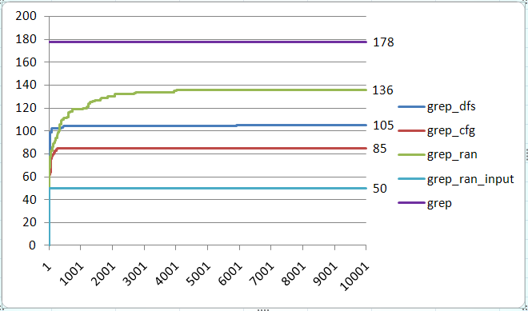
Result of grep
  Experiment 1:
Iterations: 10, 000
branches in grep.c : 178
  Execution Command:
  run_crest './busybox grep "define" test_grep.dat' 10000 -dfs
  run_crest './busybox grep "define" test_grep.dat' 10000 -cfg
  run_crest './busybox grep "define" test_grep.dat' 10000 -random
  run_crest './busybox grep "define" test_grep.dat' 10000 -random_input
Strategy | Time cost (s)
Dfs | 2758
Cfg | 56
Random | 85
Pure_random | 45

Slide 15
Test Oracles
In the busybox testing, we do not use any explicit test oracles
  Test oracle is an orthogonal issue to test case generation
  However, still violation of runtime conformance (i.e., no segmentation fault, no divide-by-zero, etc) can be checked
Segmentation fault due to integer overflow detected at grep 2.0
  This bug was detected by test cases generated using DFS
  The bug causes segmentation fault when
    -B 1073741824 (i.e. 2^32/4)
    PATTERN should match line(s) after the 1st line
    Text file should contain at least two lines
  Bug scenario
    Grep tries to dynamically allocate memory for buffering matched lines (-B option).
    But due to integer overflow (# of line to buffer * sizeof(pointer)), memory is allocated in much less amount
    Finally grep finally accesses illegal memory area

Slide 16
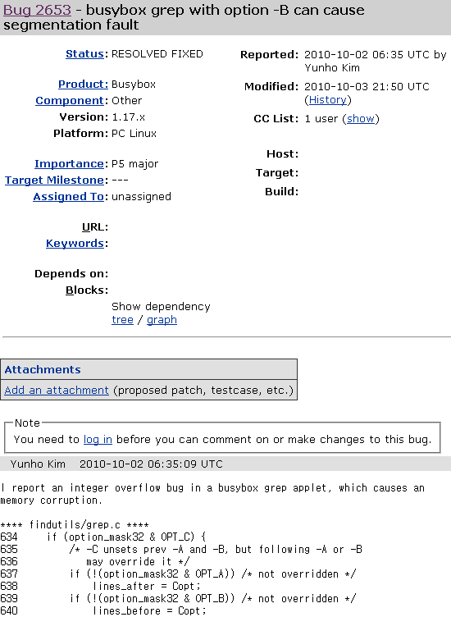
Bug patch was immediately made in 1 day, since this bug is critical one
  Importance: P5 major
    major loss of function
  Busybox 1.18.x will have fix for this bug

Slide 17
Target description -- vi
  Description: Edit FILE
Usage: vi [OPTIONS] [FILE] …
Options:
  -c Initial command to run ($EXINIT also available)
  -R Read-only
  -H Short help regarding available features
Example :
  input: cat read_vi.dat
  test for initial command
  input: cat test_vi.dat
  this is the test for vi
  @#$%&*vi?
  input: ./busybox vi -c ":read read_vi.dat" test_vi.dat
  output:
    this is the test for vi
    test for initial command
    @#$%&*vi?

Slide 18
Symbolic Variable Declaration for vi
We declared a key stroke by a user as a symbolic input character
  Restrict user key input to 50 symbolic characters.
    We modified vi source code so that vi exits after testing 50th key stroke.
Set initial command as symbolic input (initial command is only used when option “-c” is specified).
  Type of initial command is a string (i.e., an array of 17 characters)
Replace 4 library functions with source code: strncmp(), strchr(), strcpy(), memchr().
We used a concrete file “test_vi.dat”

Slide 19
Test Case Extraction
Test case extraction
  A test case consists of concrete values for symbolic variables declared by CREST_<type>(var).
  We stored concrete values of symbolic variables in a test case file
  One TC file is 67 bytes including 17 bytes of an initial command and 50 bytes of key strokes.
Two modifications for extracting test case of vi.c
    In coreuitls/vi.c, store all characters generated by CREST to a test case file -- tc.
    In crest/src/run_crest/concolic_search.cc, provides an iteration number to make test case file has unique name (e.g. a test case generated at 1000’th iteration is named as tc_1000)
//……
static FILE *finput;
int vi_main(int argc, char **argv){
//……
finput=fopen("tc", "w");
//……
}
//……
static void edit_file(char *fn)
{
//……
#ifdef CREST
for(i=0 ; i<strlen(initial_cmds[0]);i++)
{
CREST_char(initial_cmds[0][i]);
putc(initial_cmds[0][i], finput);
}
#endif
//……
}
//……
static int readit(void){
//……
#ifndef CREST
c = read_key(STDIN_FILENO, readbuffer, /*timeout off:*/ -2);
#else
if(count<50){
char ch;
CREST_char(ch);
putc(ch, finput);
c=(int)ch;
count++;
}else {
fclose(finput);
exit(0);
}
#endif
//……
}
void Search::LaunchProgram(const vector<value_t>& inputs) {
WriteInputToFileOrDie("input", inputs);
char name[10];
char cmd[100];
system("mkdir -p results/inputs");
sprintf(name, "tc_%d", num_iters_);
sprintf(cmd, "cp tc results/inputs/%s", name);
system(cmd);
system(program_.c_str());
}
vi.c
concolic_search.cc

Slide 20
4 Functions Added
static int sym_strncmp (const char *first,const char *last,int count)
{
if (!count)
return(0);
while (--count && *first && *first == *last){
first++;
last++;
}
return( *(unsigned char *)first - *(unsigned char *)last );
}
static char *sym_strchr(const char *str, char ch){
while (*str && *str != ch)
str++;
if (*str == ch)
return str;
return(NULL);
}
static char *sym_strcpy(char *to, const char *from)
{
char *save = to;
for (; (*to = *from) != '\0'; ++from, ++to);
return(save);
}
void *sym_memchr(const void* src, int c, size_t count)
{
assert(src!=NULL);
char *tempsrc=(char*)src;
while(count&&*tempsrc!=(char)c)
{
count--;
tempsrc++;
}
if(count!=0)
return tempsrc;
else
return NULL;
}

Slide 21
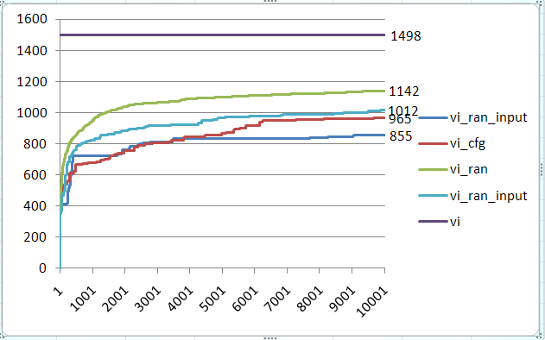
Result of vi
Experiment 1:
Iterations: 10,000
Branches in vi.c : 1498
  Execution Command:
  run_crest './busybox -c ":read read_vi.dat" test_vi.dat' 10000 -dfs
  run_crest './busybox -c ":read read_vi.dat" test_vi.dat' 10000 -cfg
  run_crest './busybox -c ":read read_vi.dat" test_vi.dat' 10000 -random
  run_crest './busybox -c ":read read_vi.dat" test_vi.dat' 10000 -random_input
Strategy | Time cost (s)
Dfs | 1495
Cfg | 1306
Random | 723
Pure_random | 463

Slide 22
Example of Generating/Feeding TCs Together
static FILE *finput; //create a file stream to read from TC
//create a buffer to store TC data
#if ENABLE_APPEND_CHAR
static struct tcbuf{
unsigned char bitmask[BITSIZE];
unsigned char modemask[MODESIZE];
}tcbuf;
#endif
int ls_main(int argc UNUSED_PARAM, char **argv)
{
int i,j;
#if TC_FED //read TC data into buffer
finput=fopen("results/ts/tc_1", "r");
if(finput==NULL){
fprintf(stderr, "Can not open TC file, please check TC path!\n");
exit(0);
}
struct tcbuf tc1;
fread(tc1.bitmask, sizeof(unsigned char), BITSIZE, finput);
fread(tc1.modemask, sizeof(unsigned char), MODESIZE, finput);
fclose(finput);
#endif
//……
#if CREST_TC_GEN
for(i=0 ; i<BITSIZE ; i++){
CREST_unsigned_char(bitmask[i]);
}
fwrite(bitmask, sizeof(unsigned char), BITSIZE, foutput);
#endif
#if TC_FED
memcpy(bitmask, tc1.bitmask, BITSIZE);
option_mask32=bstoi(bitmask, BITSIZE);
#endif
#if ENABLE_APPEND_CHAR
#if CREST_TC_GEN
//source code for tc generation
#endif
#if TC_FED //execute append_char with buffer data
unsigned int mode=bstoi(tc1.modemask, MODESIZE);
#endif
char a = append_char(mode);
#endif
}

