Slide 1
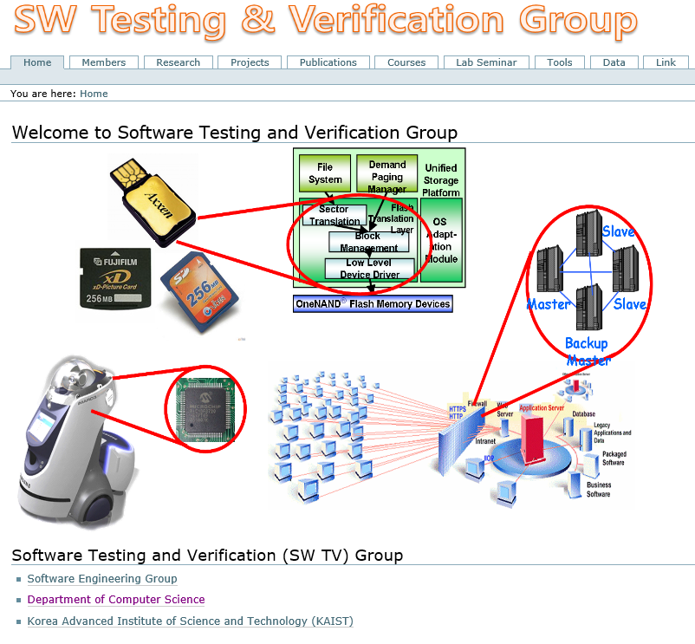
CS492: Automated Software Analysis Techniques
Moonzoo Kim
Software Testing and Verification Group
CS Dept. KAIST

Slide 2
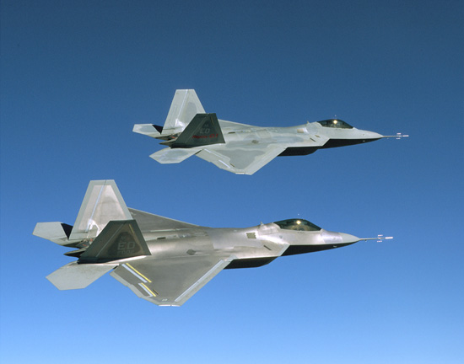
Role of S/W: Increased in Everywhere
F-35 (8 Mloc)
2012년
자료출처: Watts Humphrey 2002

Slide 3
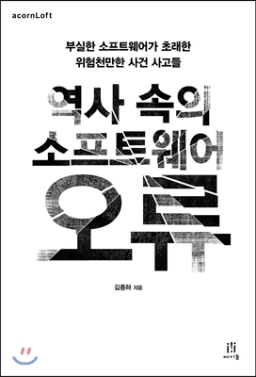
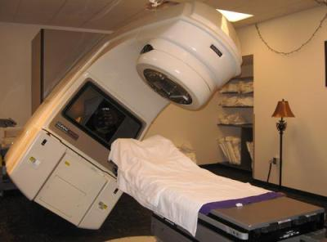
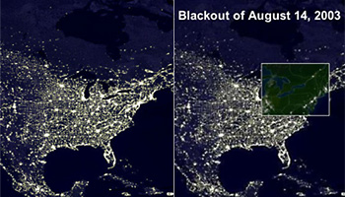
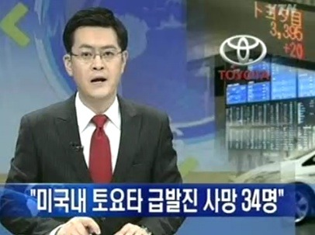
Social and Economic Loss due to High Complexity of SW
Although most areas of modern society depends on SW,
reliability of SW is not improved much due to it high complexity
Medical accident: Therac 25
- For 1985-1987, excessive radio
reactive beam enforced.
- 6 persons died due to the problem
- Data race bug was the cause of
the problem
2003 US & Canada Blackout
7 states in US and 1 state in Canada
suffered 3 days electricity blackout
Caused by the failures of MISO
monitoring SW
50 million people suffered and
economic loss of 6 billion USD
Toyoda SUA (sudden
unintended acceralation)
Dozens of people died
since 2002
SW bugs detected in 2012
Fined 1.2 Billion USD in 2014
Notes:
4차 산업혁명 사회의 핵심은 SW인데요,
SW가 사회 모든 곳에 사용되는 파급성 및 그 유용성에 비해,
SW의 신뢰성, 안전성, 무결성을 검사하는 테스팅 및 검증 기술은 아직 많이 발전해 있지 못합니다.
가장 큰 이유는 SW의 복잡도가 너무 높기 때문에, 요즘 스마트폰에 탑재되는 안드로이드도 몇백만 라인 규모입니다,
SW 테스팅 자체가 굉장히 어려운 일이고 (조금 뒤에 다시 설명드리겠습니다),
그 복잡도를 감당할 수 있는 선진적인 테스팅 기술 연구가 SW의 확대 속도를 따라잡지 못하고 있습니다.
그로 인해 SW 오류로 인한 심각한 사건사고가 꾸준히 있어 왔습니다. 그 중 몇 사례만 말씀드리자면
1985년에 Therac 25라는 방사선 치료기가 race condition SW 오류로 인해 과다 방사선 피폭을 하여 3명이 사망하고 3명이 피폭후유증을 앓게 됬습니다.
2003년에는 상태관측 SW의 오류로 인해 미국 북동부 7개 주와 캐나다 1개주가 3일동안 정전이 됬습니다. 사진에 보시듯이 북동부 지역의 밤에 불빛이 안보이죠?
이로인해 5000만명이 피해를 봤고60억 달러의 경제적 손실을 끼쳤습니다.
3. 가장 최근에는 2014년 토요타 자동타 급발진 사건
수백년 이상 꾸준히 발전한 다른 엔지니어링 분야의 역사에 비해, SW는 너무 짧은 시간에 규모나 복잡도 면에서 급격히 성장을 한 탓에, 그 복잡도에 비해 체계적이고 과학적인 검증 기술의 연구가 미흡한 상태이기 때문입니다.

Slide 4
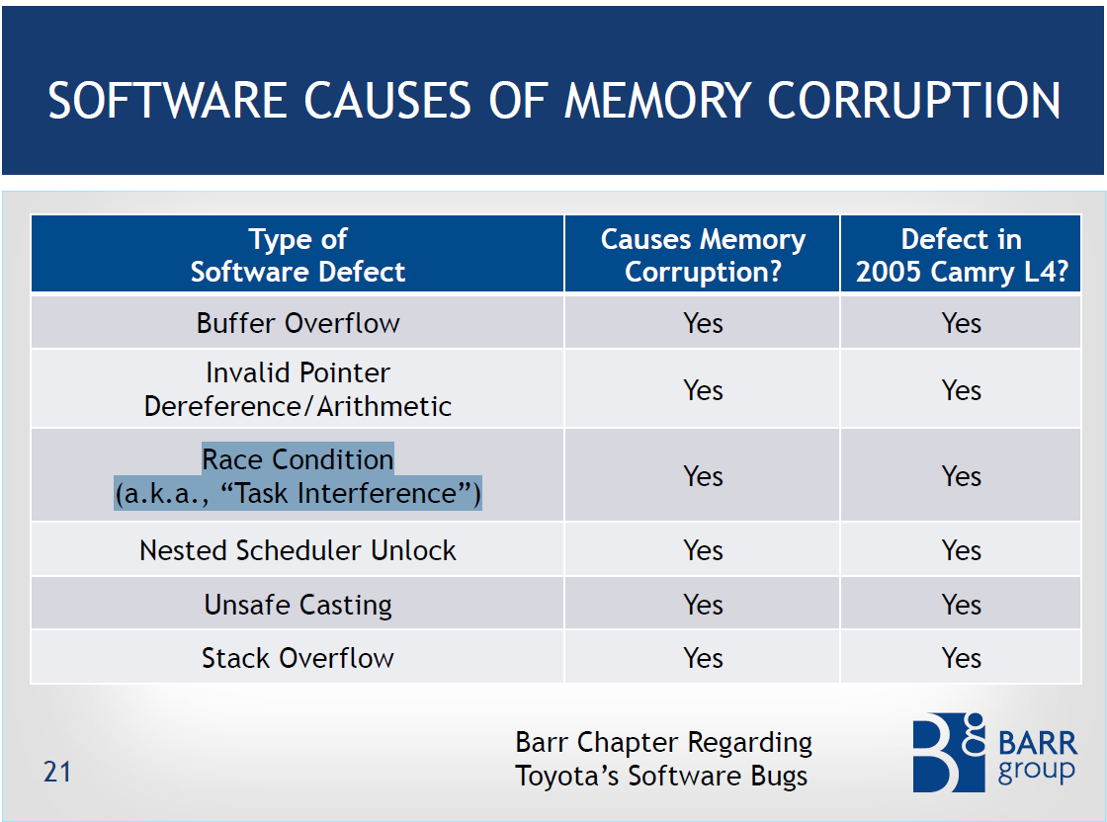
Static analysis falls short of detecting
such complex bugs accurately
High false negatives
High false positives
Systematic and dynamic analysis
(i.e. automated sw testing) is
MUST for high quality SW

Slide 5
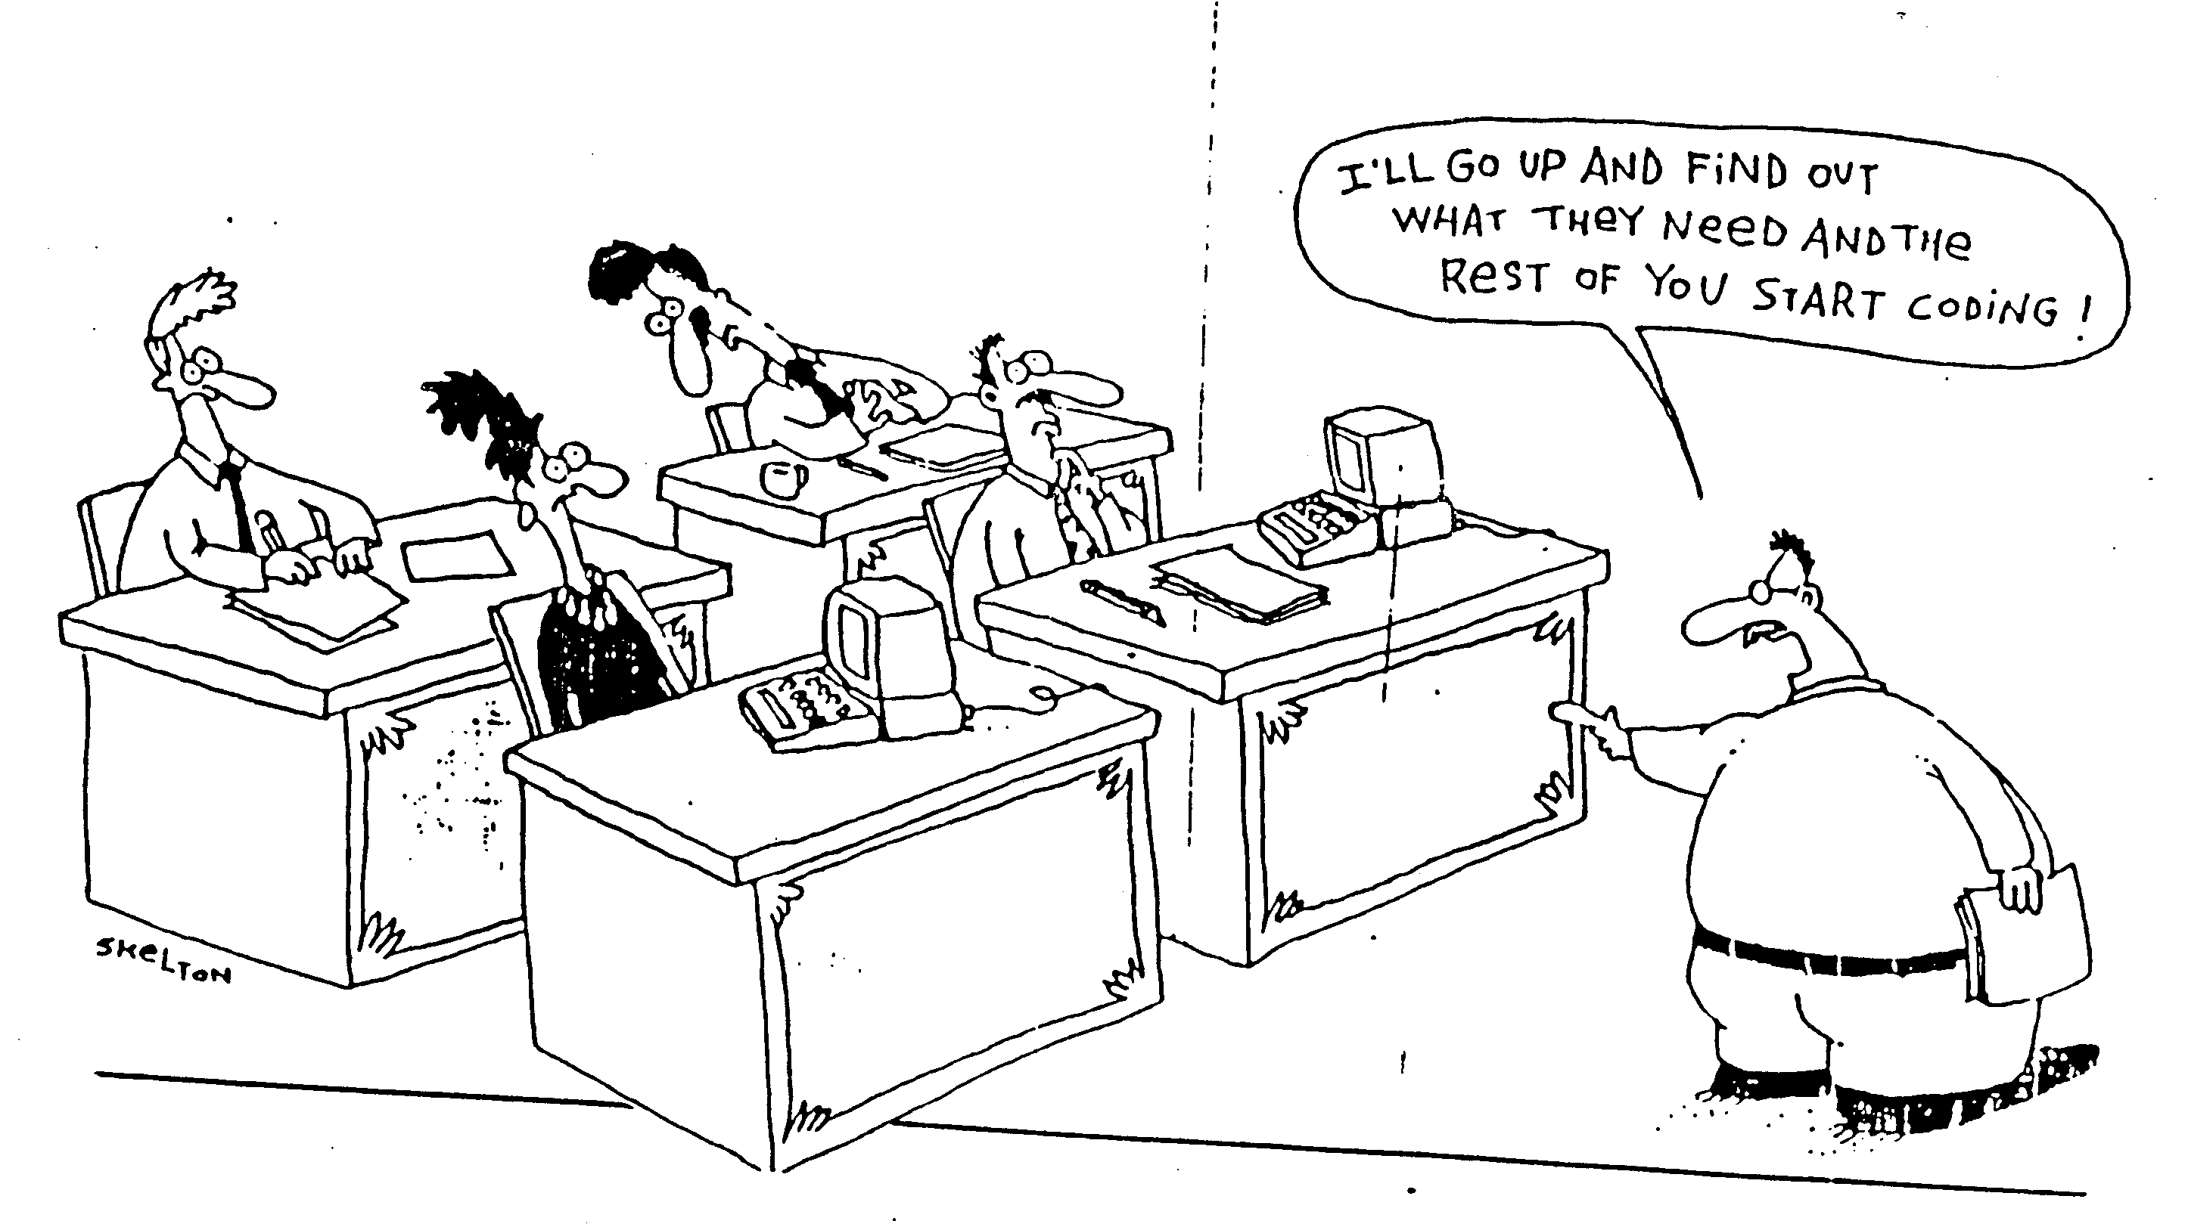
Current Practice for SW
SW developers have to follow systematic disciplines for building and analyzing software with high quality
  This class focuses on the analysis activities
Notes:
-SW development cost takes 35% of total automotive production cost (Software Engineering for Automotive Systems Workshop, 2004)
-Due to complexity for reliable SW, the low productivity causes severe problem

Slide 6
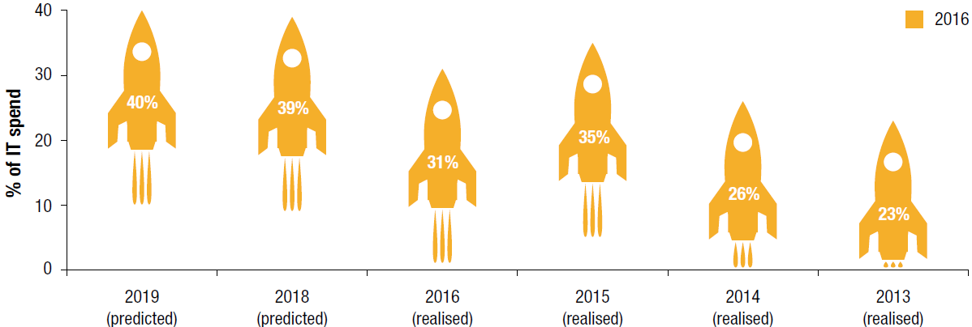
SW Verification & Testing Market Trends
SW verification and testing market: 19.3 Million USD (193억원) @ 2015, annual growth: 15% (expected) [IDC ]
31% of total expenses of IT companies is due to QA and SW testing, increasing to 40% (expected)
[World Quality Report 2016-2017]
Notes:
먼저 세계 SW 검증 시장 동향을 살펴 보겠습니다.
SW 자동 분석 기술은 연구 측면에만이 아니라 사회적/경제적으로 굉장히 중요한 이슈입니다.
SW 검증에 이렇게 많은 비용이 드는 가장 큰 이유는, SW 가 굉장히 복잡해 지기 때문입니다.

Slide 7
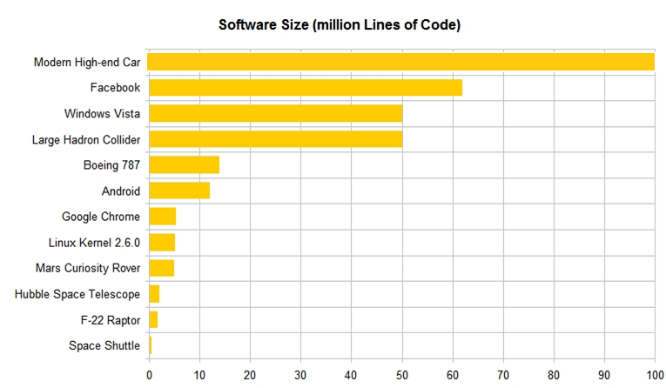
Size and Complexity of Modern SW
A.Busnelli, Counting, https://www.linkedin.com/pulse/20140626152045-3625632-car-software-100m-lines-of-code-and-counting
http://www.informationisbeautiful.net/visualizations/million-lines-of-code/
Notes:
예를 들어서 몇가지 현대 SW의 크기를 살펴 보겠습니다.
문제는, SW의 복잡도는 SW 크기에 선형적이 아니라 지수적으로 증가합니다.
따라서, 40%의 개발 자원을 투입해도 SW 오류를 놓치게 되서, 토요타 급발진 사건 등과 같은 큰 문제가 발생합니다.
이렇게 복잡해진 SW를 개발자가 수작업으로 분석하는 것은 사실상 매우 어렵고 효율적이지 못합니다.
따라서, SW 자동 분석의 중요성이 대두되고 있고, 세계적인 연구 동향도 SW 자동 분석 연구로 집중되고 있습니다.

Slide 8
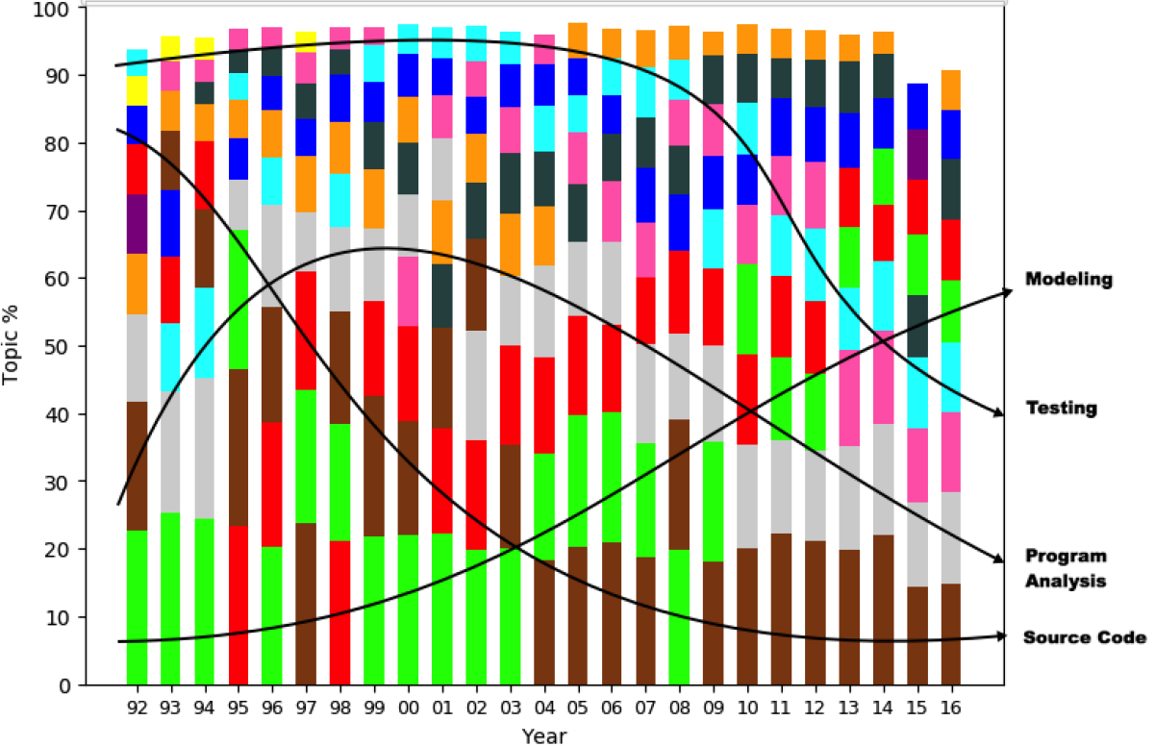
SE Research Topic Trends among 11 Major Topics (1992-2016)
Less papers
per topic
More papers
per topic
G.Mathew et al., Trends in Topics in Software Engineering, IEEE TSE 2018 submission
Notes:
18개 SE 우수학회
36000개 논문 title + abstract

Slide 9
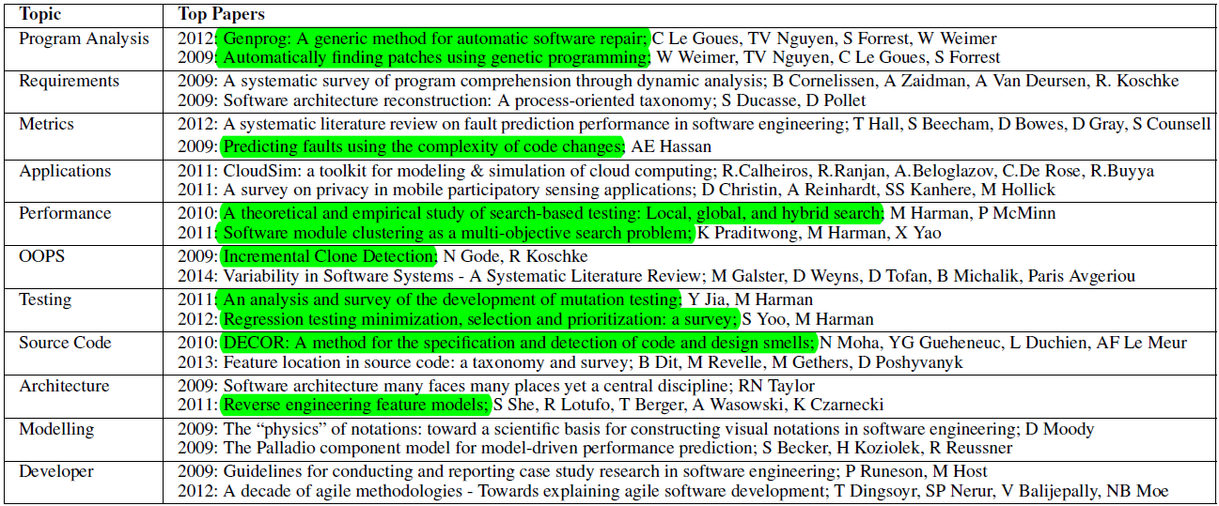
Most Cited Papers in Each of the 11 Major SE Topics
G.Mathew et al., Trends in Topics in Software Engineering, IEEE TSE 2018 submission

Slide 10
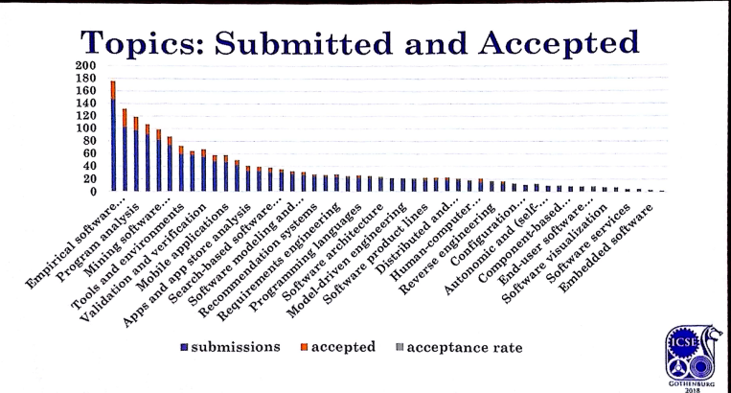
ICSE 2018 Topics
(Top SE conf. w/ accept. rate: 20%)
1. 연구개발의 중요성

Slide 11

Software Development Cycle
A practical end-to-end formal framework for software development
A SW Development Framework for SW with High Assurance
Requirement
analysis
System
design
Design
analysis
Implement-
ation
Testing
Monitoring
Formal
require-
ment
Spec.
Formal
system
modeling
Model
analysis/
verification
Model-
assisted
code
generation
Model-
based
testing
Runtime
monitoring
and
checking

Slide 12
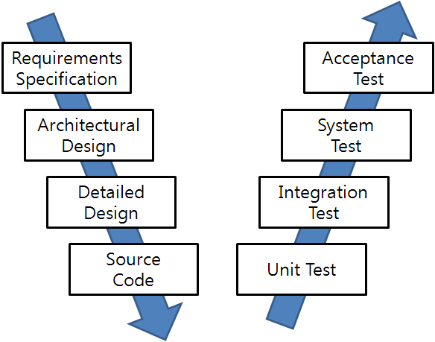
SW Development and Testing Model
(a.k.a. V model)
Manual
Labor
Abstraction

Slide 13
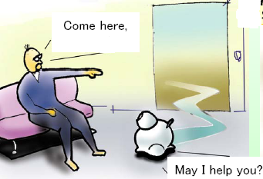
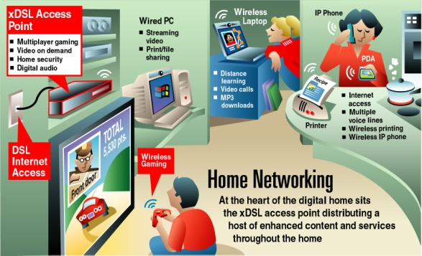
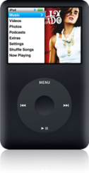
Main Target Systems
Embedded systems where highly reliable SW technology is a key to the success
  The portion of SW in commercial embedded devices increases continuously
  More than 50% of development time is spent on SW testing and debugging
Intelligent Medical Devices
Home Service Robots
Home Network
Intelligent Mobile Systems
Highly Reliable Systems
Notes:
-SW development cost takes 35% of total automotive production cost (Software Engineering for Automotive Systems Workshop, 2004)
-Due to complexity for reliable SW, the low productivity causes severe problem

Slide 14



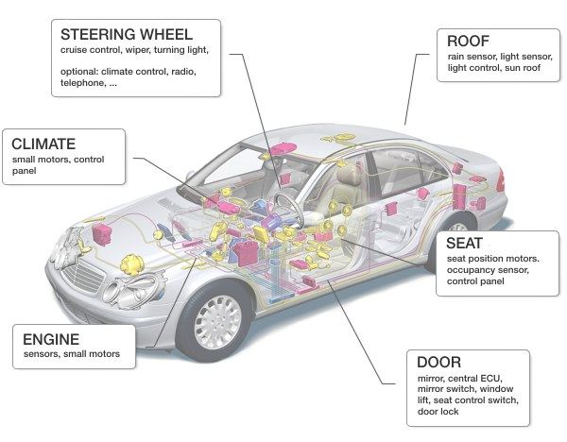
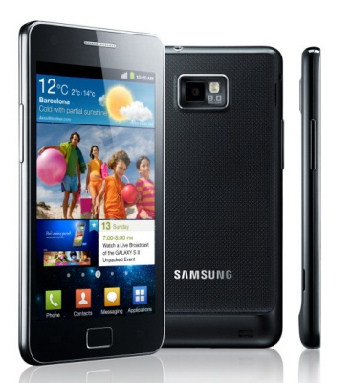
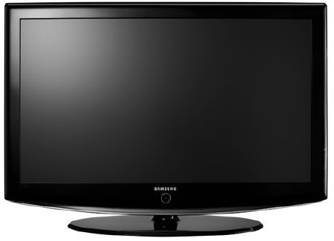
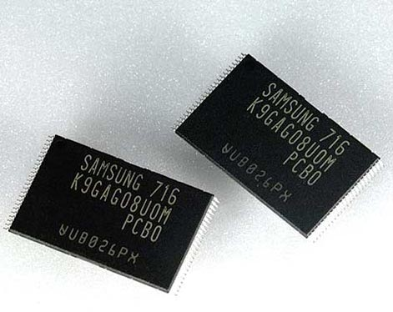
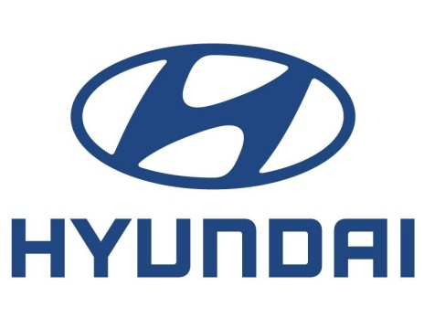

Strong IT Industry in South Korea
Time-to-Market?
SW Quality?
Moonzoo Kim
Notes:
Not method oriented, but problem oriented research

Slide 15
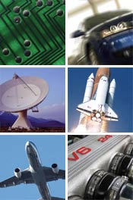
Embedded Software in Two Different Domains
Conventional Testing
Concolic testing
Model checking
 | Consumer Electronics | Safety Critical Systems
Examples | Smartphones, flash memory platforms | Nuclear reactors, avionics, cars
Market competition | High | Low
Life cycle | Short | Long
Development time | Short | Long
Model-based development | None | Yes
Important value | Time-to-market | Safety
Moonzoo Kim
Notes:
Not method oriented, but problem oriented research

Slide 16
How to Improve the Quality of SW
Systematic testing (can be still manual)
  Coverage criteria
  Mutation analysis
Testing through automated analysis tools
  Scientific treatment of SW with computing power
    Generate test inputs to detect bugs
    Localize detected faults
    Repairing the fault with patches
Formal verification
  Guarantee the absence of bugs

Slide 17
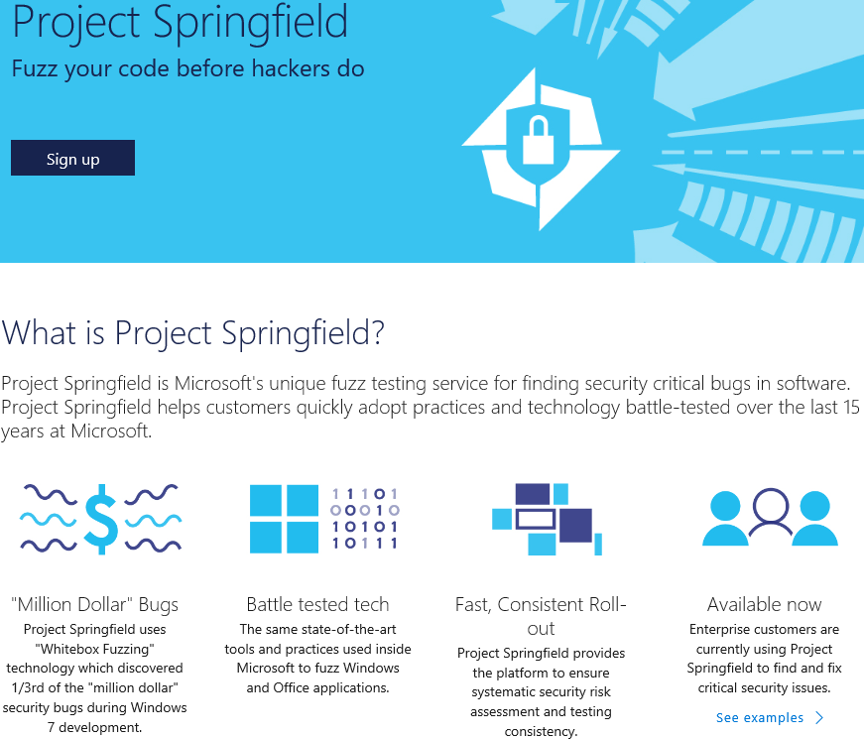
Microsoft Project Springfield
Azure-based cloud service to find security bugs in x86 windows binary
Based on concolic testing techniques of SAGE

Slide 18
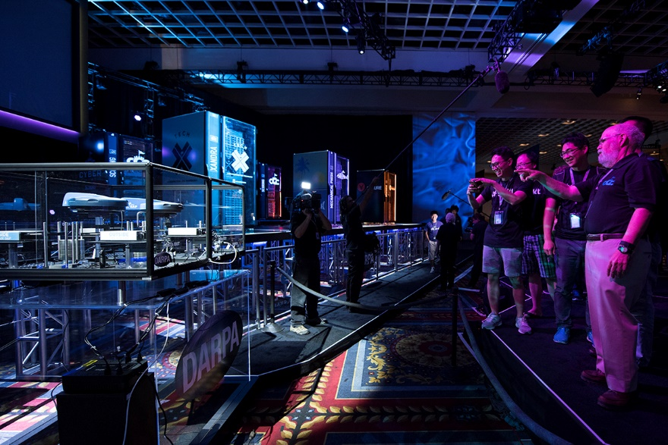
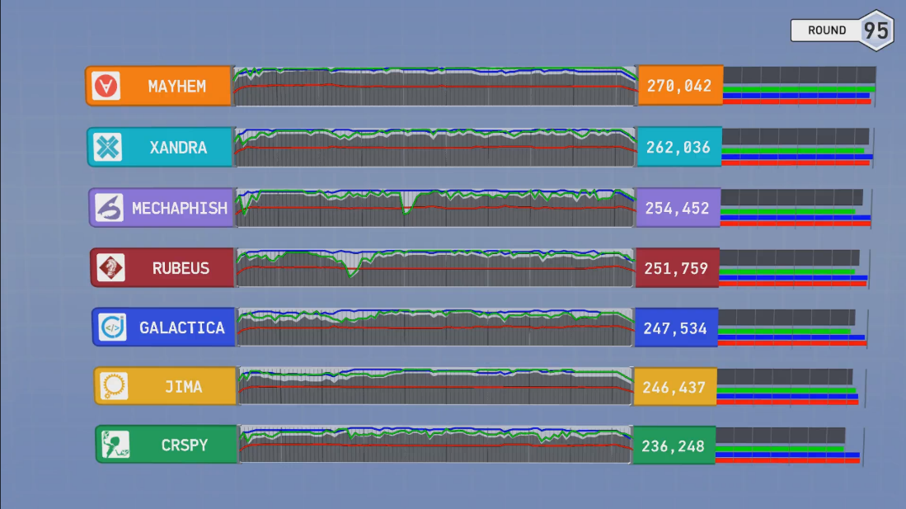
2016 Aug DARPA Cyber Grand Challenge
-the world’s 1st all-machine hacking tournament
Each team’s Cyber Reasoning System automatically identifies security flaws and applies patches to its own system in a hack-and-defend style contest targeting a new Linux-based OS DECREE
Mayhem won the best score, which is CMU’s concolic testing based tool
Notes:
Sendmail crackaddr bug

Slide 19
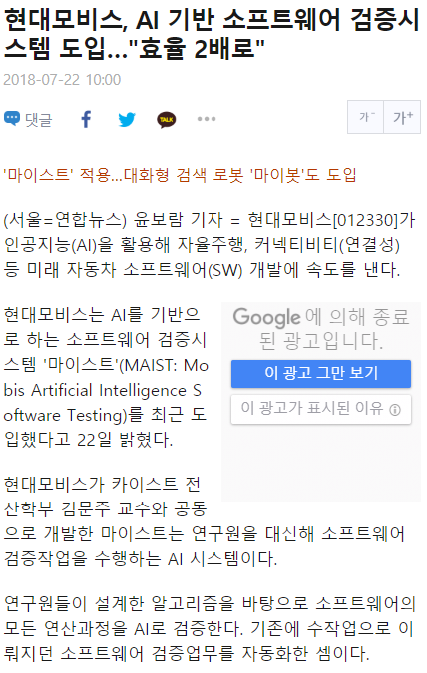
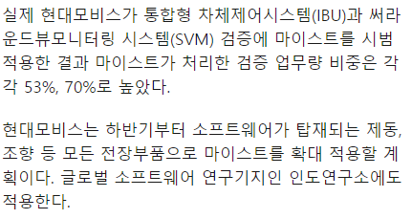
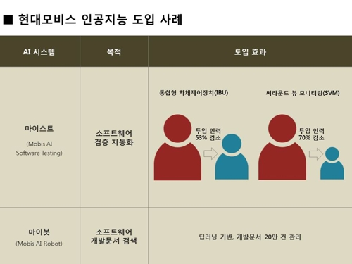
http://m.yna.co.kr/kr/contents/?cid=AKR20180720158800003&mobile

Slide 20
Questions???
Is automated testing really beneficial in industry?
  Yes, dozens of success stories at Samsung
Is automated testing academically significant?
  Yes, 3 Turing awardees in ‘07
Is automated testing too hard to learn and use?
  No, there are tools available

Slide 21
Research Trends toward Quality Systems
Academic research on developing embedded systems has reached stable stage
  just adding a new function to a target system is not considered as an academic contribution anymore
Research focus has moved on to the quality of the systems from the mere functionalities of the systems
  Energy efficient design, ez-maintenance, dynamic configuration, etc
Software reliability is one of the highly pursued qualities
  USENIX Security 2015 best paper
    “Under-Constrained Symbolic Execution: Correctness Checking for Real Code” @ Stanford
  ICSE 2014 best paper
    “Enhancing Symbolic Execution with Veritesting” @ CMU
  ASPLOS 2011 Best paper
    “S2E: a platform for in-vivo multi-path analysis for software systems” @ EPFL
  OSDI 2008 Best paper
    “Klee: Unassisted and Automatic Generation of High-Coverage Tests for Complex Systems Programs” @ Stanford
  NSDI 2007 Best paper
    “Life, Death, and the Critical Transition: Finding Liveness Bugs in Systems Code” @ U.C. San Diego

Slide 22
Tool-based Interactive Learning
Code analyzer
  C/C++ AST parser: Clang
  Language independent Intermediate representation (IR) : LLVM
Model checker
  Explicit model checker: Spin home page
Software model checker
  Bounded model checker for C program: CBMC home page
Satisfiability solver
  MiniSAT home page
Satisfiability Module Solver
  Z3 home page
Concolic testing tools
  CROWN home page

Slide 23
Final Remarks
For undergraduate students:
  Highly recommend URP studies or independent studies
    이아청 detected several crash bugs in Hyundai Mobis SW during 2018 summer interns
For graduate students:
  Welcome research discussions to apply SW analysis techniques
    Systematically testing/debugging C programs
    Concurrency bug detection
Pre-requisite:
  Knowledge of the C/C++/Java programing language
  Basic understanding of linux/unix
  ~6 hours of analysis/programming per week for HW

