Slide 1
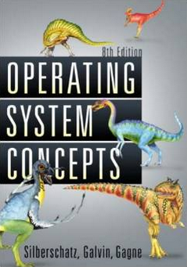
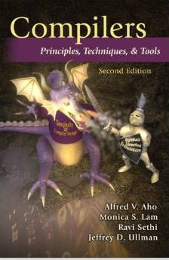

Necessity of Systematic & Automated Testing Techniques
- Fight the Complexity of SW
Moonzoo Kim
SWTV Group CS Dept. KAIST

Slide 2

Testing is a Complex and Challenging task!!!
Object-Oriented Programming, Systems Languages, and Applications, Seattle, Washington, November 8, 2002
“… When you look at a big commercial software company like Microsoft, there's actually as much testing that goes in as development. We have as many testers as we have developers. Testers basically test all the time, and developers basically are involved in the testing process about half the time…”
“… We've probably changed the industry we're in. We're not in the software industry; we're in the testing industry, and writing the software is the thing that keeps us busy doing all that testing.”
“…The test cases are unbelievably expensive; in fact, there's more lines of code in the test harness than there is in the program itself. Often that's a ratio of about three to one.”
Notes:
심지어는 Bill Gate 가 말하길, “MS는 소프트웨어 기업이 아니라, 테스팅 기업” 이라고 까지 말할 정도로 테스팅에 많은 시간, 인원, 비용을 소모하고 있다. 그렇다고 완전한 것도 아니다.
2

Slide 3
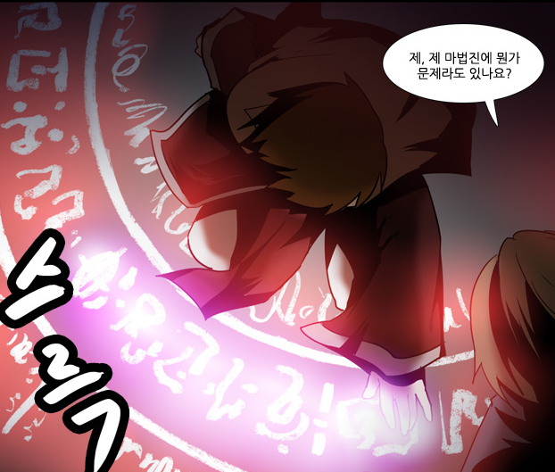
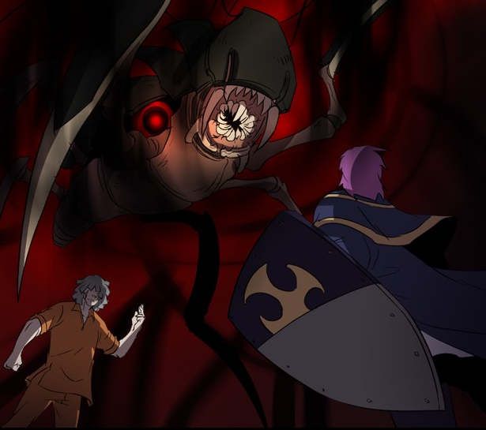
Software v.s. Magic Circle (마법진)
Written by a software developers line by line
Requires programming expertise
SW executes complicated tasks which are far more complex than the code itself
The software often behaves in unpredicted ways and crash occurs
Written by a human magician line by line
Requires magic spell knowledge
Summoned monsters are far more powerful than the magic spell itself
The summoned demon is often uncontrollable and disaster occurs
네이버 웹툰 “그 판타지 세계에서 사는법“ by 촌장

Slide 4
Ex. Testing a Triangle Decision Program
Input : Read three integer values from the command line. The three values represent the length of the sides of a triangle.
Output : Tell whether the triangle is
• 부등변삼각형 (Scalene) : no two sides are equal
• 이등변삼각형(Isosceles) : exactly two sides are equal
• 정삼각형 (Equilateral) : all sides are equal
Create a Set of Test Cases for this program
(3,4,5), (2,2,1), (1,1,1) ?

Slide 5
Precondition (Input Validity) Check
Condition 1: a > 0, b > 0, c > 0
Condition 2: a < b + c
  Ex. (4, 2, 1) is an invalid triangle
  Permutation of the above condition
    a < b +c
    b < a + c
    c < a + b
What if b + c exceeds 2³² (i.e. overflow)?
  long v.s. int v.s. short. v.s. char
Developers often fail to consider implicit preconditions
  Cause of many hard-to-find bugs

Slide 6
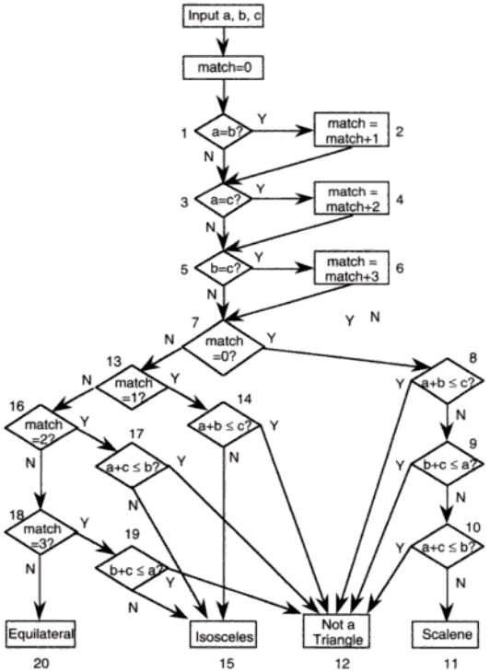
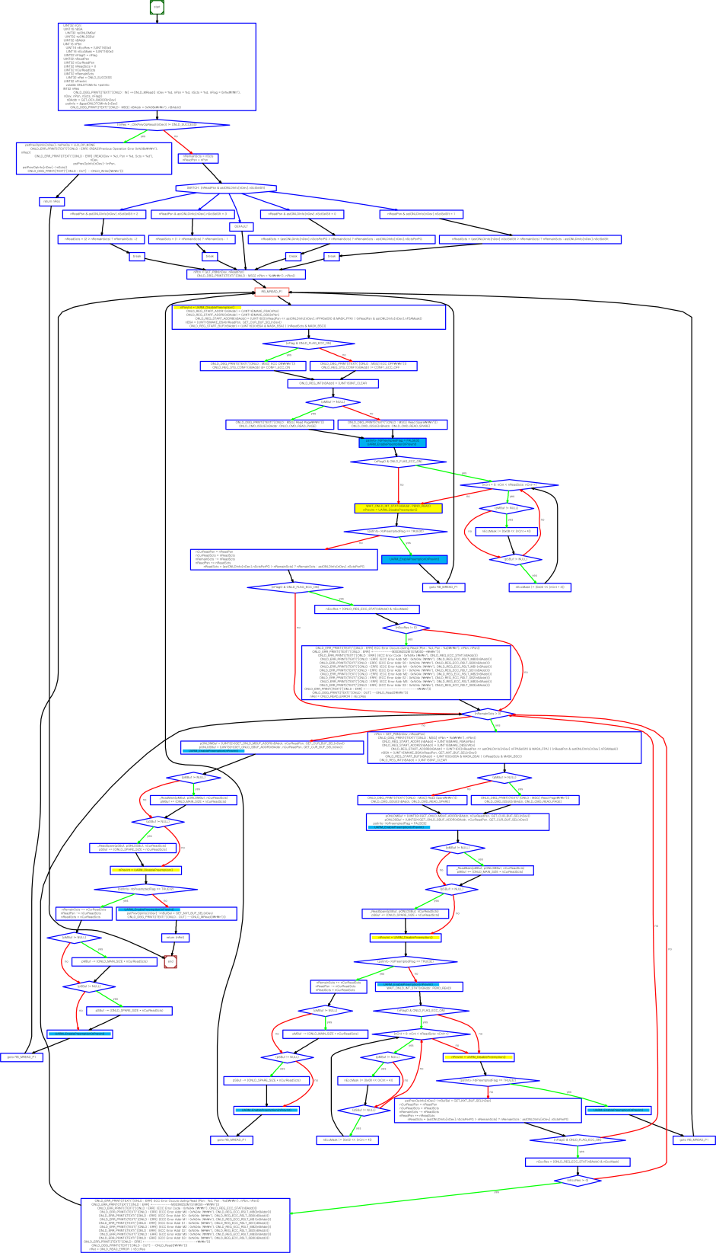
“Software Testing a craftsman’s approach” 2nd ed by P.C.Jorgensen
(no check for positive inputs)
# of test cases required?
  4
  10
  50
  100
# of feasible unique execution paths?
  11 paths
  guess what test cases needed
Notes:
a,b,c = 1,1,1:result=0
a,b,c = 2,1,1:result=2
a,b,c = 2,1,2:result=1
a,b,c = 1,2,1:result=2
a,b,c = 3,2,1:result=2
a,b,c = 2,1,3:result=2
a,b,c = 4,3,2:result=3
a,b,c = 2,3,1:result=2
a,b,c = 3,2,2:result=1
a,b,c = 2,2,1:result=1
a,b,c = 1,1,2:result=2
~

Slide 7
More Complex Testing Situations (1/3)
Software is constantly changing
  What if “integer value” is relaxed to “floating value” ?
    Round-off errors should be handled explicitly
  What if new statements S₁ … S_{n} are added to check whether the given triangle is 직각삼각형 (a right angle triangle)?
    Will you test all previous tests again?
    How to create minimal test cases to check the changed parts of the target program

Slide 8
More Complex Testing Situations (2/3)
Regression testing is essential
  How to select statements/conditions affected by the revision of the program?
  How to create test cases to cover those statements/conditions?
  How to create efficient test cases?
    How to create a minimal set of test cases (i.e. # of test cases is small)?
    How to create a minimal test case (i.e. causing minimal execution time)?
  How to reuse pre-existing test cases?

Slide 9
More Complex Testing Situations (3/3)
However, conventional coverage is not complete
  Ex. Int adder(int x, int y) { return 3;}
    Test case (x=1,y=2) covers all statements/branches of the target program and detects no error
    In other words, all variable values must be explored for complete results
Formal verification aims to guarantee completeness
  Model checking analyzes all possible x, y values through 2⁶⁴ (=2³² x 2³²) cases
  However, model checking is more popular for debugging, not verification

Slide 10
Concurrency
Concurrent programs have very high complexity due to non-deterministic scheduling
Ex. int x=0, y=0, z =0;
  void Thread1() {x=y+1; y=z+1; z= x+1;}
  Void Thread2() {y=z+1; z=x+1; x=y+1;}
  Total 20 interleaving scenarios
    = (3+3)!/(3!x3!)
  However, only 11 unique outcomes
    assert(x+y+z > 5)???
    assert(x+y+z < 15)???
Thread1()
x=y+1
y=z+1
z=x+1
Thread2()
y=z+1
z=x+1
x=y+1
Trail1: 2,1,2
Trail2: 2,1,3
Trail3: 2,2,3
Trail4: 2,3,3
Trail5: 2,4,3
Trail6: 3,2,3
Trail7: 3,2,4
Trail8: 4,3,2
Trail9: 4,3,5
Trail10: 5,4,3
Trail11: 5,4,6
Notes:
x,y,z
2,1,2
2,1,3
2,2,3
2,3,3
2,4,3
3,2,3
4,3,2
4,3,5

Slide 11
An Example of Mutual Exclusion Protocol
char cnt=0,x=0,y=0,z=0;
void process() {
char me=_pid +1; /* me is 1 or 2*/
again:
  x = me;
  If (y ==0 || y== me) ;
  else goto again;
  z =me;
  If (x == me) ;
  else goto again;
  y=me;
  If(z==me);
  else goto again;
  /* enter critical section */
  cnt++;
  assert( cnt ==1);
  cnt --;
  goto again;
}
Process 0
x = 1
If(y==0 || y == 1)
z = 1
If(x == 1)
y = 1
If(z == 1)
cnt++
Process 1
x = 2
If(y==0 || y ==2)
z = 2
If(x==2)
y=2
If (z==2)
cnt++
Software
locks
Critical
section
Violation detected !!!
Mutual
Exclusion
Algorithm
Counter
Example

Slide 12
More Concurrency Bugs
Data race bugs
Atomicity bugs
class Account_DR {
double balance;
// INV:balance should be always non-negative
void withdraw(double x) {
1: if (balance >= x) {
2: balance = balance–x;}
...
}}
class Account_BR {
Lock m;
double balance;
// INV: balance should be non-negative
double getBalance() {
double tmp;
1: lock(m);
2: tmp = balance ;
3: unlock(m);
4: return tmp; }
void withdraw(double x){
/*@atomic region begins*/
11: if (getBalance() >= x){
12: lock(m);
13: balance = balance – x;
14: unlock(m); }
/*@atomic region ends*/
... }
(a) Buggy program code
(a) Buggy program code
[Initially, balance:10]
-th1: withdraw(10)-
1: if(balance >= 10)
2: balance = 0 – 10;
-th2: withdraw(10)-
1: if(balance >= 10)
2: balance = 10-10;
[Initially, balance:10 ]
-th1: withdraw(10)-
11:if(getBalance()>=10)
getBalance()
1:lock(m);
2:tmp = balance;
3:unlock(m);
4:return tmp;
12: lock(m);
13: balance=0 – 10;
14: unlock(m);
-th2 : withdraw(10)-
...
12: lock(m);
13: balance=10–10;
14: unlock(m);
operation block b_{i}
The invariant is violated as
balance becomes -10.
The invariant is violated as
balance becomes -10.
(b) Erroneous execution
(b) Erroneous execution

Slide 13

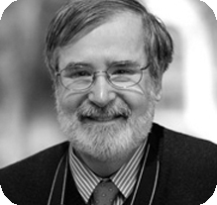
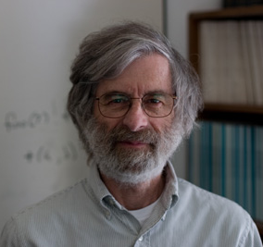
Formal Analysis of Software as a Foundational and Promising CS Research
2007 ACM Turing Awardees
  Prof. Edmund Clarke, Dr. Joseph
  Sipfakis, Prof. E. Allen Emerson
  For the contribution of migrating
  from pure model checking research
  to industrial reality
2013 ACM Turing Awardee
  Dr. Leslie Lamport
  For fundamental contributions to the theory and practice of distributed and concurrent systems
    Happens-before relation, sequential consistency, Bakery algorithm, TLA+, and LaTeX

Slide 14
Significance of Automated SW Testing to Fight SW Complexity
Software has become more ubiquitous and more complex at the same time
Human resources are becoming less reliable and more expensive for highly complex software systems
Computing resources are becoming ubiquitous and free
  Tencent @ China provides 10TB storage free
  Amazon EC2 price: you can use thousands of CPUs @ 0.057$/hr for 3.2Ghz Quad-core CPU
Remaining task?
  To develop automated and scientific software analysis tools to utilize computing resource effectively and efficiently
Notes:
0.057$ *24*365=500$/year

Slide 15
Summary
Software = a large set of unique executions
SW testing = to find an execution that violates a given requirement among the large set
  A human brain is poor at enumerating all executions of a target SW, but computer is good at the task
Automated SW testing
= to enumerate and analyze the executions of SW systematically (and exhaustively if possible)

