Slide 1
Shared Memory Multiprocessing
Jaehyuk Huh
Computer Science, KAIST

Slide 2
Limits of Uniprocessors
Era of uniprocessor improvement: mid 80s to early 2000s
  50% per year performance improvement
  Faster clock frequency at every new generation of technology
    Faster and smaller transistors
    Deeper pipelines
  Instruction-level Parallelism (ILP) : speculative execution + superscalar
  Improved cache hierarchy
Limits of uniprocessors : after mid 2000s
  Increasing power consumption started limiting microprocessor designs
    Limits clock frequency
    Heat dissipation problem
    Need to reduce energy
  Cannot keep increasing pipeline depth
  Diminishing returns of ILP features

Slide 3
Diminishing Returns of ILP
Get harder to extract more ILP → already picked low-hanging fruits of ILP…
Control dependence (imperfect branch prediction)
Slow memory (imperfect cache hierarchy)
Inherent data dependence
Significant increase of design complexity
Performance
Number of Transistors

Slide 4
Efforts to Improve Uniprocessors
More aggressive out-of-order execution cores
  Large instructions window: a few hundreds or even thousands in-flight instructions
  Wide superscalaer → 8 or 16 way superscalar
  Invest large area to increase front-end bandwidth
  Mostly research effort, not yet commercialized → never?
Data-level parallelism (vector processing)
  Bring back traditional vector processors
  New stream computation model
  Apply similar computations to different data elements
  SSE (in x86), Cell processors, GPGPU
Uniprocessor performance is still critical → effort to improve it will continue

Slide 5
Advent of Multi-cores
Aggregate performance of 2 cores with N/2 transistors >> performance of 1 core with N transistors
Performance
Number of Transistors
N/2 transistors
N transistors

Slide 6

Power Efficiency of Multi-cores
For the same aggregate performance
  4 Cores with 600MHz consumes much less power than 2 cores with 1.2GHz
$P_{total}=P_{dynamic}+ P_{static}$
$≈α∙C∙V^{2}∙f+V∙I_{leak}$
Normalized to
3Core 600MHz 100%
Normalized to
3Core 400MHz 100%

Slide 7
Parallelism is the Key
Multi-cores may look like a much better design than a huge single-core processor both for performance and power efficiency
However, there is a pitfall → It assumes the perfect parallelism.
  Performance parallelism: N-core performance == N x 1-core performance
Can we achieve the perfect parallelism always?
If not, what make parallelism imperfect?

Slide 8
Flynn’s Texonomy
Flynn’s classification by data and control (instruction) streams in 1966
Single-Instruction Single-Data (SISD) : Uniprocessor
Single-Instruction Multiple-Data (SIMD)
  Single PC with multiple data → Vector processors
  Data-level parallelism
Multiple-Instruction Single-Data (MISD)
  Doesn’t exist…
Multiple-Instruction Multiple-Data (MIMD)
  Thread-level parallelism
  In many contexts, MIMD = multiprocessors
  Flexible: N multiple programs or 1 programs with N threads
  Cost-effective: same CPU (core) in from uniprocessors to N-core MPs

Slide 9
SIMD and MIMD

Slide 10
Communication in Multiprocessors
How processors communication with each other?
Two models for processor communication
Message Passing
  Processors can communicate by sending messages explicitly
  Programmers need to add explicit message sending and receiving codes
Shared Memory
  Processors can communicate by reading from or writing to shared memory space
  Use normal load and store instructions
  Most commercial shared memory processors do not have separate private or shared memory → the entire address is shared among processors

Slide 11
Message Passing Multiprocessors
Communication by explicit messages
Commonly used in massively parallel systems (or large scale clusters)
  Each node of clusters can be shared-memory MPs
  Each node may have own OS
MPI (Message Passing Interface)
  Popular de facto programming standard for message passing
  Application-level communication library
IBM Blue Gene/L (2005)
  65,536 compute nodes (each node has dual processors)
  360 teraflops of peak performance
  Distributed memory with message passing
  Used relatively low-power, low-frequency processors
  Used MPI

Slide 12
MPI Example
MPI_Comm_size(MPI_COMM_WORLD,&numprocs);
MPI_Comm_rank(MPI_COMM_WORLD,&myid);
if(myid == 0) {
for(i=1;i<numprocs;i++) {
sprintf(buff, "Hello %d! ", i);
MPI_Send(buff, BUFSIZE, MPI_CHAR, i, TAG, MPI_COMM_WORLD);
}
for(i=1;i<numprocs;i++) {
MPI_Recv(buff, BUFSIZE, MPI_CHAR, i, TAG, MPI_COMM_WORLD, &stat);
printf("%d: %s\n", myid, buff);
}
} else {
MPI_Recv(buff, BUFSIZE, MPI_CHAR, 0, TAG, MPI_COMM_WORLD, &stat);
sprintf(idstr, "Processor %d ", myid);
strcat(buff, idstr);
strcat(buff, "reporting for duty\n");
/* send to rank 0: */
MPI_Send(buff, BUFSIZE, MPI_CHAR, 0, TAG, MPI_COMM_WORLD);
}

Slide 13
Shared Memory Multiprocessors
Dominant MP models for small- and medium-sized multiprocessors
Single OS for all nodes
Implicit communication by loads and stores
  All processors can share address space → can read from or write to any location
  Arguably easier to program than message passing
Terminology: UMA vs NUMA
  UMA (Uniform Memory Access Time) : centralized memory MPs
  NUMA (Non Uniform Memory Access Time) : distributed memory MPs
What happens to caches?
  Caches can hold copies of the same address
  How to make them coherent → Cache Coherence Problem
This class will focus on shared memory MPs

Slide 14
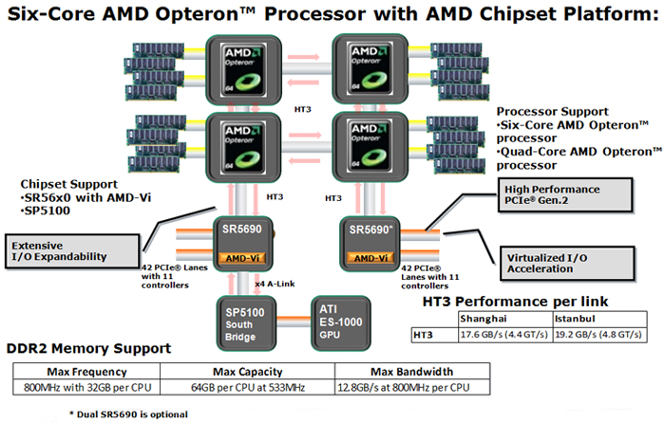
Comtemporary NUMA Multiprocessors
Contemporary NUMA

Slide 15
Shared Memory Example: pthread
int arrayA [NUM_THREADS*1024]
int arrayB [NUM_THREADS*1024]
int arrayC [NUM_THREADS*1024]
void *sum(void *threadid) {
long tid;
tid = (long)threadid;
for (i = tid; i < tid*1024; i++) {
arrayC[i] = arrayA[i] + arrayB[i];
}
pthread_exit(NULL);
}
int main (int argc, char *argv[]) {
...
for(t=0; t<NUM_THREADS; t++){
pthread_create(&threads[t], NULL, psum, (void *)t);
}
for(t=0; t<NUM_THREADS; t++){
pthread_join(threads[i],NULL);
}
}

Slide 16
Shared Memory Example: OpenMP
int arrayA [NUM_THREADS*1024]
int arrayB [NUM_THREADS*1024]
int arrayC [NUM_THREADS*1024]
#pragma omp parallel default(none) shared(arrayA,arrayB,arrayC) private(i)
{
#pragma omp for
for (i=0; i<NUM_THREADS*1024; i++)
arrayC[i] = arrayA[i] + arrayB[i];
} /*-- End of parallel region --*/

Slide 17
Performance Goal => Speedup
SpeedupN = ExecutionTime₁ / ExecutionTime_{N}
Ideal scaling: performance improve linearly with the number of cores

Slide 18
What Hurt Parallelism?
Lack of inherent parallelism in applications
  Amdahl’s law
Unbalanced load in each core (thread)
Excessive lock contention
High communication costs
Ignoring limitation of memory systems

Slide 19
Limitation of Parallelism
How much parallelism is available?
  There are some computations hard to parallelize
Example: what fraction of the sequential program can be parallelized?
  Want to achieve 80% speedup with 100 processors,
  Use Amdahl’s Law
  Fraction_{parallel} = 0.9975

Slide 20

Simulating Ocean Currents
(a) Cross sections
(b) Spatial discretization of a cross section
Model as two-dimensional grids
  Discretize in space and time
  finer spatial and temporal resolution => greater accuracy
Many different computations per time step
    set up and solve equations
  Concurrency across and within grid computations
Static and regular

Slide 21
Limited Concurrency: Amdahl’s Law
If fraction s of seq execution is inherently serial,
speedup <= 1/s
Example: 2-phase calculation
  sweep over n-by-n grid and do some independent computation
  sweep again and add each value to global sum
Time for first phase = n²/p
Second phase serialized at global variable, so time = n²
Speedup <= or at most 2
Trick: divide second phase into two
  accumulate into private sum during sweep
  add per-process private sum into global sum
Parallel time is n²/p + n2/p + p, and speedup at best
2n²
n²
+ n²
p
2n²
2n² + p²

Slide 22
Understanding Amdahl’s Law
1
(a)
n²
n²
p
work done concurrently
1
(b)
n²/p
n²
p
1
(c)
Time
n²/p
n²/p
p

Slide 23
Load Balance and Synchronization
Speedup _{problem}(p) <
Sequential Work
Max Work on any Processor
P₀
P₀
P₁
P₁
P₂
P₂
P₃
P₃
Instantaneous load imbalance revealed as wait time
  at completion
  at barriers
  at flags, even at mutex
Sequential Work
Max (Work + Synch Wait Time)

Slide 24
Improving Load Balance
Decompose into more smaller tasks (>>P)
Distribute uniformly
  variable sized task
  randomize
  bin packing
  dynamic assignment
Schedule more carefully
  avoid serialization
  estimate work
  use history info.
P
0
P
1
P
2
P
4

Slide 25
Example: Barnes-Hut
Divide space into roughly equal # particles
Particles close together in space should be on same processor
Nonuniform, dynamically changing

Slide 26
Dynamic Scheduling with Task Queues
Centralized versus distributed queues
Task stealing with distributed queues
  Can compromise comm and locality, and increase synchronization
  Whom to steal from, how many tasks to steal, ...
  Termination detection
  Maximum imbalance related to size of task

Slide 27
Impact of Dynamic Assignment
Barnes-Hut on SGI Origin 2000 (cache-coherent shared memory):

Slide 28
Lock Contention
Lock: low-level primitive to regulate access to shared data
  acquire and release operations
  Critical section between acquire and release
  Only one process is allowed in the critical section
Avoid data race condition in parallel programs
  Multiple threads access a shared memory location with an undetermined
  accessing order and at least one access is write
  Example: what if every thread executes total_count += local_count, when
  total_count is a global variable? (without proper synchronization)
Writing highly parallel and correctly synchronized programs is difficult
  Correct parallel program: no data race → shared data must be protected by locks

Slide 29
Coarse-Grain Locks
Lock the entire data structure → correct but slow
+ Easy to guarantee the correctness: avoid any possible interference by multiple threads
- Limit parallelism: only a single thread is allowed to access the data at a time
Example
  struct acct_t accounts [MAX_ACCT]
  acquire (lock);
  if (accounts[id].balance >= amount) {
  accounts[id].balance -= amount;
  give_cash();
  }
  release (lock)

Slide 30
Fine-Grain Locks
Lock part of shared data structure → more parallel but difficult to program
+ Reduce locked portion by a processor at a time → fast
- Difficult to make correct → easy to make mistakes
- May require multiple locks for a task → deadlocks
Example
  struct acct_t accounts [MAX_ACCT]
  acquire (accounts[id].lock);
  if (accounts[id].balance >= amount) {
  accounts[id].balance -= amount;
  give_cash();
  }
  release (accounts[id].lock)

Slide 31
Cache Coherence
Primary communication mechanism for shared memory multiprocessors
Caches keep both shared and private data
  Shared data: used by multiple processors
  Private data: used by single processors
  In shared memory model, usually cannot tell whether an address is private or shared.
Data block can be any caches in MPs
  Migration: moved to another cache
  Replication: exist in multiple caches
  Reduce latency to access shared data by keeping them in local caches
Cache coherence
  make values for the same address coherent

Slide 32
HW Cache Coherence
SW is not aware of cache coherence
  HW may keep values of the same address in multiple caches or the main memory
  HW must support the abstraction of single shared memory
Cache coherence → communication mechanism in shared memory MPs
  Processors read from or write to local caches to share data
  Cache coherence is responsible for providing the shared data values to processors
Good cache coherence mechanisms
  Need to reduce inter-node transactions as much as possible → i.e. need to keep useful cache-blocks in local caches as long as possible
  Need to provide fast data transfer from producer to consumers

Slide 33
Coherence Problem
Data for the same address can reside in multiple caches
A processor updates its local copy of the block → write must propagate through the system
P
P
P
1
2
3
u
= ?
u
= ?
3
$
4
$
5
$
u
u
:5
u
= 7
:5
1
I/O devices
u
:5
2
Memory
  Processors see different values for u after event 3

Slide 34
Propagating Writes
Updated-based protocols
  All updates must be sent to the other caches and the main memory
  Send writes for each store instruction → huge write traffics through the networks to other caches
  Can make producer-consumer communication fast
Invalidation-based protocols
  To update a block, send invalidations to the other caches
  Writer’s copy : modified (dirty state)
  Other copies : invalidated
  If other caches access the invalidated address → cause a cache miss and writer (or memory) must provide the data
  Used in most of commercial multiprocessors

Slide 35
Update-based Protocols
Wasting huge bandwidth
  Temporal locality of writes: may send temporary updates (only the final write need to be seen by others)
  Updated block in other caches may not be used
  Takes long to propagate write since actual data must be transferred
P
P
P
1
2
3
3
$
$
$
u
:5
u: 7
u
:5
u
= 7
1
u: 7
I/O devices
u
:5
2
Memory

Slide 36
Invalidation-based Protocols
Send only invalidation message with command/address
No data are transferred for invalidation
Data are transferred only when needed
  Save network and write traffics to caches
  May slow down producer-consumer communication
P
P
P
1
2
3
3
$
$
$
u
:5
invalidation
u
:5
u
= 7
1
?
I/O devices
u
:5
2
Memory

Slide 37
False Sharing
Unit of invalidation: cache blocks
  Even if only part of cache block is updated → need to invalidate the entire block
What if two processors P1 and P2 read and write different parts of the same cache block?
  P1 and P2 may repeatedly invalidate
  cache blocks in the caches
  Known as false sharing
Solution
  Programmers can align data structure properly to avoid false sharing
P2 read and write this word
1
2
3
4
P1 read and write this word

Slide 38
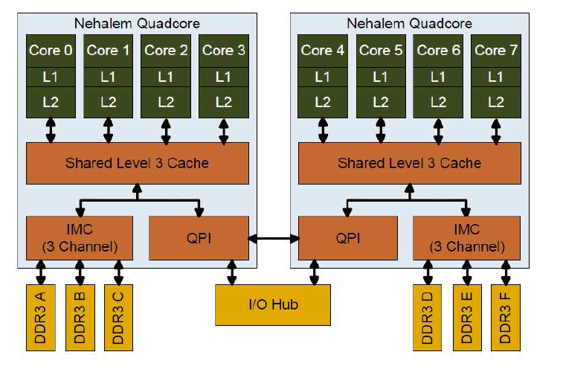
Understanding Memory Hierarchy
Idealized view: local cache hierarchy + single main
memory
But reality is more complex
  Centralized Memory: caches of other processors
  Distributed Memory: some local, some remote + network topology
  Levels closer to processor are lower latency and higher bandwidth

Slide 39
Exploiting Temporal Locality
Structure algorithm so working sets map well to hierarchy
  often techniques to reduce inherent communication do well here
  schedule tasks for data reuse once assigned
Multiple data structures in same phase
  e.g. database records: local versus remote
Solver example: blocking
(a) Unblocked access pattern in a sweep
(b) Blocked access pattern with B = 4
  More useful when O(n^{k+1}) computation on O(n^{k}) data
  Many linear algebra computations (factorization, matrix multiply)

Slide 40
Exploiting Spatial Locality
Besides capacity, granularities are important:
  Granularity of allocation
  Granularity of communication or data transfer
  Granularity of coherence
Major spatial-related causes of artifactual communication:
  Conflict misses
  Data distribution/layout (allocation granularity)
  False sharing of data (coherence granularity)
All depend on how spatial access patterns interact with data structures
  Fix problems by modifying data structures, or layout/alignment

