Slide 1
Data Race Detection Technique
CS492B Analysis of Concurrent Programs
Prof. Moonzoo Kim
Computer Science, KAIST

Slide 2
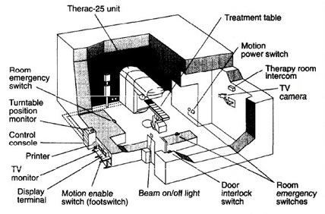
Race Condition in Multithreaded Program
A multithreaded program has a race condition if (1) execution order of certain operations are not fixed, and (2) their execution results are decided by their non-deterministic execution orders.
Race conditions sometime cause serious errors in SW
e.g. Radiation therapy machine: Therac-25
Q: Is a race condition always problematic?

Slide 3
Harmful Race Condition
Ex. Parallel adder
Has a race condition?
Is this race condition harmful?
long cnt=0 ;
long arr[100] ;
long sum1=0, sum2=0;
main() {
read(arr, 100) ;
start(work, &sum1);
start(work, &sum2);
print(sum1 + sum2) ;
}
work(long * sum) {
while (cnt < 100) {
*sum += arr[cnt] ;
cnt++ ;
}
}

Slide 4
Not Harmful Race Condition
Ex. Seminar room reservation system
1 service() {
2 input(&room, &timeslot) ;
3 if(isAvailable(room, timeslot){
4 print(“available. continue?”) ;
5 input(&continue) ;
6 if(continue)
7 if(reserve(room, timeslot))
8 print(“reserved.”) ;
9 else
10 print(“not available.”) ;
11 } }
Is this race condition harmful?
User#1: “Rm01”, “7PM Today”
System: available. continue?
User#1: “Yes”
System: not available.
User#2: “Rm01”, “7PM Today”
System: available. continue?
User#2 “yes”
System: reserved.

Slide 5
Race Bug
A race bug is a multithreaded program fault that causes race conditions leading to unintended program behaviors (i.e. invalid states)
Race bug detectors detect (predict) race conditions that may violate common concurrency requirements

Slide 6
Data Race
A data race is a pair of concurrent operations that read and write (or both write) data on a same memory location without synchronization (i.e., concurrently without any coordination)
A data race may violate sequential consistency* of a target program execution
* L. Lamport: How to Make a Multiprocessor Computer That Correctly Executes Multiprocess Programs, IEEE Transactions on Computers, 1978

Slide 7
Sequential Consistency
Lamport’s definition
“A multiprocessor is sequentially consistent if the result of any execution is the same as if the operations of all the processors were executed in some sequential order,
and the operations of each individual processor occur in this sequence in the order specified by its program”
Most intuitive consistency model for programmers
Processors see their own loads and stores in program order
Processors see others’ loads and stores in program order
All processors see same global load and store ordering
Excerpts from the Prof. Huh’s lecture note on “Consistency”

Slide 8
Sequential Consistency
initially flag = 0
Processor 1 Processor 2
Store (a), 10; L: Load r1, (flag);
Store (flag), 1; if r₁ == 0 goto L;
Load r2, (a);
In-order instruction execution
Atomic loads and stores
A SC preserved program is easy to understand but architects and compiler writers want to violate it for performance

Slide 9
Data Race Example
class Account {
1 long balance; //must be non-negative
2 void withdraw(long x){
3 if(balance >= x){
4 synchronized(this){
5 balance=balance–x ;
6 }
7 }
8 }
}
Initially, balance:10
-t1: withdraw(10) –
3 if(balance>=10)
4 lock(this)
5 t = balance
5 balance=t–10
6 unlock(this)
-t2: withdraw(5) –
3 if(balance>=5)
4 lock(this)[blocked]
4 lock(this)
5 t = balance
5 balance=t–5
6 unlock(this)
10
balance:
0? 10?
0
balance: -5

Slide 10
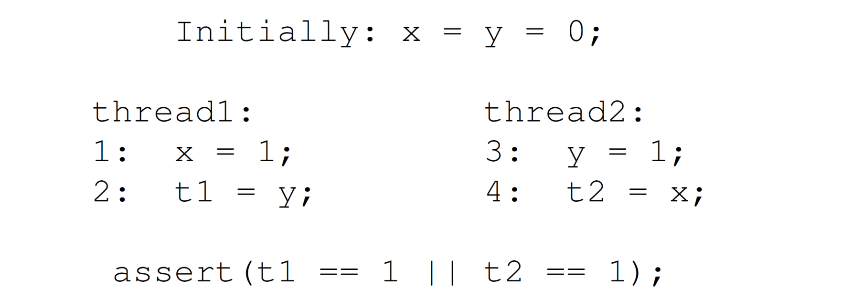
Data Race Breaks Sequential Consistency
Delayed update
Out-of-order
execution
Out-of-order
execution
Does the assertion hold with SC memory model?
Does the assertion hold with weak memory model?
* J. Burnim, K. Sen, C. Stergiou: Testing concurrent programs on relaxed memory models. ISSTA 2011

Slide 11
Why is Data Race Harmful? (1/2)
Sometimes developers intentionally induce data races for efficient read on shared variables (benign race or dirty read)
e.g. test-test-and-set pattern
if(balance>=x){
synchronized(this){
if(balance>=x){
balance=balance–x ;
}
}
* H. J. Boehm: Nondeterminism is unavoidable, but data races are pure evil, RACES Workshop, 2012

Slide 12
Why is Data Race Harmful? (2/2)
However, data races are harmful in most cases
Execution results are (almost) unpredictable with weak memory models
Compilers may reorder statements around data races*
Performance benefit of benign race is really marginal*
It is bad for maintenance
* H. J. Boehm: Nondeterminism is unavoidable, but data races are pure evil, RACES Workshop, 2012

Slide 13
Data Race Detection (prediction)
Data races are notoriously difficult to detect
Unlike deadlock, the program behavior change by a data race may not be noticeable to users
Data races induce errors only under specific thread schedules
There are too many shared variables
There have been two approaches:
Happens-before based detection technique
Lockset algorithm based detection technique

Slide 14
Happens-Before Example
Initially, balance: 10
class Account {
long balance; //must be non-negative
void withdraw(long x){
1 if(balance >= x){
2 synchronized(this){
3 balance=balance–x;
4 }
5 }
}
void deposit(long x){
11 synchronized(this){
12 balance=balance+x;
13 }
}
}
t1: deposit(10)
t2: withdraw(15)
Which execution order is by program/sync?
Which is by chance?
11:lock(this)
12:t=balance
12:balance=t+10
12:balance=t+10
12:balance=t+10
13:unlock(this)
20
1:if(balance>=15)
1:if(balance>=15)
2:lock(this)
3:t=balance
3:t=balance
3:balance=t-15
4:unlock(this)

Slide 15
Happens-before Relation (1/2)
The happens-before relation $≺$is a smallest relation over operations in an execution that satisfies the following conditions:
(1) $a≺b$ when $a$ and $b$ are executed by the same thread, and $a$ comes before $b$
(2) $a≺b$ when $a$ and $b$ are ordered by the same synchronization entity, and $a$ comes before $b$ (e.g. lock, wait/notify, join)
(3) If $a≺b$ and $b≺c$ then $a≺c$
→ $a$ and $b$ are concurrent if $a⊀b$ and $b⊀a$

Slide 16
Happens-before Relation (2/2)
Leslie Lamport (Microsoft research)
Winner of the 2013 Turing award for advances in reliability of distributed/ concurrent systems
Happens-before relation, sequential consistency, Bakery algorithm, TLA+, and LaTeX
http://amturing.acm.org/
http://research.microsoft.com/apps/video/default.aspx?id=210551

Slide 17

Happens-Before Example
Initially, balance: 10
class Account {
long balance; //must be non-negative
void withdraw(long x){
1 if(balance >= x){
2 synchronized(this){
3 balance=balance–x;
4 }
5 }
}
void deposit(long x){
11 synchronized(this){
12 balance=balance+x;
13 }
}
}
t1: deposit(10)
t2: withdraw(15)
p₁
11:lock(this)
p₂
12:t=balance
p₃
12:balance=t+10
12:balance=t+10
p₄
13:unlock(this)
q₁
1:if(balance>=15)
1:if(balance>=15)
(1) $a≺b$ when $a$ and $b$ are executed by the same thread, and $a$ comes before $b$
E.g. p₁ $≺$ p₂, p₁ $≺$ p₃, p₁ $≺$ p₄
(2) $a≺b$ when $a$ and $b$ are ordered by the same lock, and $a$ comes before $b$
E.g. p₁ $≺$ q₂
(3) If $a≺b$ and $b≺c$ then $a≺c$
E.g. p₁ $≺$ q₂ $∧$ q₂ $≺$ q₃ $→$ p₁ $≺$ q₃
q₂
2:lock(this)
q₃
3:t=balance
q₄
3:balance=t-15
q₅
4:unlock(this)
Notes:
data race detected by using the happens-before relation based detection techniques

Slide 18
Happens-before Based Detection (1/2)
The pair of operations $a$ and $b$ is data race if all of the following conditions hold:
(1) $a$ and $b$ access the same variable, and
(2) at least one operation is writing, and
(3) $a⊀b$ and $b⊀a$
Several tools such as MultiRace¹ and FastTrack² use this definition for data race detection
¹ E. Pozniansky et al.: MultiRace: Efficient on-the-fly data race detection in multithreaded C++ programs, PPoPP, 2003
² C. Flanagan et al.: FastTrack: Efficient and Precise Dynamic Race Detection, PLDI, 2009

Slide 19
Another Execution Scenario
Initially, balance: 10
class Account {
long balance; //must be non-negative
void withdraw(long x){
1 if(balance >= x){
2 synchronized(this){
3 balance=balance–x;
4 }
5 }
}
void deposit(long x){
11 synchronized(this){
12 balance=balance+x;
13 }
}
}
t1: deposit(10)
t2: withdraw(5)
1:if(balance>=5)
1:if(balance>=5)
2:lock(this)
3:t=balance
3:balance=t-5
4:unlock(this)
11:lock(this)
12:t=balance
12:balance=t+10
12:balance=t+10
13:unlock(this)
Notes:
No data race detected by using the happens-before relation based detection techniques

Slide 20
Happens-before Based Detection (2/2)
Happens-before relation provides precise reasoning of concurrency of operations
However, these techniques may or may not detect data races depending on observed execution scenario (i.e., false negative)
In addition, tracking happens-before relation induces heavy runtime overhead

Slide 21
Lockset Based Data Race Detection
Lock discipline
Every access to a shared variable MUST be guarded by at least one lock consistently
Dynamic data race detector Eraser [Savage, SOSP 97]
Checks that every shared memory location follows the lock discipline
Consider memory locations for global variables, and heap memory locations as shared memory locations

Slide 22
Lockset Algorithm
Eraser monitors every read/write operation and every lock/unlock operation in an execution
For each variable v, Eraser maintains the lockset C(v), candidate locks for the lock discipline
Let L(t) be the set of locks held by thread t
For each v, initialize C(v) to the set of all locks
For each read/write on variable v by thread t
C(v) := C(v) $∩$ L(t)
If C(v) = $∅$, report that there is a data race for v

Slide 23
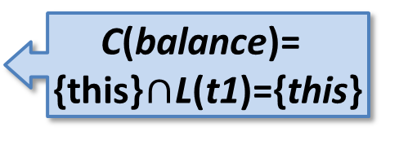
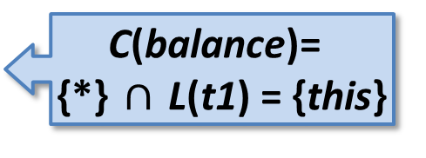
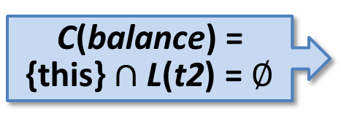
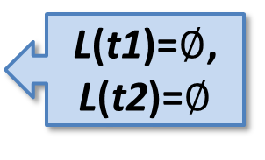
Lockset Algorithm Example
L(t1)=$∅$, L(t2)=$∅$
Initially, balance: 10
class Account {
long balance; //must be non-negative
void withdraw(long x){
1 if(balance >= x){
2 synchronized(this){
3 balance=balance – x;
4 }
5 }
}
void deposit(long x){
11 synchronized(this){
12 balance=balance + x;
13 }
}
}
t1: deposit(10)
t2: withdraw(5)
L(t1)={this}
11:lock(this)
C(balance)=
{*} $∩$L(t1) = {this}
12:t=balance
C(balance)=
{this}$∩$L(t1)={this}
12:balance=t+10
L(t1)=$∅$
13:unlock(this)
C(balance) = {this}$∩$L(t2) = $∅$
1:if(balance>=5)
2:lock(this)
3:t=balance
3:balance=t-5
4:unlock(this)

Slide 24
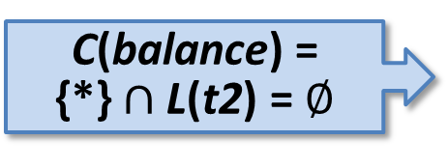
Revisiting False Negative Example
Initially, balance: 10
class Account {
long balance; //must be non-negative
void withdraw(long x){
1 if(balance >= x){
2 synchronized(this){
3 balance=balance – x;
4 }
5 }
}
void deposit(long x){
11 synchronized(this){
12 balance=balance + x;
13 }
}
}
t1: deposit(10)
t2: withdraw(5)
C(balance) = {*}$∩$L(t2) = $∅$
1:if(balance>=5)
1:if(balance>=5)
2:lock(this)
3:t=balance
3:balance=t-5
4:unlock(this)
11:lock(this)
12:t=balance
12:balance=t+10
13:unlock(this)

Slide 25
Improving Lockset Algorithm
The naïve locking discipline generate many false positives and false negatives
2 common cases that generate false positives
Initialization
A thread writes data on the variable without locking before it makes the variable accessible by other threads
Read-shared variable
After initialization, the variable is only read, and never updated.
1 common case that generates false negatives
Readers-writer lock

Slide 26
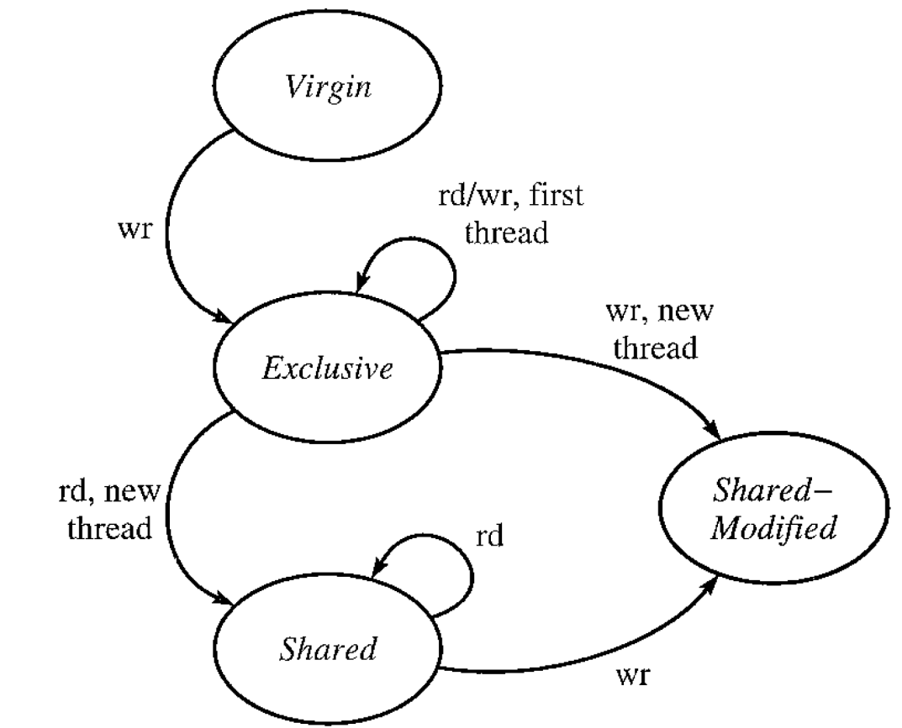
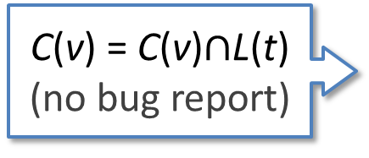
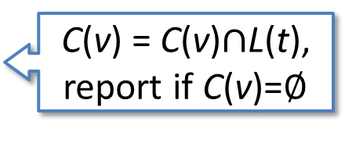
Memory Location State
Eraser maintains the state for each memory location to check if it is in initialization, and if read-shared.
C(v) = {*}
Initialization
C(v) is not updated
C(v) = C(v)$∩$L(t),
report if C(v)=$∅$
C(v) = C(v)$∩$L(t)
(no bug report)
Read-shared

Slide 27
Example
int max, iter ;
Lock m ;
main(){
iter= 10;
max = 0 ;
start(f);
start(f);
}
f() {
int i, t;
for(i=0;i<iter;i++){
t = input();
lock(m);
if (t>max)
max = t ;
unlock(m);
}
}
t1:main()
iter= 10
max = 0
start(t2)
start(t3)
t2:f()
if(0 < iter)
t = 10
lock(m)
if(t > max)
max = t
unlock(m)
…
t3:f()
if(0 < iter)
t = 5
lock(m)
if(t>max)
unlock(m)
…

Slide 28
Example
t0 | t1 | t2 | L(t0) | L(t1) | L(t2) | C(iter) | S(iter) | C(max) | S(max)
(initial state)
iter=10
max = 0
start(f)
start(f)
 | if(0<iter)
 |  | if(0<iter)
 | lock(m)
 | if(t>max)
 | max = t
 | unlock(m)
 |  | lock(m)
 |  | if(t>max)
 |  | unlock(m)
 | ... | ...

Slide 29
Considering Readers-Writer Locks
A thread acquires a readers-writer lock either in read-mode or write-mode
For each variable, Eraser additionally checks if there is a lock consistently held in write-mode for write accesses
In Shared-Modified state
For each read on variable v by thread t
C(v) := C(v) $∩$ L(t)
If C(v) = $∅$, report that there is a data race for v
For each write on variable v by thread t
C(v) := C(v) $∩$ LW(t)
If C(v) = $∅$, report that there is a data race for v

Slide 30
Reducing More False Positives
Use happens-before relation induced by wait/notify and thread start/join to reduce false positives
Check if one memory location is once used for a variable, and then re-used for another variable
For cases where malloc() reuses allocated memory
Track all references to a memory location to precisely check if multiple threads can access the memory location
For cases where global variables become local (e.g., an element of a global list which is removed from the list)

Slide 31
Reducing False Negative
Check for a set of memory locations assigned for a single variable rather than a single memory location
E.g. long, double, array, compound data (struct)

Slide 32
Performance Improvement (1/2)
Dynamic data race detection tools are still too slow to be practical
Inter ThreadChecker incurs 100—200x slow down, Google ThreadSanitizer 30--40x, and FastTrack 8.5x in average*
Approach
Pre-processing: use static analyses to filter out non-shared variables and read-only variables before runtime monitoring
Hardware assisted monitoring: use a customized hardware to monitor memory accesses and synchronization with low cost
* T. Sheng et al.: RACEZ: A Lightweight and Non-invasive Race Detection Tool for Production Applications, ICSE 2011

Slide 33
Performance Improvement (2/2)
Approach (cond.)
Sampling: monitor only a subset of operations, or a subset of memory locations
LiteRace [Marino, PLDI 09] assumes the cold region hypothesis “data races are likely to occur when a thread is executing cold (infrequently accessed) region in the program”
Pacer [Bond, PLDI 10] allows users to configure sampling ratio, and guarantees higher detection ratio for higher sampling ratio.
RACEZ [Sheng, ICSE 11] exploits performance monitoring unit to obtain partial information on memory accesses with low cost

Slide 34
Race Bug Which Is Not a Data Race
class Account {
long balance; //must be non-negative
void getBalance(){
1 synchronized(this){
2 return balance;
3 }
}
void withdraw(long x){
4 if(getBalance()>=x){
5 synchronized(this){
6 balance=balance–x;
7 }
}
}
}
Initially, balance: 10
t1: withdraw(10)
t2: withdraw(10)
1: lock(this)
2: tmp = balance
3: unlock(this)
1: lock(this)
2: tmp = balance
3: unlock(this)
4: if(tmp>=10)
5: lock(this)
6: tmp = balance
6: balance = tmp-10
7: unlock(this)
4: if(tmp>=10)
5: lock(this)
6: tmp = balance
6: balance = tmp-10
7: unlock(this)
Data race free,
but race bug

