Slide 1
Pthread and OpenMP
Jaehyuk Huh
Computer Science, KAIST

Slide 2
Thread Basics
A single, sequential stream of control in a program
All memory in the logical machine model of a thread is globally accessible to every thread: global variables and heap objects.
Stack is generally local to the thread
A logical machine model with both global memory (default) and local memory (stacks).
Useful for scheduling and load balancing
especially for dynamic concurrency
Relatively easy to program
significantly easier than message-passing!

Slide 3
The POSIX Thread API
Commonly referred to as Pthreads, POSIX has emerged as the standard threads API, supported by most vendors.
The concepts discussed here are largely independent of the API and can be used for programming with other thread APIs (NT threads, Solaris threads, Java threads, etc.) as well.

Slide 4
Creation and Termination
Pthreads provides two basic functions for specifying concurrency in a program:
#include <pthread.h>
int pthread_create (
pthread_t *thread_handle,
const pthread_attr_t *attribute,
void * (*thread_function)(void *),
void *arg);
int pthread_join (
pthread_t thread,
void **ptr);
The function pthread_create invokes function thread_function as a thread

Slide 5
Example
#include <pthread.h>
#include <stdlib.h>
#define MAX_THREADS 512
void *compute_pi (void *);
....
main() {
...
pthread_t p_threads[MAX_THREADS];
pthread_attr_t attr;
pthread_attr_init (&attr);
for (i=0; i< num_threads; i++) {
hits[i] = i;
pthread_create(&p_threads[i], &attr, compute_pi,
(void *) &hits[i]);
}
for (i=0; i< num_threads; i++) {
pthread_join(p_threads[i], NULL);
total_hits += hits[i];
}
...
}

Slide 6
Example
void *compute_pi (void *s) {
int seed, i, *hit_pointer;
double rand_no_x, rand_no_y;
int local_hits;
hit_pointer = (int *) s;
seed = *hit_pointer;
local_hits = 0;
for (i = 0; i < sample_points_per_thread; i++) {
rand_no_x =(double)(rand_r(&seed))/(double)((2<<14)-1);
rand_no_y =(double)(rand_r(&seed))/(double)((2<<14)-1);
if (((rand_no_x - 0.5) * (rand_no_x - 0.5) +
(rand_no_y - 0.5) * (rand_no_y - 0.5)) < 0.25)
local_hits ++;
seed *= i;
}
*hit_pointer = local_hits;
pthread_exit(0);
}

Slide 7
Programming and Performance
Executing this on a 4-processor SGI Origin, we observe a 3.91 fold speedup at 32 threads. This corresponds to a parallel efficiency of 0.98!
We can also modify the program slightly to observe the effect of false-sharing.
The program can also be used to assess the secondary cache line size.

Slide 8
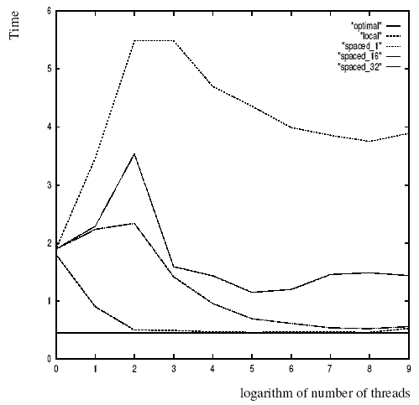
Programming and Performance Notes
Execution time of the compute_pi program.

Slide 9
Synchronization Primitives
When multiple threads attempt to manipulate the same data item, the results can often be incoherent if proper care is not taken to synchronize them.
Consider:
/* each thread tries to update variable best_cost as follows */
if (my_cost < best_cost)
best_cost = my_cost;
Assume that there are two threads, the initial value of best_cost is 100, and the values of my_cost are 50 and 75 at threads t1 and t2.
Depending on the schedule of the threads, the value of best_cost could be 50 or 75!
The value 75 does not correspond to any serialization of the threads.

Slide 10
Mutual Exclusion
The code in the previous example corresponds to a critical segment; i.e., a segment that must be executed by only one thread at any time.
Critical segments in Pthreads are implemented using mutex locks.
Mutex-locks have two states: locked and unlocked. At any point of time, only one thread can lock a mutex lock. A lock is an atomic operation.
A thread entering a critical segment first tries to get a lock. It goes ahead when the lock is granted.

Slide 11
Mutual Exclusion
The Pthreads API provides the following functions for handling mutex-locks:
int pthread_mutex_lock (
pthread_mutex_t *mutex_lock);
int pthread_mutex_unlock (
pthread_mutex_t *mutex_lock);
int pthread_mutex_init (
pthread_mutex_t *mutex_lock,
const pthread_mutexattr_t *lock_attr);

Slide 12
Mutual Exclusion
We can now write our previously incorrect code segment as:
pthread_mutex_t minimum_value_lock;
...
main() {
....
pthread_mutex_init(&minimum_value_lock, NULL);
....
}
void *find_min(void *list_ptr) {
....
pthread_mutex_lock(&minimum_value_lock);
if (my_min < minimum_value)
minimum_value = my_min;
/* and unlock the mutex */
pthread_mutex_unlock(&minimum_value_lock);
}

Slide 13
Producer-Consumer Using Locks
The producer-consumer scenario imposes the following constraints:
The producer thread must not overwrite the shared buffer when the previous task has not been picked up by a consumer thread.
The consumer threads must not pick up tasks until there is something present in the shared data structure.
Individual consumer threads should pick up tasks one at a time.

Slide 14
Producer-Consumer Using Locks
pthread_mutex_t task_queue_lock;
int task_available;
...
main() {
....
task_available = 0;
pthread_mutex_init(&task_queue_lock, NULL);
....
}
void *producer(void *producer_thread_data) {
....
while (!done()) {
inserted = 0;
create_task(&my_task);
while (inserted == 0) {
pthread_mutex_lock(&task_queue_lock);
if (task_available == 0) {
insert_into_queue(my_task);
task_available = 1;
inserted = 1;
}
pthread_mutex_unlock(&task_queue_lock);
}
}
}

Slide 15
Producer-Consumer Using Locks
void *consumer(void *consumer_thread_data) {
int extracted;
struct task my_task;
/* local data structure declarations */
while (!done()) {
extracted = 0;
while (extracted == 0) {
pthread_mutex_lock(&task_queue_lock);
if (task_available == 1) {
extract_from_queue(&my_task);
task_available = 0;
extracted = 1;
}
pthread_mutex_unlock(&task_queue_lock);
}
process_task(my_task);
}
}

Slide 16
Types of Mutexes
Pthreads supports three types of mutexes - normal, recursive, and error-check.
A normal mutex deadlocks if a thread that already has a lock tries a second lock on it.
A recursive mutex allows a single thread to lock a mutex as many times as it wants. It simply increments a count on the number of locks. A lock is relinquished by a thread when the count becomes zero.
An error check mutex reports an error when a thread with a lock tries to lock it again (as opposed to deadlocking in the first case, or granting the lock, as in the second case).
The type of the mutex can be set in the attributes object before it is passed at time of initialization.

Slide 17
Overheads of Locking
Locks represent serialization points since critical sections must be executed by threads one after the other.
Encapsulating large segments of the program within locks can lead to significant performance degradation.
It is often possible to reduce the idling overhead associated with locks using an alternate function, pthread_mutex_trylock.
int pthread_mutex_trylock (
pthread_mutex_t *mutex_lock);
pthread_mutex_trylock is typically much faster than pthread_mutex_lock on typical systems since it does not have to deal with queues associated with locks for multiple threads waiting on the lock [Current futex implementation]

Slide 18
Alleviating Locking Overhead (Example)
/* Finding k matches in a list */
void *find_entries(void *start_pointer) {
/* This is the thread function */
struct database_record *next_record;
int count;
current_pointer = start_pointer;
do {
next_record = find_next_entry(current_pointer);
count = output_record(next_record);
} while (count < requested_number_of_records);
}
int output_record(struct database_record *record_ptr) {
int count;
pthread_mutex_lock(&output_count_lock);
output_count ++;
count = output_count;
pthread_mutex_unlock(&output_count_lock);
if (count <= requested_number_of_records)
print_record(record_ptr);
return (count);
}

Slide 19
Alleviating Locking Overhead (Example)
/* rewritten output_record function */
int output_record(struct database_record *record_ptr) {
int count;
int lock_status;
lock_status=pthread_mutex_trylock(&output_count_lock);
if (lock_status == EBUSY) {
insert_into_local_list(record_ptr);
return(0);
}
else {
count = output_count;
output_count += number_on_local_list + 1;
pthread_mutex_unlock(&output_count_lock);
print_records(record_ptr, local_list,
requested_number_of_records - count);
return(count + number_on_local_list + 1);
}
}

Slide 20
Condition Variables for Synchronization
A condition variable allows a thread to block itself until specified data reaches a predefined state.
A condition variable is associated with this predicate. When the predicate becomes true, the condition variable is used to signal one or more threads waiting on the condition.
A single condition variable may be associated with more than one predicate.
A condition variable always has a mutex associated with it. A thread locks this mutex and tests the predicate defined on the shared variable.
If the predicate is not true, the thread waits on the condition variable associated with the predicate using the function pthread_cond_wait.

Slide 21
Condition Variables for Synchronization
Pthreads provides the following functions for condition variables:
int pthread_cond_wait(pthread_cond_t *cond,
pthread_mutex_t *mutex);
int pthread_cond_signal(pthread_cond_t *cond);
int pthread_cond_broadcast(pthread_cond_t *cond);
int pthread_cond_init(pthread_cond_t *cond,
const pthread_condattr_t *attr);
int pthread_cond_destroy(pthread_cond_t *cond);

Slide 22
Producer-Consumer Using Condition Variables
pthread_cond_t cond_queue_empty, cond_queue_full;
pthread_mutex_t task_queue_cond_lock;
int task_available;
/* other data structures here */
main() {
/* declarations and initializations */
task_available = 0;
pthread_init();
pthread_cond_init(&cond_queue_empty, NULL);
pthread_cond_init(&cond_queue_full, NULL);
pthread_mutex_init(&task_queue_cond_lock, NULL);
/* create and join producer and consumer threads */
}

Slide 23
Producer-Consumer Using Condition Variables
void *producer(void *producer_thread_data) {
int inserted;
while (!done()) {
create_task();
pthread_mutex_lock(&task_queue_cond_lock);
while (task_available == 1)
pthread_cond_wait(&cond_queue_empty,
&task_queue_cond_lock);
insert_into_queue();
task_available = 1;
pthread_cond_signal(&cond_queue_full);
pthread_mutex_unlock(&task_queue_cond_lock);
}
}

Slide 24
Producer-Consumer Using Condition Variables
void *consumer(void *consumer_thread_data) {
while (!done()) {
pthread_mutex_lock(&task_queue_cond_lock);
while (task_available == 0)
pthread_cond_wait(&cond_queue_full,
&task_queue_cond_lock);
my_task = extract_from_queue();
task_available = 0;
pthread_cond_signal(&cond_queue_empty);
pthread_mutex_unlock(&task_queue_cond_lock);
process_task(my_task);
}
}

Slide 25
Controlling Thread and Synchronization Attributes
The Pthreads API allows a programmer to change the default attributes of entities using attributes objects.
An attributes object is a data-structure that describes entity (thread, mutex, condition variable) properties.
Once these properties are set, the attributes object can be passed to the method initializing the entity.
pthread_mutexattr_init(&Attr);
pthread_mutexattr_settype(&Attr, PTHREAD_MUTEX_RECURSIVE);
pthread_mutex_init(&Mutex, &Attr);

Slide 26
Composite Synchronization Constructs
By design, Pthreads provide support for a basic set of operations.
Higher level constructs can be built using basic synchronization constructs.
We discuss two such constructs - read-write locks and barriers.

Slide 27
Read-Write Locks
In many applications, a data structure is read frequently but written infrequently. For such applications, we should use read-write locks.
A read lock is granted when there are other threads that may already have read locks.
If there is a write lock on the data (or if there are queued write locks), the thread performs a condition wait.
If there are multiple threads requesting a write lock, they must perform a condition wait.
With this description, we can design functions for read locks mylib_rwlock_rlock, write locks mylib_rwlock_wlock, and unlocking mylib_rwlock_unlock.

Slide 28
Read-Write Locks
The lock data type mylib_rwlock_t holds the following:
a count of the number of readers,
the writer (a 0/1 integer specifying whether a writer is present),
a condition variable readers_proceed that is signaled when readers can proceed,
a condition variable writer_proceed that is signaled when one of the writers can proceed,
a count pending_writers of pending writers, and
a mutex read_write_lock associated with the shared data structure

Slide 29
Read-Write Locks
typedef struct {
int readers;
int writer;
pthread_cond_t readers_proceed;
pthread_cond_t writer_proceed;
int pending_writers;
pthread_mutex_t read_write_lock;
} mylib_rwlock_t;
void mylib_rwlock_init (mylib_rwlock_t *l) {
l -> readers = l -> writer = l -> pending_writers = 0;
pthread_mutex_init(&(l -> read_write_lock), NULL);
pthread_cond_init(&(l -> readers_proceed), NULL);
pthread_cond_init(&(l -> writer_proceed), NULL);
}

Slide 30
Read-Write Locks
void mylib_rwlock_rlock(mylib_rwlock_t *l) {
/* if there is a write lock or pending writers, perform condition wait.. else increment count of readers and grant read lock */
pthread_mutex_lock(&(l -> read_write_lock));
while ((l -> pending_writers > 0) || (l -> writer > 0))
pthread_cond_wait(&(l -> readers_proceed),
&(l -> read_write_lock));
l -> readers ++;
pthread_mutex_unlock(&(l -> read_write_lock));
}

Slide 31
Read-Write Locks
void mylib_rwlock_wlock(mylib_rwlock_t *l) {
/* if there are readers or writers, increment pending writers count and wait. On being woken, decrement pending writers count and increment writer count */
pthread_mutex_lock(&(l -> read_write_lock));
while ((l -> writer > 0) || (l -> readers > 0)) {
l -> pending_writers ++;
pthread_cond_wait(&(l -> writer_proceed),
&(l -> read_write_lock));
}
l -> pending_writers --;
l -> writer ++;
pthread_mutex_unlock(&(l -> read_write_lock));
}

Slide 32
Read-Write Locks
void mylib_rwlock_unlock(mylib_rwlock_t *l) {
/* if there is a write lock then unlock, else if there are read locks, decrement count of read locks. If the count is 0 and there is a pending writer, let it through, else if there are pending readers, let them all go through */
pthread_mutex_lock(&(l -> read_write_lock));
if (l -> writer > 0)
l -> writer = 0;
else if (l -> readers > 0)
l -> readers --;
pthread_mutex_unlock(&(l -> read_write_lock));
if ((l -> readers == 0) && (l -> pending_writers > 0))
pthread_cond_signal(&(l -> writer_proceed));
else if (l -> readers > 0)
pthread_cond_broadcast(&(l -> readers_proceed));
}

Slide 33
Barriers
As in MPI, a barrier holds a thread until all threads participating in the barrier have reached it.
Barriers can be implemented using a counter, a mutex and a condition variable.
A single integer is used to keep track of the number of threads that have reached the barrier.
If the count is less than the total number of threads, the threads execute a condition wait.
The last thread entering (and setting the count to the number of threads) wakes up all the threads using a condition broadcast.

Slide 34
Barriers
typedef struct {
pthread_mutex_t count_lock;
pthread_cond_t ok_to_proceed;
int count;
} mylib_barrier_t;
void mylib_init_barrier(mylib_barrier_t *b) {
b -> count = 0;
pthread_mutex_init(&(b -> count_lock), NULL);
pthread_cond_init(&(b -> ok_to_proceed), NULL);
}

Slide 35
Barriers
void mylib_barrier (mylib_barrier_t *b, int num_threads) {
pthread_mutex_lock(&(b -> count_lock));
b -> count ++;
if (b -> count == num_threads) {
b -> count = 0;
pthread_cond_broadcast(&(b -> ok_to_proceed));
}
else
while (pthread_cond_wait(&(b -> ok_to_proceed),
&(b -> count_lock)) != 0);
pthread_mutex_unlock(&(b -> count_lock));
}

Slide 36
Barriers
The barrier described above is called a linear barrier.
The trivial lower bound on execution time of this function is therefore O(n) for n threads.
This implementation of a barrier can be speeded up using multiple barrier variables organized in a tree.
We use n/2 condition variable-mutex pairs for implementing a barrier for n threads.
At the lowest level, threads are paired up and each pair of threads shares a single condition variable-mutex pair.
Once both threads arrive, one of the two moves on, the other one waits.
This process repeats up the tree.
This is also called a log barrier and its runtime grows as O(log p).

Slide 37
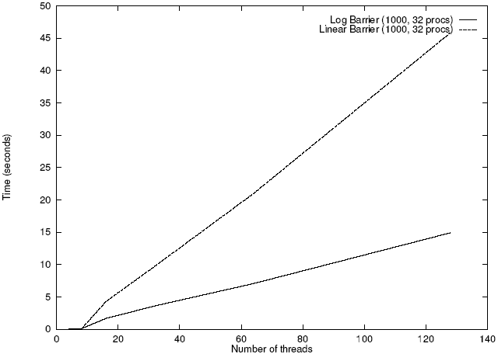
Barrier
Execution time of 1000 sequential and logarithmic barriers as a function of number of threads on a 32 processor SGI Origin 2000.

Slide 38
OpenMP
Standard for directive based parallel programming
OpenMP is a directive-based API that can be used with FORTRAN, C, and C++ for programming shared address space machines.
OpenMP directives provide support for concurrency, synchronization, and data handling while obviating the need for explicitly setting up mutexes, condition variables, data scope, and initialization.

Slide 39
OpenMP Programming Model
OpenMP directives in C and C++ are based on the #pragma compiler directives.
A directive consists of a directive name followed by clauses.
#pragma omp directive [clause list]
OpenMP programs execute serially until they encounter the parallel directive, which creates a group of threads.
#pragma omp parallel [clause list]
/* structured block */
The main thread that encounters the parallel directive becomes the master of this group of threads and is assigned the thread id 0 within the group.

Slide 40
OpenMP Programming Model
The clause list is used to specify conditional parallelization, number of threads, and data handling.
Conditional Parallelization: The clause if (scalar expression) determines whether the parallel construct results in creation of threads.
Degree of Concurrency: The clause num_threads(integer expression) specifies the number of threads that are created.
Data Handling: The clause private (variable list) indicates variables local to each thread. The clause firstprivate (variable list) is similar to the private, except values of variables are initialized to corresponding values before the parallel directive. The clause shared (variable list) indicates that variables are shared across all the threads.

Slide 41
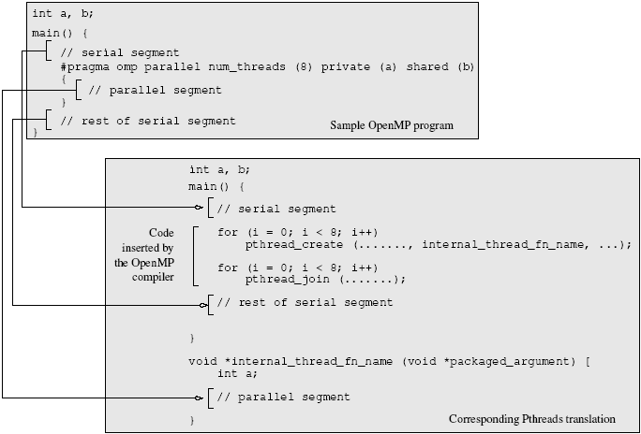
OpenMP Programming Model
A sample OpenMP program along with its Pthreads translation that might be performed by an OpenMP compiler.

Slide 42
OpenMP Programming Model
#pragma omp parallel if (is_parallel== 1) num_threads(8) \
private (a) shared (b) firstprivate(c) {
/* structured block */
}
If the value of the variable is_parallel equals one, eight threads are created.
Each of these threads gets private copies of variables a and c, and shares a single value of variable b.
The value of each copy of c is initialized to the value of c before the parallel directive.
The default state of a variable is specified by the clause default (shared) or default (none).

Slide 43
Reduction Clause in OpenMP
The reduction clause specifies how multiple local copies of a variable at different threads are combined into a single copy at the master when threads exit.
The usage of the reduction clause is reduction (operator: variable list).
The variables in the list are implicitly specified as being private to threads.
The operator can be one of +, *, -, &, |, ^, &&, and ||.
#pragma omp parallel reduction(+: sum) num_threads(8) {
/* compute local sums here */
}
/*sum here contains sum of all local instances of sums */

Slide 44
OpenMP Programming: Example
/* ******************************************************
An OpenMP version of a threaded program to compute PI.
****************************************************** */
#pragma omp parallel default(private) shared (npoints) \
reduction(+: sum) num_threads(8)
{
num_threads = omp_get_num_threads();
sample_points_per_thread = npoints / num_threads;
sum = 0;
for (i = 0; i < sample_points_per_thread; i++) {
rand_no_x =(double)(rand_r(&seed))/(double)((2<<14)-1);
rand_no_y =(double)(rand_r(&seed))/(double)((2<<14)-1);
if (((rand_no_x - 0.5) * (rand_no_x - 0.5) +
(rand_no_y - 0.5) * (rand_no_y - 0.5)) < 0.25)
sum ++;
}
}

Slide 45
Specifying Concurrent Tasks in OpenMP
The parallel directive can be used in conjunction with other directives to specify concurrency across iterations and tasks.
OpenMP provides two directives - for and sections - to specify concurrent iterations and tasks.
The for directive is used to split parallel iteration spaces across threads. The general form of a for directive is as follows:
#pragma omp for [clause list]
/* for loop */
The clauses that can be used in this context are: private, firstprivate, lastprivate, reduction, schedule, nowait, and ordered.

Slide 46
Specifying Concurrent Tasks in OpenMP: Example
#pragma omp parallel default(private) shared (npoints) \
reduction(+: sum) num_threads(8)
{
sum = 0;
#pragma omp for
for (i = 0; i < npoints; i++) {
rand_no_x =(double)(rand_r(&seed))/(double)((2<<14)-1);
rand_no_y =(double)(rand_r(&seed))/(double)((2<<14)-1);
if (((rand_no_x - 0.5) * (rand_no_x - 0.5) +
(rand_no_y - 0.5) * (rand_no_y - 0.5)) < 0.25)
sum ++;
}
}

Slide 47
Assigning Iterations to Threads
The schedule clause of the for directive deals with the assignment of iterations to threads.
The general form of the schedule directive is schedule(scheduling_class[, parameter]).
OpenMP supports four scheduling classes: static, dynamic, guided, and runtime.

Slide 48
Assigning Iterations to Threads: Example
/* static scheduling of matrix multiplication loops */
#pragma omp parallel default(private) shared (a, b, c, dim) \
num_threads(4)
#pragma omp for schedule(static)
for (i = 0; i < dim; i++) {
for (j = 0; j < dim; j++) {
c(i,j) = 0;
for (k = 0; k < dim; k++) {
c(i,j) += a(i, k) * b(k, j);
}
}
}

Slide 49
Parallel For Loops
Often, it is desirable to have a sequence of for-directives within a parallel construct that do not execute an implicit barrier at the end of each for directive.
OpenMP provides a clause - nowait, which can be used with a for directive.

Slide 50
Parallel For Loops: Example
#pragma omp parallel
{
#pragma omp for nowait
for (i = 0; i < nmax; i++)
if (isEqual(name, current_list[i])
processCurrentName(name);
#pragma omp for
for (i = 0; i < mmax; i++)
if (isEqual(name, past_list[i])
processPastName(name);
}

Slide 51
The sections Directive
OpenMP supports non-iterative parallel task assignment using the sections directive.
The general form of the sections directive is as follows:
#pragma omp sections [clause list]
{
[#pragma omp section
/* structured block */
]
[#pragma omp section
/* structured block */
]
...
}

Slide 52
The sections Directive: Example
#pragma omp parallel
{
#pragma omp sections
{
#pragma omp section
{
taskA();
}
#pragma omp section
{
taskB();
}
#pragma omp section
{
taskC();
}
}
}

Slide 53
Synchronization Constructs
OpenMP provides a variety of synchronization constructs:
#pragma omp barrier
#pragma omp single [clause list]
structured block
#pragma omp master
structured block
#pragma omp critical [(name)]
structured block
#pragma omp ordered
structured block

Slide 54
OpenMP Library Functions
In addition to directives, OpenMP also supports a number of functions that allow a programmer to control the execution of threaded programs.
/* thread and processor count */
void omp_set_num_threads (int num_threads);
int omp_get_num_threads ();
int omp_get_max_threads ();
int omp_get_thread_num ();
int omp_get_num_procs ();
int omp_in_parallel();

Slide 55
OpenMP Library Functions
/* controlling and monitoring thread creation */
void omp_set_dynamic (int dynamic_threads);
int omp_get_dynamic ();
void omp_set_nested (int nested);
int omp_get_nested ();
/* mutual exclusion */
void omp_init_lock (omp_lock_t *lock);
void omp_destroy_lock (omp_lock_t *lock);
void omp_set_lock (omp_lock_t *lock);
void omp_unset_lock (omp_lock_t *lock);
int omp_test_lock (omp_lock_t *lock);
In addition, all lock routines also have a nested lock counterpart
for recursive mutexes.

Slide 56
Environment Variables
OMP_NUM_THREADS: This environment variable specifies the default number of threads created upon entering a parallel region.
OMP_SET_DYNAMIC: Determines if the number of threads can be dynamically changed.
OMP_NESTED: Turns on nested parallelism.
OMP_SCHEDULE: Scheduling of for-loops if the clause specifies runtime

Slide 57
Explicit Threads versus Directive Based Programming
Directives layered on top of threads facilitate a variety of thread-related tasks.
A programmer is rid of the tasks of initializing attributes objects, setting up arguments to threads, partitioning iteration spaces, etc.
There are some drawbacks to using directives as well.
An artifact of explicit threading is that data exchange is more apparent. This helps in alleviating some of the overheads from data movement, false sharing, and contention.
Explicit threading also provides a richer API in the form of condition waits, locks of different types, and increased flexibility for building composite synchronization operations.
Finally, since explicit threading is used more widely than OpenMP, tools and support for Pthreads programs are easier to find.

Slide 58
Reference
Adapted from slides “Programming Shared Address Space Platforms” by Ananth Grama.
Chapter 7. “Introduction to Parallel Computing” by Ananth Grama, Anshul Gupta, George Karypis, and Vipin Kumar. Addison Wesley, 2003

