Slide 1
Transactional Memory
Jaehyuk Huh
Computer Science, KAIST
Based on Lectures by Prof. Arun Raman, Princeton University

Slide 2
Parallel Programming
Find independent tasks in the algorithm
Map tasks to execution units (e.g. threads)
Define and implement synchronization among tasks
Avoid races and deadlocks, address memory
model issues, …
Compose parallel tasks
Recover from errors
Ensure scalability
Manage locality
…
Notes:
Parallel programming encompasses all the difficulties of sequential programming, but also introduces the hard problem of coordinating interactions among concurrently executing tasks. Today, most parallel programs employ low-level programming constructs that consist of threads, locks, and semaphores. Considerable experience has shown that parallel programs written with these constructs are difficult to design, program, debug, and often do not perform well.
Transactional memory offers a higher-level abstraction for writing parallel programs.
TODO: Turn into imperatives – Find …

Slide 3
Parallel Programming
Find independent tasks in the algorithm
Map tasks to execution units (e.g. threads)
Define and implement synchronization among tasks
Avoid races and deadlocks, address memory
model issues, …
Compose parallel tasks
Recover from errors
Ensure scalability
Manage locality
…
Transactional Memory
Notes:
Transactional memory offers a higher-level abstraction for writing parallel programs.
Let’s see how transactions …

Slide 4
Transactional Programming
void deposit(account, amount) {
lock(account);
int t = bank.get(account);
t = t + amount;
bank.put(account, t);
unlock(account);
}
void deposit(account, amount) {
atomic {
int t = bank.get(account);
t = t + amount;
bank.put(account, t);
}
}
Declarative Synchronization – What, not How
System implements Synchronization transparently
Notes:
No management of locks
Implementation typically with optimistic concurrency

Slide 5
Transactional Memory
Memory Transaction - An atomic and isolated sequence of memory accesses
Transactional Memory – Provides transactions for threads running in a shared address space
Notes:
Atomicity – What this means is that although the code in a transaction may modify individual variables through a series of assignments, another computation can only observe the program state immediately before or immediately after the transaction executes.
The bottomline is that a program’s author only needs to identify a sequence of operations on shared data that should appear to execute atomically to other, concurrent threads. It is the task of the TM system to ensure this outcome.

Slide 6
Transactional Memory - Atomicity
Atomicity – On transaction commit, all memory updates appear to take effect at once; on transaction abort, none of the memory updates appear to take effect
Thread 1
Thread 2
void deposit(account, amount) {
atomic {
int t = bank.get(account);
t = t + amount;
bank.put(account, t);
}
}
CONFLICT
RD
RD A : 0
RD A : 0
WR
WR A : 5
COMMIT
WR A : 10
ABORT
Notes:
Atomicity – What this means is that although the code in a transaction may modify individual variables through a series of assignments, another computation can only observe the program state immediately before or immediately after the transaction executes.
The bottomline is that a program’s author only needs to identify a sequence of operations on shared data that should appear to execute atomically to other, concurrent threads. It is the task of the TM system to ensure this outcome.

Slide 7
Transactional Memory - Isolation
Isolation – No other code can observe updates before commit
Programmer only needs to identify operation sequence that should appear to execute atomically to other, concurrent threads
Notes:
The bottomline is that a program’s author only needs to identify a sequence of operations on shared data that should appear to execute atomically to other, concurrent threads. It is the task of the TM system to ensure this outcome.

Slide 8
Transactional Memory - Serializability
Serializability – Result of executing concurrent transactions on a data structure must be identical to a result in which these transactions executed serially.
Notes:
This is the basic correctness condition for transactions. We have already looked at this in Assignment 2.

Slide 9
Some advantages of TM
Ease of use (declarative)
Composability
Expected performance of fine-grained locking
Notes:
Other advantage
Failure atomicity and recovery
No lost locks when a thread fails
Transaction abort and restart

Slide 10
Composability : Locks
void transfer(A, B, amount) {
synchronized(A) {
synchronized(B) {
withdraw(A, amount);
deposit(B, amount);
}
}
}
void transfer(B, A, amount) {
synchronized(B) {
synchronized(A) {
withdraw(B, amount);
deposit(A, amount);
}
}
}
Fine grained locking → Can lead to deadlock
Need some global locking discipline now
Notes:
TODO Alternatives to locks and transactions while parallelizing code

Slide 11
Composability : Locks
void transfer(A, B, amount) {
synchronized(bank) {
withdraw(A, amount);
deposit(B, amount);
}
}
void transfer(B, A, amount) {
synchronized(bank) {
withdraw(B, amount);
deposit(A, amount);
}
}
Fine grained locking → Can lead to deadlock
Coarse grained locking → No concurrency

Slide 12
Composability : Transactions
void transfer(A, B, amount) {
atomic {
withdraw(A, amount);
deposit(B, amount);
}
}
void transfer(B, A, amount) {
atomic {
withdraw(B, amount);
deposit(A, amount);
}
}
Serialization for transfer(A,B,100) and transfer(B,A,100)
Concurrency for transfer(A,B,100) and transfer(C,D,100)
Notes:
Transactions compose gracefully
Programmer declares global intention (atomic transfer)
No need to know of a global implementation strategy
Transaction in transfer subsumes those in withdraw and deposit
Outermost transaction defines atomicity boundary

Slide 13
Some issues with TM
I/O and unrecoverable actions
Atomicity violations are still possible
Interaction with non-transactional code
Notes:
Of course, transactional memory is not a panacea for parallel programming
Difficult to undo output and redo input
Possible solutions:
Buffer output and log input
Finalize output and clear log on commit
Does not work if atomic does input after output

Slide 14
Atomicity Violation
Thread 1
Thread 2
atomic {
…
ptr = A;
…
}
atomic {
…
ptr = NULL;
}
atomic {
B = ptr->field;
}
Notes:
The transaction boundaries for Thread 1 code must be redefined to prevent unexpected things from happening

Slide 15
Interaction with non-transactional code
Thread 1
Thread 2
lock_acquire(lock);
obj.x = 1;
if (obj.x != 1)
fireMissiles();
lock_release(lock);
obj.x = 2;
Notes:
Thread 1 operates on obj.x inside a critical section protected by lock. Thread 2’s unprotected updates to obj.x compete with thread 1’s access, resulting in a data race on obj.x. The result of the execution is not deterministic as Thread 2’s execution may change the value of obj.x at any time. Preventing the data race requires Thread 2 to acquire lock before modifying obj.x or Thread 2 not to execute concurrently with Thread 1.

Slide 16
Interaction with non-transactional code
Thread 1
Thread 2
atomic {
obj.x = 1;
if (obj.x != 1)
fireMissiles();
}
obj.x = 2;

Slide 17
Interaction with non-transactional code
Thread 1
Thread 2
atomic {
obj.x = 1;
if (obj.x != 1)
fireMissiles();
}
obj.x = 2;
Weak Isolation – Transactions are serializable only against other transactions
Strong Isolation – Transactions are serializable against all memory accesses (Non-transactional LD/ST are 1-instruction TXs)
Notes:
Strong atomicity, while desirable, has high overheads for software transactional memory

Slide 18
Nested Transactions
void transfer(A, B, amount) {
atomic {
withdraw(A, amount);
deposit(B, amount);
}
}
void deposit(account, amount) {
atomic {
int t = bank.get(account);
t = t + amount;
bank.put(account, t);
}
}
Semantics of Nested Transactions
Flattened
Closed Nested
Open Nested
Notes:
A nested transaction is a transaction whose execution is properly contained in the dynamic extent of another transaction. For now, we assume that there is only one thread of control for the transactions, so the outer one passes control to the inner one. The inner transaction sees modifications to program state made by the outer transaction. The behavior of the two transactions can be linked in several ways.

Slide 19
Nested Transactions - Flattened
int x = 1;
atomic {
x = 2;
atomic flatten {
x = 3;
abort;
}
}
Notes:
If the transactions are flattened, aborting the inner transaction causes the outer transaction to abort, but committing the inner transaction has no effect until the outer transaction commits, at which point the inner transaction’s changes become visible to other threads. The outer transaction sees modifications to program state made by the inner transaction. If the inner transaction is flattened in the following example, when the outer transaction terminates, the variable x has value 1. Flattened transactions are easy to implement, since there is only a single transaction in execution. However, they are a poor programming abstraction that subverts program composition, since an abort in a library routine terminates all surrounding transactions.
When the system aborts a transaction, it reexecutes the transaction to give it another opportunity to complete. When the program aborts a transaction, control passes to the statement after the atomic block or to an exception handler.

Slide 20
Nested Transactions - Closed
int x = 1;
atomic {
x = 2;
atomic closed {
x = 3;
abort;
}
}
Notes:
A closed transaction aborts without terminating its parent transaction. When a closed inner transaction commits or aborts, control passes to its surrounding transaction. If the inner transaction commits, its modifications become visible to the surrounding transaction. However, nonsurrounding transactions see these changes only when the outermost surrounding transaction commits. In the example, variable x is left with the value 2 because the inner transaction’s assignment is undone by the abort. Closed nesting can have higher overheads than flattened transactions. For executions that commit successfully, the behavior of flattening and closed nesting is equivalent. If commits are common, a TM system can take advantage of flattening transactions as a performance optimization and switch to closed nesting if aborts occur

Slide 21
Nested Transactions - Open
int x = 1;
atomic {
x = 2;
atomic open {
x = 3;
}
abort;
}
Notes:
By contrast, when an open transaction commits, its changes become visible to all other transactions in the system, even if the surrounding transaction is still executing. Moreover, even if the parent transaction aborts, the results of the nested, open transactions will remain committed. In the following example, even after the outer transaction aborts, variable x is left with the value 3.

Slide 22
Nested Transactions – Open – Use Case
int counter = 1;
atomic {
…
atomic open {
counter++;
}
}
Notes:
A common programming paradigm is to use a counter to generate unique tokens. If this counter is incremented in a closed transaction, then every transaction that uses the counter conflicts, and the counter effectively serializes their execution. If the transaction that obtains value N from the counter aborts, then every transaction that obtains a later value must also abort. Open transactions provide a mechanism to increment the counter atomically without serializing execution.
On the other hand, open transactions can subvert the ACI properties of transactions. The correctness of an optimization may depend on a subtle understanding of the semantics of a program. Consider the example above. In general, tokens only have to be unique (not contiguous), so it does not matter if an aborted transaction generated a value that was discarded. However, if this counter were recording the number of operations successfully completed, an aborted transaction must decrement the counter when it fails, an action known as compensation.

Slide 23
Transactional Programming - Summary
Transactions do not generate parallelism
Transactions target performance of fine-grained locking
@ effort of coarse-grained locking
Various constructs studied previously (atomic, retry,
orelse,…)
4. Different semantics (Weak/Strong Isolation, Nesting)

Slide 24
TM Implementation
Data Versioning
Eager Versioning
Lazy Versioning
Conflict Detection and Resolution
Pessimistic Concurrency Control
Optimistic Concurrency Control
Conflict Detection Granularity
Object Granularity
Word Granularity
Cache line Granularity

Slide 25
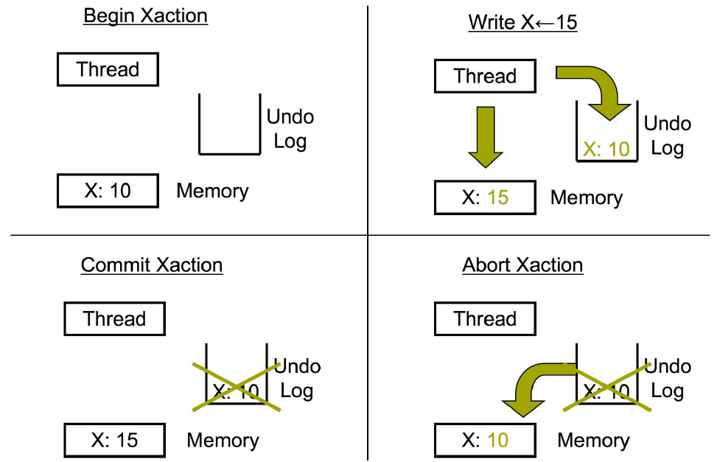
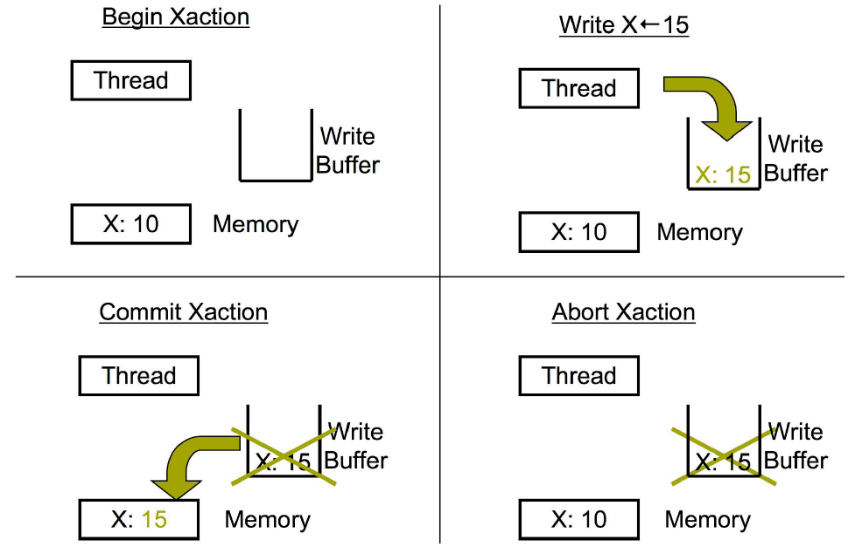
Data Versioning
Eager Versioning (Direct Update)
Lazy Versioning (Deferred Update)
Notes:
Eager versioning
Update memory location directly
Maintain undo info in a log
Faster commit, direct reads (SW)
Slower aborts, fault tolerant issues
Lazy versioning
Buffer data until commit in a write-buffer
Update actual memory location on commit
Faster abort, no fault tolerance issues
Slower commits, indirect reads (SW)

Slide 26
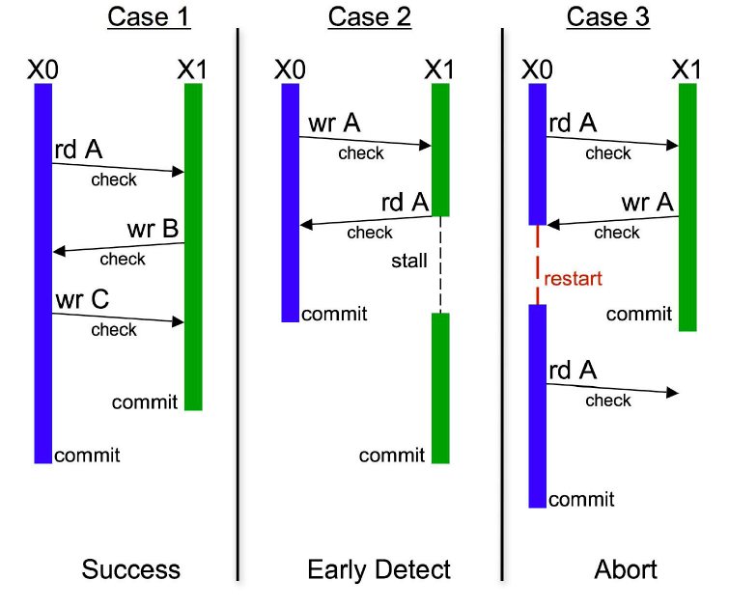
Conflict Detection and Resolution - Pessimistic
No Conflict
Conflict with Stall
Conflict with Abort
Time
Notes:
Check for conflicts during loads or stores
Acquire ownership
+ Detect conflicts early and potentially undo less work (turn some aborts into stalls)
- Locking issues (SW), fine-grained communication (HW)
SW: SW barriers using locks and/or version numbers
HW: Check through coherence actions
Mention eager or lazy

Slide 27
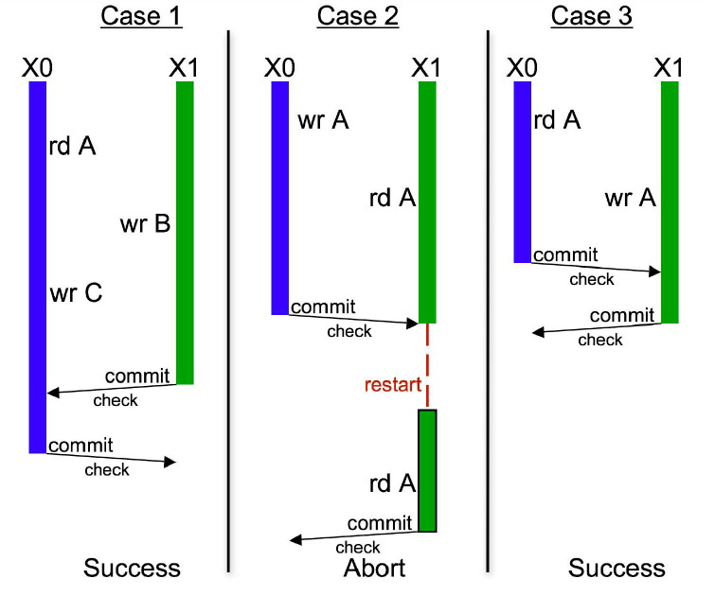
Conflict Detection and Resolution - Optimistic
No Conflict
Conflict with Abort
Conflict with Commit
Time
Notes:
Detect conflicts when a transaction attempts to commit
+ Potentially less conflicts, shorter locking (SW), bulk communication (HW)
- Detects conflicts late
SW: Validate read/write sets using locks or version numbers
HW: validate write-set using coherence actions- get exclusive access for cache lines in write set
On conflict, give priority to committing transaction
NOTE: SEVERAL STM SYSTEMS USE OPTIMISTIC FOR READS AND PESSIMISTIC FOR WRITES

Slide 28
TM Implementation
Data Versioning
Eager Versioning
Lazy Versioning
Conflict Detection and Resolution
Pessimistic Concurrency Control
Optimistic Concurrency Control
Conflict Detection Granularity
Object Granularity
Word Granularity
Cache line Granularity
Notes:
Object Granularity
+ Reduced overhead (time/space)
+ Close to programmer’s reasoning
- False sharing on large objects (e.g. arrays)
Word Granularity
+ Minimize false sharing
Increased overhead (time/space)
Cache line Granularity
+ Compromise between object and word
+ Works for both HW/SW
NOTE: COMBINED – WORD LEVEL FOR ARRAYS AND OBJECT LEVEL FOR OTHER DATA
TODO: Block granularity, combined

Slide 29
Examples
Hardware TM
Stanford TCC: Lazy + Optimistic
Intel VTM: Lazy + Pessimistic
Wisconsin LogTM: Eager + Pessimistic
UHTM
SpHT
Software TM
Sun TL2: Lazy + Optimistic (R/W)
Intel STM: Eager + Optimistic (R)/Pessimistic (W)
MS OSTM: Lazy + Optimistic (R)/Pessimistic (W)
Draco STM
STMLite
DSTM
Can find many more at http://www.dolcera.com/wiki/index.php?title=Transactional_memory
Notes:
SpHT uses minimal software support to combine multiple segments of an atomic block, each executed using a separate hardware transaction, into one atomic operation. The idea of segmenting transactions can be used for many purposes, including nesting, local retry, or Else, and user-level thread scheduling.

Slide 30
Software Transactional Memory (STM)
atomic {
a.x = t1
a.y = t2
if (a.z == 0) {
a.x = 0
a.z = t3
}
}
tmTXBegin()
tmWr(&a.x, t1)
tmWr(&a.y, t2)
if (tmRd(&a.z) != 0) {
tmWr(&a.x, 0)
tmWr(&a.z, t3)
}
tmTXCommit()

Slide 31
Intel McRT-STM
Strong or Weak Isolation | Weak
Transaction Granularity | Word or Object
Lazy or Eager Versioning | Eager
Concurrency Control | Optimistic read, Pessimistic Write
Nested Transaction | Closed

Slide 32
McRT-STM Runtime Data Structures
Transaction Descriptor (per thread)
Used for conflict detection, commit, abort, …
Includes read set, write set, undo log or write buffer
Transaction Record (per datum)
Pointer-sized record guarding shared datum
Tracks transactional state of datum
Shared: Read-only access by multiple readers
Value is odd (low bit is 1)
Exclusive: Write-only access by single owner
Value is aligned pointer to owning transaction’s descriptor
Notes:
Transaction record
LS bit: 0 if writer-locked, 1 if not locked
MS bits: Timestamp of last commit if not locked, pointer to owner TX if locked
For C/C++, hash address to record within table of records
mov rec, addr
and rec, 0x3ffc0
add rec, TxRecTableBase

Slide 33
McRT-STM: Example
Class Foo {
int x;
int y;
};
Foo bar, foo;
T1
T2
atomic {
t = foo.x;
bar.x = t;
t = foo.y;
bar.y = t;
}
atomic {
t1 = bar.x;
t2 = bar.y;
}
T1 copies foo into bar
T2 reads bar, but should not see intermediate values

Slide 34
McRT-STM: Example
T1
T2
stmStart();
t = stmRd(foo.x);
stmWr(bar.x,t);
t = stmRd(foo.y);
stmWr(bar.y,t);
stmCommit();
stmStart();
t1 = stmRd(bar.x);
t2 = stmRd(bar.y);
stmCommit();
T1 copies foo into bar
T2 reads bar, but should not see intermediate values

Slide 35
McRT-STM Operations
STM read (Optimistic)
Direct read of memory location (eager versioning)
Validate read data
Check if unlocked and data version <= local timestamp
If not, validate all data in read set for consistency
validate() {for <txnrec,ver> in transaction’s read set, if (*txnrec != ver) abort();}
Insert in read set
Return value
STM write (Pessimistic)
Validate data
Check if unlocked and data version <= local timestamp
Acquire lock
Insert in write set
Create undo log entry
Write data in place (eager versioning)
Notes:
Optimistic read (Use versioning on TxR)
+ Caching effects
+ Avoids lock operations
Pessimistic read (Read lock on TxR)
Caching effects
Lock operations
Pessimistic write (Write lock on TxR)
+ In place updates
+ Fast commits
+ Fast reads
Optimistic write (Buffer writes & acquire locks at commit)
Slow commits
Reads have to search for latest value

Slide 36
McRT-STM: Example
7
foo
T1
3
5
bar
Commit
hdr
hdr
Abort
x = 9
x = 9
x = 0
y = 7
T1
y = 7
y = 0
T2
stmStart();
t = stmRd(foo.x);
stmWr(bar.x,t);
t = stmRd(foo.y);
stmWr(bar.y,t);
stmCommit;
stmStart();
t1 = stmRd(bar.x);
t2 = stmRd(bar.y);
stmCommit();
T2 waits
Reads
Reads
<bar, 5>
<bar, 7>
<foo, 3>
<foo, 3>
Writes
<bar, 5>
T2 should read [0, 0] or should read [9,7]
Undo
<bar.x, 0>
<bar.y, 0>
Notes:
McRT-STM uses two-phase locking to control access to an object. This protocol allows
multiple transactions to read an object, but only a single transaction to modify the object. After
acquiring a read lock, a transaction records the object’s version number in its read set, to permit
subsequent validation. After acquiring a write lock, the transaction records the location’s value
and object’s version number in a log, to allow rollback if the transaction aborts. Conflicting
writes from other transactions are detected by verifying that the version numbers of all locations
read by a transaction remain unchanged when the transaction commits. Deadlock is detected
by timeouts on lock acquires. Aborting a transaction and rolling back its side effects resolves
conflicts or deadlocks.
Each object contains a transaction lock, which can be in one of two states. If the object
is unlocked or only being read, its lock contains the object’s current version number. In this
state, another transaction can open the object for reading by simply recording, in its read set,
the object and its current version.
The other state indicates that the object is open for writing. In this case, the lock points
to the transaction descriptor of the transaction modifying the object.When a transaction opens
the object for writing, it records the object and its version number (from the lock) and replaces
the version number in the lock with a pointer to its transaction descriptor. When the transaction
commits and releases its lock, it increments the object’s version number and replaces the
transaction descriptor in the lock with the new version number. Upgrades—from reading to
writing an object—require that the reader acquire a write lock and, at commit time, verify that
the object’s read version number matches the initial write version number. Active readers do
not prevent a writer from acquiring a lock and modifying an object; the conflict is detected and
resolved when a reader transaction attempts to commit.
When an object is open for writing, other transactions that attempt to open the object for
reading or writing will block on its write lock. McRT-STMimplements a policy of suspending
these contending transactions if the thread holding the lock is active and aborting the transaction
holding a write lock if its thread is suspended. This policy approximates the obstruction-free
behavior of other STM systems, by ensuring that a suspended transaction does not prevent
active transactions from making forward progress.
When a transaction opens an object for writing and modifies its value, it does not abort
transactions that previously read the object. Each of these transactions will detect the conflict
when it checks the version numbers of the objects in its read set, as part of the commit process.
Since transactions directly modify locations, any of these transactions may read values modified
by another transaction and so observe inconsistent program state. This can cause abnormal
executions, for example, unexpected exceptions or improper loop termination. The former
problem can be handled by catching these exceptions, aborting the transaction, and subsequently
retrying it. The latter problem requires the consistency of a transaction’s read set to be validated
on the backedge of every loop whose termination may be dependent on state potentially modified
by another transaction.

Slide 37
Hardware Transactional Memory
Transactional memory implementations require tracking read / write sets
Need to know whether other cores have accessed data we are using
Expensive in software
Have to maintain logs / version ID in memory
Every read / write turns into several instructions
These instructions are inherently concurrent with the actual accesses, but STM does them in series
Notes:
how does this differ from isa extention
graph – software tm
hardware accelerated
hybrid
htm

Slide 38
Hardware Transactional Memory
Idea: Track read / write sets in Hardware
Unlike Hardware Accelerated TM, handle commit / rollback in hardware as well
Cache coherent hardware already manages much of this
Basic idea: map storage to cache
HTM is basically a smarter cache
Plus potentially some other storage buffers etc
Can support many different TM paradigms
Eager, lazy
optimistic, pessimistic
Default seems to be Lazy, pessimistic

Slide 39
HTM – The good
Most hardware already exists
Only small modification to cache needed
Core
Regular
Accesses
L1 $
L1 $
Tag
Data
Kumar et al. (Intel)

Slide 40
HTM – The good
Most hardware already exists
Only small modification to cache needed
Core
Regular
Accesses
Transactional
Accesses
L1 $
L1 $
Transactional $
Addl. Tag
Old Data
New Data
Tag
Data
Tag
Kumar et al. (Intel)

Slide 41
HTM Example
Tag | data | Trans? | State | Tag | data | Trans? | state
atomic {
read B
Write A = 2
}
Bus Messages:
atomic {
read A
write B =1
}

Slide 42
HTM Example
Tag | data | Trans? | State | Tag | data | Trans? | state
 |  |  |  | B | 0 | Y | S
atomic {
read B
Write A = 2
}
Bus Messages: 2 read B
atomic {
read A
write B =1
}

Slide 43
HTM Example
Tag | data | Trans? | State | Tag | data | Trans? | state
A | 0 | Y | S
 |  |  |  | B | 0 | Y | S
atomic {
read B
Write A = 2
}
Bus Messages: 1 read A
atomic {
read A
write B =1
}

Slide 44
HTM Example
Tag | data | Trans? | State | Tag | data | Trans? | state
A | 0 | Y | S
B | 1 | Y | M | B | 0 | Y | S
atomic {
read B
Write A = 2
}
Bus Messages: NONE
atomic {
read A
write B =1
}

Slide 45
Conflict, visibility on commit
Tag | data | Trans? | State | Tag | data | Trans? | state
A | 0 | N | S
B | 1 | N | M | B | 0 | Y | S
atomic {
read B
ABORT
Write A = 2
}
Bus Messages: 1 B modified
atomic {
read A
write B =1
}

Slide 46
Conflict, notify on write
Tag | data | Trans? | State | Tag | data | Trans? | state
A | 0 | Y | S
B | 1 | Y | M | B | 0 | Y | S
atomic {
read B
ABORT?
Write A = 2
}
Bus Messages: 1 speculative write to B
2: 1 conflicts with me
atomic {
read A
write B =1 ABORT?
}

Slide 47
HTM – The good Strong isolation

Slide 48
HTM – The good ISA Extensions
Allows ISA extentions (new atomic operations)
Double compare and swap
Necessary for some non-blocking algorithms
Similar performance to handtuned java.util.concurrent implementation (Dice et al, ASPLOS ’09)
int DCAS(int *addr1, int *addr2, int old1, int old2, int new1, int new2)
atomic {
if ((*addr1 == old1) && (*addr2 == old2)) {
*addr1 = new1;
*addr2 = new2;
return(TRUE);
} else return(FALSE);
}
Notes:
show examples of how these are used

Slide 49
HTM – The good ISA Extensions
Allows ISA extentions (new atomic operations)
Atomic pointer swap
Elem 1
Loc 1
Elem 2
Loc 2
Notes:
show examples of how these are used

Slide 50
HTM – The good ISA Extensions
Allows ISA extentions (new atomic operations)
Atomic pointer swap
21-25% speedup on canneal benchmark (Dice et al, SPAA’10)
Elem 1
Loc 1
Elem 2
Loc 2
Notes:
show examples of how these are used

Slide 51
HTM – The bad False Sharing
Tag | data | Trans? | State | Tag | data | Trans? | state
 |  |  |  | C/D | 0/0 | Y | S
atomic {
read C
Write B = 2
}
Bus Messages: Read C/D
atomic {
read A
write D = 1
}

Slide 52
HTM – The bad False Sharing
Tag | data | Trans? | State | Tag | data | Trans? | state
 |  |  |  | C/D | 0/0 | Y | S
A/B | 0/0 | Y | S
atomic {
read C
Write B = 2
}
Bus Messages: Read A/B
atomic {
read A
write D = 1
}

Slide 53
HTM – The bad False sharing
Tag | data | Trans? | State | Tag | data | Trans? | state
C/D | 0/1 | Y | M | C/D | 0/0 | Y | S
A/B | 0/0 | Y | S
atomic {
read C
Write B = 2
}
Bus Messages: Write C/D
atomic {
read A
write D = 1
}
UH OH

Slide 54
HTM – The bad Context switching
Cache is unaware of context switching, paging, etc
OS switching typically aborts transactions

Slide 55
HTM – The bad Inflexible
Poor support for advanced TM constructs
Nested Transactions
Open variables
etc

Slide 56
HTM – The bad Limited Size
Tag | data | Trans? | State | Tag | data | Trans? | state
A | 0 | Y | M
Bus Messages: Read A
atomic {
read A
read B
read C
read D
}
Write C/

Slide 57
HTM – The bad Limited Size
Tag | data | Trans? | State | Tag | data | Trans? | state
A | 0 | Y | M
B | 0 | Y | M
Bus Messages: Read B
atomic {
read A
read B
read C
read D
}

Slide 58
HTM – The bad Limited Size
Tag | data | Trans? | State | Tag | data | Trans? | state
A | 0 | Y | M
B | 0 | Y | M
C | 0 | Y | M
Bus Messages: Read C
atomic {
read A
read B
read C
read D
}

Slide 59
HTM – The bad Limited Size
Tag | data | Trans? | State | Tag | data | Trans? | state
A | 0 | Y | M
B | 0 | Y | M
C | 0 | Y | M
Bus Messages: …
atomic {
read A
read B
read C
read D
}
UH OH

Slide 60
Hardware vs. Software TM
Hardware Approach
Low overhead
Buffers transactional state in Cache
More concurrency
Cache-line granularity
Bounded resource
Software Approach
High overhead
Uses Object copying to keep transactional state
Less Concurrency
Object granularity
No resource limits
Useful BUT Limited
Useful BUT Limited
What if we could have both worlds simultaneously?
Notes:
green and red

