Slide 1
Hint for Assignment#3: Implementing Lockset-Based Data Race Detector
CS492B Analysis of Concurrent Programs
Prof. Moonzoo Kim
Computer Science, KAIST

Slide 2
Java Data Structure
HashMap
“dictionary” in Java
map.put(key, value) / map.get(key)
LinkedList
can be used for stack or queue
Stack (LIFO):
push = list.addFirst(x)
pop = list.removeFirst()
Queue (FIFO):
enqueue = list.addFirst(x)
dequeue= list.removeLast()
HashSet
do not contain duplicated elements
s1.retainAll(s2): remove s1’s elements that are not in s2

Slide 3
Data Structure for Thread
HashMap<Integer, LinkedList<Integer>> stacks
Key: thread identifier
Value: a sequence of iids on methodEnter executions
c.f. HashMap is “dictionary” in Java
HashMap<Integer, LinkedList<Integer>> heldLocks
Key: thread identifier
Value: a sequence of lock identifiers currently held by this thread
A list is used instead of a set to consider recursive locking

Slide 4
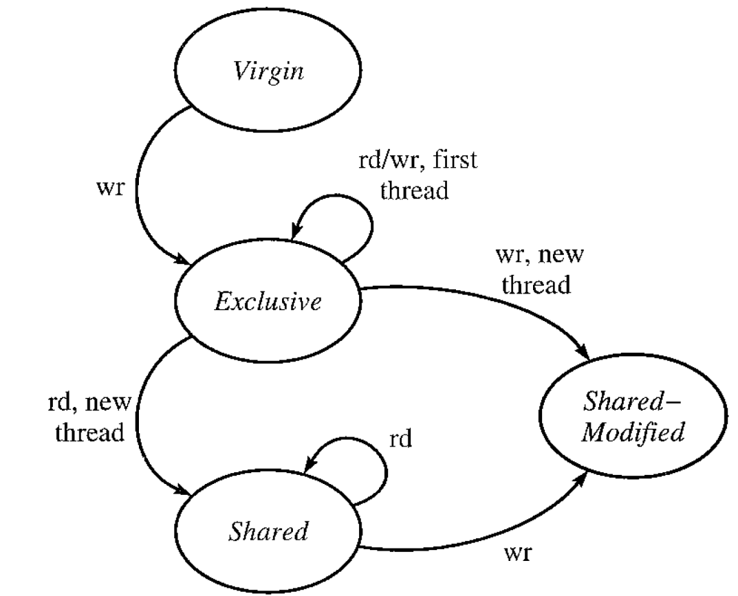
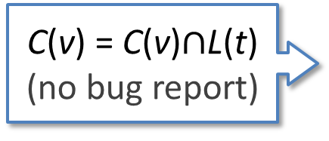
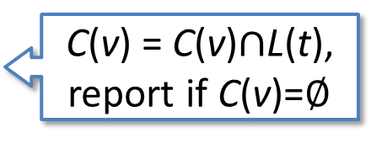
Memory Location State
Eraser maintains the state for each memory location to check if it is in initialization, and if read-shared.
state
C(v) = {*}
candidates
firstThread
Initialization
C(v) is not updated
C(v) = C(v)$∩$L(t),
report if C(v)=$∅$
C(v) = C(v)$∩$L(t)
(no bug report)
Read-shared

Slide 5
Data Structure for Memory Address (1/2)
HashMap<Long, HashSet<Integer>> candidates
Key: memory
Value: a set of candidate locks
HashMap<Integer, MemoryState> state
Key: memory
Value: the monitoring state of the memory

Slide 6
Data Structure for Memory Address (2/2)
HashMap<Long, Integer> firstThread
Key: memory
Value: thread that first accesses memory
HashMap<Integer, Integer> lastAccessLoc
Key: memory
Value: iid of an operation that access memory right before the data race detection
javato.activetesting.analysis.Observer.getIidToLoc(iid) converts iid to the corresponding code line information

Slide 7
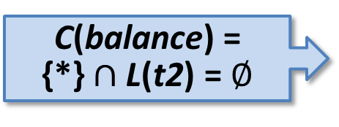
Lockset Algorithm Example
Initially, balance: 10
class Account {
long balance; //must be non-negative
void withdraw(long x){
1 if(balance >= x){
2 synchronized(this){
3 balance=balance – x;
4 }
5 }
}
void deposit(long x){
11 synchronized(this){
12 balance=balance + x;
13 }
}
}
t1: deposit(10)
t2: withdraw(5)
11:lock(this)
12:t=balance
lastAccessLoc (balance): 12
12:balance=t+10
13:unlock(this)
C(balance) = {*}$∩$L(t2) = $∅$
1:if(balance>=5)
2:lock(this)
3:t=balance
3:balance=t-5
4:unlock(this)

