Slide 1
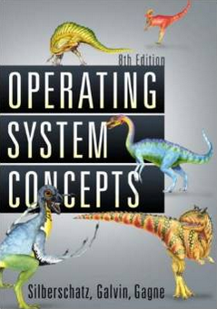
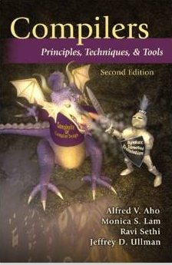
Quality Concurrent SW - Fight the Complexity of SW
Moonzoo Kim
CS Dept. KAIST

Slide 2
Testing is a Complex and Challenging task!!!
Object-Oriented Programming, Systems Languages, and Applications, Seattle, Washington, November 8, 2002
“… When you look at a big commercial software company like Microsoft, there's actually as much testing that goes in as development. We have as many testers as we have developers. Testers basically test all the time, and developers basically are involved in the testing process about half the time…”
“… We've probably changed the industry we're in. We're not in the software industry; we're in the testing industry, and writing the software is the thing that keeps us busy doing all that testing.”
“…The test cases are unbelievably expensive; in fact, there's more lines of code in the test harness than there is in the program itself. Often that's a ratio of about three to one.”
Notes:
심지어는 Bill Gate 가 말하길, “MS는 소프트웨어 기업이 아니라, 테스팅 기업” 이라고 까지 말할 정도로 테스팅에 많은 시간, 인원, 비용을 소모하고 있다. 그렇다고 완전한 것도 아니다.
2

Slide 3
Ex. Testing a Triangle Decision Program
Input : Read three integer values from the command line. The three values represent the length of the sides of a triangle.
Output : Tell whether the triangle is
• 부등변삼각형 (Scalene) : no two sides are equal
• 이등변삼각형(Isosceles) : exactly two sides are equal
• 정삼각형 (Equilateral) : all sides are equal
Create a Set of Test Cases for this program
(3,4,5), (2,2,1), (1,1,1) ?

Slide 4
Precondition (Input Validity) Check
Condition 1: a > 0, b > 0, c > 0
Condition 2: a < b + c
Ex. (4, 2, 1) is an invalid triangle
Permutation of the above condition
a < b +c
b < a + c
c < a + b
What if b + c exceeds 2³² (i.e. overflow)?
long v.s. int v.s. short. v.s. char
Developers often fail to consider implicit preconditions
Cause of many hard-to-find bugs

Slide 5
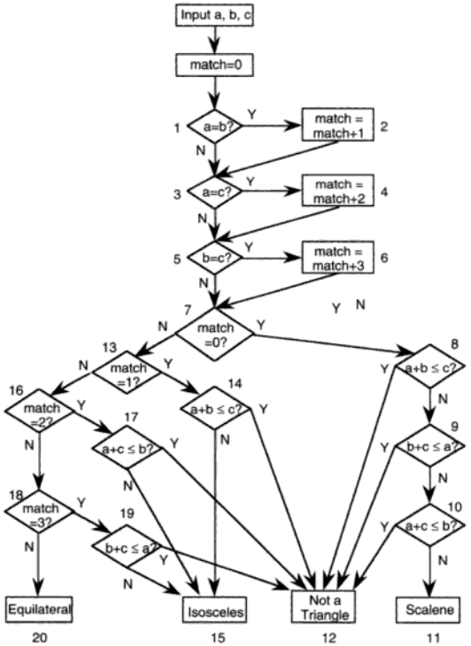
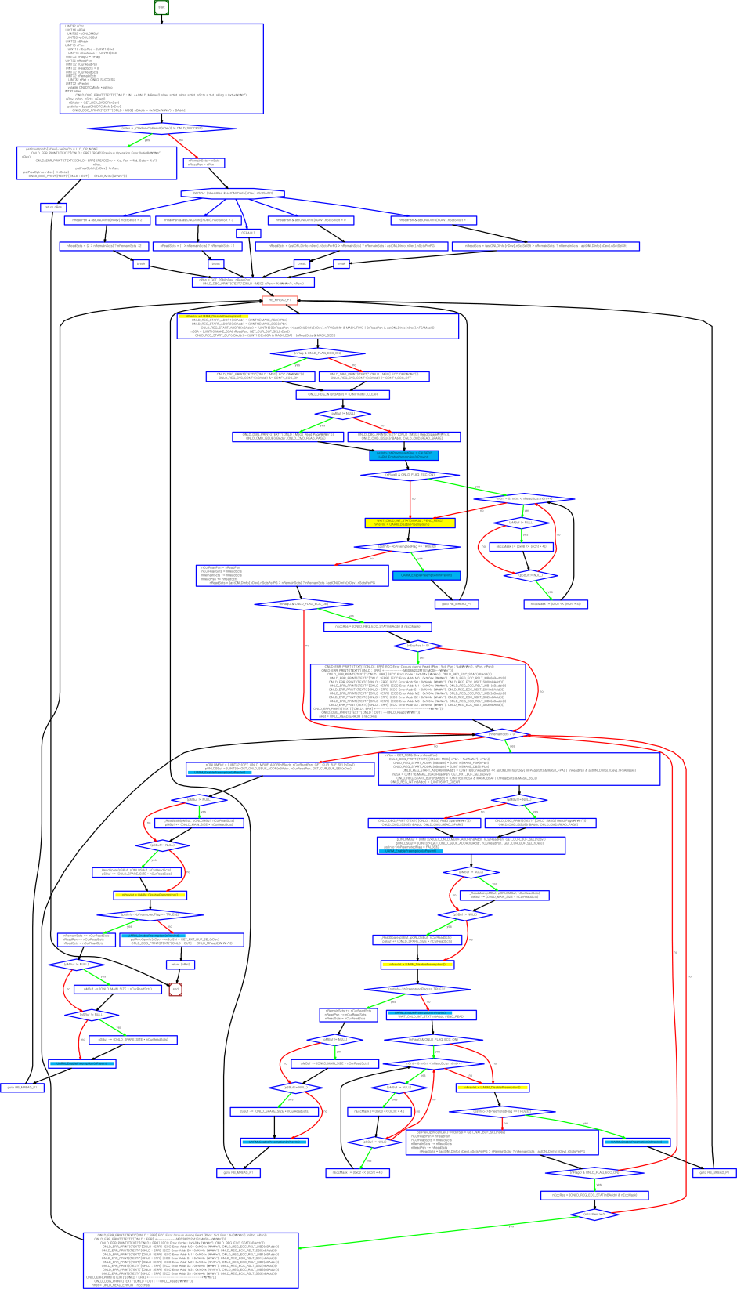
“Software Testing a craftsman’s approach” 2nd ed by P.C.Jorgensen
(no check for positive inputs)
# of test cases required?
4
10
50
100
# of feasible unique execution paths?
11 paths
guess what test cases needed
Notes:
a,b,c = 1,1,1:result=0
a,b,c = 2,1,1:result=2
a,b,c = 2,1,2:result=1
a,b,c = 1,2,1:result=2
a,b,c = 3,2,1:result=2
a,b,c = 2,1,3:result=2
a,b,c = 4,3,2:result=3
a,b,c = 2,3,1:result=2
a,b,c = 3,2,2:result=1
a,b,c = 2,2,1:result=1
a,b,c = 1,1,2:result=2
~

Slide 6
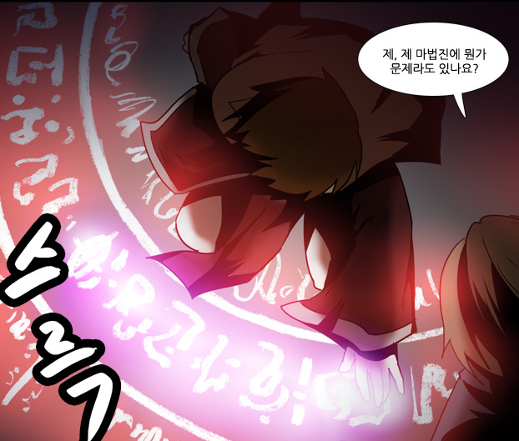
Software v.s. Magic Circle (마법진)
Written by a software developers line by line
Requires programming expertise
SW executes complicated tasks which are far more complex than the code itself
The software often behaves in unpredicted ways and crash occurs
Written by a human magician line by line
Requires magic spell knowledge
Summoned monsters are far more powerful than the magic spell itself
The summoned demon is often uncontrollable and disaster occurs
네이버 웹툰 “그 판타지 세계에서 사는법“ by 촌장

Slide 7
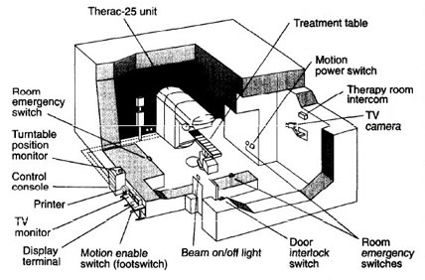
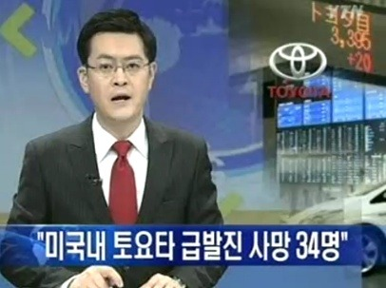
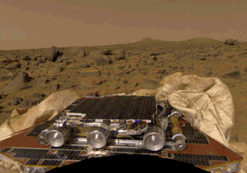
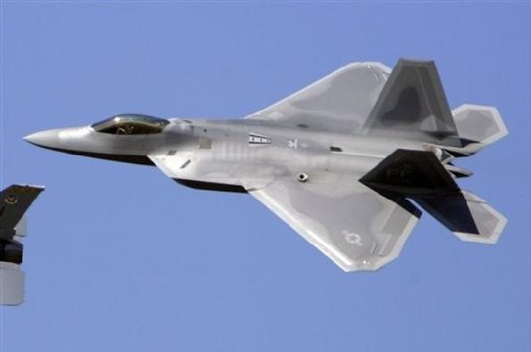
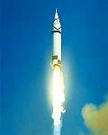
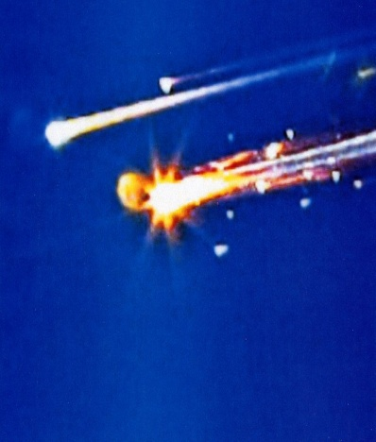
Safety Problems due to Poor Quality of SW

Slide 9
Research Trends toward Quality Systems
Academic research on developing embedded systems has reached stable stage
Research focus has moved on to the quality of the systems from the mere functionalities of the systems
Energy efficient design, ez-maintenance, dynamic configuration, etc
Software reliability is one of the highly pursued qualities
USENIX Security 2015 Best paper
“Under-Constrained Symbolic Execution: Correctness Checking for Real Code” @ Stanford University
ASPLOS 2011 Best paper
“S2E: a platform for in-vivo multi-path analysis for software systems” @ EPFL
OSDI 2008 Best paper
“Klee: Unassisted and Automatic Generation of High-Coverage Tests for Complex Systems Programs” @ Stanford
Notes:
NSDI 2007 Best paper
“Life, Death, and the Critical Transition: Finding Liveness Bugs in Systems Code” @ U.C. San Diego

Slide 10
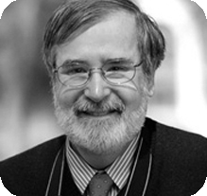
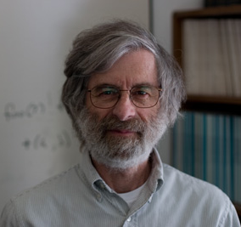
Formal Analysis of Software as a Foundational and Promising CS Research
2007 ACM Turing Awardees
Prof. Edmund Clarke, Dr. Joseph Sipfakis, Prof. E. Allen Emerson
For the contribution of migrating from pure model checking research to industrial reality
2013 ACM Turing Awardee
Dr. Leslie Lamport
For fundamental contributions to the theory and practice of distributed and concurrent systems
Happens-before relation, sequential consistency, Bakery algorithm, TLA+ (Temporal Logic for Actions), and LaTeX

Slide 11
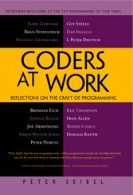
Motivation for Concurrency Analysis
Multithreaded programming are becoming popular more and more
37 % of all open-source C# applications and 87% of large applications in active code repositories use multi-threading [Okur & Dig FSE 2012]
However, multithreaded programming remains as error-prone
Writing correct multithreaded program is difficult
Testing written multithreaded program is difficult
Most of my subjects (interviewee) have found that the hardest bugs to track down are in concurrent code
…
And almost every one seem to think that
ubiquitous multi-core CPUs are going to force some serious changes in the way software is written
 | Small (1K-10K) | Medium (10K-100K) | Large (>100K)
# of all projects in the study | 6020 | 1553 | 205
# of projects with multithreading | 1761 | 916 | 178
# of projects with parallel library uses | 412 | 203 | 40
P. Siebel, Coders at work (2009) -- interview with 15 top programmers of our times:
Jamie Zawinski, Brad Fitzpatrick, Douglas Crockford, Brendan Eich,
Joshua Bloch, Joe Armstrong, Simon Peyton Jones, Peter Norvig,
Guy Steele, Dan Ingalls, L Peter Deutsch, Ken Thompson, Fran Allen,
Bernie Cosell, Donald Knuth

Slide 12
Concurrency
Concurrent programs have very high complexity due to non-deterministic scheduling
Ex. int x=0, y=0, z =0;
void p() {x=y+1; y=z+1; z= x+1;}
void q() {y=z+1; z=x+1; x=y+1;}
p()
q()
Notes:
x,y,z
2,1,2
2,1,3
2,2,3
2,3,3
2,4,3
3,2,3
4,3,2
4,3,5

Slide 13
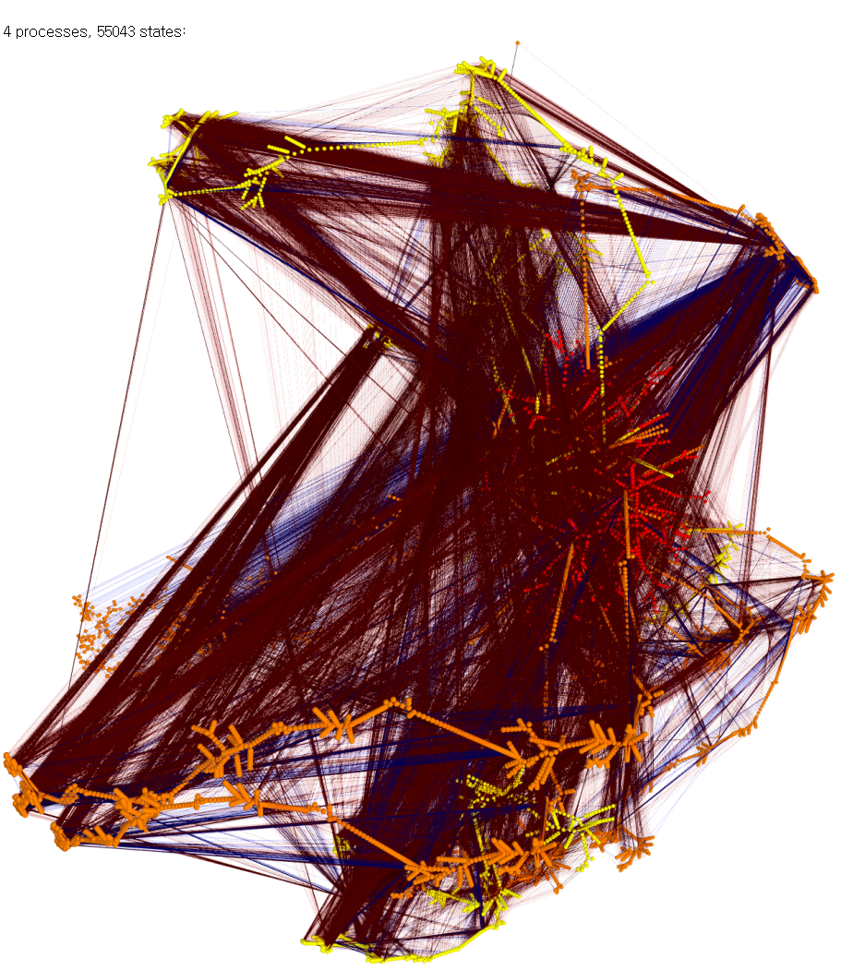
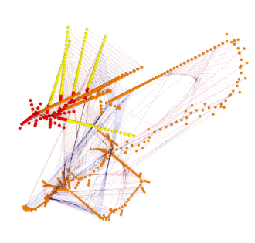
Concurrent Programming is Error-prone
Correctness of concurrent programs is hard to achieve
Interactions between threads should be carefully performed
A large # of thread executions due to non-deterministic thread scheduling
Testing technique for sequential programs do not properly work
4 processes, 55043 states
3 processes, 853 states
2 processes
, 30 states
Ex. Peterson mutual exclusion (From Dr. Moritz Hammer’s Visualisierung )

Slide 14
An Example of Mutual Exclusion Protocol
char cnt=0,x=0,y=0,z=0;
void process() {
char me=_pid +1; /* me is 1 or 2*/
again:
x = me;
If (y ==0 || y== me) ;
else goto again;
z =me;
If (x == me) ;
else goto again;
y=me;
If(z==me);
else goto again;
/* enter critical section */
cnt++;
assert( cnt ==1);
cnt --;
goto again;
}
Process 0
x = 1
If(y==0 || y == 1)
z = 1
If(x == 1)
y = 1
If(z == 1)
cnt++
Process 1
x = 2
If(y==0 || y ==2)
z = 2
If(x==2)
y=2
If (z==2)
cnt++
Software
locks
Critical
section
Violation detected !!!
Mutual
Exclusion
Algorithm
Counter
Example

Slide 15
Research on Concurrent Program Analysis
We have developed static/dynamic techniques for finding bugs in large concurrent programs effectively
Coverage-guided testing is a promising technique for effective/efficient concurrent program quality assurance
CUVE [ISSTA’12]
Industry-size concurrent programs
Precision
MOKERT
[MBT’08]
Coverage-guided
thread scheduling
generation
Model-
based
testing
Model
Checking
Testing
Code pattern-based
analysis
Sync. pattern based
bug
detection
COBET
[JSS’12]
Race bug
classification
Bug pattern +
static analysis
Scalability

Slide 16
Techniques to Test Concurrent Programs
Pattern-based bug detection
Systematic testing
Find predefined patterns of suspicious synchronizations [Eraser, Atomizer, CalFuzzer]
Limitation: focused on specific bug
Explore all possible thread scheduling cases [CHESS, Fusion]
Limitation: limited scalability
Random testing
Generate random thread scheduling [ConTest]
Limitation: may not investigate
new interleaving
Direct thread scheduling
for high test coverage

Slide 17
Challenge: Thread Schedule Generation
Thread-1
5 | 4 | 3 | 2 | 1
Thread
scheduler
Interleaved execution-1
Thread-2
5 | 4 | 3 | 2 | 1
5 | 5 | 5 | … | 4 | 3 | 2 | 1 | 2 | 1 | 2 | 1
Thread-3
Interleaved execution-2
5 | 4 | 3 | 2 | 1
5 | 5 | 5 | … | 4 | 3 | 2 | 1 | 2 | 1 | 2 | 1
Interleaved execution-3
Testing environment
5 | 5 | 5 | … | 4 | 3 | 2 | 1 | 2 | 1 | 2 | 1
The basic thread scheduler repeats similar schedules in a fixed environment
Testing with the basic thread scheduler is not effective to generate diverse schedules, possible for field environments

Slide 18
Limitation of Random Testing Technique
Noise injector
Thread-1
5 | 4 | 3 | 2 |  |  | 1
Interleaved execution-1
Thread
scheduler
5 | 5 | 5 | … | 2 | 3 | 2 | 3 | 1 | 2 | 1 | 1
Thread-2
5 |  | 4 |  | 3 | 2 | 1
Interleaved execution-2
Thread-3
5 | 5 | 5 | … | 2 | 3 | 2 | 1 | 3 | 2 | 1 | 1
5 | 4 | 3 | 2 |  | 1
Testing environment
5 | 4 | 3 | … | 3 | 2 | 5 | 1 | 4 | 3 | 2 | 1
Limitation
The probability to cover subtle behavior may be very low
No guarantee that the technique keeps discover new behaviors

Slide 19
Systematic Testing Technique
Thread-1
5 | 4 | 3 | 2 | 1
Interleaved execution-1
Systematic
testing
technique
5 | 4 | 3 | … | 3 | 2 | 1 | 5 | 4 | 3 | 2 | 1
Thread-2
5 | 4 | 3 | 2 | 1
Interleaved execution-2
Thread-3
5 | 4 | 3 | … | 3 | 2 | 5 | 1 | 4 | 3 | 2 | 1
5 | 4 | 3 | 2 | 1
$$\frac{\left(5+5+5\right)!}{5!5!5!}$$
:
:
Testing environment
Interleaved execution-10
5 | 4 | 3 | … | 3 | 5 | 4 | 2 | 1 | 3 | 2 | 1
Limitation
Not efficient to check diverse behaviors
A test might be skewed for checking local behaviors

Slide 20
Pattern-directed Testing Technique
Pattern-based
bug predictor
Thread-1
Interleaved execution-1
5 | 4 | 3 | 2 | 1
5 | 4 | 3 | … | 2 | 1 | 4 | 3 | 2 | 1 | 2 | 1
Bug-driven
scheduler
Thread-2
Interleaved execution-2
5 | 4 | 3 | 2 | 1
5 | 4 | 3 | … | 2 | 1 | 4 | 3 | 2 | 1 | 2 | 1
Thread-3
5 | 4 | 3 | 2 | 1
Interleaved execution-3
Testing environment
5 | 4 | 3 | … | 3 | 2 | 4 | 3 | 2 | 1 | 1 | 1
Limitation
Not effective to discover diverse behaviors
The technique may miss concurrency faults not predicted
No guarantee to have a chance to induce predicted faults

Slide 21
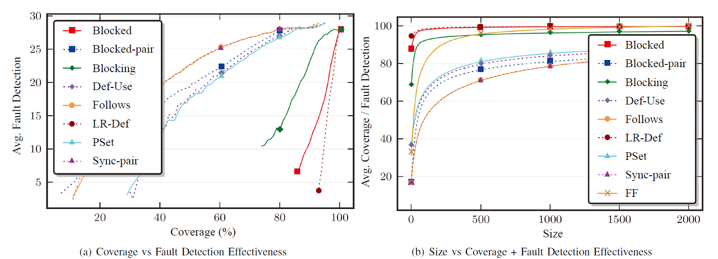
Coverage-based Testing Technique
Coverage
metric
Coverage
info.
Coverage
measure
Thread-1
5 | 4 | 3 | 2 | 1
Coverage-
based
scheduler
Interleaved execution-1
Thread-2
5 | 4 | 3 | 2 | 1
5 | 5 | 4 | … | 2 | 3 | 2 | 3 | 1 | 2 | 1 | 1
:
:
Thread-3
5 | 4 | 3 | 2 | 1
Testing environment
Advantage
High co-relation between concurrent coverage and fault-finding
Engineer can measure testing progress explicitly
Note that coverage-based testing is a standard testing process in sequential program testing

