Slide 1
Atomicity Violation Detection
CS492B Analysis of Concurrent Programs
Prof. Moonzoo Kim

Slide 2
Data Race Free, Yet Race Bug (1/2)
public class Vector implements Collection {
int elementCount ;
Object [] elementData ;
public Vector(Collection c){
elementCount = c.size() ;
elementData = new Object[elementCount] ;
c.toArray(elementData) ; }
public synchronized int size(){
return elementCount ; }
public synchronized Object[] toArray(Object a[]){
...
System.arraycopy(elementData, 0, a, 0, elementCount) ;
... }
public synchronized boolean add(Object o) {
...
elementCount++; ...} }
Data race free (protected by this)
Should
be
executed
atomically
Thread 1
Vector v2=new Vector(v1);
Thread 2
v1.add(obj);

Slide 3
Data Race Free, Yet Race Bug (2/2)
Thread 1
Thread2
//v1.size()
lock(v1)
t=v1.elementCount// 10
unlock(v1)
v2.elementCount=t
v2.elementData=new Object[10]
//v1.toArray()
lock(v1)
System.arraycopy(v1.elementData ,0,v2.elementData,0, v1.elementCount)
//v1.add()
lock(v1)
…
v1.elementCount++ // 11
…
unlock(v1)
Array out of bound error

Slide 4
Time-Of-Check to Time-Of-Use (TOCTOU) Attack
Victim
Attacker
//a program installed setuid root
if (access(“sym_link_file”,“w”) != 0)
exit(1) ;
fd = fopen(“sym_link_file”, “w+”);
// Do something about fd
//after the access check
symlink(“/etc/passwd”,“sym_link_file”);
An attacker can exploit the race condition between the access and open to trick the victim into reading/overwriting an entry in the system password database.
http://en.wikipedia.org/wiki/Time_of_check_to_time_of_use
http://cecs.wright.edu/~pmateti/InternetSecurity/Lectures/RaceConditions/index.html
Notes:
Recall that access() checks whether the calling process can access the file named by pathname. If pathname is a symbolic link, it is dereferenced

Slide 5
Atomicity
A code block is atomic if for every interleaved execution, there is an equivalent execution with the same result where the code block is executed serially (i.e., not interleaved with other threads).
Programmers often assume the atomicity of a code block to reason its behavior as if it is a sequential code.
c.f. atomic block: code block defined as atomic by programmers

Slide 6
Atomicity Violation
An atomicity violation (atomicity bug) is a race bug that violates the atomicity of an atomic block defined by programmers
Atomicity violation detection techniques check if an observed execution is equivalent to any serial execution (i.e., serializable)
Reduction based technique
Access pattern based technique
Happens-before relation based techniques

Slide 7
Lipton’s Reduction (1/2)
An interleaved execution σ can be reduced to an equivalent interleaved execution σ’ by swapping commuting operations.
Two operations a and b in σ are commuting if
a and b are executed by different threads, and
a is immediately followed by b, and
their execution orders do not change the resulting state in an execution.
s₀
s₁
s₂
σ :
t1:lock(m)
t2:tmp=0
s₀
s₁’
s₂
σ’ :
t2:tmp=0
t1:lock(m)

Slide 8
Lipton’s Reduction (2/2)
An operation p is right-mover if p commutes with the operation that immediately follows p and executed by another thread
An operation p is left-mover if p is commutes with the operation immediately followed by p , executed by another thread
An operation p is both-mover if p is right-mover and left-mover at the same time
non-mover if p is neither right-mover nor left-mover.

Slide 9
Atomizer [Flanagan, POPL 04]
Atomizer checks if an observed execution σ can be reduced to an equivalent serial execution σ’
Atomizer assumes that every public methods are atomic blocks
Note that, in a serial execution, executions of atomic blocks do not overlap with each other.
Reduction rule
Operation type | Right-mover and/or left-mover
lock(m) (i.e., lock m is held by a thread) | right-mover
unlock(m) | left-mover
read(v) or write(v) where v is thread-local | both-mover
read(v) or write(v) where v is shared, and consistently guarded by a lock | both-mover
read(v) or write(v) where v is shared, and not consistently guarded by a lock | non-mover

Slide 10
Serializable Execution Example
Variable A and B are consistently guarded by lock X and Y, respectively
Variable C is not consistently guarded by any lock
Left
Thread 1
Thread 2
Thread 1
Thread 2
Thread 1
Thread 2
lock(X)
lock(Y)
lock(Y)
read(A)
read(B)
read(B)
lock(Y)
write(C)
write(C)
read(B)
lock(X)
write(B)
write(C)
read(A)
unlock(Y)
write(tmp)
write(tmp)
lock(X)
read(C)
read(C)
read(A)
write(A)
write(A)
write(tmp)
write(B)
write(B)
read(C)
unlock(Y)
unlock(Y)
write(A)
unlock(X)
unlock(X)
unlock(X)
Right
Equivalent to a serial execution

Slide 11
Non-serializable Execution Example
Variables A and B are consistently guarded by lock X and Y, respectively
Variable C is not consistently guarded by any lock
Left
Thread 1
Thread 2
Thread 1
Thread 2
Thread 1
Thread 2
lock(X)
lock(Y)
lock(X)
read(A)
read(B)
read(A)
lock(Y)
write(C)
write(tmp)
read(B)
unlock(Y)
lock(Y)
write(C)
lock(X)
read(B)
write(tmp)
read(A)
write(C)
read(C)
write(tmp)
unlock(Y)
unlock(X)
read(C)
read(C)
unlock(Y)
unlock(X)
unlock(X)
unlock(X)
lock(X)
lock(X)
lock(X)
lock(X)
write(A)
write(A)
write(A)
unlock(X)
unlock(X)
unlock(X)
Right
Not equivalent to any serial execution

Slide 12
Atomicity Checking
Atomizer’s serializability checking with the reduction is the same as checking if every transaction is in the following pattern:
[Right-mover]* [Non-mover]? [Left-mover]*
e.g: Two-phase locking
lock(X)
lock(Y)
lock(Z)
/* data accesses */
unlock(Z)
unlock(Y)
unlock(X)
Expanding phase
Shrinking phase
L. Wang and S. D. Stoller: Runtime Analysis of Atomicity for Multithreaded Programs, IEEE TSE, 32(2), 2006

Slide 13
False Positive of Atomizer
class Vector {
Object [] elementData;
int elementCount ;
int size(){
1: synchronized(this){
2: return elementCount;
3: }
}
boolean contains(Object x){
//atomic block begins
4: int i=0;
5: while(i < size()){
6: synchronized(this){
7: if(elementData[i].equals(x))
8: return true;
9: }
10: i++;
11: }
12: return false;
//atomic block ends
}
}
t1: contains(o1)
t2: contains(o2)
1:lock(this)
2:read(elementCount)
3:unlock(this)
1:lock(this)
2:read(elementCount)
…
3:unlock(this)
1:lock(this)
2:read(elementCount)
3:unlock(this)
Detected as atomicity violation, but “semantically” serializable

Slide 14
Access Pattern Based Detection
Detect interleaved accesses on a shared variable that match to non-serializable patterns as atomicity violations
Select 4 among total 8 patterns as buggy based on experiences in real-bugs
read(x)
write(x)
Unlike serial executions, first and second read operations may see different values
write(x)
write(x)
Intended data-flow from first write to read operations may be interfered by the second write
read(x)
read(x)
Unserializable pattern#1
Unserializable pattern#2
Read operation may see the data before the update is completedㅠ
write(x)
read(x)
check-and-set in the left thread may be interfered by right thread
read(x)
write(x)
write(x)
write(x)
Unserializable pattern#3
Unserializable pattern#4
S. Lu et al.: AVIO: Detecting Atomicity Violations via Access Interleaving Invariants, ASPLOS 2006

Slide 15
False Negative of Access Patterns
Thread1(){
//atomic block begins
synchronized(X){
a = 0 ; }
synchronized(Y){
b = 0 ; }
//atomic block ends
}
Thread2(){
//atomic block begins
synchronized(X){
a = 1 ; }
synchronized(Y){
b = 1 ; }
//atomic block ends
}
t1: Thread1()
t2: Thread2()
lock(X)
write(a,0)
unlock(X)
lock(X)
write(a,1)
unlock(X)
lock(X)
write(b,1)
unlock(X)
lock(X)
write(b,0)
unlock(X)
a:1, b:0

Slide 16
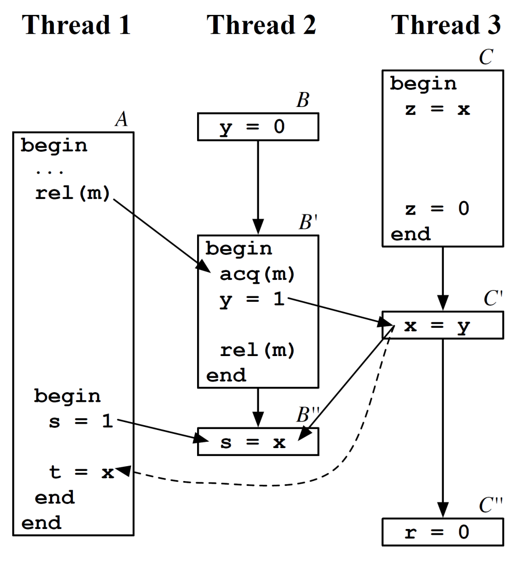
Velodrome [Flanagan, PLDI 08]
Velodrome defines happens- before relation over atomic block executions
Veldorome detects an inconsistency in the happens-before relation (i.e. cycle) as an atomicity violation

Slide 17
Happens-Before in Transactions (1/3)
An execution is a sequence of operations
A transaction in an execution is the sequence of operations in a thread, that correspond to an execution of an atomic block
Users can specify where an atomic block starts/ends in code
An execution is serial if each transaction’s operation execute contiguously, without interleaving

Slide 18
Happens-Before in Transactions (2/3)
Two operations in an execution conflict if
these access the same variable, and at least one is writing, or
these operate on the same lock, or
these are executed in the same thread
If two operations do not conflict, they commute
The happens-before relation over operations ($≺$) in an execution satisfies the following properties:
a $≺$ b if a occurs before b in the execution, and a conflicts with b
a $≺$ b if a occurs before b, and a and b are in the same transaction
a $≺$ c if a $≺$ b and b $≺$ c

Slide 19
Happens-Before in Transactions (3/3)
A transaction $P$ happens-before a transaction $Q$ in an execution ($P⋖Q$) if
$P≠Q$, and
$∃ p∈P, ∃q∈Q: p≺q$
An execution is serializable if and only if the transactional happens-before relation $(⋖)$ is acyclic*
A blame assignment is a set of happens-before relation over operations that construct a cycle in the transactional happens-before relation
* P. A. Bernstein et al., Concurrency Control and Recovery in Database Systems, Addison-Wesley, 1987

Slide 20
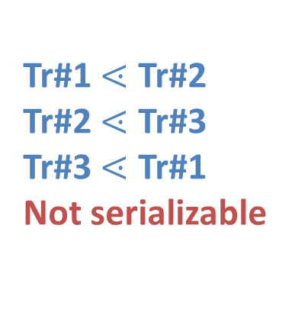
Example
t1: Thread1()
t2: Thread2()
t3: Thread2()
Tr#1
lock(X)
Tr#2
write(a)
lock(Y)
Tr#3
unlock(X)
write(b)
Tr#1 $⋖$ Tr#2
Tr#2 $⋖$ Tr#3
Tr#3 $⋖$ Tr#1
Not serializable
unlock(Y)
lock(Z)
lock(Y)
read(b)
write(c)
unlock(Y)
unlock(Z)
lock(Z)
lock(X)
read(c)
read(a)
unlock(Z)
unlock(X)

Slide 21
False Positive of Velodrome
t1: Thread1()
t2: Thread2()
Thread1(){
//atomic block begins
synchronized(X){
a = 1}
synchronized(X){
a = 2 ; }
//atomic block ends
}
Thread2(){
//atomic block begins
synchronized(X){
a = 11 ;
a = 12 ; }
//atomic block ends
}
Tr#1
lock(X)
write(a, 1)
Tr#2
unlock(X)
lock(X)
write(a, 11)
write(a, 12)
unlock(X)
lock(X)
write(a, 2)
lock(X)
Execution order of write operations on a variable without read operations do not change result states, except for the last one

Slide 23
View-Serializability (1/2)
Conflict-serializability (used by Velodrome)
An execution is conflict-serializable if there exists a serial execution s.t. (1) the two executions have the same operations, and (2) for every pair of conflicting operations, the two operations have the same order in both executions
View-serializability*
An execution is view-serializable if there exists a serial execution s. t. (1) two executions have the same operations, and (2) each read operation has the same write predecessor in both executions, and
- The write-predecessor of a read operation is the last write operation on the variable that the read operation reads in an execution
(3) each variable has the same final write operation in both executions
*L. Wang et al.: Accurate and Efficient Runtime Detection of Atomicity Errors in Concurrent Programs, PPoPP 2006
Notes:
If an execution is view-serializable, that execution is conflict serializale. But not vice versa

Slide 24
View-Serializability (2/2)
We can implement the view-serializability checking by modifying the conflict definition
Two operations p and q in an execution conflict if
these access the same variable where
p is writing, and q is reading, or
q is the final write operation on the variable in the execution
these operate on the same lock, or
these are executed in the same thread

