Slide 1
Variable and Thread Bounding for Systematic Testing of Multithreaded Programs
CS750 Advanced Automated SW Testing, Fall 2014
Sandeep Bindal, Sorav Bansal (IIT Delhi), Akash Lal (MSR India)
Originally presented in ISSTA 2013
Shin Hong

Slide 2
Overview
The authors propose two new thread schedule bounding search strategies for multithreaded program testing: variable bounding and thread bounding
Variable bounding: new search strategy + tighter bound of fault finding probability
Thread bounding: tighter bounds of fault finding probability
The authors implemented the variable bound strategy on the Probabilistic Concurrency Testing (PCT) technique
The experiments with 21 Java and 1 C# programs show that the studied bugs have low variable/thread bounds (i.e. 1, 2), and the new techniques are more efficient than the conventional one.

Slide 3
Concurrent Program Testing At a Glance
Stateful model checking
Effectiveness
PCT with VB and TB
PCT
CHESS
Random
exploration
Efficiency
(cost-effectiveness)

Slide 4
Bounded Search Strategy for Concurrent Program Testing
Context bounding (preemption, depth bounding)
Explore schedules while restricting the number of preemptions (preemptive context-switches) in an execution to less than or equal to a certain number.
Variable bounding
Explore schedules while allowing preemptions only at the accesses on certain variables.
Thread bounding
Explore a certain number of schedules first, that are sufficient to explore all ordering of a certain number of thread.

Slide 5
Variable Bounding
Definition
A concurrency bug is a c-context bug if the minimum number of ordering constraints sufficient to induce an error is c.
A concurrency bug is a v-variable bug if a minimal set of ordering constraints sufficiently induce an error is defined over the accesses on at least v distinct variables.
Examples
Thread2() {
11: a = 1;
12: a = 0;
}
Initially, a = 0, b = 0
Thread1() {
1: t1 = a;
2: t2 = a;
3: t3 = b;
4: assert(t1==t2 || t3!=1);
}
Thread2() {
11: a = 1;
12: b = 1;
13: b = 0;
}
Initially, a = 0
Thread1() {
1: t1 = a;
2: t2 = a;
3: assert(t1==t2);
}

Slide 6
Variable Bounded Search Strategy
Explore the schedules that exhaustively cover all ordering relations involving a small number of variables first
Example:
for v ∈ [1..b] begin
for sub ∈ C(Var, v) begin
test(P, s₀, sub) ;
end
end
Advantage of the variable bounded search strategy
Most concurrency bugs would be found with 1-variable bound
The survey result shows that 66% of non-deadlock concurrency bugs are involved with one shared variable [Lu, ASPLOS 08]
The strategy reduces the runtime overhead of a testing technique as it reduces the number of schedule-controlling points

Slide 7
Search Space Reduction by Variable Bounding
A case with the context-bounded search
Suppose that a multithreaded program has a set of n threads T, a set of shared variables V.
Suppose that a thread accesses a variable v $∈$ V exactly d times.
- The number of schedules of context bound c is O((nd|V|)^{C}).
Choosing each context-switch point among nd|V| points for c times.
- The number of schedules of context bound c and variable bound v is O(|V|^{v} (ndv)^{C})
Choosing each context-switch point among ndv points for c times
There are C(|V|, v) ~ |V|^{v} number of v-sized shared variable subset (v $≪$|V|)
- O((nd|V|)^{C}) is significantly greater than O(|V|^{v}(ndv)^{C}) if v < c$≪$|V|
(nd|V|)^{c} : |V|^{v}(ndv)^{c} = |V|^{c-v} : v^{c}

Slide 8
PCT with Variable Bounding
Probabilistic Concurrency Testing (PCT) for d-depth bugs
Choose d-1 thread scheduling points randomly;
Generates executions that have various ordering of the chosen points
PCT with the variable bounding search strategy
Choose a set of v variables randomly;
Choose d-1 thread scheduling points among the accesses to the chosen variables
Generate executions that have various ordering of the chosen points
PCT with the variable bounding strategy provides more tight bounds of finding d-depth concurrency bugs than PCT itself

Slide 9
PCT Overview
Partitioning: initially, the technique defines partitions (fragments) over a target multithreaded programs
Scheduling: at the beginning of an execution, the technique randomly decides priorities (i.e., execution orders) of the partitions
Test generation: in the execution, the scheduler selects the partition of the highest priority for each step
Similar to priority scheduling
No interleaving within each execution of a partition except when the thread starts to wait for another thread

Slide 10
Partitioning
Suppose that a program has n threads, the program has total k instructions, and the of target concurrency bug is d-depth.
The technique defines each thread as a partition (n partitions)
Each partition starts at the thread starting point, and ends at the thread termination point
In addition, the technique randomly divides a partition into 2 for d-1 times (d-1 partitions in addition)
For an instruction in a program, the probability that the instruction belongs to an additional partition is 1/k at minimum

Slide 11
Partitioning
t₁
t₂
t_{n}
t₁
t₂
t_{n}
1:
2:
3:
4:
…
k-1:
k:
Partitioning
New partition defined randomly

Slide 12
Priority Assignment (Static Scheduling)
The technique randomly assigns the priorities d, d+1,...,d+n-1 to n partitions each of which starts from a thread
The priority d+n-1 is the highest one
The probability that a partition has the lowest priority (i.e. d) is 1/n at minimum.
For a partition generated by i-th division (1 $≤$ i $≤$ d-1), the technique assigns its priority as d-i.
For an instruction s in a program, the probability that s has a priority i is 1/(k-1) at minimum

Slide 13
Test Case Execution (Dynamic Scheduling)
Before test case executions, a user sets the number of context-switches in an execution, and a starting state
Before each test execution, the technique sets the partitions, and their priorities
For each state, the PCT runtime scheduler selects the thread that executes the partition of the highest priority in enabled threads
A thread enabled when it is not terminated, and not blocked by any synchronization
A context-switching occurs if
A thread begins/ends, or
A thread is blocked, or
A thread reaches to the end of a partition (randomly selected)

Slide 14
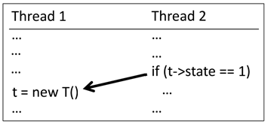
Probability to Detect 1-depth Bug (1/2)
Suppose that a target program has n threads and there is a 1-depth concurrency bug
The bug consists of two instructions p₁ and p₂ in two threads t₁ and t₂
The bug induces an error if p₂ is executed before p₁.
The technique defines n partitions each of which corresponds to each thread (no additional partition since d = 1)
The partition s₁ and s₂ correspond to t₁ and t₂
s₁
s₂

Slide 15
Probability to Detect 1-depth Bug (2/2)
The probability for a generated execution to detect an error for the bug is 1/n at minimum (in worst case)
The probability that s₂ has a higher priority than s₁ $≥$ the probability that s₁ has the lowest priority.
The probability that s₁ has the lowest priority is 1/n

Slide 16
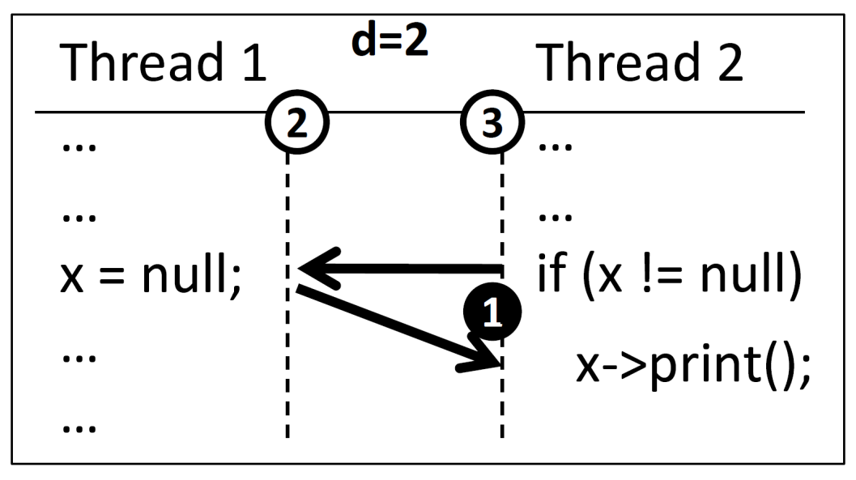
Probability to Detect 2-depth Bug (1/2)
Suppose that a target program has n threads and k instructions, and there is a 2-depth concurrency bug
The bug consists of p₁, p₂, and p₃ where p₁ and p₂ belong to different threads (t₁$≠$t₂), and p₂ and p₃ belongs to different threads (t₂$≠$t₃).
The technique defines n partitions that begins from thread starts, and one partition that starts from a randomly selected instruction.

Slide 17
Probability to Detect 2-depth Bug (2/2)
The probability of a generated execution to detect the error is $\frac{1}{n ×(k−1)}$ at minimum
The probability that p₃ belongs to the additional partition $≥1/(k−1)$
because the probability that the additional partition starts from p₃ is $1/(k−1)$ at minimum
The probability that s₁ has a higher priority than s₂ $≥ 1/n$

Slide 18
Probability to Detect d-depth Bugs
Suppose that a target program has n threads and k instructions, and there is a d-depth concurrency bug
Suppose that the bug consists of the instructions p₁, p₂, …, p_{d+1} and
The bug induces an error only if these instructions are executed in order
The probability of a generated execution to detects the error is $\frac{1}{n{ ×(k−1)}^{d−1}}$ at minimum
The probability that p₁ executes before p₂ $≥ \frac{1}{n}$
The probability that p₃, … , p_{d+1} belongs to the corresponding additional partitions $≥ \frac{1}{{(k−1)}^{d−1}}$

Slide 19
Improve PCT with Variable Bound
PCT-VB tries to create new partitions right after a thread updates certain variables, such that the schedules of partitions will explore different variable access sequences
Improve the probability of finding most bugs which have low variable bounds
Reduce runtime overhead by selective instrumentation
t₁
t₂
t_{n}
1:
2: W(x)
3:
4: R(x)
…
…
80:W(x)
81: R(x)
…
90: W(x)
…
…
k-2: R(x)
k-1:R(x)
k: …

Slide 20
Algorithm of PCT with Variable Bounding
Suppose that a target program has n threads, the depth bound and the variable bound are given as d and v
Choose a set of v variables a₁, a₂, …, a_{v} arbitrary (v < d)
Let b₁, b₂, …, b_{v} represent the upper-bounds on the number of operations accessing a₁, …, a_{v} in an execution, respectively. Construct S={(a_{i}, j) | i ∈[i..v] and j ∈[1..b_{i}]}
Select d-1 random elements from S (s₁, s₂, …, s_{d-1})
Instrument all statements possible to access any chosen variable
Assign the priorities d, d+1,…,d+n to n threads randomly
Execute the program while honoring assigned priorities
If a thread accesses a_{i} for j-th time where (a_{i}, j) = s_{k}, change the priority of the thread with k

Slide 21
Probabilistic Guarantee of PCT with VB
For a v variable subset, the probability of a generated execution to detects the error is $\frac{1}{n{ ×(\sum_{i=1..v}{bi})}^{d−1}}$ at minimum
$C(\left|Var\right|,v)$ : the number of $v$ variable subsets of the variables $Var$
$\sum_{i=1..v}{bi}$ : the number of thread scheduling point candidates
Suppose that $\sum_{i=1..v}{b_{i}}=f\frac{v}{|Var|}k$ and $f≪1$. $\frac{1}{n{ ×k}^{d−1}}$ : $\frac{1}{C(\left|Var\right|, v)}× \frac{1}{n{ ×(f\frac{v}{|Var|}k)}^{d−1}}$ = ${\left|Var\right|}^{d−v−1}$ : ${\left(vf\right)}^{d−1}$
Variable bounding significantly improves the lower bound if $v<d−1$and $f$ is small
Variable bounding is useful if the bug involves few variables that are accessed less than average

Slide 22
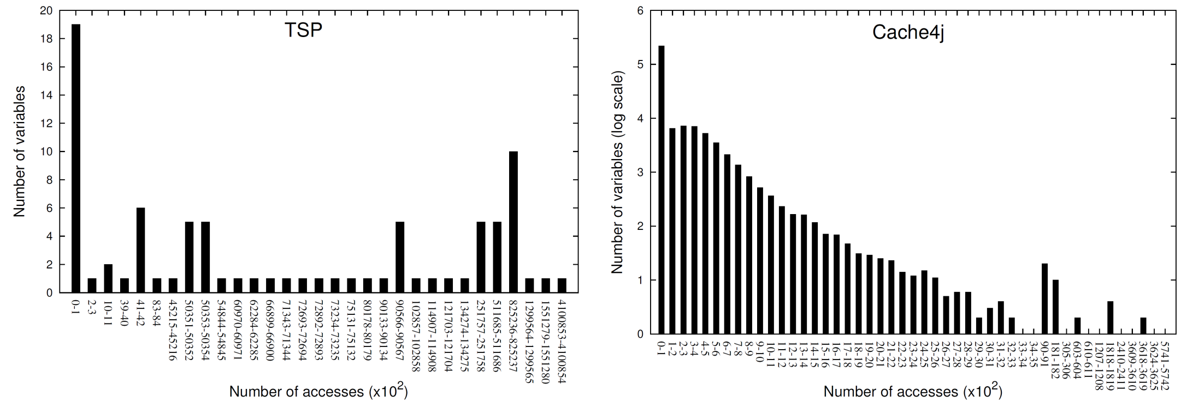
Advantage of PCT-VB
65 shared variables,
2.55b accesses
101 shared variables,
21.4m accesses
Many variables in the studied programs are not frequently accessed.
As we assume that a bug may be related to any variable in a target program, PCT-VB effectively reduce the search space in general.

Slide 23
Thread Bounding
A concurrency bug is t-thread bug if the minimal ordering constraints that sufficiently induce an error are defined over at least t distinct threads.
The study on real concurrency bugs indicate that most concurrency bugs induce an error with only two threads.
- Example
Initially, a=0
Thread1() {
1: a++ ;
}
Thread2() {
2: a++ ;
}
Thread3() {
3: assert(a!=1);
}
Thread3() {
3: assert(a<1);
}

Slide 24
Probabilistic Guarantee of Thread Bounding (1/2)
Suppose that the target program has N threads (n₁, n₂, …, n_{N}). Let $σ$be an arbitrary permutation of N threads.
Select an arbitrary set of t threads as S={s₁, s₂, …, s_{t}}. Let $π$be an arbitrary permutation of S.
The probability that $π$ is a subsequence (i.e. has the same ordering) of $σ$ is $\frac{1}{t!}$.
The probability that none of p random permutations of N threads contains $π$ as a subsequence is ${\left(1−\frac{1}{t!}\right)}^{p}$.
The expected number of t-length permutations not covered in p random permutations of N threads is ${P\left(N, t\right)×\left(1−\frac{1}{t!}\right)}^{p}$.
The number of permutations that makes the expected number less than $ε$: ${P\left(N, t\right)×\left(1−\frac{1}{t!}\right)}^{p}<ε$

Slide 25
Probabilistic Guarantee of Thread Bounding (2/2)
The number of permutations that makes the expected number less than $ε$: ${P\left(N, t\right)×\left(1−\frac{1}{t!}\right)}^{p}<ε$
Suppose that $p=a×t!$; approximate $\left(1−\frac{1}{t!}\right)t!≅\frac{1}{e}$ and $P(N,t)≅N^{t}$
$${N^{t}×\left(\frac{1}{e}\right)}^{a}<ε$$
$$tlog\left(N\right)−log⁡(ε)<a$$
$$t!×(tlog\left(N\right)−\log\left(ε\right))<p$$
To detect a d-depth, t-thread bug in a program with N threads, the number of test case executions should be greater than $\left(t+d−1\right)!×\left(t+d−1\right)\log{(N+d−1)}$

Slide 26
Experiment
Research questions
RQ1: What are typical values of variable-bound and thread-bound in common concurrency bugs?
RQ2: What is the runtime overhead due to variable bounding?
RQ3: Do variable and thread bounding improve the number of executions required to detect a concurrency bug?

Slide 27
Experiment Setup
Built a testing tool for Java, called RankChecker
Instrument the bytecode of a target program using Javaassist
Use a static alias analysis for variable bounding
Provide both PCT and the exhaustive search
Target programs
21 Java programs each of which has a concurrency bug
13 small programs from the ConTest benchmark
8 moderate size programs commonly used in other research (e.g.Arraylist, TSP)
1 C# program with a complex concurrency bug (from CHESS)

Slide 28
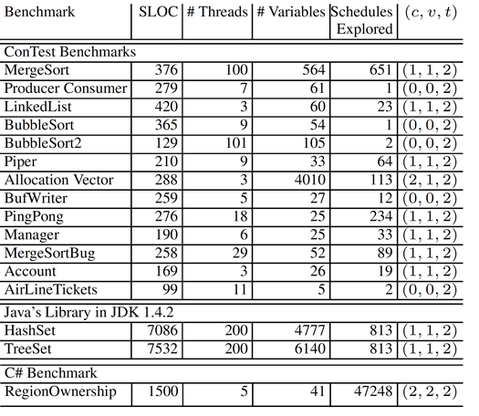
RQ1: Variable and Thread Bound
All bugs in the study have the bound $c≤2, v≤2, t=2$

Slide 29
RQ2: Runtime Overhead by Variable Bounding
CHESS with variable bounding requires moderate runtime overhead for generating each execution in spite of controlling data access operations
2.9x in average
8.1x in average
14.8x in average

Slide 30
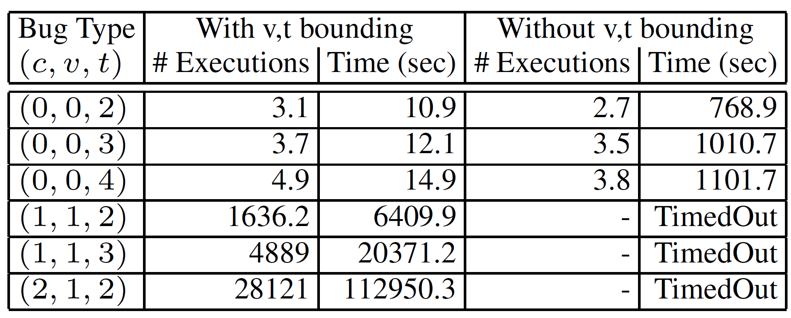
RQ3: Fault Finding Efficiency
Finding the RegionOwnership bug (3-context bug) using VT-CHESS
VT reduces the number of executions to find the bug
Finding the artificial bugs using RankChecker

Slide 31
Discussion
Variable bounding decreases the testing efficiency if the bug in a target program is related to frequently accessed variables.
The paper does not clearly present the thread bounding criteria in any particular testing technique.
The experiment does not validate the probabilistic guarantee, and does not compare it with any observed value.
All concurrency bugs used for the experiment are very simple such that the advantage of new bounded strategies does not seem significant.

