Slide 1

Test Case Purification for Improving Fault Localization
CS750 Advanced Automated Software Testing, Fall 14
[FSE’14]
Jifeng Xuan, Martin Monperrus
presented by Taehoon Kwak
SoftWare Testing & Verification Group

Slide 2
Contents
Motivation
Approach
Implementation
Evaluation
Experiment result
Conclusion

Slide 3

Motivation
Generate additional failing test cases to execute all assertions in a given failing test case.
  When assertion violation occurs, some assertions do not be executed.
  The paper claims that executing all assertions can improve the effectiveness of fault localization, because the effectiveness of fault localization depends on the quantity of assertions.
Failing test case t1
Target code
1 Public class targetTest{
2 @Test
3 void t1(){
4 target t = new target();
5 int a=1;
6 assertEquals(2, t.inc(a));
7 int b=1;
8 assertEquals(0, t.dec(b));
9 int c=3;
10 assertEquals(1, t.dec_twice(c));
11 };
12}
1 Public class target{
2 int inc(int n){
3 return ++n;
4 };
5 int dec(int n){
6 return ++n;
7 };
8 int dec_twice(int n){
9 n = dec(n);
10 return dec(n);
11 };
12}
Assertion violation
Unexecuted assertion
Notes:
focus on subject programs written in Java and tested with JUnit.

Slide 4

Approach
When an assertion violation occurs, ignore the exception to execute another assertions.
test case a3
Target code
1 Public class targetTest{
2 @Test
3 void a3(){
4 target t = new target();
5 int a=1;
6 assertEquals(2, t.inc(a));
7 int b=1;
8 assertEquals(0, t.dec(b));
9 int c=3;
10 assertEquals(1, t.dec_twice(c));
11 };
12}
1 Public class target{
2 int inc(int n){
3 return ++n;
4 };
5 int dec(int n){
6 return ++n;
7 };
8 int dec_twice(int n){
9 n = dec(n);
10 return dec(n);
11 };
12}
Ignore
the exception
The assertion will be executed
Notes:
focus on subject programs written in Java and tested with JUnit.

Slide 5
Approach
When an assertion violation occurs, ignore the exception to execute another assertions.
test case a3
Target Code | Test case
 | t1 | a2 | a3
1 Public class target{
2 int inc(int n){
3 return ++n; | ● | ● | ●
4 };
5 int dec(int n){
6 return ++n; | ● | ● | ●
7 };
8 int dec_twice(int n){
9 n = dec(n); |  |  | ●
10 return dec(n); |  |  | ●
11 };
12}
1 Public class targetTest{
2 @Test
3 void a3(){
4 target t = new target();
5 int a=1;
6 assertEquals(2, t.inc(a));
7 int b=1;
8 assertEquals(0, t.dec(b));
9 int c=3;
10 assertEquals(1, t.dec_twice(c));
11 };
12}
Ignore
the exception
The assertion will be executed
● means the statement is executed by the test case
Notes:
focus on subject programs written in Java and tested with JUnit.

Slide 6
Approach
Using existing failing test cases, sliced test cases (called purified test cases) are generated.
  Each of sliced test case contains only one assertion and the statements which have dependency with the variables in the assertion.
  The test result of the sliced test case must be fail.
Combine the suspiciousness score of existing fault localization techniques with a ratio of executions by sliced test cases which are generated by the approach.
Purified test case p3
Target Code | Test case
 | t1 | a2 | a3 | p2 | p3
1 Public class target{
2 int inc(int n){
3 return ++n; | ● | ● | ●
4 };
5 int dec(int n){
6 return ++n; | ● | ● | ● | ● | ●
7 };
8 int dec_twice(int n){
9 n = dec(n); |  |  | ● |  | ●
10 return dec(n); |  |  | ● |  | ●
11 };
12}
1 Public class targetTest{
2 @Test
3 void p3(){
4 target t = new target();
5 int a=1;
6 assertEquals(2, t.inc(a));
7 int b=1;
8 assertEquals(0, t.dec(b));
9 int c=3;
10 assertEquals(1, t.dec_twice(c));
11 };
12}
dynamic
slicing
● means the statement is executed by the test case
Notes:
focus on subject programs written in Java and tested with JUnit.

Slide 7
An overview of the approach
Input/output
Intermediate file
Function
Test suite
Fault localization technique (e.g., Tarantula)
Original Fault localization
Subject program
Localizing faults with the given technique
Statement suspiciousness
Failed test cases
Test Case Atomization
Atomizing
test cases
Single-assertion test cases
Test Case Slicing
Running test cases
Broken statements
Slicing criteria
Failed single-assertion test cases
Slicing test cases
Purified test cases
Rank Refinement
Running test cases
Spectra
Ranking statements
Final statement ranking

Slide 8
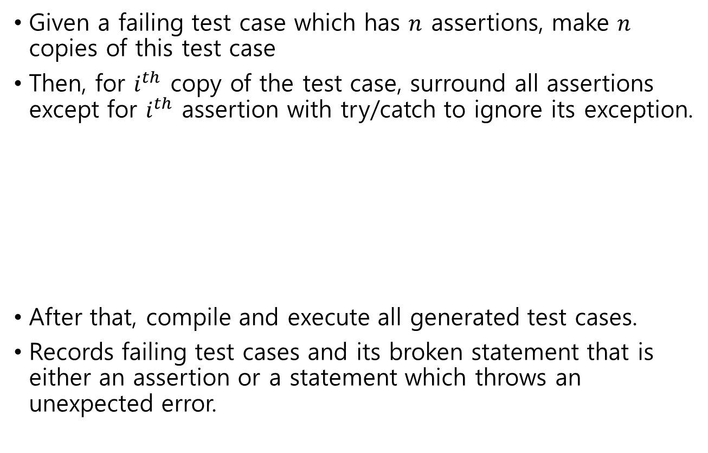
(1) Test case atomization
Given a failing test case which has $n$ assertions, make $n$ copies of this test case
Then, for $i^{th}$ copy of the test case, surround all assertions except for $i^{th}$ assertion with try/catch to ignore its exception.
After that, compile and execute all generated test cases.
Records failing test cases and its broken statement that is either an assertion or a statement which throws an unexpected error.
try {
/* assertion */
}
catch (java.lang.Throwable throwable) {
/* do nothing */
}

Slide 9
An example of test case atomization
test case a2
Failing test case t1
1 Public class targetTest{
2 @Test
3 void a2(){
4 target t = new target();
5 int a=1;
6 assertEquals(2, t.inc(a));
7 int b=1;
8 assertEquals(0, t.dec(b));
9 int c=3;
10 assertEquals(1, t.dec_twice(c));
11 };}
1 Public class targetTest{
2 @Test
3 void t1(){
4 target t = new target();
5 int a=1;
6 assertEquals(2, t.inc(a));
7 int b=1;
8 assertEquals(0, t.dec(b));
9 int c=3;
10 assertEquals(1, t.dec_twice(c));
11 };
12}
try{
} catch (java.lang.Throwable t){
/* do nothing */ }
try{
} catch (java.lang.Throwable t){
/* do nothing */ }
test case a1
test case a3
1 Public class targetTest{
2 @Test
3 void a1(){
4 target t = new target();
5 int a=1;
6 assertEquals(2, t.inc(a));
7 int b=1;
8 assertEquals(0, t.dec(b));
9 int c=3;
10 assertEquals(1, t.dec_twice(c));
11 };
12}
1 Public class targetTest{
2 @Test
3 void a3(){
4 target t = new target();
5 int a=1;
6 assertEquals(2, t.inc(a));
7 int b=1;
8 assertEquals(0, t.dec(b));
9 int c=3; try{
10 assertEquals(1, t.dec_twice(c));
11 };
12}
try{
} catch (java.lang.Throwable t){
/* do nothing */ }
try{
} catch (java.lang.Throwable t){
/* do nothing */ }
try{
} catch (java.lang.Throwable t){
/* do nothing */ }
try{
} catch (java.lang.Throwable t){
/* do nothing */ }

Slide 10
(1) Test case atomization
Passing test cases are removed because the passing test cases do not improve the effectiveness of fault localization.
Failing test case t1
Target Code | Test case
 | t1 | a1 | a2 | a3
1 Public class target{
2 int inc(int n){
3 return ++n; | ● | ● | ● | ●
4 };
5 int dec(int n){
6 return ++n; | ● | ● | ● | ●
7 };
8 int dec_twice(int n){
9 n = dec(n); |  | ● |  | ●
10 return dec(n); |  | ● |  | ●
11 };
12}
Test Result | F | P | F | F
1 Public class targetTest{
2 @Test
3 void t1(){
4 target t = new target();
5 int a=1;
6 assertEquals(2, t.inc(a));
7 int b=1;
8 assertEquals(0, t.dec(b));
9 int c=3;
10 assertEquals(1, t.dec_twice(c));
11 };
12}
● means the statement is executed by the test case

Slide 11
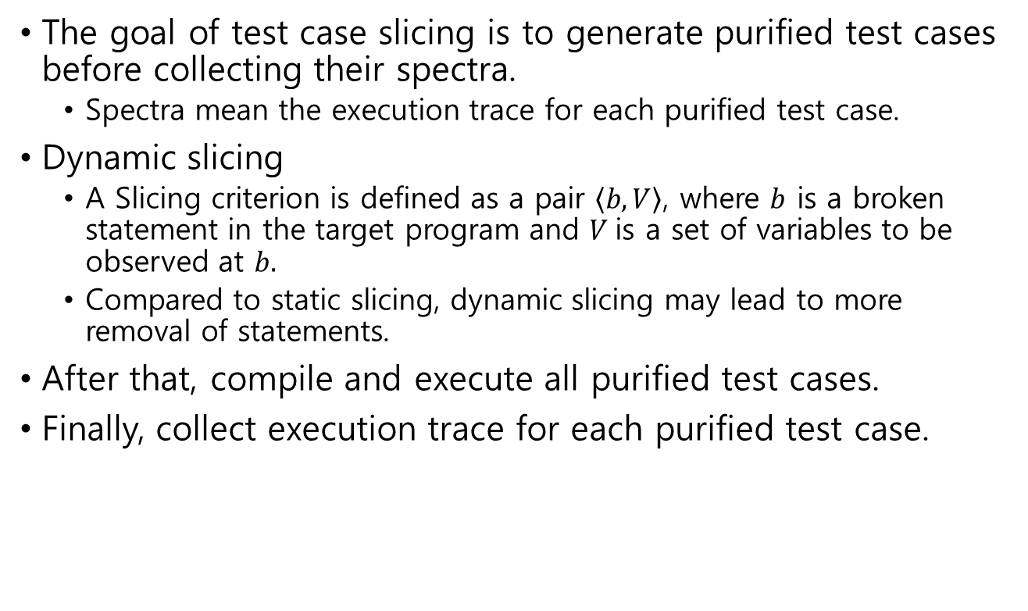
(2) Test case slicing
The goal of test case slicing is to generate purified test cases before collecting their spectra.
  Spectra mean the execution trace for each purified test case.
Dynamic slicing
  A Slicing criterion is defined as a pair $\left\langle b, V\right\rangle$, where $b$ is a broken statement in the target program and $V$is a set of variables to be observed at $b.$
  Compared to static slicing, dynamic slicing may lead to more removal of statements.
After that, compile and execute all purified test cases.
Finally, collect execution trace for each purified test case.

Slide 12
An example of test case slicing
test case a3
purified test case p3
1 Public class targetTest{
2 @Test
3 void a3(){
4 target t = new target();
5 int a=1;
6 assertEquals(2, t.inc(a));
7 int b=1;
8 assertEquals(0, t.dec(b));
9 int c=3; try{
10 assertEquals(1, t.dec_twice(c));
11 };
12}
1 Public class targetTest{
2 @Test
3 void p3(){
4 target t = new target();
5 int a=1;
try{
6 assertEquals(2, t.inc(a));
} catch (java.lang.Throwable t){
/* do nothing */ }
7 int b=1;
try{
8 assertEquals(0, t.dec(b));
| catch (java.lang.Throwable t){
/* do nothing */ }
9 int c=3; try{
10 assertEquals(1, t.dec_twice(c));
11 };
12}
try{
} catch (java.lang.Throwable t){
/* do nothing */ }
try{
} catch (java.lang.Throwable t){
/* do nothing */ }
A slicing criterion is <assertEquals(1, t.dec_twice(c)), {c}>

Slide 13
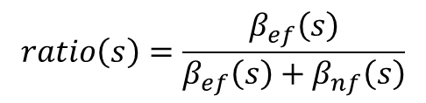
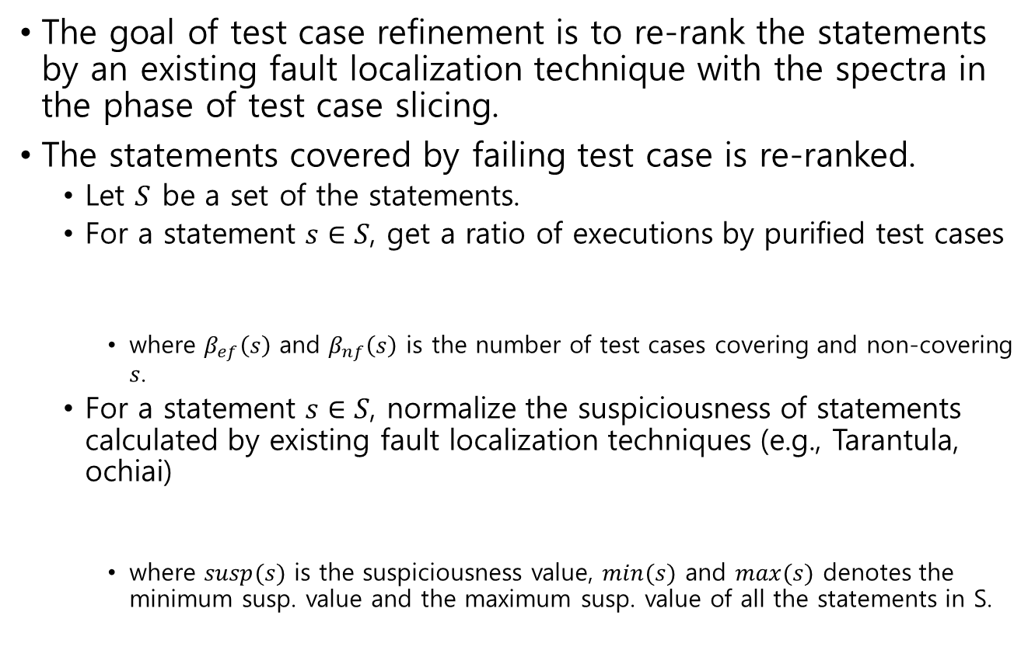
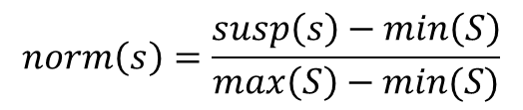
(3) Rank refinement (1/2)
The goal of test case refinement is to re-rank the statements by an existing fault localization technique with the spectra in the phase of test case slicing.
The statements covered by failing test case is re-ranked.
  Let $S$ be a set of the statements.
  For a statement $s∈S$, get a ratio of executions by purified test cases
    where $β_{ef}\left(s\right)$ and $β_{nf}\left(s\right)$ is the number of test cases covering and non-covering $s$.
  For a statement $s∈S$, normalize the suspiciousness of statements calculated by existing fault localization techniques (e.g., Tarantula, ochiai)
    where $susp(s)$ is the suspiciousness value, $min⁡(s)$ and $max⁡(s)$ denotes the minimum susp. value and the maximum susp. value of all the statements in S.
$$ratio\left(s\right)=\frac{β_{ef}\left(s\right)}{β_{ef}\left(s\right)+β_{nf}\left(s\right)}$$
$$norm\left(s\right)=\frac{susp\left(s\right)−\min\left(S\right)}{\max\left(S\right)−min⁡(S)}$$

Slide 14

(3) Rank refinement (2/2)
  Refine the ranking of a statement $s∈S$ by combining $ratio(s)$ and $norm(s).$
    where $norm(s)$ is the normalized suspiciousness value, $ratio(s)$ is the ratio of execution by purified test cases.

Slide 15

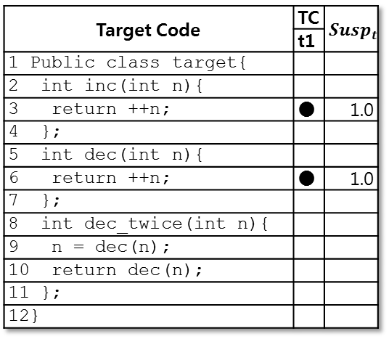
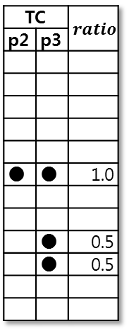
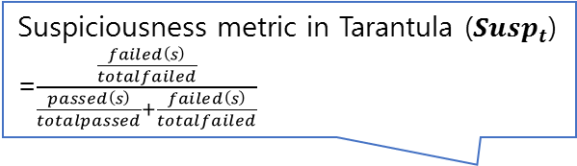
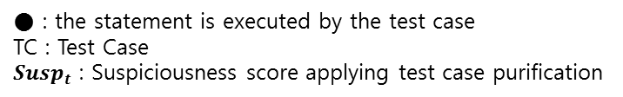
An example of rank refinement
Suspiciousness metric in Tarantula ($Susp_{t}$)
=$\frac{\frac{failed\left(s\right)}{totalfailed}}{\frac{passed\left(s\right)}{totalpassed}+\frac{failed\left(s\right)}{totalfailed}}$
Failing test case t1
Target Code | TC | $$Susp_{t}$$
 | t1
1 Public class target{
2 int inc(int n){
3 return ++n; | ● | 1.0
4 };
5 int dec(int n){
6 return ++n; | ● | 1.0
7 };
8 int dec_twice(int n){
9 n = dec(n);
10 return dec(n);
11 };
12}
TC |  | $$ratio$$
p2 | p3
● | ● | 1.0
 | ● | 0.5
 | ● | 0.5
$$Susp_{r}$$
0.5
1.0
0.75
0.75
1 Public class targetTest{
2 @Test
3 void t1(){
4 target t = new target();
5 int a=1;
6 assertEquals(2, t.inc(a));
7 int b=1;
8 assertEquals(0, t.dec(b));
9 int c=3;
10 assertEquals(1, t.dec_twice(c));
11 };
12}
● : the statement is executed by the test case
TC : Test Case
$Susp_{t}$ : Suspiciousness score applying test case purification
Notes:
spectrum matrix
(also called a test coverage matrix)

Slide 16
Implementation
Existing fault localization techniques
  Six fault localization techniques are implemented on top of GZoltar 0.0.3
    Tarantula, SBI, Ochiai, Jaccard, Ochiai2, Kulczynski2.
Test case atomization
  Spoon 1.5
    A library for Java source code transformation and analysis.
    With the support by Spoon, a Java test class is considered as an abstract syntax tree.
Test case slicing
  JavaSlicer
    JavaSlicer collects runtime trace for a subject program and removes traces with dynamic backward slicing.
Timeout
  Set the timeout of running faulty program as five times of that of the originally correct version to avoid performance bugs.

Slide 17
Evaluation
Compare the suspiciousness score of faulty statement with and without applying test case purification on six fault localization.
  Tarantula, SBI, Ochiai, Jaccard, Ochiai2, and Kulczynski2
6 Java open-source projects with 1800 seeded bugs.
  Employ six mutant operators to generate 300 mutants per program.
    Steimann et al. [ISSTA’13] have shown that a sample size of 300 mutants gives stable fault localization results.
  Using PIT tool to generate mutants in Java
#SLoC : the number of source lines in a target code
Notes:
6 mutation operators
1) Invert negatives: Invert an integer or a floating-point number as its negative
2) Return values: Change a returned object to null, or increase (or decrease) a returned number
3) Math : Replace a binary math operator with another math operator
4) Negate conditionals: Negate a condition as its opposite
5) Conditional boundary: Add or remove the boundary to a conditional statements
6) Increments: Convert between an increment (++, +=) and a decrement (–, -=)

Slide 18
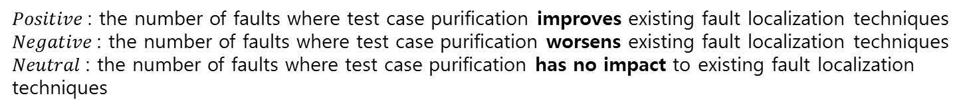
Result (1/3)
The number changes of the suspiciousness score of the faulty statement in faults after applying the approach.
  Better fault localization on 18 to 43% of faults
  Worse on only 1.3 to 2.4% of faults
  Tarantula-Purification performs better than Tarantula on 43.28% of the faults with an average fault-localization improvement of 36.44 statements.
$Positive$: the number of faults where test case purification improves existing fault localization techniques
$Negative$: the number of faults where test case purification worsens existing fault localization techniques
$Neutral$: the number of faults where test case purification has no impact to existing fault localization techniques
Notes:
The columns Positive gives the absolute and relative numbers of faults, which are improved after applying test case purification, compared to basic techniques in fault localization.
Column Negative indicates the number of faults when the basic fault localization
gives better results.
Column Neutral shows the number of faults, which are not changed after applying test case purification.
그냥 랭킹이 올라가기만 하면 좋아졌다고?

Slide 19

Result (2/3)
Wasted effort
  $\left|\{s∈S\right| susp\left(s\right)>susp\left(s^{∗}\right)\}| + \frac{1}{2}|\{s∈S\left| susp\left(s\right)=susp\left(s^{∗}\right)\}\right| + \frac{1}{2}$
    where $S$ is a set of candidate statements, $s^{∗}∈S$ is the faulty statement, and $\left|·\right|$ indicates the size of a set

Slide 20
Result (3/3)
Computation time
  The paper claims that the computation time of test case purification is acceptable since the whole process can be executed automatically.
Table 7: Time of Tarantula with test case purifications (in seconds)

Slide 21
Conclusion
The paper proposed a test case purification approach for improving existing fault localization techniques.
  Input : given failing test cases, target code, existing fault localization technique.
  Output : revised suspiciousness scores applying test cases purification.
In the experiment result, the authors have shown that the fault localization applying the test case purification performs better on 18 to 43% of faults while performing worse on only 1.3 to 2.4% of faults

Slide 22
Appendix
Spectrum-based fault localization techniques

Slide 23

Spectrum-based fault localization
  Spectrum : a set of program entities (e.g., statements) executed by a test case
  computing suspiciousness of each entity based on program spectra.
  E.g., $Susp_{jaccard}\left(s\right)=\frac{\left|f_{p}\left(s\right)\right|}{\left|f_{p}\left(s\right)\right|+\left|p_{p}\left(s\right)\right|}$, where $f_{p}\left(s\right)$ and $p_{p}\left(s\right)$ are a set of failing and a set of passing test cases that execute $s$ in a target program $P$, respectively.
int max = 0; void Setmax(int x, int y) { | Spectrum of test cases |  |  |  |  | Jaccard
 | tc 1 | tc 2 | tc 3 | tc 4 | tc 5 | Susp. | Rank
 | (3,1) | (5,‐4) | (0,‐4) | (0,7) | (‐1,3)
1: max ‐= x; // should be ‘max=x;’ | ● | ● | ● | ● | ● | 0.40 | 6
2: if (max<y) { | ● | ● | ● | ● | ● | 0.40 | 6
3: max = y; | ● | ● |  | ● | ● | 0.50 | 3
4: if(x*y<0) | ● | ● |  | ● | ● | 0.50 | 3
5: print (“diff. sign”); } |  | ● |  |  | ● | 0.50 | 3
6: print (“%d”, max); } | ● | ● | ● | ● | ● | 0.40 | 6
Pass/Fail status | Fail | Fail | Pass | Pass | Pass

Slide 24
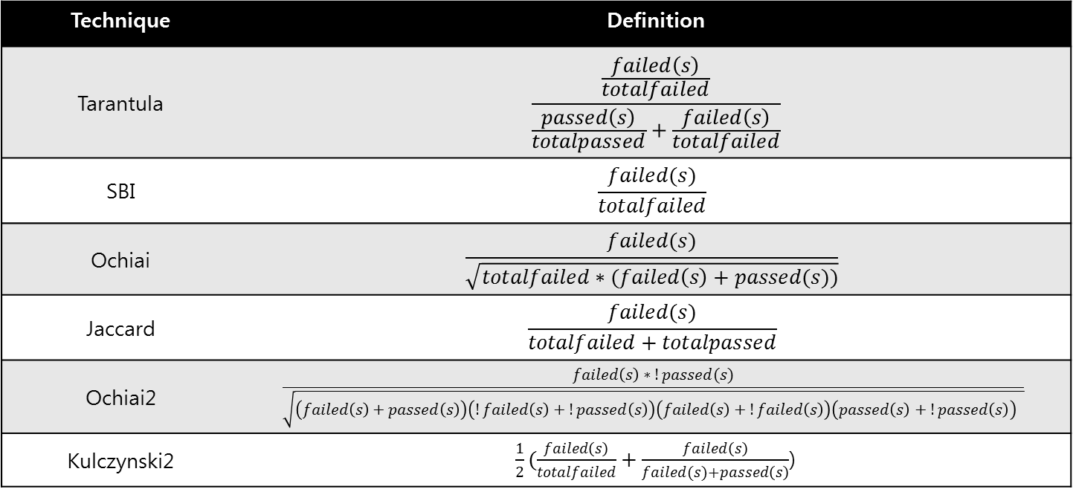

Six SBFL techniques
For a statement s in target program,
  $passed(s)$means the number of passing test cases that execute the statement $s.$
  $!passed(s)$means the number of passing test cases that do not execute the statement $s.$
  $totalpassed$ means the number of passing test cases
  The notation for failing test cases is similar to this notation for passing test cases.
Technique | Definition
Tarantula | $$\frac{\frac{failed\left(s\right)}{totalfailed}}{\frac{passed\left(s\right)}{totalpassed}+\frac{failed\left(s\right)}{totalfailed}}$$
SBI | $$\frac{failed(s)}{totalfailed}$$
Ochiai | $$\frac{failed(s)}{\sqrt{totalfailed∗(failed\left(s\right)+passed(s))}}$$
Jaccard | $$\frac{failed(s)}{totalfailed+totalpassed}$$
Ochiai2 | $$\frac{failed\left(s\right)∗!passed(s)}{\sqrt{\left(failed\left(s\right)+passed\left(s\right)\right)\left(!failed\left(s\right)+!passed\left(s\right)\right)\left(failed\left(s\right)+!failed\left(s\right)\right)\left(passed\left(s\right)+!passed\left(s\right)\right) }}$$
Kulczynski2 | $\frac{1}{2}(\frac{failed\left(s\right)}{totalfailed}+\frac{failed\left(s\right)}{failed(s)+passed\left(s\right)}$)

