Slide 1
Model Checking Application Areas
Willem Visser Stellenbosch University

Slide 2
Overview
The shift from hardware to software
Early days of program model checking
Bounded Software Model Checking
CBMC
ESBMC
Java PathFinder (JPF)
Other types of Model Checking
Timed
Probabilistic
Statistical

Slide 3
Hardware Model Checking
BDD-based model checking was the enabling technology
Hardware is typically synchronous and regular, hence the transition relation can be encoded efficiently
Execution paths are typically very short
The Intel Pentium bug, was the “disaster” that got model checking on the map in the hardware industry
What is it going to take in the software world?
Intel, IBM, Motorola, etc. now employ hundreds of model checking experts

Slide 4
Software Model Checking
Although the early papers on model checking focused on software, not much happened until 1997
Until 1997 most work was on software designs
Since catching bugs early is more cost-effective
Problem is that everybody use a different design notation, and although bugs were found the field never really moved beyond some compelling case-studies
Reality is that people write code first, rather than design
The field took off when the seemingly harder problem of analyzing actual source code was first attempted

Slide 5
Program Model Checking
Why is program analysis with a model checker so much more interesting?
Designs are hard to come by, but buggy programs are everywhere!
Testing is inadequate for complex software (concurrency, pointers, objects, etc.)
Static program analysis was already an established field, mostly in compiler optimization, but also in verification.

Slide 6
The Early Trends in Program Model Checking
Most model checkers cannot deal with the features of modern programming languages
Bringing programs to model checking
Abstraction (including translation)
Bringing model checking to programs
Improve model checking to directly deal with programs as input

Slide 7
Program Model Checking Enabling Technology
Abstraction
Program
Model Checker Input
void add(Object o) {
buffer[head] = o;
head = (head+1)%size;
}
Object take() {
…
tail=(tail+1)%size;
return buffer[tail];
}
Infinite state
Finite state

Slide 8
Abstraction
Model checkers don’t take real “programs” as input
Model checkers typically work on finite state systems
Abstraction therefore solves two problems
It allows model checkers to analyze a notation they couldn’t deal with before, and,
Cuts the state space size to something manageable
Abstraction comes in three flavors
Over-approximations, i.e. more behaviors are added to the abstracted system than are present in the original
Under-approximations, i.e. less behaviors are present in the abstracted system than are present in the original
Precise abstractions, i.e. the same behaviors are present in the abstracted and original program

Slide 9
Under-Approximation “Meat-Axe” Abstraction
Remove parts of the program deemed “irrelevant” to the property being checked
Limit input values to 0..10 rather than all integer values
Queue size 3 instead of unbounded, etc.
The abstraction of choice in the early days of program model checking – used during the translation of code to a model checker’s input language
Typically manual, with no guarantee that the right behaviors are removed.
Precise abstraction, w.r.t. the property being checked, may be obtained if the behaviors being removed are indeed not influencing the property
Program slicing is an example of an automated under-approximation that will lead to a precise abstraction w.r.t. the property being checked

Slide 10
Over-Approximations Abstract Interpretation
Maps sets of states in the concrete program to one state in the abstract program
Reduces the number of states, but increases the number of possible transitions, and hence the number of behaviors
Can in rare cases lead to a precise abstraction
Type-based abstractions
Replace int by Signs abstraction {neg,pos,zero}
Predicate abstraction
Replace predicates in the program by boolean variables, and replace each instruction that modifies the predicate with a corresponding instruction that modifies the boolean.
Automated (conservative) abstraction
Eliminating spurious errors is the big problem
Abstract program has more behaviors, therefore when an error is found in the abstract program, is that also an error in the original program?
Most research focuses on this problem, and its counter-part the elimination of spurious errors, often called abstraction refinement

Slide 11
Bringing Model Checking to Programs
Allow model checkers to take modern programming languages as input, or, notations that are of similar expressive power
Major hurdle is how to encode the state of the system efficiently
Alternatively state-less model checking
No state encoding or storing
Almost exclusively explicit-state model checking
Abstraction can still be used as well
Source to source abstractions

Slide 12
The Early Years
Hand-translation with ad-hoc abstractions
1980 through mid 1990s
Semi-automated, table-driven translations
1998
Automated translations still with ad-hoc abstractions
1997-1999
State-less model checking for C
VeriSoft 1997

Slide 13
SPIN Model Checker
Kripke structures are described as “programs” in the PROMELA language
Kripke structure is generated on-the-fly during model checking
Automata based model checker
Translates LTL formula to Büchi automaton
By far the most popular model checker
10th SPIN Workshop to be held with ICSE – May 2003
Relevant theoretical papers can be found here
http://netlib.bell-labs.com/netlib/spin/whatispin.html
Ideal for software model checking due to expressiveness of the PROMELA language
Close to a real programming language
Gerard Holzmann won the ACM software award for SPIN

Slide 14
Hand-Translation
abstraction
Verification model
translation
Program
Hand translation of program to model checker’s input notation
“Meat-axe” approach to abstraction
Labor intensive and error-prone

Slide 15
Hand-Translation Examples
Remote Agent – Havelund,Penix,Lowry 1997
http://ase.arc.nasa.gov/havelund
Translation from Lisp to Promela (most effort)
Heavy abstraction
3 man months
DEOS – Penix, Visser, et al. 1998/1999
http://ase.arc.nasa.gov/visser
C++ to Promela (most effort in environment generation)
Limited abstraction - programmers produced sliced system
3 man months

Slide 16
State-less Model Checking
No state storing, hence no state matching
Must limit search-depth to ensure termination
Enabling technology is partial-order reduction
Avoid revisiting some states
Annotate code to allow verifier to detect “important” statements
Communications and nondeterministic choice
Model checker will try all interleavings of the these statements, but will consider all other statements “atomic”, i.e. the last statement in any group will be an important one.
Examples include
VeriSoft
http://www1.bell-labs.com/project/verisoft/
Rivet
http://sdg.lcs.mit.edu/rivet.html
See also work by Scott Stoller
http://www.cs.sunysb.edu/~stoller/

Slide 17
Partial-Order Reductions
Reduce the number of interleavings of independent concurrent transitions
x := 1 || y := 1 where initially x = y = 0
00
00
00
x := 1
y := 1
x := 1
y := 1
x := 1
10
01
10
01
10
y := 1
x := 1
y := 1
y := 1
11
11
11
No Reductions
Transitions Reduced
States Reduced

Slide 18
Partial Order Reductions Basic Ideas
Independence
Independent transitions cannot disable nor enable each other
Enabled independent transitions are commutative
Partial-order reductions only apply during the on-the-fly construction of the Kripke structure
Based on a selective search principle
Compute a subset of enabled transitions in a state to execute
Sleep sets (Reduce transitions)
Persistent sets (Reduce states)

Slide 19
Persistent Set Reductions
A subset of the enabled transitions is called persistent, when any transition can be executed from outside the set and it will not interact or affect the transitions inside the set
Use the static structure of the system to determine what goes into the persistent set
Note, all enabled transitions are trivially persistent
Only execute transitions in the persistent set
Persistent set algorithm is used within SPIN
See papers by Godefroid and Peled

Slide 20
VeriSoft
The first model checker that could handle programs directly
C programs running on Unix
Relies on partial-order reductions to limit the number of times a state is revisited
Persistent sets
Reduce states visited
Sleep sets
Reduce transitions executed
Paths must be replayed from the initial state to try new branches
No check-pointing
T₁ || T₂
T₁
T₂
T₂
T₁
T₁ || T₂
T₁ || T₂
T₁
T₁
T₂
T₂
T₂
T₁
Persistent Sets
Sleep Sets

Slide 21
State-less Example
T₁
T₃
T₂
T₄
T₃
T₁
T₃
T₂
T₄
T₁
T₄
T₂
T₁ ; T₂ || T₃ ; T₄
DFS with state storage – executes 12 transitions
DFS state-less – executes 24 transitions

Slide 22
State-less Example
T₁
T₃
T₂
T₄
T₃
T₁
T₃
T₂
T₄
T₁
T₄
T₂
T₁ ; T₂ || T₃ ; T₄
DFS with state storage – executes 12 transitions
DFS state-less – executes 24 transitions
DFS state-less with partial-order reduction
Sleep sets - executes 8 transitions (all states)

Slide 23
State-less Example
T₁
T₃
T₂
T₄
T₃
T₁
T₃
T₂
T₄
T₁
T₄
T₂
T₁ ; T₂ || T₃ ; T₄
DFS with state storage – executes 12 transitions
DFS state-less – executes 24 transitions
DFS state-less with partial-order reduction
Sleep sets - executes 8 transitions (all states)
Persistent sets – executes 4 transitions (only 5 states)

Slide 24
Semi-Automatic Translation
Table-driven translation and abstraction
Feaver system by Gerard Holzmann
User specifies code fragments in C and how to translate them to Promela (SPIN)
Translation is then automatic
Found 75 errors in Lucent’s PathStar system
http://cm.bell-labs.com/cm/cs/who/gerard/
Advantages
Can be reused when program changes
Works well for programs with long development and only local changes

Slide 25
Fully Automatic Translation
Advantage
No human intervention required
Disadvantage
Limited by capabilities of target system
Examples
Java PathFinder 1- http://ase.arc.nasa.gov/havelund/jpf.html
Translates from Java to Promela (Spin)
JCAT - http://www.dai-arc.polito.it/dai-arc/auto/tools/tool6.shtml
Translates from Java to Promela (or dSpin)
Bandera - http://www.cis.ksu.edu/santos/bandera/
Translates from Java bytecode to Promela, SMV or dSpin

Slide 26
Program Model Checking More Early Trends
Program
Abstract Program
Correct
void add(Object o) {
buffer[head] = o;
head = (head+1)%size;
}
Object take() {
…
tail=(tail+1)%size;
return buffer[tail];
}
T1 > T2
T3 > T4
T5 > T6
…
Custom
Model Checker
Abstraction
Error-trace
Abstraction refinement
Abstraction
Custom-made model checkers for programming languages with automatic abstraction at the source code level
Automatic abstraction & translation based transformation to new “abstract” formalism for model checker
Abstraction refinement mostly automated

Slide 27
Custom-made Model Checkers
Translation based
dSpin
Spin extended with dynamic constructs
Essentially a C model checker
Source-2-source abstractions can be supported
http://www.dai-arc.polito.it/dai-arc/auto/tools/tool7.shtml
SPIN Version 4+
PROMELA language augmented with C code
Table-driven abstractions
Bandera
Translated Bandera Intermediate Language (BIR) to a number of back-end model checkers, but, a new BIR custom-made model checker is under development
Supports source-2-source abstractions as well as property-specific slicing
http://www.cis.ksu.edu/santos/bandera/

Slide 28
Custom-made Model Checkers
Abstraction based
SLAM
C programs are abstracted via predicate abstraction to boolean programs for model checking
http://research.microsoft.com/slam/
BLAST
Similar basic idea to SLAM, but using lazy abstraction, i.e. during abstraction refinement don’t abstract the whole program only certain parts
http://www-cad.eecs.berkeley.edu/~tah/blast/
3-Valued Model Checker (3VMC) extension of TVLA for Java programs
http://www.cs.tau.ac.il/~yahave/3vmc.htm
http://www.math.tau.ac.il/~rumster/TVLA/

Slide 29
Abstraction
Data type based abstractions
Abstract Interpretation (Patrick Cousot)
E.g. replace integer variable with odd-even range or Signs abstraction {negative,zero,positive}
Replace all operations on the concrete variable with corresponding abstract operations
add(pos,pos) = pos
subtract(pos,pos) = negative | zero | pos
eq(pos,pos) = true | false
Predicate Abstraction (Graf, Saïdi see also Uribe)
Create abstract state-space w.r.t. set of predicates defined in concrete system

Slide 30
Data Type Abstraction
Collapses data domains via abstract interpretation:
Code
Data domains
int x = 0;
if (x == 0)
x = x + 1;
int
(n<0) : NEG
(n==0): ZERO
(n>0) : POS
Signs x = ZERO;
if (Signs.eq(x,ZERO))
x = Signs.add(x,POS);
Signs
NEG
ZERO
POS
Notes:
The technique can be illustrated on this fragment of code; assume we would like to keep only enough info about x to allow the conditional test to be decided. So we only need to know if x is zero or not
for this we could use the signs abstraction that maps integers onto a set of 3 symbolic values:neg,zero,pos
we transform the code so that to operate on the abs domain and it looks like this; here the concrete type int was replaced by abs type signs, concrete constants 0 and 1 were replaced with abs ct 0 and pos; and primitive ops on ints were replaced with calls to some methods that implement the abs.ops.that manipulate abstract values. Ex : equality operator was replaced with a call to method signs.eq and + was replace by signs.add .
So, how do we apply this abstraction technique to the DEOS example ?
We have to decide which variables to abstract, what abstrations to use and then we have to effectively transform the system to encode the abstractions.

Slide 31
Predicate Abstraction
Abstract
T
F
EQ = T
EQ := F
EQ = F
α : int × int bool
EQ ≡ (x = y)
EQ ≡ (x = y)
Concrete
x = y
x ≠ y
x = 0
y = 0
y++
x = 0
y = 1
Mapping of a concrete system to an abstract system, whose states correspond to truth values of a set of predicate
Create abstract state-graph during model checking, or,
Create an abstract transition system before model checking

Slide 32
Example Predicate Abstraction
Predicate: B ≡ (x = y)
Concrete Statement
y := y + 1
Abstract Statement
Step 1: Calculate pre-images
{x = y + 1}
y := y + 1 {x = y}
{x ≠ y + 1}
y := y + 1 {x ≠ y}
Step 2: Rewrite in terms of predicates
Step 2a: Use Decision Procedures
{x = y + 1} y := y + 1 {B}
{B} y := y + 1 {~B}
x = y → x = y + 1
x = y → x ≠ y + 1
x ≠ y → x = y + 1
x ≠ y → x ≠ y + 1
Step 3: Abstract Code
IF B THEN B := false
ELSE B := true | false

Slide 33
Example of Infeasible Counter-example
[1] if(Signs.gt(Signs.add(NEG,POS),ZERO))
then
[2] assert(true);
else
[3] assert(false);
[1] if (-2 + 3 > 0)
then
[2] assert(true);
else
[3] assert(false);
{NEG,ZERO,POS}
Signs:
n < 0 -> neg
0 -> zero
n > 0 -> pos
[1]:
[1]:
Infeasible counter-example
[2]:
X
[2]:
[3]:

Slide 34
SLAM Simplified View
Predicate Abstraction
C2BP
C Program
annotated with
API usage rules
void add(Object o) {
buffer[head] = o;
head = (head+1)%size;
}
Object take() {
…
tail=(tail+1)%size;
return buffer[tail];
}
Custom
Model Checker
BEBOP
Predicates
Correct
Symbolic Execution
NEWTON
Error-trace
False
Error-trace is Feasible

Slide 35
SLAM (Now Static Driver Verifier)
Check API usage rules for sequential C programs
Mostly applied to device driver code
C2BP
Inputs: C program and predicates
Output: boolean program over the predicates
BEBOP
Symbolic interprocedural data flow analysis
Concrete CFG and BDD encoding of states
NEWTON
Symbolic execution of C programs
Using Simplify theorem prover for checking feasibility of conditionals

Slide 36
Abstraction Refinement Example Adapted from Ball & Rajamani POPL02
Property: if a lock is held it must be released before reacquiring
do {
//get the write lock
KeAcquireSpinLock(&devExt->writeListLock);
nPacketsOld = nPackets;
request = devExt->WLHeadVa;
if (request){
KeReleaseSpinLock(&devExt->writeListLock);
...
nPackets++;
}
} while (nPackets != nPacketsOld);
KeReleaseSpinLock(&devExt->writeListLock);

Slide 37
Initial Abstraction and Model Checking
Boolean Program
[1] do
//get the write lock
[2] AcquireLock();
[3] if (*) then
[4] ReleaseLock();
fi
[5] while (*);
[6] ReleaseLock();
Error-trace : 1,2,3,5,1,2

Slide 38
Symbolic Execution
[1] do {
[2] KeAcquireSpinLock(&devExt->writeListLock);
nPacketsOld = nPackets;
request = devExt->WLHeadVa;
[3] if (request){
[4] KeReleaseSpinLock(&devExt->writeListLock);
...
nPackets++;
}
[5] } while (nPackets != nPacketsOld);
[6] KeReleaseSpinLock(&devExt->writeListLock);
Symbolic execution of 1,2,3,5,1,2 shows that when 5 is executed nPackets == nPacketsOld hence the path is infeasible.
The predicate nPackets == nPacketsOld is then added and
used during predicate abstraction

Slide 39
Next Abstraction and Model Checking
New Predicate b : (nPacketsOld == nPackets)
[1] do
[2] AcquireLock();
[3] b = true; // nPacketsOld = nPackets
[4] if (*) then
[5] ReleaseLock();
[6] b = b ? False : *; // nPackets++
fi
[7] while (!b); //(nPacketsOld != nPackets)
[8] ReleaseLock();
Now property holds

Slide 40
The Future of Software Model Checking As predicted in 2002
Abstraction based approaches
Combine object abstractions (e.g. shape analysis) with predicate abstraction
Automation is crucial
Symbolic Execution
Solving structural (object) and numerical constraints
Acceleration techniques (e.g. widening)
Model checking as a companion to testing
Test-case generation by model checking
Runtime monitoring and model checking
Modular model checking for software
Exploiting the interface between components
Interface automata (de Alfaro & Henzinger )
Environment generation
How to derive a “test-harness” for a system to be model checked
Result representation
Much overlooked, but without this we are nowhere!
“Analysis is necessary, but not sufficient” – Jon Pincus

Slide 41
Fast Forward to 2014
JPF is still around
SLAM turned into Static Driver Verifier
Ships with Windows
Major success story for model checking
SPIN is still actively used
BLAST is still around (barely)
CPAChecker probably best in the CEGAR class
New arrival: BMC tools
CBMC, ESBMC, …
RIP
Bandera, JPF v1, and numerous others
Mostly the translation based approached
Fairly decent list at http://en.wikipedia.org/wiki/List_of_model_checking_tools

Slide 42
Bounded Model Checking for Software
CBMC is a bounded model checker for ANSI-C programs
Handles function calls using inlining
Unwinds the loops a fixed number of times
Allows user input to be modeled using non-determinism
So that a program can be checked for a set of inputs rather than a single input
Allows specification of assertions which are checked using the bounded model checking
Slide by Tevfik Bultan

Slide 43
Loops
Unwind the loop n times by duplicating the loop body n times
Each copy is guarded using an if statement that checks the loop condition
At the end of the n repetitions an unwinding assertion is added which is the negation of the loop condition
Hence if the loop iterates more than n times in some execution, the unwinding assertion will be violated and we know that we need to increase the bound in order to guarantee correctness
A similar strategy is used for recursive function calls
The recursion is unwound up to a certain bound and then an assertion is generated stating that the recursion does not go any deeper
Slide by Tevfik Bultan

Slide 44
A Simple Loop Example
Original code
Unwinding the loop 3 times
x=0;
while (x < 2) {
y=y+x;
x++;
}
x=0;
if (x < 2) {
y=y+x;
x++;
}
if (x < 2) {
y=y+x;
x++;
}
if (x < 2) {
y=y+x;
x++;
}
assert (! (x < 2))
Unwinding
assertion:
Slide by Tevfik Bultan

Slide 45
From Code to SAT
After eliminating loops and recursion, CBMC converts the input program to the static single assignment (SSA) form
In SSA each variable appears at the left hand side of an assignment only once
This is a standard program transformation that is performed by creating new variables
In the resulting program each variable is assigned a value only once and all the branches are forward branches (there is no backward edge in the control flow graph)
CBMC generates a Boolean logic formula from the program using bit vectors to represent variables
Slide by Tevfik Bultan

Slide 46
Another Simple Example
Original code
Convert to static single assignment
x=x+y;
if (x!=1)
x=2;
else
x++;
assert(x<=3);
x₁=x₀+y₀;
if (x₁!=1)
x₂=2;
else
x₃=x₁+1;
x₄=(x₁!=1)?x₂:x₃;
assert(x₄<=3);
Generate constraints
C ≡ x₁=x₀+y₀ ∧ x₂=2 ∧ x₃=x₁+1 ∧(x₁!=1 ∧ x₄=x₂ ∨ x₁=1 ∧ x₄=x₃)
P ≡ x₄ <= 3
Check if C ∧ ¬ P is satisfiable, if it is then the assertion is
violated
C ∧ ¬ P is converted to boolean logic using a bit vector
representation for the integer variables y₀,x₀,x₁,x₂,x₃,x₄
Slide by Tevfik Bultan

Slide 47
Bounded Verification Approaches
What we have discussed above is bounded verification by bounding the number of steps of the execution.
For this approach to work the variable domains also need to be bounded, otherwise we cannot convert the problems to boolean SAT
Bounding the execution steps and bounding the data domain are two orthogonal approaches.
When people say bounded verification it may refer to either of these
When people say bounded model checking it typically refers to bounding the execution steps
Slide by Tevfik Bultan

Slide 48
Bounded model checking with SMT-Solvers
Bounded model checking has been originally proposed based on SAT solvers
More recently, there has been work on doing bounded model checking with SMT-solvers
SMT: Satisfiability Modula Theories
SMT-solvers are a type of theorem provers
They combine decision procedures for multiple theories such as
Theory of integers with addition
Theory of uninterpreted functions with equality
Theory of reals
Theory of arrays
Slide by Tevfik Bultan

Slide 49
SMT-solvers vs. SAT-solvers
Since SMT-solvers can express and reason about high level constraints such as x=y+z in some cases they can be more efficient than SAT solvers
To handle a constraint like x=y+z using a SAT solver, we need convert the constraint to a Boolean logic formula using a bit-vector representation
SMT-solvers can also be used for bounded model checking like SAT solvers
Instead of generating a SAT formula, we generate a formula using the theories that are supported by the SMT-solver
There are several public domain SMT-solvers
Slide by Tevfik Bultan

Slide 50
ESBMC
ESBMC is a SMT-based bounded model checking tool for concurrent C programs
Concurrent C programs consist of a set of threads
In order to verify behavior of a concurrent program all possible thread interleavings must be checked
The number of thread interleavings can be exponential in the number of threads
This is one of the causes of state space explosion problem
Slide by Tevfik Bultan

Slide 51
Context-bounded verification
A recent approach to verification of concurrent programs is to bound the number of context-switches
This means bounding the number of thread interleavings that are being explored
The motivation is that, if there is a concurrency error in the program, it can typically be caught using a bounded number of context switches
So the idea, in context-bounded verification is to bound the number of context-switches, but then explore all thread interleavings within that bound
Slide by Tevfik Bultan

Slide 52
Context-bounded verification with ESBMC
ESBMC is a SMT-based context-bounded model checker for concurrent C programs
ESBMC bounds the number of context-switches and explores all possible interleavings within that bound
It uses three different heuristics in exploring different thread interleavings
Lazy approach
Schedule recording approach
Under-approximation and widening approach
Slide by Tevfik Bultan

Slide 53
Goto programs
ESBMC converts C programs to a simplified language (has gotos, but no loops)
C programs are converted to this basic language automatically by a front end
Goto programs support “assume” and “assert” statements
These statements are used to specify properties to be verified (assertions) and the assumptions under which we want to verify them (assumes)
What ESBMC tries to determine is the following:
Assuming that the constraints specified in assume statements hold, is it guaranteed that all the assertions hold?
Slide by Tevfik Bultan

Slide 54
Formal model for a concurrent program
A concurrent program is a tuple M = (S, S₀, T, V) where
S is a finite set of states
T = t₀, t₁, …, t_{n} is the set of threads
V = V_{global} ∪ V_{j} where V_{j} is the set of local variables for t_{j}
Each state s ∈ S consists of values of all global and local variables and values of program counters for all threads
Each thread j is a tuple t_{j} = (R^{j}, l^{j}) where
R^{j} ⊆ S × S is the transition relation of thread j, and
l^{j} = <l_{i}^{j} > is the sequence of thread locations
Slide by Tevfik Bultan

Slide 55
Reachability Tree
They model the execution of the concurrent program as a reachability tree (RT), where execution of instructions create new children and thread interleavings cause the branches in the tree
Each node in the RT is a tuple v = (A_{i}, C_{i}, s_{i}, <l_{i}^{j}, G^{j}_{i}>_{j=1}^{n})_{i}
A_{i} represents the currently active thread
C_{i} represents the context switch number
s_{i} represents the current state
l^{j}_{i} represents the current location of thread j
G^{j}_{i} represents the control flow guards accumulated in thread j along the path from l₀^{j} to l_{i}^{j}
They discuss how the reachability tree can be expanded for each type of statement
Slide by Tevfik Bultan

Slide 56
Exploring the Reachability Tree
Lazy approach: It is a type of depth first search. They create a single formula from a single interleaving and then send it to the SMT-solver. If they do not find an error in that interleaving, they continue with the next interleaving.
Schedule Recording approach: They create a single formula that encodes all the interleavings (part of the formula encodes the different scheduling choices). Then they send the formula to the SMT-solver at the end.
Under-approximation and widening approach: They start with a single interleaving and send it to the SMT-solver and then add more interleavings iteratively. While choosing the new interleavings to add they use the results from the previous call to the SMT-solver.
Slide by Tevfik Bultan

Slide 57
Lazy Approach
Given a particular thread interleaving schedule I, they generate a formula ψ^{I}_{k} such that the property (an assertion) is violated at step k with the interleaving I, if and only if the formula is satisfiable
ψ^{I}_{k} = I(s₀) ∧ R(s₀,s₁) ∧ R(s₁,s₂) ∧ … ∧ R(s_{k-1},s_{k}) ∧ ¬ p_{k}
The formula corresponds to unrolling of the transition relation R k times
If the generated formula is satisfiable, then the satisfying assignment to the formula demonstrates a counter-example behavior showing thevassertion violation and we are done
If the generated formula is unsatisfiable, then a new formula is generated for another thread interleaving, and the process continues
Slide by Tevfik Bultan

Slide 58
Schedule Recording Approach
In this approach, the interleaving schedule is encoded as part of the generated formula by using schedule guards
Schedule guards record in which order the scheduler has executed the program
Using this approach all interleavings are encoded as part of a single formula
ψ_{k} = I(s₀) ∧ R(s₀,s₁) ∧ R(s₁,s₂) ∧ … ∧ R(s_{k-1},s_{k}) ∧ ¬ p_{k}
∧ SCH(s₀) ∧ SCH(s₁) ∧ … ∧ SCH(s_{k})
SCH(s_{i}) represents the schedule guard on state s_{i}
If there are no additional constraints then
∧_{i=0}^{k} SCH(s₀) = true
which means that all possible interleavings are considered
However, it is possible to remove interleavings by restricting the schedule constraints
Slide by Tevfik Bultan

Slide 59
Under-approximation and widening approach
They first generate a formula that characterizes all interleavings: ψ
Then, they restrict is to a single interleaving using schedule guards: ψ’ = ψ ∧ SCH(s₀) ∧ SCH(s₁) ∧ … ∧ SCH(s_{k})
Note that ψ’ is an under-approximation of ψ and if we find a counter-example using ψ’ then that means that there is a real error and we are done.
However, if we cannot find a counter-example using ψ’ that does not mean there is no error. So they incrementally relax the schedule constraints to add more interleavings.
While modifying the schedule constraints, they use the information obtained from the SMT-solver about the unsatisfiability of the ψ’, so that they modify the schedule constraints to make it more likely that the modified formula will be satisfiable
Slide by Tevfik Bultan

Slide 60
Implementation and Experiments
They model the synchronization operations in Pthread library using their approach
They make some atomicity assumptions which may cause them miss some errors (false negatives), but they say that they did not observe this in their experiments
They compare their approach with an explicit state context-bounded model checker (CHESS). Their approach performs better and the Lazy heuristic performs the best.
They compare their approach with a SAT based model checker that uses the CEGAR technique (SATABS). Their approach performs better.
ICSE 2011 Distinguished Paper Award Cordeiro and Fischer
Slide by Tevfik Bultan

Slide 61
JPF Overview
What is JPF?
Extending JPF
Listeners
Bytecode Factories
Model classes
Getting started
Download, Install and Run (in Eclipse)
Google Summer of Code

Slide 62
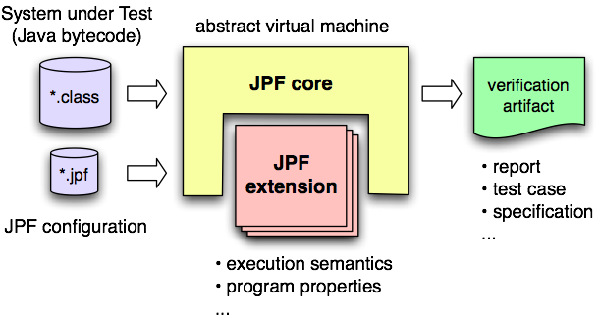
What is JPF?
surprisingly hard to summarize - can be used for many things
extensible virtual machine framework for Java bytecode verification: workbench to efficiently implement all kinds of verification tools
typical use cases:
software model checking (deadlock & race detection)
deep inspection (numeric analysis, invalid access)
test case generation (symbolic execution)
... and many more

Slide 63
History of JPF
not a new project: around for 10 years and continuously developed:
1997 - project started as front end for Spin model checker
1999 - reimplementation as concrete virtual machine for software model checking (concurrency defects)
2003 - introduction of extension interfaces
2005 - open sourced on Sourceforge
2008 - participation in Google Summer of Code
2009 - moved to own server, hosting extension projects and Wiki

Slide 64
Users?
major user group is academic research - collaborations with >20 universities worldwide (uiuc.edu, unl.edu, byu.edu, umn.edu, Stellenbosch Za, Waterloo Ca, AIST Jp, Charles University Prague Cz, ..)
companies not so outspoken (exception Fujitsu - see press releases, e.g. http://www.fujitsu.com/global/news/pr/archives/month/2010/20100112-02.html) , but used by several Fortune 500 companies
lots of (mostly) anonymous and private users (~1000 hits/day on website, ~10 downloads/day, ~60 read transactions/day, initially 6000 downloads/month)
many uses inside NASA, but mostly model verification at Ames Research Center

Slide 65
Awards
widely recognized, awards for JPF in general and for related work, team and individuals
2003 - “Turning Goals into Reality” (TGIR) Engineering Innovation Award from the Office of AeroSpace Technology
2004, 2005 - Ames Contractor Council Awards
2007 - IBM's Haifa Verification Conference (HVC) award
2009 - “Outstanding Technology Development” award of the Federal Laboratory Consortium for Technology Transfer (FLC)

Slide 66
No Free Lunch
you need to learn
JPF is not a lightweight tool
flexibility has its price - configuration can be intimidating
might require extension for your SUT (properties, libraries)
you will encounter unimplemented/missing parts (e.g. UnsatisfiedLinkError)
usually easy to implement
exception: state-relevant native libraries (java.io, java.net)
can be either modeled or stubbed
you need suitable test drivers

Slide 67
JPF’s Home
http://babelfish.arc.nasa.gov/trac/jpf
JPF’s User Forum
http://groups.google.com/group/java-pathfinder

Slide 68
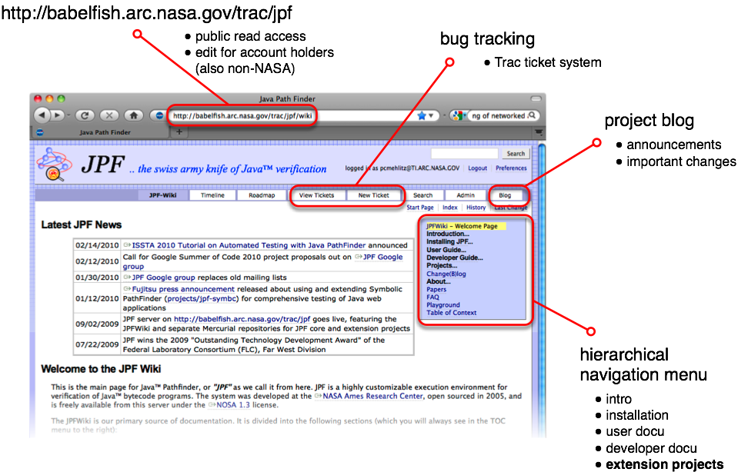
Where to learn more - the JPF-Wiki
68
Notes:
68

Slide 69
Key Points
JPF is research platform and production tool (basis)
JPF is designed for extensibility
JPF is open source
JPF is an ongoing collaborative development project
JPF cannot find all bugs
JPF is moderately sized system (~200ksloc core + extensions)
JPF represents >20 man year development effort
JPF is pure Java application (platform independent)

Slide 70
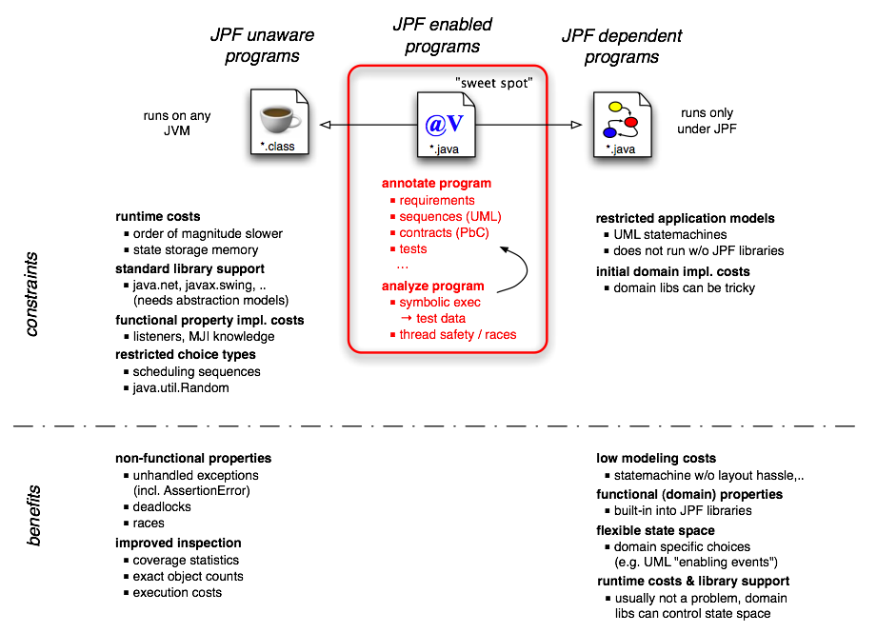
Application Types
70
Notes:
70

Slide 71
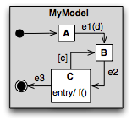
Examples
software model checking (SMC) of production code
data acquisition (random, user input)
concurrency (deadlock, races)
deep inspection of production code
property annotations (Const, PbC,..)
numeric verification (overflow, cancellation)
model verification
UML statecharts
test case generation
@Const
int dontChangeMe() {..}
double x = (y - z) * c
numeric error of x?

Slide 72
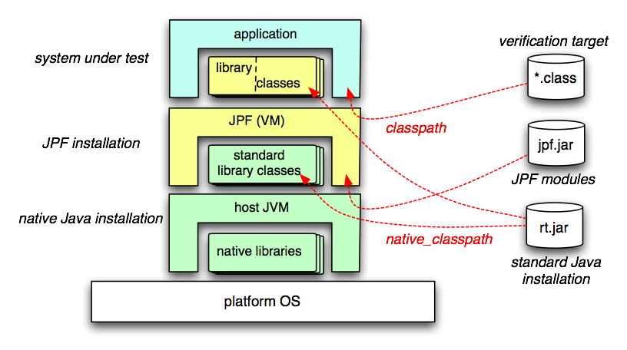
JPF and the Host JVM
verified Java program is executed by JPF, which is a virtual machine implemented in Java, i.e. runs on top of a host JVM ⇒ easy to get confused about who executes what

Slide 73
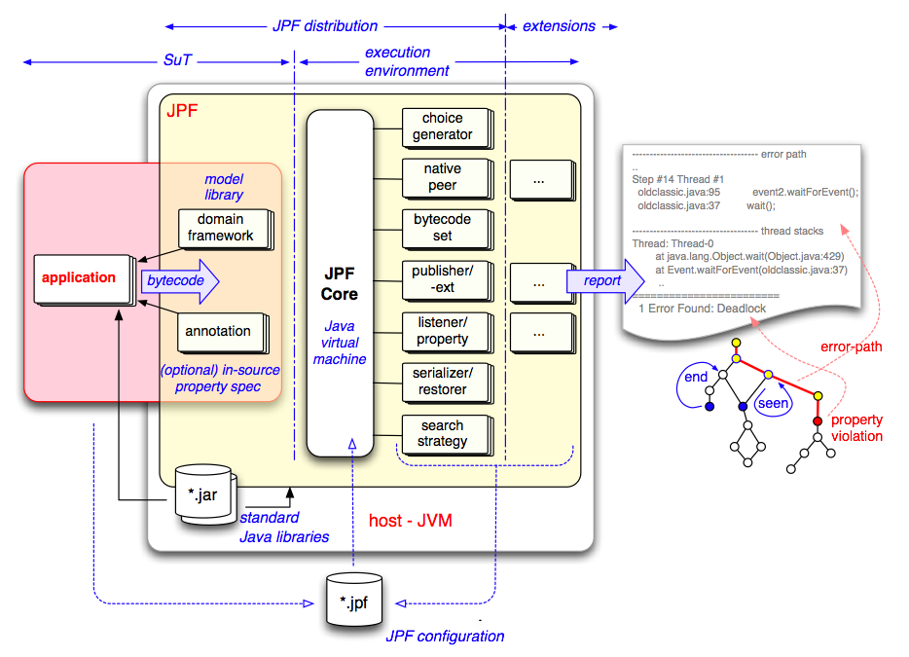
JPF Structure

Slide 74
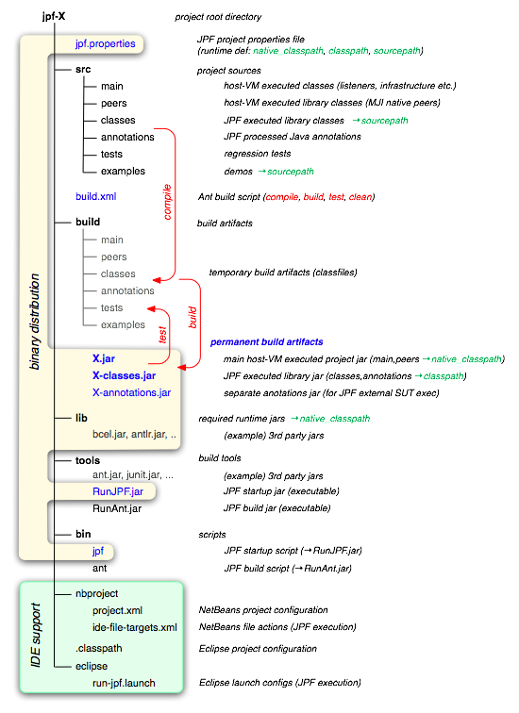
Directory Structure
all JPF projects share uniform directory layout
binary distributions are slices of source distributions (interchangeable)
3rd party tools & libraries can be included (self-contained)
all projects have examples and regression test suites (eventually ☹)
projects have out-of-the-box IDE configuration (NB,Eclipse)

Slide 75
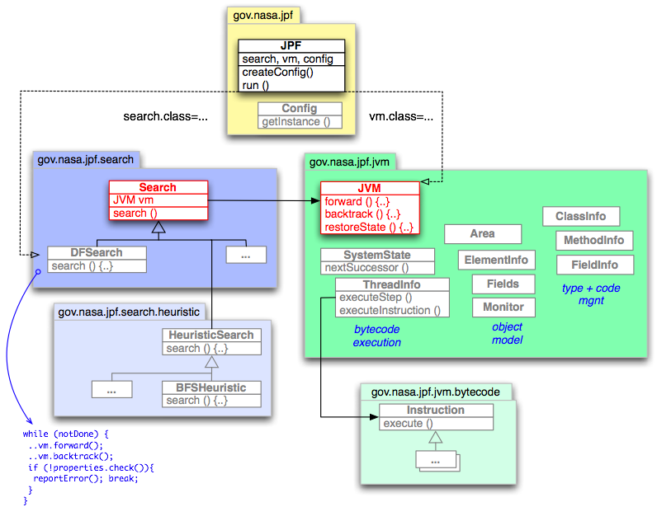
JPF Top-level Structure
two major constructs: Search and JVM
JVM produces program states
Search is the JVM driver

Slide 76
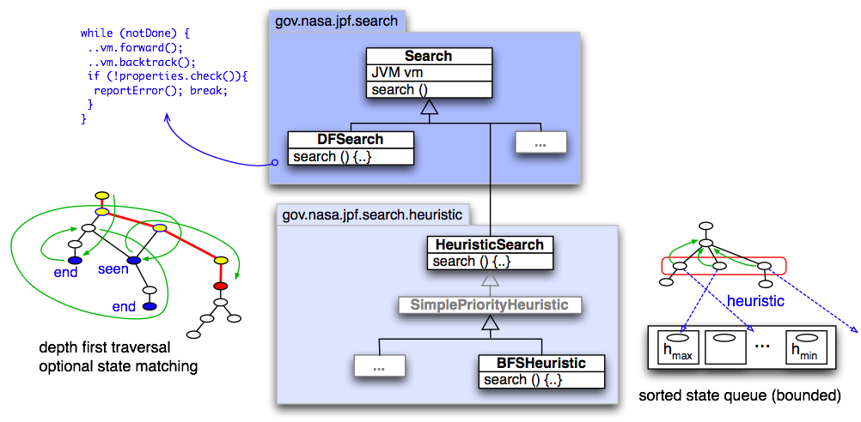
Search Policies
state explosion mitigation: search the interesting state space part first (“get to the bug early, before running out of memory”)
Search instances encapsulate (configurable) search policies

Slide 77
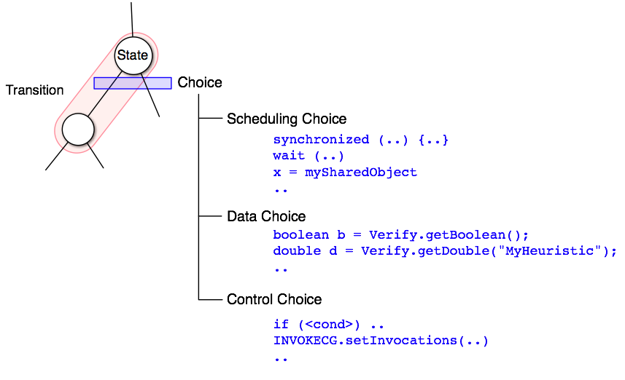
Exploring Choices
model checker needs choices to explore state space
there are many potential types of choices (scheduling, data, ..)
choice types should not be hardwired in model checker

Slide 78
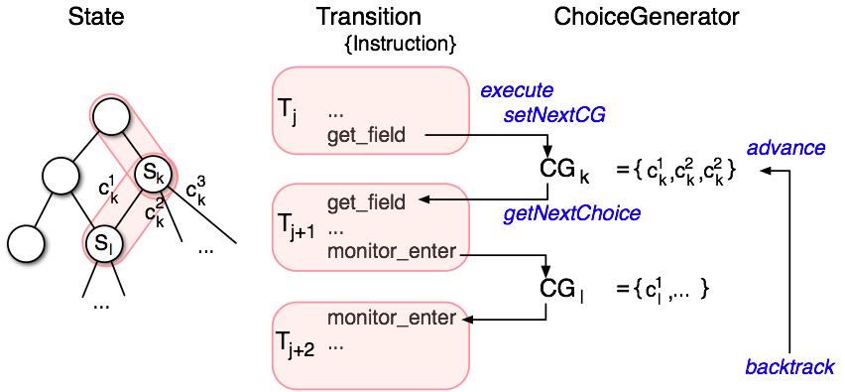
Choice Generators
transitions begin with a choice and extend until the next ChoiceGenerator (CG) is set (by instruction, native peer or listener)
advance positions the CG on the next unprocessed choice (if any)
backtrack goes up to the next CG with unprocessed choices
Choice Generators are configurable as well, i.e. create your own

Slide 79
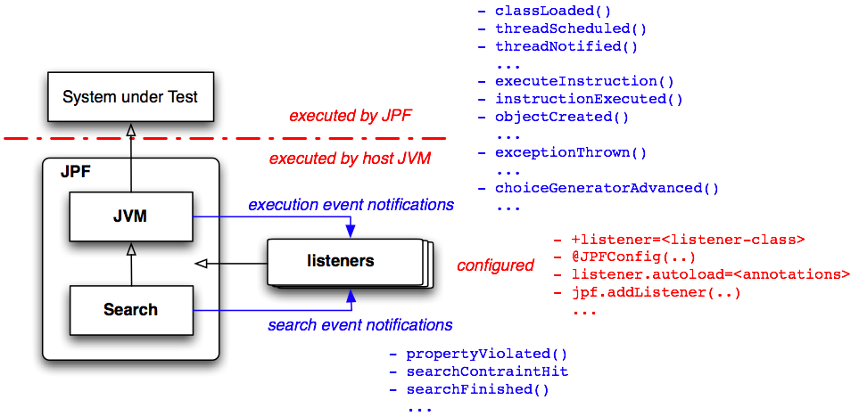
Listeners, the JPF Plugins

Slide 80
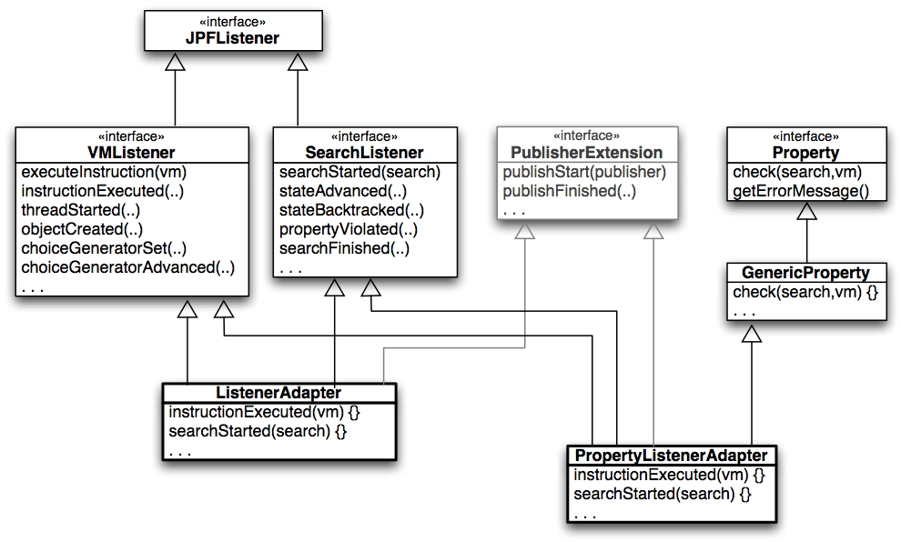
Listeners Implementation

Slide 81
Example Listener Checking NonNull Annotation on Return
public class NonnullChecker extends ListenerAdapter {
...
public void executeInstruction (JVM vm) {
Instruction insn = vm.getLastInstruction();
ThreadInfo ti = vm.getLastThreadInfo();
if (insn instanceof ARETURN) { // check @NonNull method returns
ARETURN areturn = (ARETURN)insn;
MethodInfo mi = insn.getMethodInfo();
if (areturn.getReturnValue(ti) == null) {
if (mi.getAnnotation(“java.annotation.Nonnull”) != null) {
Instruction nextPc = ti.createAndThrowException( "java.lang.AssertionError",
"null return from @Nonnull method: " +
mi.getCompleteName());
ti.setNextPC(nextPC);
return;
}
}
...

Slide 82
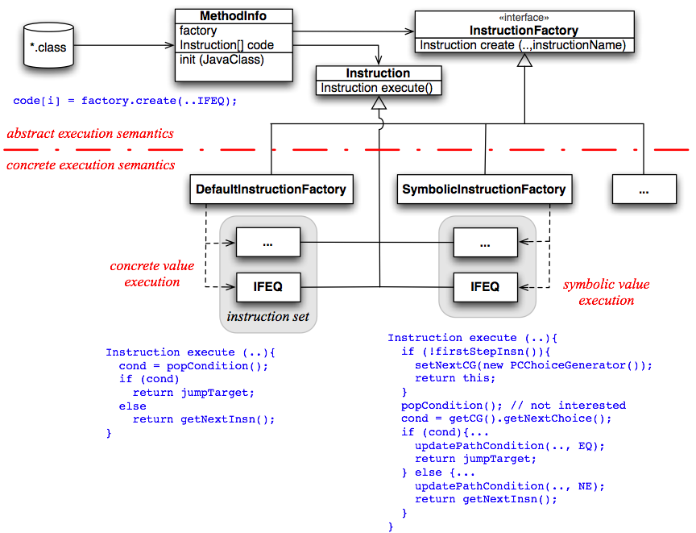
Bytecode Instruction Factories

Slide 83
Example – Bytecode Factory
provide alternative Instruction classes for relevant bytecodes
create & configure InstructionFactory that instantiates them
...
[20] iinc
[21] goto 10
[10] iload_4
[11] bipush
[12] if_icmpge 22
[13] iload_3
[14] iload_2
[15] iadd
...
compiler
void notSoObvious(int x){
int a = x*50;
int b = 19437583;
int c = a;
for (int k=0; k<100; k++){
c += b;
System.out.println(c);
}}
...
notSoObvious(21474836);
JPF configuration
vm.insn_factory.class =
.numeric.NumericInstructionFactory
class loading
code execution
(by JPF)
class IADD extends Instruction {
Instruction execute (.., ThreadInfo ti) {
int v1 = ti.pop();
int v2 = ti.pop();
int res = v1 + v2;
if ((v1>0 && v2>0 && res<=0) …throw ArithmeticException..

Slide 84
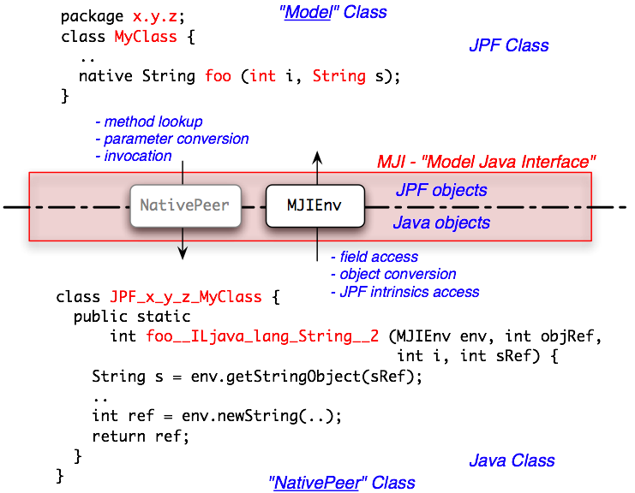
MJI - Model-Java-Interface
execution lowering from JPF executed code into JVM executed code

Slide 85
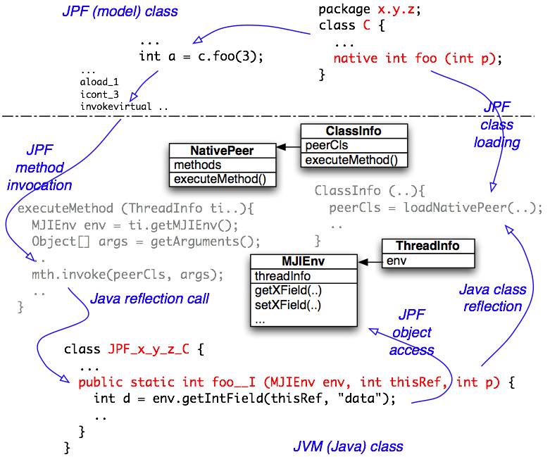
MJI - Implementation

Slide 86
MJI - Example
public class JPF_java_lang_String {
...
public static int indexOf__I__I (MJIEnv env, int objref, int c) {
int vref = env.getReferenceField(objref, "value");
int off = env.getIntField(objref, "offset");
int len = env.getIntField(objref, "count");
for (int i=0, j=off; i<len; i++, j++){
if ((int)env.getCharArrayElement(vref, j) == c)
return i;
}
return -1;
}
public static int toCharArray_____3C (MJIEnv env, int objref){
...
int cref = env.newCharArray(len);
for (int i=0, j=off; i<len; i++, j++){
env.setCharArrayElement(cref, i, env.getCharArrayElement(vref, j));
}
return cref;
}
public static boolean matches__Ljava_lang_String_2__Z(MJIEnv env,int objRef, int regexRef) {
String s = env.getStringObject(objRef);
String r = env.getStringObject(regexRef);
return s.matches(r);
}

Slide 87
Obtaining JPF
Mercurial repositories on http://babelfish.arc.nasa.gov/hg/jpf/{jpf-core,jpf-aprop,...}
Eclipse Steps
Get Mercurial
Eclipse Update site: http://cbes.javaforge.com/update
Get jpf-core
File – Import – Mercurial - Clone repository using Mercurial - Next
Specify http://babelfish.arc.nasa.gov/hg/jpf/jpf-core
Check the box for 'Search for .project files in clone and use them to create projects'
Finish
Build
Project – Properties - Select Builders - Ant Builder - Click Edit
Click JRE tab - Separate JREs - Installed JREs
Pick a JDK 1.6xxx…JRE will not find javac

Slide 88
Running JPF (1)
Create site.properties in $(user.home)/.jpf
One line is enough for now:
$(user.home)/My Documents/workspace/jpf-core
Install Eclipse Plugin (from the website description)
Ensure that you are running Eclipse >= 3.5 (Galileo)
In Eclipse go to Help -> Install New Software
In the new window selected "Add"
The name is up to you but, set "Location" to http://babelfish.arc.nasa.gov/trac/jpf/raw-attachment/wiki/install/eclipse-plugin/update/
From the "Work with:" drop down menu select the update site that you just entered from the previous step
Check the "Eclipse-JPF" check box, select "Next" and go through the install process.

Slide 89
Running JPF (2)
Right click on *.jpf file and pick “Verify”
Go to src/examples and right click on oldclassic.jpf
Should see a deadlock!

Slide 90
Configuring JPF
almost nothing in JPF is hardwired ⇒ great flexibility but config can be intimidating
all of JPFs configuration is done through Java properties (but with some extended property file format)
keyword expansion jpf-root = ${user.home}/jpf
previously defined properties
system properties
append extensions+=,jpf-aprop
prepend +peer_packages=jpf-symbc/build/peers,
directives
dependencies @requires jpf-awt
recursive loading @include ../jpf-symbc/jpf.properties
hierarchical process
system defaults (from jpf.jar)
site.properties
project properties from all site configured projects (<project-dir>/jpf.properties)
current project properties (./jpf.properties)
selected application properties file (*.jpf)
command line args (e.g. bin/jpf +listener=.listeners.ExecTracker ...)
no space between key and ‘+’ !

Slide 91
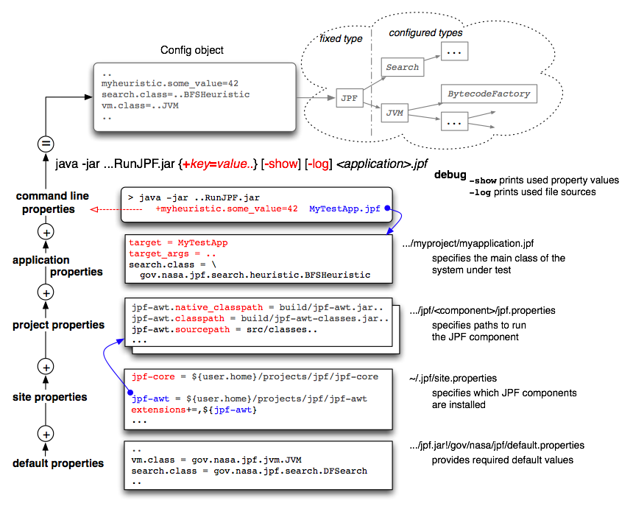
Configuration cont.

Slide 92
Running JPF
for purists (tedious, do only if you have to)
setting up classpaths >export CLASSPATH=...jpf-core/build/jpf.jar...
invoking JVM >java gov.nasa.jpf.JPF +listener=... x.y.MySUT
using site config and starter jars (much easier and portable)
explicitly >java -jar tools/RunJPF.jar MySUT-verify.jpf
using scripts >bin/jpf MySUT-verify.jpf
running JPF from within JUnit
running JPF from your program (tools using JPF)
using NetBeans or Eclipse plugins
“Verify..” context menu item for selected *.jpf application property file
using provided launch configs (Eclipse) or run targets (NetBeans)

Slide 93
JPF and JUnit
derive your test cases from gov.nasa.jpf.util.test.TestJPF
run normally under JUnit or from Ant <junit ..> task
be aware of that test case is run by JVM and JPF
public class ConstTest extends TestJPF {
static final String[] JPF_ARGS = { "+listener=.aprop.listener.ConstChecker" };
//--- standard driver to execute single test methods
public static void main(String[] args) {
runTestsOfThisClass(args);
}
//--- the test methods
@Test
public void testStaticConstOk () {
if (verifyNoPropertyViolation(JPF_ARGS)){ ConstTest.checkThis();
} }
...
Verification goal
code checked by JPF

Slide 94
Conclusions
JPF is a highly extensible tool suite
It is now 15 years old and has been open source for half that time
So please, use it, change it…
Contact for more information
Peter Mehlitz (peter.c.mehlitz@nasa.gov)
Neha Rungta (neha.s.rungta@nasa.gov)
Corina Pasareanu (Corina.S.Pasareanu@nasa.gov)
Willem Visser (willem@gmail.com)

Slide 95
Other Types of Model Checking
Real-time Model Checking
Probabilistic Model Checking
Statistical Model Checking

Slide 96
UPPAAL
UPPAAL is a tool box for simulation and verification of real-time systems based on constraint solving and other techniques.
UPPAAL was developed jointly by Uppsala University and Aalborg University.
It can be used for systems that are modeled as a collection of non-deterministic processes w/ finite control structures and real-valued clocks, communicating through channels and/or shared variables.
It is designed primarily to check both invariants and reachability properties by exploring the statespace of a system.
Slide by Chien-Liang Chen

Slide 97
Intelligent Light Control
press?
Off
press?
x:=0
Light
press?
Bright
x<=3
x>3
press?
Requirements: If a user quickly presses the light control twice, then the light should get brighter; on the other hand, if the user slowly presses the light control twice, the light should turn off.
Solution: Add a real-valued clock, x.
Slide by Chien-Liang Chen

Slide 98
Probabilistic Model Checking
Finite-state machines
State transitions are probabilistic
Probabilistic model checking question:
What’s the probability of reaching bad state?
0.3
0.2
0.5
...
...
“bad state”
Slide by Vitaly Shmatikov

Slide 99
Discrete-Time Markov Chains
(S, s₀, T, L)
S is a finite set of states
s₀ ∈S is an initial state
T :S×S→[0,1] is the transition relation
∀s,s’∈S Σ_{s’} T(s,s’)=1
L is a labeling function
Slide by Vitaly Shmatikov

Slide 100
Markov Chain: Simple Example
Probabilities of outgoing
transitions sum up to 1.0
for every state
C
0.5
0.2
A
s₀
0.1
0.5
E
0.8
D
1.0
B
0.9
1.0
Probability of reaching E from s₀ is 0.2•0.5+0.8•0.1•0.5=0.14
The chain has infinite paths if state graph has loops
Need to solve a system of linear equations to compute probabilities
Slide by Vitaly Shmatikov

Slide 101
PRISM Kwiatkowska et al., U. of Birmingham
[
Probabilistic model checker
System specified as a Markov chain
Parties are finite-state machines w/ local variables
State transitions are associated with probabilities
Can also have nondeterminism (Markov decision processes)
All parameters must be finite
Correctness condition specified as PCTL formula
Computes probabilities for each reachable state
Enumerates reachable states
Solves system of linear equations to find probabilities
Slide by Vitaly Shmatikov

Slide 102
PRISM Syntax
C
0.5
0.2
A
s₀
0.1
0.5
E
0.8
D
1.0
B
0.9
1.0
module Simple
state: [1..5] init 1;
[] state=1 -> 0.8: state’=2 + 0.2: state’=3;
[] state=2 -> 0.1: state’=3 + 0.9: state’=4;
[] state=3 -> 0.5: state’=4 + 0.5: state’=5;
endmodule
IF state=3 THEN with prob. 50% assign 4 to state,
with prob. 50% assign 5 to state
Slide by Vitaly Shmatikov

Slide 103
PCTL Logic
[Hansson, Jonsson ‘94]
Probabilistic Computation Tree Logic
Used for reasoning about probabilistic temporal properties of probabilistic finite state spaces
Can express properties of the form “under any scheduling of processes, the probability that event E occurs is at least p”
Slide by Vitaly Shmatikov

Slide 104
PCTL Syntax
State formulas
First-order propositions over a single state
Φ ::= True | a | Φ ∧ Φ | Φ ∨ Φ | ¬Φ | P_{>p}[Ψ]
Path formulas
Properties of chains of states
Ψ ::= X Φ | Φ U^{≤k} Φ | Φ U Φ
Slide by Vitaly Shmatikov

Slide 105
PCTL: Probabilistic State Formulas
Specify that a certain predicate or path formula holds with probability no less than some bound
True
True
False
X=1
y=2
1.0
X=2
y=0
0.2
X=1
y=1
0.5
X=3
y=0
1.0
s₀
0.5
0.8
False
ϕ = P_{>0.5}[(y>0) U (x=2)]
Slide by Vitaly Shmatikov

Slide 106
Statistical Probabilistic MC
The numerical approaches has issues
Only works for certain structures
High time and space requirements
Another approach is to sample paths and do hypothesis testing
With enough statistical evidence
Just need to know the input distributions
Can even be large complex system
Just need to be able to run it

Slide 107
Statistical Probabilistic MC
Disadvantages are plenty too
Only probabilistic guarantees
Sample size grows very high for high accuracy
Problematic to handle nondeterminism
Initially impossible, must be purely probabilistic
Now finding an optimal scheduler that states how the nondeterminism should be resolved for maximum accuracy is possible

