Slide 1
ZigZagFuzz:
Interleaved Fuzzing
of Program Options
and Files
ICSE 2025
ACM TOSEM 2025
Ahcheong Lee (KAIST)
Youngseok Choi (KAIST)
Shin Hong (CBNU)
Yunho Kim (HYU)
Kyutae Cho (LIG Nex1)
Moonzoo Kim (KAIST)

Slide 2
ZigZagFuzz: Interleaved Fuzzing of Program Options and Files
page 1
Objective - generate diverse commands as well as files
CLI (Command Line Interface) programs use command lines to determine which features to execute
Image processing program cjpeg execution space
cjpeg -rotate
cjpeg -gray
cjpeg -convert
Notes:
The main goal of ZigZagFuzz is to generate a wide variety of both command lines and input files.
Program options or command lines play a crucial role in determining which features are exercised during execution.
In other words, depending on the options you provide, it will cover totally different execution spaces.
For example, let’s consider an image processing program cjpeg.
If we run it with dash gray option, it produces gray-scaled image,
but if we execute the program with dash rotate option, it will generate a rotated image.
As you can see, it shares very small common execution area, so it is important to test diverse program options.

Slide 3
ZigZagFuzz: Interleaved Fuzzing of Program Options and Files
page 2
Previous fuzzing techniques did not care commands,
but they focused on mutating only files
cjpeg execution space
cjpeg -rotate
cjpeg -gray
cjpeg -convert
Notes:
We conducted a survey of 100 recent fuzzing papers and discovered that the majority of them used only a single command line for their experiments.
For example, they can select just one command line “-gray” here, and focus on generating diverse image input files.
However, if we rely on just one program option, we can not cover this big execution space.
And as a result, we will lost many potential bugs in this space.

Slide 4
ZigZagFuzz: Interleaved Fuzzing of Program Options and Files
page 3
Previous program option fuzzing techniques
Problem: All of them either
1. do NOT mutate options
2. simultaneously mutate both options and files
POWER (ICST 2021) | Simultaneously mutates both options and files
ConfigFuzz (ACM TOSEM 2023) | Simultaneously mutates both options and files
CarpetFuzz (USENIX Sec’ 2023) | Does not mutate options
ZigZagFuzz (ACM TOSEM 2025) | Separately mutates options and files
Notes:
There were a few fuzzing techniques that treid to utilze and generate diverse program options.
However, they had two common problems,
first, some of them do not mutate options at all,
and next, some of them simultaneously mutate both options and files.
We found both approaches have inefficiency problem,
so we developed zigzagfuzz to avoid it by separately mutate options and files.
I’ll explain what is the problem of these approaches in later slides.

Slide 5
ZigZagFuzz: Interleaved Fuzzing of Program Options and Files
page 4
Why does ZigZagFuzz mutates them separately?
argv[1] == “-rotate”
F
T
2 Observations
+
2 Lessons
filebytes[1] == ‘B’
F
T
atoi(argv[2]) < 90
T
F
//crash bug
Notes:
So what is the problem of simultaneously mutating both options and files?
We found three observations and lessons from CLI programs that will explain the problem.
I’ll explain the observations with this crashing code example.
To reach and detect crash bug at the bottom, you need to satisfy all three branch conditions,
and each branch condition reads either program option value argv or filebytes.

Slide 6
ZigZagFuzz: Interleaved Fuzzing of Program Options and Files
page 5
Why does ZigZagFuzz mutates them separately?
Observation # 1.
Simultaneously mutating options and files easily break (previously satisfied) pre-conditions.
argv[1] == “-rotate”
F
T
filebytes[1] == ‘B’
F
T
atoi(argv[2]) < 90
T
F
//crash bug
Notes:
The second observations is that simultaneously mutating options and files easily break previously satisfied pre conditions

Slide 7
ZigZagFuzz: Interleaved Fuzzing of Program Options and Files
page 6
Observation # 1. Simultaneously mutating options and files
easily break (previously satisfied) pre-conditions.
option: -rotate 150
filebytes: “ABCD”
argv[1] == “-rotate”
F
T
filebytes[1] == ‘B’
F
T
atoi(argv[2]) < 90
T
F
//crash bug
Notes:
Let’s assume that we have this purple test input with this option value and file values.
It is very close to the crash, we just need to satisfy the last branch condition here.
To satisfy the last branch condition, you just need to mutate option values.
If you change 150 to like, 80, then you should be able to reach the crash bug.
However,

Slide 8
ZigZagFuzz: Interleaved Fuzzing of Program Options and Files
page 7
Observation # 1. Simultaneously mutating options and files
easily break (previously satisfied) pre-conditions.
option: -rotate 150
filebytes: “ABCD”
argv[1] == “-rotate”
F
T
filebytes[1] == ‘B’
option: -rotate 80
filebytes: “AFPD”
F
T
atoi(argv[2]) < 90
T
F
//crash bug
Notes:
However, if we mutate options and files at the same time,
it has a high probability to make test inputs like this red one.
To iteratively progress and generate a test input that reach deeper part of a program,
it is important not to break pre-conditions of the execution path.
But in this case, by mutating files, you introduce probability to invalidate the second file-dependent branch condition,
which prevent us to reach the deeper part of a program efficiently.
We found this can happen frequently when you mutating both options and files at the same time,
so we developed ZigZagFuzz based on this observation.

Slide 9
ZigZagFuzz: Interleaved Fuzzing of Program Options and Files
page 8
Why does ZigZagFuzz mutates them separately?
Observation # 1.
Simultaneously mutating options and files easily break (previously satisfied) pre-conditions.
argv[1] == “-rotate”
F
T
filebytes[1] == ‘B’
F
T
atoi(argv[2]) < 90
Lesson # 1.
We should NOT simultaneously mutate options and files.
T
F
//crash bug
Notes:
However, if we mutate options and files at the same time,
it has a high probability to fall through other execution path as shown in red.
Even if we could generate an option that satisfy the last branch condition,
since we mutate files at the same time, it has a high probability to invalidate previously satisfied file-dependent condition here.
We found this can happen frequently when you mutating both options and files at the same time,
so we developed ZigZagFuzz based on this observation.

Slide 10
ZigZagFuzz: Interleaved Fuzzing of Program Options and Files
page 9
Why does ZigZagFuzz mutates them separately?
Observation # 2.
We need to satisfy an interleaved sequence of “option-dependent branches” and “file-dependent branches” to reach deeper parts.
argv[1] == “-rotate”
F
T
filebytes[1] == ‘B’
F
T
atoi(argv[2]) < 90
T
F
//crash bug

Slide 11
ZigZagFuzz: Interleaved Fuzzing of Program Options and Files
page 10
Why does ZigZagFuzz mutates them separately?
option: -rotate 80
filebytes: “ABDA”
option: -rotate 150
filebytes: “AAAA”
option: -gray 150
filebytes: “AAAA”
option: -rotate 150
filebytes: “ABDA”
argv[1] == “-rotate”
F
T
filebytes[1] == ‘B’
F
T
atoi(argv[2]) < 90
T
F
//crash bug

Slide 12
ZigZagFuzz: Interleaved Fuzzing of Program Options and Files
page 11
Why does ZigZagFuzz mutates them separately?
Observation # 2.
We need to satisfy an interleaved sequence of “option-dependent branches” and “file-dependent branches” to reach deeper parts.
argv[1] == “-rotate”
F
T
filebytes[1] == ‘B’
F
T
atoi(argv[2]) < 90
T
Lesson # 2.
We should mutate options and files in an interleaving way.
F
//crash bug

Slide 13
ZigZagFuzz: Interleaved Fuzzing of Program Options and Files
page 11
Why does ZigZagFuzz mutates them separately?
argv[1] == “-rotate”
Lesson # 1.
No simultaneous mutations of options and files.
F
T
filebytes[1] == ‘B’
F
T
atoi(argv[2]) < 90
Lesson # 2.
Mutate options and files in an interleaving way.
T
F
//crash bug

Slide 14
ZigZagFuzz: Interleaved Fuzzing of Program Options and Files
page 12
Why is it called ZigZagFuzz?
It separately mutates options and files, in a zigzag manner.
Mutate
program options
Mutate files

Slide 15
ZigZagFuzz: Interleaved Fuzzing of Program Options and Files
page 13
Contributions
Contribution 1.
We present ZigZagFuzz that separately mutates options and files in a “ZigZag” manner.
Contribution 2.
ZigZagFuzz detected 85 new crash bugs, which was 1.9-10.6 times more than cutting-edge fuzzers.

Slide 16
ZigZagFuzz: Interleaved Fuzzing of Program Options and Files
page 14
Overall Architecture
Initial Corpus
Option
Mutation
Domain-wise Corpus Shrinking
Option
Mutation
File
Mutation
Shrunken
Corpus

Slide 17
ZigZagFuzz: Interleaved Fuzzing of Program Options and Files
page 15
Overall Architecture
Initial Corpus
Option
Mutation
File
Mutation
Domain-wise Corpus Shrinking
Shrunken
Corpus

Slide 18
ZigZagFuzz: Interleaved Fuzzing of Program Options and Files
page 16
Overall Architecture
Initial Corpus
Option
Mutation
File
Mutation
Domain-wise Corpus Shrinking
Shrunken
Corpus

Slide 19
ZigZagFuzz: Interleaved Fuzzing of Program Options and Files
page 17
Overall Architecture
Initial Corpus
Option
Mutation
File
Mutation
Domain-wise Corpus Shrinking
Shrunken
Corpus

Slide 20
ZigZagFuzz: Interleaved Fuzzing of Program Options and Files
page 18
Evaluation
Does ZigZagFuzz
1. detect more crash bugs and
2. achieve higher branch coverage
than other state-of-the-art fuzzing techniques?
Conducted five separate 12-hour runs and
collected data on coverage and bug detection.
Notes:
To evaluate our methods,
we implemented ZigZagFuzz and compared its branch coverage and bug detection power with other state-of-the art fuzzing techniques.

Slide 21
ZigZagFuzz: Interleaved Fuzzing of Program Options and Files
page 19
Fuzzing subject programs
20 C/C++ real open-source programs with diverse program options
Program | Size (Loc) | # of CLI Keywords | Program | Size (Loc) | # of CLI Keywords
avconv | 454,936 | 761 | nasm | 70,903 | 218
bison | 54,423 | 51 | objdump | 877,165 | 84
cjpeg | 6,308 | 33 | pdftohtml | 38,111 | 26
dwarfdump | 83,545 | 103 | pdftopng | 97,890 | 18
exiv2 | 33,417 | 76 | pspp | 4,901 | 20
ffmpeg | 774,186 | 1817 | readelf | 74,789 | 98
gm | 197,891 | 757 | tiff2pdf | 8,234 | 30
gs | 1,174,673 | 350 | tiff2ps | 5,646 | 34
jasper | 2,920 | 20 | xmllint | 11,285 | 66
mpg123 | 11,298 | 122 | xmlwf | 4,147 | 15
 | Size (LoC) | # of CLI keywords
Average | 199,333 | 235
Maximum | 1,174,673 | 1817
Notes:
We conducted experiments on 20 real open-source programs with about 2 hundred thousands lines of code.
We also tried to select a set of programs with diverse program options. In average, they have about 200 program option keywords.

Slide 22
ZigZagFuzz: Interleaved Fuzzing of Program Options and Files
page 20
Result 1 - # of new crash bugs detected
ZigZagFuzz detected 46 crash bugs that are not found by others.
ZigZagFuzz detected 45%-74% of crashes found by other techniques.
x1.9
AFL++
CarpetFuzz
ConfigFuzz
POWER
ZigZagFuzz
Notes:
As a result, we can find that ZigZagFuzz detected 85 new crash bugs from 15 programs,
which is 1.89 times more crash bugs than other cutting-edge fuzzers.

Slide 23
ZigZagFuzz: Interleaved Fuzzing of Program Options and Files
page 21
Result 2 - branch coverage achievement
+ 12%
AFL++
CarpetFuzz
ConfigFuzz
POWER
ZigZagFuzz
Notes:
On the branch coverage aspect, we also could that ZigZagFuzz showed the best branch coverage performance.
It achieved 12.3% more coverage than others.

Slide 24
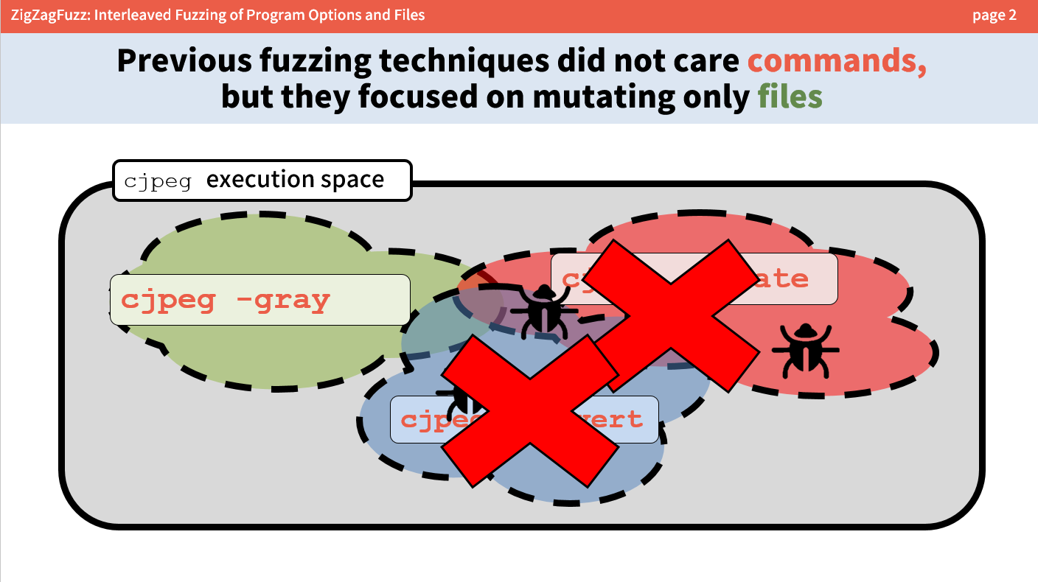
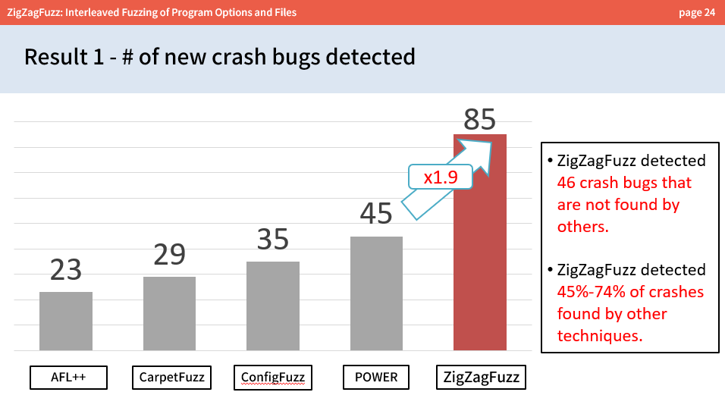
ZigZagFuzz: Interleaved Fuzzing of Program Options and Files
Presenter : Ahcheong Lee from KAIST
Notes:
In summary, we present ZigZagFuzz which mutates different input domains separately in a zigzag manner,
Which resulted in significant bug detection ability improvement.
You will find much more interesting analysis about fuzzing different input domains in the paper.
That was the end of the presentation,
This is Ahcheong Lee, and please feel free to ask any questions.

