Slide 1
CITRUS: Automated Unit Testing Tool for Real-world C++ Programs
Robert Sebastian Herlim – KAIST
Yunho Kim – Hanyang University
Moonzoo Kim – KAIST

Slide 2
Introduction
C++ is popular in many application domains.
Database engines
Web browsers
Operating systems
Video game engines
However, there are almost no automated unit testing tool publicly available for real-world C++ programs,
although the need to automatically test C++ programs has been high.
Moreover, previous system-level testing (e.g., AFL, KLEE) has very limited applicability to generate unit-level test inputs, as it still requires manually-written stub drivers to be provided by human testers.

Slide 3
CITRUS: C++ UnIt Testing for Reliable and Usable Software
Proposed Approach
Generate Drivers
Mutate Drivers
Argument Fuzzing
CITRUS receives the source code of a target C++ program $P$ and it automatically generates test driver files for $P$, each of which consists of various method calls of $P$.
Then, CITRUS generates more diverse test drivers by mutating the test driver code to increase the test coverage of $P$.
In other words, CITRUS explores diverse states of $P$ by executing various method sequences of functions in $P$.
In addition, CITRUS improves the test coverage of $P$ further by applying libfuzzer to change $P$'s state by mutating arguments of the methods.

Slide 4
Contributions
CITRUS generates test cases on real-world C++ programs in fully-automated manner.
CITRUS is one of the very few tools that can automatically generate unit-level test cases due to the high complexity of C++ language features.
CITRUS achieved high testing effectiveness (up to 95% for line coverage and 79% for branch coverage) and testing efficiency (saving up to 14.6 hours in average by applying libfuzzer fuzzing after the method sequence generation stage).
We have reported a case study to demonstrate how CITRUS detects real crash bugs on C++ programs, which remains as a challenging task in automated unit-level testing due to its proneness to false alarms.
CITRUS has been made as an open-source tool, which is available at
https://github.com/swtv-kaist/CITRUS

Slide 5
Motivating Example
Consider the following code snippet of Stack:
Arbitrary method call sequence ordering affects the program executions.
1: template<typename T>
2: class Stack {
3: public:
4: void Push(T item) {
5: if (Size() == GrowCap())
6: Enlarge();
7: ...
8: }
9: void Pop() {
10: if (IsEmpty())
11: throw std::bad_call();
12: ...
13: if (Size() < ShrinkCap())
14: Shrink();
15: }
16: };
Scenario | Operations | Expected Behavior
1 | Push Pop | Normal execution
2 | Push Push ... | Enlarge the stack capacity
3 | Push ... Pop | Shrink the stack capacity
4 | Pop | (CRASH) Exception when performing Pop on an empty stack
Notes:
Using static drivers cannot discover some executions.

Slide 6
CITRUS on Approaching the Motivating Example
Consider the following code snippet of Stack:
1: template<typename T>
2: class Stack {
3: public:
4: void Push(T item) {
5: if (Size() == GrowCap())
6: Enlarge();
7: ...
8: }
9: void Pop() {
10: if (IsEmpty())
11: throw std::bad_call();
12: ...
13: if (Size() < ShrinkCap())
14: Shrink();
15: }
16: };
CITRUS automatically generates unit-level test drivers by directly composing arbitrary method call sequences from the target program.
Any method call sequences that increases the coverage are considered “interesting”, and will be kept for further test case mutations.
CITRUS handles various C++ complex language features to improve unit-level testing.
e.g., implicit default constructor in Stack.

Slide 7
CITRUS Test Case Construction
Consider the following code snippet of Stack:
CITRUS constructs test cases by invoking arbitrary method calls from the target program.
The following example demonstrates how CITRUS constructs interesting test cases.
CITRUS selects the function Push (randomly selected).
CITRUS recognizes the requirements to invoke the function. To invoke Push, CITRUS requires:
a stack instance, on which Push will be invoked;
an argument item of type T.
Then, CITRUS constructs the call statement (to Push) with all of its supporting argument-constructing statements.
1: template<typename T>
2: class Stack {
3: public:
4: void Push(T item) {
5: if (Size() == GrowCap())
6: Enlarge();
7: ...
8: }
9: void Pop() {
10: if (IsEmpty())
11: throw std::bad_call();
12: ...
13: if (Size() < ShrinkCap())
14: Shrink();
15: }
16: };
COVERED
Stack<int> stack1;
int int2 = 255;
stack1.Push(int2);

Slide 8
CITRUS Test Case Mutation (1/2)
Consider the following code snippet of Stack:
Then, CITRUS performs test case mutation to generate more diverse test drivers.
Test case mutation happened in $n$-stacked modifications consisting of either insertion, deletion, or modification.
The test case will be kept as it improves the test coverage.
1: template<typename T>
2: class Stack {
3: public:
4: void Push(T item) {
5: if (Size() == GrowCap())
6: Enlarge();
7: ...
8: }
9: void Pop() {
10: if (IsEmpty())
11: throw std::bad_call();
12: ...
13: if (Size() < ShrinkCap())
14: Shrink();
15: }
16: };
COVERED
Stack<int> stack1;
int int2 = 255;
stack1.Push(int2);
stack1.Push(-1);
stack1.Pop();
stack1.Push(8); // Size reaches GrowCap
stack1.Push(0); // Enlarge
COVERED
+
+
+
+
COVERED

Slide 9
CITRUS Test Case Mutation (2/2)
Consider the following code snippet of Stack:
Some object states require more complex call sequences (to construct) than some others.
e.g., a stack with its capacity enlarged.
CITRUS reuses existing interesting test cases to harness past sequences that constructs complex object states.
1: template<typename T>
2: class Stack {
3: public:
4: void Push(T item) {
5: if (Size() == GrowCap())
6: Enlarge();
7: ...
8: }
9: void Pop() {
10: if (IsEmpty())
11: throw std::bad_call();
12: ...
13: if (Size() < ShrinkCap())
14: Shrink();
15: }
16: };
COVERED
Stack<int> stack1;
int int2 = 255;
stack1.Push(int2);
stack1.Push(-1);
stack1.Pop();
stack1.Push(8); // Size reaches GrowCap
stack1.Push(0); // Enlarge
stack1.Pop(); // Shrink
COVERED
Previous Test Case
COVERED
COVERED
+

Slide 10
Challenge in C++ Template Class Instantiation
Testing template classes in C++ is challenging because:
It is almost impossible to instantiate template classes with all possible types.
Inappropriate type instantiation may generate many uncompilable test cases.
The following code snippet demonstrates the complexity of instantiating C++ template classes:
At L12, Outer<char> can be compiled because Inner(char*) was defined (at L2).
At L13, Outer<int> causes a compilation error because Inner(int*) was not defined.
To mitigate this, CITRUS conservatively binds free type variable T according to the existing type bindings in the target program.
e.g., binding T $→$ char while testing Decode (at L10)
Inner(int*) is not available
1: class Inner {
2: public: Inner (char *a) {}
3: };
4: template <typename T>
5: class Outer {
6: public: Outer (T* t) {
7: const Inner &tmp = Inner(t);
8: }
9: };
10: void Decode (Outer<char> &arg) { ... }
11:
12: Outer<char> ok((char*) nullptr); /* OK */
13: Outer<int> err((int*) nullptr); /* FAIL */
Inner(char*) is available
t is a char*
t is now an int*

Slide 11
Challenge in C++ STL Class Instantiation
Testing STL classes have challenges for method call sequence generation (MSG), such as:
Some STL classes have indirect ways of construction (rather than using constructor-calling convention)
e.g., convention to use make_tuple and make_unique for constructing tuple and unique_ptr.
To mitigate C++ STL class challenges,
CITRUS handles the unique construction of each STL class without performing random sequence generation.
CITRUS handles 23 STL classes:
16 containers (e.g., vector, list, queue)
3 strings (e.g., string, wstring)
2 utilities (pair and tuple)
2 smart pointers (unique_ptr and shared_ptr)
STL classes contain many member functions, and including all of such functions in MSG may not contribute to exploring diverse program states.
e.g., CITRUS can use only push_back API to generate various vector objects (with arbitrary sizes and elements). Thus, resize, erase, size do not contribute to explore diverse vector states.

Slide 12
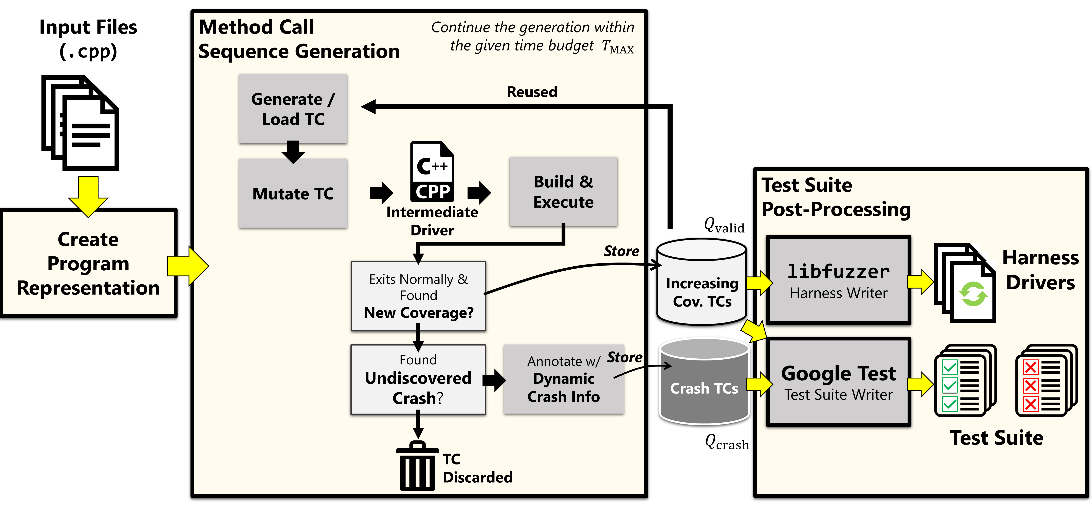
CITRUS Overview Process
CITRUS operates in three major stages as illustrated in the following process overview:
Y
N
Y
N

Slide 13
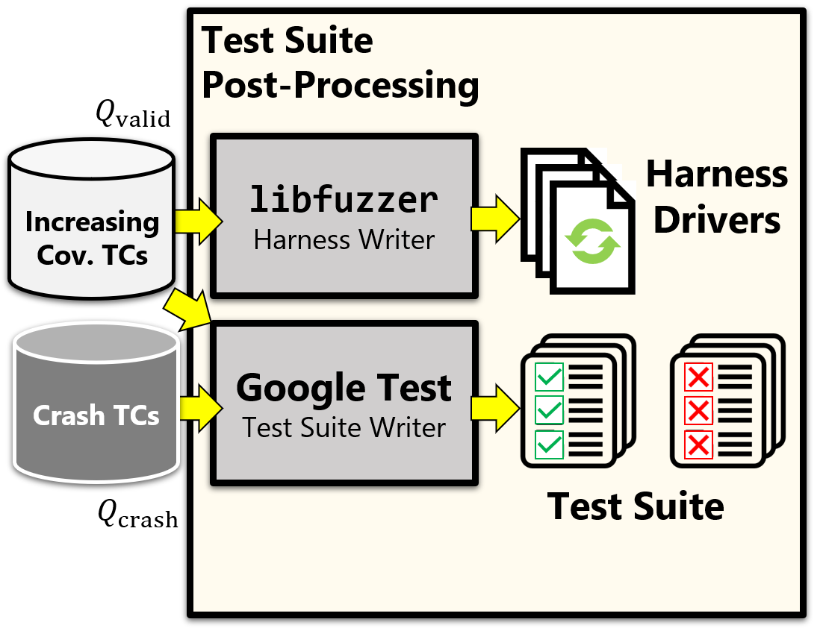
Test Suite Post-Processing
Finally, CITRUS outputs the test cases in the following two different formats:
libfuzzer-compatible harness drivers In contrast to the method call sequence generation (i.e., diversifying a state of a target program $P$ through various sequences of the method calls), libfuzzer alters the states of $P$ by randomly generating various inputs to $P$.
Google Test-compatible test cases The Google Test-compatible test cases are provided to integrate the CITRUS test cases with an existing Google test suite in the target program (if any).

Slide 14
Evaluation

Slide 15
Research Questions
We developed the following two research questions to evaluate CITRUS:
RQ1. How effective is CITRUS in terms of branch coverage?
To what extent does CITRUS achieve test coverage on real-world C++ programs?
To answer RQ1, we allocated 12 hours to perform method call sequence generation, and 2 minutes libfuzzer fuzzing time for each test case generated.
RQ2. How effective and efficient is CITRUS compared to other CITRUS variants?
In which configuration does CITRUS achieve the highest test coverage?
To answer RQ2, we introduced four CITRUS variants by assigning different time budgets for the method call sequence generation stage and libfuzzer fuzzing stage.

Slide 16
Experiment Setup
The following table lists 8 target subjects used in CITRUS experiment:
To answer RQ2, we used four CITRUS variants to compare, as follows:
Name | Size (LoC) | Version
jsonbox | 1,477 | 6f86f81
hjson | 2,911 | 0c40199
tinyxml2 | 3,606 | 1dee28e
jvar | 4,860 | e2a6a43
jsoncpp | 5,420 | c39fbda
json-voorhees | 8,614 | 046083c
yaml-cpp | 8,800 | b591d8a
re2 | 20,373 | bc42365
C_{12+LF2}* | 12H MSG, | 2mins libfuzzer.
C_{6+LF1} | 6H MSG, | 1mins libfuzzer.
C_{6+LF3} | 6H MSG, | 3mins libfuzzer.
C₂₄ | 24H MSG.
To reduce the random variance in the experiment,
we repeated the experiment in 10 runs and measured the average result from those runs.
* C_{12+LF2} is the main configuration of CITRUS
Notes:
(summarize target subjects + CITRUS variants)

Slide 17
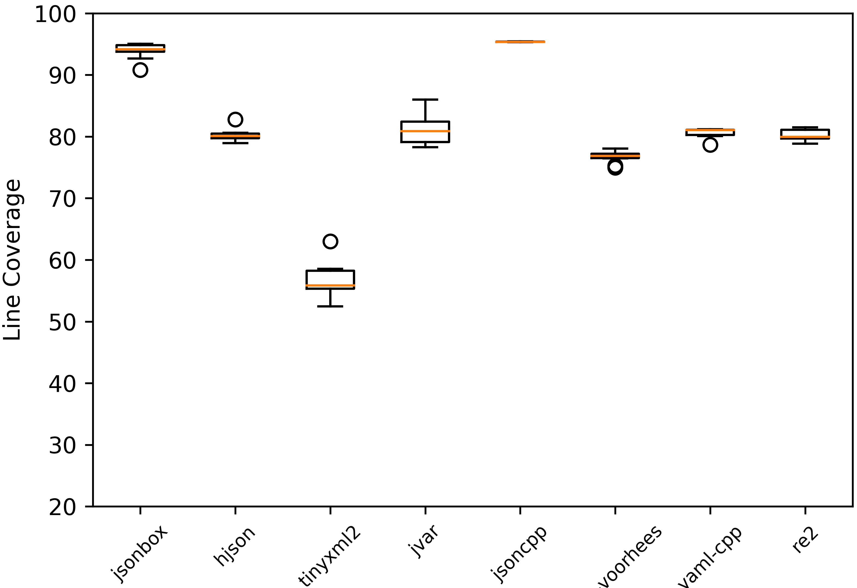
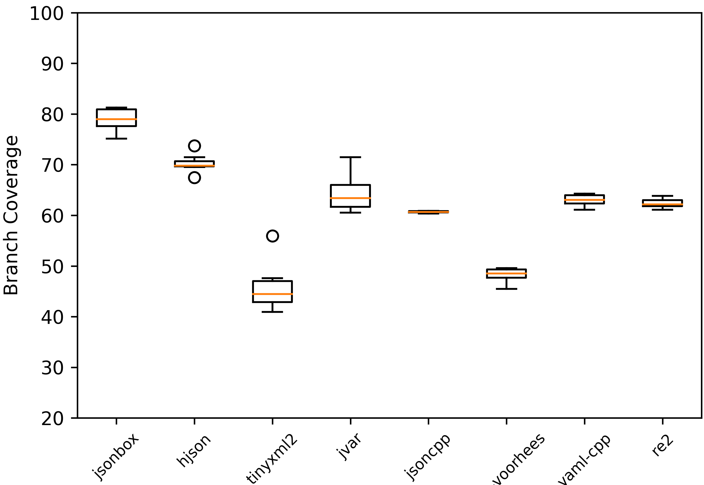
Result to RQ1. How effective is CITRUS in terms of branch coverage?
Answer to RQ1: On the eight real-world C++ target programs, CITRUS shows high testing effectiveness
in terms of both statement and branch coverage (i.e., it achieved 50% to 95% statement coverage and
40% to 79% branch coverage).

Slide 18
Result to RQ2. How effective and efficient is CITRUS compared to other CITRUS variants? (1/2)
The figures below describe the coverage achievement (averaged) over all 8 subjects.
In overall, CITRUS (C_{12+LF2}) achieved the highest coverage in all metrics when compared with other variants.

Slide 19
Result to RQ2. How effective and efficient is CITRUS compared to other CITRUS variants? (2/2)
Saving up to 14.6 hours
of testing time budget
CITRUS variants that utilize libfuzzer (C_{6+LF1}, C_{6+LF3}, C_{12+LF2})
achieved higher test coverage than the one variant with only
method sequence generation (C₂₄).
Answer to RQ2: In most subjects, CITRUS variant C_{12+LF2} produced the best result. Also, applying libfuzzer
helps CITRUS improve the coverage score and time cost, compared to the technique that uses only method
call sequence generation C₂₄.

Slide 20
New Crash Fix Bug Report in Yaml-CPP (1/2)
A crash bug has been reported to the developers of Yaml-CPP.
The crash was a due to an incorrect type casting in DecodeBase64 function (at L9).
The faulty code used unsigned int to cast from the signed char type input[i].
Negative values on input[i] leads into an out-of-bound index accesses on decoding array.
The decoding array size is only 256.
1: std::vector<unsigned char> DecodeBase64(
2: const std::string &input
3: ) {
4: using ret_type = std::vector<unsigned char>;
5: if (input.empty()) return ret_type();
6: ...
7: for (std::size_t i = 0; i < input.size(); i++) { ...
8: unsigned char d =
9: decoding[static_cast<unsigned>(input[i])];
10: if (d == 255)
11: return ret_type();
12: ...
13: }
FAULTY
Notes:
https://github.com/jbeder/yaml-cpp/pull/1051

Slide 21
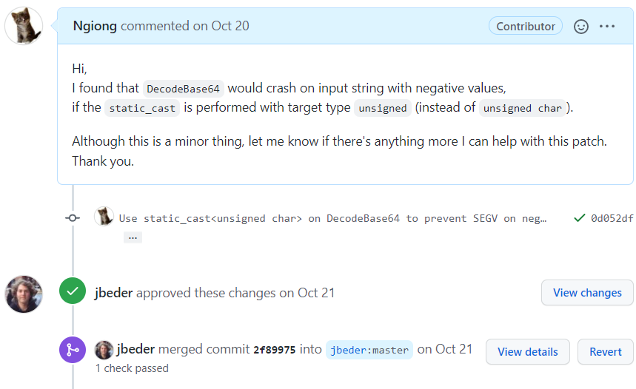
New Crash Fix Bug Report in Yaml-CPP (2/2)
The patch has been approved and merged to the master branch.
Notes:
https://github.com/jbeder/yaml-cpp/pull/1051

Slide 22
Conclusion
This work presents CITRUS, which is a new automated unit-level testing tool targeting C++ programs based on method call sequence generation to produce test cases automatically.
CITRUS handles challenging technical issues of C++ language features in unit-level, such as template instantiation, complex STL classes, implicit constructors, and so on.
On 8 real-world C++ programs, we have demonstrated that CITRUS achieved high statement coverage (up to 95%) and high branch coverage (up to 79%).
We have demonstrated that CITRUS had successfully discovered crash bug.
CITRUS is one of the very few existing C++ testing tools, which is now available at
https://github.com/swtv-kaist/CITRUS

Slide 23
Future Work
Support more complex C++ features, such as more recent STL classes, function pointers, STL’s threads and synchronization locks, and so on.
Introduce a new function selection heuristic to prioritize complex functions that require more attention to be extensively tested.
Reduce the false positive crash reports by a more careful crash filtering, and more effective crash de-duplication scheme.
Notes:
Finally, based on the false positive crash types I found in
this work, I will try to limit the number of false positive alarms produced by CITRUS through a more
effective crash de-duplication scheme and with a more careful false positive filtering.

Slide 24
Thank You

