Slide 1
On Understanding and Improving Automated Unit-level Test Generation for C++ Programs
Accepted paper at ICST 2022
Apr 4–13 2022
Robert Sebastian Herlim
Advisor: Prof. Moonzoo Kim
School of Computing – KAIST
December 15th 2021

Slide 2
Introduction
C++ is popular in many application domains.
Database engines
Web browsers
Operating systems
Video game engines
However, there are almost no automated unit testing tool publicly available for real-world C++ programs,
although the need to automatically test C++ programs has been high.
Moreover, previous system-level testing (e.g., AFL, KLEE) has very limited applicability to generate unit-level test inputs, as it still requires manually-written stub drivers to be provided by human testers.

Slide 3
Previous Approaches
Comparison with other tools to target C++ programs is listed in the following table.
Tool | Year | Remark | Auto. Driver? | C++ Engineering Efforts*? | Tool Available?
KLEE | 2008 | system-level testing tools | ❌ | ❌ | ✔
AFL | 2013
FUDGE | 2019 | automatic fuzz driver synthesis for library APIs | ✔ | ❌ | ❌
FuzzGen | 2020 |  |  |  | ✔
IntelliGen | 2021 |  |  |  | ❌
KLOVER | 2011 | automatic unit test generation for C++ | ✔ | ❌ | ❌
FSX | 2016
CITRUS | 2021 |  | ✔ | ✔ | ✔
* C++ Engineering Efforts: handling template instantiation, STL classes, implicit constructor, and so on.

Slide 4
Thesis Statement
The thesis statement for this work is written as follows:
An automated testing tool based on method call sequence generation
can generate high-coverage test cases for C++ programs that address the notoriously
high complexity of C++ language features in unit-level testing context.
There has been only very few existing tools to automatically generate unit tests for C++ programs due to the notoriously highly-complex C++ language features, such as: template instantiation, complex STL classes, implicit constructors, and so on.

Slide 5
CITRUS: C++ UnIt Testing for Reliable and Usable Software
Proposed Approach
Generate Drivers
Mutate Drivers
Argument Fuzzing
CITRUS receives the source code of a target C++ program $P$ and it automatically generates test driver files for $P$, each of which consists of various method calls of $P$.
Then, CITRUS generates more diverse test drivers by mutating the test driver code to increase the test coverage of $P$.
In other words, CITRUS explores diverse states of $P$ by executing various method sequences of functions in $P$.
In addition, CITRUS improves the test coverage of $P$ further by applying libfuzzer to change $P$'s state by mutating arguments of the methods.

Slide 6
Contributions
CITRUS generates test cases on real-world C++ programs in fully-automated manner.
CITRUS is one of the very few tools that can automatically generate unit-level test cases due to the high complexity of C++ language features.
CITRUS achieved high testing effectiveness (up to 95% for line coverage and 79% for branch coverage) and testing efficiency (saving up to 14.6 hours in average by applying libfuzzer fuzzing after the method sequence generation stage).
I have reported a case study to demonstrate how CITRUS detects real crash bugs on C++ programs, which remains as a challenging task in automated unit-level testing due to its proneness to false alarms.
CITRUS has been made as an open-source tool, which is available at
https://github.com/swtv-kaist/CITRUS

Slide 7
Motivating Example
Consider the following code snippet of Stack:
Arbitrary method call sequence ordering affects the program executions.
1: template<typename T>
2: class Stack {
3: public:
4: void Push(T item) {
5: if (Size() == GrowCap())
6: Enlarge();
7: ...
8: }
9: void Pop() {
10: if (IsEmpty())
11: throw std::bad_call();
12: ...
13: if (Size() < ShrinkCap())
14: Shrink();
15: }
16: };
Scenario | Operations | Expected Behavior
1 | Push Pop | Normal execution
2 | Push Push ... | Enlarge the stack capacity
3 | Push ... Pop | Shrink the stack capacity
4 | Pop | (CRASH) Exception when performing Pop on an empty stack
Notes:
Using static drivers cannot discover some executions.

Slide 8
CITRUS on Approaching the Motivating Example
Consider the following code snippet of Stack:
1: template<typename T>
2: class Stack {
3: public:
4: void Push(T item) {
5: if (Size() == GrowCap())
6: Enlarge();
7: ...
8: }
9: void Pop() {
10: if (IsEmpty())
11: throw std::bad_call();
12: ...
13: if (Size() < ShrinkCap())
14: Shrink();
15: }
16: };
CITRUS automatically generates unit-level test drivers by directly composing arbitrary method call sequences from the target program.
Any method call sequences that increases the coverage are considered “interesting”, and will be kept for further test case mutations.
CITRUS handles various C++ complex language features to improve unit-level testing.
e.g., implicit default constructor in Stack.

Slide 9
CITRUS Test Case Construction
Consider the following code snippet of Stack:
CITRUS constructs test cases by invoking arbitrary method calls from the target program.
The following example demonstrates how CITRUS constructs interesting test cases.
CITRUS selects the function Push (randomly selected).
CITRUS recognizes the requirements to invoke the function. To invoke Push, CITRUS requires:
a stack instance, on which Push will be invoked;
an argument item of type T.
Then, CITRUS constructs the call statement (to Push) with all of its supporting argument-constructing statements.
1: template<typename T>
2: class Stack {
3: public:
4: void Push(T item) {
5: if (Size() == GrowCap())
6: Enlarge();
7: ...
8: }
9: void Pop() {
10: if (IsEmpty())
11: throw std::bad_call();
12: ...
13: if (Size() < ShrinkCap())
14: Shrink();
15: }
16: };
COVERED
Stack<int> stack1;
int int2 = 255;
stack1.Push(int2);

Slide 10
CITRUS Test Case Mutation (1/2)
Consider the following code snippet of Stack:
Then, CITRUS performs test case mutation to generate more diverse test drivers.
Test case mutation happened in $n$-stacked modifications consisting of either insertion, deletion, or modification.
The test case will be kept as it improves the test coverage.
1: template<typename T>
2: class Stack {
3: public:
4: void Push(T item) {
5: if (Size() == GrowCap())
6: Enlarge();
7: ...
8: }
9: void Pop() {
10: if (IsEmpty())
11: throw std::bad_call();
12: ...
13: if (Size() < ShrinkCap())
14: Shrink();
15: }
16: };
COVERED
Stack<int> stack1;
int int2 = 255;
stack1.Push(int2);
stack1.Push(-1);
stack1.Pop();
stack1.Push(8); // Size reaches GrowCap
stack1.Push(0); // Enlarge
COVERED
+
+
+
+
COVERED

Slide 11
CITRUS Test Case Mutation (2/2)
Consider the following code snippet of Stack:
Some object states require more complex call sequences (to construct) than some others.
e.g., a stack with its capacity enlarged.
CITRUS reuses existing interesting test cases to harness past sequences that constructs complex object states.
1: template<typename T>
2: class Stack {
3: public:
4: void Push(T item) {
5: if (Size() == GrowCap())
6: Enlarge();
7: ...
8: }
9: void Pop() {
10: if (IsEmpty())
11: throw std::bad_call();
12: ...
13: if (Size() < ShrinkCap())
14: Shrink();
15: }
16: };
COVERED
Stack<int> stack1;
int int2 = 255;
stack1.Push(int2);
stack1.Push(-1);
stack1.Pop();
stack1.Push(8); // Size reaches GrowCap
stack1.Push(0); // Enlarge
stack1.Pop(); // Shrink
COVERED
Previous Test Case
COVERED
COVERED
+

Slide 12
Challenge in C++ Template Class Instantiation
Testing template classes in C++ is challenging because:
It is almost impossible to instantiate template classes with all possible types.
Inappropriate type instantiation may generate many uncompilable test cases.
The following code snippet demonstrates the complexity of instantiating C++ template classes:
At L12, Outer<char> can be compiled because Inner(char*) was defined (at L2).
At L13, Outer<int> causes a compilation error because Inner(int*) was not defined.
To mitigate this, CITRUS conservatively binds free type variable T according to the existing type bindings in the target program.
e.g., binding T $→$ char while testing Decode (at L10)
Inner(int*) is not available
1: class Inner {
2: public: Inner (char *a) {}
3: };
4: template <typename T>
5: class Outer {
6: public: Outer (T* t) {
7: const Inner &tmp = Inner(t);
8: }
9: };
10: void Decode (Outer<char> &arg) { ... }
11:
12: Outer<char> ok((char*) nullptr); /* OK */
13: Outer<int> err((int*) nullptr); /* FAIL */
Inner(char*) is available
t is a char*
t is now an int*

Slide 13
Challenge in C++ STL Class Instantiation
Testing STL classes have challenges for method call sequence generation (MSG), such as:
Some STL classes have indirect ways of construction (rather than using constructor-calling convention)
e.g., convention to use make_tuple and make_unique for constructing tuple and unique_ptr.
To mitigate C++ STL class challenges,
CITRUS handles the unique construction of each STL class without performing random sequence generation.
CITRUS handles 23 STL classes:
16 containers (e.g., vector, list, queue)
3 strings (e.g., string, wstring)
2 utilities (pair and tuple)
2 smart pointers (unique_ptr and shared_ptr)
STL classes contain many member functions, and including all of such functions in MSG may not contribute to exploring diverse program states.
e.g., CITRUS can use only push_back API to generate various vector objects (with arbitrary sizes and elements). Thus, resize, erase, size do not contribute to explore diverse vector states.

Slide 14
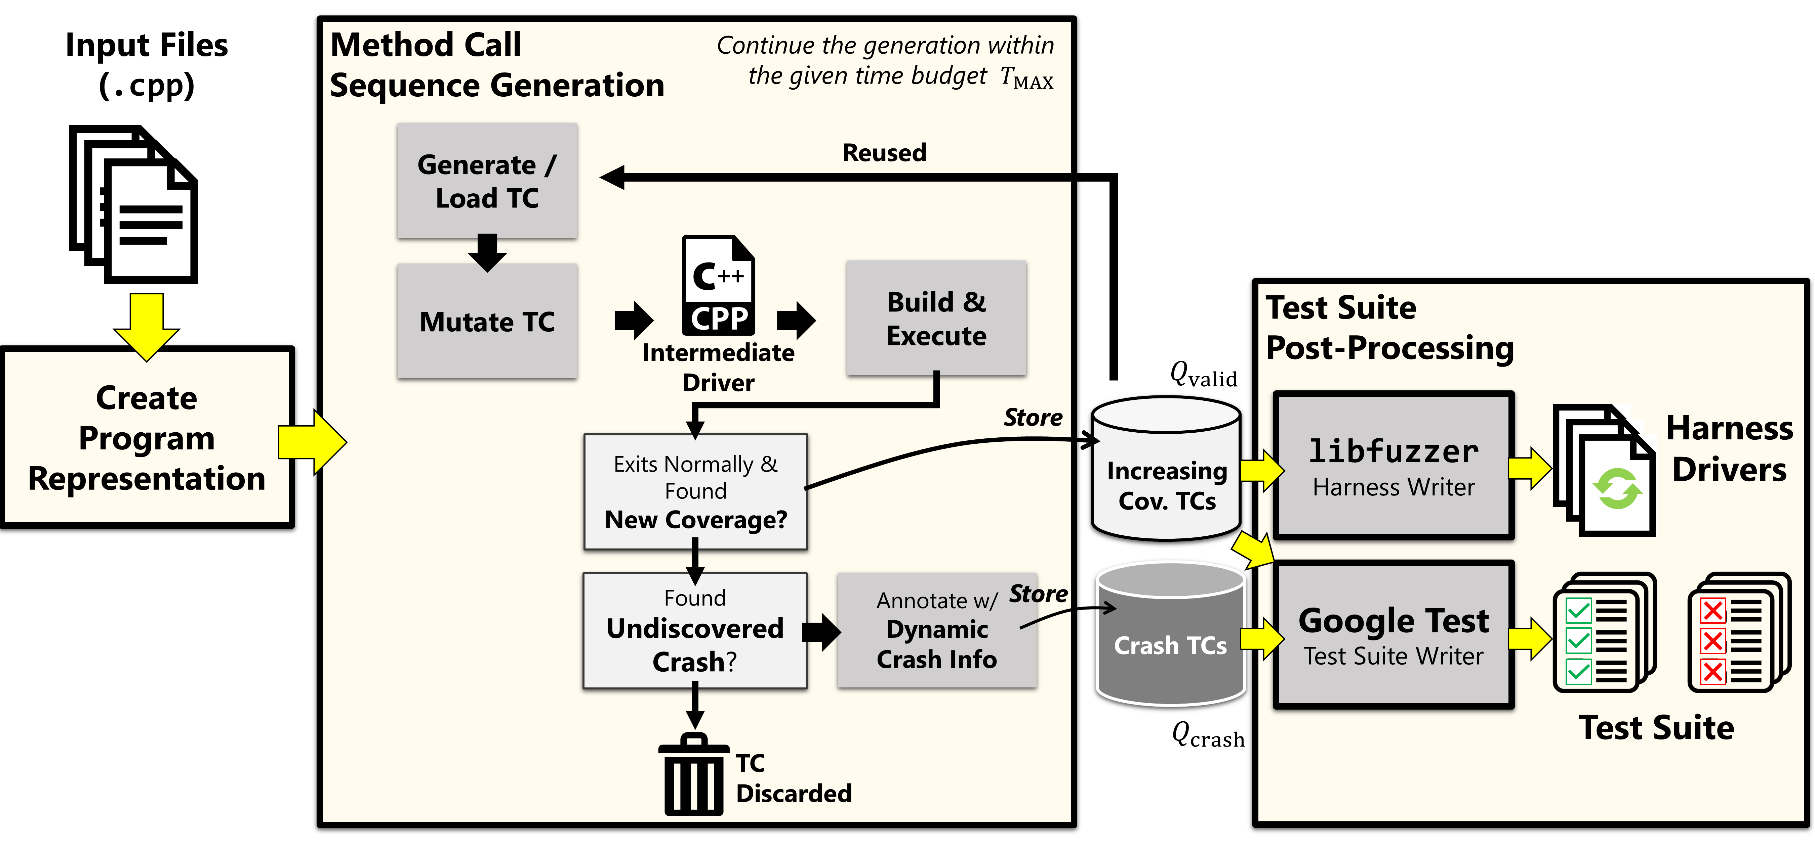
CITRUS Overview Process
CITRUS operates in three major stages as illustrated in the following process overview:
Y
N
Y
N

Slide 15
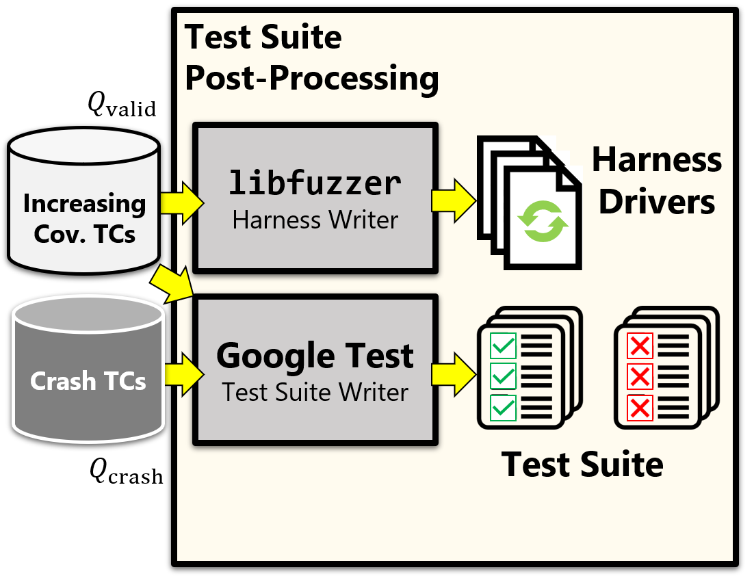
Test Suite Post-Processing
Finally, CITRUS outputs the test cases in the following two different formats:
libfuzzer-compatible harness drivers In contrast to the method call sequence generation (i.e., diversifying a state of a target program $P$ through various sequences of the method calls), libfuzzer alters the states of $P$ by randomly generating various inputs to $P$.
Google Test-compatible test cases The Google Test-compatible test cases are provided to integrate the CITRUS test cases with an existing Google test suite in the target program (if any).

Slide 16
Evaluation

Slide 17
Research Questions
I developed the following two research questions to evaluate CITRUS:
RQ1. How effective is CITRUS in terms of branch coverage?
To what extent does CITRUS achieve test coverage on real-world C++ programs?
To answer RQ1, I allocated 12 hours to perform method call sequence generation, and 2 minutes libfuzzer fuzzing time for each test case generated.
RQ2. How effective and efficient is CITRUS compared to other CITRUS variants?
In which configuration does CITRUS achieve the highest test coverage?
To answer RQ2, I introduced four CITRUS variants by assigning different time budgets for the method call sequence generation stage and libfuzzer fuzzing stage.

Slide 18
Experiment Setup
The following table lists 8 target subjects used in CITRUS experiment:
To answer RQ2, I used four CITRUS variants to compare, as follows:
Name | Size (LoC) | Version
jsonbox | 1,477 | 6f86f81
hjson | 2,911 | 0c40199
tinyxml2 | 3,606 | 1dee28e
jvar | 4,860 | e2a6a43
jsoncpp | 5,420 | c39fbda
json-voorhees | 8,614 | 046083c
yaml-cpp | 8,800 | b591d8a
re2 | 20,373 | bc42365
C_{12+LF2}* | 12H MSG, | 2mins libfuzzer.
C_{6+LF1} | 6H MSG, | 1mins libfuzzer.
C_{6+LF3} | 6H MSG, | 3mins libfuzzer.
C₂₄ | 24H MSG.
To reduce the random variance in the experiment,
I repeated the experiment in 10 runs and measured the average result from those runs.
* C_{12+LF2} is the main configuration of CITRUS
Notes:
(summarize target subjects + CITRUS variants)

Slide 19
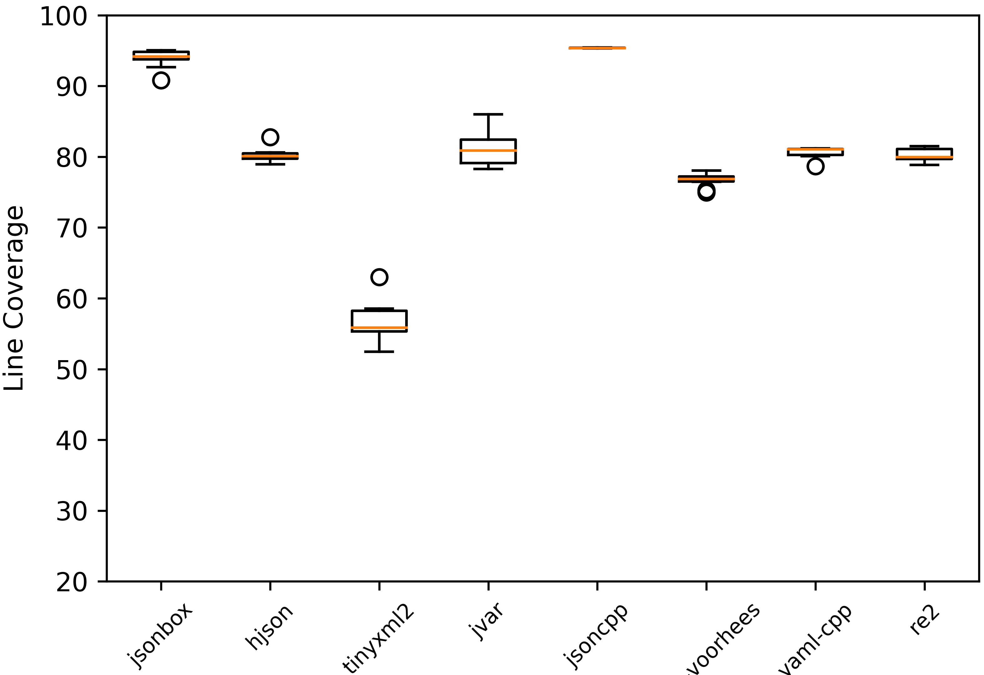
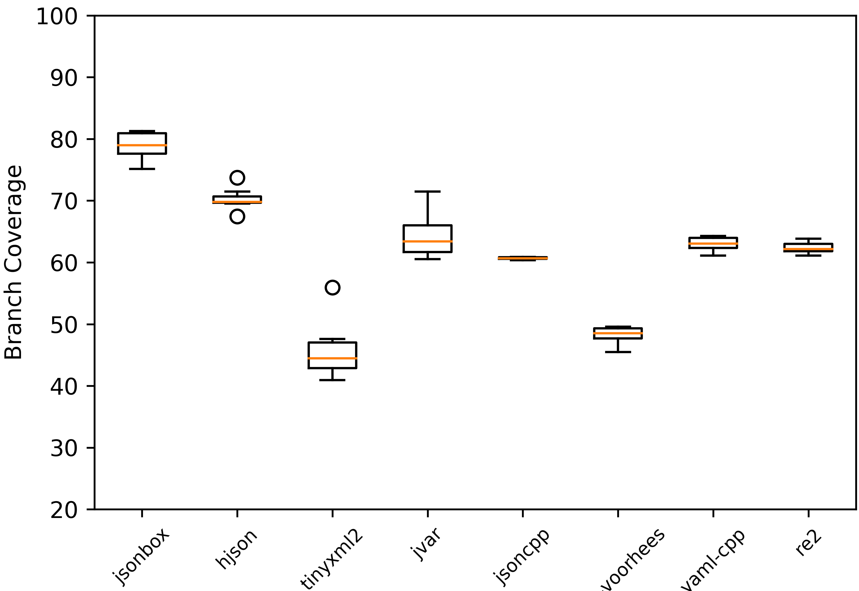
Result to RQ1. How effective is CITRUS in terms of branch coverage?
Answer to RQ1: On the eight real-world C++ target programs, CITRUS shows high testing effectiveness
in terms of both statement and branch coverage (i.e., it achieved 50% to 95% statement coverage and
40% to 79% branch coverage).

Slide 20
Result to RQ2. How effective and efficient is CITRUS compared to other CITRUS variants? (1/2)
The figures below describe the coverage achievement (averaged) over all 8 subjects.
In overall, CITRUS (C_{12+LF2}) achieved the highest coverage in all metrics when compared with other variants.

Slide 21
Result to RQ2. How effective and efficient is CITRUS compared to other CITRUS variants? (2/2)
Saving up to 14.6 hours
of testing time budget
CITRUS variants that utilize libfuzzer (C_{6+LF1}, C_{6+LF3}, C_{12+LF2})
achieved higher test coverage than the one variant with only
method sequence generation (C₂₄).
Answer to RQ2: In most subjects, CITRUS variant C_{12+LF2} produced the best result. Also, applying libfuzzer
helps CITRUS improve the coverage score and time cost, compared to the technique that uses only method
call sequence generation C₂₄.

Slide 22
New Crash Fix Bug Report in Yaml-CPP (1/2)
I also have made a contribution by reporting a crash bug to the developers of Yaml-CPP.
The crash was a due to an incorrect type casting in DecodeBase64 function (at L9).
The faulty code used unsigned int to cast from the signed char type input[i].
Negative values on input[i] leads into an out-of-bound index accesses on decoding array.
The decoding array size is only 256.
The fix was modifying the type casting from the unsigned int into unsigned char.
1: std::vector<unsigned char> DecodeBase64(
2: const std::string &input
3: ) {
4: using ret_type = std::vector<unsigned char>;
5: if (input.empty()) return ret_type();
6: ...
7: for (std::size_t i = 0; i < input.size(); i++) { ...
8: unsigned char d =
9: decoding[static_cast<unsigned>(input[i])];
10: if (d == 255)
11: return ret_type();
12: ...
13: }
FAULTY
Notes:
https://github.com/jbeder/yaml-cpp/pull/1051

Slide 23
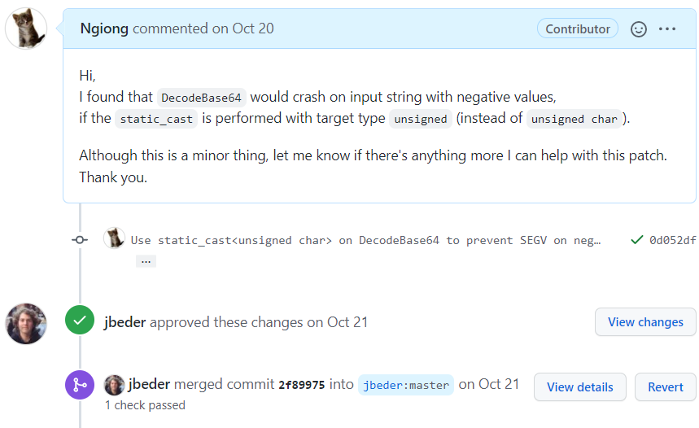
New Crash Fix Bug Report in Yaml-CPP (2/2)
The patch has been approved and merged to the master branch.
Notes:
https://github.com/jbeder/yaml-cpp/pull/1051

Slide 24
Bug Detection Case Study

Slide 25
Case Study Motivation & Setup
To demonstrate that CITRUS can detect real crash bugs, I conducted a case study on past bugs of C++ programs.
I used the following search criteria to mine relevant crash bugs from the git commit messages of all 8 target programs:
The commit message contains either one of the following keywords: “crash”, “segmentation fault”, “SIG”, or “SEGV”;
The patch is still available in the latest version of the target program;
The crash bug resides in the implementation source code;
The crash occurs due to an internal logic-error problem (i.e., not environmental-related);
The crash bug can be understood without deep domain expertise. (Otherwise, it is unverifiable if a crash execution of a CITRUS test case really conforms to that of the reported crash bug)

Slide 26
CITRUS Crash Replication Result
The following table describes the crash replication result.
Subject | Patch Date | Commit Hash | Commit Message | Detected by CITRUS?
hjson | 2018-10-07 | e8f8693 | Fix segfault in deep_equal comparison of empty vectors (#8) | ✔
tinyxml2 | 2017-09-15 | e8f4a8b | Fix crash when element is being inserted “after itself” | ✔
jsoncpp | 2016-09-25 | f6d785f | Fix poss SEGV | ❌
jsoncpp | 2017-01-17 | f251f15 | Fix crash issue due to NULL value. | ✔
yaml-cpp | 2014-03-22 | 396a970 | Fix SEGV in ostream_wrapper | ✔
CITRUS detected 80% of the target crash bugs.
❌
For jsoncpp f6d785f case, CITRUS failed to discover the crash bug
because the bug was located inside a private method (CITRUS does not directly invoke private methods).

Slide 27
Conclusion
This work presents CITRUS, which is a new automated unit-level testing tool targeting C++ programs based on method call sequence generation to produce test cases automatically.
CITRUS handles challenging technical issues of C++ language features in unit-level, such as template instantiation, complex STL classes, implicit constructors, and so on.
On 8 real-world C++ programs, I have demonstrated that CITRUS achieved high statement coverage (up to 95%) and high branch coverage (up to 79%).
I have demonstrated that CITRUS had successfully discovered new crash bug.
CITRUS is one of the very few existing C++ testing tools, which is now available at
https://github.com/swtv-kaist/CITRUS

Slide 28
Future Work
Support more complex C++ features, such as more recent STL classes, function pointers, STL’s threads and synchronization locks, and so on.
Introduce a new function selection heuristic to prioritize complex functions that require more attention to be extensively tested.
Reduce the false positive crash reports by a more careful crash filtering, and more effective crash de-duplication scheme.
Notes:
Finally, based on the false positive crash types I found in
this work, I will try to limit the number of false positive alarms produced by CITRUS through a more
effective crash de-duplication scheme and with a more careful false positive filtering.

Slide 29
Q & A

Slide 30
Motivating Example (2/2)
Consider the following code snippet of Stack:
System-level approaches (e.g., AFL) require complex input encoding to represent both Push and Pop in method call sequences.
To use system-level approaches on unit-level testing, testers must provide test drivers that transforms from raw input bytes into an arbitrary method call sequence.
An example of working input encoding:
1 X : Push X into the stack
2 : Pop from the stack
Thus, “519181122” represents 5 operations: Push(9), Push(8), Push(1), Pop(), Pop().
This could be more complex if the stack elements are not from primitive types (e.g., pointers, Json, String).
e.g., how do we construct a Stack<Stack<std::string>> ?
1: template<typename T>
2: class Stack {
3: public:
4: void Push(T item) {
5: if (Size() == GrowCap())
6: Enlarge();
7: ...
8: }
9: void Pop() {
10: if (IsEmpty())
11: throw std::bad_call();
12: ...
13: if (Size() < ShrinkCap())
14: Shrink();
15: }
16: };

Slide 31
How CITRUS detected Crash Bug in Hjson e8f8693
1: TEST(CITRUS_TestSuite, tc_id_129) {
2: // gdb output: ...
3: // hjson/src/hjson_value.cpp:536:
4: // bool Hjson::Value::deep_equal(const Hjson::Value &) const:
5: // ...
6: //
7: // Program received signal SIGABRT, Aborted.
8: // #0 __GI_raise (sig=sig@entry=6) at .../raise.c:50
9: // #1 0x00007ffff7a59859 in __GI_abort () at abort.c:79
10: // ... */
11: Hjson::Value value0{0.251040};
12: bool bool1 = value0.operator!=(0.666285);
13: char char2[1] = "";
14: Hjson::Value value3 = Hjson::Unmarshal(char2);
15: char char4[5] = "h6yA";
16: Hjson::Value value5 = Hjson::Unmarshal(char2);
17: /* PROGRAM CRASHED AT THE EXACT LINE BELOW */
18: bool bool6 = value5.deep_equal(value3);
19: Hjson::Value value7 = Hjson::Unmarshal(nullptr, 50);
20: ... }
In the crash environment, CITRUS detected
the crash bug in e8f8693.
The root cause of e8f8693 fix was
an off-by-one error in deep_equal method
when it is invoked on an empty map
(or empty vector).
At L14 & L16, CITRUS created empty maps
in value3 and value5.
At L18, CITRUS invoked deep_equal on
value3 and value5, which triggered the crash.
CITRUS also highlights the corresponding
line where the crash occurred.

Slide 32
List of Handled STL Classes (23 Types) Source: https://en.cppreference.com/w/cpp
Containers (16)
std::vector
std::deque
std::forward_list
std::list
std::stack
std::queue
std::priority_queue
std::set
std::multiset
std::unordered_set
std::unordered_multiset
std::map
std::multimap
std::unordered_map
std::unordered_multimap
std::array
Utility (2)
std::pair
std::tuple
Strings (3)
std::basic_string
std::string
std::wstring
Smart Pointers (2)
std::unique_ptr
std::shared_ptr

