Slide 1
Analysis on Unit-level Concolic
Testing for Real-world C Programs
Zidong Yang
School of Computing – KAIST
Advisor: Prof. Moonzoo Kim
December 15th 2021
Notes:
Good Morning Professors. My name is Zidong Yang and I am from Prof. Moonzoo Kim’s lab.
Thank you all for your time.
Today I will present my master’s thesis with the title “Analysis on Unit-level Concolic Testing for Real-world C programs”.

Slide 2
Background Concolic Unit Testing
Automatically generating test cases to cover all execution paths of target function.
// Symbolic input: a, b, c
void f(int a, int b, int c) {
if (a == 1)
if (b == 2)
if (c == a + b)
Error();
}
Concolic unit testing will generate 4 test cases for the function f
First TC: (0,0,0)
SPF (symbolic path formula): a!=1
Next SPF: !(a!=1)
Next TC: (1,0,0)
SPF: a==1 && b!=2
Next SPF: a==1 && !(b!=2)
Next TC: (1,2,0)
SPF: a==1 && b==2 && c!=a+b
Next SPF: a==1 && b==2 && c==a+b
Next TC: (1,2,3)
All the paths are covered
a!=1
a==1
(0,0,0)
b!=2
b==2
(1,0,0)
c!=a+b
c==a+b
(1,2,0)
(1,2,3)
Notes:
My thesis focuses on the improvement of concolic unit testing, so in the beginning I will briefly introduce the background of this technique.
This technique tries to automatically generate (first paragraph).
The following example shows how this approach works:
There is a target function f with 3 symbolic inputs a, b and c.
To cover all the paths of the target function, concolic unit testing will generate 4 test cases.
At first, an initial test case (0,0,0) is created. By executing this , we obtained the SPF (i.e., a sequence of conditions obtained from current TC).
Here is !(a!=1)
Then we negate one condition of the SPF to generate the next test case. We get (1,0,0)
Then we execute the new input and obtain its SPF a==1 && !(b!=2)
Again, repeat the negation and generation process until all the paths of the target function are covered.

Slide 3
Related Work
The following table lists the unit-level test case generation techniques.
Tool | Test Case Generation Approach | Driver? | Stub? | Support Local Static Variable | Comb. SS | Random Value Gen If 1st TC Crash | Support Func Pointer | Stub for File-handling Func | Utilize different testing engine
CUTE | Concolic Testing | ✔ | ❌ | ❌ | ❌ | ❌ | ❌ | ❌ | ❌
UC-KLEE | Symbolic Execution | ✔ | ❌ | ❌ | ✔ | ❌ | ❌ | ❌ | ❌
CONBOL | Concolic Testing | ✔ | ✔ | ❌ | ❌ | ❌ | ❌ | ✔ | ❌
CONBRIO | Concolic Testing | ✔ | ✔ | ❌ | ❌ | ❌ | ❌ | ✔ | ❌
MAESTRO | Concolic Testing , Fuzzing | ✔ | ✔ | ✔ | ✔ | ❌ | ✔ | ❌ | ✔
CR2^{imp} | Concolic Testing | ✔ | ✔ | ✔ | ✔ | ✔ | ✔ | ✔ | ✔
Notes:
This slide shows the unit-level test case generation techniques.
Unit testing contains many features, for example , driver generation, stub generation, support for local static variable.
the provious approaches in this table do not support all the features.
But the CR2imp which is an approach of this thesis, implements all the features in this table.

Slide 4
Motivation
In principle, concolic unit testing can achieve 100% branch coverage.
The experimental results (branch coverage) on real-world subjects are not as good as expected.
The following table shows the branch coverage achieved by concolic unit testing.
Subject | # Branch | Branch Coverage
flex2.4.3 | 2,021 | 22.6%
grep2.0 | 3,416 | 22.7%
The detailed experimental settings and results will be shown later.
Concolic unit testing may have some limitations that prevent it from achieving high branch coverage.
To discover these limitations, we need to analyze the not-covered branches of the real-world subjects.
Notes:
My thesis targets concolic unit testing.
In principle, this technique can
However, read second, as shown in the following table.
For flex and grep, concolic unit testing only achieves around 20% branch coverage.
So read third sentence. and summarize those limitations. Then improve the coverage achievement ability of concolic testing.

Slide 5
Thesis Statement
Concolic testing can be improved to achieve high branch coverage by addressing its limitations identified through systematic coverage analysis on real-world subjects.
Systematic coverage analysis:
Obtain the coverage achieved by concolic testing.
For each target real-world subject, find all the not-covered branches.
Analyze each not-covered branch to discover the limitations of concolic unit testing.
This dissertation performs coverage analysis on the result of CROWN2.0 ver 2020, a popular commercial concolic unit testing tool.
Notes:
Here is the thesis statement.
The systematic coverage analysis contains the following three steps
Read 1,2,and 3
The coverage analysis is based on the result of CR2 ver 2020, a well-known commercial concolic unit testing tool.

Slide 6
Contributions
I highlight 13 common problems of CROWN2.0 ver 2020 by extensively analyzing 324 groups of not-covered branches on 6 different widely-used target subjects.
flex, grep, gzip, sed, libquantum, and sjeng
I propose and implement 6 ideas that address 8/13 common problems
My solutions improved branch coverage of CROWN 2.0 ver 2020 by up to 188% on a target subject (i.e., sed) and by 77% on average on the 6 subjects.
I provide a detailed report to explain the reasons of 324 not-covered branch groups.
The detailed report can contribute to the concolic testing research.
Notes:
The contributions of this paper are as follows.
First read 1.
Second read 2.
Third read 3.

Slide 7
CROWN2.0:
Commercial Concolic Unit Testing Tool (1/2)
CR2 (CROWN2.0) automatically generates driver/stubs for the unit testing of a target function.
The driver symbolically sets all global variables and parameters of the target function.
Type | Description | Code Example
Primitive | set a corresponding symbolic value | int a; SYM_int(a);
Array | set all elements of the array | int a[3]; for(int i=0; i<3; i++) {SYM_int(a[i]);}
Pointer | allocate an array with n symbolic pointee elements and make the pointer point to the array (n is decided by users) | int *a; a = malloc(n* sizeof(int)); for(int i=0; i<n; i++) {SYM_int(a[i]);}
Structure | set symbolic for each field of the structure | struct _st{int e1,char *e2} a; SYM_int(a.e1); a.e2 = malloc(n* sizeof(char)); for(int i=0; i<n; i++) {SYM_char(a.e2[i]);}
CR2 replaces the external function (i.e., the function defined in other C file) with stub function.
Example is provided in the next page.
Notes:
As the coverage analysis is based on the result of CR2, I will briefly introduce the CR2.
It (read1)
The driver symbolically sets all global variables and parameters of the target function.
according to the input types as follows.
Primitive type, read
Array type, set all element as symbolic
Pointer type allocate an array with n element and set each element of the array as symbolic,
Then make the pointer point to the beginning address of the array.
Structure type, set symbolic for each field of the structure.
Besides, CR2 replaces the external function (i.e., the function defined in other C file) with stub function.
I will provide an example in the next page.

Slide 8
CROWN2.0:
Commercial Concolic Unit Testing Tool (2/2)
CR2 replaces the external functions invoked by the target function with stubs.
Replace external function with stub function that returns a symbolic variable.
int h(){
int h_ret;
SYM_int(h_ret);
return h_ret;
}
int h(){…}
…
other_file.c
Stub
extern int h();
int a[10];
int f(char * b){
return h()+ a[0] + b[0];
}
Each element of the array is symbolic.
void f_driver(){
for(int i=0; i<10; i++){
SYM_int(a[i]);
}
char * b = malloc(n*sizeof(char));
for(int i=0; i<n; i++){
SYM_char(b[i]);
}
f(b);
}
target.c
Pointer points to an array that has <n> symbolic elements.
Driver
Notes:
Here we can see there is a target file target.c that contains a target function f
At line 1, these is a external function h defined in other c file, CR2 replaces it with stub function which returns a symbolic variable.
CR2 declares each element of array a as symbolic using a loop statement.
CR2 allocates an array with n symbolic elements (n is decided by the users), and make the pointer point to the beginning address of this array.

Slide 9
Target Subjects
This part introduces the experimental settings and experimental results of the baseline CR2 (version 2020).
The coverage analysis is based on the baseline results.
This paper targets six subjects (four from SIR and two from SPEC2006).
Four SIR subjects are frequently used by Linux users.
I choose two SPEC2006 subjects to avoid making the analysis results overfitted to one benchmark.
Benchmark | Subject | Loc | # Branch | # Function
SIR | flex2.4.3 | 11,864 | 2,021 | 144
 | grep 2.0 | 10,930 | 3,416 | 119
 | gzip1.0.7 | 6,358 | 1,446 | 80
 | sed1.17 | 8,060 | 2,395 | 63
SPEC2006 | libquantum0.2.4 | 5,059 | 724 | 111
 | sjeng11.2 | 18,057 | 6,364 | 164
Notes:
This is the information of 6 target subjects.
Four are from SIR and 2 from SPEC 2006.
We perform the experiment using the baseline CR2 (issued at 2020) and obtain the coverage result.
The following table shows the subject name, size, # of branch and # of function of each subject.

Slide 10
Experimental Setup
Baseline Technique (CR2 ver 2020)
The experimental settings of baseline CR2 are as follows.
Array size: 3
The # elements of an allocated array that a pointer points to.
Strategy: dfs (depth-first-search)
The search heuristic of concolic testing (e.g., dfs, rev-dfs, random)
Timeout1: 60s
The maximum execution time of a test case.
Timeout2: 300s
The test case generation time for each function.
Target Subjects: Six subjects
4 from SIR benchmark and 2 from SPEC2006 benchmark.
Machine: Ubuntu 18.04 with AMD 8-core Ryzen 7 3800 XT (3.9GHz) and 16 GB RAM
Notes:
Here is the experimental settings of baseline CR2.
Array size,
Search strategy
Timeout1
Timeout2
All the experiments are performed on Ubuntu 18 with 8 core CPU and 16 GB RAM

Slide 11
Baseline Results
The following table shows the branch coverage achieved by the baseline technique (i.e., CR2 ver 2020)
Benchmark | Subject | Loc | # Branch | # Function | Branch Coverage | # Function that Reach Timeout2 | Avg TCgen Time (s) for Each Func
SIR | flex2.4.3 | 11,864 | 2,021 | 144 | 22.6% | 20 | 15.3
 | grep 2.0 | 10,930 | 3,416 | 119 | 22.7% | 9 | 27.3
 | gzip1.0.7 | 6,358 | 1,446 | 80 | 41.4% | 9 | 52.7
 | sed1.17 | 8,060 | 2,395 | 63 | 17.7% | 1 | 15.8
SPEC2006 | libquantum0.2.4 | 5,059 | 724 | 111 | 41.6% | 5 | 5.5
 | sjeng11.2 | 18,057 | 6,364 | 164 | 27.9% | 20 | 26.7
Avg: 28.9%
The branch coverage achieved by baseline CR2 on average for 6 subjects is poor
Notes:
This is the coverage result of baseline CR2, we can see that the baseline CR2 only achieves 28.9% branch coverage on average for six subjects.
To find the obstacles that prevents CR2 from achieving high coverage,
I collected the not-covered branches of all subjects and analyze the coverage results in detail

Slide 12
Analysis
on Baseline Results
To discover the limitations that make CR2 only achieve 28.9% branch coverage on average, I performed an analysis for each subject.
Check Coverage Report
Check the not-covered branches and discover the reasons
STEP 01
STEP 02
STEP 03
Download Coverage Report
.
Summarize Limitations
Download the coverage report of each target subject
Summarize and list all the limitations
Covered
branches
Not-covered
branch
Line #
Snapshot of coverage report
Notes:
This slide shows how I perform coverage analysis for the target subjects.
At first, I download the coverage report of each subject.
Then I check each line of the coverage report to discover the reasons.
Here is a snapshot of the coverage report.
In the end, I collect all the reasons and summarize them to classify the limitations.

Slide 13
Limitations
Overview
After analyzing the not-covered branches of six subjects, 13 limitations of CR2 are discovered.
The table on the right shows the information of each limitation.
Abbreviation | Description
FTCC | First TC crashes
NSEF | No support for external C library functions (except for C file handling functions)
NSFF | No support for external file-handling functions
NSFP | No support for function pointers
NSGP | No support for global void pointer
NSLS | No support for local static variable
NSSF | No support for symbolic file
NSSP | No support for symbolic pointers
RT1 | Timeout1 is reached
TIWC | Target program’s Illegal write to the structure of CROWN
UB | Existence of unreachable branches in unit-testing
USV | Uncovered branch caused by the unrealistic symbolic input values
WDFS | Weakness of dfs
Notes:
Finally, I discovered 13 limitations, as shown in the table.
Due to the time limit, I cannot introduce all of them.
So I will introduce some interesting limitations, and the detail of other limitations are written in the thesis.

Slide 14
Limitations
NSLS: No support for Local Static Variables
CR2 cannot set local static variables as symbolic, and the unit driver calls the target function only once.
This feature may produce some not-covered branches.
f1_driver(){
...
f1();
}
Solution: Execute f1 twice
The driver code calls f1 once.
1. void f1(){
2. static int var = 0;
3. if(var == 1){
4. ... // not-covered branches
5. }else{
6. ... // f1 is not called
7. }
8. var += 1;
9. }
The local static variable var is initialized with 0
CR2 cannot cover line 4 because the value of var is 0
The value of var is updated, so the 2nd execution of f2 can cover line 4.
nsls.c
Notes:
First, NSLS
It stands for no support for local static variables.
CR2 cannot set local static variables as symbolic, and the unit driver calls the target function only once.
This feature may produce some not-covered branches.
As shown in the following example.
At line 2,
At line 3, the “then” branch cannot be covered because the value of var is 0.
But we can observe that at line 8, the value of var is updated. so the 2nd execution of f1 can cover line 4.

Slide 15
Report Example
NSLS: No support for Local Static Variables
Subject: Sed
File Name: sed.c
Function Name: init_syntax_once
Reason: NSLS
Line No: 2302
Description:
Line 2299: done is a local static variable, and it is assigned with 0
Line 2301: the “then” branch cannot be reached as the value of done is 0
Line 2317: done is set to 1, which means the second execution of the target function (i.e., init_syntax_once) can cover line 2302
CR2 executes the target function only once for each TC, so line 2302 cannot be covered.
2295. static void
2296. init_syntax_once()
2297. {
...
2299. static int done = 0;
2300.
2301. if(done)
2302. return; // not-covered
... // done is not altered
2317. done = 1;
2318. }
Source code of function init_syntax_once
Notes:
This slide shows an example of a detailed report of one not-covered branch group of subject sed.
We can see the file name, function name, Reason to be not covered, line # of the not-covered branch
And description step by step.
The right side shows the code of the subject.

Slide 16
Limitations
WDFS: Weakness of Dfs
Solution: use rev-dfs
The symbolic variable a is assigned with 0 for the first test case
1. long f2(int a){
2. long b = 0;
3. if(a < 0){
4. ... // not-covered branches
5. }
6. for(int i=0; i<a; i++){
7. b += i;
8. }
9. return b;
10. }
The first TC will not cover line 4 because the value of a is 0
execution paths of
lines 6-8
In the “for” loop, each non-negative value of a produces a unique execution path (i.e., a TC).
execution paths of
line 4
a=0
a=1
…
wdfs.c
a=2
a=$2^{31}$-1
execution paths of f2
Path explosion problem happens because the dfs strategy has to generate $2^{31}$ test cases before covering line 4.
Test case generation timeout is reached.
Notes:
Second, Wdfs means the weakness of dfs.
Dfs may spend all the timeout on exploring the loop statements thus causing low branch coverage.
Because the loop statements have many execution paths.
We can see this limitations in the following example.
A target function f2 has a symbolic integer input a.
The first test case assigns a with 0.
The first TC will not cover line 4 because the value of a is 0
In the for loop, each non-negative value of a produces a unique execution path (i.e., a TC).
Path explosion problems happens because …

Slide 17
Report Example
WDFS: Weakness of DFS
Subject: Sjeng
38. int board[144]; // symbolic array
…
448. bool nk_attacked(int square, int color){
...
453. static const int bishop_o[4] = {11,-11,13,-13};
...
460. if (color&1){
... // not-covered
}
499.
500.
501. else{
...
508. if(basq=bpawn && ...) return true;
509. // a_sq = 0, ndir = 11 initially
510. while(basq != frame){
511. if(basq == bbishop || basq == bqueen) {...}
512. if(basq != npiece) {...}
513. a_sq += ndir;
514. basq = board[a_sq]; // board[0,11,22,…,143]
515. }
}
...
542. }
File Name: attacks.c
Function Name: nk_attacked
Reason: WDFS
Line No: 461-498
Description:
Line 460: color is a symbolic integer, and it is assigned with 0, the “else” branch is explored first.
Lines 503-515 have huge possible execution paths (i.e., at least $2_{<L508>}∗{\left({2_{<L510>}∗4}_{<L511>}∗2_{<L512>}\right)}^{13}$ unique paths)
Dfs strategy has to explore all the paths mentioned above before exploring lines 461-498. Timeout2 will be reached.
Source code of function nk_attacked
Notes:
This slide shows an example of a detailed report of one not-covered branch group of subject Sjeng.

Slide 18
Solutions
Overview
I provide 6 ideas to overcome the limitations mentioned previously.
01
Execute target function multiple times
Target: NSLS
02
Implement combined strategy
Target: WDFS
03
Random values for symbolic inputs
Target: FTCC
04
Static analysis for function pointers
Target: NSFP
05
Stub for all file-handling functions
Target: NSFF
06
Utilize other concolic testing tool
Targets: NSEF, NSSP, USV
Notes:
To resolve these limitations, I proposed 6 ideas..
As shown in this slide, each limitations has its target limitation(s).
I will introduce two of them, and the remaining detain is written in my thesis.

Slide 19
Solutions
NSLS => Execute Target Function Multiple Times
This approach allows the users to decide the number of calls (M) to the target function.
1. void f1(){
2. static int var = 0;
3. if(var == 1){
4. ... // not-covered branches
5. }else{
6. ... // f1 is not called
7. }
8. var += 1;
9. }
Line 4 can be covered if M is greater than 2
Covered
1. f1_driver(){
2. ...
3. for(int i = 0; i < M; i++){
4. f1();
5. }
6. }
nsls.c
driver.c
Notes:
This approach allows the users to decide the number of calls (M) to the target function.
The driver code will use a for loop to call target function M times.
We can notice that if M is greater than 2, the branch at line 4 can be covered.

Slide 20
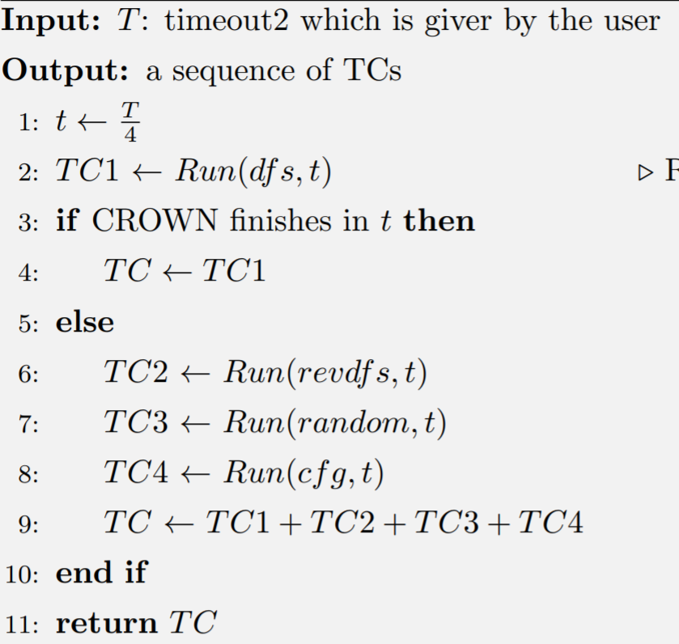
Solutions
WDFS => Implement Combined Strategy
The combined strategy is to overcome the limitation of dfs strategy.
It integrates four search strategies (i.e., dfs, rev-dfs, cfg, random) of CROWN and works as follows.
The users give the test case generation timeout $T$
Generate test case using dfs strategy in $T/4$
If dfs strategy finishes in $T/4$, we assume CROWN has explored all the paths of the target function, and stop the TC generation process.
Otherwise, we assume dfs stuck in the complex statements (e.g., loop statement).
We run the remaining 3 search strategies in order, each strategy uses $T/4$
Accumulate all the test cases generated by the combined strategy.
Notes:
I use combined strategy to overcome the limitation of dfs.
This strategy read.
At first, read the users give
Then it divides T into 4 time slots and use dfs in the first time slot.
If dfs strategy finishes in the a time slot, we assume CROWN read.
Otherwise, we assume dfs stuck read
And run the remaining 3 read.
Finally, we accumulate the test cases generated by these sub strategies.

Slide 21
Evaluation
Experimental Results
I developed CR2^{imp} to intergrade the six ideas mentioned above.
The experimental settings of CR2^{imp} are identical to the ones of baseline CR2.
Benchmark | Subject | Loc | # Branch | # Function | Branch Coverage (CR2) | Avg TCgen Time (s) for Each Func (CR2) | Branch Coverage (CR2^{imp}) | Avg TCgen Time (s) for Each Func (CR2^{imp}) | # Crash TCs
SIR | flex2.4.3 | 11,864 | 2,021 | 144 | 22.6% | 15.3 | 53.2% | 122.7 | 4,341
 | grep 2.0 | 10,930 | 3,416 | 119 | 22.7% | 27.3 | 52.7% | 56.7 | 9,172
 | gzip1.0.7 | 6,358 | 1,446 | 80 | 41.4% | 52.7 | 50.1% | 98.9 | 10,359
 | sed1.17 | 8,060 | 2,395 | 63 | 17.7% | 15.8 | 51.1% | 54.9 | 10,315
SPEC2006 | libquantum0.2.4 | 5,059 | 724 | 111 | 41.6% | 5.5 | 50.4% | 9.8 | 3,392
 | sjeng11.2 | 18,057 | 6,364 | 164 | 27.9% | 26.7 | 50.1% | 93.7 | 19,477
Avg: 28.9% 23.9 51.3% 72.8
CR2^{imp} improved the branch coverage relatively by 77% on average for six subjects.
CR2^{imp} reports more than 40k crash TCs.
Notes:
To evaluate the ideas, I developed CR2imp that integrates the aforementioned six ideas.
The branch coverage has been improved relatively by 77% on average for six subjects.
We can also see in the example, CR2 has reported many crashes TCs.
Read.

Slide 22
Crash Deduplication
CR2^{imp} reports more than 40k crashes.
Manually analyzing all the crashes is impractical and time-consuming.
Many crashes may have the same execution path (i.e., they are duplicate crashes).
I developed a crash deduplication approach, which compares the first K stack frames of the crashes to remove the duplicate crashes.
Crash deduplication results are shown in the following table.
Target Subject | # Crash TC | # Unique Crash TC (K=3) | # Unique Crash TC (K=5)
flex2.4.3 | 4,341 | 123 | 124
grep 2.0 | 9,172 | 241 | 248
gzip1.0.7 | 10,359 | 56 | 56
sed1.17 | 10,315 | 166 | 167
libquantum0.2.4 | 3,392 | 289 | 289
sjeng11.2 | 19,477 | 581 | 579
I analyzed these crashes to find the root cause of them.
Notes:
CR2^{imp} reports more than 40k crashes.
Many crashes may have the same execution crash.
To reduce the duplicate crash, I developed … read.
The result are show in the following table.
I analyzed these around 600 crashes to find the root cause of these crashes

Slide 23
Crash Analysis
After analyzing the 595 crashes, three causes of false alarms are identified.
USIV. Unrealistic Symbolic Input Value
USVI. Unrealistic Symbolic Variable Initialization
ICIO. Invalid Comparison Caused by Integer Overflow
Notes:
Finally I discovered 3 root causes.

Slide 24
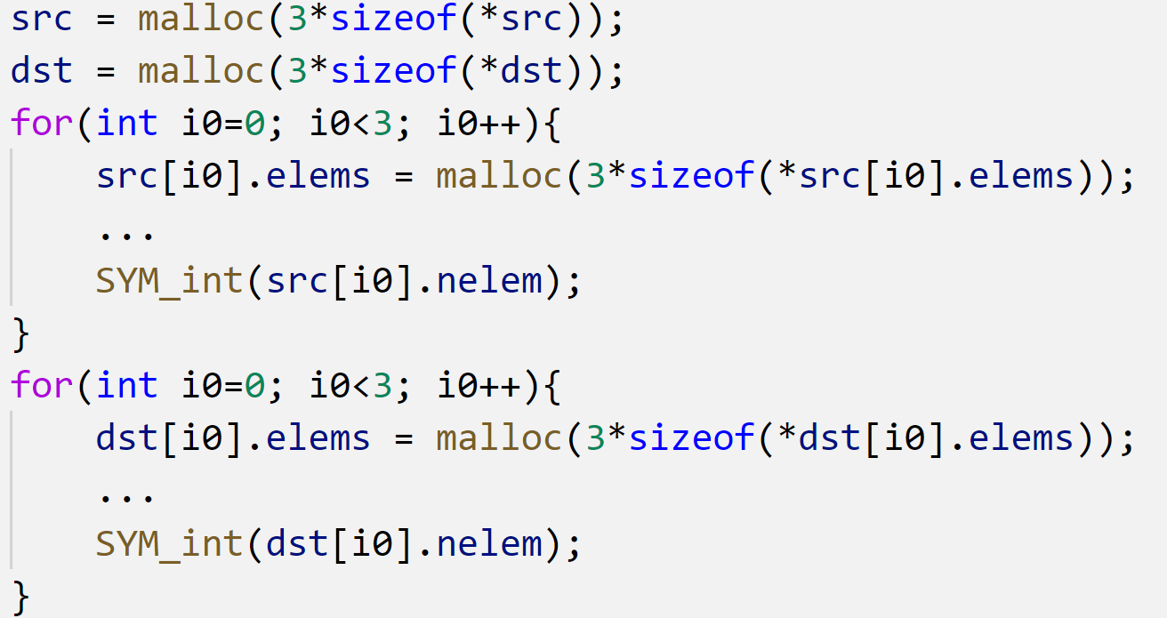
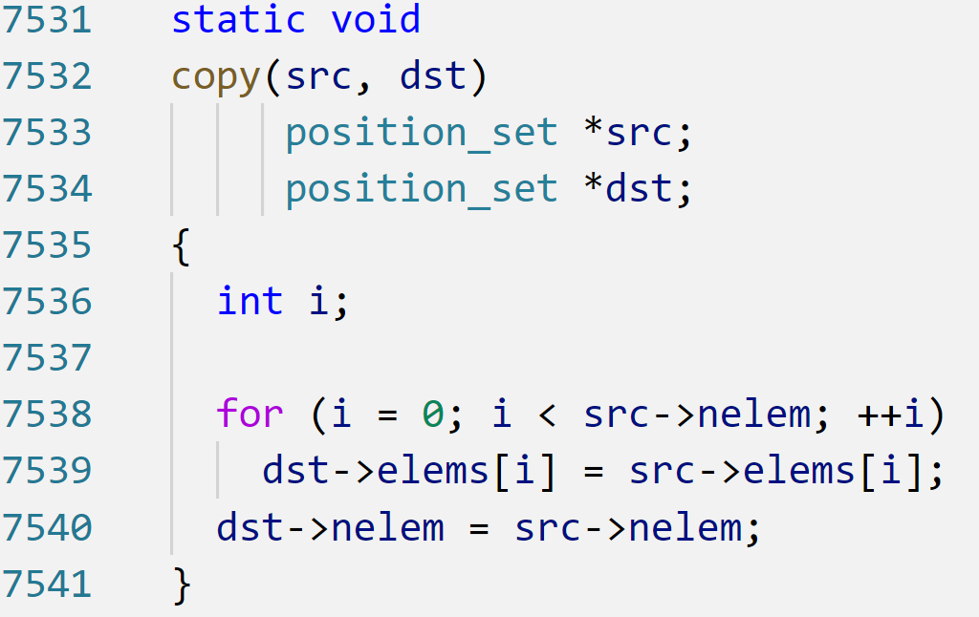
Crash Analysis
USIV: Unrealistic Symbolic Input Values
The following is a false alarm example, which is caused by USIV, of subject grep.
1. src and dst are used as the parameter of copy
2. CR2 assigns src->nelem with 19 to cover line 7539
3. Crash happens because dst->elems[i] only has 3 (<<19) elements
Driver code of function copy (grep)
Source code of function copy (grep)
Notes:
CR2 may not consider the execution context (for example, the value of a symbolic variable that will access an array is greater than the array’s size) of a target function.
This may cause false alarm.

Slide 25
Conclusion
Discovered 13 limitations of CR2 through systematic coverage analysis on six subjects.
Proposed six ideas to address the discovered limitations
Developed CR2^{imp} that integrates the six ideas and improved the branch coverage relatively by 77% on average
Notes:
I discovered read
I proposed six read
Developed CR2imp that read

Slide 26
Future Work
More analysis on the detected crashes.
Performing experiment on more subjects.
Integrating other testing tools (e.g., AFL).
Obtaining seed TC from system level TC to guide concolic testing

Slide 27
Q&A
THANK YOU FOR WATCHING

Slide 28
Crash Analysis
USVI: Unrealistic Symbolic Variable Initialization
The driver code will ignore some useful statements in the target source code.
For example, a global pointer variable b is initialized with an array a which has 100 elements (L2), but the driver code just ignores this important information and make b point to a new array which has 3 elements only (L6).
1. int a[100];
2. int *b = a;
3. void target(){…}
5. void target(){
6. b = malloc(3*sizeof(int));
7. ...
8. }
Source code
Driver code

Slide 29
Crash Analysis
ICIO: Invalid Comparison Caused by Integer Overflow
Integer overflow may cause some unexpected branches to be covered under error conditions, causing some crashes when executing that branch.
slide+0(w)
slide+9136(d)
slide+9136(d)+23632(e)
0
9136
23632
memcpy(L1520)
Overlap CRASH
L1518: both w, d and e are unsigned variable, so (unsigned)(0-9136) =4294958160 > 23632 and the “then” branch is executed.
L1520: memory overlap crash happens when executing memcpy.
memcpy(des, src, n)
Functionality: Copy n bytes from src to des.
Crash: if des+n>src, memory overlap crash will happen

