Slide 1



Ask the Mutants: Mutating Faulty Programs for Fault Localization
Seokhyeon Moon, Yunho Kim,
Moonzoo Kim
CS Dept. KAIST, South Korea
http://swtv.kaist.ac.kr
Shin Yoo
CS Dept. University
College London, UK
http://crest.cs.ucl.ac.uk/

Slide 2
Talk Summary
MUSE: MUtation-baSEd fault localization technique
  Utilize mechanical program changes (mutation) to get hints for localizing a fault precisely
  5.6x more precise than the state-of-the-art SBFL Op2
    MUSE ranks the faulty statement within the top 10 for 38 out of the 51 SIR benchmark programs/faults (10KLOC)
  Also we introduce a new evaluation metric:
  Locality Information Loss (LIL) to measure the aptitude of a technique for automated fault repair
    MUSE also shows better LIL than Jacard, Ochiai, and Op2
25%
Tarantula
[ICSE 2002]
Ranking of faulty stmt among all executed stmts (%)
Ochiai
[PRDC 06]
Wong
[JSS 10]
9%
Op2
[TOSEM 11]
MUSE
(MUtation baSEd FL)
1%
2002
2014 Year
On the 10KLOC SIR benchmark programs

Slide 3
Talk Summary
MUSE: MUtation-baSEd fault localization technique
  Utilize mechanical program changes (mutation) to get hints for localizing a fault precisely
  5.6x more precise than the state-of-the-art SBFL Op2
    MUSE ranks the faulty statement within the top 10 for 38 out of the 51 SIR benchmark programs/faults (10KLOC)
  Also we introduce a new evaluation metric:
  Locality Information Loss (LIL) to measure the aptitude of a technique for automated fault repair
    MUSE also shows better LIL than Jacard, Ochiai, and Op2

Slide 4
Contents
Motivation: Limitations of current FL techniques
  Too low precision for practical application
  Inadequacy of the Expense metric
Key idea:
  Different mutants have different impact on test results
Experiments:
  51 versions of 5 SIR benchmark programs (~10KLOC each)
  Comparison with Jaccard, Ochiai, and Op2
Results
  MUSE is 5.6X more precise than the SBFL techniques
  MUSE is more precise in LIL than the SBFL techniques
Conclusion and Future Work

Slide 5
Motivation: Finding Cause of SW Error is Difficult
Debugging is an expensive step in SW development
Locating the cause of errors (i.e. fault Localization), is one of the most expensive tasks in whole debugging activity [Vessey, 1985]
01 int max;
02 setMax(int x, int y){
03 if (x >= y)
04 max = y;//should be max=x;
05 else
06 max = y;
07 print max;
08 assert(x>=y → max==x);
}
x:10
y:1
max==1
MUSE can automatically localize a fault precisely
  MUSE can find a fault by examining 10 statements in 10,000 LOC programs

Slide 6
Limitation of the Expense Metric
Expense metric conflates the accuracy of localization with the mode using localization techniques
  Only meaningful when rankings are formed and inspected linearly
Qi et al[ISSTA’13] proposed to evaluate SBFL techniques by using them for automated bug fixing (GenProg)
  Jaccard: proved to be worse than Op2 w.r.t. ranking, but GenProg found patches quicker when faults are localized with Jaccard
We need a new evaluation metric for fault localization technique that can measure the accuracy of localization precisely!

Slide 7

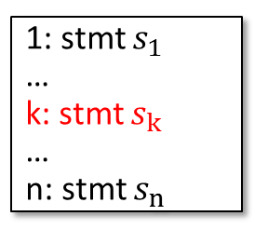
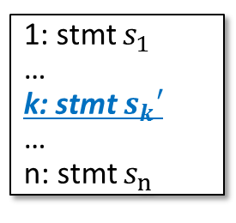

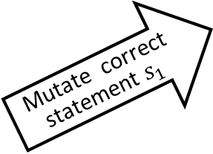
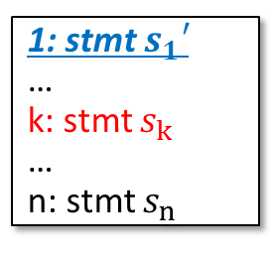
Key Idea of MUSE
Utilize differences between testing result changes of mutating
  faulty statements
  correct statements
Conjecture 2
1: stmt $s_{1}′$
…
k: stmt $s_{k}$
…
n: stmt $s_{n}$
Test 1
Test 2
Test 3
Test 4
Test 5
Test 6
 | : Failed test
 | : Passed test
Mutate correct statement $s_{1}$
1: stmt $s_{1}$
…
k: stmt $s_{k}$
…
n: stmt $s_{n}$
Test 1
Test 2
Test 3
Test 4
Test 5
Test 6
.
.
.
Conjecture 1
Mutate faulty statement $s_{k}$
1: stmt $s_{1}$
…
k: stmt $s_{k}′$
…
n: stmt $s_{n}$
Test 1
Test 2
Test 3
Test 4
Test 5
Test 6
What is the mutation?
single syntactic code change Ex.: if(a) → if(!a)
a+b → a–b

Slide 8
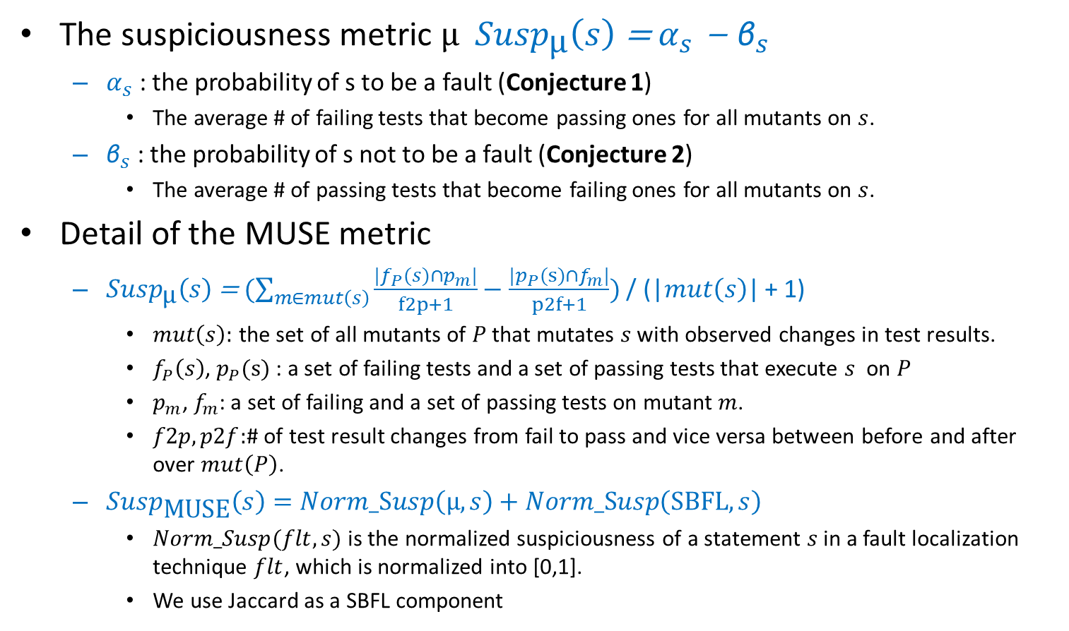
Suspiciousness Metric of MUSE
The suspiciousness metric μ ${Susp}_{\text{μ}}\left(s\right)$ = $α_{s}$ – ${\text{β}}_{s}$
  $α_{s}$ : the probability of s to be a fault (Conjecture 1)
    The average # of failing tests that become passing ones for all mutants on $s$.
  ${\text{β}}_{s}$ : the probability of s not to be a fault (Conjecture 2)
    The average # of passing tests that become failing ones for all mutants on $s$.
Detail of the MUSE metric
  ${Susp}_{\text{μ}}\left(s\right)$ = $(\sum_{m∈mut\left(s\right)}{\frac{|f_{P}(s)∩p_{m}|}{f2p+1}−\frac{|p_{P}(s)∩f_{m}|}{p2f+1}})$ / (|$mut\left(s\right)$| + 1)
    $mut\left(s\right):$ the set of all mutants of $P$ that mutates $s$ with observed changes in test results.
    $f_{P}\left(s\right)$, $p_{P}(s)$ : a set of failing tests and a set of passing tests that execute $s$ on $P$
    $p_{m}$, $f_{m}$: a set of failing and a set of passing tests on mutant $m$.
    $f2p, p2f:$# of test result changes from fail to pass and vice versa between before and after over $mut\left(P\right)$.
  ${Susp}_{\text{MUSE}}\left(s\right)=Norm_Susp\left(\text{μ}, s\right)+Norm_Susp\left(\text{SBF}L, s\right)$
    $Norm_Susp(flt, s)$ is the normalized suspiciousness of a statement $s$ in a fault localization technique $flt$, which is normalized into [0,1].
    We use Jaccard as a SBFL component

Slide 9
MUSE Framework
Test
suite T
Exec.
m₁
Test
result₁
Execution
Test
result
Coverage
analysis
Stmts.
covered by
failing tests
Mutation
Calc.
Susp.
Program
P
m_{n}
Exec.
Test
result_{n}
Step 1
Step 2
Susp.
& Rank
Step 3
Selecting target statements to mutate
Generating and testing the mutants
Calculating suspiciousness using the MUSE metric

Slide 10
Locality Information Loss (LIL)
Borrows from the domain of Information Theory
  First, take normalized suspiciousness scores as probability distribution for the likelihood of fault locality
  Second, compare the said distribution with the ideal distribution: P = 1.0 for the faulty statement, 0.0 for correct statements
  We use Kullbeck-Leibler divergence, a cross-entropy metric that measures the agreement between two probability distributions (the lower the LIL is, the more precise the localization is)

Slide 11
3 Research Questions
RQ1. Foundation of MUSE:
  How many test results change from failure to pass and vice versa on
    a mutant generated by mutating a faulty statement, compared with
    a mutant generated by mutating a correct one?
RQ2. Precision in terms of the Expense metric:
  How precise is MUSE, compared with Jaccard, Ochiai, and Op2 in terms of Expense metric?
RQ3. Precision in terms of the LIL metric:
  How precise is MUSE, compared with Jaccard, Ochiai, and Op2 in terms of LIL metric?

Slide 12
Experiment Design
Target subjects:
  51 versions of the 5 SIR benchmark programs
    flex, grep, gzip, sed, and space (~10KLOC each)
Test suites
  5.9~91.0 failing TCs and 24.4~235.0 passing TCs per subject
Generates all possible mutants using Proteum [Maldonado et al]
  66.4 mutants per statements (30.0 non-equivalent ones)
25 machines with 3.6 Ghz quad-core CPU
  22 min/version

Slide 13
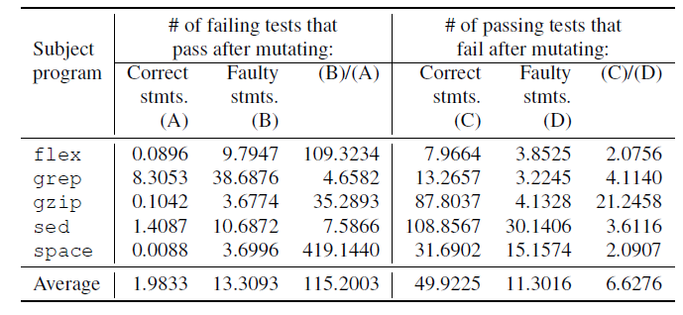
RQ1: Foundation of MUSE
The # of the failing test cases on P that pass on m_{f} is 115.2 times greater than the # on m_{c} on average
  i.e., Conjecture 1 is valid
The # of the passing test cases on P that fail on m_{c} is 6.6 times greater than the # on m_{f} on average
  i.e., Conjecture 2 is valid

Slide 14
RQ2: Precision in terms of the Expense metric
MUSE is 5.6 times more precise than Op2
  Average rank of faulty statements: MUSE 1.65% vs. Op2 9.25%
  Faulty statements ranked in Top 10: MUSE 38/51 vs. Op2 9/51
Note that MUSE is precise on the subject with real faults (i.e., space) as well as subjects with seeded faults.
More precise

Slide 15
RQ3: Precision in terms of the LIL metric
LIL measures confirm the empirical results of Qi et al.
  Jaccard shows lower LIL values than Ochiai or Op2, both proven to produce higher ranking
  However, on average, MUSE shows the lowest LIL value
Space v21

Slide 16
Remark1. Why is MUSE so precise?
MUSE directly finds where (partial) fix can (and cannot) potentially exist by analyzing numerous mutants
  In a few cases, MUSE actually finds a fix
    it performs a program mutation that makes all test cases pass (this, in turn, increases the first term in the metric)
  In most other cases, MUSE finds a partial fix, i.e. a mutation that makes only some of previously failing test cases pass.
A partial fix captures the chain of control and data dependencies relevant to the failure and provides a guidance towards the location of the fault.

Slide 17
Remark 2. MUSE is precise to detect multiple faults in a target program
Target program | # of versions |  |  | % of executed stmts examined
 |  |  |  | MUSE
 | w/ single fault | w/ multi faults | total | Avg of single fault versions | Avg of multi faults versions | Total
flex | 11 | 2 | 13 | 5.07 | 0.59 | 4.38
grep | 1 | 1 | 2 | 1.31 | 0.50 | 0.91
gzip | 6 | 1 | 7 | 0.96 | 0.07 | 0.84
sed | 2 | 3 | 5 | 0.23 | 0.60 | 0.45
space | 10 | 14 | 24 | 0.78 | 2.30 | 1.67
SUM/AVG | 30 | 21 | 51 | 1.67 | 0.81 | 1.65
# of multiple faults: 2~15 per version

Slide 18
Conclusion and Future Work
MUSE utilizes mutants to identify fault location precisely
  ranks a faulty statement among the top 10 for 38 out of 51 studied faults
    5.6 times more precise than Op2 (i.e., 1.65%)
We propose a new metric LIL
  Information theoretic metric that measures the disagreement between real and given localization
Future work
  upgrade MUSE to provide ``explanation’’ of the detected fault based on the generated partial fixes
  apply MUSE to larger programs such as PHP
  demonstrate MUSE actually helps developers localize faults effectively through case study (contacting Samsung Electronics)

Slide 19
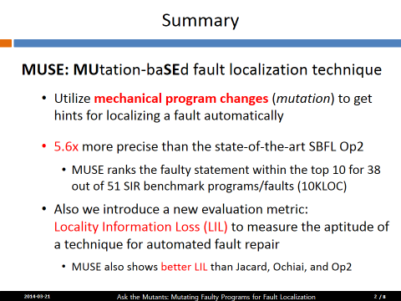
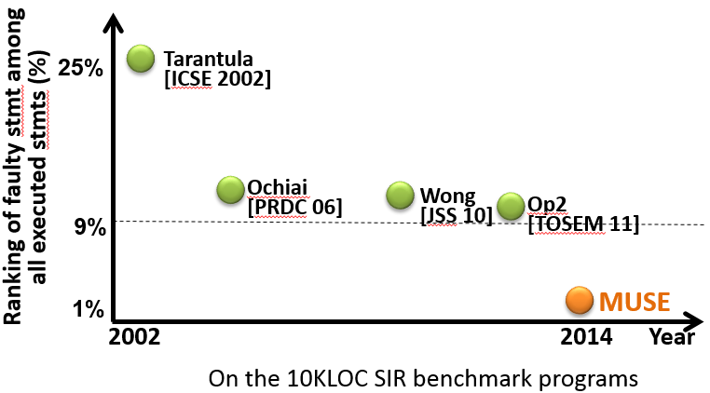
Ask the Mutants: Mutating Faulty Programs for Fault Localization (ICST ‘2014)

