Slide 1
Automated Analysis of Industrial Embedded Software
Moonzoo Kim and Yunho Kim
Provable Software Lab
KAIST, South Korea
Thanks to Hotae Kim and Yoonkyu Jang
Samsung Electronics, South Korea

Slide 2
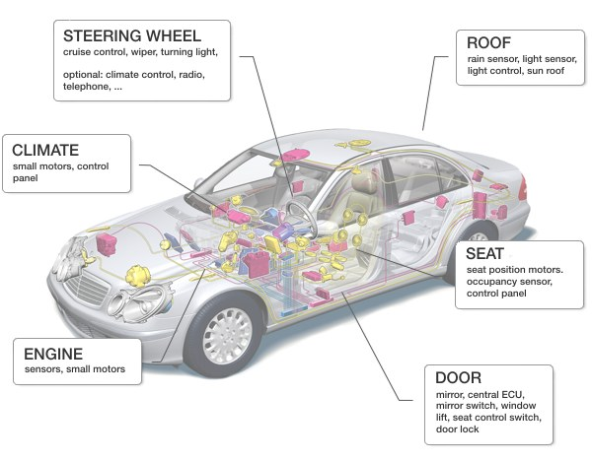
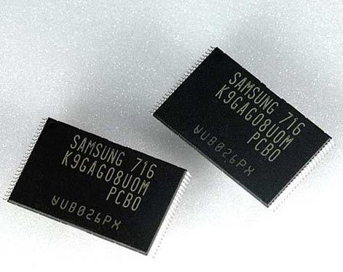
Strong IT Industry in South Korea
Moonzoo Kim
Automated Analysis of Industrial Embedded Software

Slide 3
Personal Research Roadmap
Past: RV (dynamic) && MC (static)
Runtime Verification
Model Checking
Software Model Checking
FMSD’04
Spin’08
ASE ‘08
TSE’11
Current: Extended Concolic Testing
Concolic Testing
Distributed Concolic Testing
Hybrid Algorithm (i.e., w/ Genetic Alg)
Better
Industrial
Application
FACJ’12
FSE’11a
SBMF’09
FSE’11b
ICTAC’10
ISSRE ’11
Future: Concolic Testing with Intelligence
Statistic Inference
Machine Learning
User Assistance
Moonzoo Kim
Automated Analysis of Industrial Embedded Software
3

Slide 4
Part I: Experience from SW Model Checking
Target system: Samsung Unified Storage Platform (USP) for OneNAND® flash memory
(around 30K lines of C code)
App₁
App₂
App₃
Source:
Software Center
of Samsung
Electronics ‘06
Characteristics of OneNAND® flash mem
Each memory cell can be written limited number of times only
Logical-to-physical sector mapping
Bad block management, wear-leveling, etc
Concurrent I/O operations
Synchronization among processes is crucial
XIP by emulating NOR interface through demand-paging scheme
binary execution has a highest priority
Performance enhancement
Multi-sector read/write
Asynchronous operations
Deferred operation result check
File
System
Demand
Paging
Manager (DPM)
Unified
Storage
Platform
Flash
Translation Layer
OS
Adapt-
ation
Module
Sector
Translation (STL)
Block
Management (BML)
Low Level (LLD)
Device Driver
OneNAND® Flash Memory Devices
Moonzoo Kim
Automated Analysis of Industrial Embedded Software

Slide 5
Results of Unit Analysis through CBMC and BLAST [TSE’11]
Demand paging manager (234 LOC)
Detected a bug of not saving the status of suspended erase operation
Concurrency handling
Confirmed that the BML semaphore was used correctly in all 14 BML functions (150 LOC on average)
Detected a bug of ignoring BML semaphore exceptions in a call sequence from STL (2500 LOC on average)
Multi-sector read operation (MSR) (157 LOC)
Provided high assurance on the correctness of MSR
no violation was detected even after exhaustive analysis (at least with a small number of physical units(~10))
In addition, we evaluated and compared pros and cons of CBMC and BLAST empirically
Moonzoo Kim
Automated Analysis of Industrial Embedded Software
5

Slide 6
Logical to Physical Sector Mapping
1:N mapping from a LUN to PUNs
Sector Allocation Map (SAM)
In flash memory, logical data are distributed over physical sectors.
Sector mapping
Moonzoo Kim
Automated Analysis of Industrial Embedded Software
6

Slide 7
Multi-sector Read Operation (MSR)
SAM0~SAM4
PU0~PU4
SAM0~SAM4
PU0~PU4
SAM0~SAM4
PU0~PU4
Sector 0
Sector 1
Sector 2
Sector 3
1 |  |  | 0
 | 1 |  |  | 1
 | 2
 |  | 3
 |  |  | E
A | B |  |  | F
 | C
 |  | D
 | 3 |  |  | 3
0 |  |  | 2
 |  | 3
 | 1
B
 | D
 |  |  | F
 | A | C |  | E
 | 0
 | 1
 | 2
 | 3
 |  |  | E
A | B |  |  | F
 | C
 |  | D
A distribution of “ABCDEF”
b) Another distribution of “ABCDEF”
c) Invalid distribution of “ABCDEF”
MSR reads adjacent multiple physical sectors once in order to improve read speed
MSR is 157 lines long, but highly complex due to its 4 level loops
4 parameters to specify logical data to read (from, to, how long, read flag )
The requirement property is to check
after_MSR -> (∀i. logical_sectors[i] == buf[i])
We built a verification environment model for MSR
Moonzoo Kim
Automated Analysis of Industrial Embedded Software

Slide 8
Environment Modeling
One PU is mapped to at most one LU
Valid correspondence between SAMs and PUs:
If the i th LS is written in the k th sector of the j th PU, then the i th offset of the j th SAM is valid and indicates the k’th PS ,
Ex> 3rd LS (‘C’) is in the 3rd sector of the 2nd PU, then SAM1[2] ==2
i=2 k=2 j=1
3. For one LS, there exists only one PS that contains the value of the LS:
The PS number of the i th LS must be written in only one of the (i mod 4) th offsets of the SAM tables for the PUs mapped to the corresponding LU.
SAM0~SAM4
PU0~PU4
Sector 0
Sector 1
Sector 2
Sector 3
1 |  |  | 0
 | 1 |  |  | 1
 | 2
 |  | 3
 |  |  | E
A | B |  |  | F
 | C
 |  | D
Moonzoo Kim
Automated Analysis of Industrial Embedded Software

Slide 9
Model Checking Results of MSR [Spin’08]
Verification of MSR by using NuSMV, Spin, and CBMC
No violation was detected within |LS|<=8, |PU| <=10
10¹⁰ configurations were exhaustively analyzed for |LS|=8, |PU|=10
Moonzoo Kim
Automated Analysis of Industrial Embedded Software
Notes:
10^10 configuration for LS=8 PU=10

Slide 10
Feedbacks from Samsung Electronics
Main challenge :
IT industry is not mature enough to conduct unit testing
Current SW development of Samsung is not ready to apply unit testing
Tight project deadline does not allow defining detailed asserts and environment models
Needs large scalability even at the cost of accuracy
Rigorous automated tools for small unit (i.e., SW model checker) is of limited practical value
Many embedded SW components have dependency on external libraries
Pure analysis methods on source code only are of limited value
It is desirable to generate test cases as a result of the analysis.
Current SW V&V practice operates on test cases
Moonzoo Kim
Automated Analysis of Industrial Embedded Software

Slide 11
Background on Concolic Testing
Concrete runtime execution guides symbolic path analysis
a.k.a. dynamic symbolic execution (DSE), white-box fuzzing
Automated test case (TC) generation technique
Applicable to a large target program (no memory bottleneck)
Applicable to testing stages seamlessly
External binary library can be handled (partially)
Explicit path model checker
All possible execution paths are explored based on the generated TCs
Anytime algorithm
User can get partial analysis result (i.e., TCs) anytime
Analysis of each path is independent from each other
Parallelization for linear speed up
Ex. Scalable COncolic testing for Reliable Embedded Software (SCORE) on thousands of Amazon EC2 cloud computing nodes [FSE’11b]
Moonzoo Kim
Automated Analysis of Industrial Embedded Software

Slide 12
Part II: Experience from Concolic Testing using CREST
Target system: Samsung Smartphone Platform
Unit-level testing
Busybox ls (1100 LOC)
98% of branches covered and 4 bugs detected
Samsung security library (2300 LOC)
73% of branches covered and a memory violation bug detected
System level testing
Samsung Linux Platform (SLP) file manager
Covered 20% of the branches and detected an infinite loop bug
10 Busybox utilities
Covered 80% of the branches with 4 different search strategy and 10,000 TCs in 20 min each
A buffer overflow bug in grep was detected
Libexif
Covered 43% of the branches with 4 different search strategy and 10,000 TCs in 8 hours each
2 null pointer dereferences and 5 divide-by-0 bugs were detected
Moonzoo Kim
Automated Analysis of Industrial Embedded Software

Slide 13
Samsung Security Library [FSE’11a]
Providing complete security protocol APIs
3 level layered structure
Complex mathematical operation involved
Security functions
(AES, SHA, etc.)
Complex math functions
Large integer functions
We targeted the large integer functions layer using the CREST tool
Upper 2 layers heavily use external math library functions and are hard to understand due to complex algorithms
Moonzoo Kim
Automated Analysis of Industrial Embedded Software

Slide 14
Symbolic Inputs
All 14 functions in the large integer functions layer receive struct L_INT as inputs
struct L_INT {
unsigned int size; // Allocated memory size in 32 bits
unsigned int len; // # of valid 32 bit elements, thus len <= size
unsigned int *da; // Actual data, da[len-1] are the most-significant bytes
unsigned int sign; // 0: non-negative, 1: negative
}
Ex. 4294967298 (=2*2⁰ + 1*2³²) is represented by
unsigned int size=3;
unsigned int len=2;
unsigned int *da ={2,1,0}; // 2*2⁰ + 1*2³² + 0*2⁶⁴
unsigned int sign=0;
da[0] | da[1] | da[2]
2 | 1 | 0
Moonzoo Kim
Automated Analysis of Industrial Embedded Software

Slide 15
Symbolic L_INT Generator
gen_s_int() generates symbolic L_INT whose size is between min and max
Allocate memory of L_INT with symbolic size of data buffer (line 2~6)
Fill L_INT data when to_fill is not 0 (line 8~12)
01: L_INT* gen_s_int(int min,int max,int to_fill) {
02: unsigned int size, i;
03: CREST_unsigned_int(size); //sym. var.
04: if(size> max || size< min) exit(0);
05: L_INT *n=L_INT_Init(size);
06: n->len=size;
07:
08: if(to_fill){// sym. value assignment
09: for(i=0; i < size; i++) {
10: CREST_unsigned_int(n->da[i]);}
11: if(n->da[size-1]==0) exit(0); }
12: return n;}
Moonzoo Kim
Automated Analysis of Industrial Embedded Software

Slide 16
Test Driver for L_INT_ModAdd()
L_INT_ModAdd(dest, n1, n2, m)
dest := (n1+n2)%m // (6+7)% 10 = 3
Check (n1+n2)%m == (n2+n1)%m (line 11)
Generate 3 symbolic L_INT operands for n1, n2, and m (line 2~4)
Generate 2 symbolic L_INT dest and dest2 to store the results
01: void test_L_INT_ModAdd() {
02: L_INT *n1 = gen_s_int(1,4,1),
03: *n2 = gen_s_int(1,4,1),
04: *m = gen_s_int(1,4,1),
05: *dest = gen_s_int(1,4,0), // Do not fill *da
06: *dest2 = gen_s_int(1,4,0); // Do not fill *da
07:
08: L_INT_ModAdd(dest,n1,n2,m);
09: L_INT_ModAdd(dest2,n2,n1,m);
10: // (n1+n2)%m == (n2+n1)%m
11: assert(L_INT_Cmp(dest,dest2)==0);}
Moonzoo Kim
Automated Analysis of Industrial Embedded Software

Slide 17
Results
Correct behavior
We tested all 14 functions and all of them violated assertions
7537 TCs generated in 5 mins
1284/1953 branches covered(73.2%)
L_INT_ModAdd()
831 TCs generated
129 among 150 branches covered (86%)
17 violations of assert (dest == dest2)
------- Test input ---------
n1 : 2 :7f7d4b02 6b702b0d
n2 : 1 :3787923c
m: 1 :777d0295
dest.size=1
dest2.size=1
--------Test output ---------
dest: 1 :539b103d
dest2: 1 :539b103d
L_INT_Cmp(dest,dest2)==0
Violation of assert(dest1=dest2)
------- Test input ---------
n1 : 4 :777d0295 3787923c 7f7d4b02 6b702b0d
n2 : 3 :513a3234 7d0b4f12 5789fd36
m: 3 :08cae318 61d52574 73331ffa
dest.size=1
dest2.size=1
--------Test output ---------
dest: 3 :00000001 dc5f0f9e a0862e99
dest2: 3 :0874a808 dc5f0f9e a0862e99
L_INT_Cmp(dest,dest2)==-1
test_L_INT_ModAdd: Assertion `result == 0' failed.
Moonzoo Kim
Automated Analysis of Industrial Embedded Software

Slide 18
Observations from these Verification Projects
Main challenge:
State space explosion problem
Expensive computational cost
Huge state space ( |TCs| = ~ 2 ^{|exec|}. )
~90% of time spent by a SMT solver
SMT solvers seem good at solving a complex formula but not good at solving millions of similar short formulas
Proper selection of symbolic input to reduce state space
requires deep knowledge of a target program
Build process and runtime environment dependence causes additional burden
Moonzoo Kim
Automated Analysis of Industrial Embedded Software

Slide 19
Conclusion and Future Work
Formal verification techniques really work in IT industry !
Software model checking and concolic testing detected hidden bugs in industrial embedded software
To alleviate the limitations of concolic testing
Fault-tolerance for distributed concolic testing (SCORE framework [FSE’11b])
External function summaries through dynamic invariance generation
Develop a new search strategy for fast branch coverage
Data mining on a huge set of runtime execution information
Automated oracle generation through dynamic invariant generation
Automated debugging
Technical papers can be downloaded at http://pswlab.kaist.ac.kr
Moonzoo Kim
Automated Analysis of Industrial Embedded Software

