Slide 1
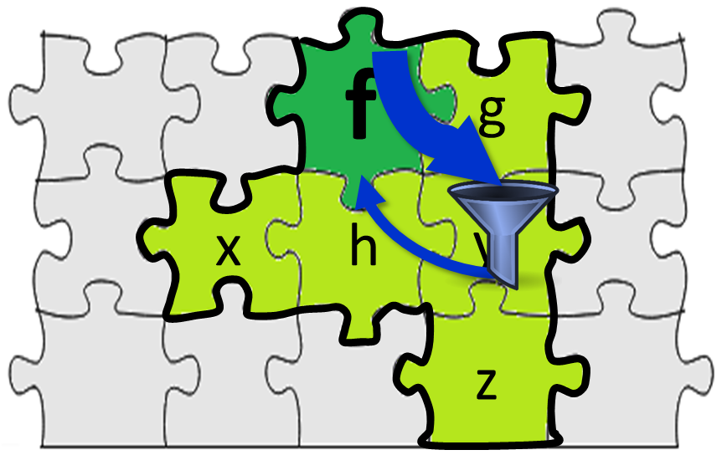
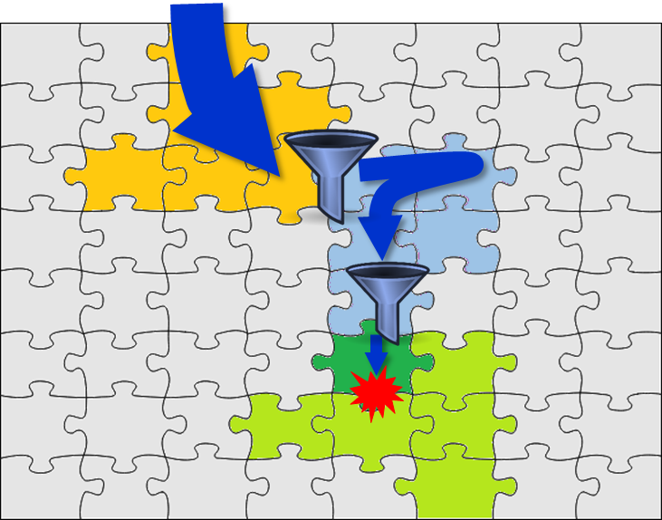
Precise Concolic Unit Testing of C programs using Extended Units and Symbolic Alarm Filtering
Yunho Kim, SWTV group
KAIST, South Korea
Joint work with
Yunja Choi @ KNU and
Moonzoo Kim @ KAIST
Notes:
Thank you for coming. My name is Yunho kim from KAIST, south korea. Today, I will present our recent work, precise concolic unit testing of c programs using extended units and symbolic alarm filtering. This is joint work with yunja choi @ knu and moonzoo kim @ kaist.

Slide 2
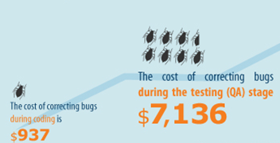
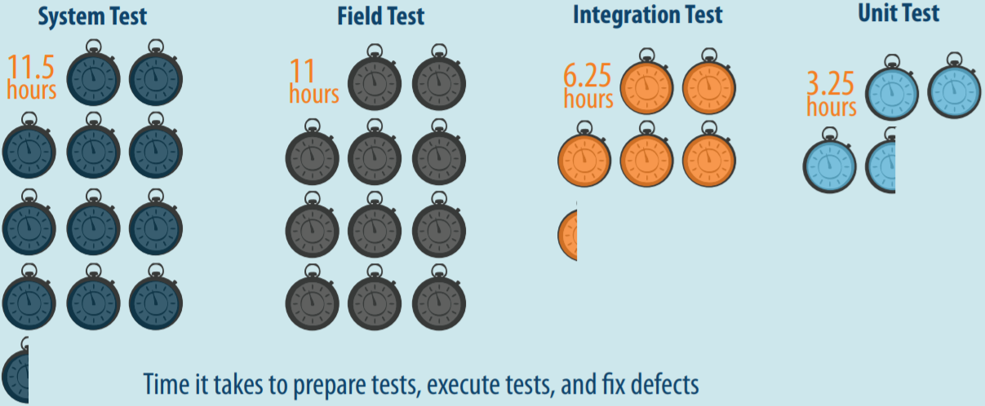
Benefits of Unit Testing
Bug correction cost: 7x cheaper than system tests
$937 (unit test) vs $7,136 (system test)
Bug correction time: 3x faster than system testing
3.25 hours vs 11.5 hours
False Alarms!
Source: B. Boehm and V. Basil, Software Defect Reduction Top 10 List, IEEE Computer, January 2001
Source: Capers Jones, Applied Software Measurement: Global Analysis of Productivity and Quality
Notes:
All of us know that unit testing has benefits over system testing. Unit testing is 7 times cheaper than system testing to detect and fix a bug as well as unit testing is 3 times faster than system testing to run and detect a bug. Unfortunately, such benefits of unit testing is not much enjoyed in real-world because of false alarm problems. To run a target unit in an isolated environment for unit testing, we have to write down stub and mock functions to provide contexts to the unit. If such stub and mock functions provide inaccurate context, unit testing raises a false alarm, which is feasible in unit execution, but infeasible in system execution. Such false alarm problem is severe in automated unit test generation techniques because such techniques do not know the appropriate context of the target unit. To address such false alarm problems in automated unit test generation techniques, we propose two ideas

Slide 3
Unit Testing f without or with Contexts of f
Without Contexts of f
Pros: fast exploration of target unit execution paths
Cons: infeasible target unit executions
With Contexts of f
Pros: reduced infeasible target
unit executions
Cons: slow exploration of target unit execution due to large cost of
exploring context functions
Notes:
If we perform unit testing on a target function f without its contexts functions such as f’s callers and f’s callees,
+ the unit testing can be very fast because f’s code size is small.
But, we are testing f without any constraints enforced by f’s real contexts, many infeasible target unit executions may occur which can raise false alarms.
In contrast, if we utilize the context functions of a target function f,
+ we can reduce infeasible target unit executions because the context functions enforces realistic constraints to target unit executions
- But, unit testing becomes slow and misses bugs because target unit execution paths may not be fully explored in given time budget of unit testing. This is because we have to also explore the execution paths of the context functions (shown as light blue arrows).
Therefore, we have clear trade-off between unit testing accuracy and unit testing cost by the decision of how much target unit context to include in unit testing.
We propose the 2 ideas to identify and utilize sweet spot of this trade-off so that unit testing can be *both effective and accurate* using

Slide 4
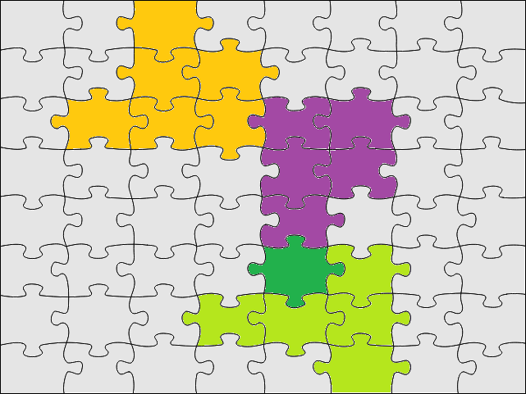
CONBRIO: 2 Main Ideas
Extended Units
Symbolic Alarm Filtering
f
g
x
h
y
z
Green: Target function f
Light green: Functions highly relevant to the target
Grey: Functions not relevant to the target
Green + light green: Extended Unit of f
Yellow & sky blue: a calling context of a target func. f
Notes:
First idea is extended units. Here green puzzle piece represents a target function f. Extended units utilize relevant callee functions of the target function that are invoked directly or transitively to filter out infeasible execution path and provide more likely-feasible execution paths to the target function.
Second idea is symbolic alarm filtering. Symbolic alarm filtering utilizes closely relevant caller functions of the target unit. Here yellow unit calls blue one and blue one calls the target function. By utilizing the caller functions of the target functions, symbolic alarm filtering effectively filters out infeasible execution paths and provide more likely-feasible paths to the target function.
One important
Conbrio combines these two ideas for effective and accurate automated unit testing for C programs.

Slide 5
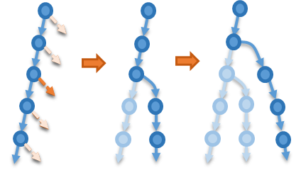
Overview of CONBRIO CONcolic unit testing with symBolic alaRm fIltering using symbolic calling cOntexts
Closely relevant
calling context
Phase1:
Defining extended units
and calling contexts
A program P
Sys. TCs
Sys. TC profile analysis
Extended unit
Phase2: Concolic unit testing with an extended unit
Concolic testing
Notes:
CONBRIO consists of three phases. In first phase, conbrio constructs extended units and calling contexts from system test execution. Conbrio takes a program source code and a set of system tests as inputs and computes function relevance from system test execution. Using the function relevance, conbrio constructs extended units and closely relevant calling context of
Phase 1: CONBRIO use simple dynamic analysis to extract relevant information from system test and constructs extended units
Phase 2: CONBRIO performs concolic testing to detect crash bugs such as bof on extended units
Overview 3단계로 단순화
1: dynamic dependency
2: concolic
3: filtering

Slide 6
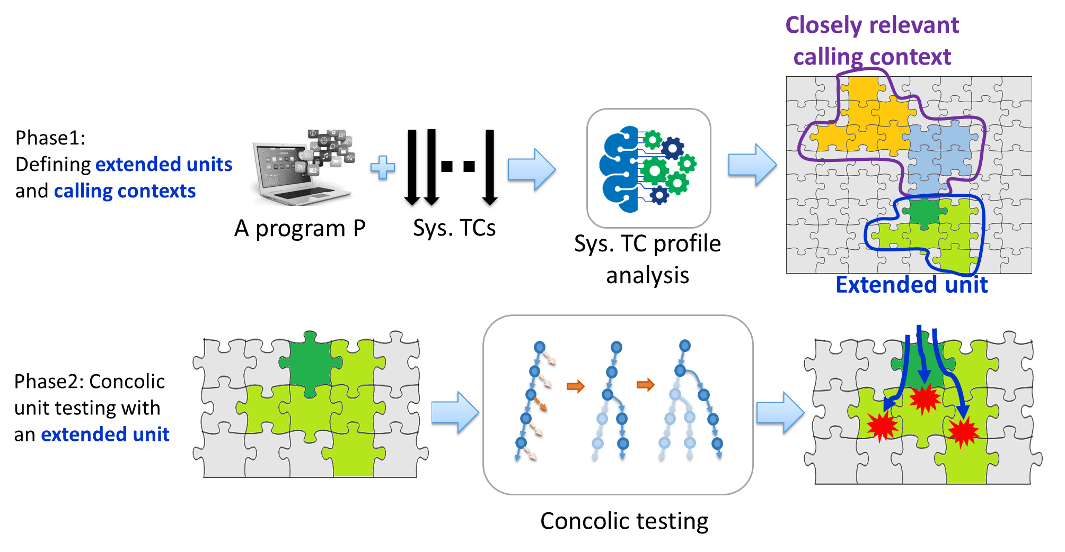
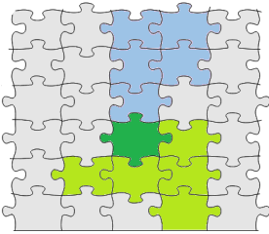
Overview of CONBRIO
Phase3:
Symbolic false alarm filtering
Notes:
Phase 3: CONBRIO performs symbolic alarm filtering to determine the crash bugs found in phase 2 is real one. Infeasible execution paths that cannot come from caller are filtered. Many calling context exist for target, but we use relevant context to reduce the complexity.
Overview 3단계로 단순화
1: dynamic dependency
2: concolic
3: filtering

Slide 7
Computing Function Relevance based-on System TCs
Function call profile
Relevance of f on other functions
(Threshold τ =0.6)
TC1 | TC2 | TC3
main
main
main
$$P\left(g | f\right)= \frac{|f calls g| }{|f|}$$
$$=\frac{|TC2, TC3|}{|TC1, TC2,TC3|}=0.66$$
a2
a1
a1
P(b|f) = 0.66
P(g|f) = 0.66
P(h|f) = 0.33
…
f
f
f
b
g
b
g
h
Notes:
we utilize dynamic conditional probability of function calls, which is simple, but effective, to find relevant functions to the given target function.

Slide 8
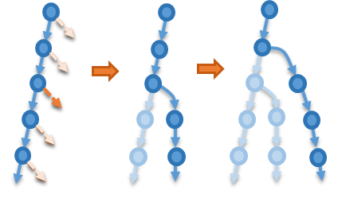
Concolic Testing on Each Extended Unit
Phase2: Concolic unit testing with an extended unit
Detecting crash bugs
1 concolic_test_driver(){
2 set sym. params;
3 set sym. globals;
4 target_unit(sym. params);
5 }
Buffer overflow
NULL Ptr. Deref.
Div-by-Zero
Notes:
We target crash bugs which can be detected without user-give test oracles

Slide 9
Symbolic Alarm Filtering
ϕ_{a→f}∧σ_{f2}
ϕ_{b→a}∧ϕ_{a→f} ∧σ_{f2}
ϕ_{b→a}∧ϕ_{a→f} ∧σ_{f3}
ϕ_{a→f}∧σ_{f1}
ϕ_{a→f}∧σ_{f3}
b
σ_{f1}
σ_{f2}
σ_{f3}
a
a
Alarm
Report
ϕ_{a→f}∧σ_{f1}
ϕ_{b→a}∧ϕ_{a→f} ∧σ_{f2}
ϕ_{a→f}∧σ_{f2}
ϕ_{b→a}∧ϕ_{a→f} ∧σ_{f3}
ϕ_{a→f}∧σ_{f3}
SAT
SAT
UNSAT
UNSAT
Notes:
Unsat delay
2d 코드 xy
전체 3d
Z축 exec space
동적 스페이스

Slide 10
Main Research Questions
RQ1: How many
known crash bugs does CONBRIO detect?
RQ2: How much false/true alarm ratio does CONBRIO decrease?
Notes:
Precision 을 먼저 나오게 순서 조절

Slide 11
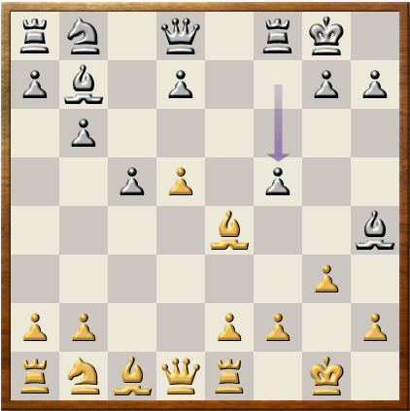
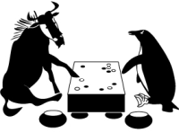
Target Programs
Total 15,915 functions
in 15 Programs
SIR
7 Programs
8 Programs
Notes:
다른 프로그램 이미지도 추가

Slide 12
Trade-off between Bug Detection Ability and Accuracy
Bug Detection Ability
(aiming low false negative)
Bug Detection Accuracy
(aiming low false positive)
Recall
Precision

Slide 13
CONBRIO Unit Crash Bug Benchmark
~2M commits
2,502 crash fix
SIR
2,000,000
67
1993
Apr. 2017
http://github.com/swtv-kaist/conbrio

Slide 14
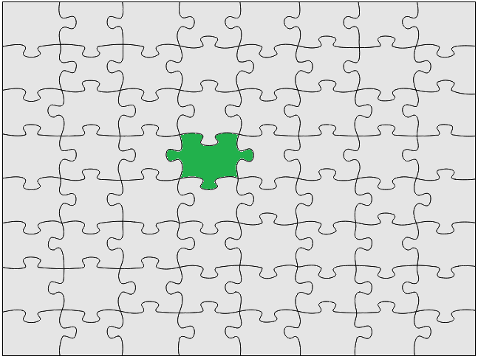
Other Techniques to Compare
Static bound
Symbolic Unit Testing
(k=0)
k=3
k=6
k=9

Slide 15
Results: Bug Detection Ability (RQ1)
61/67 (91.0%)
61/67 (91.0%)
Higher
is better
51/67 (76.1%)
41/67 (61.2%)
39/67 (58.2%)
w/ τ=0.7
CONBRIO spent 4.1 hours on 100 machines

Slide 16
Results: Bug Detection Accuracy (RQ2)
82.7:1
(18.4x)
Lower is
more
accurate
22.9:1
(5.1x)
14.6:1
(3.2x)
11.5:1
(2.6x)
4.5:1
Notes:
Static bound → Random (with same ext. unit size)

Slide 17
Cutting-edge Accuracy of Unit Testing
CONBRIO: 4.5:1 w/ 91% of bugs detected
Randoop: 5.9:1 [Gross et al., 2012]
Evosuite: 6.3:1
[Fraser and Arcuri, 2013]
UC-KLEE: 5.7:1
[Ramos and Engler, 2015]
OOP features
Manual Assumption
Notes:
OOP 타겟 도움 받음, 쉽다. OOP 얘기 하지말고
Randoop, Garg et al., Evosuite, UC-KLEE False alarm 비교 슬라이드

Slide 18
Future Work
Refined Relevance Analysis
Synthesis System TCs from Unit TCs
main()
Static features
Dynamic features

Slide 19
Precise Concolic Unit Testing of C programs using Extended Units and Symbolic Alarm Filtering
Yunho Kim, SWTV group
KAIST, South Korea
Joint work with
Yunja Choi @ KNU and
Moonzoo Kim @ KAIST
Notes:
Thank you for coming. My name is Yunho kim from KAIST, south korea. Today, I will present our recent work, precise concolic unit testing of c programs using extended units and symbolic alarm filtering. This is joint work with yunja choi @ knu and moonzoo kim @ kaist.

