Slide 1
Concolic Testing for High Test Coverage and Reduced Human Effort in Automotive Industry
Yunho Kim, SWTV group
KAIST, South Korea
Dongju Lee
Junki Baek
Moonzoo Kim

Slide 2
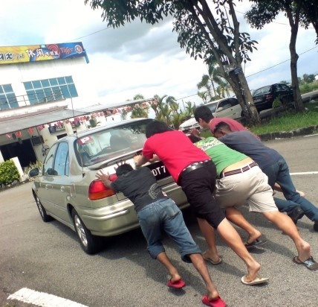
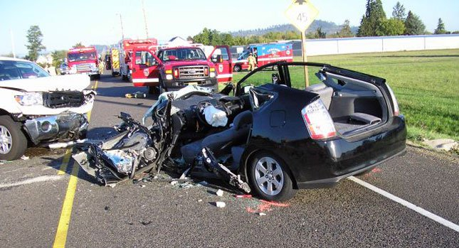
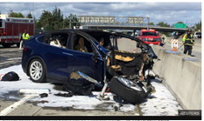
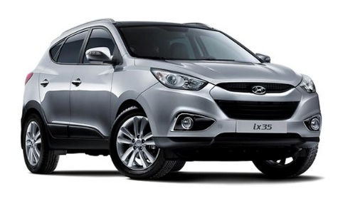
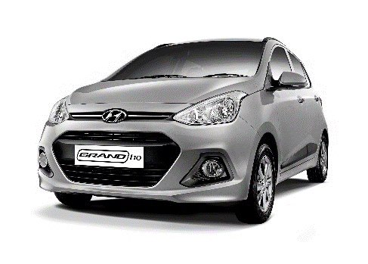
Manual Testing in Automotive Industry: - Large Human Effort Required
Manual Testing
SW reliability is critical for cars
Toyota “Unintended Acceleration” has killed 89
Tesla fatal crash was on Autopilot
Achieving high reliability requires large human effort
…
$$÷$$
1MLoC / a car * 10 models $÷$ 7KLoC/MM
= 120MYr (for coverage testing)
Notes:
Achieving high coverage requires large human effort because Automotive SW is large and complex due to many sources of inputs and complex logic.
Automotive SW 이미지 (자동차를 사람이 밀고 (시동꺼진 차))
예. 분기 커버리지 달성에 100 LOC = 1.5 MM
ISO 26262
테슬라 차 사고 => SW 신뢰성이 매우 억수로 중요. => 매우 복잡한 MC/DC 테스팅 인력 억수로 많이 들고 힘듦

Slide 3
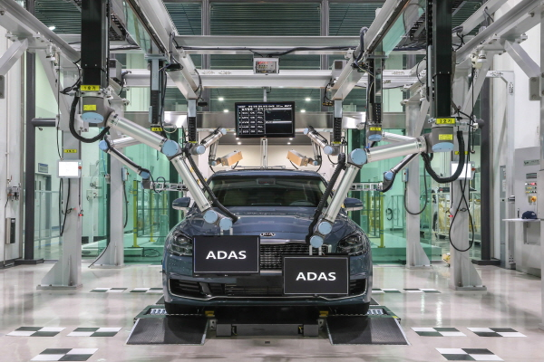
Automated Testing can Achieve High Reliability and Reduce Human Testing Effort
Automated testing achieves high reliability
Automated Testing
Achieving high code coverage
Detecting
hidden bugs
Automated testing can be 100x faster than manual one
…
$$÷$$
1MLoC/a car * 10 models $÷$
700KLoC/1CM
= 1.2CYr (= 0.1M on 100 cloud cores)
Notes:
2페이지랑 동일한 레이아웃, 박스로 구분
Automated testing is 100x faster than manual testing and reduce manual testing effort.
100 cores, 1.2 yr
예. 분기 커버리지 달성에 100 LOC = 1.5 MM
ISO 26262
테슬라 차 사고 => SW 신뢰성이 매우 억수로 중요. => 매우 복잡한 MC/DC 테스팅 인력 억수로 많이 들고 힘듦

Slide 4
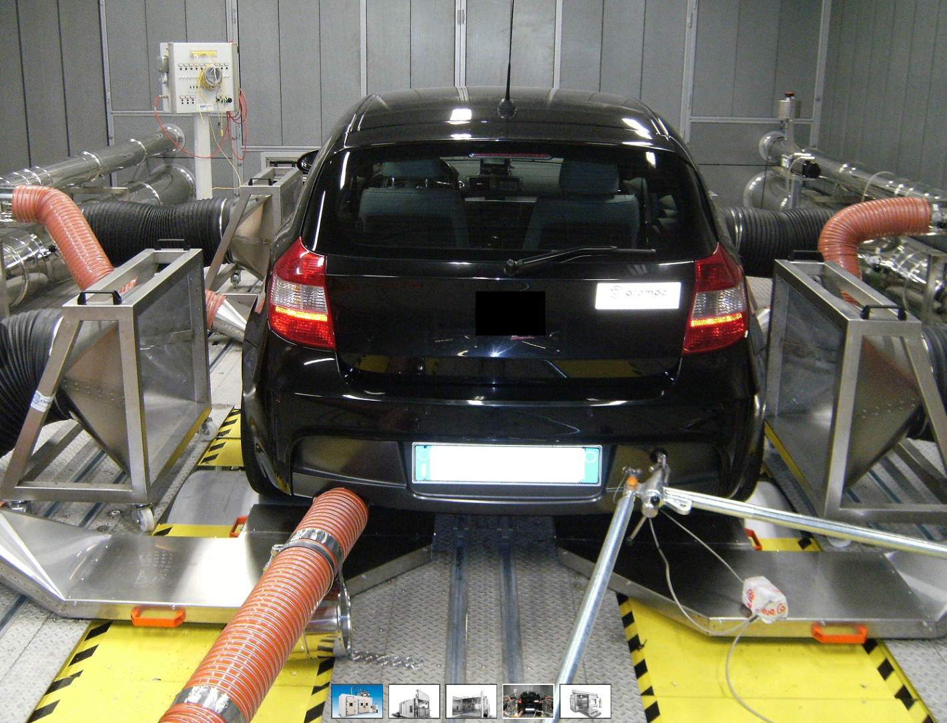
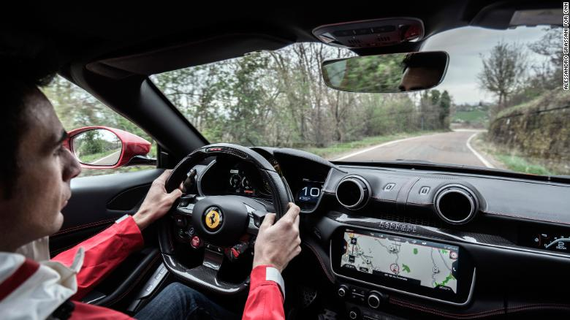
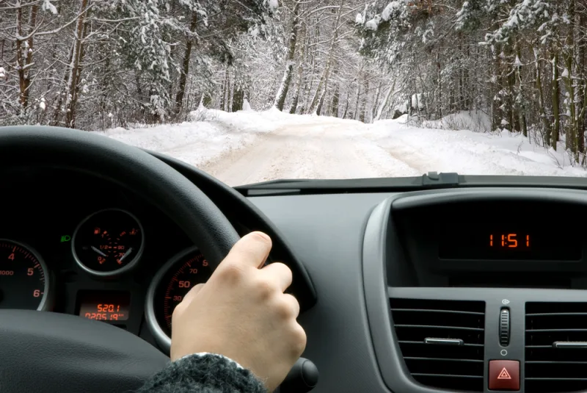
Importance of Automated Unit Testing In Automotive SW
System testing is expensive and less effective
Full vehicle HW and human drivers are required
Driving a car with various physical environments spends a lot of time
Hard-to-achieve high test coverage due to low controllability
Unit testing is cheap and more effective
Full vehicle HW and human drivers are NOT necessary
No need to drive a car
Easy-to-achieve high coverage due to high controllability
VS
Notes:
Unit testing 서서히 나타나는 애니메이션으로
Compared to system testing requires lots of resources,
Unit testing rmfla\
비주얼
자동차 테스트 장비 등

Slide 5
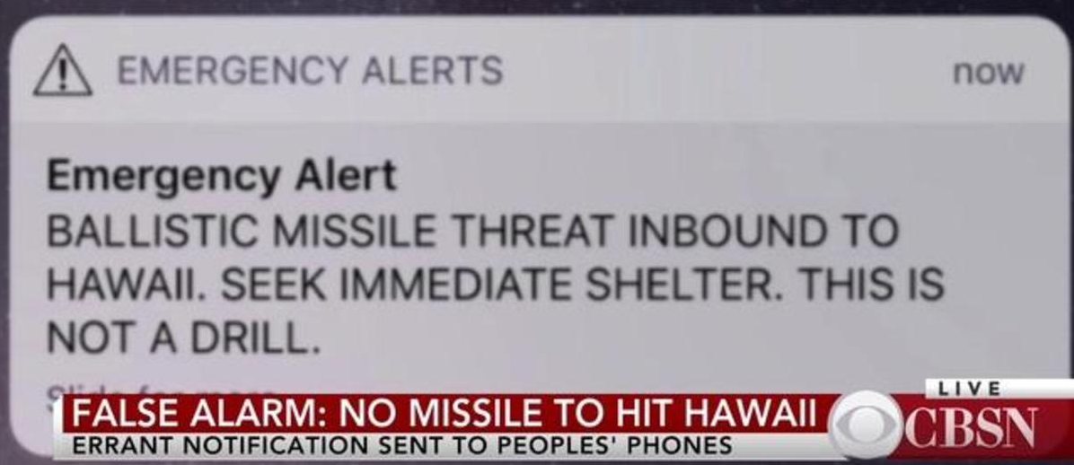
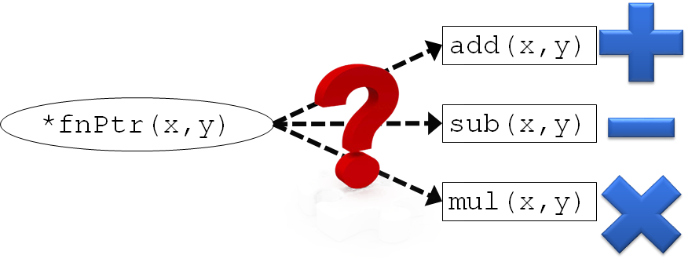
3 Technical Challenges for Automated Unit Testing
False alarms
Bit-fields
18bits
5bits
int z:18
int y:5
char x
struct S : 4 Bytes
Function pointers
Notes:
To achieve high test coverage using automated testing, we need to address 3 technical challenges to address
False alarm 그림 다시

Slide 6
False Alarms due to Infeasible Unit Executions
False alarms can be raised due to missing contexts
Target unit’s behavior
w/o any contexts
Target unit’s REAL behavior w/
proper contexts in a pgm P
False alarm
Erroneous behaviors
(e.g., NULL-ptr deref, $÷0$)
Erroneous behaviors
(e.g., NULL-ptr deref, $÷0$)
Notes:
False alarms
False alarm 나타낼 더 명확한 그림(bug가 아니어야 함)

Slide 7
No Support of Symbolic Bit-fields
Tracking symbolic expression for bit-fields is NOT possible
bit-fields are NOT addressable (i.e., &(s.y) is not allowed)
Symbolic Memory Map
1: struct S{
2: char x;
3: int y:5;
4: int z:18;};
Memory address (key) | Sym. Exp. (value)
&(S.x) | S.x₀+3
&(S.y) NOT allowed | N/A
&(S.z) NOT allowed | N/A
Notes:
18 bits, 5 bits (띄어쓰기)
Bitfield 왜 사용하나 설명
그림으로 (pictorial) 하게

Slide 8
No Support of Symbolic Function Pointers
Hard-to-know which function a given func. ptr. points to
add(x,y)
*fnPtr(x,y)
sub(x,y)
mul(x,y)
Notes:
Add, sub, mul clipart 추가
그림으로 (pictorial) 하게

Slide 9
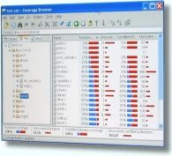
Overview of MAIST
Sol. 1: Task-oriented
driver/stub gen. to
reduce false alarms
MAIST
Test harness generator
Test
drivers/
stubs
MAIST
Test input
generator
Driver gen.
Test cases
Target
C code p
Stub gen.
Search strategy coordinator
Sol. 2: Bit-field
transform. to support
sym. bit-fields
MAIST
Converter
Target
C code p’
CROWN
Coverage
Report
Bit-field transform.
Sol. 3: Static
analysis to support
sym. function pointer
Legend
CROWN features
- Bit-level accuracy
- Easy-to-extend
- Low memory overhead
- Fast through lightweight instr.
MAIST
External tool
C code
Notes:
말풍선 사라지지 않게
CROWN features
솔루션이랑 매칭되게

Slide 10
Task-oriented Unit-test Driver/Stubs Generation
A Task is a mostly minimal independent unit
Task t₁
Task t₂
Legend
driver_f
f
g
File scope
h
Entry function
driver_g
s1
s4
s5
Static function
stub_h
Driver/stub functions
s2
s3
Function call
sym_harness.c
file1.c
file2.c
Notes:
자동차 DOMAIN 의 특성상 task 위주의 개발을 하게 되는데
이유1.
이유2.
…..
Task oriented unit testing is a key to the success of MAIST

Slide 11
Bit-field Transformation
1: struct S{
2: char x;
3: int y:5;
4: int z:18;};
1: struct S_nb{
2: char x;
3: unsigned char ba0[3];
4: } ;
Original program p | Transformed program p’
n=S.z+1; | n=(((S_nb.ba0[2]&127)<<16)| (S_nb.ba0[1]<<8)| S_nb.ba0[0])>>5 +1;
S.z=S.x+3; | S_nb . ba0 [2]= ((((S_nb.x+3) <<5) > >(2*8)) &127)| (S_nb .ba0 [2]&128); S_nb . ba0 [1]= (((S_nb.x+3) <<5) > >(1*8)) &255; S_nb . ba0 [0]= (((S_nb.x+3) <<5) &224) | ( S_nb .ba0 [0]&31);
struct S : 4 Bytes
high address
low address
18 bits
5 bits
int z:18
int y:5
char x
ba0[2] | ba0[1] | ba0[0] | x
struct S_nb : 4 bytes
Notes:
회색 진하게

Slide 12
Symbolic Function Pointer Support
Step 1: Identifying candidate functions using static analysis
Step 2: Set *fnPtr as one of the candidates using a symbolic var sym_choice
Function pointer input
harness_target.c
1:void drv_do_chk(){
2: …
3: SYM_int(sym_choice);
4: switch(sym_choice){
5: case 0:
6: fnPtr=add;
7: break;
8: case 1:
9: fnPtr=sub;
10: break;
11: case 2:
12: fnPtr=mul;
13: default: break;}
14: SYM_int(p1);
15: do_chk(p1);}
target.c
1:int (*fnPtr)(int,int);
2:int add(int,int) {…}
3:int sub(int,int) {…}
3:int mul(int,int) {…}
4:void f() {…
5: fnPtr=add;}
6:int g(){…
7: fnPtr=sub;}
7:int h(){…
8: fnPtr=mul;}
8:void do_chk(int model){
9:…
10: int ret=fnPtr(x,y);
11: …}
Set *fnPtr as add()
if sym_choice==0
Candidate1: add()
Set *fnPtr as sub()
if sym_choice==1
Candidate2: sub()
Candidate3: mul()
Set *fnPtr as mul()
if sym_choice==2
Notes:
함수 포인터 +, -, *로 3개
12-13 한 장으로

Slide 13
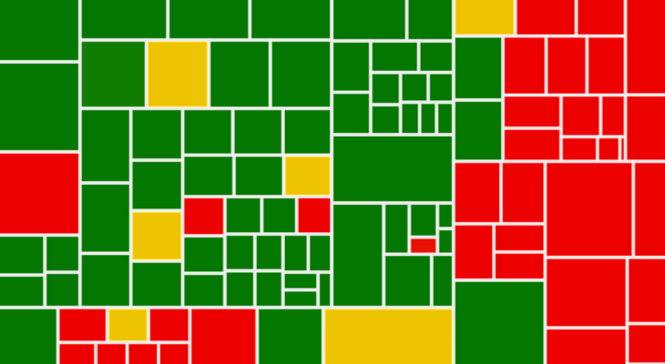
Research Questions
RQ1-2: Overall benefit of MAIST
RQ1: How much
test coverage
does MAIST achieve?
RQ2: How much
human test effort
does MAIST reduce?
Notes:
RQ4-6 은 달라보이게 시각적으로

Slide 14
Research Questions
RQ3-5: Effectiveness of MAIST for addressing the technical difficulties
False alarm
RQ3: Effect of Task-oriented test Gen.
RQ4: Effect of Sym. bit-fields
RQ5: Effect of Sym. Func. Ptr.
Notes:
RQ4-6 은 달라보이게 시각적으로

Slide 15
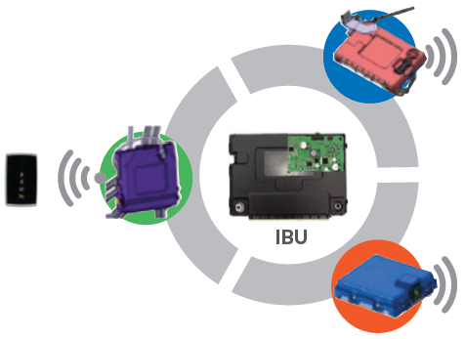
Overview of Target SW: Integrated Body Unit
Body Control Module (BCM)
Wiper, door control
Burglar alarm
Smart Key (SMK)
Remote door lock/unlock
Button start
IBU
Tire Pressure Monitor (TPM)
Tire pressure sensing
Module | #files | #tasks | #functions | LoC | Avg. CC per func.
BCM | 27 | 143 | 656 | 53,690 | 4.3
SMK | 198 | 554 | 2,521 | 135,877 | 5.8
TPMS | 29 | 68 | 302 | 16,951 | 4.1
Total | 254 | 767 | 3,479 | 206,518 | 4.9
Notes:
LoC

Slide 16
RQ1:MAIST Achieved 90.5% Branch and 77.8% MC/DC Cov.
100% branch cov. of 72.2% of funcs
100% MC/DC cov. of 57.1% of funcs
* Running 20 hours on 12 CPU cores (3.0GHz)
Notes:
그래프 label
메시지 각 RQ별로 (BR > 90, 90.5%) almost all possible
빠진 uncovered branches RQ 다시 넣기

Slide 17
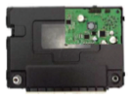
RQ2. MAIST Reduced Testing Cost from 30MM to 5MM (↓83.3%)
5MM
Manual testing for 9.5% uncovered brs
IBU code
210KLoC
30MM
$$÷$$
$$=$$
9MM
MAIST
Development
(one time cost!)
7KLoC/MM
(cov. testing)
Manual testing cost
Notes:
5mm 9mm 공간 띄어서
9mm 색 변경 (회색, 연노랑)
30MM(붉은색)이랑 5MM 색 다르게
Cost of manual testing of IBU
210KLoC (IBU LoC) / (350 LoC (LoC that 1 engineer can handle in a day) * 20 business day) = 30 MM
Cost of automated testing of MAIST
9 MM (to develop MAIST and train engineers to use MAIST) + 5 MM (to cover 9.5% of branches that MAIST did not cover)

Slide 18
RQ3:No false crash alarms by Task-oriented driver/stub generation
146
#false crash alarms
No false crash alarm at all!
Function-oriented
unit testing
Task-oriented Unit testing (MAIST)
Notes:
그래프 label
그래프에서 그라데이션 전부 삭제

Slide 19
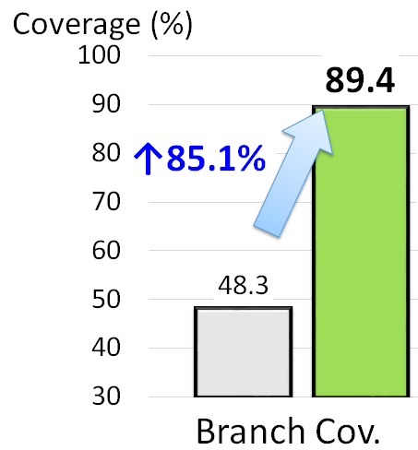
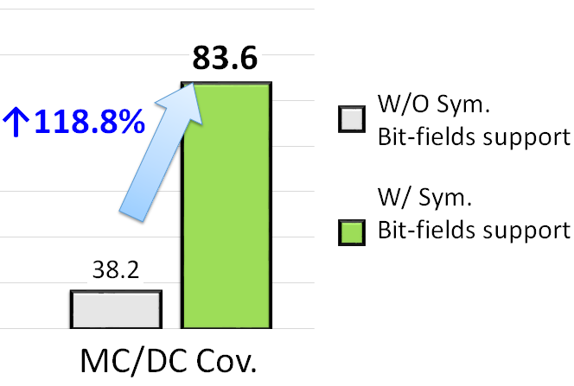
RQ4: Symbolic Bit-fields Support Highly Increases Test Coverage
Notes:
그래프 label
그래프로 작성 예정

Slide 20
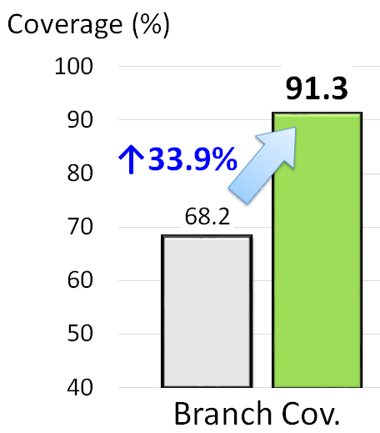
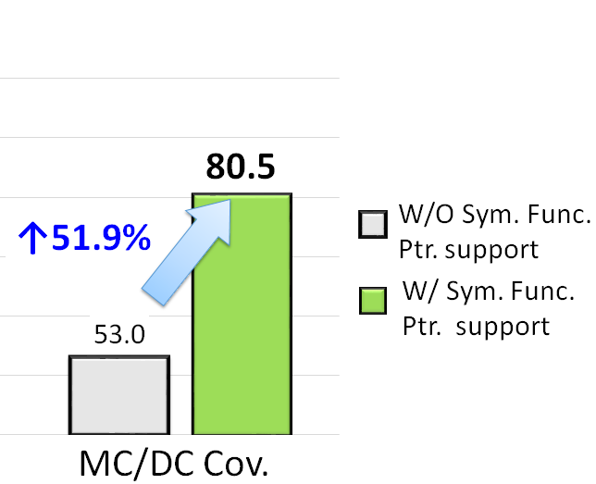
RQ5: Sym. Function Pointer Support Increases Test Coverage
Notes:
그래프로 작성 예정

Slide 21
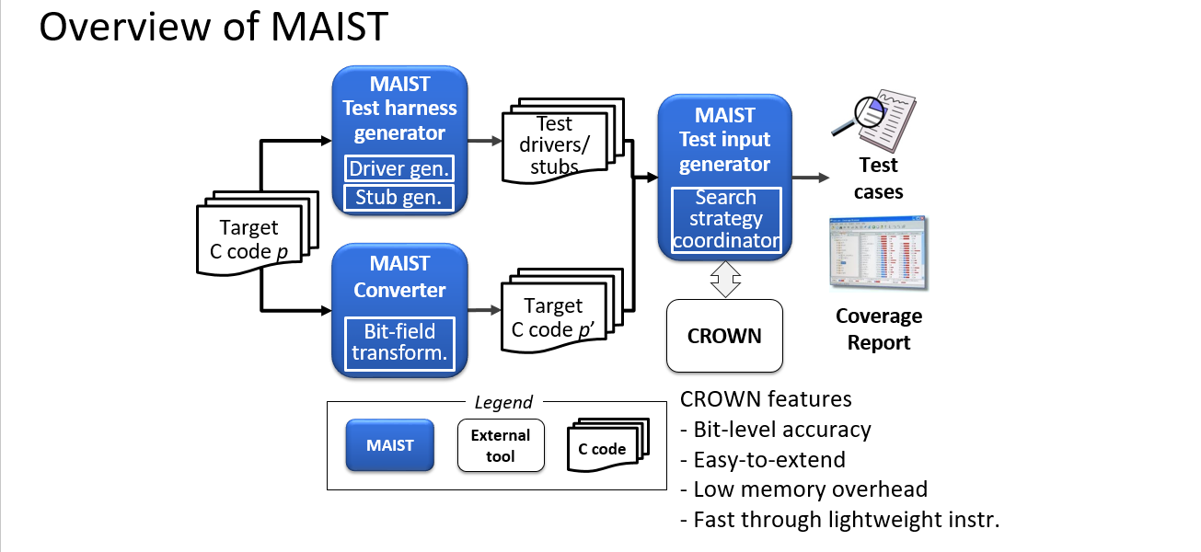
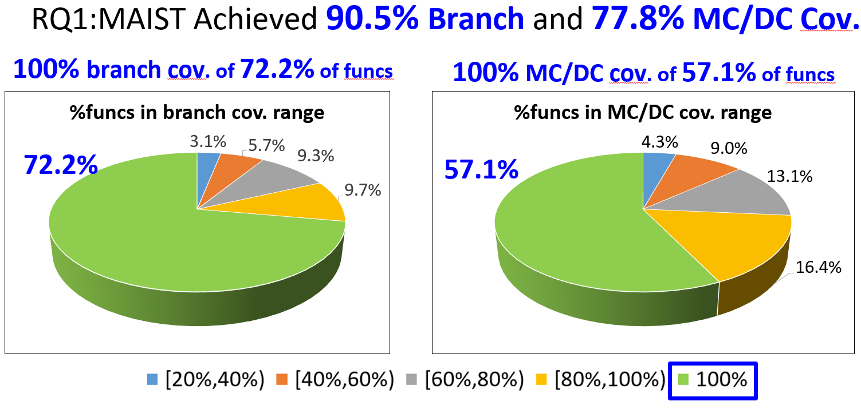
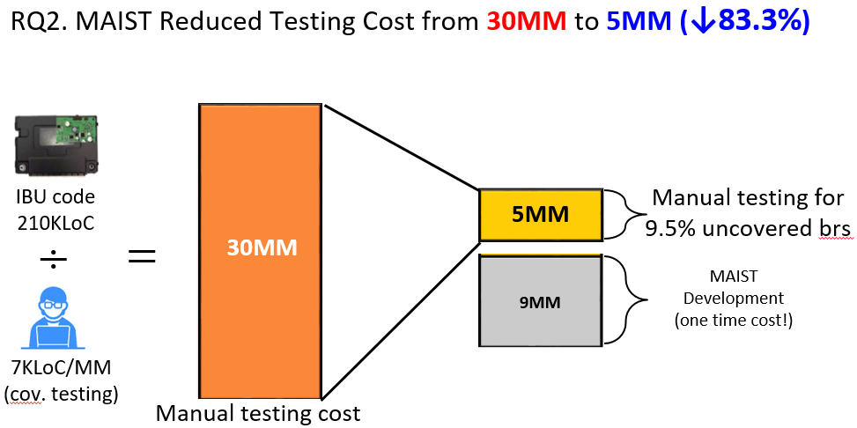
Conclusion

Slide 22
Concolic Testing for High Test Coverage and Reduced Human Effort in Automotive Industry
Yunho Kim, SWTV group
KAIST, South Korea
Dongju Lee
Junki Baek
Moonzoo Kim

