Slide 1
Efficient Mutant Reduction using Fine-Grained Mutation Operators
Loc Phan Duy
School of Computing – KAIST
Advisor: Prof. Moonzoo Kim
December 16th 2019
Notes:
Good Morning Professors. My name is Loc and I am from Prof. Kim Moonzoo lab.
Thank you all for your time.
Today I will present my master’s thesis with the title “Efficient Mutant Reduction using Fine-grained Mutation Operators”.
Please feel free to interrupt me in the middle of my slides if you have any questions.

Slide 2
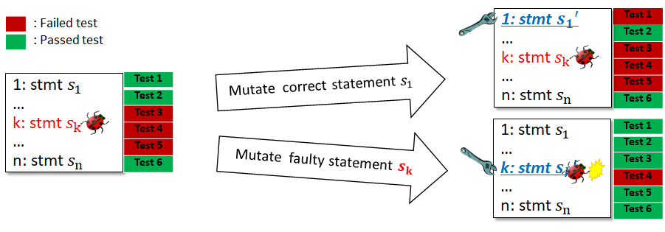
Mutation Analysis
Mutation Analysis is a versatile technique that has been used in various aspects of software testing
Test suite quality evaluation
Mutation Score of T = $\frac{\#mutants killed by T}{\#mutants generated}$
Fault localization
Example: Mutation-based fault localization technique (MUSE, ICST 2014)
Test case generation
Example: Guided test generation using mutation exploration (DeMiner, ICST 2018)
MUSE
Notes:
My thesis proposes solutions for two weaknesses of Mutation Analysis in practice.
Mutation Analysis is a versatile technique that has been used in various aspects of software testing. Here are a few examples.
The most wellknown application of mutation analysis is test suite quality evaluation.
A mutant is seen as a potential fault that can be made by a programmer. And we can assess the quality of a test suite by checking the ratio of mutants that T can kill.
Besides that, two other example of applications of mutation analysis includes fault localization and test case generation.
MUSE and DeMiner are two works from our lab which incorporate mutation analysis to improve the performance of fault localization and test case generation respectively.

Slide 3
Challenge #1
Existing, publicly available mutation tools for C programs suffer from several limitations
Tool | Applicability to modern C programs (i.e. > C89) | Avoid generation of stillborn mutants | Easy implementation of new mutation operator | Fine-grained level tool configuration
Proteum¹ | X | O | X | X
Milu (TAIC’08) | O | X | X | X
MUSIC (ICSTW’18) | O | O | O | O
¹ Mutation Testing for the New Century 2001
Stillborn mutants = mutants whose code are syntactically incorrect → cannot compile.
Notes:
The first is the lack of practical mutation tool for C programs.
Two popular existing mutation tools for C programs were Proteum and Milu.
Proteum fails to apply to modern C programs. Milu generates a lot stillborn mutants, which are mutants whose code are syntactically incorrect.
Generation of lots of stillborn mutants hurt the time cost of mutation analysis and should be avoided.
In addition, both tools does not provide an easy way to implement a new mutation operator and a fine-grain level of tool configuration.
In order to cope with this problem, I have developed MUSIC which supports all 4 mentioned features.
A paper about MUSIC has been published in Mutation Workshop at ICST18.

Slide 4
Challenge #2
Mutation analysis suffers from high runtime cost due to execution of all generated mutants against test suites.
Example:
use MUSIC to apply 108 C mutation operators to Grep-2.0
Killmap
Grep-2.0
(5,696 LoC)
Mutant
Test
Output Analysis
Mutant Generation
Test Execution
347,636 mutants
809 tests
Test execution takes ~483 hours
Impractical to conduct whenever program changes
Notes:
A second challenge of mutation analysis is the runtime cost.
Mutation analysis runtime cost is known to be high because in order to generate the killmap, we need to execute all mutants against given test suite.
For example, if I apply MUSIC on Grep-2.0 program, which has 5600 LoC, around 350k mutants are generated.
Executing all mutants on a set of 809 tests takes around 483 hours of machine time
Conducting mutation analysis becomes quite impractical.

Slide 5
Existing Solutions for Challenge #2
Category | Technique | Brief description | Target Programs | Avg. LoC | Mutant Reduction %
Random Selection | Wong and Mathur (J. Sys. Soft. 95) | Randomly select 10-40% of generated mutants | 4 Fortran programs | 82.5 | 60-90%
Mutation Operator based | Offutt et al. (TOSEM’96) | 5 Fortran expression-level mutation operators | 10 Fortran programs | 20.6 | 77.6%
 | Barbosa et al. (STVR’01) | 10 C mutation operators identified through proposed 6-step guidelines | 27 C programs | 22.9 | 65.0%
 | Namin et al. (ICSE’08) | 28 C mutation operators identified using Cost-based Linear Regression | 7 C programs (Siemens) | 312.6 | 92.6%
 | Deng et al. (ICST’13) | Only Statement-Deletion (SSDL-only) mutation operator | 40 Java Classes | 97.0 | 81.0%
 | REFINER | Mutant reduction technique, applying Cost-considerate Linear Regression on Fine-grained Mutation Operators | 6 C programs (SIR) | 5879.8 | >98%
Notes:
To address this problem, 2 categories of solutions are proposed by previous studies.
The first category is random selection.
Wong and Mathur analyze the effectiveness of randomly selecting 10-40% of mutants to evaluate test suite quality. They conducted experiments on 4 small Fortran programs and concluded that the technique can reduces 60-90% of mutant usage while maintaining accurate test suite quality assessment.
The second category is mutation operator-based mutant reduction.
Offutt, Barbosa Namin and Deng each have proposes their technique to identify a subset of mutation operators to predict MS. They have conducted experiments to show that their technique can reduce 60-90% of mutant usage while still assess test suite quality accurately.
***** However, a large program may generate millions of mutants and reducing 80% 90% of that still leaves us with a large number of mutants. And to address that, my thesis proposes a mutant reduction technique that can reduce more than 98% of mutant usage while maintaining accurate test suite assessment ability. *****

Slide 6
Thesis Statement
Fine-grained mutation operators refined from coarse-grained mutation operators can improve mutant reduction practically
Coarse-grained mutation operators refer to the 108 C mutation operators proposed by Agrawal et al. [1] and Delamaro et al. [2].
Fine-grained mutation operator is an idea proposed in this dissertation to improve the effectiveness of mutation reduction techniques.
[1] Agrawal H, DeMillo R, Hathaway R, Hsu W, Krauser EW, Martin RJ, Mathur AP, Spafford E. Design of mutant operators for the C programming language. Technical Report SERC-TR-41-P, Software Engineering Research Center, Purdue University; 1989 Mar 20. [2] Delamaro ME, Maidonado JC, Mathur AP. Interface mutation: An approach for integration testing. IEEE transactions on software engineering. 2001 Mar;27(3):228-47.
Notes:
My thesis statement is as follow: *READ*
Here, coarse-grained mutation operators refer to the 108 C mutation operators proposed by Agrawal and Delamaro
Fine-grained mutation operator is an idea proposed in this dissertation to improve the effectiveness of mutant reduction techniiques, which I will explain more details in later slides.
Let me show you an example of fine-grain mutation operators.

Slide 7
Example - Coarse-grained Mutation Operator
A mutation operator represents a rule to change target program code to create a mutant.
OASN (Operator Arithmetic to Shift Replacement)
Rule: Arithmetic Operator → Shift Operator
1: int double_addone(int a) {
2: return a >> 2 + 1;
3: }
Domain
Range
+
1: int double_addone(int a) {
2: return a << 2 + 1;
3: }
-
>>
1: int double_addone(int a) {
2: return a * 2 + 1;
3: }
OASN
*
1: int double_addone(int a) {
2: return a * 2 >> 1;
3: }
/
<<
%
1: int double_addone(int a) {
2: return a * 2 << 1;
3: }
Domain: set of tokens a mut. op. mutates
Range : set of tokens a mut. op. mutates to
Notes:
POINT AND EXPLAIN IN DETAIL: * IS MUTATED TO >> TO MAKE THIS MUTANT; AND REPEAT
So a mutation operator represents a …
This is a mutation operator OASN, which is a mutation operator that mutates an arithmetic operator to shift operator.
In this example code, OASN will target these 2 arithmetic operators: multiply and plus. And will mutate them to generate 4 mutants like this.

Slide 8
Example - Coarse-grained Mutation Operator
10 Fine-grained Operators refined from OASN
OASN_{+ → >>}, OASN_{+ → <<,} OASN_{- → >>,} OASN_{- → <<,} OASN* → >>, OASN* → <<, OASN/ → >>, OASN/ → <<, OASN% → >>, OASN% → <<
OASN (Operator Arithmetic to Shift Replacement)
Rule: Arithmetic Operator → Shift Operator
Domain
Range
+
>>
OASN_{+ → >>}
+
+
<<
OASN_{+ → <<}
-
>>
*
>>
OASN* → >>
*
/
<<
%
<<
OASN% → <<
%
%
>>
OASN% → >>
Notes:
From coarse-grained mutation operator OASN, I can create these 10 fine-grained mutation operators, each representing a connection from an element in the domain to an element in range of OASN.
A connection from + to >> becomes the rule for a new fine-grained mutation operator OASN+to>>.
A connection from + to << becomes the rule for a new fine-grained mutation operator OASN+to<<. And so on.

Slide 9
Example - Fine-grained Mutation Operator
10 Fine-grained Operators
refined from OASN
1: int double_addone(int a) {
2: return a >> 2 + 1;
3: }
OASN* → >>
OASN_{+ → >>}
+
>>
1: int double_addone(int a) {
2: return a << 2 + 1;
3: }
OASN_{+ → <<}
+
<<
OASN* → <<
1: int double_addone(int a) {
2: return a * 2 + 1;
3: }
OASN* → >>
*
>>
OASN_{+ → >>}
1: int double_addone(int a) {
2: return a * 2 >> 1;
3: }
OASN% → <<
%
<<
OASN_{+ → <<}
1: int double_addone(int a) {
2: return a * 2 << 1;
3: }
OASN% → >>
%
>>
Notes:
When I apply these 10 fine-grained opreators to the previous target program, 2 of them will mutate the * operator and 2 other operators will mutate the + operator.
This operator will mutate * to >>. This operator will mutate …
Even though the new set of fine-grained operators is larger than the traditional set of coarse-grained mutation operators, they generate the same number of mutants.
So what makes fine…

Slide 10
Why Fine-grained Mutation Operator is better than Coarse-grained Mutation Operator?
Fine-grained mutation operators can be used to predict MS more accurately and more efficiently
Select Coarse-grained Mutation Operators to predict MS
Select Fine-grained Mutation Operators to predict MS
Notes:
And for that, I would like to show the following illustration.
In this problem, I would like to estimate mutation scores, which is represented as the area inside this red curve, using a subset of mutation operators.
In the figure on the left, each large square is a coarse-grained mutation operator, and on the right, each small square is a fine-grained mutation operator.
As observed from previous example, there are more fine-grained mutation operators than coarse grained mutation operators but they generate the same number of mutants (more small squares, but cover the same area).
I apply some operator selection algorithm to select subset of operators to cover the area to be predicted.
For coarse-grained mutation operators, these yellow highlighted operators are selected, which account for more than 50% of all mutants.
For fine-grained mutation operators, these green highlighted operators are selected.
The green area is smaller and enclose tightly the area to be predicted.
By using fine-grained mutation operators, not only can we make more accurate prediction of the area inside the red curve, but we also used less mutants.

Slide 11
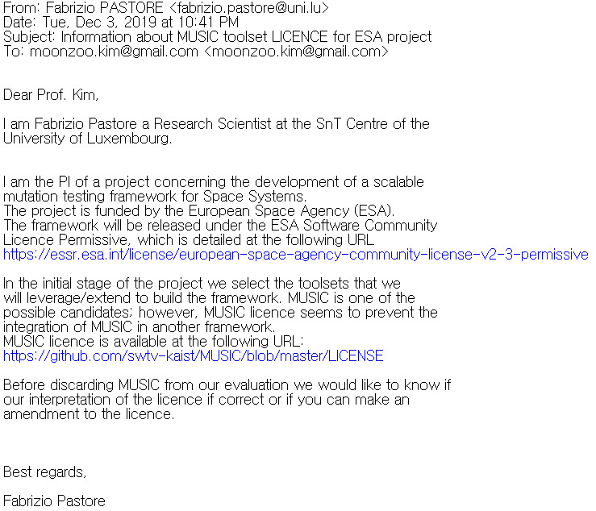
Contributions (1/2)
I have developed MUSIC, a highly configurable and easy-to-extend mutation tool targeting modern, complex, real-world C programs.
A paper about MUSIC has been published at ICSTW18
“MUSIC: Mutation Analysis Tool with High Configurability and Extensibility”
MUSIC is available at https://github.com/swtv-kaist/MUSIC and has been applied in a number of mutation researches. (3 forks on Github)
I have performed a case study to compare MUSIC against Milu, Proteum on 7 C programs in Siemens benchmarks and a modern real-world C program cURL
The results showed that MUSIC has high applicability and generates no stillborn mutant while 38% and 4% of mutants generated by Milu and Proteum are stillborn mutants.
Proteum fails to generate mutants for cURL
Notes:
The contributions of my thesis are as follow
*READ 1*
MUSIC is available at … and has been applied in a number of researches.
Recently, we have also been also contacted by Researcher from University of Luxembourg to discuss using MUSIC in their commercial project funded by European Space Agency.
To evaluate MUSIC, I have … *READ*

Slide 12
Contribution (2/2)
I have proposed the idea of fine-grained mutation operators to improve mutant reduction in terms of cost and accuracy.
I have developed REFINER, a new technique that learns an accurate and cost-efficient model of fine-grained mutation operators to predict hard-to-kill mutation score.
I have conducted experiments on 6 real-world C programs to evaluate REFINER and show that REFINER outperforms existing mutant reduction techniques.
REFINER predict hard-to-kill mutation score accurately ($MSE=0.011$) while reducing 98% of generated mutants on average.
REFINER predicts hard-to-kill mutation scores 4.5, 4.4, 4.3 times more accurate than random selection, Offutt et al.’s, and SSDL-only, respectively
Notes:
Thirdly, I have proposed …
I have developed REFINE, *READ*
Lower MSE indicates more accurate prediction, while higher reduction ratio indicates that the technique is more efficient.

Slide 13
REFINER in Detail

Slide 14
Mutation Operator-based Mutant Reduction
Set of Mutation Operators O
(e.g. {OASN, SSDL,…})
Too many mutants
O
Set of Mutants M generated by O
O
O
O
O
O
O
O
O
Program P
O
O
O
$MS(T) =$ $\frac{\#mutants in M killed by T}{\#mutants in M}$
Test Suite T
Mutant Execution
$$MS(T)≈MS′(T)$$
Subset of Mutation Operators O’ $⊂$ O
Accurately estimate $MS(T)$ using much less mutants
O
Set of Mutants M’ generated by O’
Program P
O
O
O
Test Suite T
Mutant Execution
MS’(T) = Formula(killmap(M’, T))
Notes:
This is the classical method of applying mutation analysis to evaluate a test suite T of program P.
We apply a set of mutation operators O on target program P to generate a set of mutants M.
And then we execute these mutants against T and measure Mutation Score of T using this formula.
However, as I have explained before too many mutants are generated which make this process impractical.
Mutation operator based technique suggest to use a small subset of mutation operators O’.
With a small O’, we only generate few mutants in M’, we execute a small number of mutants and apply some proposed formula MS’(T) to predict the mutation score accurately using much less mutants.
What REFINER does is to use machine learning to learn a small subset of operators, and a formula which use O’ to predict MS accurately.

Slide 15
Example – Existing Mutation Operator-based Mutant Reduction Technique
Set of Mutation Operators O
KillMap
Mutant | Operator Used | Test Suite T
 |  | Test 1 | Test 2 | Test 3
$$m_{1}$$ | $$SSDL$$ | 0 | 0 | 0
$$m_{2}$$ | $$SSDL$$ | 1 | 0 | 0
$$m_{3}$$ | $$OAAN$$ | 0 | 1 | 1
$$m_{4}$$ | $$ORRN$$ | 0 | 0 | 0
$$m_{5}$$ | $$OLLN$$ | 0 | 1 | 0
Program P
$$MS(T) = \frac{\#mutants in M killed by T}{\#mutants in M}$$
$=\frac{3}{5}=0.6$
Test Suite T
Accurately estimate MS(T) using only 2 mutants instead of 5 mutants
$$O^{′}=\left\{SSDL\right\}$$
SSDL
Mutant | Operator Used | Test Suite T
 |  | Test 1 | Test 2 | Test 3
$$m_{1}$$ | $$SSDL$$ | 0 | 0 | 0
$$m_{2}$$ | $$SSDL$$ | 1 | 0 | 0
$MS’\left(T\right)=MS_{SSDL}\left(T\right)$
$$=\frac{\begin{aligned}\#\#\#\#\#\#\#\#SSDL mutants \\ killed by T\end{aligned}}{\#SSDL mutants}=\frac{1}{2}=0.5$$
Program P
Test Suite T
Notes:
POINT AND EXPLAIN (KILLMAP EXPLANATION: THIS MUTANT GENERATION DIFFERENT OUTPUT FROM PROGRAM SO IT IS DETECTED/KILLED BY TEST CASE X)
This is the classical way to calculate MS of T. we apply set of operators O to P and generate 5 mutants, m1 to m5.
And then we execute 5 mutants on T and generate this kill map. So if a cell is 1, then a mutant is killed by a test case.
Now with this killmap we calculate MS of T using this formula. #mutants in M is 5. #mutants killed is 3. so 0.6
While this is a small example but executing 5 mutants to me still takes so long so I want to reduce it.
And a scientist named Deng suggest I can just use SSDL operator.
So that instead of using all operators in O, I will apply only SSDL on P. and again, I execute mutants on test suite. But this time, only 2 of them.
Then I use this formula MSSSDL to calculate MS’(T) and estimate MS(T), the formula is as follow and the estimated value is 0.5, which is quite close to the actual MS and I only have to use 2 mutants instead of 5.

Slide 16
REFINER Overview
Training Phase
Input: set of progs, test suites, set of ops O
Output:
$O′$: subset of mutation operators
$MS′(T)$: a function to calculate $MS(T)$ using mutants of $O^{′}$
$$MS_{Q}\left(T\right)=\frac{\#mutants generated by op. Q, killed by T}{\#mutants generated by op. Q}$$
Deployment Phase
Input: program P, test suite T, $O′$, $MS′(T)$
Output:
Predicted Mutation Score of T
Only generate mutants of $O’$
Calculate $MS_{Q}(T)$ for all $Q∈O′$
Apply $MS^{′}\left(T\right)$ to predict $MS(T)$
Notes:
This figure shows an overview of REFINER
It includes 2 phases, similar to framework to a machine learning problem: a training phase and a deployment phase (also called testing phase)
The training phase takes as input a set of programs and test suites, and a set of mutation operators O.
Then I conduct model training to learn a small subset O’ of mutation operators, and a linear function which utilizes O’ for predict mutation score.
In this figure here we have the output subset O’ and we have the formula to predict mutation score having this form.
C and b are constants. While MSq1 MSqL are defined by this equation. If you guys remember, this is a similar equaltion with MSSSDL on the previous slide.
So now I have this outputs and I can apply them to predict mutation scores of new test suite of new program.
In the testing phase, given a program P and a test suite T, instead of running mutation analysis on all mutants, we generate mutants using only mutation operators in O’. Then, we execute the mutants and calculate MSq(T) for each operator in O’. And apply the linear function to predict MS(T)

Slide 17
REFINER Training Process
Step 1: Conduct mutation analysis on each program in training data
Step 2: Generate input data for CLARS
$MS\left(T\right)=\frac{\#mutants generated by all ops, killed by T}{\#mutants generated by all ops}$
$MSQ(T) = \frac{\#mutants generated by op. Q, killed by T }{\# mutants generated by op. Q}$
Cost = #mutants generated by each operator
Step 3: Apply CLARS to generate model ($MS′(T)$) and subset of operators
Set of progs & test suites
Set of Mut. Op.
Notes:
Next I am going to explain more details about the training phase of REFINER. It has 3 steps.
In the first step, I conduct mutation analysis on each input target program and their test suite to generate killmaps.
In this figure KM1 is the generated killmap of program P1 and test suite TS1, in which m1 is killed by test case 1 and mutant 2 is killed by test case 2.
Similarly, KMN is the generated killmap for program PN and test suite TSN.
In the second step, I generate 3 inputs for my model training algorithm CLARS.
The first input is matrix MS, which contains what I want to predict, mutation score of test suites using all mutant. MS is calculated using this formula. *READ*
The second input is matrix MSQ, which contains the values of variables which will be used to predict MS. Each cell of MSQ is calculated using this formula *READ*
Lastly, I want to select a subset of operators that generate small number of mutants, so I give CLARS an additional input cost matrix, which contains *READ*
In the third step, I run CLARS with 3 generated inputs to generate outputs for the training phase.

Slide 18
Example
Training Phase
 | MS_{Q} | Q₁ |  |  | Q₂ |  |  | Q₃
 |  | Q₁₁ | Q₁₂ | Q₁₃ | Q₂₁ | Q₂₂ | Q₂₃ | Q₃₁ | Q₃₂ | Q₃₃
P1 | TS1-1 | 0.20 | 0.15 | 0.07 | 0.09 | 0.07 | 0.12 | 0.06 | 0.00 | 0.22
 | TS1-2 | 0.20 | 0.15 | 0.71 | 0.27 | 0.00 | 0.00 | 0.56 | 0.83 | 0.78
 | TS1-3 | 1.00 | 0.23 | 0.71 | 0.36 | 0.20 | 0.59 | 0.38 | 0.75 | 1.00
P2 | TS2-1 | 0.20 | 0.11 | 0.24 | 0.25 | 0.09 | 0.05 | 0.11 | 0.24 | 0.36
 | TS2-2 | 0.67 | 0.47 | 0.47 | 0.44 | 0.27 | 0.35 | 0.26 | 0.43 | 0.64
 | TS2-3 | 0.93 | 0.63 | 0.59 | 0.88 | 0.68 | 0.60 | 0.74 | 0.71 | 0.93
$$MS$$
0.10
0.36
0.54
0.17
0.43
0.73
CLARS
Reduced set of operators {Q₁₁,Q₂₁,Q₃₃}
$${MS}^{′}\left(T\right)=0.07 {MS}_{Q_{11}}+0.34 {MS}_{Q_{21}}+0.31 {MS}_{Q_{33}}+0.024$$
 | Q₁₁ | Q₁₂ | Q₁₃ | Q₂₁ | Q₂₂ | Q₂₃ | Q₃₁ | Q₃₂ | Q₃₃ | Total
$$cost$$ | 25 | 32 | 31 | 27 | 37 | 37 | 35 | 33 | 23 | 280
Testing Phase
Evaluate prediction accuracy:
Mean Squared Error MSE = $\frac{\sum_{TS}{{\left(MS\left(TS\right)−MS^{′}\left(TS\right)\right)}^{2}}}{\#TS}$ = 0.005
 | W | O₁₁ | O₁₂ | O₁₃ | O₂₁ | O₂₂ | O₂₃ | O₃₁ | O₃₂ | O₃₃
P3 | TS3-1 | 0.00 | 0.17 | 0.22 | 0.26 | 0.18 | 0.33 | 0.15 | 0.09 | 0.09
 | TS3-2 | 0.65 | 0.00 | 0.44 | 0.21 | 0.65 | 0.67 | 0.23 | 0.18 | 0.48
 | TS3-3 | 0.05 | 0.57 | 0.33 | 0.53 | 0.29 | 0.71 | 0.73 | 0.32 | 0.87
$$MS$$
0.17
0.38
0.50
$MS$’
0.14
0.29
0.47
MS Prediction
 | O₁₁ | O₁₂ | O₁₃ | O₂₁ | O₂₂ | O₂₃ | O₃₁ | O₃₂ | O₃₃ | Total
$$cost$$ | 20 | 23 | 27 | 19 | 17 | 21 | 26 | 22 | 23 | 198
Evaluate reduction ratio:
Reduce Ratio = $1−\frac{20+19+23}{198}$ = $0.69$
Actual MS vs Predicted MS
Notes:
POINT AND EXPLAIN
This slide shows an example demonstrating how REFINER works.
After step 2 of training phase, i obtain 3 inputs matrices for CLARS: MS, MSQ and cost.
The set of all operators contains 9 fine-grained mutation operators: Q11 to Q33, which were created from a set of 3 coarse grained mutation operator Q1 Q2 Q3.
After applying CLARS, I obtain the following outputs:
*READ*
In the testing phase, when given a new program P3, I only generate mutants for these 3 selected operators, calculate MSQ for each test suite and each operator, and apply the formula to predict MS.
*READ how to calculate MS’ for TS1*
To evaluate my technique, I need to measure prediction accuracy and reduction ratio.
For prediction accuracy, I calculate the actual MS of each TS using mutants generated by all 9 operators. And compare it with the predict MS using mean squared error.
MSE is the average of squared difference between the actual and predict MS.
*READ how to get 0.005*
For reduction ratio, my technique used 3 operators, each generate 20, 19 and 23 mutants. 9 oeprators generates 198 mutants. Hence the reduction ratio is 69%

Slide 19
Experiments and Results

Slide 20
Research Questions
RQ1. Correlation between fine-grained mutation operators vs Correlation between coarse-grained mutation operators
In linear regression, if the variables (mutation operators) are less correlated with each other, then the algorithm may produce a more accurate model.
RQ2. Effect of the fine-grained mutation operators on REFINER
How much do fine-grained mutation operators affect the number of selected mutants and the accuracy (MSE) of generated models compared to coarse-grained mutation operators?
RQ3. Comparison of REFINER with random mutant selection
RQ4. Comparison of REFINER with existing mutation-operator based mutant selection techniques
Notes:
Here are my research questions.
RQ1 compares the correlation between fine-grained muitation oeprators and coarse-grained mutation operators.
In linear regression, if the variables are less correlated with each other, then the algorithm may produce more accurate model.
RQ2 compare the prediction accuracy and reduction ratio of applying REFINER to select a subset of fine-grained mutation operators, comparing to REFINER selecting a subset of coarse-grained mutation operators?
RQ3 and 4 compares REFINER with existing techniques: random selection, Offutt and ssdl

Slide 21
Target Programs
MUSIC is applied to generate mutants for 6 SIR programs
Why? They contain various C language features: floating-point arithmetic, pointer arithmetic, loops, switch-case, and structs
Mutants killed by less than 3%, 5%, 7% of available test suite are hard-to-kill-3%, hard-to-kill-5% and hard-to-kill-7% , respectively
I targeted hard-to-kill mutants because they are more valuable for measuring quality of test suite
Prog. | LoC | #tests | #mutants | #hard-to-kill k% mutants
 |  |  |  | $$k=3$$ | $$k=5$$ | $$k=7$$
flex | 7254 | 567 | 1146413 | 312561 | 337336 | 347732
grep | 5696 | 809 | 187913 | 78929 | 86532 | 95984
gzip | 3040 | 208 | 371289 | 107033 | 114904 | 198787
make | 9820 | 1006 | 282328 | 169702 | 172148 | 173035
sed | 3980 | 360 | 72187 | 11064 | 16290 | 20264
space | 5489 | 13585 | 108598 | 55377 | 61075 | 65137
Average | 5879.8 | 2755.8 | 361454.7 | 122444.3 | 131380.8 | 150156.5
Notes:
MY experiments target 6 SIR programs: *naming*
Their numbers of lines of code, number of tests and number of generated mutants are shown in the table
MUSIC is applied …
In my thesis I target predicting hard-to-kill mutation score.
To identify hardtokill mutants i used the following definitions: *READ*
I targeted htk mutants because they are more valuable for measuring the quality of test suite.

Slide 22
Techniques to Compare
Technique | Description
REFINER | Apply REFINER with input set of ops $O$ = {fine-grained mutation operators}
REFINER^{TRD} | Apply REFINER with input set of ops $O$ = {coarse-grained mutation operators}
RND^{SN} | Randomly selects the same number of mutants generated by REFINER
E-SELECTIVE | 4 C mutation operators corresponding to Offutt et al.’s selective mutation operator set OAAN: (a + b) → (a – b) ORRN: (a > b) → (a == b) OLLN : (a && b) → (a || b) OLNG: if (cond) → if (!condition)
SSDL | Use only SSDL mutants
Notes:
Here are the techniques to be compared in my experiments.
REFINER is the original technique which applies REFINER with input set of fine-grained mutation operators
REFINERTRD applies REFINER with input set of coarse-grained mutation operators.
RNDSN is the existing technique random selection. Here I randomly selects the same number of mutants generated by REFINER.
E-SELECTIVe is Offutt selective operator set which includes the following 4 operators. *DESCRIBE WITH FOR EXAMPLE*
Lastly, SSDL uses only SSDL mutants

Slide 23
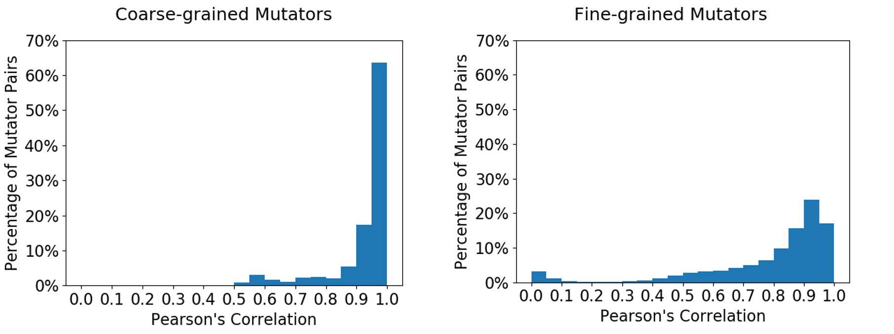
Results - RQ1
Coarse-grained mutation operators are more highly correlated to each other than fine-grained mutation operators.
Using Fine-grained mutation operators may help REFINER produce more accurate models.
E.g.: results of Make
Results of other programs show similar pattern.
~80%
~40%
Higher Pearson → More Correlated
Notes:
For RQ1 I measure the Pearson correlation between each pair of operators.
The higher the pearson correalation, the more correlated the pair of operators is.
This 2 figures show the result for Make program.
The figure on the left show the distribution of Pearson correlation of pairs of coarse grained operators and the right figure shows that of pairs of fine-grained operators.
80% of coarse grained operator pairs are highly correlated while only 40% of fine-grained oeprators pairs are highly correlated.
This pattern is similar in other programs as well.
So I conclude that coarse grained … *READ*

Slide 24
Results - RQ2
REFINER selects much fewer mutants (5.3 times) and achieves more accurate prediction (3.1 times) of hard-to-kill mutation scores than REFINER^{TRD}
Similar trends are observed in results of Hard-to-kill 3% and 7%
 | Target Programs | REFINE^{TRD} |  |  | REFINER
 |  | #selected mutants | %selected mutants | MSE | #selected mutants | %selected mutants | MSE
Hard-to-kill 5% | flex | 9718 | 0.8% | 0.016 | 9806 | 0.9% | 0.013
 | grep | 30000 | 16.0% | 0.008 | 5172 | 2.8% | 0.007
 | gzip | 13593 | 3.7% | 0.053 | 1285 | 0.3% | 0.025
 | make | 39973 | 14.2% | 0.073 | 7328 | 2.6% | 0.002
 | sed | 19028 | 26.4% | 0.043 | 1262 | 1.7% | 0.015
 | space | 37944 | 34.9% | 0.012 | 3454 | 3.2% | 0.002
 | Average | 25042.7 | 6.9% | 0.034 | 4717.8 | 1.3% | 0.011
Notes:
POINT AND EXPLAIN

Slide 25
Results - RQ3 & RQ4
REFINER can predict hard-to-kill mutation scores more accurately (4.5, 4.4, 4.3 times) than RND^{SN}, E-SELECTIVE and SSDL.
Despite using more mutants than SSDL and E-SELECTIVE, REFINER uses less than 2% of generated mutants
 | Target Programs | RND^{SN} |  |  | E-SELECTIVE |  |  | SSDL |  |  | REFINER
 |  | #selected mutants | %selected mutants | MSE | #selected mutants | %selected mutants | MSE | #selected mutants | %selected mutants | MSE | #selected mutants | %selected mutants | MSE
Hard-to-kill 5% | flex | 9806 | 0.9% | 0.052 | 1820 | 0.2% | 0.059 | 1372 | 0.1% | 0.051 | 9806 | 0.9% | 0.013
 | grep | 5172 | 2.8% | 0.035 | 3315 | 1.8% | 0.020 | 1604 | 0.9% | 0.030 | 5172 | 2.8% | 0.007
 | gzip | 1285 | 0.3% | 0.116 | 1989 | 0.5% | 0.119 | 852 | 0.2% | 0.100 | 1285 | 0.3% | 0.025
 | make | 7328 | 2.6% | 0.043 | 4385 | 1.6% | 0.035 | 2630 | 0.9% | 0.040 | 7328 | 2.6% | 0.002
 | sed | 1262 | 1.7% | 0.049 | 1912 | 2.6% | 0.045 | 972 | 1.3% | 0.055 | 1262 | 1.7% | 0.015
 | space | 3454 | 3.2% | 0.007 | 2564 | 2.4% | 0.008 | 2074 | 1.9% | 0.008 | 3454 | 3.2% | 0.002
 | Average | 4717.8 | 1.3% | 0.050 | 2664.2 | 0.7% | 0.048 | 1584.0 | 0.4% | 0.047 | 4717.8 | 1.3% | 0.011
Notes:
POINT AND EXPLAIN

Slide 26
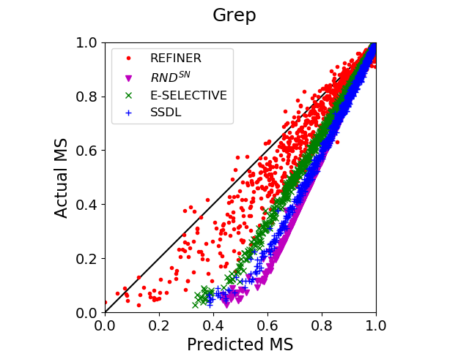
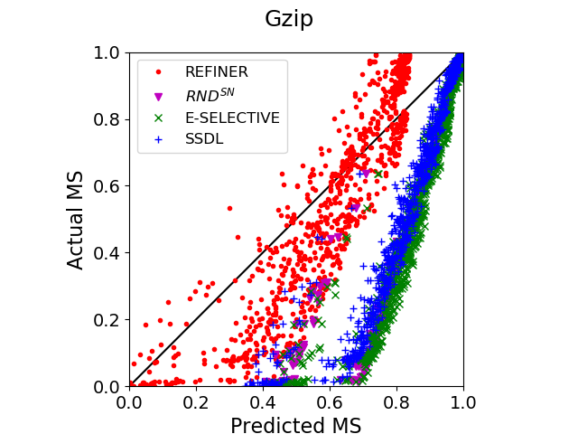
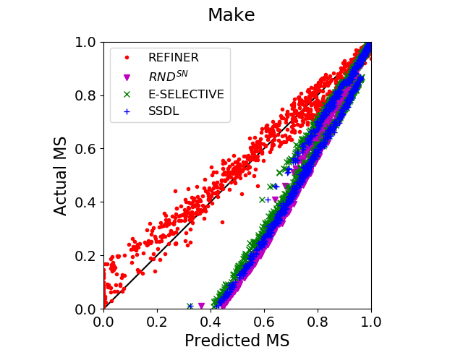
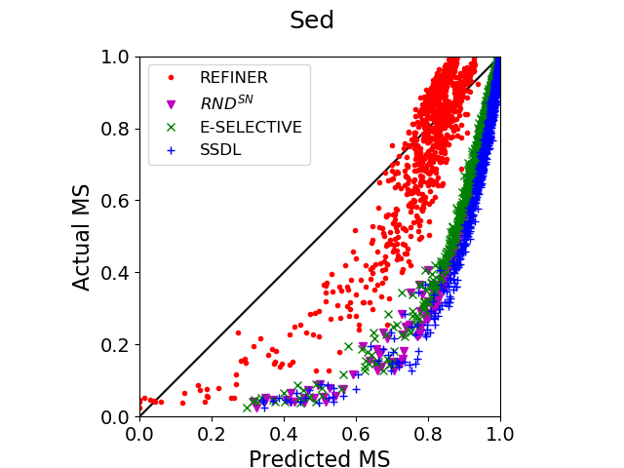
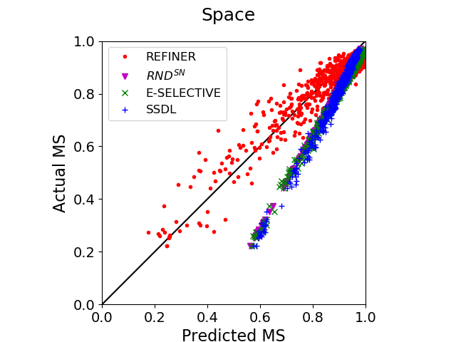
RQ3 & RQ4 Results Illustration
If a point is closer to $y=x$ line, the prediction is more accurate.
Notes:
POINT AND EXPLAIN

Slide 27
Conclusion

Slide 28
Conclusion
Fine-grained mutation operators refined from coarse-grained mutation operators can improve mutant reduction technique practically
I have developed MUSIC, a practical mutation tool for modern, complex C programs and showed that MUSIC has higher applicability and generates no stillborn mutants comparing to existing tools, Proteum and Milu
Case study is conducted on Siemens programs and cURL
I have developed REFINER, a fine-grained mutation operator based mutant reduction technique to predict hard-to-kill mutation score accurately and efficiently
Experiments on 6 SIR programs show that REFINER selects less than 2.0% of generated mutants on average and achieves lowest prediction error compared to existing techniques.
Notes:
MUSIC helps implementing fine-grained operators easily.

Slide 29
Future Work
Apply MUSIC to larger, more complex C projects to evaluate its applicability further
Provide more diverse mutation operators for various software analysis tasks
Develop program semantics based mutant reduction heuristics and combine with REFINER to improve mutant reduction furthermore
Apply REFINER to select mutants for mutation based fault localization, test case generation

Slide 30
Q & A

Slide 31
Mutation Analysis Overview

Slide 32
Mutation Analysis – Overview (1/3)
void f(int a, int b)
{
if (a == 2) {
if (b >= 2) {
print(“pass”);
}}
}
Mutation analysis generates many variants of a program by applying a set of syntactic code changes
Mutant = a variant of a program
Mutation Operator = syntactic code change
Ex: 3 mutation operators are applied to generate 3 mutants for function f
Cccr: mutate constant to constant
ORRN: mutate operator to operator
SSDL: delete a statement
Cccr
Mutant 1
Target Program
void f(int a, int b)
{
if (a == 1) {
if (b >= 2) {
print(“pass”);
}}
}
void f(int a, int b)
{
if (a == 1) {
if (b < 2) {
print(“pass”);
}}
}
ORRN
Mutant 2
SSDL
void f(int a, int b)
{
if (a == 1) {
if (b >= 2) {
;
}}
}
Mutant 3
Notes:
The first step of Mutant Analysis is to generate variants of a program by applying a set of syntactic code changes on a target program.
In Mutant Analysis, a variant of a target program is called a Mutant; a syntactic code change is called a Mutation Operator
Lets look at this example. Here we have target program with 1 function f which takes 2 integers a and b as input.
I can apply 3 different mutation operators to 3 locations in f to generate 3 mutants.
Operator cccr represents the syntactic code change from a constant to another constant. In this case, from 1 to 2. which creates mutant #1
Operator ORRN mutates a relational operator to another relational operator. From >= to < which creates mutant #2
Operator SSDL delete a statement by mutating it to a null statement. Statement print(pass) is deleted to makes mutant #3

Slide 33
Mutation Analysis – Overview (2/3)
Mutation analysis runs test suites on the mutants, and analyzes the output difference between the original program and the mutants.
A mutant m is killed by a test set T if for some test case t $∈$ T, the output of m is different from that of the original program.
Mutant 1 is killed by Test 2
Mutant 2 is killed by Test 3
Mutant 3 is not killed by any test
Test 1
PASS
Original Program
Test 2
PASS
Test 3
PASS
Test 1
PASS
Mutant 1
Test 2
FAIL
KILLED
Test 3
PASS
Mutant 2
Test 1
PASS
Test 2
PASS
Test 3
FAIL
KILLED
Test 1
PASS
Mutant 3
Test 2
PASS
Test 3
PASS
Notes:
Step 2 mutation analysis run test suites on the mutants and analysis the output difference between the original program and each mutant.
On the previous slide we generate 3 mutants for target program.
Now assume target program has a test suite of 3 test cases.
Then in this step of mutation analysis, we execute 3 test cases against the original program and each mutant and record the results
Mutant 3 produces exactly the same results while mutant 1 and 2 differ from the original program in 1 test case each
In this case, we say mutant 1 is killed by test 2 and mutant 2 is killed by test 3.
Or we can say mutant 1 and 2 is killed by the given test suite.

Slide 34
Mutation Analysis – Overview (3/3)
The output of mutation analysis is the following table called the killmap.
Each row represents a mutant
Each column represents a test case
The last column represents the whole test suite (all test cases)
A cell (i, j) is:
0 if mutant i is not killed by test j
1 if mutant i is killed by test j
 | Test 1 | Test 2 | Test 3 | Test Suite T
Mutant 1 | 0 | 1 | 0 | 1
Mutant 2 | 0 | 0 | 1 | 1
Mutant 3 | 0 | 0 | 0 | 0
The quality of a test suite can be measured using mutation score.
$MS\left(Test Suite T\right)=\frac{\#mutants killed by T}{\#mutants generated}$
Example: in the above killmap, $MS\left(T\right)=\frac{2}{3}$
Notes:
The last step of mutation analysis is to create the following table called the killmap based on results of previous step.
In the killmap, each row represents a mutant, each column represents a test case.
I add an additional column at the end representing the whole test suite
So if mutant i is killed by test j then that cell value is 1, otherwise it is 0.
With this killmap we can now apply mutation analysis into aspects of software testing.
One of which is test suite quality evaluation.
So to evaluate a test suite T, we calculate the mutation score of T which is the ratio of #mutants killed by T over #mutants generated.
In case of the killmap above, mutation score of T is 2/3
The higher the MS is, the better a test suite is.

Slide 35
MUSIC in Detail

Slide 36
MUSIC Overview
MUSIC is a mutant generation tool for C programs with high extensibility, configurability, and applicability
Extensibility: It is easy implement a new mutation operator
Configurability: A user can specify domains and ranges of mutation operators as well as code ranges to be mutated
Applicability: MUSIC can generate mutants of a large complex C project automatically
In addition, MUSIC avoids stillborn mutant generation using type checking
MUSIC is implemented using Clang/LLVM 7.0 and supports 108 C mutation operators defined by Agrawal et al. and Delamaro et al.
Clang/LLVM 7.0 supports compiling, parsing C source code following C standards upto C18 (most recent)

Slide 37
MUSIC Overview
Input: C source code(s) with a build script and configuration
Output: Mutants and a mutant DB
Mutant DB: set of pairs of mutant id and information for the mutation
C code
MUSIC
Mutants
Mutation
Operators
Mutation ID
Mutation point
Mutation operator
Target tokens
New tokens
C parser
Build
script
OAAN
OLLN
Mutant
DB
Conf. parser
ORRN
…
Configuration

Slide 38
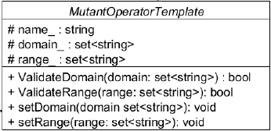
Extensibility of MUSIC
A new mutation operator may extend StmtMutantOperator or ExprMutantOperator
User have to implement only two following functions in ~50 LoC
IsMutationTarget(): Checking a current AST node is a right target to mutate
Mutate(): Generating mutants

Slide 39
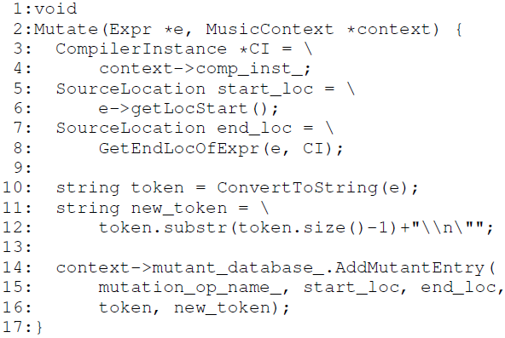
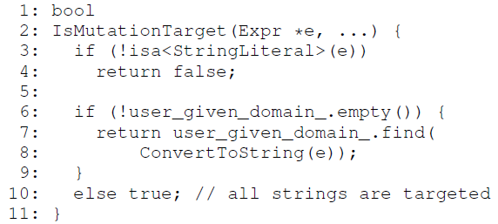
Example
String Add New Line (SANL) mutation operator adds ‘\n’ to the end of any string and can be implemented in 28 LoC
IsMutationTarget() checks a given expression is a string literal (11 LoC)
Mutate() generates mutants (17LoC)
Retrieve string literal and adds ‘\n’
Add the new mutant to mutant database

Slide 40
Configurability of MUSIC
MUSIC provides mainly four options for mutation configuration
-m mut_op[:A[:B]]:
mut_op: mutation operator type
A: a set of mutation domains
B: a set of mutation ranges
Ex. -m OAAN:{*}:{+,-}: replace all occurrences of * with + and -
-rs <filename>:<line>[:<col>]:
to specify a starting position of a target mutation range
Ex. -rs source.c:10:1
-re <filename>:<line>[:<col>]:
to specify a ending position of a target mutation range
Ex. -re source.c:20:80
-l max_num:
max. # of mutants generated per mutation point and mutation operator

Slide 41
Avoid Generation of Stillborn Mutants
It is a serious problem that a mutation tool generates a large number of stillborn mutants since it wastes large computing resources.
MUSIC avoids stillborn mutant generation by performing type checking
Previous tools apply OAAN W/O
type checking
q = p - 1;
q = p * 1;
q = p / 1;
q = p % 1;
Stillborn mutants
(A pointer {*,/,%} an integer are not allowed in C)
1 int f(int x)
2 {
3 int *p, *q;
4 q = p + 1;
5 …
q = p - 1;
No stillborn mutant is generated
MUSIC applies OAAN W/ type checking

Slide 42
Case Study: Siemens Benchmarks and cURL

Slide 43
Results
Target Program | LOC | Mutation Tool | #Gen. Mutants | #Stillborn Mutants | %Stillborn Mutants
printtokens | 343 | Milu | 3077 | 995 | 32.34
 |  | Proteum | 4273 | 200 | 4.68
 |  | MUSIC | 11274 | 0 | 0.00
printtokens2 | 355 | Milu | 2424 | 523 | 21.58
 |  | Proteum | 4680 | 162 | 3.46
 |  | MUSIC | 4791 | 0 | 0.00
replace | 513 | Milu | 3927 | 353 | 8.99
 |  | Proteum | 10872 | 509 | 4.68
 |  | MUSIC | 9925 | 0 | 0.00
schedule | 296 | Milu | 1310 | 640 | 48.85
 |  | Proteum | 2241 | 103 | 4.60
 |  | MUSIC | 2365 | 0 | 0.00
schedule2 | 263 | Milu | 1919 | 915 | 47.68
 |  | Proteum | 2950 | 114 | 3.86
 |  | MUSIC | 3033 | 0 | 0.00
tcas | 137 | Milu | 874 | 271 | 31.01
 |  | Proteum | 2872 | 74 | 2.58
 |  | MUSIC | 3415 | 0 | 0.00
totinfo | 281 | Milu | 2381 | 996 | 41.83
 |  | Proteum | 6390 | 122 | 1.91
 |  | MUSIC | 10486 | 0 | 0.00
cURL | 12,753 | Milu | 41,470 | 31,232 | 75.31
 |  | Proteum | N/A | N/A | N/A
 |  | MUSIC | 1,035,088 | 0.0 | 0.00
MUSIC generates mutants for Siemens and cURL with no stillborn mutants
Milu generated mutants with 29.5% and 75.3% stillborn mutants for Siemens and cURL
Proteum could not parse cURL source code because cURL code follows modern C standard (>C89)
I have manually modified more than 20 lines in cURL source codes in an attempt to resolve the issue but Proteum still fails.

Slide 44
CLARS explanation

Slide 45
Cost-considerate Least Angle Regression (CLARS)
Independent Variables
$$\left[\begin{matrix}x_{1} & x_{2} & x_{3}\end{matrix} \begin{matrix}… & x_{n}\end{matrix}\right]$$
$$c_{1}x_{1}+c_{2}x_{2}+…+c_{n}x_{n}+b=Y′$$
such that:
Minimize $\left|Y−Y′\right|$
Minimize $\sum_{selected variables}{cost_{i}}$
A variable $x_{i}$ is selected by the model if $c_{i}≠0$
CLARS
Cost Vector $\left[\begin{matrix}{cost}_{1} & {cost}_{2} & {cost}_{3}\end{matrix} \begin{matrix}… & {cost}_{n}\end{matrix}\right]$
LINEAR REGRESSION
Dependent Variable
$$Y$$
In mutant reduction problem
$Y$ : MS of test suites w.r.t. all mutants
$x_{i}$ : MS of test suites w.r.t. mutants generated by mut. op. $i$
$cost_{i}$ : number of mutants generated by mut. op. $i$
Notes:
Next I would like to briefly explain the difference between classical linear regression and cost-considerate linear regression (CLARS)
Classical linear regression, takes as input a list of independent variables and a dependent variable, and it output a formula to calculate Y’ from the independent variables, which estimate Y as accurately as possible. In other words, the algorithm attempts to minimize the absolute difference between Y and Y’
Cost-considerate linear regression, takes an additional input, variable cost. And attempts to minimize not only the difference between Y and Y’ but also the total cost of the selected variables.
Which makes this algorithm suitable for the mutant reduction problem.

Slide 46
Fine-grained Mutation Operator

Slide 47
Fine-grained Mutation Operator - Conjecture
Coarse-grained Mutation Operator
$x_{i}$: mutation score of test suite w.r.t. mutants generated by coarse-grained mutation operator $i$
Traditional, coarse-grained mutation operators may be similar/redundant to each other.
Independent variables $x_{i}$ are highly correlated.
Fine-grained Mutation Operator
$x_{i}$: mutation score of test suite w.r.t. mutants generated by fine-grained mutation operator $i$
Fine-grained mutation operators may be more distinct to each other.
Independent variables $x_{i}$ are less correlated.
CLARS can explore more diverse combinations of mutation operators → Higher chance to identify more accurate, more efficient model.
Result of RQ1 confirms that the conjecture is correct.
Notes:
Given all that overview, why does fine-grained mutation operator help?
My conjecture for developing and using fine-grained mutation operator is as follow:
Traditional, coarse-grained mutation operators may be similar/redundant to each other. In a sense that, many mutants generated by operator A and operator B may be killed by the a similar set of tests. This makes the mutation scores calculated using mutants of A and B to be highly correlated.
In other words, if we use coarse-grained mutation operators, the independent variables xi are highly correlated.
On the other hands, if I can break down coarse-grained mutation operators into a set of fine-grained mutation operators that are more distinct to each other, the independent variables xi will become less correlated. This means that CLARS can explore more diverse combinations of mutation operators and along with that a higher chance to identify a more accurate and more efficient model.
For now, this remains a conjecture. Later through RQ1, I will show that the conjecture is correct. Fine-grained mutation operators are more distinct and less correlated than coarse-grained operators.

Slide 48
Fine-grained Mutation Operator - Definition
Divide into n partitions
Each pair of (D_{i}, R_{j}) forms a new fine-grained mutation operator
Divide into m partitions
Domain of
a Coarse-grained Mut. Op. O_{coarse}
D₁
R₁
Range of
a Coarse-grained Mut. Op. O_{coarse}
D₂
R₂
D₃
D_{n}
R_{m}
O_{coarse}
Notes:
Given a coarse-grained mutation operator O_coarse, this is how I divide it into a set of fine-grained mutation operators.
Depending on the category of the domain and range of O_coarse, I partition its domain into n partitions and its range into m partitions.
There is no overlaps between each partitions and their union is O_coarse domain or range.
Each pair of domain and range partitions will form a new fine-grained mutation operator.
As you can see, O_coarse and the set of newly created fine-grained muitation operators generate the same number of mutants.
and each fine-grained mutation operator generates a much smaller number of mutants than O_coarse, this opens up an opportunity for a more efficient CLARS model.
Next, I will talk about categories of domain and range and the way to partition for each category

Slide 49
Partition Methods for Domain/Range
Category of Domain/Range | Partition Method | Example
A set of operators | Singleton sets of operators | OAAN: $\left\{+,−,∗, /,\%\right\}$ $$→\left\{+\right\},\left\{−\right\},\left\{∗\right\},\left\{/\right\},\left\{\%\right\}$$
A set of expressions | Singleton sets of expressions | VTWD: $\left\{x+1, x−1\right\}$ $$→\left\{x+1\right\},\{x−1\}$$
A set of variables | Sort in alphabetical order. Divide into N partitions whose size are (almost) equal. | CGSR: {set of all global vars} If N=10, $\{a,b,c,x,y,z\}$ $$\left\{a\right\},\left\{b\right\},\left\{c\right\},\left\{x\right\},\left\{y\right\},\left\{z\right\}$$ $$\{\},\{\},\{\},\{\}$$
A set of constants | Sort in ascending numerical order. Divide into N partitions whose size are (almost) equal. | CLCR: {set of all local consts} If N=5, $\{1,2,3,5,10,15\}$ $$\left\{1,2\right\},\left\{3\right\},\left\{5\right\},\left\{10\right\},\left\{15\right\}$$
A set of statements | {set of lines containing a stmt} Sort in ascending numerical order. Divide into N partitions whose size are (almost) equal. | If N=5, $\left\{4,5,7,8,11\right\}$ is set of lines with a stmt $$\left\{4\right\},\left\{5\right\},\left\{7\right\},\left\{8\right\},\left\{11\right\}$$
108 coarse-grained operators → 3711 fine-grained operators
Notes:
There are 5 types of domain or range.
A set of operators expressions variables constants or statements.
Operators and expressions has the same partition method. These domain or range are fixed across any programs for example arithmetic, relational operators, or add one, minus one.
For these two, I just divide them into set of 1 element as you have seen with the example of OAAN at the beginning of the slide
Variables constants and statements share the same partition method.
The set of token is first sorted in ascending numerical order for constant and statement, and in alphabetical order for variables.
After that, I divide the sorted set into N equal partitions.
Lets look at an example in the next slide

Slide 50
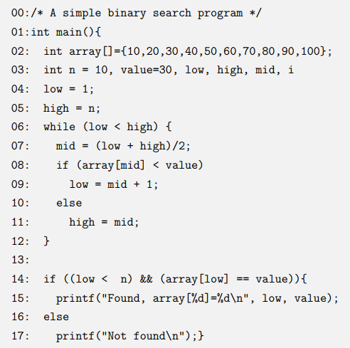
Example
CLSR mutates scalar variables to local constants.
Making partitions with N=10.
Domain
Range
high
i
low
mid
n
value
high
1,2
1
2
10
20
30
40
50
60
70
80
90
100
i
10,20
low
30
mid
40
n
50
value
60
70
80
90
100
100 fine-grained mut. op.
Notes:
Given this example code, operator CLSR mutates scalar variable to local constants
So the domain of CLSR in this example are these 6 variables
And its range are these 12 constants.
If I make 10 partitions, that means I have 100 fine-grained mutation operators.
And the elements in the domain and range will be assigned into the partitions as follow
For domain, we have 6 elements so only first 6 partitions contains element, the last 4 does not.
This means that any fine-grained operators created by mutating elements from these 4 partitions will generate 0 mutants.
For range, since we have 12 elements, the first 2 partitions will contains an extra element each.
Yeah and that is how I create fine-grained mutation operators.

Slide 51
Experiment Setup

Slide 52
Experiment Setup
Generate 1000 test suites for each program P with test suite T (given by SIR)
Generate 20 test suites randomly for each test suite size of $1\%×\left|T\right|,3\%×\left|T\right|,…,99\%×\left|T\right|$
For each target program P
Use other 5 programs and their 5000 TS as training data and P as testing data.
Apply CLARS on training data for 10 minutes
After 10 minutes, MSE of generated models almost converged (difference < 0.0005)
Select the model with lowest MSE w.r.t. training data
Evaluate selected model on 1000 TS of P using MSE and %selected mutants
Lower MSE and lower %selected mutants is better

Slide 53
RQ1-4 Full Results

Slide 54
Results - RQ2
 | Target Programs | REFINE^{TRD} |  |  | REFINER
 |  | #selected mutants | %selected mutants | MSE | #selected mutants | %selected mutants | MSE
Hard-to-kill 3% | flex | 195062 | 17.0% | 0.049 | 9062 | 0.8% | 0.072
 | grep | 55672 | 29.6% | 0.008 | 3846 | 2.0% | 0.037
 | gzip | 18882 | 5.1% | 0.040 | 912 | 0.2% | 0.034
 | make | 59272 | 21.0% | 0.129 | 6777 | 2.4% | 0.035
 | sed | 1363 | 1.9% | 0.016 | 1810 | 2.5% | 0.057
 | space | 57353 | 52.8% | 0.010 | 3821 | 3.5% | 0.005
 | Average | 64600.7 | 17.9% | 0.042 | 4371.3 | 1.2% | 0.040
Hard-to-kill 5% | flex | 9718 | 0.8% | 0.016 | 9806 | 0.9% | 0.013
 | grep | 30000 | 16.0% | 0.008 | 5172 | 2.8% | 0.007
 | gzip | 13593 | 3.7% | 0.053 | 1285 | 0.3% | 0.025
 | make | 39973 | 14.2% | 0.073 | 7328 | 2.6% | 0.002
 | sed | 19028 | 26.4% | 0.043 | 1262 | 1.7% | 0.015
 | space | 37944 | 34.9% | 0.012 | 3454 | 3.2% | 0.002
 | Average | 25042.7 | 6.9% | 0.034 | 4717.8 | 1.3% | 0.011
Hard-to-kill 7% | flex | 46440 | 4.1% | 0.031 | 20808 | 1.8% | 0.018
 | grep | 97274 | 51.8% | 0.002 | 4354 | 2.3% | 0.008
 | gzip | 1052 | 0.3% | 0.014 | 1412 | 0.4% | 0.006
 | make | 17468 | 6.2% | 0.001 | 3829 | 1.4% | 0.015
 | sed | 2880 | 4.0% | 0.007 | 1733 | 2.4% | 0.013
 | space | 1407 | 1.3% | 0.031 | 3662 | 3.4% | 0.002
 | Average | 27753.5 | 7.7% | 0.014 | 5966.3 | 1.7% | 0.010
REFINER selects much fewer mutants and achieves more accurate prediction of hard-to-kill mutation scores than REFINER^{TRD}

Slide 55
Results - RQ3
 | Target Programs | RND^{SN} |  |  | REFINER
 |  | #selected mutants | %selected mutants | MSE | #selected mutants | %selected mutants | MSE
Hard-to-kill 3% | flex | 9062 | 0.8% | 0.060 | 9062 | 0.8% | 0.072
 | grep | 3846 | 2.0% | 0.046 | 3846 | 2.0% | 0.037
 | gzip | 912 | 0.2% | 0.132 | 912 | 0.2% | 0.034
 | make | 6777 | 2.4% | 0.045 | 6777 | 2.4% | 0.035
 | sed | 1810 | 2.5% | 0.096 | 1810 | 2.5% | 0.057
 | space | 3821 | 3.5% | 0.010 | 3821 | 3.5% | 0.005
 | Average | 4371.3 | 1.2% | 0.065 | 4371.3 | 1.2% | 0.040
Hard-to-kill 5% | flex | 9806 | 0.9% | 0.052 | 9806 | 0.9% | 0.013
 | grep | 5172 | 2.8% | 0.035 | 5172 | 2.8% | 0.007
 | gzip | 1285 | 0.3% | 0.116 | 1285 | 0.3% | 0.025
 | make | 7328 | 2.6% | 0.043 | 7328 | 2.6% | 0.002
 | sed | 1262 | 1.7% | 0.049 | 1262 | 1.7% | 0.015
 | space | 3454 | 3.2% | 0.007 | 3454 | 3.2% | 0.002
 | Average | 4717.8 | 1.3% | 0.050 | 4717.8 | 1.3% | 0.011
Hard-to-kill 7% | flex | 20808 | 1.8% | 0.048 | 20808 | 1.8% | 0.018
 | grep | 4354 | 2.3% | 0.024 | 4354 | 2.3% | 0.008
 | gzip | 1412 | 0.4% | 0.029 | 1412 | 0.4% | 0.006
 | make | 3829 | 1.4% | 0.027 | 3829 | 1.4% | 0.015
 | sed | 1733 | 2.4% | 0.031 | 1733 | 2.4% | 0.013
 | space | 3662 | 3.4% | 0.005 | 3662 | 3.4% | 0.002
 | Average | 5966.3 | 1.7% | 0.027 | 5966.3 | 1.7% | 0.010
REFINER achieves much lower MSE than RND^{SN} while using the exact same number of mutants
REFINER achieves 1.6 times, 4.5 times, and 2.7 times lower MSE than RND^{SN} in predicting hard-to-kill 3%, 5%, 7% mutation scores respectively.

Slide 56
Results - RQ4
 | Target Programs | E-SELECTIVE |  |  | SSDL |  |  | REFINER
 |  | #selected mutants | %selected mutants | MSE | #selected mutants | %selected mutants | MSE | #selected mutants | %selected mutants | MSE
Hard-to-kill 3% | flex | 1820 | 0.2% | 0.068 | 1372 | 0.1% | 0.059 | 9062 | 0.8% | 0.072
 | grep | 3315 | 1.8% | 0.028 | 1604 | 0.9% | 0.040 | 3846 | 2.0% | 0.037
 | gzip | 1989 | 0.5% | 0.140 | 852 | 0.2% | 0.119 | 912 | 0.2% | 0.034
 | make | 4385 | 1.6% | 0.037 | 2630 | 0.9% | 0.042 | 6777 | 2.4% | 0.035
 | sed | 1912 | 2.6% | 0.091 | 972 | 1.3% | 0.105 | 1810 | 2.5% | 0.057
 | space | 2564 | 2.4% | 0.011 | 2074 | 1.9% | 0.011 | 3821 | 3.5% | 0.005
 | Average | 2664.2 | 0.7% | 0.063 | 1584.0 | 0.4% | 0.063 | 4371.3 | 1.2% | 0.040
Hard-to-kill 5% | flex | 1820 | 0.2% | 0.059 | 1372 | 0.1% | 0.051 | 9806 | 0.9% | 0.013
 | grep | 3315 | 1.8% | 0.020 | 1604 | 0.9% | 0.030 | 5172 | 2.8% | 0.007
 | gzip | 1989 | 0.5% | 0.119 | 852 | 0.2% | 0.100 | 1285 | 0.3% | 0.025
 | make | 4385 | 1.6% | 0.035 | 2630 | 0.9% | 0.040 | 7328 | 2.6% | 0.002
 | sed | 1912 | 2.6% | 0.045 | 972 | 1.3% | 0.055 | 1262 | 1.7% | 0.015
 | space | 2564 | 2.4% | 0.008 | 2074 | 1.9% | 0.008 | 3454 | 3.2% | 0.002
 | Average | 2664.2 | 0.7% | 0.048 | 1584.0 | 0.4% | 0.047 | 4717.8 | 1.3% | 0.011
Hard-to-kill 7% | flex | 1820 | 0.2% | 0.054 | 1372 | 0.1% | 0.046 | 20808 | 1.8% | 0.018
 | grep | 3315 | 1.8% | 0.012 | 1604 | 0.9% | 0.020 | 4354 | 2.3% | 0.008
 | gzip | 1989 | 0.5% | 0.032 | 852 | 0.2% | 0.022 | 1412 | 0.4% | 0.006
 | make | 4385 | 1.6% | 0.033 | 2630 | 0.9% | 0.037 | 3829 | 1.4% | 0.015
 | sed | 1912 | 2.6% | 0.028 | 972 | 1.3% | 0.036 | 1733 | 2.4% | 0.013
 | space | 2564 | 2.4% | 0.006 | 2074 | 1.9% | 0.006 | 3662 | 3.4% | 0.002
 | Average | 2664.2 | 0.7% | 0.027 | 1584.0 | 0.4% | 0.028 | 5966.3 | 1.7% | 0.010
REFINER can predict hard-to-kill mutation scores more accurately than SSDL and E-SELECTIVE
Despite using more mutants than SSDL and E-SELECTIVE, REFINER uses less than 2% of generated mutants

Slide 57
Hard-to-kill Mutant

Slide 58
Hard-to-kill Mutants
Hard-to-kill mutants are mutants that are killed by only a small portion of the test suite.
In my experiment, I define Hard-to-kill k% mutants as mutants killed by less than k% of test suite (given by SIR)
K = 3, 5, 7
REFINER targets hard-to-kill mutation score because it can assess fault detection capability of a test suite more accurately than the whole set of mutants
As shown in previous studies by Papadakis et al., Yao et al.

Slide 59
Example – Coarse-grained Operators
Training Phase
 | MS_{Q} | Q₁ | Q₂ | Q₃
P1 | TS1-1 | 0.14 | 0.09 | 0.08
 | TS1-2 | 0.38 | 0.07 | 0.70
 | TS1-3 | 0.62 | 0.40 | 0.65
P2 | TS2-1 | 0.18 | 0.12 | 0.22
 | TS2-2 | 0.53 | 0.34 | 0.43
 | TS2-3 | 0.71 | 0.71 | 0.78
$$MS$$
0.10
0.36
0.54
0.17
0.43
0.73
CLARS
Reduced set of operators {Q₁,Q₃}
$$0.81×MS_{Q_{1}}+0.16×MS_{Q_{3}}−0.03=MS′(T)$$
 | Q₁ | Q₂ | Q₃ | Total
$$cost$$ | 88 | 101 | 91 | 280
Testing Phase
Evaluate prediction:
Mean Squared Error MSE =
$$\frac{\sum_{TS}{{\left(MS\left(TS\right)−MS^{′}\left(TS\right)\right)}^{2}}}{\#TS}=0.011$$
 | MS_{Q} | Q₁ | Q₂ | Q₃
P3 | TS3-1 | 0.14 | 0.26 | 0.11
 | TS3-2 | 0.36 | 0.51 | 0.30
 | TS3-3 | 0.33 | 0.53 | 0.65
MS
0.17
0.38
0.50
$MS$’
0.10
0.31
0.34
MS Prediction
Evaluate reduction:
Reduction Ratio = $1−\frac{70+71}{198}$ = $0.29$
 | Q₁ | Q₂ | Q₃ | Total
$$cost$$ | 70 | 57 | 71 | 198
Actual MS vs Predicted MS
Notes:
Here is an example of REFINER in action.
In training phase, I have 2 programs, each has 3 test cases. And to make things simple, we only consider 3 mutation operators O1 O2 and O3
After conducting mutation analysis, we process the killmaps to produce the following 3 matrices: W, h and gamma.
These are fed into CLARS to produce the following output.
This output means that in order to calculate mutation score using this linear function, we don’t have to consider mutants of operator O2 anymore.
In testing phase, given data of a third program P3, we ignore mutants of O2 and calculate entries of matrix W for O1 and O3.
After that, we use the linear model to predict the mutation score of 3 test suites of P3.
The predicted mutation scores are as follow while the actual mutation scores are here.
And to evaluate this results, I measure Mean Squared Error and Reduction Ratio.
MSE is 0.011 and reduction ratio is 29%

Slide 60
Example – Fine-grained Operators
Training Phase
 | MS_{Q} | Q₁ |  |  | Q₂ |  |  | Q₃
 |  | Q₁₁ | Q₁₂ | Q₁₃ | Q₂₁ | Q₂₂ | Q₂₃ | Q₃₁ | Q₃₂ | Q₃₃
P1 | TS1-1 | 0.20 | 0.15 | 0.07 | 0.09 | 0.07 | 0.12 | 0.06 | 0.00 | 0.22
 | TS1-2 | 0.20 | 0.15 | 0.71 | 0.27 | 0.00 | 0.00 | 0.56 | 0.83 | 0.78
 | TS1-3 | 1.00 | 0.23 | 0.71 | 0.36 | 0.20 | 0.59 | 0.38 | 0.75 | 1.00
P2 | TS2-1 | 0.20 | 0.11 | 0.24 | 0.25 | 0.09 | 0.05 | 0.11 | 0.24 | 0.36
 | TS2-2 | 0.67 | 0.47 | 0.47 | 0.44 | 0.27 | 0.35 | 0.26 | 0.43 | 0.64
 | TS2-3 | 0.93 | 0.63 | 0.59 | 0.88 | 0.68 | 0.60 | 0.74 | 0.71 | 0.93
$$MS$$
0.10
0.36
0.54
0.17
0.43
0.73
CLARS
Reduced set of operators {Q₁₁,Q₂₁,Q₃₃}
$$0.07 {MS}_{Q_{11}}+0.34 {MS}_{Q_{21}}+0.31 {MS}_{Q_{33}}+0.024=MS′(T)$$
 | Q₁₁ | Q₁₂ | Q₁₃ | Q₂₁ | Q₂₂ | Q₂₃ | Q₃₁ | Q₃₂ | Q₃₃ | Total
$$cost$$ | 25 | 32 | 31 | 27 | 37 | 37 | 35 | 33 | 23 | 280
Testing Phase
Evaluate prediction:
MSE (fine-grained) = 0.005
MSE (coarse-grained) = 0.011
 | W | O₁₁ | O₁₂ | O₁₃ | O₂₁ | O₂₂ | O₂₃ | O₃₁ | O₃₂ | O₃₃
P3 | TS3-1 | 0.00 | 0.17 | 0.22 | 0.26 | 0.18 | 0.33 | 0.15 | 0.09 | 0.09
 | TS3-2 | 0.65 | 0.00 | 0.44 | 0.21 | 0.65 | 0.67 | 0.23 | 0.18 | 0.48
 | TS3-3 | 0.05 | 0.57 | 0.33 | 0.53 | 0.29 | 0.71 | 0.73 | 0.32 | 0.87
$$MS$$
0.17
0.38
0.50
$MS$’
0.14
0.29
0.47
MS Prediction
Evaluate reduction:
Reduce Ratio = $1−\frac{20+19+23}{198}$ = $0.69$
Reduce Ratio (coarse-grained) = 0.29
 | O₁₁ | O₁₂ | O₁₃ | O₂₁ | O₂₂ | O₂₃ | O₃₁ | O₃₂ | O₃₃ | Total
$$cost$$ | 20 | 23 | 27 | 19 | 17 | 21 | 26 | 22 | 23 | 198
Actual MS vs Predicted MS
Notes:
This slide shows an example demonstrating how fine-grained operators may improve mutant reduction technique.
P1 P2 and P3 are the same programs as the example on slide 17.
But now I divide each coarse-grained mutation operator O1 O2 O3 into 9 fine-grained mutation operators.
This change the value of matrix W and gamma as follow while matrix h remains the same.
Following the same procedure, we reached a model with higher mutant reduction ratio and lower MSE. A more accurate and more efficient model of fine-grained mutation operators.

Slide 61
REFINER Training Details

Slide 62
REFINER Training Process – Step 1
Step 1: Conduct mutation analysis on each program in training data
2: return a >> 2 + 1;
Mutant | Test 1 a = 0 | Test 2 a = 1
$$m_{1}$$ | 0 | 1
$$m_{2}$$ | 0 | 1
$$m_{3}$$ | 1 | 1
$$m_{4}$$ | 1 | 1
$$m_{5}$$ | 1 | 1
Program P
if a mutant produces different result from original program
→ Mutant is killed → Cell is 1
2: return a << 2 + 1;
1: int double_addone(int a) {
2: return a * 2 + 1;
3: }
2: return a * 2 >> 1;
2: return a * 2 << 1;
2: return ;
Set of progs & test suites
Set of Mut. Op.
Notes:
After receiving the programs and test suites as inputs, step 1 is to conduct mutation analysis on each input program to generate the killmap.
For example this is program P and after applying set of operators O on P I generate 5 mutants.
The test suite T of P contains 2 test cases a = 0 and a = 1
After executing mutants against the test case I can generate this killmap

Slide 63
REFINER Training Process – Step 2
Step 2: Generate input data for model training algorithm CLARS
Matrix $MS$ contains MS of each test suite w.r.t. all mutants → what we want to predict
$$MS\left(T\right)=\frac{\#mutants generated by all ops, killed by T}{\#mutants generated by all ops}$$
Matrix $MS_{Q}$ contains MS of each test suite w.r.t mutants generated by each operator
$$MSQ(T) = \frac{\#mutants generated by op. Q, killed by T }{\# mutants generated by op. Q}$$
Matrix $cost$ contains #mutants generated for each operator
Set of progs & test suites
Set of Mut. Op.
Notes:
In step 2, we process the killmap to generate input data for model training algorithm CLARS.
This includes 3 matrices here MSQ, MS, cost.
So the MS matrix contains what we want our linear function to predict and in this case, it is mutation scores of each test suite w.r.t. all mutants.
Matrix MSQ contains mutation score of each test suite w.r.t. mutants generated by each operator.
So for example, this cell (2,1) contains the MSQ1 of TS 2
In addition, we want the algorithm to select a subset of operators that generate a small number of mutants, so we provide the algorithm with a cost matrix. Which contains the number of mutants generated by each operator.
I will show an example of how step 2 is done is the next slide.

Slide 64
Example – Step 2
$$MS\left(T\right)=\frac{\#mutants generated by all ops, killed by T}{\#mutants generated by all ops}=\frac{3}{5}=0.6$$
KillMap
$$MSQ(T) = \frac{\#mutants generated by op. Q, killed by T }{\# mutants generated by op. Q}$$
Mutant | Operator Used | Test Suite T
 |  | Test 1 | Test 2 | Test 3
$$m_{1}$$ | $$Q_{1}$$ | 0 | 0 | 0
$$m_{2}$$ | $$Q_{1}$$ | 1 | 0 | 0
$$m_{3}$$ | $$Q_{1}$$ | 0 | 1 | 1
$$m_{4}$$ | $$Q_{2}$$ | 0 | 0 | 0
$$m_{5}$$ | $$Q_{2}$$ | 0 | 1 | 0
$$MSQ_{1}\left(T\right)=\frac{2}{3}=0.7$$
$$MSQ_{2}\left(T\right)=\frac{1}{2}=0.5$$
$$MSQ$$ | $$Q_{1}$$ | $$Q_{2}$$
$$T$$ | $$0.7$$ | $$0.5$$
 | $$MS$$
$$T$$ | $$0.6$$
REFINER Step 2: Generate inputs for CLARS
 | $$Q_{1}$$ | $$Q_{2}$$
$$cost$$ | $$3$$ | $$2$$

Slide 65
REFINER Training Process – Step 3
Step 3: Apply CLARS to generate model ($MS′(T)$) and subset of operators
Set of progs & test suites
Set of Mut. Op.
Notes:
This slide provide more insight into the process of the training phase.
After receiving the programs and test suites as inputs, step 1 is to conduct mutation analysis on each input program to generate the killmap.
In step 2, we process the killmap to generate input data for model training algorithm CLARS.
This includes 3 matrices here W, h, gamma.
So the h matrix contains what we want the model to calculate/predict and in this case, it is mutation scores of each test suite w.r.t. all mutants.
Matrix W contains mutation score of each test suite w.r.t. mutants generated by each operator.
So for example, this cell (2,1) contains the MS of TS 2 w.r.t. mutants generated by operator S1
In addition, the model training algorithm I used, cost considerate linear regression also requires the cost of each variable.
In the context of mutant reduction, variable represents mutation operators so the cost is the number of mutants generated by each operator
And that is what matrix gamma contains.
In step 3 these 3 matrices are fed to CLARS algorithm and our model is generated.

Slide 66
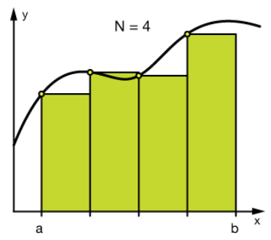
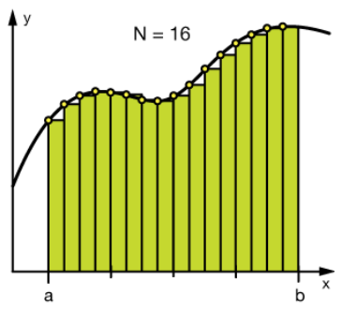
Why Fine-grained Mutation Operator is better than Coarse-grained Mutation Operator?
A fine-grained mutation operator generates much less mutants than coarse-grained mutation operator
CLARS may identify a more efficient models (i.e. predict MS using much less mutants)
Applying Linear Regression on fine-grained mutation operators generates model that can predict MS more accurately.
Applying CLARS on Coarse-grained Mutation Operators to predict MS
Applying CLARS on Fine-grained Mutation Operators to predict MS

